Slide 1
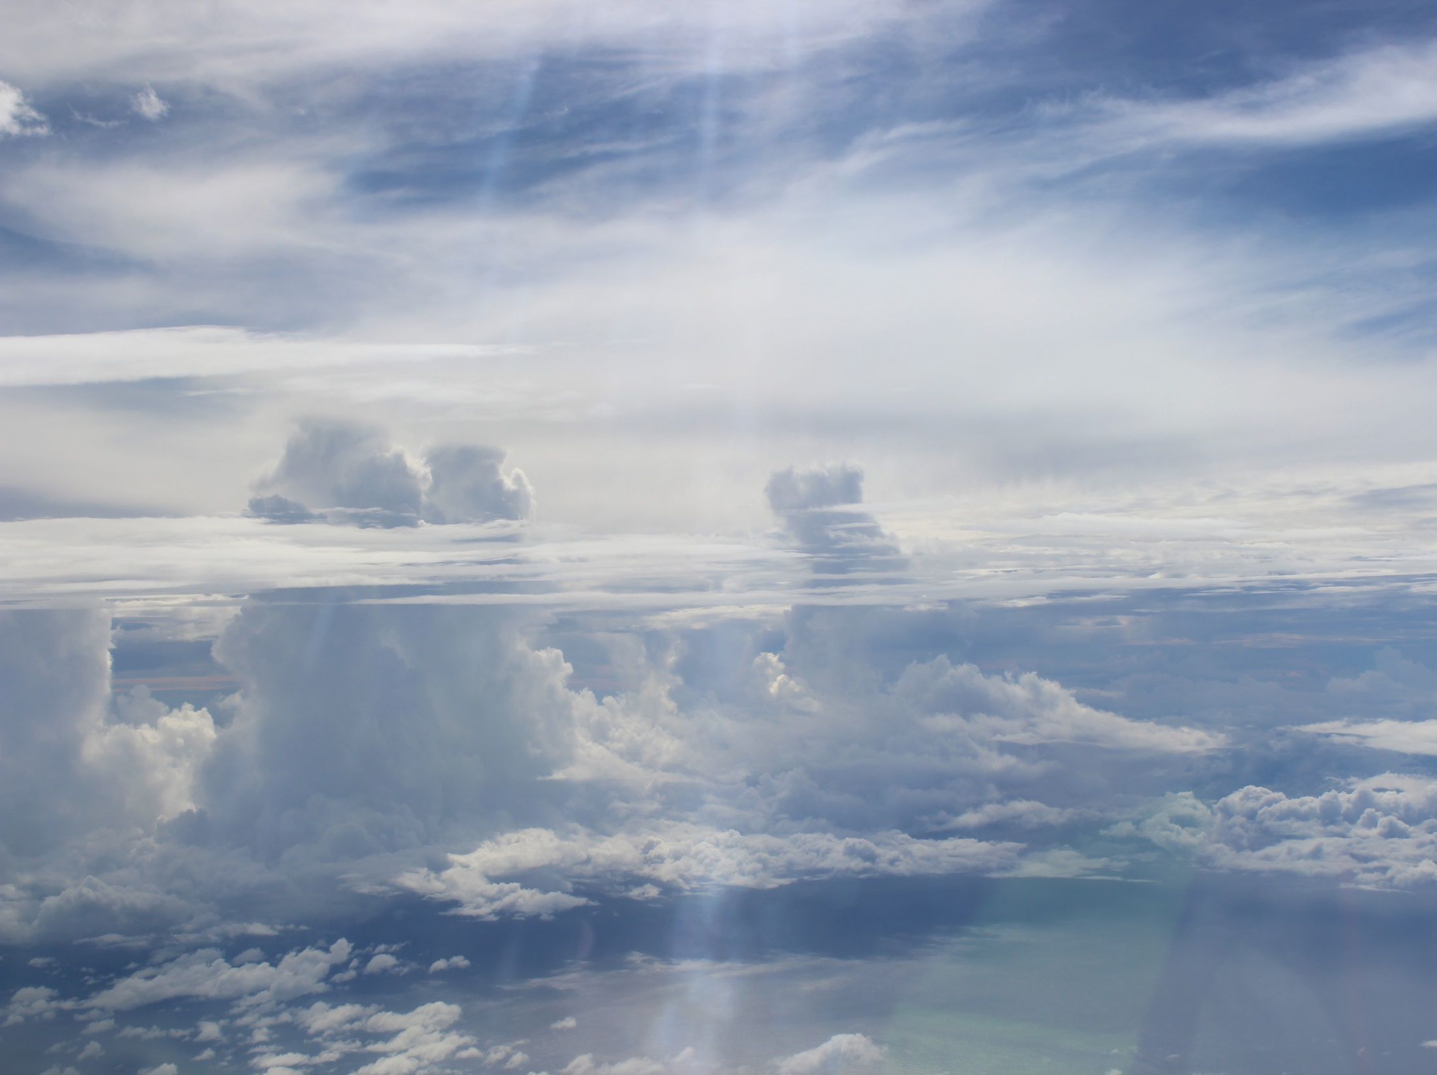
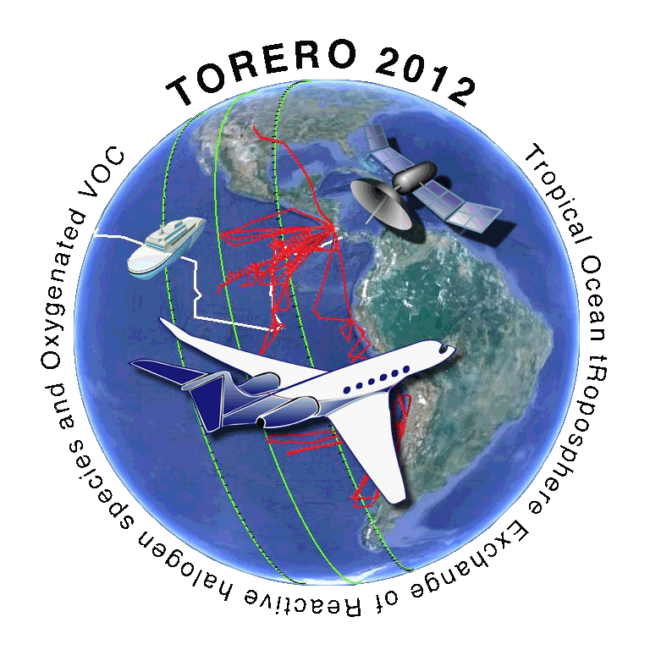

CAM-chem model evaluation of
the emissions and distributions of VSLS
using TOGA VOC observations
from CONTRAST and TORERO
(in the lower and free troposphere over the eastern and western Pacific)
TOGA and AWAS observations:
Rebecca Hornbrook, Eric Apel, Alan Hills, Dan Riemer,
Nicola Blake, Stacey Hughes, Elliot Atlas, Valeria Donets,
Sue Schauffler, Rich Lueb
CAM-chem modeling:
Jean-Francois Lamarque, Doug Kinnison, Simone Tilmes
CONTRAST-ATTREX-CAST Science Meeting
22-Oct-2014
Photo: ITCZ convection during RF10

Slide 2
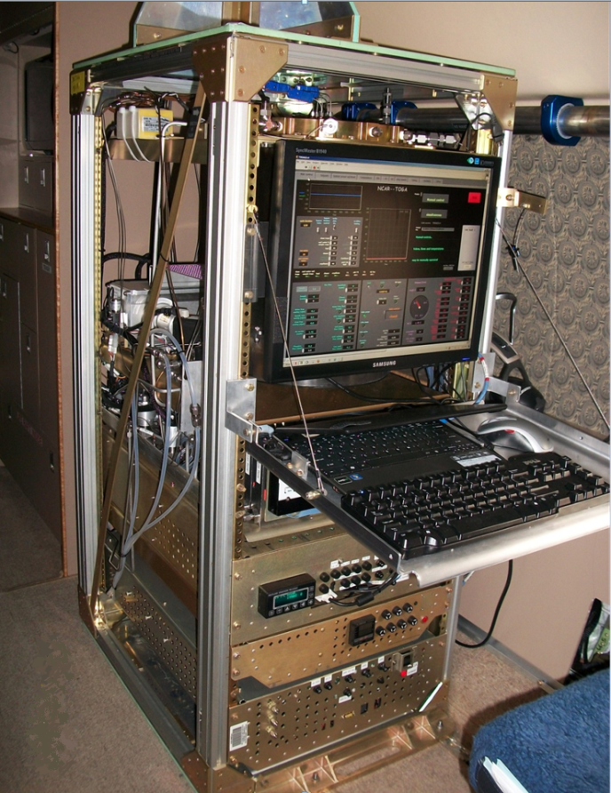
TOGA: Trace Organic Gas Analyzer
VOC tracers from several sources/types:
Biogenic VOCs and oxidation products
Anthropogenic VOCs
Oil and Gas Tracers
Long-lived Halogenated VOCs
Short-lived Halogenated VOCs
OVOCs, including HCHO
DMS
Alkyl Nitrates
Biomass burning tracers (HCN, CH₃CN)
For more information, see these posters this afternoon:
TOGA and AWAS measurements during CONTRAST
Inter-comparisons of TOGA and AWAS measurements during CONTRAST
TOGA Installed on the G-V
NCAR/ACD TOGA group
CONTRAST-CAST-ATTREX science meeting
Notes:
You’ve already heard some talk about TOGA, and for those who aren’t familiar with it, here’s a photo of it installed on the GV. It’s a fast online GC-MS that can quantify about 70 different VOCs from several different sources and types including anthropogenic gases, short lived halocarbons, DMS, biomass burning tracers, and several others. We have two posters in the poster session this afternoon, so if you’re curious about more details on TOGA or on a more extensive intercomparison between AWAS, TOGA and even some of the CAST VOC data, I would refer you to those.

Slide 3
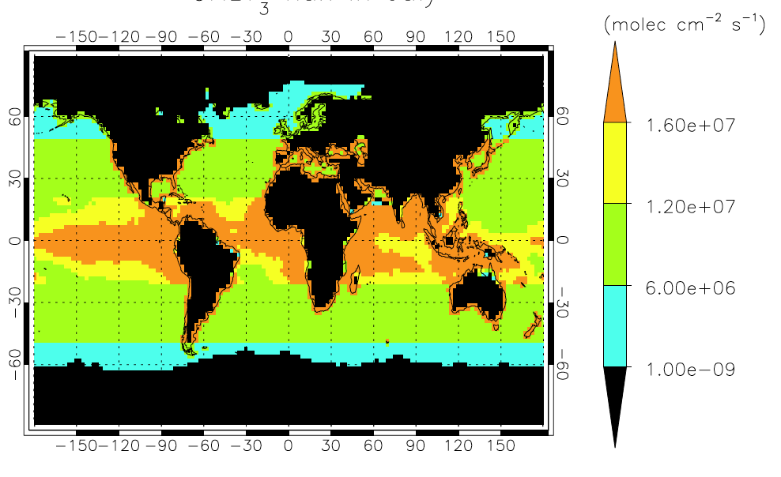
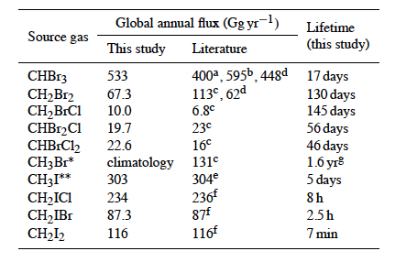
CAM-Chem with VSL Chemistry
CESM CAM-CHEM
  Global Chemistry-Climate Model
  ~1.0° horizontal resolution
  Specified Dynamics Version (GEOS5)
  56 vertical levels (surface to ~ 2 hPa)
  Lamarque et al., Geosci. Mod. Dev., 2012
CHBr₃ Flux in CAM-Chem
Tropospheric Halogen Chemistry
Halogenated sources from the ocean.
Emissions following Chl-a over tropics
Catalytic release from sea-salt
Do NOT have polar emission processes
Chemical Processes
Photochemistry (Cl, Br, and I)
Dry / wet deposition
9 Additional vsl Organic species included.
160 species, 427 reactions
CHBr₃
17 days
CH₂Br₂
130 days
CH₂ICl
8 h
Total Bromine: 632 Gg Br yr⁻¹
Total Iodine: 600 Gg I yr⁻¹
Ordoñez et al., ACP, 2012; Saiz-Lopez et al., ACP, 2012, Fernandez et al., ACP, 2014
Notes:
CAM-chem is a chemical model that operates either inside or independent of the global CESM model. For this talk, I’m comparing our observations to model output from 1° model runs. The model include halogenate emissions based on chlorophyll-a in the tropics and catalytic release from sea salt. It also includes halogen photochemistry, wet and dry deposition, and 160 species.
In this talk, I’m going to focus specifically on bromoform, dibromomethane, and a little on chloroiodomethane. Although they are all called very short lived species, VSLs vary significantly in their tropospheric lifetimes. Bromoform is on the order of a few weeks, dibromomethane has a lifetime of about 4 months, and chloroiodomethane has a lifetime of only 8 hours. We observe and are looking at several other VSLS, but for the sake of time, I won’t be discussing those in this talk.

Slide 4
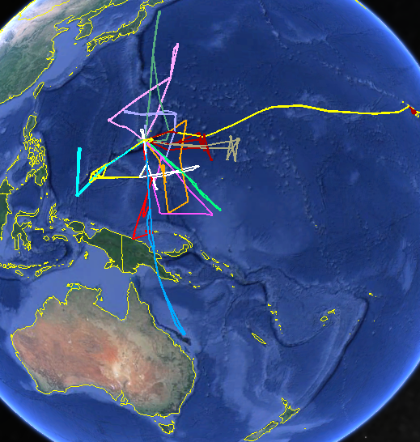
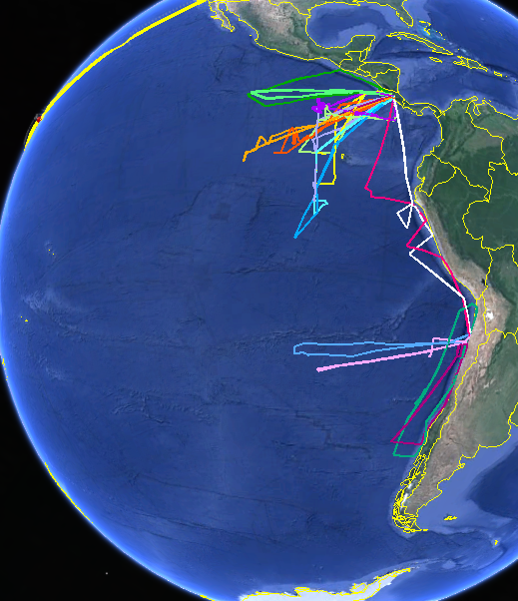
Data Coverage: Western and Eastern Tropical Pacific
All CONTRAST Flights, Jan - Feb 2014
All TORERO Flights, Jan - Feb 2012
NCAR/ACD TOGA group
CONTRAST-CAST-ATTREX science meeting
Notes:
TOGA was also deployed on TORERO, our first deployment with the GV system, which, with CONTRAST, gives us data in both the western and eastern tropical pacific, including the biologically inactive oligotrophic ocean. We had excellent data coverage over these two studies, although the number of compounds that we routinely observe has increased over the last couple years, so there are some compounds that we have in the CONTRAST data set that are lacking from our TORERO data.

Slide 5
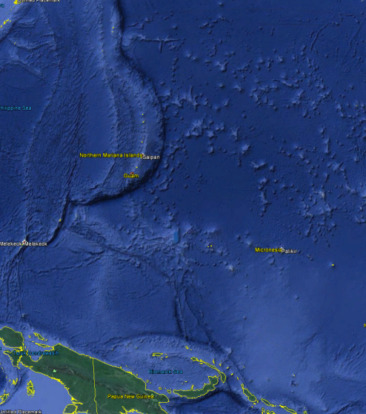
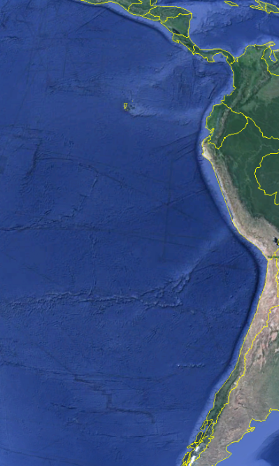
Spatial Distribution: DMS (Dimethyl sulfide, CH₃SCH₃)
CONTRAST
TOGA obs.
CAM-chem
TORERO
TOGA obs.
CAM-chem
NCAR/ACD TOGA group
CONTRAST-CAST-ATTREX science meeting
Notes:
These are plots of the BL data (below 500 m) DMS from both projects.
The observed DMS in the western pacific was significantly lower than in the eastern pacific, and the distribution in the BL during CONTRAST was relatively uniform with the exception of the flight that took us very close to the coast of Papua New Guinea. This is in contrast to the spatial variability that we saw during TORERO.
Sampling the CAM-chem model output along the flight track, in general, the model predicts higher concentrations of DMS in both regions. As well, we see that the model predicts more variable BL concentrations in the western region than were observed.
Looking at the vertical scale, which I’ll show in a log plot so that we can see the structure, there appears to be a steeper fall-off in the DMS obs than the model predicts, which also implies that the DMS loss rate may be too slow in the model.

Slide 6
Spatial Distribution of VSLS: Dibromomethane (CH₂Br₂)
CONTRAST
TOGA obs.
CAM-chem
TORERO
TOGA obs.
CAM-chem
NCAR/ACD TOGA group
CONTRAST-CAST-ATTREX science meeting
Notes:
For dibromomethane, again we see that there is less observed variability in the western tropical pacific than we observed during TORERO in the east, where we encountered a wider range of observations, both higher and lower. Comparing to CAM-chem, I think we are all impressed at how well the model is predicting the observations in both regions, but particularly in the CONTRAST study area. Vertically, we don’t see a very large difference between the regions, but this is not surprising based on the 4-month lifetime of dibromomethane. There is a greater fall-off with altitude in the observations during TORERO than the model predicts, so that may indicate that the convection is overpredicted in the model for that region.

Slide 7


Spatial Distribution of VSLS: Bromoform (CHBr₃)
CONTRAST
TOGA obs.
CAM-chem
TORERO
TOGA obs.
CAM-chem
NCAR/ACD TOGA group
CONTRAST-CAST-ATTREX science meeting
Notes:
The bromoform boundary layer distributions are again fairly uniform in the western pacific sampling region compared to the TORERO study region, and tend to be on the lower side, not much higher than the oligotrophic region of the eastern Pacific. In both regions, with only a couple exceptions, the model tends to predict higher bromoform than is observed, both horizontally and vertically, although the shapes of the vertical distributions seem similar. The more significant convection in the CONTRAST measurement region tends to result in a more uniform column of bromoform in both the TOGA observations and the model.

Slide 8
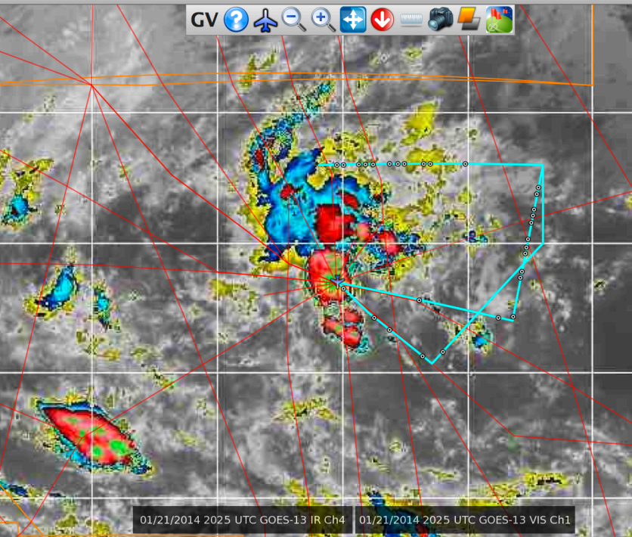
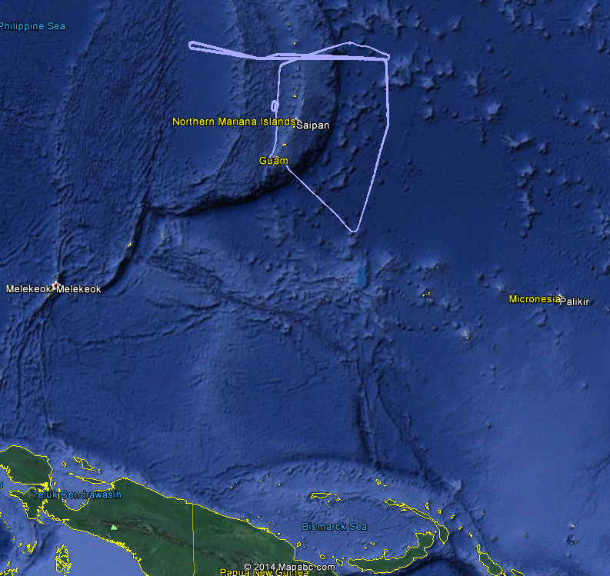
Case Study: Smaller scale convective region north of Guam – CONTRAST RF05, Jan 22
Flight plan and active convection
Actual Flight Track
05:00
profile
06:30
profile
Guam
Palau
Guam
Papua New Guinea
NCAR/ACD TOGA group
CONTRAST-CAST-ATTREX science meeting
Notes:
I want to narrow the focus a little more and consider a couple case studies from CONTRAST. The first is the RF05 aged convection region that Johnny talked about on Monday. He estimated this is a few hours old, which is consistent with our observations. The convection is an isolated storm that is north of Guam, away from the ITCZ and the majority of the on-going convection. The aged convective outflow was sampled in the east-west section north of Guam, followed by two profiles, one to the BL, and the other to about 2km asl.

Slide 9
VSLS behavior during CONTRAST RF05 – Localized Convection Region
With only localized convection, CHBr₃ increases slightly in aged convection (see acetone). Shorter-lived species are not observed aloft, so the convection is not very recent. This region is less impacted by wide-spread convection, hence no clear
C-shapes in the altitude profiles.
CAM-chem predicts more
CHBr₃ and DMS than is observed aloft and in the MBL.
Convection
NCAR/ACD TOGA group
CONTRAST-CAST-ATTREX science meeting
Notes:
With only localized convection, CHBr₃ increases slightly in aged convection (see acetone). Shorter-lived DMS, with a lifetime of a day or less, is not observed aloft, so the convection is not very recent. This region is less impacted by wide-spread convection, which may be why there are no clear C-shapes in the altitude profiles.
CAM-chem predicts more CHBr₃ and DMS than is observed aloft and in the MBL.
It actually captures the aged convection in this region quite well, despite having larger emissions and likewise higher concentrations throughout the column.

Slide 10
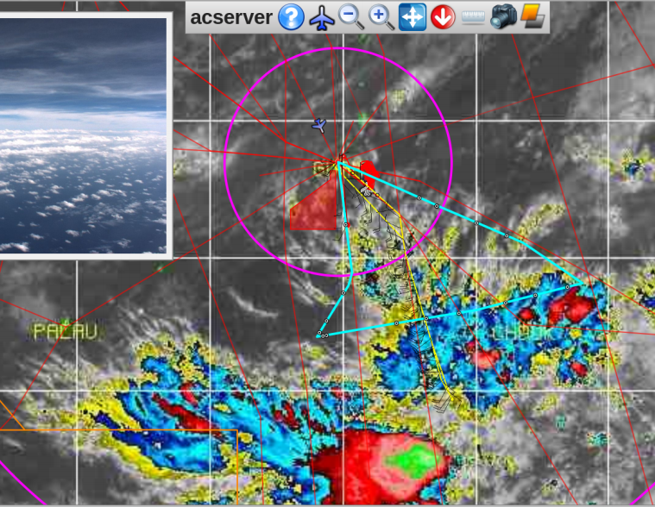
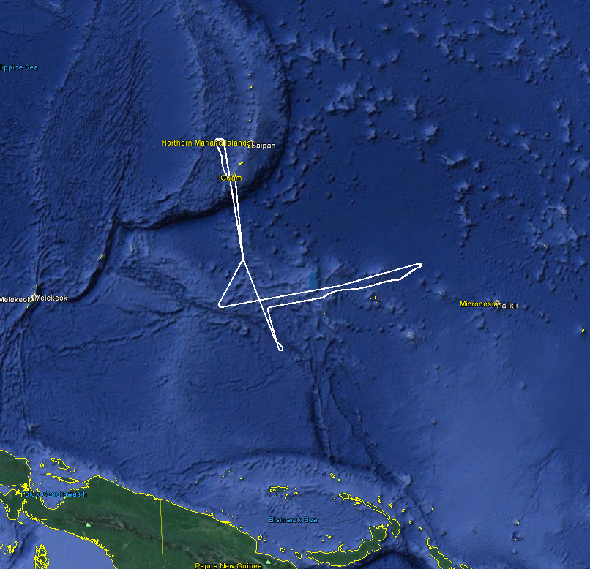
Case Study: Large scale convective region south of Guam – CONTRAST RF12, Feb 17
Flight plan and active convection
Actual Flight Track
Guam
Guam
RF12
Palau
Palau
Papua New Guinea
NCAR/ACD TOGA group
CONTRAST-CAST-ATTREX science meeting
Notes:
The second case study I want to show from CONTRAST is not everyone’s favourite RF11, but the next flight, RF12. In this flight we went back south towards the region of generally wide-spread convection, and were able to sample some more fresh convection. If you take a look at the altitude trace here in the time-series plot, you can see that what wasn’t sampled in this flight was the boundary layer in the region of the convection, but rather we merely have profiles right near Guam at take-off and landing.

Slide 11
VSLS behavior during CONTRAST RF12 – Sustained Convection Region
In regions with wide-spread convection, CHBr₃ and CH₂Br₂ are unaffected by local updrafts. However, in the entire region they are elevated compared to the profiles near Guam, hence the C-shapes in the flight altitude profiles.
CAM-chem predicts more
CHBr₃ and DMS than is observed aloft and more DMS at the surface near Guam.
Recent
convection
NCAR/ACD TOGA group
CONTRAST-CAST-ATTREX science meeting
Notes:
Regions of fresh convection can be marked by the observation of DMS in the upper troposphere. In these regions, we see very little impact on bromoform and dibromomethane due to convection, even though we went through two regions with fairly recent convection. In this example, the dibromomethane observations and model agree remarkably well in the profile, but as I mentioned, we need to keep in mind that these profiles are not in the convective outflow region, but near Guam. Similarly, bromoform obs and model agree very well in the profile, while in the convective region the modeled bromoform is more affected by the updrafts, which we can see in the time-series plot based on correlation with DMS increase.

Slide 12
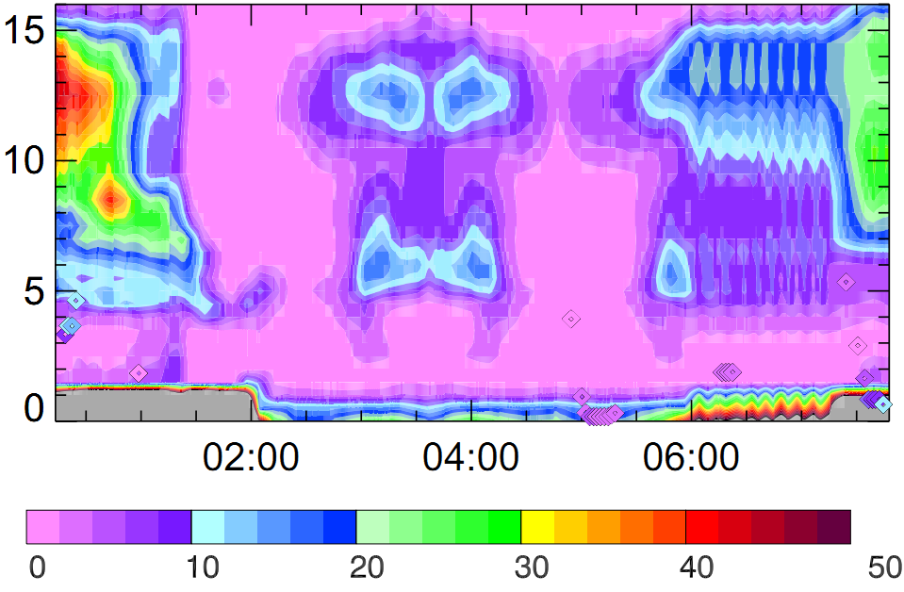
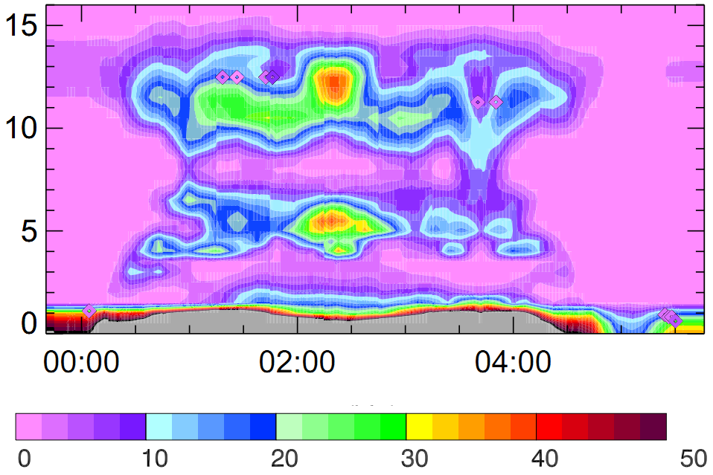
CAM-chem convection during CONTRAST RF05 and RF12 - DMS
(DMS – lifetime ~ 1 day)
RF05 - no DMS obs in the UT.
convection present in CAM-chem in region where convection was observed (in acetone, etc.)
However MBL DMS was predicted to be relatively low.
RF12 - DMS observed in the UT.
MBL DMS predicted to be > 50 pptv
Max convection predicted in slightly different region, DMS up to 40 pptv.
RF05
Altitude, km
RF12
Altitude, km
Max
CAM-chem
convection
Time, UTC
DMS, pptv
NCAR/ACD TOGA group
CONTRAST-CAST-ATTREX science meeting
Notes:
These are curtain plots of the two case studies, RF05 and RF12, which both show that the model was capable of capturing the convection in the flight regions. Although the DMS emissions were higher, we can also see that the relative boundary layer DMS in the two convection regions differed significantly. The max convection for RF12 was predicted to be at the flight turnaround, rather than the middle where TOGA observed DMS. As shown earlier, these are plots from the 1° model, and just last week, the model was run at ½° resolution and there are plans to run it at ¼°. It will be interesting to see if this makes a difference in the fine-scale convection modeling.

Slide 13
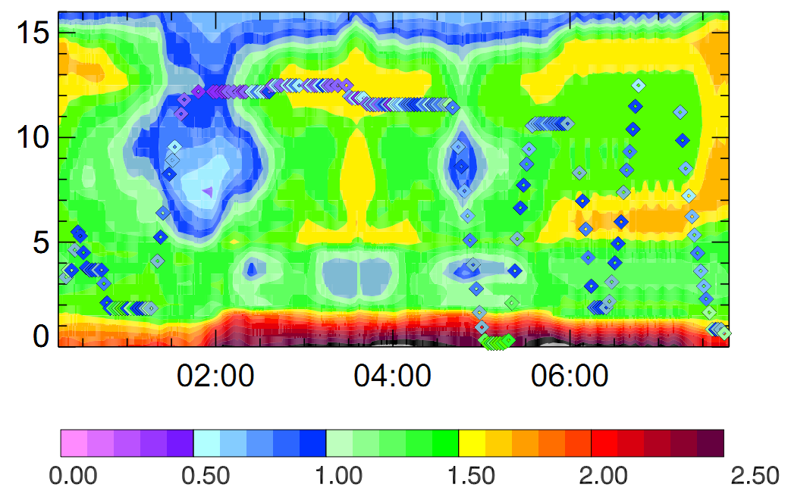
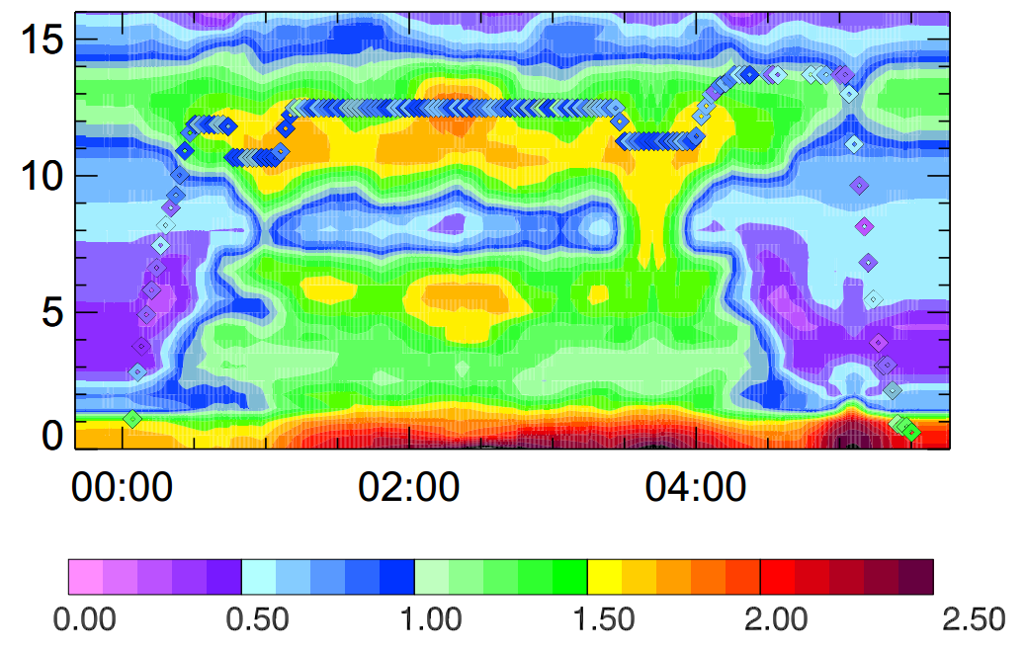
CAM-chem convection during CONTRAST RF05 and RF12 – CHBr₃
(bromoform – lifetime ~ 17 days)
RF05
The intrusion of low VSLS air from above was captured by the model.
In general, BL bromoform was too high in the model, but the aged convection was seen.
RF12
Without sampling the boundary layer, we can’t definitely state that the modeled bromoform was too high in the BL.
The profiles near Guam were predicted really well by the model.
RF05
Altitude, km
RF12
Altitude, km
Time, UTC
CHBr₃, pptv
NCAR/ACD TOGA group
CONTRAST-CAST-ATTREX science meeting
Notes:
For bromoform, again, the model accurately predicted convection in the appropriate regions, which is very encouraging, but likely overpredicted the boundary layer bromoform concentrations in these regions. As well, early in RF05, there was an upper level intrusion of low VSLS air that was captured by the model.
In RF12, without sampling the boundary layer, we can’t definitely state that the modeled bromoform was too high in the BL, but certainly the convected air is predicted to have higher bromoform than the was observed, even with the presence of convection... However, the model profiles near Guam are in very good agreement with the observations.

Slide 14
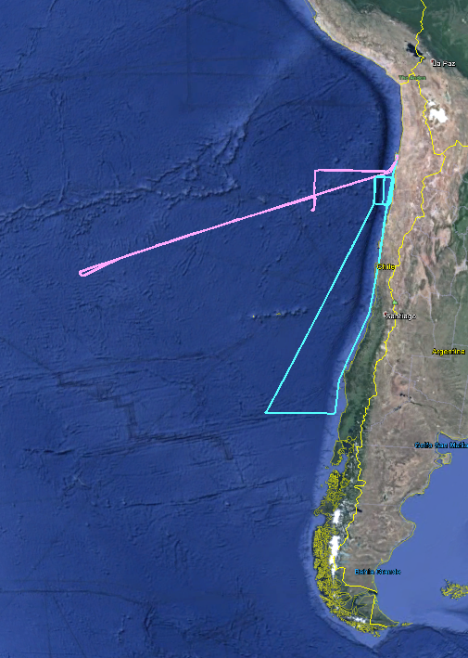
VSLS behavior during TORERO RF04 & RF05 – S. American Coast v. Oligotrophic Ocean
RF05
RF04
NCAR/ACD TOGA group
CONTRAST-CAST-ATTREX science meeting
Notes:
I wanted to take a couple minutes to show some of the differences in the VSLS behavior during TORERO, contrasting the S. American Coast and the Oligotrophic ocean region. Here I’m showing two flights from TORERO, RF04, which stayed near the coast, with several profiles fairly far south, as well as a number of profiles just before landing, and compare that to RF05, which took the GV deep into the oligotrophic ocean performing several en route profiles before returning and profiling further off shore than during RF04.

Slide 15
VSLS behavior during TORERO RF04 & RF05 – S. American Coast v. Oligotrophic Ocean
NCAR/ACD TOGA group
CONTRAST-CAST-ATTREX science meeting
Notes:
This shows the magnitude of the bromoform, dibromomethane and even chloroiodomethane observations and CAM-chem model output in this region. The agreement between the model and the measurements is great for chloroiodo and bromoform, and decent for dibromomethane.
In the top panel, the bromoform along the coast is quite high compared to the BL runs sampled in the middle of the oligotrophic ocean, which I can show a little more if I zoom in on just the profiles at the end of the flight.

Slide 16
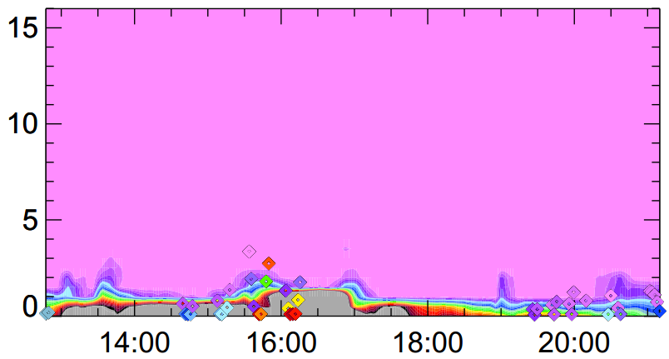
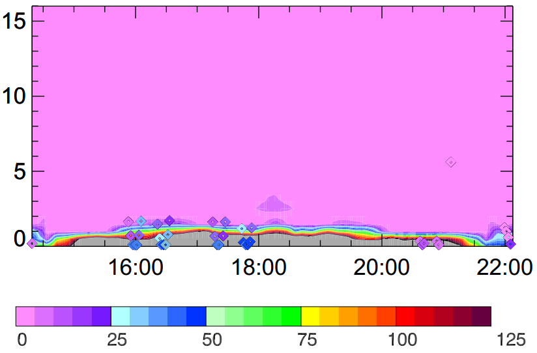
CAM-chem convection during TORERO RF04 and RF05 - DMS
RF04
Altitude, km
RF05
Altitude, km
Time, UTC
DMS, pptv
NCAR/ACD TOGA group
CONTRAST-CAST-ATTREX science meeting
Notes:
I didn’t show DMS in the last plots, but you can see that there is a not a significant amount of convection observed or modeled in either of these flights. As we’ve seen before, boundary layer DMS tends to be overpredicted in the model, indicating that the emissions are likely too high, but there is significant DMS obs in the boundary layer in both regions.

Slide 17
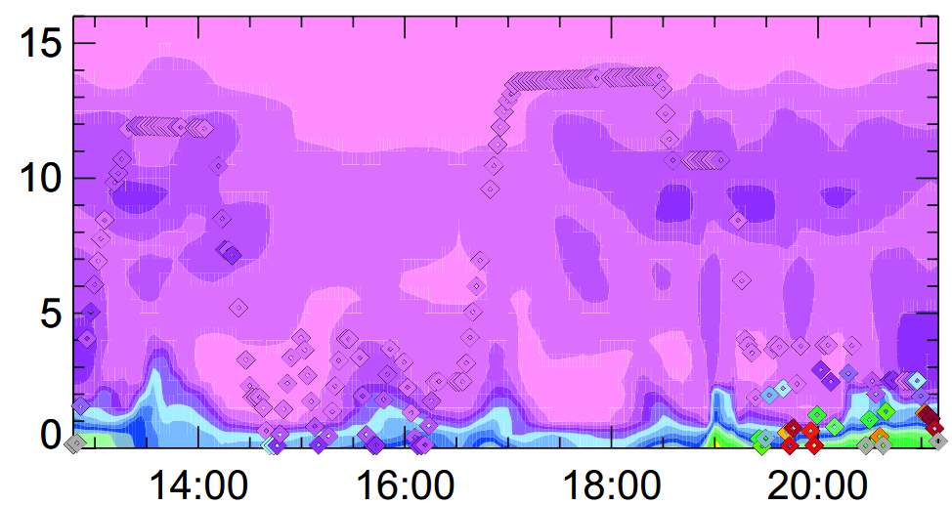
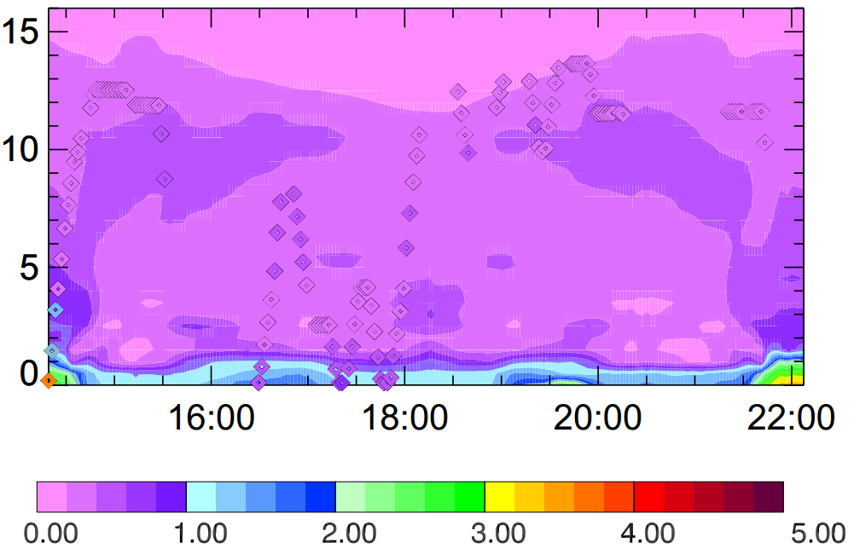
CAM-chem convection during TORERO RF04 and RF05 – CHBr₃
RF04
Altitude, km
RF05
Altitude, km
Time, UTC
CHBr₃, pptv
NCAR/ACD TOGA group
CONTRAST-CAST-ATTREX science meeting
Notes:
For bromoform, there is very good agreement for much of the flights, with more bromoform predicted in the boundary layer in the coastal areas than the model predicted.

Slide 18
Summary
Marine boundary layer VSLS concentrations in the CONTRAST study region were lower and less variable than in the eastern Pacific.
Overall there is good agreement between the observations and CAM-chem. For many HCs and OVOCs (not shown), the agreement is excellent.
For the VSLs, CAM-chem tends to predict higher bromoform and DMS in both the Eastern and Western Tropical Pacific, although the general spatial and vertical trends agree with the observations.
Moving forward:
  Continue to compare model and observations from the other CONTRAST and TORERO flights to better understand the horizontal and vertical distributions of VSLs throughout the Tropical Pacific.
  Use these findings to better constrain the impact of VSLS convection on the UT/LS, and contribute feedback to the model emissions.
  Compare different model resolutions on the convective scale to see what, if any, improvement we can see on the convective modeling.
NCAR/ACD TOGA group
CONTRAST-CAST-ATTREX science meeting

