Slide 1
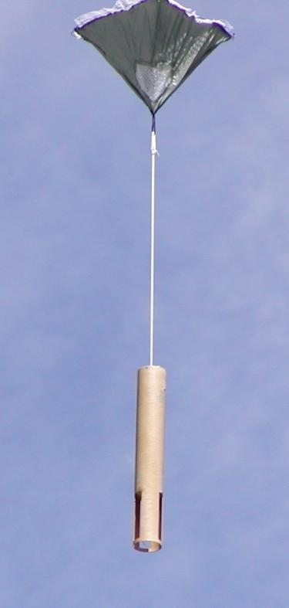
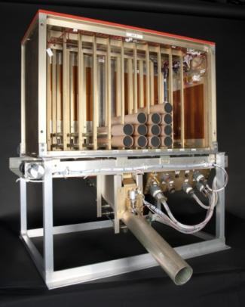
AVAPS – Dropsonde HS3 2014 Field Program & Global Hawk NOAA G-4 Intercomparison
HS3 Science Meeting
May 5-6, 2015
Terry Hock¹, Holger Vömel¹, Kate Young¹, Gary Wick²,
¹National Center for Atmospheric Research
² National Oceanic & Atmospheric Administration
NCAR EOL ISF 2015

Slide 2
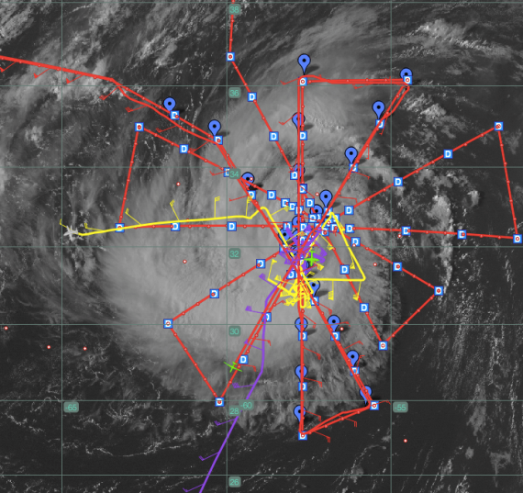
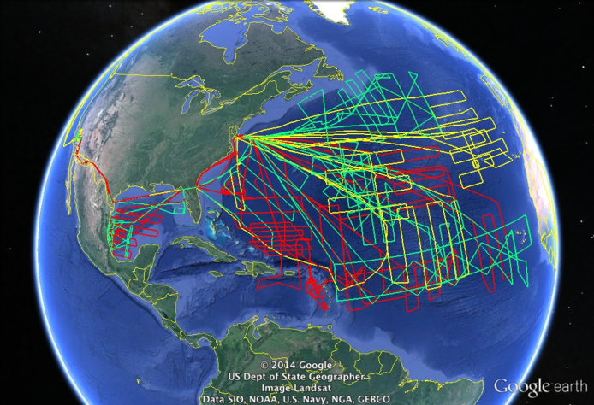
Three Years of HS3 Science with AVAPS Dropsondes
Year | Flights | Hours | Sondes
2012 | 8 | 174 | 343
2013 | 12 | 232 | 433
2014 | 10 | 236 | 656
Total | 30 | 642 | 1432
19 Flights Over Named Storms
2012
Leslie – 1 Flight, Nadine – 5 Flights
2013
Gabrielle – 4 Flights, Ingrid – 1 Flight
Humberto – 1 Flight
2014
Cristobal – 2 Flights, Dolly – 1 Flight
Edouard – 4 Flights
HS3 2012 - 2014
Notes:
The Global-Hawk AVAPS went to HS3 (Hurricane and Severe Storm Sentinel) each of the past 3 years.
Every year had both challenges and successes.
Highlights are:
A total of 1425 mini dropsondes were deployed with very high success rate
We used HS3 as an opportunity to develop a rapid-drop capability: Drops every 1 minute, which became enabling for collecting data over the hurricane eye. [The technique is called pre-launch GPS Aiding]
Over the 3 years, the GH made 19 flights over named tropical storms. (Right picture). This summer, the final year of HS3, Four flights sampled almost the complete life cycle of Edouard from tropical storm, to category 1 hurricane, to category 3 hurricane, and to decay over cold water into an extra-tropical storm. The Left picture shows the GH flight track in RED for the Cat-3 flight. [Purple and Yellow are other NOAA aircraft]

Slide 3
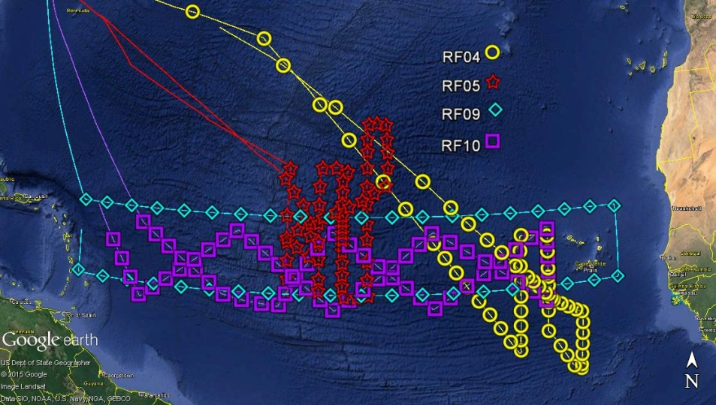
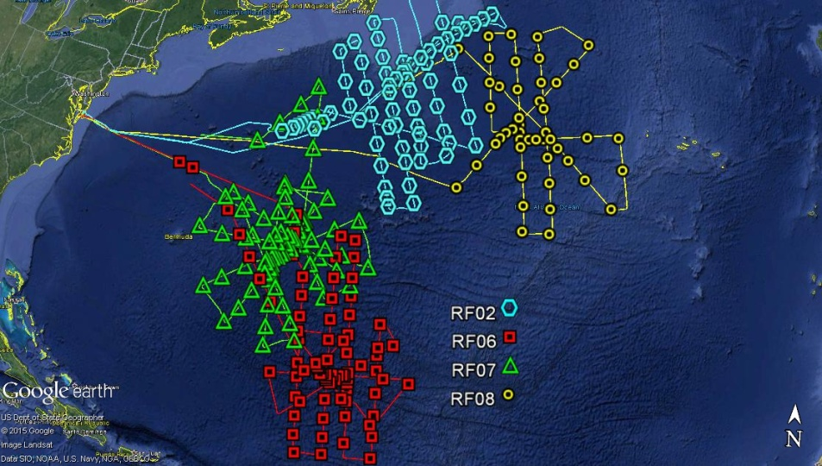
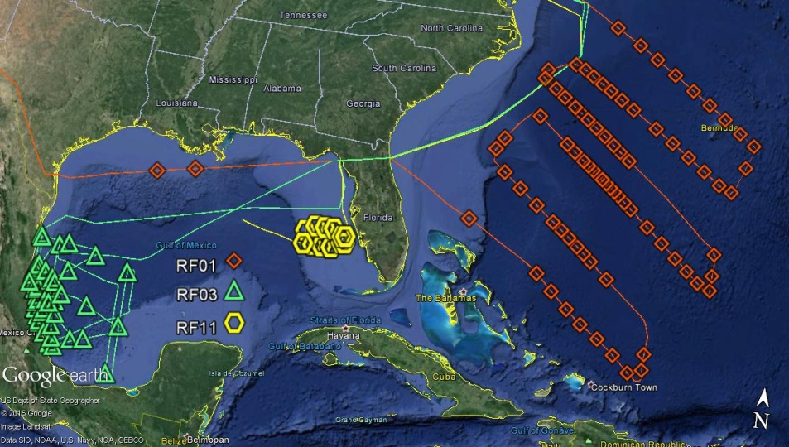
Summary of 2014 Drops
NASA Global Hawk AV-6
656 Dropsondes
11 Research Flights for AV-6
Aug 20 to Sept 19, 2013
Research Flight | Dates | Sondes deployed | Soundings in final archive
RF01 | Aug 26 | 81 | 81
RF02 | Aug 29 | 70 | 69
RF03 | Sept 2 | 50 | 50
RF04 | Sept 5 | 59 | 59
RF05 | Sept 11 | 64 | 60
RF06 | Sept 14 | 80 | 80
RF07 | Sept 16 | 88 | 87
RF08 | Sept 18 | 50 | 50
RF09 | Sept 22 | 40 | 40
RF10 | Sept 28 | 65 | 65
RF11 | Sept 30 | 15 | 15
Total |  | 662 | 656 *
* There were AVAPS aircraft system issues which prevented data collection of 6 sondes launched.

Slide 4
HS3 2013 & 2014
Sonde Performance Summary
HS3 Data Quality Issues | 2013 # of soundings | 2013 % of dataset | 2014 # of Soundings | 2014 % of dataset
Fast Falls (complete & partial) | 28 | 6.4% | 2 | 0.3%
No Temperature Data | 0 | - | 1 | 0.2%
No RH Data | 0 | - | 0 | -
Loss of data near surface due to RFI | 8 | 1.8% | 13 | 2.0%
No Winds at surface | 45 | 10.4% | 73 | 11.1%
Sonde Position Information – GPS Latitude, Longitude and GPS Height
HS3 2012: No issues
HS32013 : Errors in Lat-Long - GPS Height 158 Drops ( 36.5%) All corrected May 2015
HS32014: No issues
Overall Success rate | # of Soundings | Success rate
Perfect Soundings, no issues | 352 | 81.3%
Good soundings including with small data gaps (RFI data loss, no winds at surface) | 405 | 93.5%
Useful scientific data - Includes Fast falls, RFI, GPS multipath (Buyer beware) | 433 | 100%

Slide 5
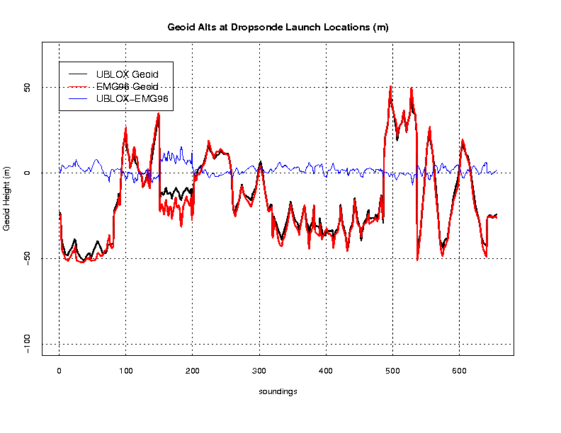
GEOID Altitude corrections
- Sonde Real-time Geoid
- EMG96 Geoid
- Difference
Black line shows dropsonde geoid values originally contained in real-time dropsonde GPS altitudes. Red line shows the geoid measurements from the EMG96 which replaced the dropsonde geoid values.

Slide 6
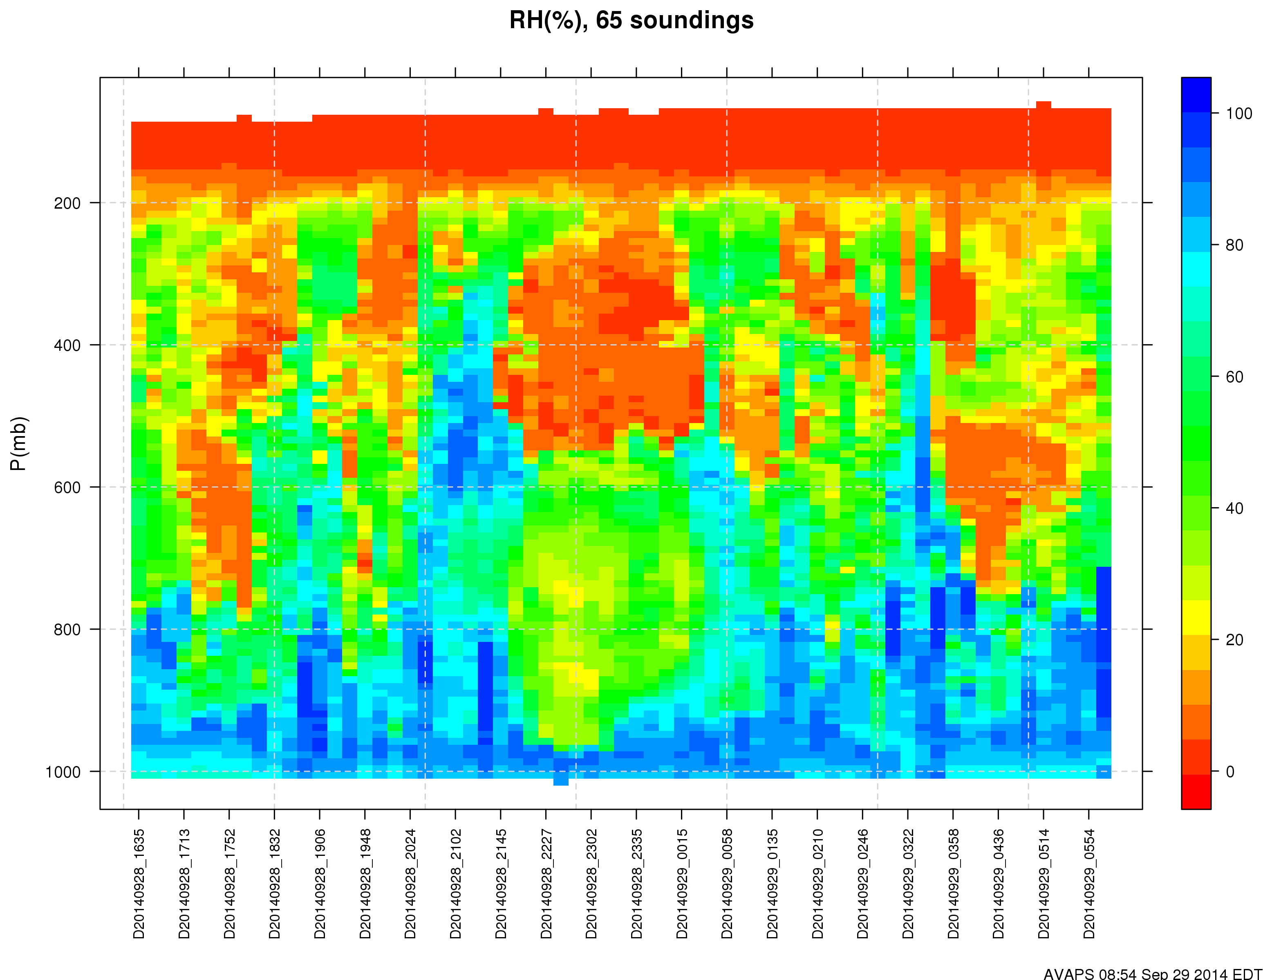
RF10 Sept 28 RH Data
Sonde Performance Summary

Slide 7
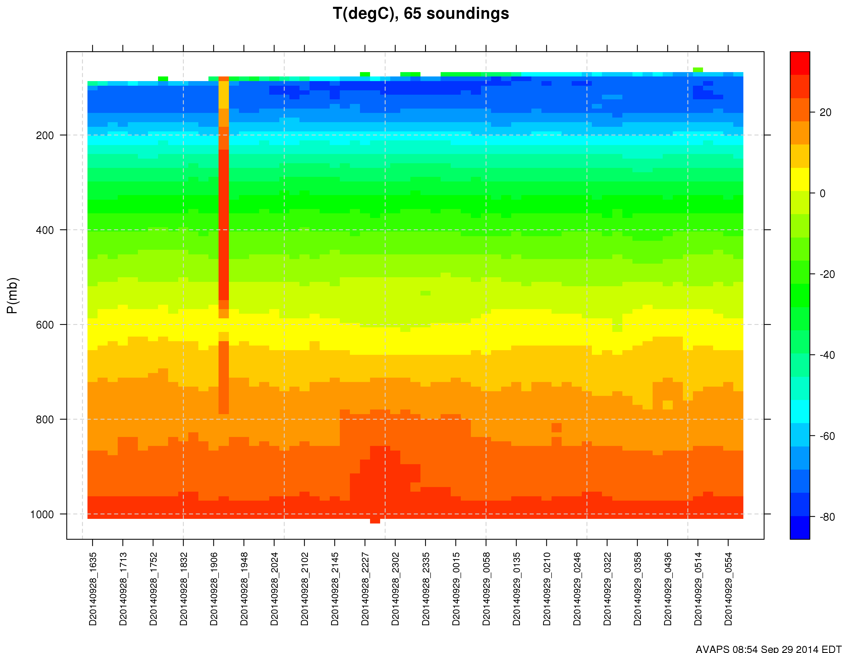
RF10 Sept 28 Temperature Data
Sonde Performance Summary

Slide 8
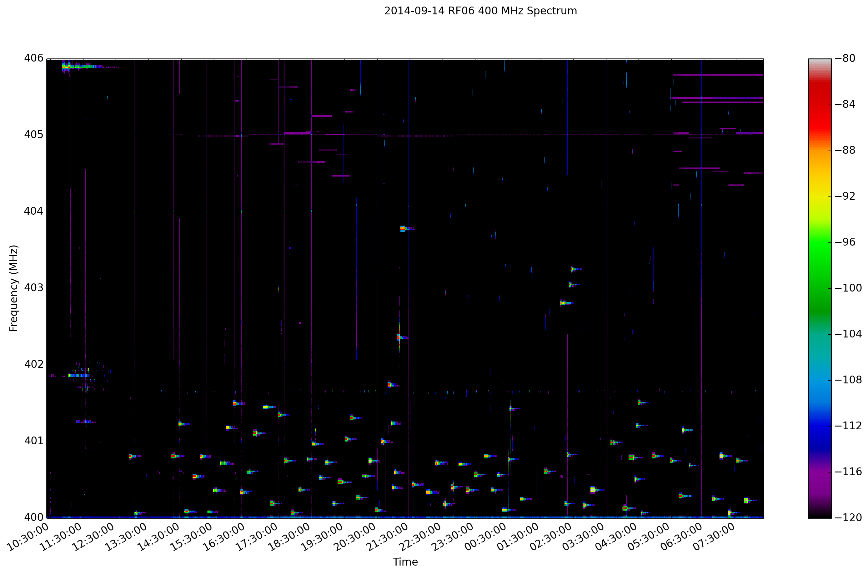
Flight RF06 Sept 9 RF Spectrum Summary
RF Spectrum

Slide 9
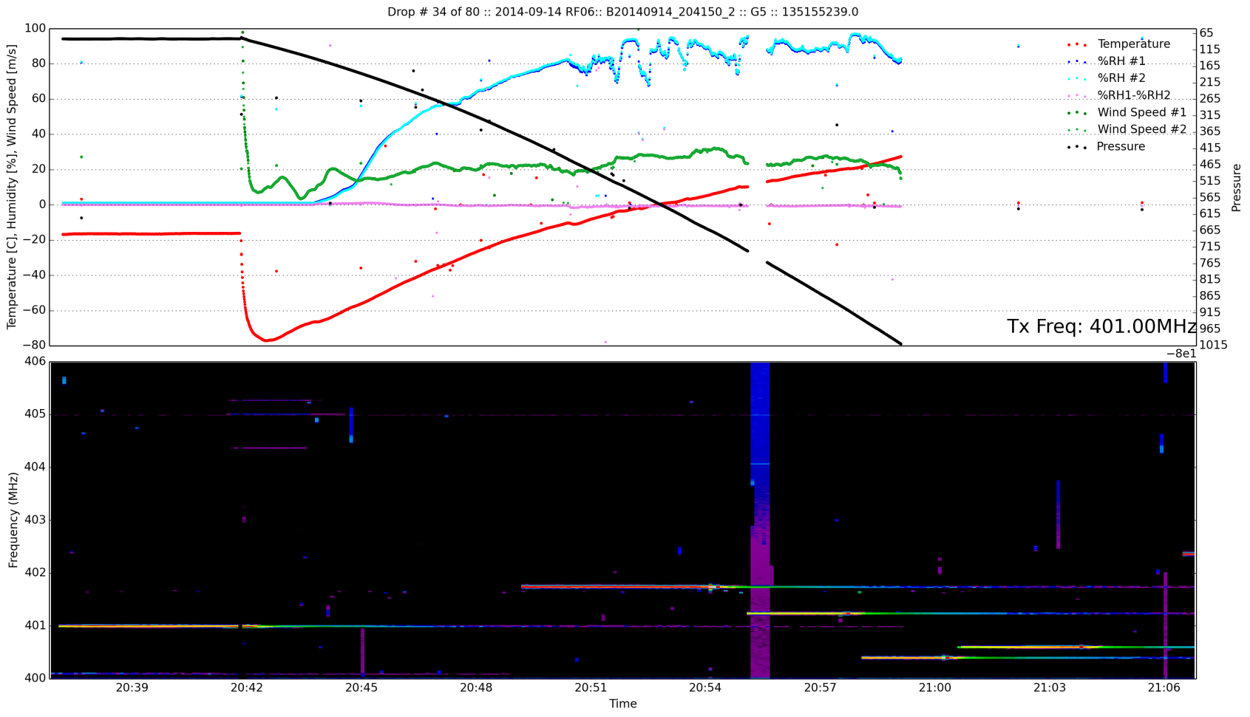
RF06 Sept 9 RF Spectrum
Drop #34
Raw Data
RF Spectrum

Slide 10
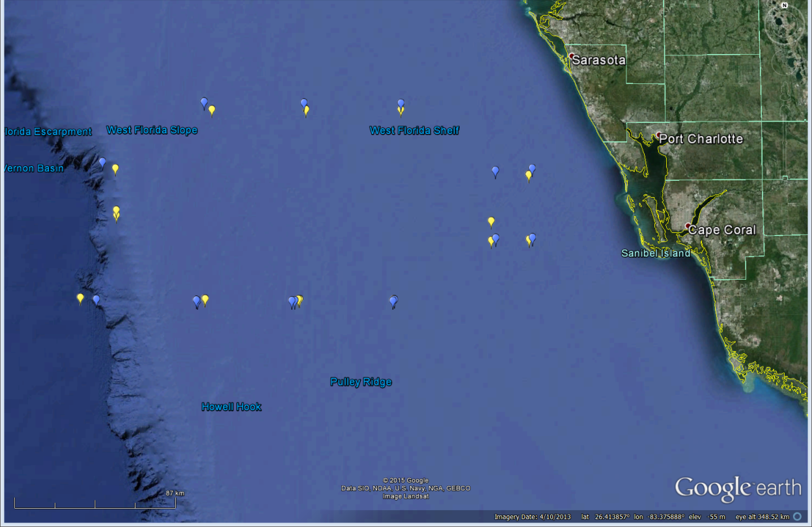
Update on NOAA G-4 RD94 Dropsonde Inter-comparison NASA Global Hawk Mini Dropsonde 2011 (23 pair) and 2014 (15 pair)
14 Sep 2011
30 Sep 2014

Slide 11
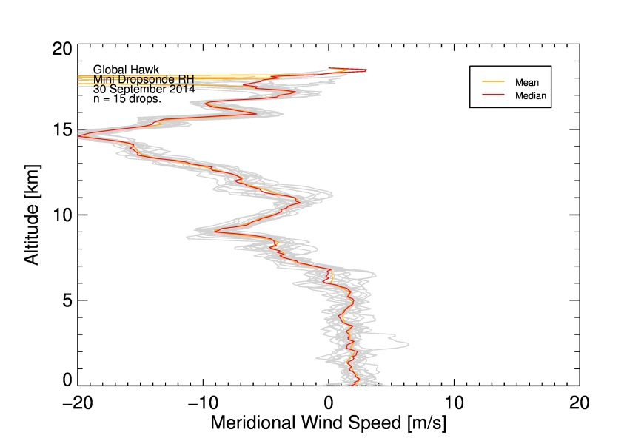
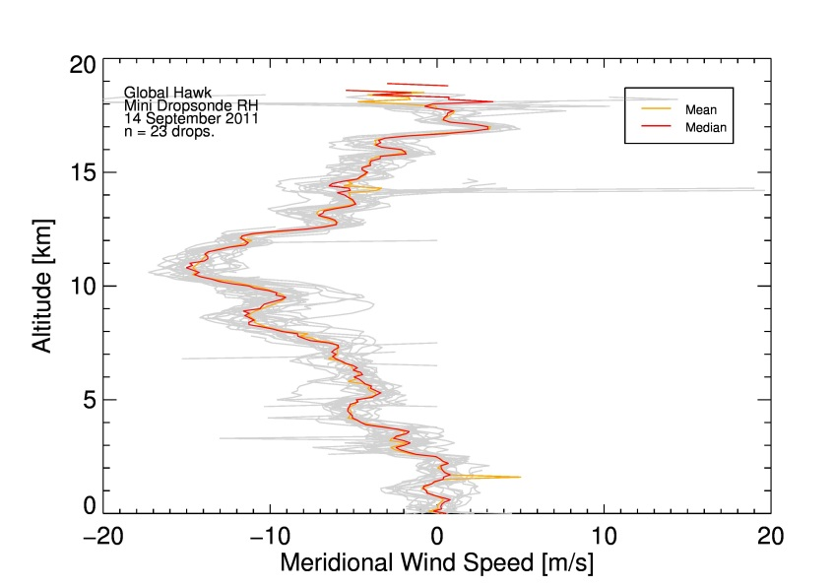
Winds
2011 2014

Slide 12
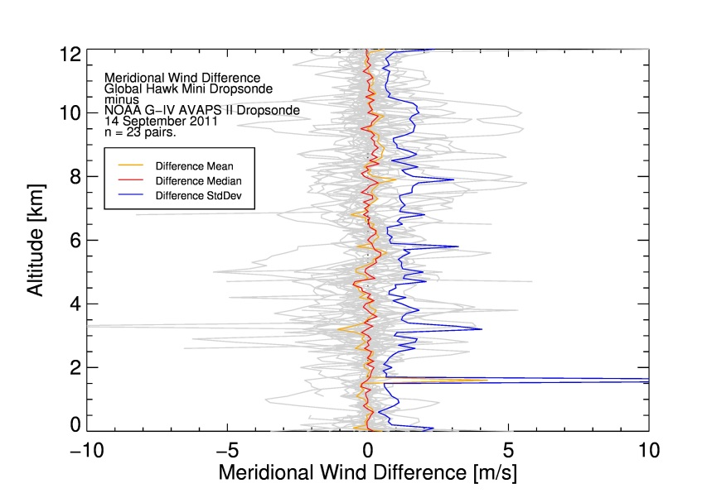
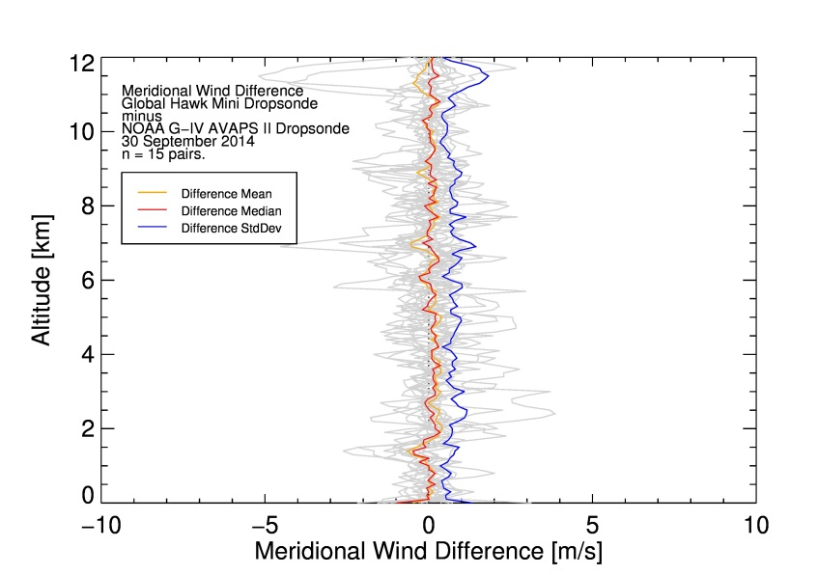
Winds
Wind comparisons: Good agreement in 2011 and 2014
2011 2014

Slide 13
Temperature Global Hawk Drops only
2011 2014

Slide 14
Temperature Difference GH_{T} - GV_{T}
2011 2014

Slide 15
Relative Humidity Global Hawk Drops only
2011 2014

Slide 16
Relative Humidity Difference GH_{RH} - GV_{RH}
2011 2014
${ΔRH}_{abs,(0−2 km)}=−3.6±0.2 \%$ ${ΔRH}_{abs,(0−2 km)}=+2.7±0.3 \%$
In boundary layer:
Absolute difference changed by 6 % between 2011 and 2014
Notes:
Mini Dropsonde has dry bias in 2011, RD-94 has dry bias in 2014
2011 comparison:
Both sondes of similar vintage (a few months old)
2014 comparison:
Mini dropsonde several months old RD94 between one and three years old

Slide 17
Summary of Mini vs RD-94 Dropsonde Comparison
Notes:
2011 comparison: Both sondes of similar vintage (a few months old)
2014 comparison: Mini dropsonde several months old, RD94 between one and three years old
The comparisons show excellent agreements for wind profiles without any systematic bias for both 2011 & 2014.
The temperature showed excellent agreement in 2014, whereas the mini dropsnde showed a showed a warm bias with a mean of 0.2°C in 2011
The RH profiles agree well with each other above~750 hPa, (RH<50%)
2011 show eda 3-5% dry bias in the GH data below ~750 hPa.
2014 data shows a 3-5% dry bias in the RD-94 data
Pre-flight sonde procures of RH re-conditioning is important
Future Lab testing at NCAR to understand and improve the temperature bias.

Slide 18
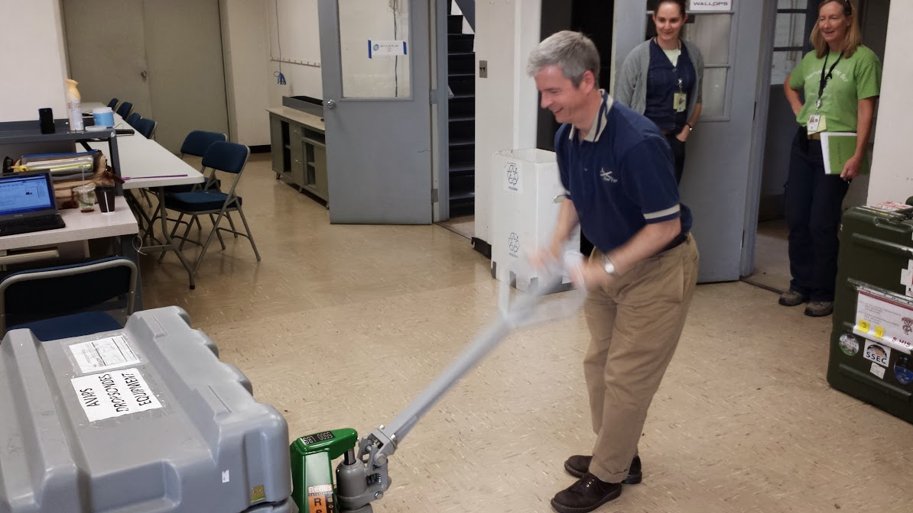
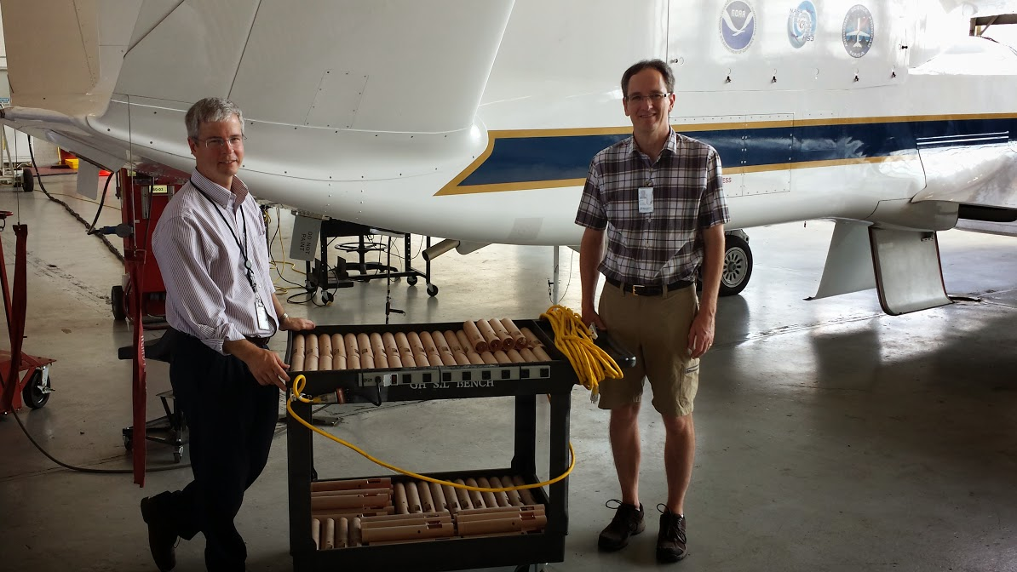
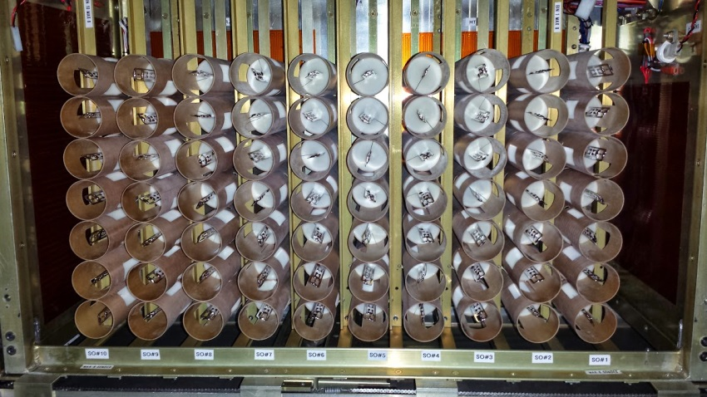
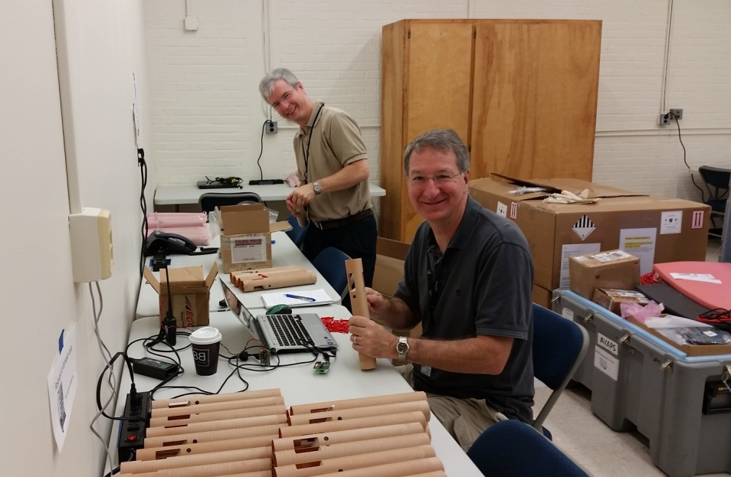
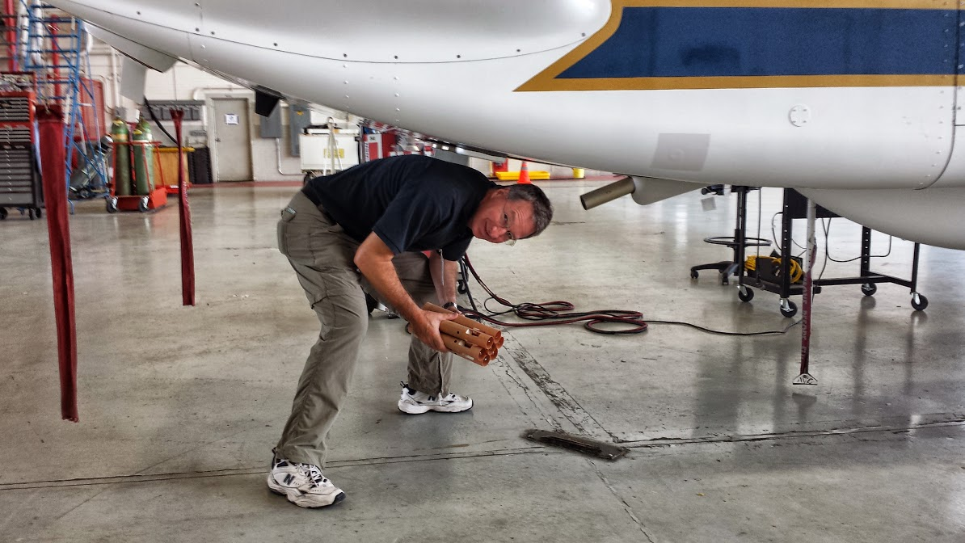
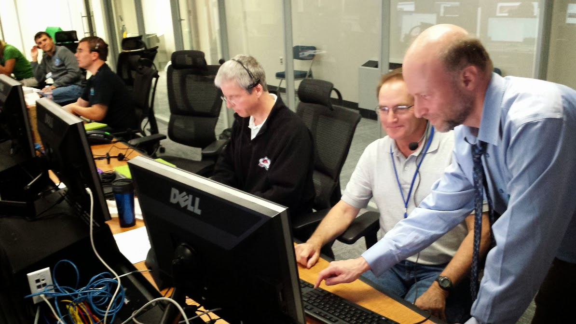
HS3
2014
Global Hawk
NCAR AVAPS
Thanks for your
Attention

