Slide 1
Low ozone in the Tropical Tropopause Layer (TTL) over the western tropical Pacific
Eric Hintsa, Fred Moore, Geoff Dutton, Brad Hall, David Nance, Alex Haugstad, Audra McClure, James Elkins, Bruce Daube, Jasna Pittman, Steve Wofsy, Ru-Shan Gao, Andrew Rollins, Troy Thornberry, Laurel Watts, David Fahey, Tao Wang, Paul Bui, Boon Lim, Maria Navarro, Elliot Atlas, Lenny Pfister, Cameron Homeyer, and the ATTREX Science Team

Slide 2
Background
Low ozone has been previously observed over the tropical Pacific Ocean (Kley et al., 1996; Takashima et al., 2007, 2008).
This has been hypothesized to lead to an “OH hole”, which could more easily allow short-lived ozone depleting substances to reach the stratosphere (Rex et al., 2014; Gao et al., 2014)
Notes:
From deep convection or halogen chemistry?

Slide 3
Data
Ozone from NOAA/CSD photometer and UCATS 2B photometers (±5 ppb in TTL).
Tracers from UCATS (N₂O, SF₆, CH₄, CO), HUPCRS (CH₄, CO, CO₂), AWAS (Organic bromine).
Meteorological data from MMS and MTP.
Back trajectory calculations.

Slide 4
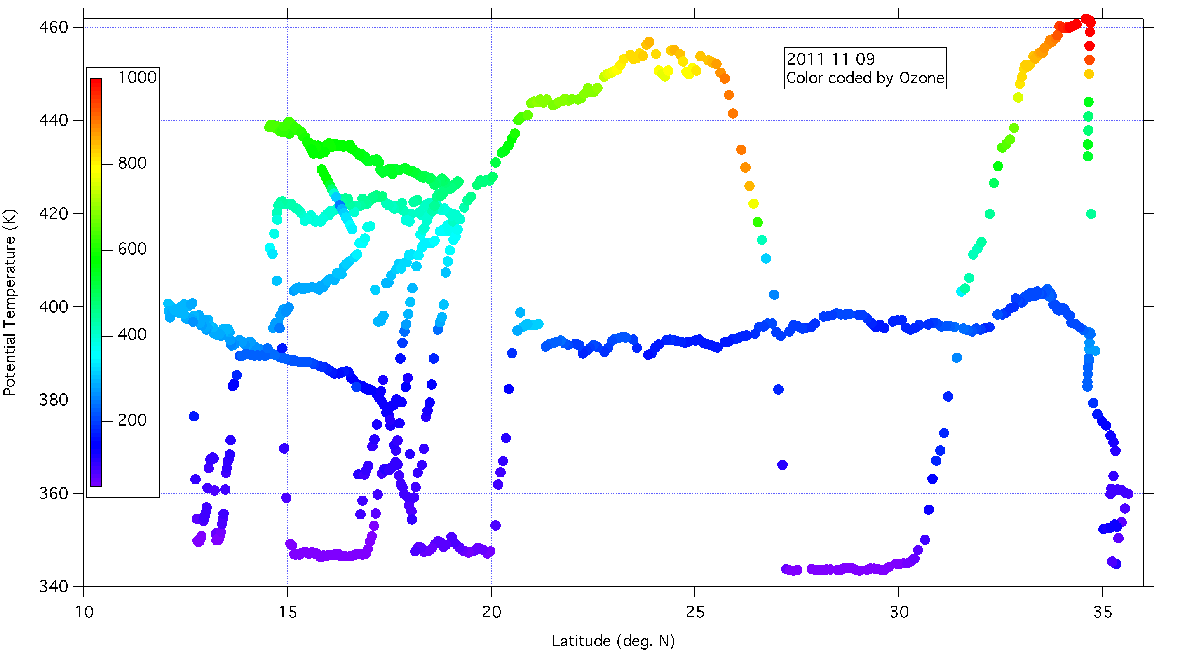
ATTREX-1 Ozone (November 9, 2011)
Notes:
Ozone distribution relaxed?
What is lifetime of ozone at 380-400 K in tropics and subtropics?

Slide 5
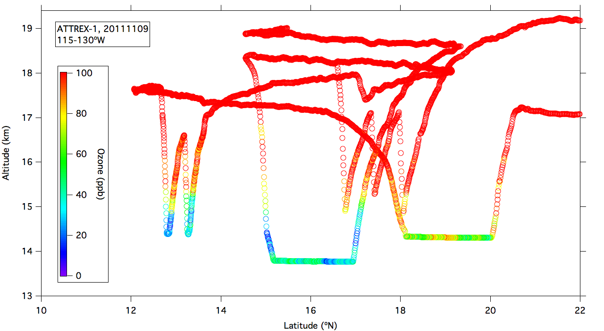
Flight curtain in tropics, low ozone
Notes:
UCATS ozone
Only flight in ATTREX-1 with low enough altitudes and latitudes for low ozone

Slide 6
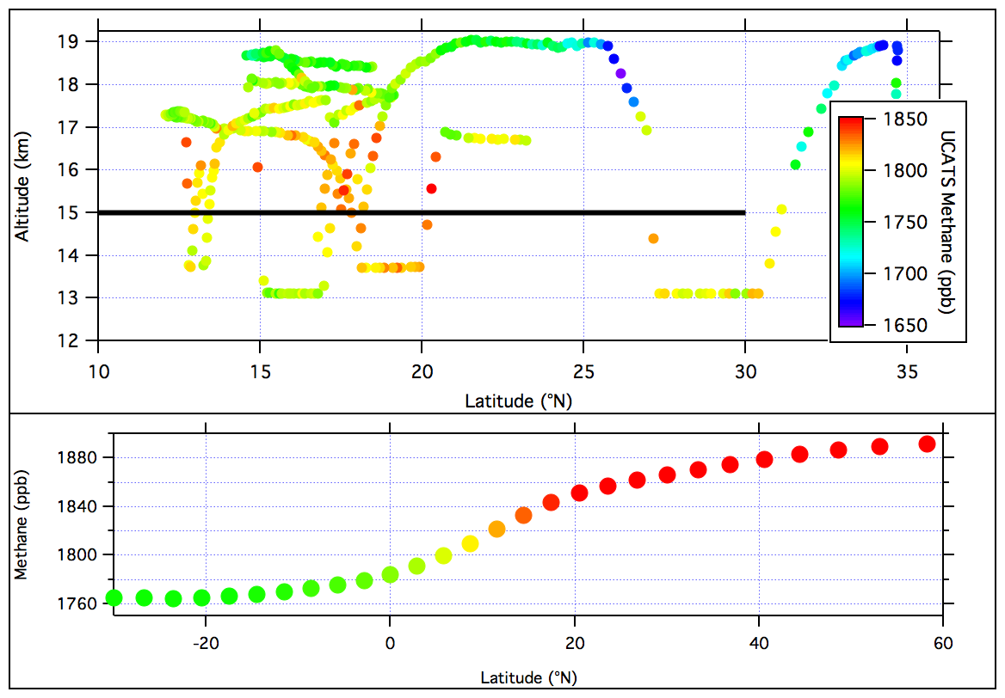
November 9, 2011; methane
Notes:
Lower panel is NOAA surface site data

Slide 7
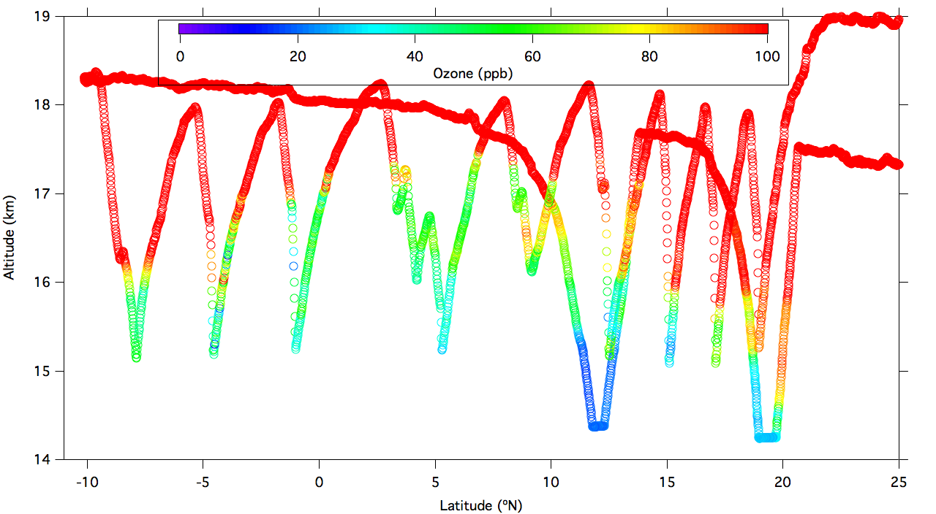
ATTREX-2 Ozone, February 9, 2013
Notes:
Central Pacific (150 W)

Slide 8
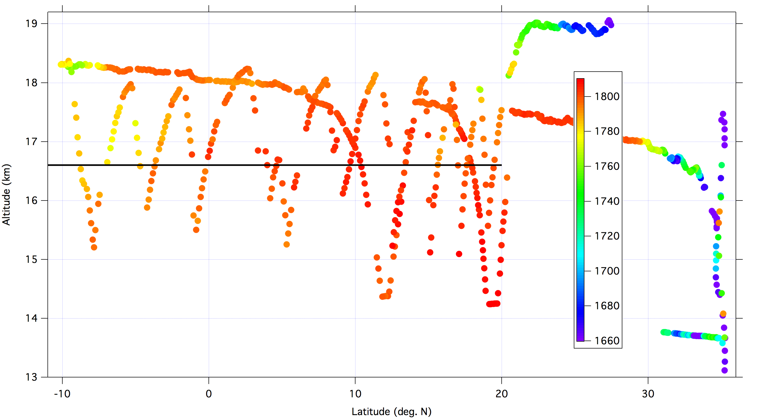
ATTREX-2 Methane, February 9, 2013

Slide 9
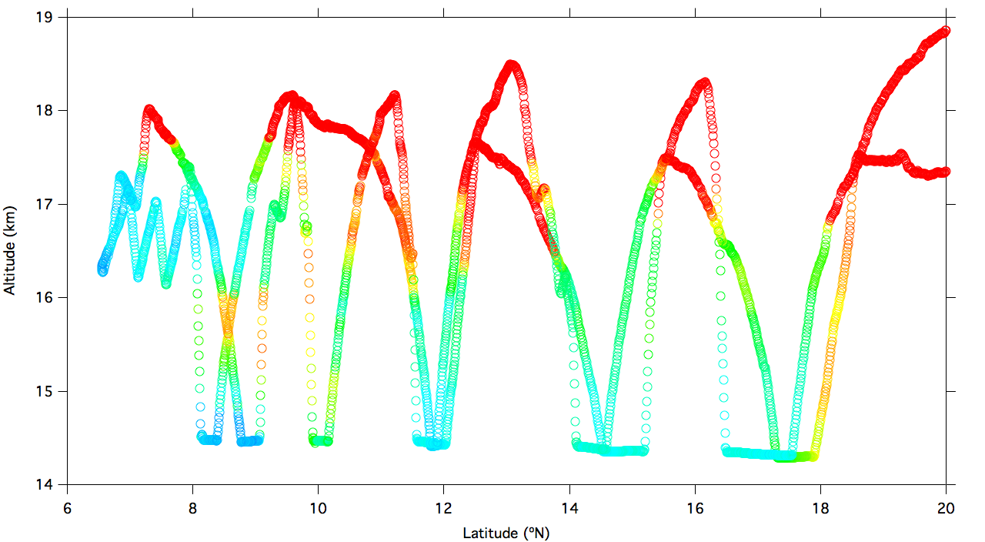
ATTREX-2 Ozone, February 26, 2013
Notes:
Vertical structure in ozone at 8-10 km
Minimum ozone around 25 ppb at 8 N

Slide 10
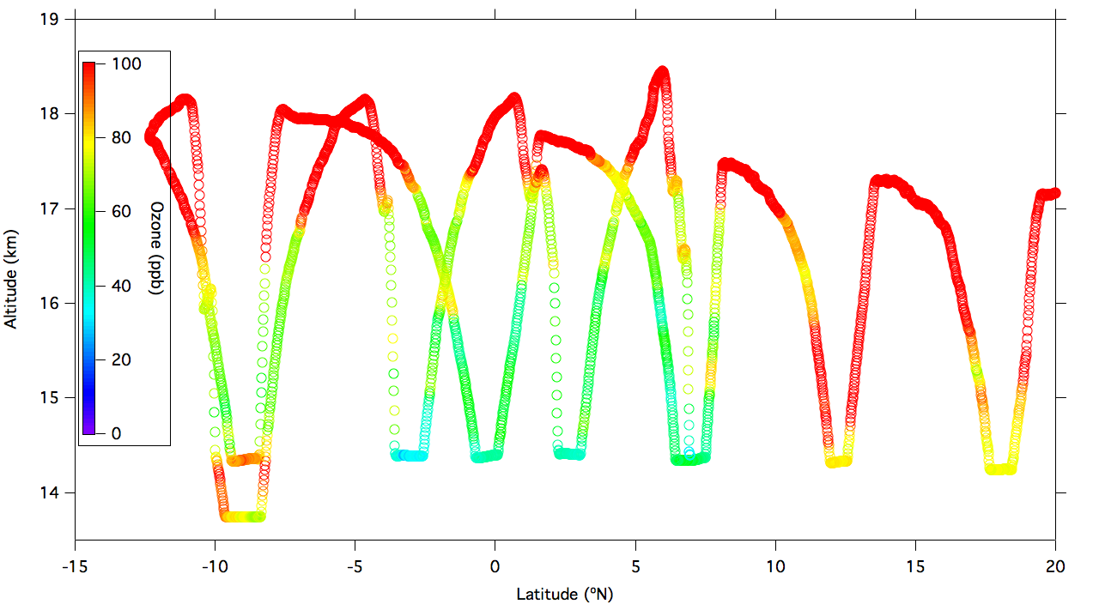
Eastern Pacific (100 W) Feb. 21, 2013
Notes:
Ozone even higher in eastern tropical Pacific

Slide 11
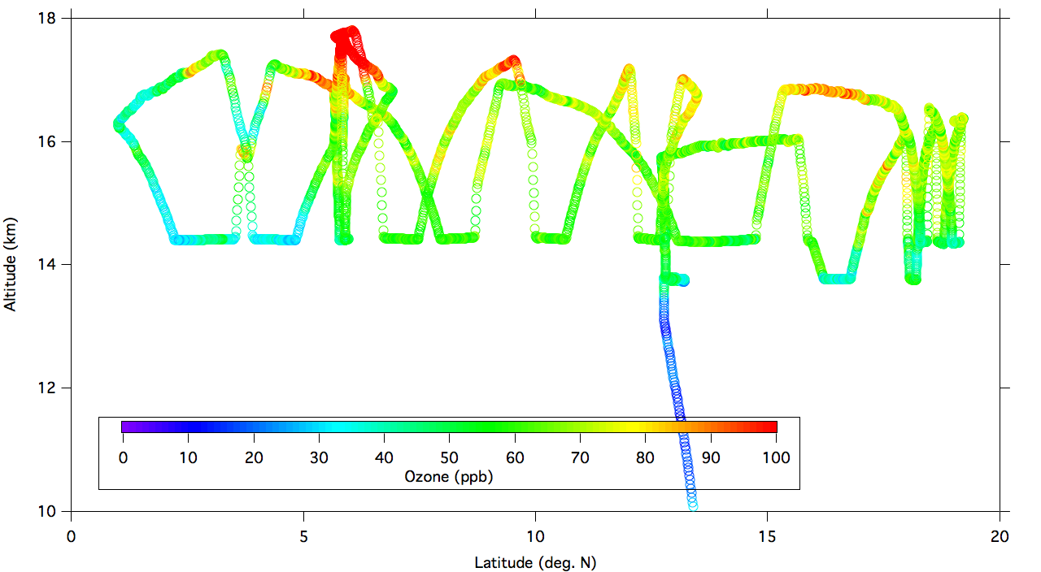
ATTREX-3 Ozone, February 12, 2014
Notes:
Now of course in western tropical Pacific

Slide 12
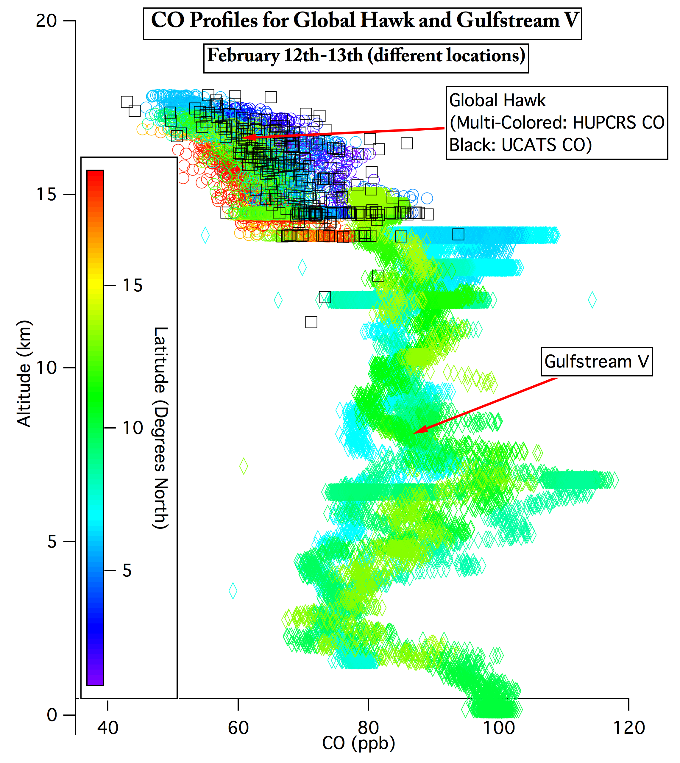
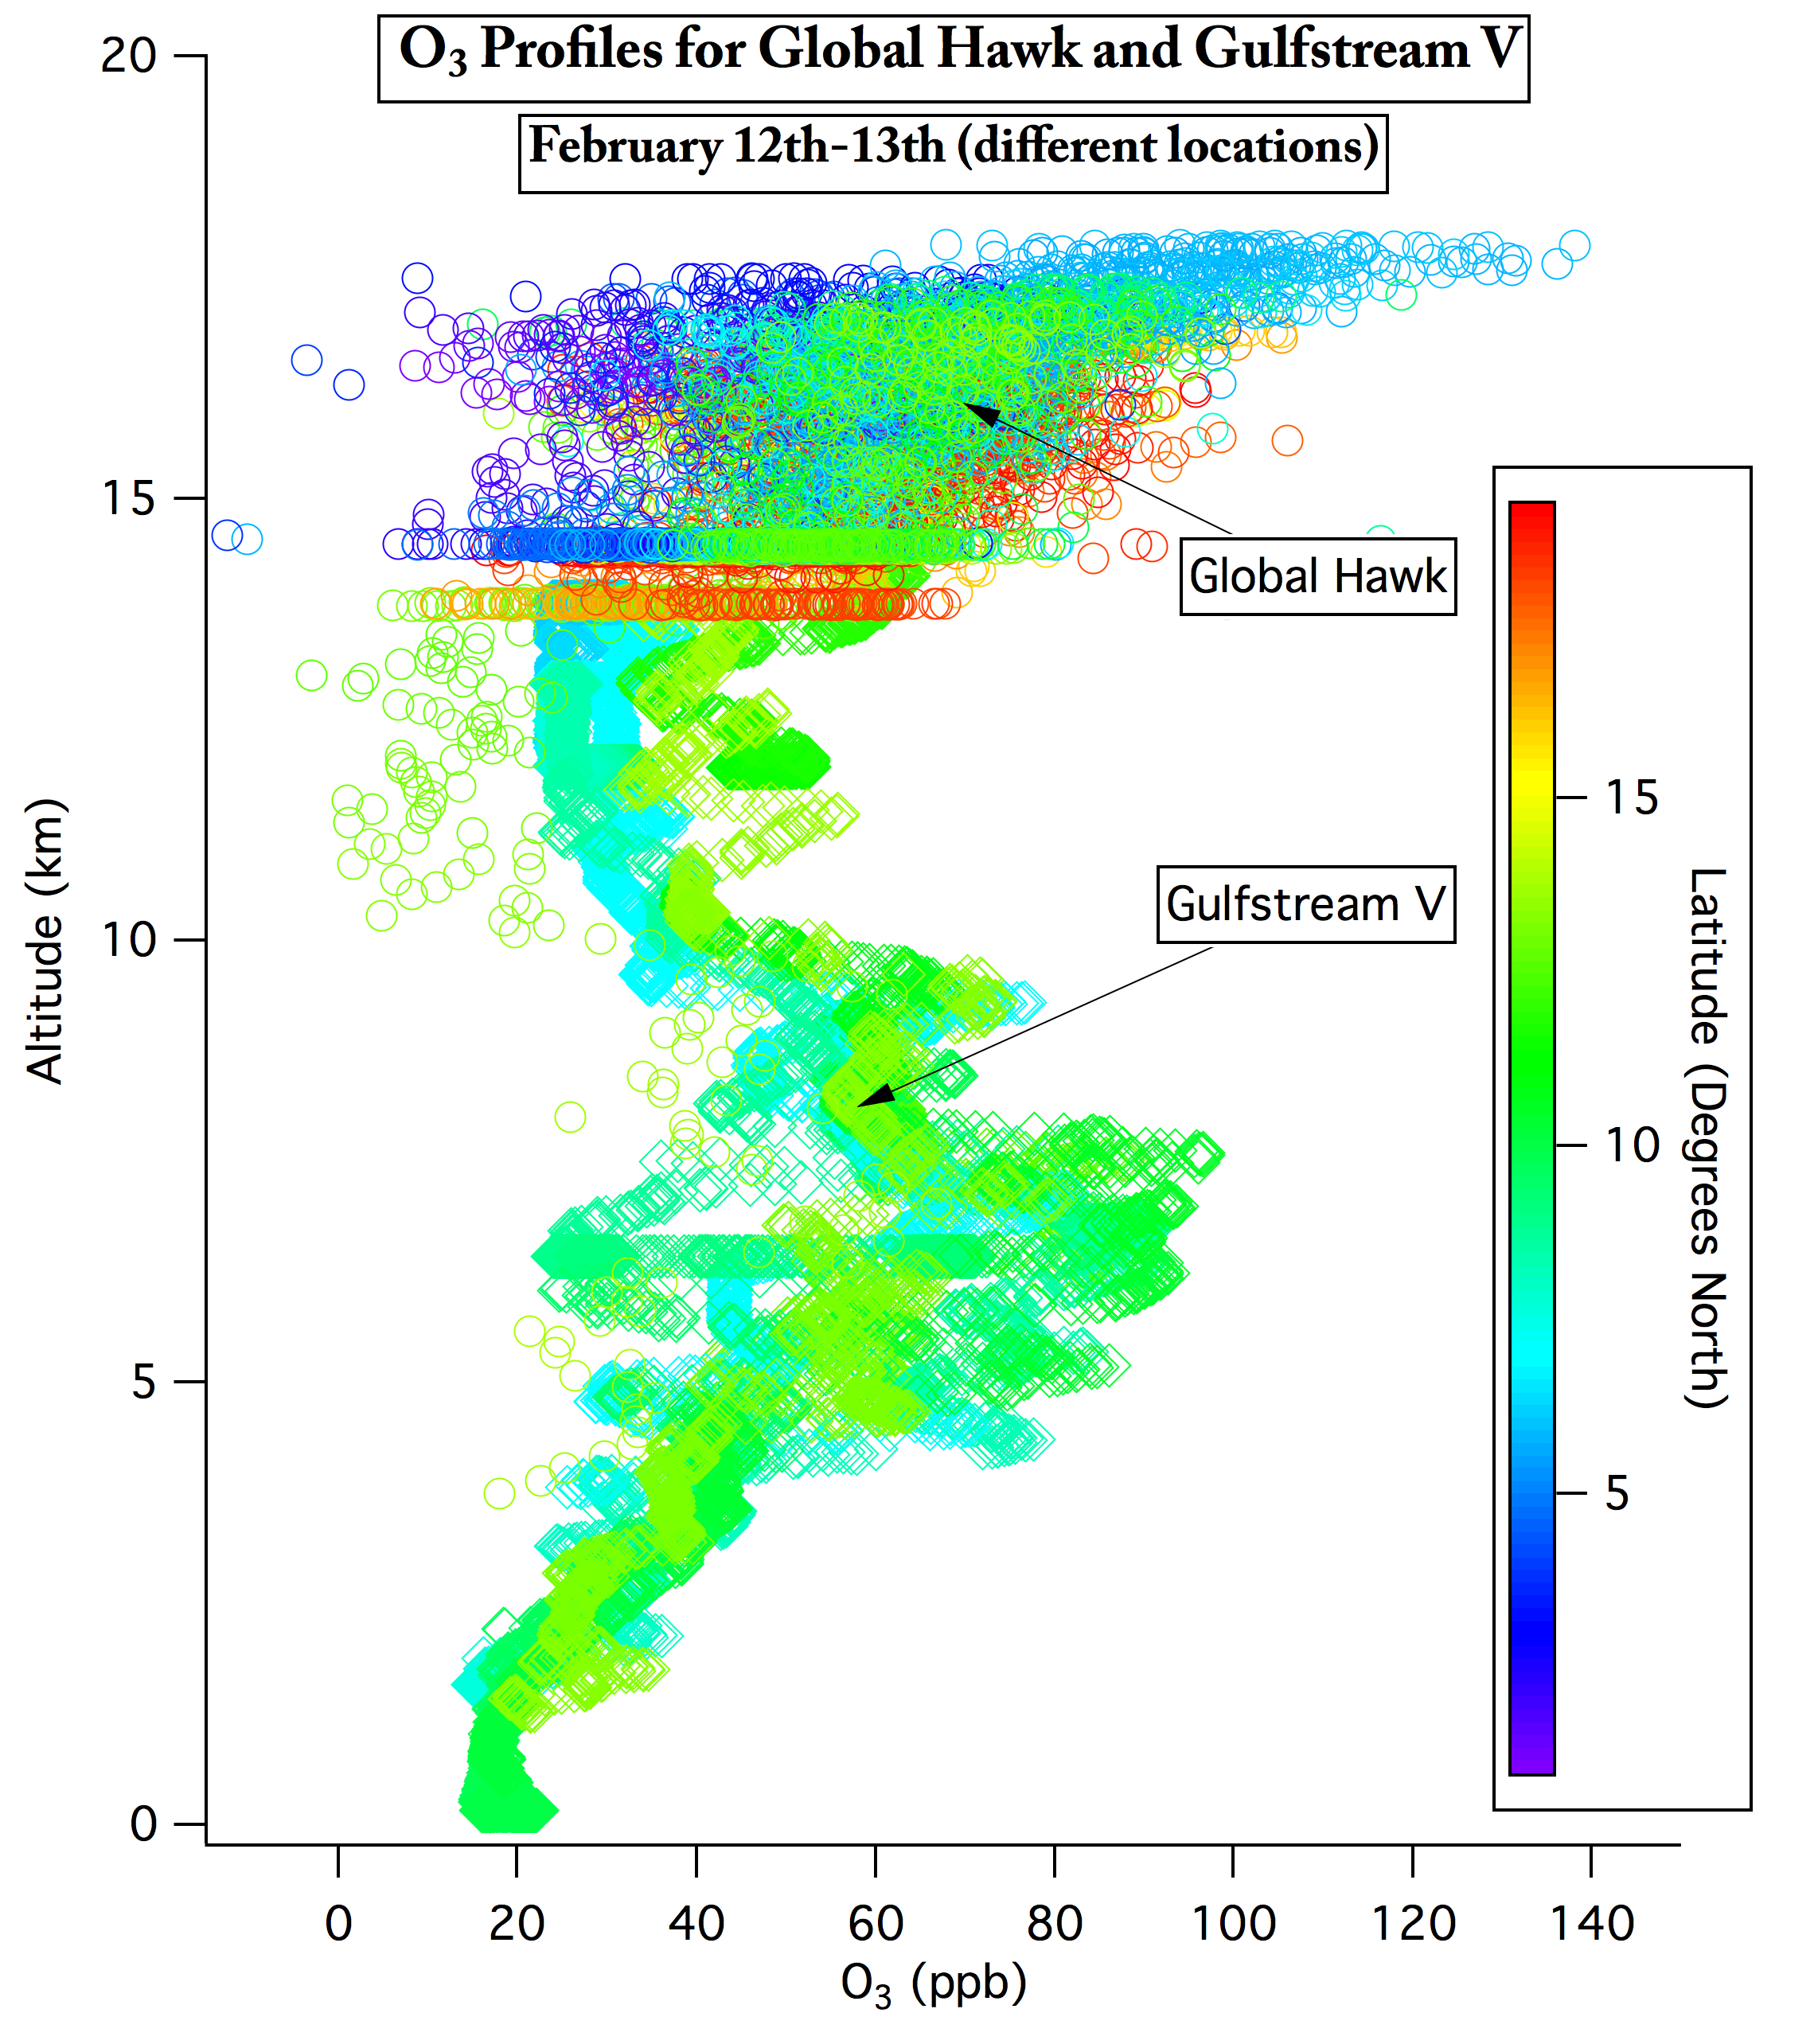
Combined ATTREX and CONTRAST data
Gulfstream V
Aircraft
Notes:
Both profiles from Feb. 12th-13th
Taken in different locations
Agree fairly well, what looks like an offset in CO may simply just be because flights were on different days. Important to see that the profiles appear to fit together well on average. GV shows pollution in middle troposphere, shown by coincident plumes of both high CO and high ozone. (around 7 km)
UCATS CO generally between HUPCRS and GV
Ozone agrees better than CO
TIMEGOAL: 1 minute

Slide 13
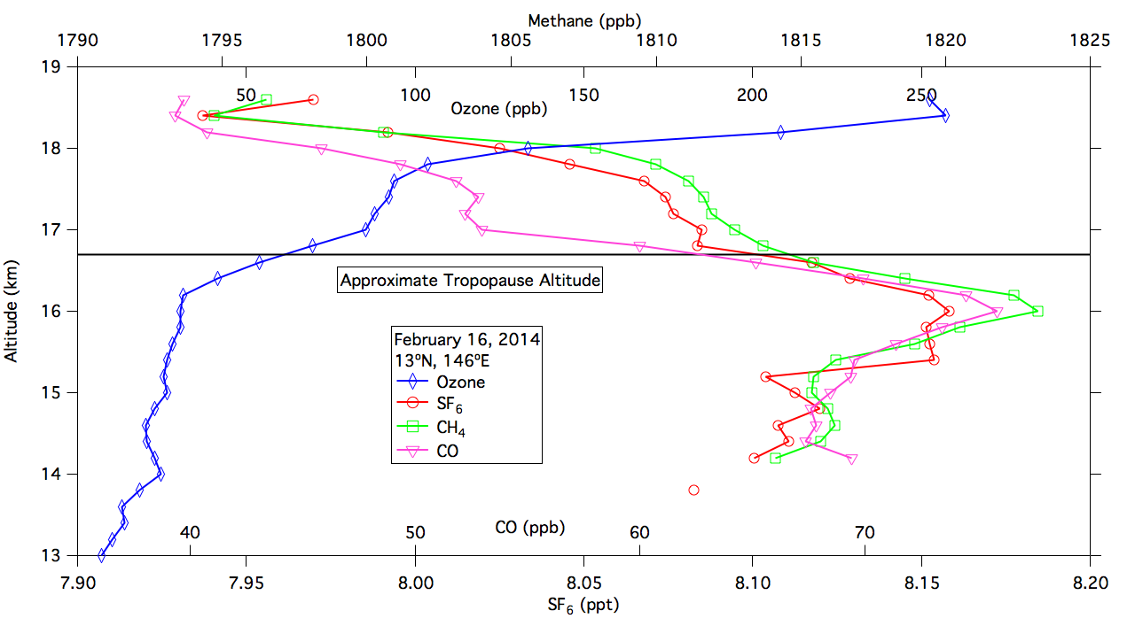
Local Guam flight, February 16, 2014
Notes:
All data binned and averaged
Tropopause is lower of two, from temperature data
Tracers peak just below tropopause
Flat region between tropopauses; may be even flatter in individual profiles

Slide 14
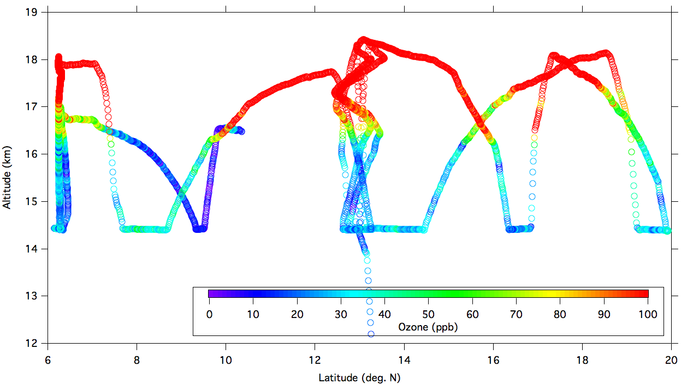
ATTREX-3 Ozone, March 6, 2014
Notes:
Lots of ozone values 10-20 ppb

Slide 15
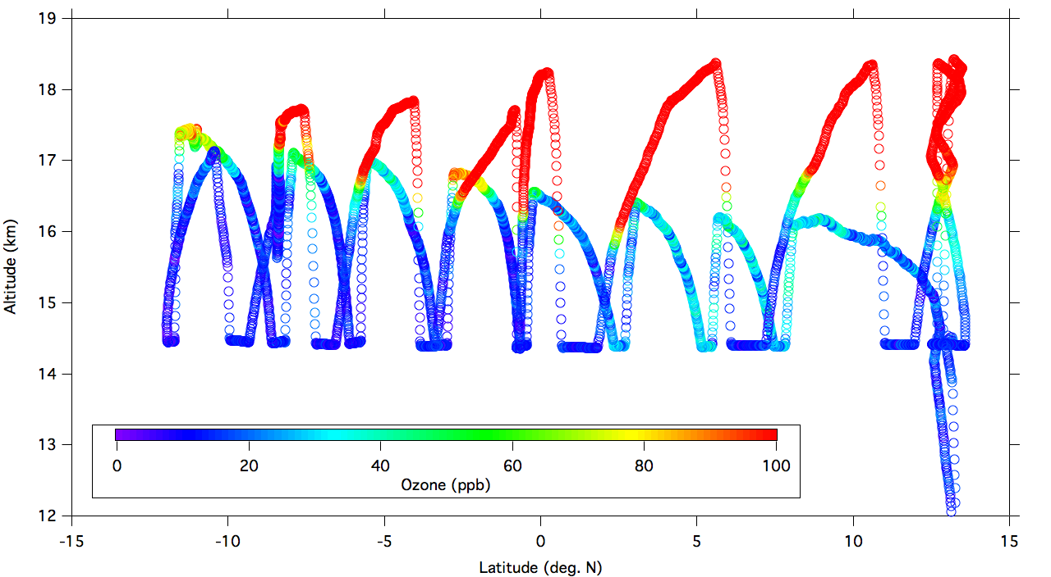
ATTREX-3 Ozone, March 9, 2014
Notes:
Ozone often 10 ppb

Slide 16
Back Trajectories from Tao Wang
Notes:
From Tao Wang
16-17 N

Slide 17
February 12, 2014; 3.5-5°N
Notes:
From Tao Wang

Slide 18
February 16, 2014; “in the box”
Notes:
From Tao Wang

Slide 19
March 4, 2014; 17-18°N
Notes:
From Tao Wang

Slide 20
March 6, 2014; 8°N
Notes:
From Tao Wang

Slide 21
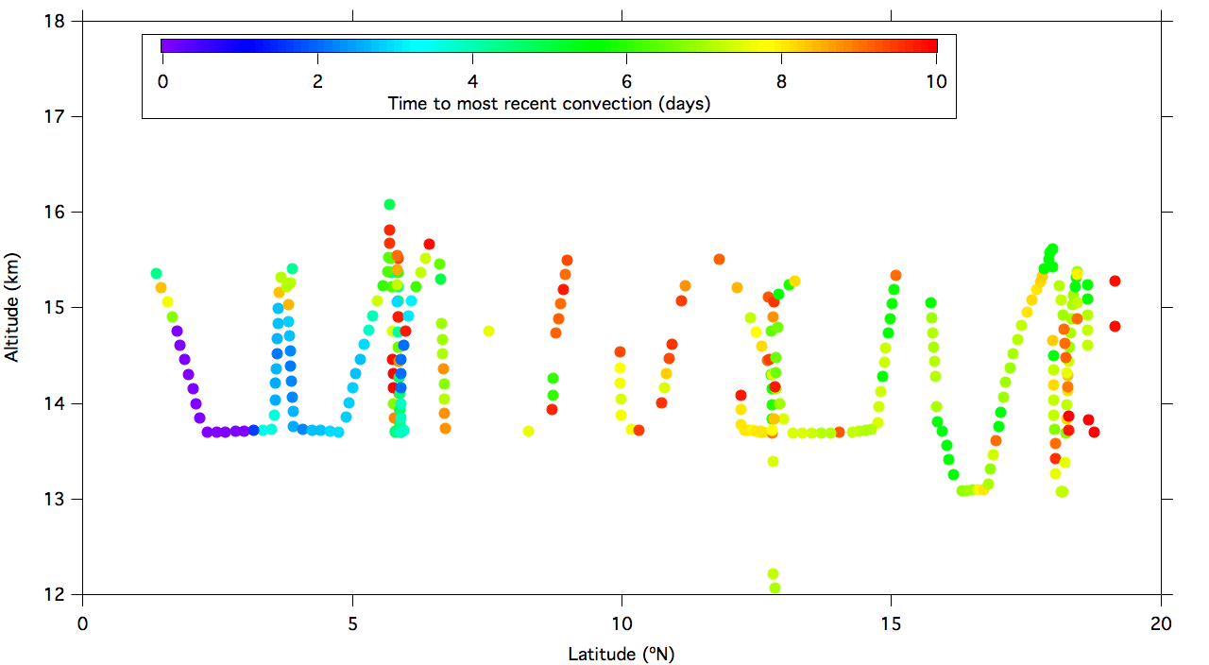
Time since convection, Feb. 12, 2014
Notes:
From Lenny Pfister

Slide 22
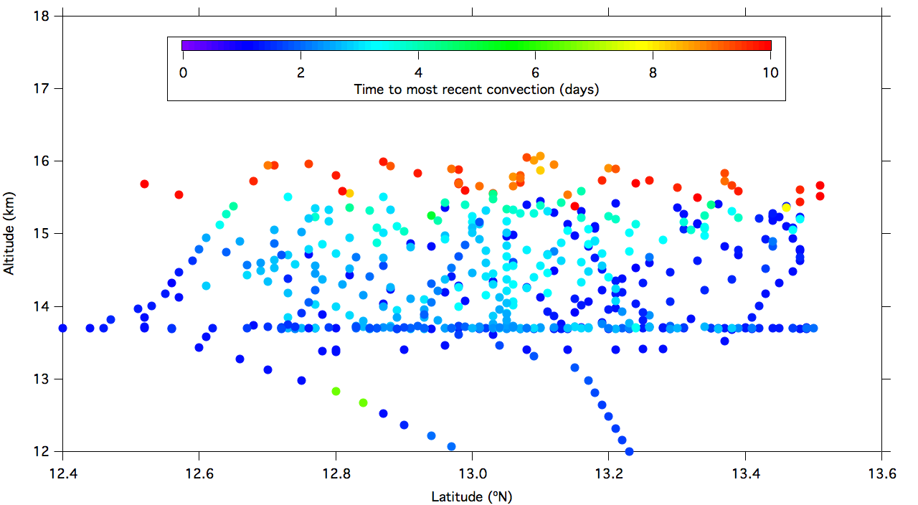
Time since convection, Feb. 16, 2014
Notes:
From Lenny Pfister

Slide 23
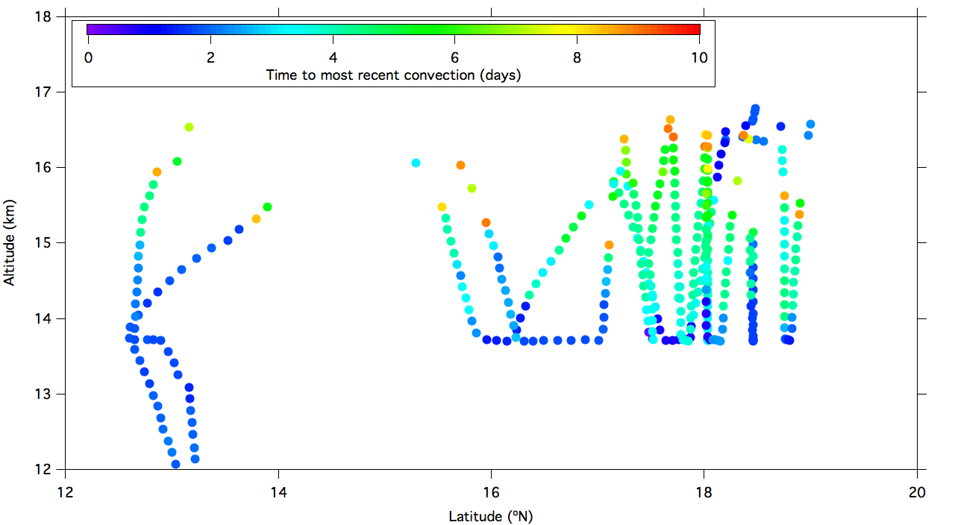
Time since convection, March 4, 2014
Notes:
From Lenny Pfister

Slide 24
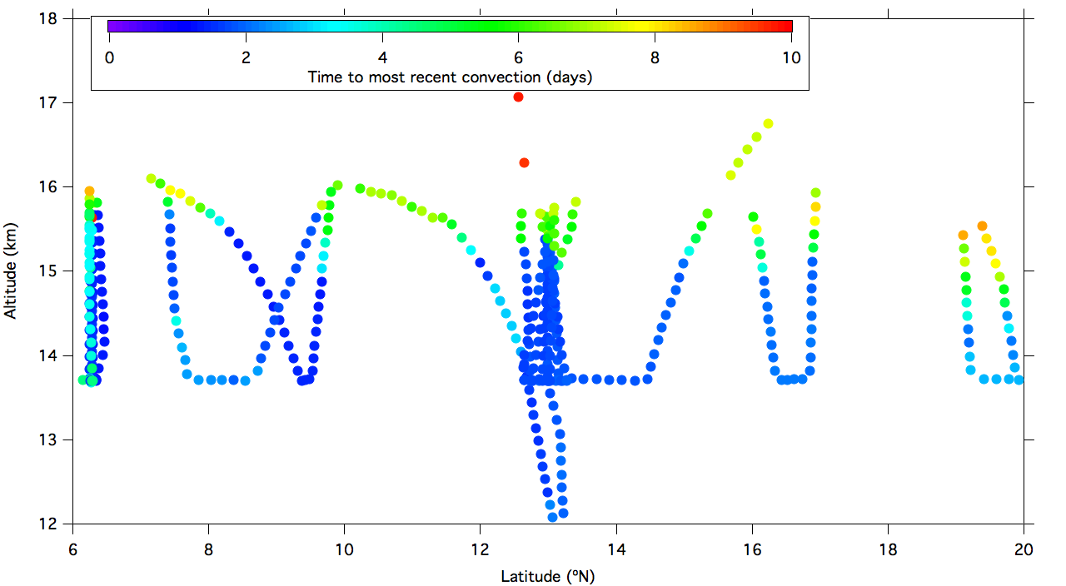
Time since convection, March 6, 2014
Notes:
From Lenny Pfister

Slide 25
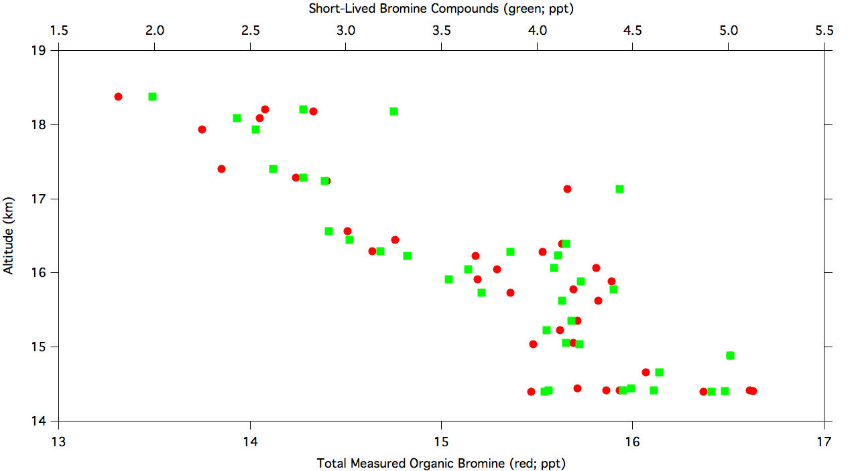
WAS data; February 16, 2014
Notes:
From Lenny Pfister

Slide 26
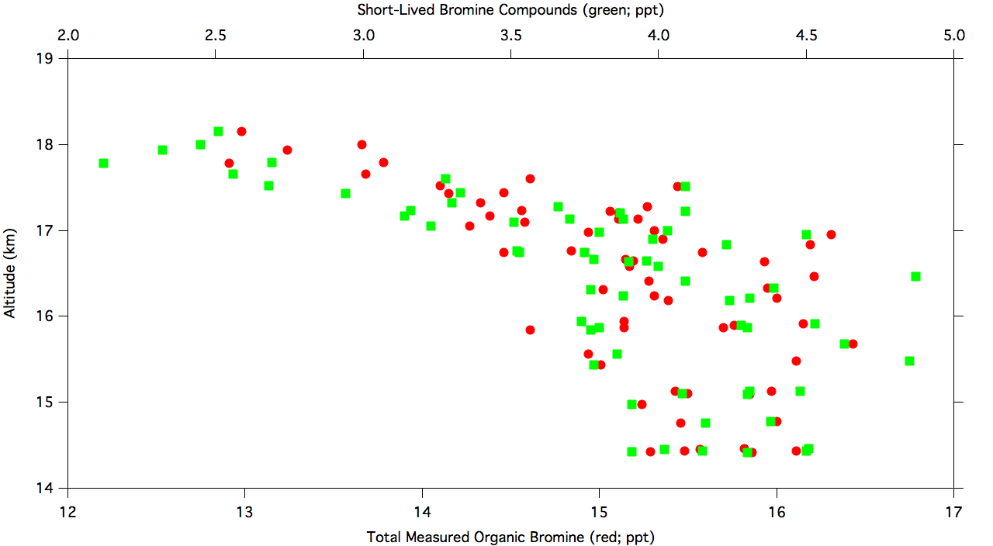
WAS data; March 4, 2014
Notes:
From Lenny Pfister

Slide 27
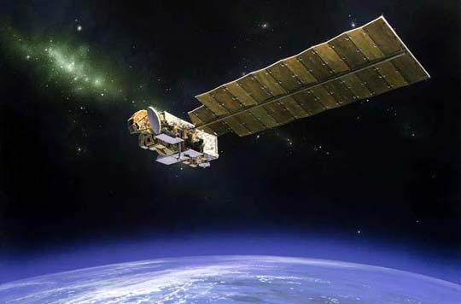
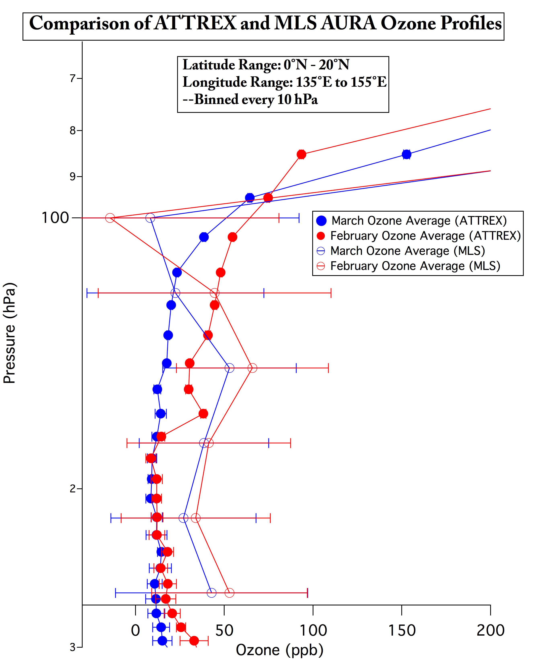
ATTREX-3 Satellite Comparison
AURA Satellite
MLS uncertainty overlaps UCATS ozone data
  Large Error Bars
  ~3 km vert. resolution
  UCATS lower than MLS
March vs. February
  Lower in TTL
  Higher in stratosphere
Notes:
Notes: Be sure to discuss methods of averaging for both MLS and ATTREX data, and what error bars are. For both, error bars are just arithmetic. Satellite Data is a weighted average, not an arithmetic average. Global Hawk data simple average.
TIMEGOAL: 1 minute

Slide 28
Summary
Ozone was lower in ATTREX-3, particularly in March 2014, compared to ATTREX-1 and 2.
Long-lived tracers were relatively uniform in the TTL over the western tropical Pacific.
Tracers and back trajectory calculations suggest deep convection reaching into the TTL.
Organic bromine begins to decline (and ozone increases) above 16 km, which is also the approximate highest altitude influenced by recent convection.
Data are consistent with deep convection bringing air with low ozone up to the tropopause.
Notes:
Long-lived tracers – particularly N2O
Need a mission to the same area with a full chemical payload in the TTL (NOx, OH, halogen CIMS, OVOCs + other HOx precursors).

Slide 31
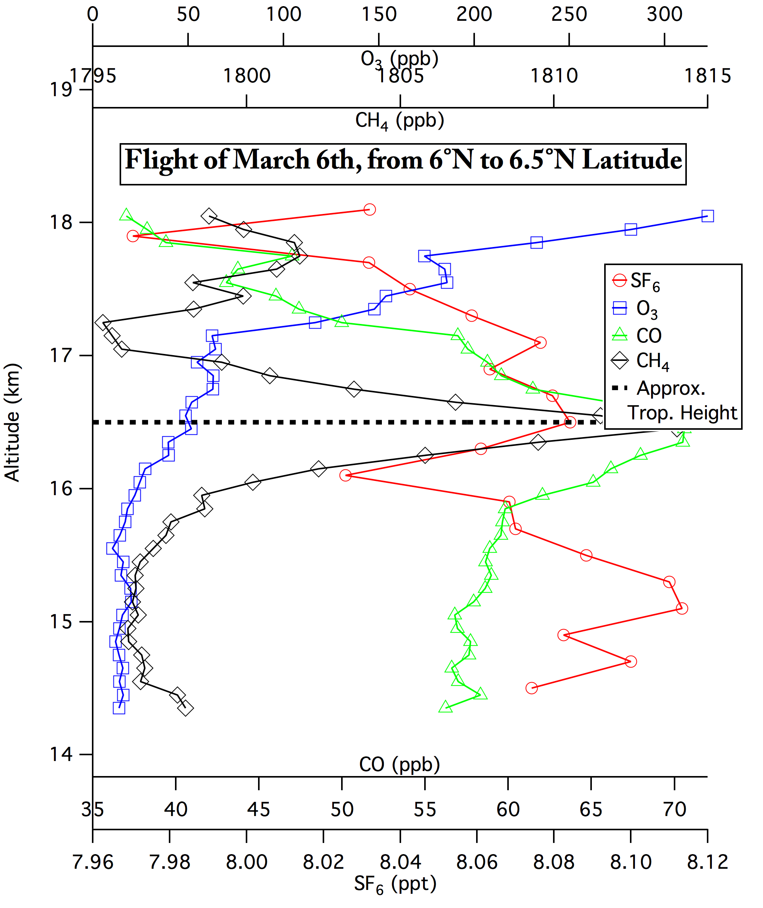
Results: Binned Profiles
Near tropopause, spike in CH₄ and CO, low values of ozone above
  Implies deep convective mixing
SF₆ ~8.08 ppt
  Mauna Loa Observatory (MLO) (19.5°N): SF₆ ~ 8.21 ppt
  American Samoa (SMO)(14.2°S): SF₆ ~ 8.01 ppt
CH₄: (1795-1815 ppb)
  MLO: 1839 ppb
  SMO: 1767 ppb
Notes:
Notes: tropopause here is cold point tropopause, marked simply where the temperature profile reaches a minimum (since temp begins to increase in the stratosphere).
Also, Methane (CH4) levels between MLO and SMO as well (MLO: 1839 ppb, SMO: 1767 ppb)—values between 1795 and 1815 ppb in profile above. All these values taken at surface of locations indicated.
SF6 is basically right between MLO and SMO, which is to be expected if there is little inter-hemispheric exchange of air. In other words, this means the air likely predominantly came from lower in the atmosphere, instead of from other latitudes.
TIMEGOAL: 1 minute

Slide 32
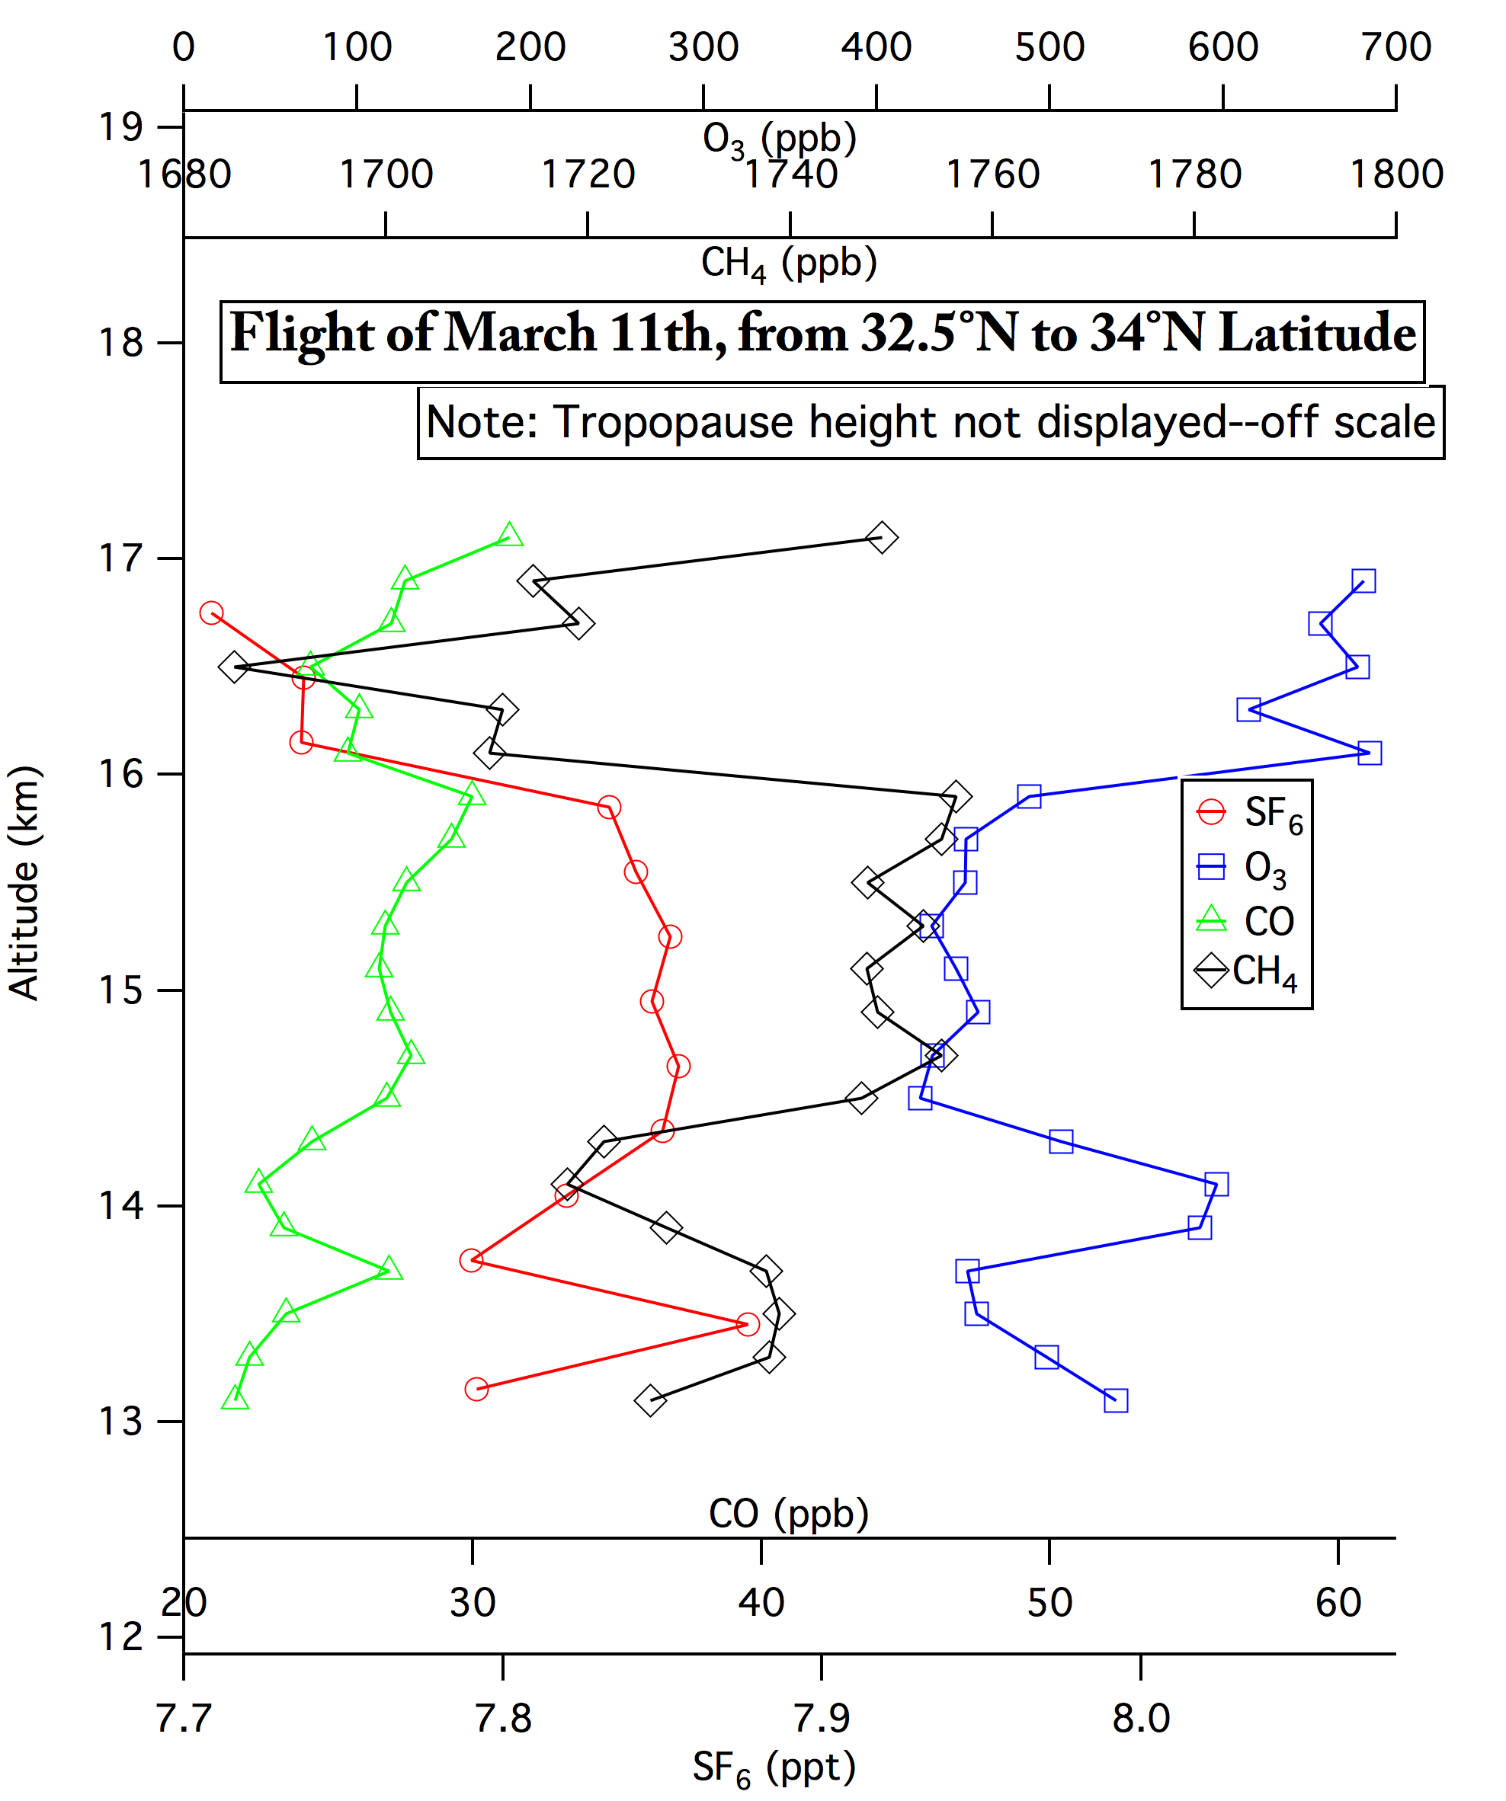
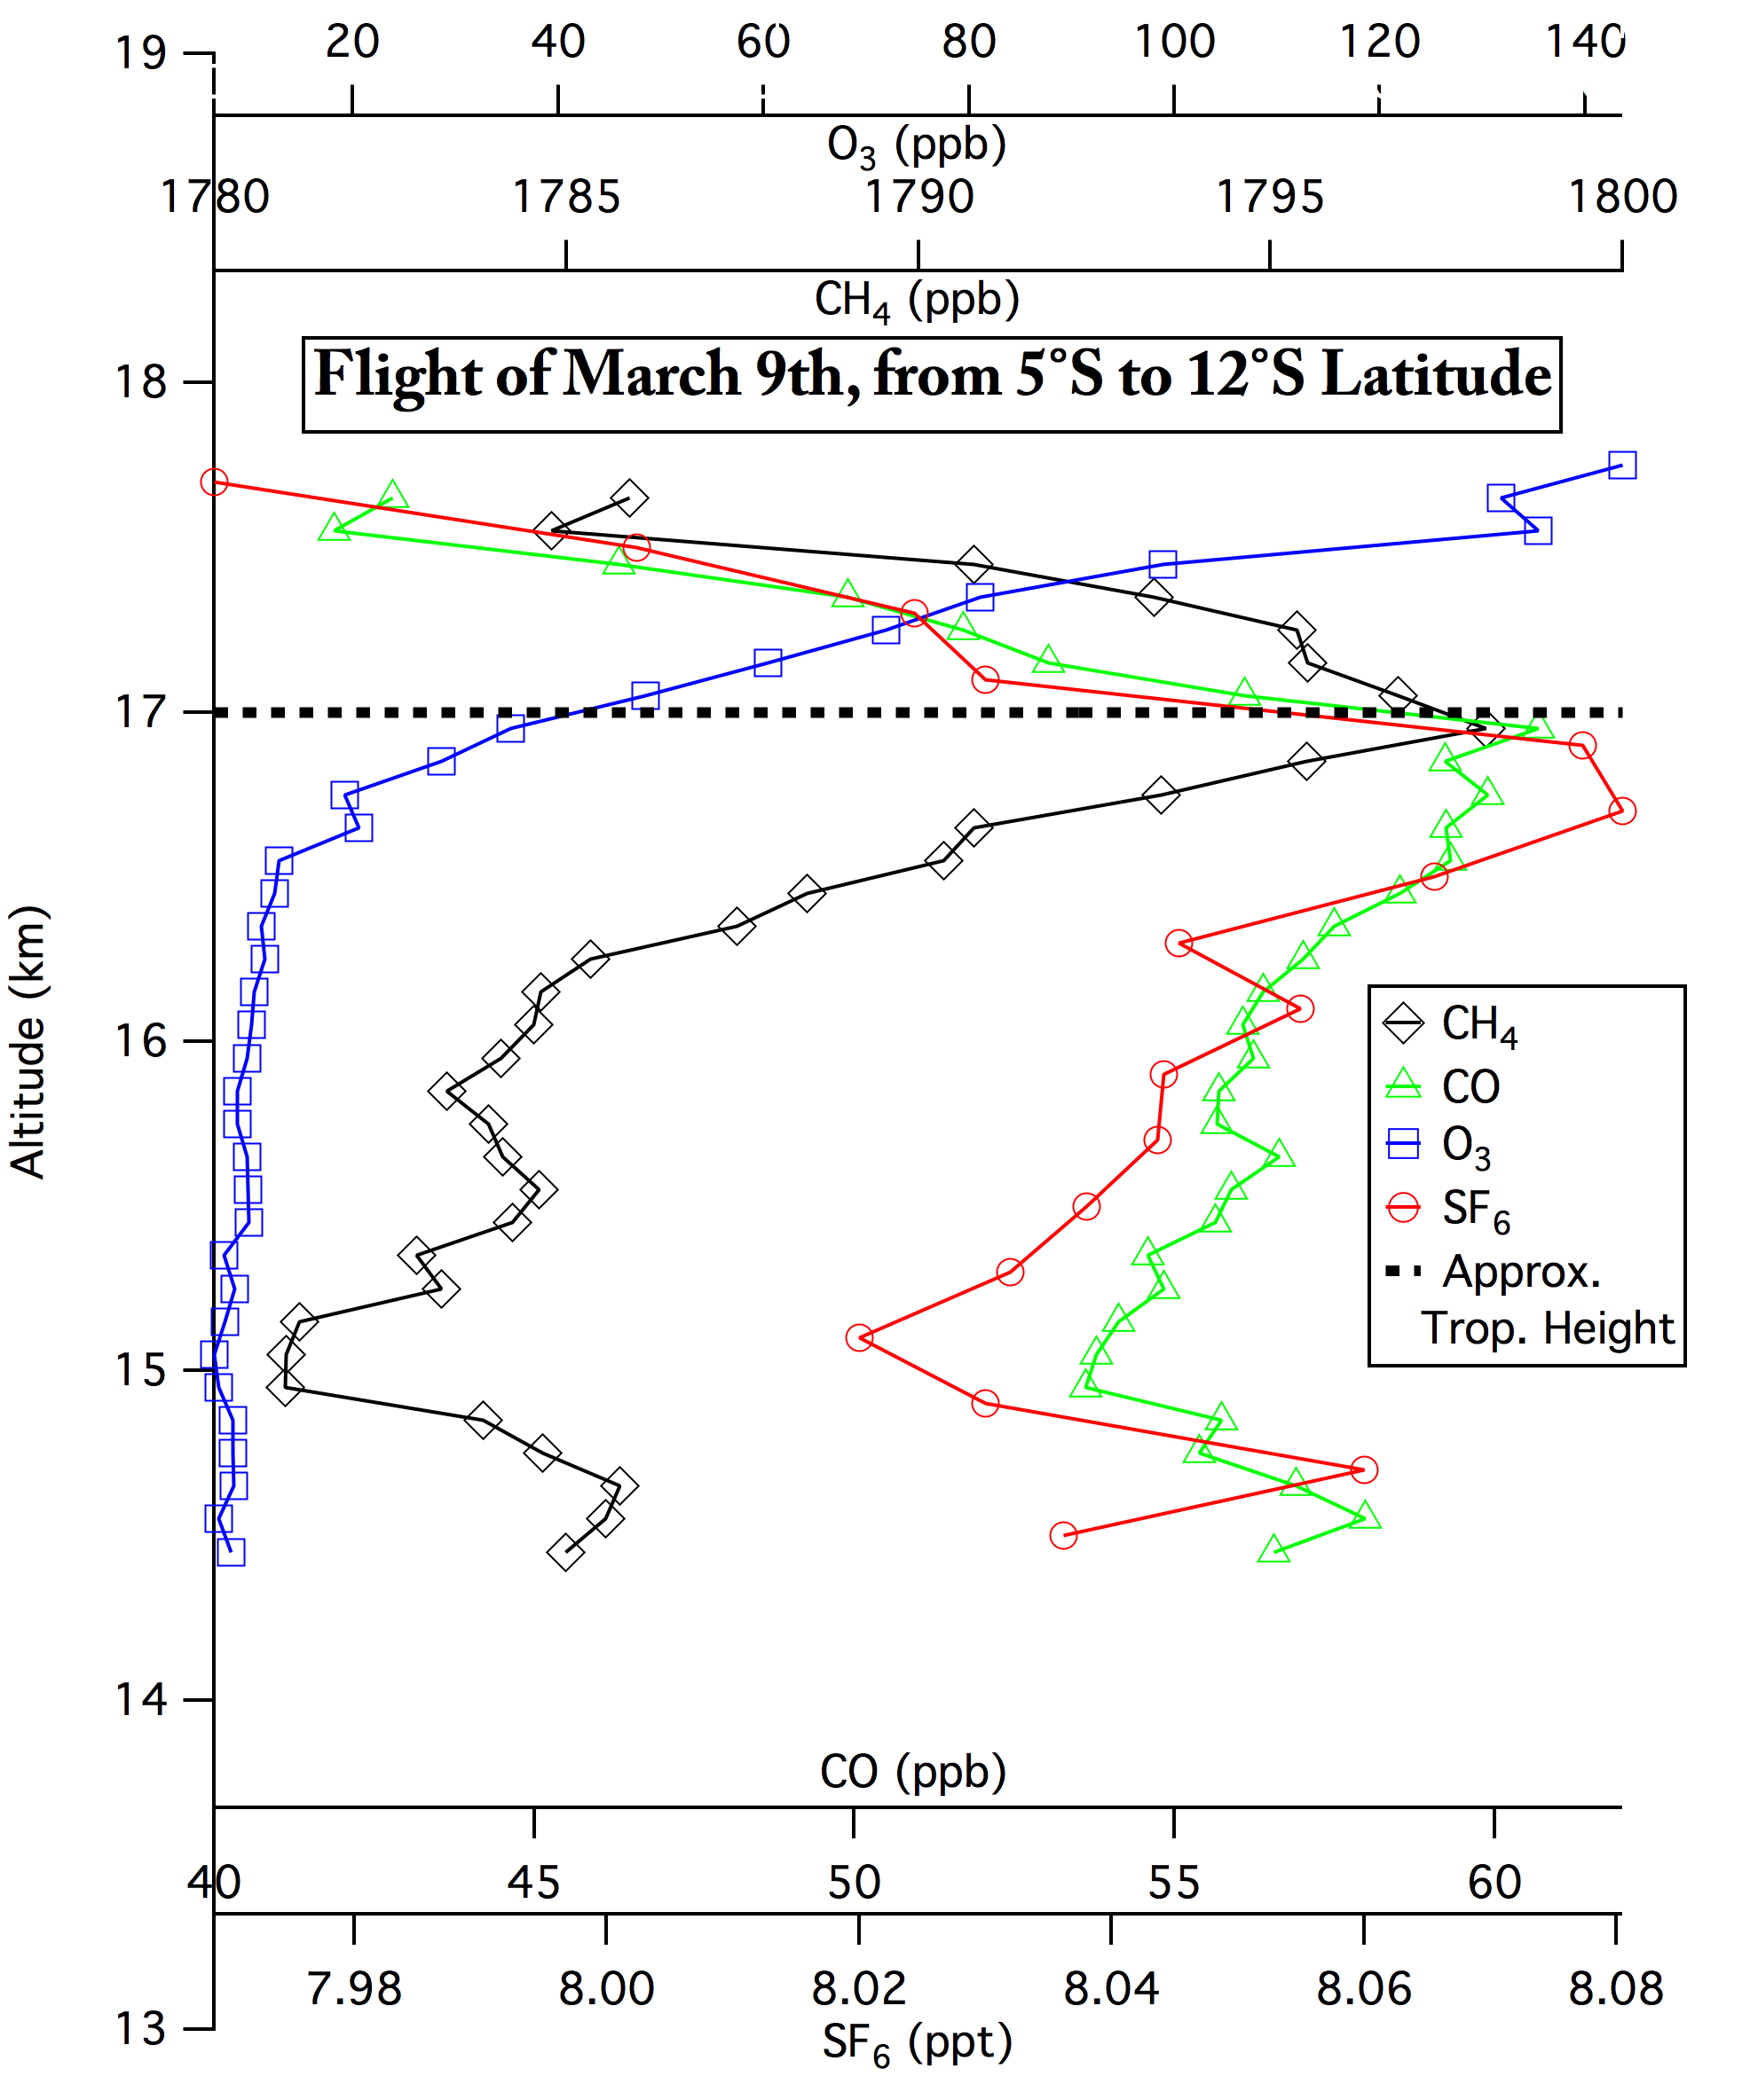
Other Binned Profiles
Left: March 11th (crossed subtropical jet into mid-latitudes)
Right: March 9th (crossed equator)
Notes:
Notes: Here discuss differences in SF6 average values, as well as differences in how other tracers and ozone appear at higher/southern latitudes, respectively. Can go through pretty quickly.
All tracers lower in stratosphere, but ozone increases sharply (in March 11th). Again, even in southern hemisphere, we have higher CO and CH4 at tropopause: convection is bringing this air up from the boundary layer, which is why it is high in CH4 and CO but low in ozone. photolysis starts to take effect just below tropopause, as we can see. We see values of SF6 and CH4 more comparable to SMO, which is again to be expected, further backs that it is more convection than other methods of transport.
TIMEGOAL: 1 minute

Slide 33
The Main Points
The parts of the TTL sampled by the Global Hawk during ATTREX-2 (February 2013) had young and relatively uniform air.
Small variations in tracer mixing ratios show that there was some mixing in of extratropical or older air.
TTL air sampled in ATTREX-1 (November 2011) had much more extratropical character.
Notes:
In contrast to ATTREX-1

Slide 34
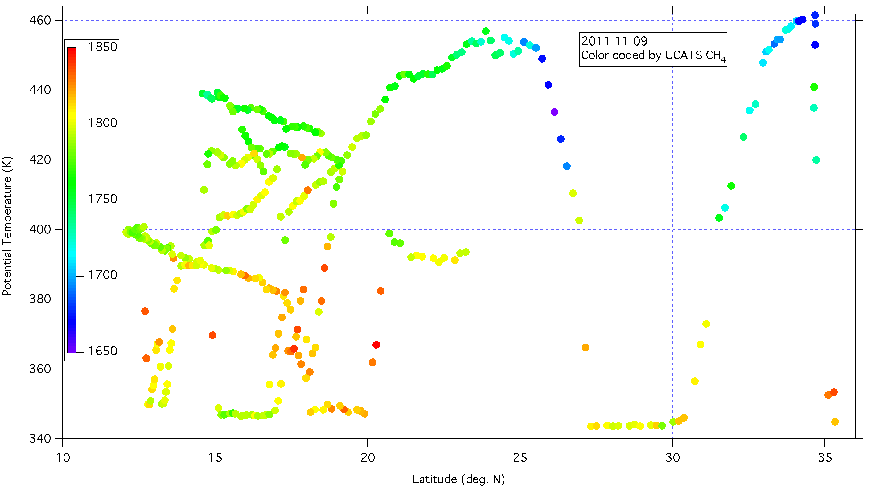
ATTREX-1: Possible intrusions of extratropical air into the tropical tropopause region (115-135°W)
Notes:
Methane ~ 1780-1790 at 12-13 N, 390-400 K; agreement with AWAS (even a little bit lower) – Tropospheric methane = 1785 (Eq.), 1880 (NH), 1765 (SH)
N2O – dips from 321 to 317 ppb, SF6 also drops from 12-14 N
Decrease in methane on dive at 15-17 N may be due to seasonal cycle (agreement with AWAS, but no dips on other trace gases)

Slide 35
Notes:
November 9, 2011 – approximate tropopause is at 15 km from 10 to 30 N
February 2013 methane distribution – similar average but hemispheric gradient even larger (~150 ppb)

Slide 36
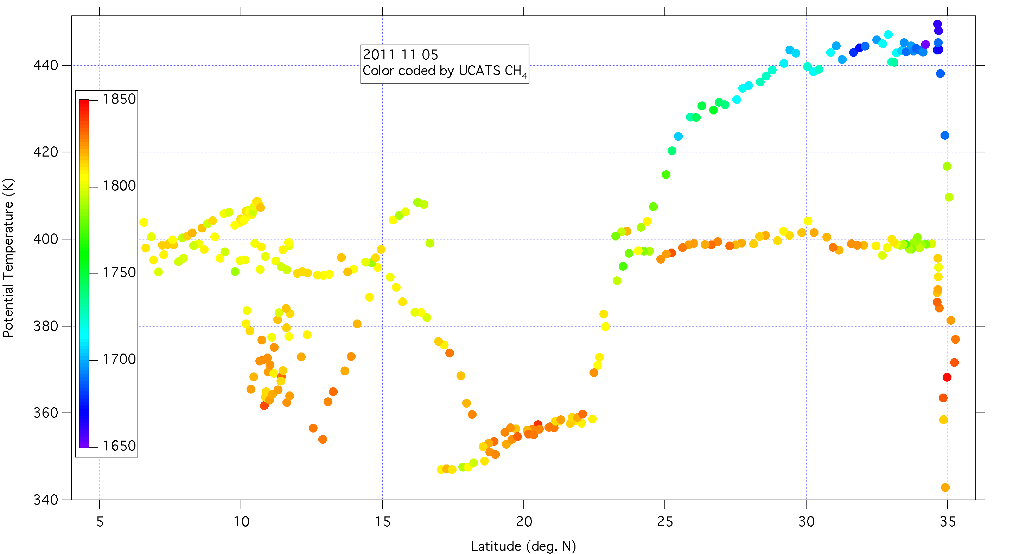
Variations in methane distribution on November 5, 2011
(Latitude-theta slice along 118-128°W)
Notes:
Just a few points here – 9-10 N, 390 K. Even lower CH4 in AWAS.
N2O dip from 322 to 319 ppb

Slide 37
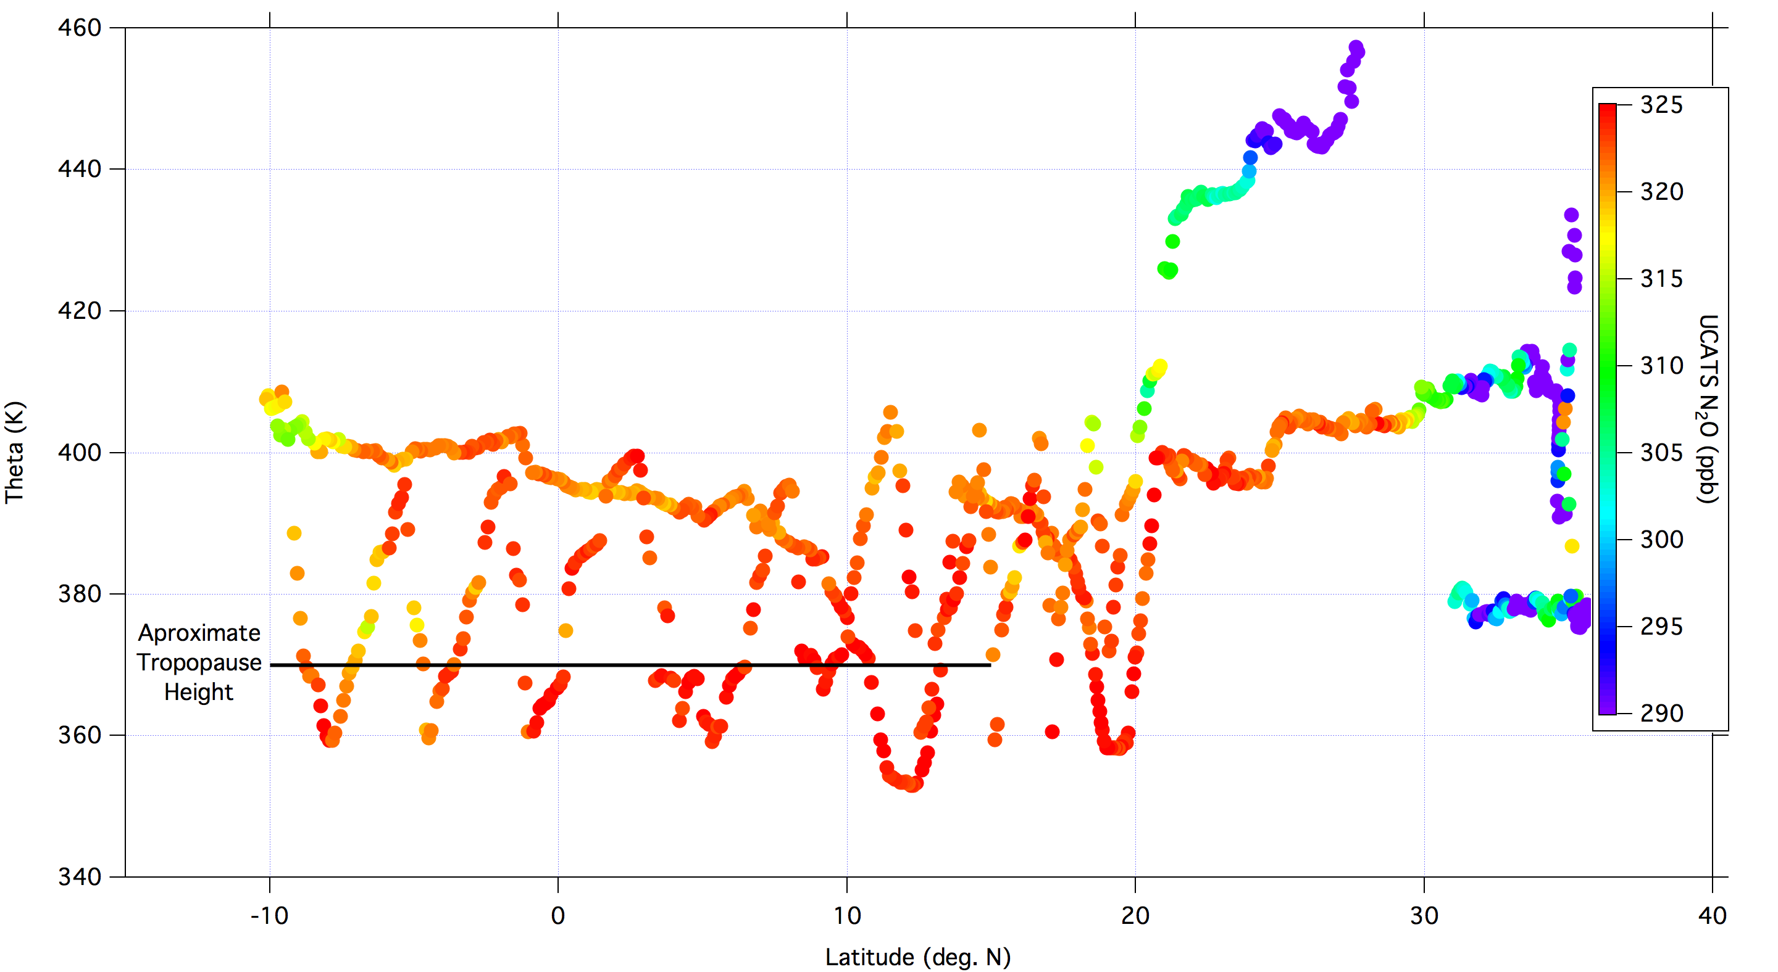
Potential Temperature – Latitude Cross-section, February 9, 2013

Slide 38
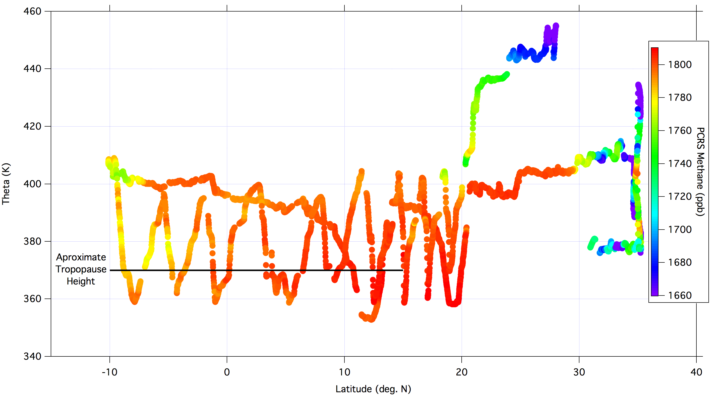
Feb. 9, 2013, Color-coded by Methane

Slide 39
START-08 Data – GV flights in NH midlatitudes
Stratospheric air with
tropical entry
Tropical
pipe
Tropopause
Free Trop.
Boundary layer

Slide 40
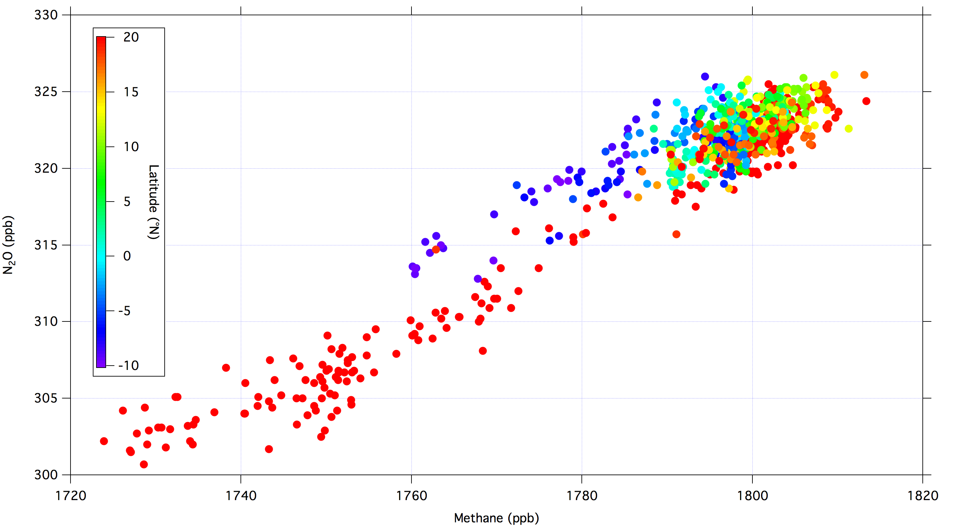
Feb. 9, 2013, Color-coded by Latitude
Notes:
Bin by PV?

Slide 41
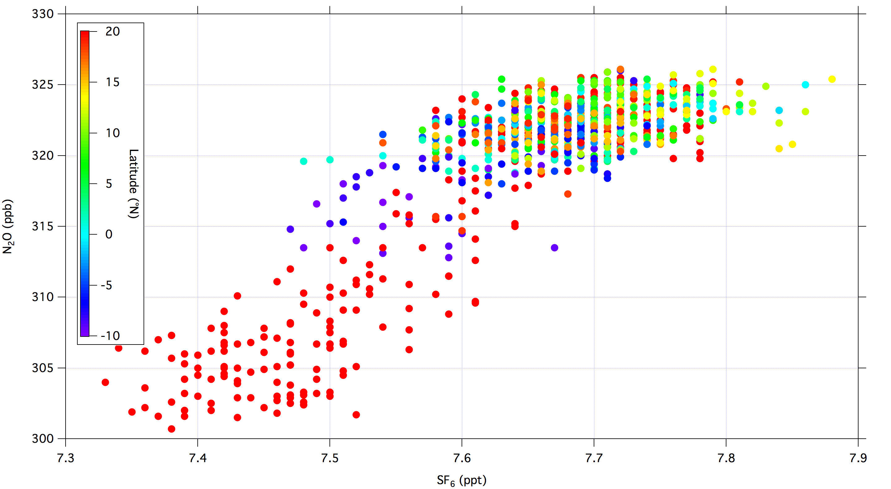
Feb. 9, 2013, Color-coded by Latitude
Notes:
Instrument noise? No.
All along one branch. PV may help, but probably not.

Slide 42
Simple model for mixing
Measured mixing ratio = x*(mixing ratio of midlatitude air) + (1-x)*(mixing ratio of tropospheric air)
x = fraction of midlatitude (or older) air
Tropospheric values from NOAA ground sites
Mixing ratios for midlatitude air from Global Hawk measurements: N₂O = 290 ppb and CH₄ = 1805 ppb
x_{N2O} = (325 ppb – measured)/(325-290 ppb)
Notes:
For CH4, (1805-meas.)/(1805-1690) but with additional uncertainty because of latitudinal gradient of CH4

Slide 43
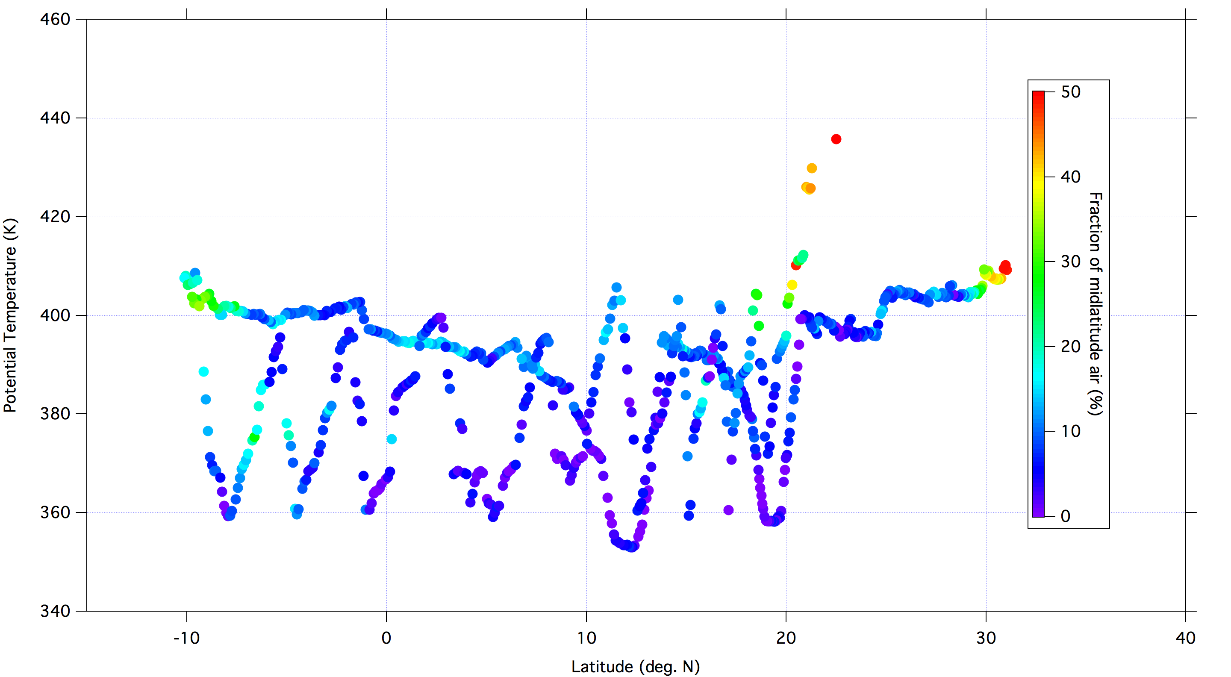
Percent of midlatitude or older air based on N₂O, February 9, 2013
Notes:
Average = ~7%

Slide 44
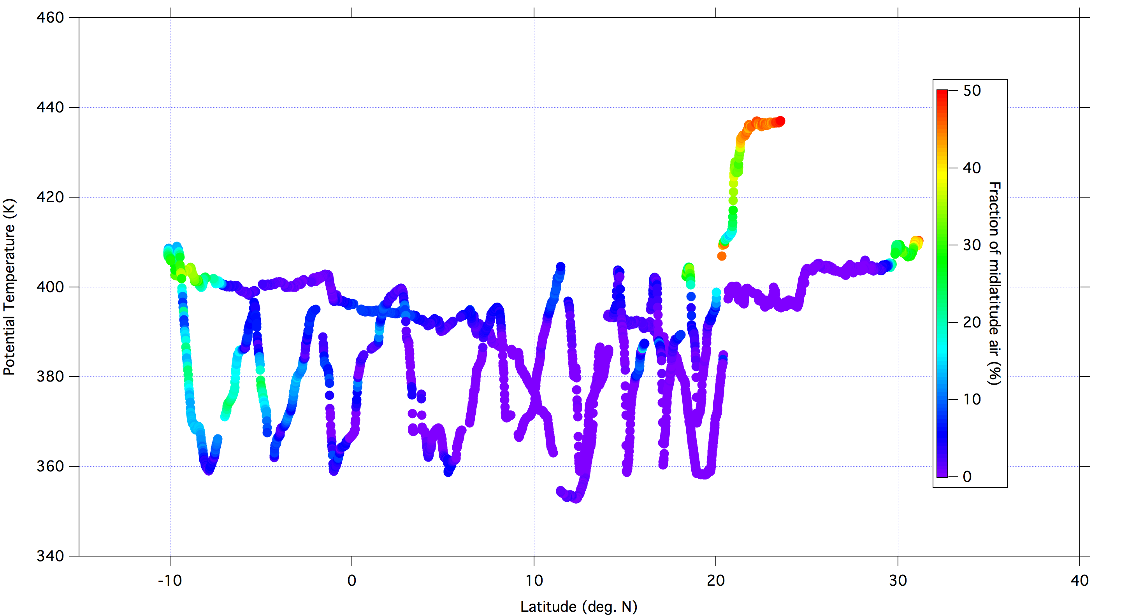
Percent of midlatitude or older air based on methane, February 9, 2013

Slide 45
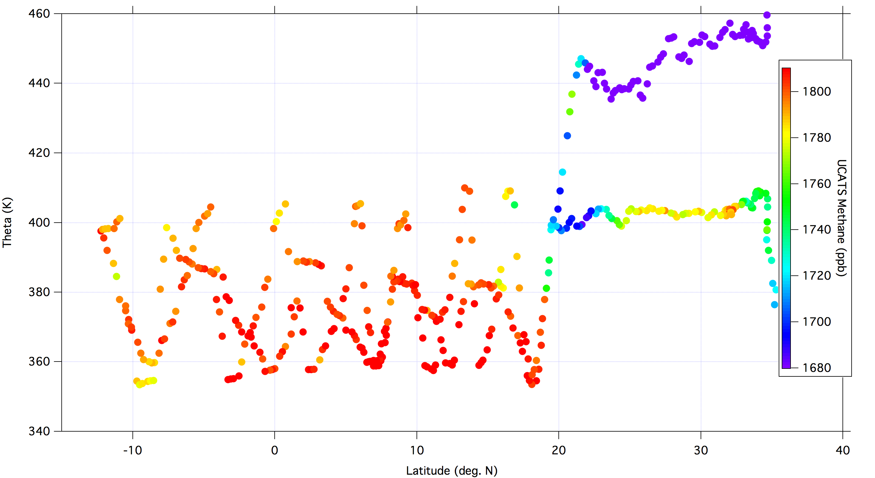
Feb. 21, 2013; UCATS Methane
Notes:
Tropopause height = 375-380 K in tropics

Slide 46
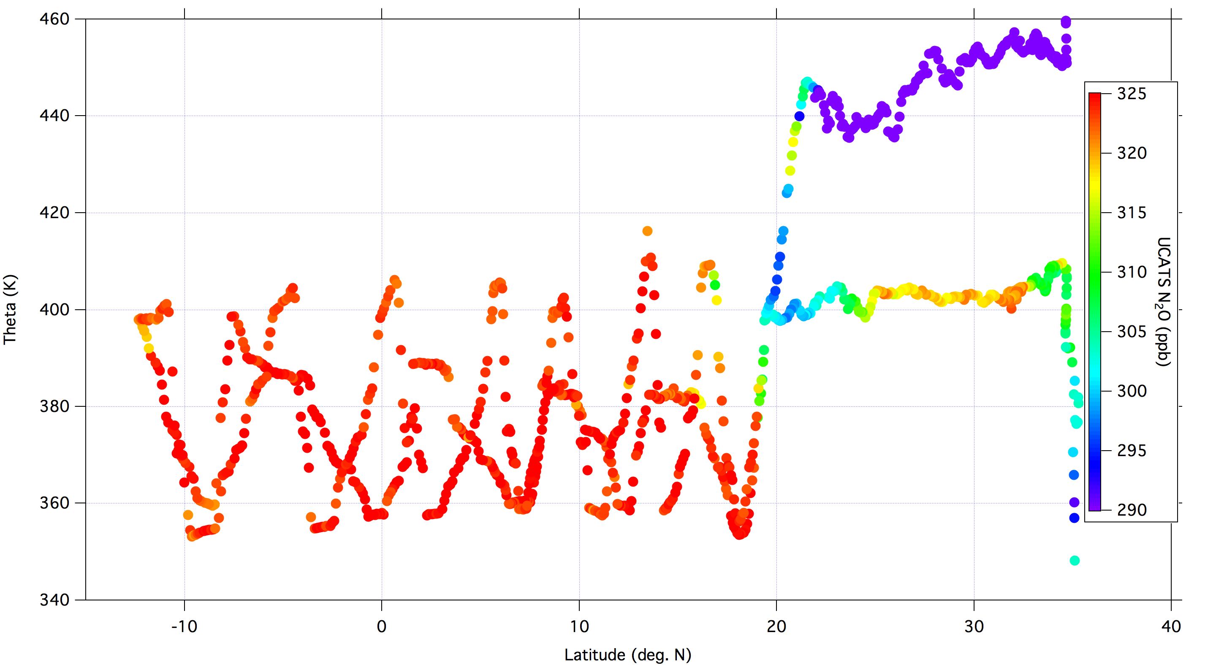
Feb. 21, 2013, Color-coded by N₂O

Slide 47
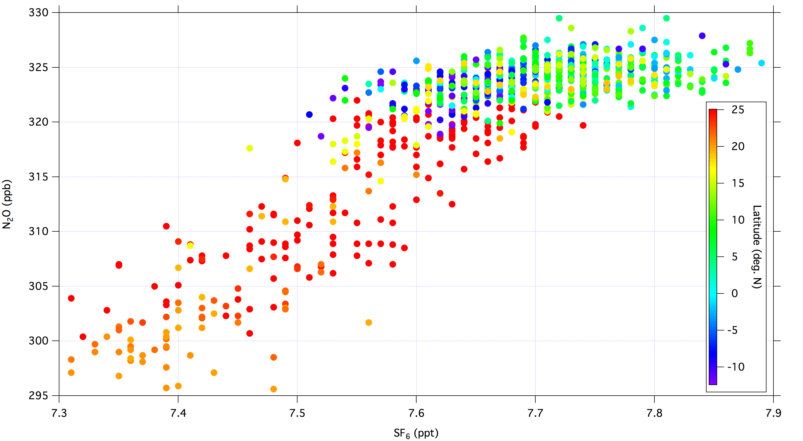
Feb. 21, 2013, Color-coded by Latitude

Slide 48
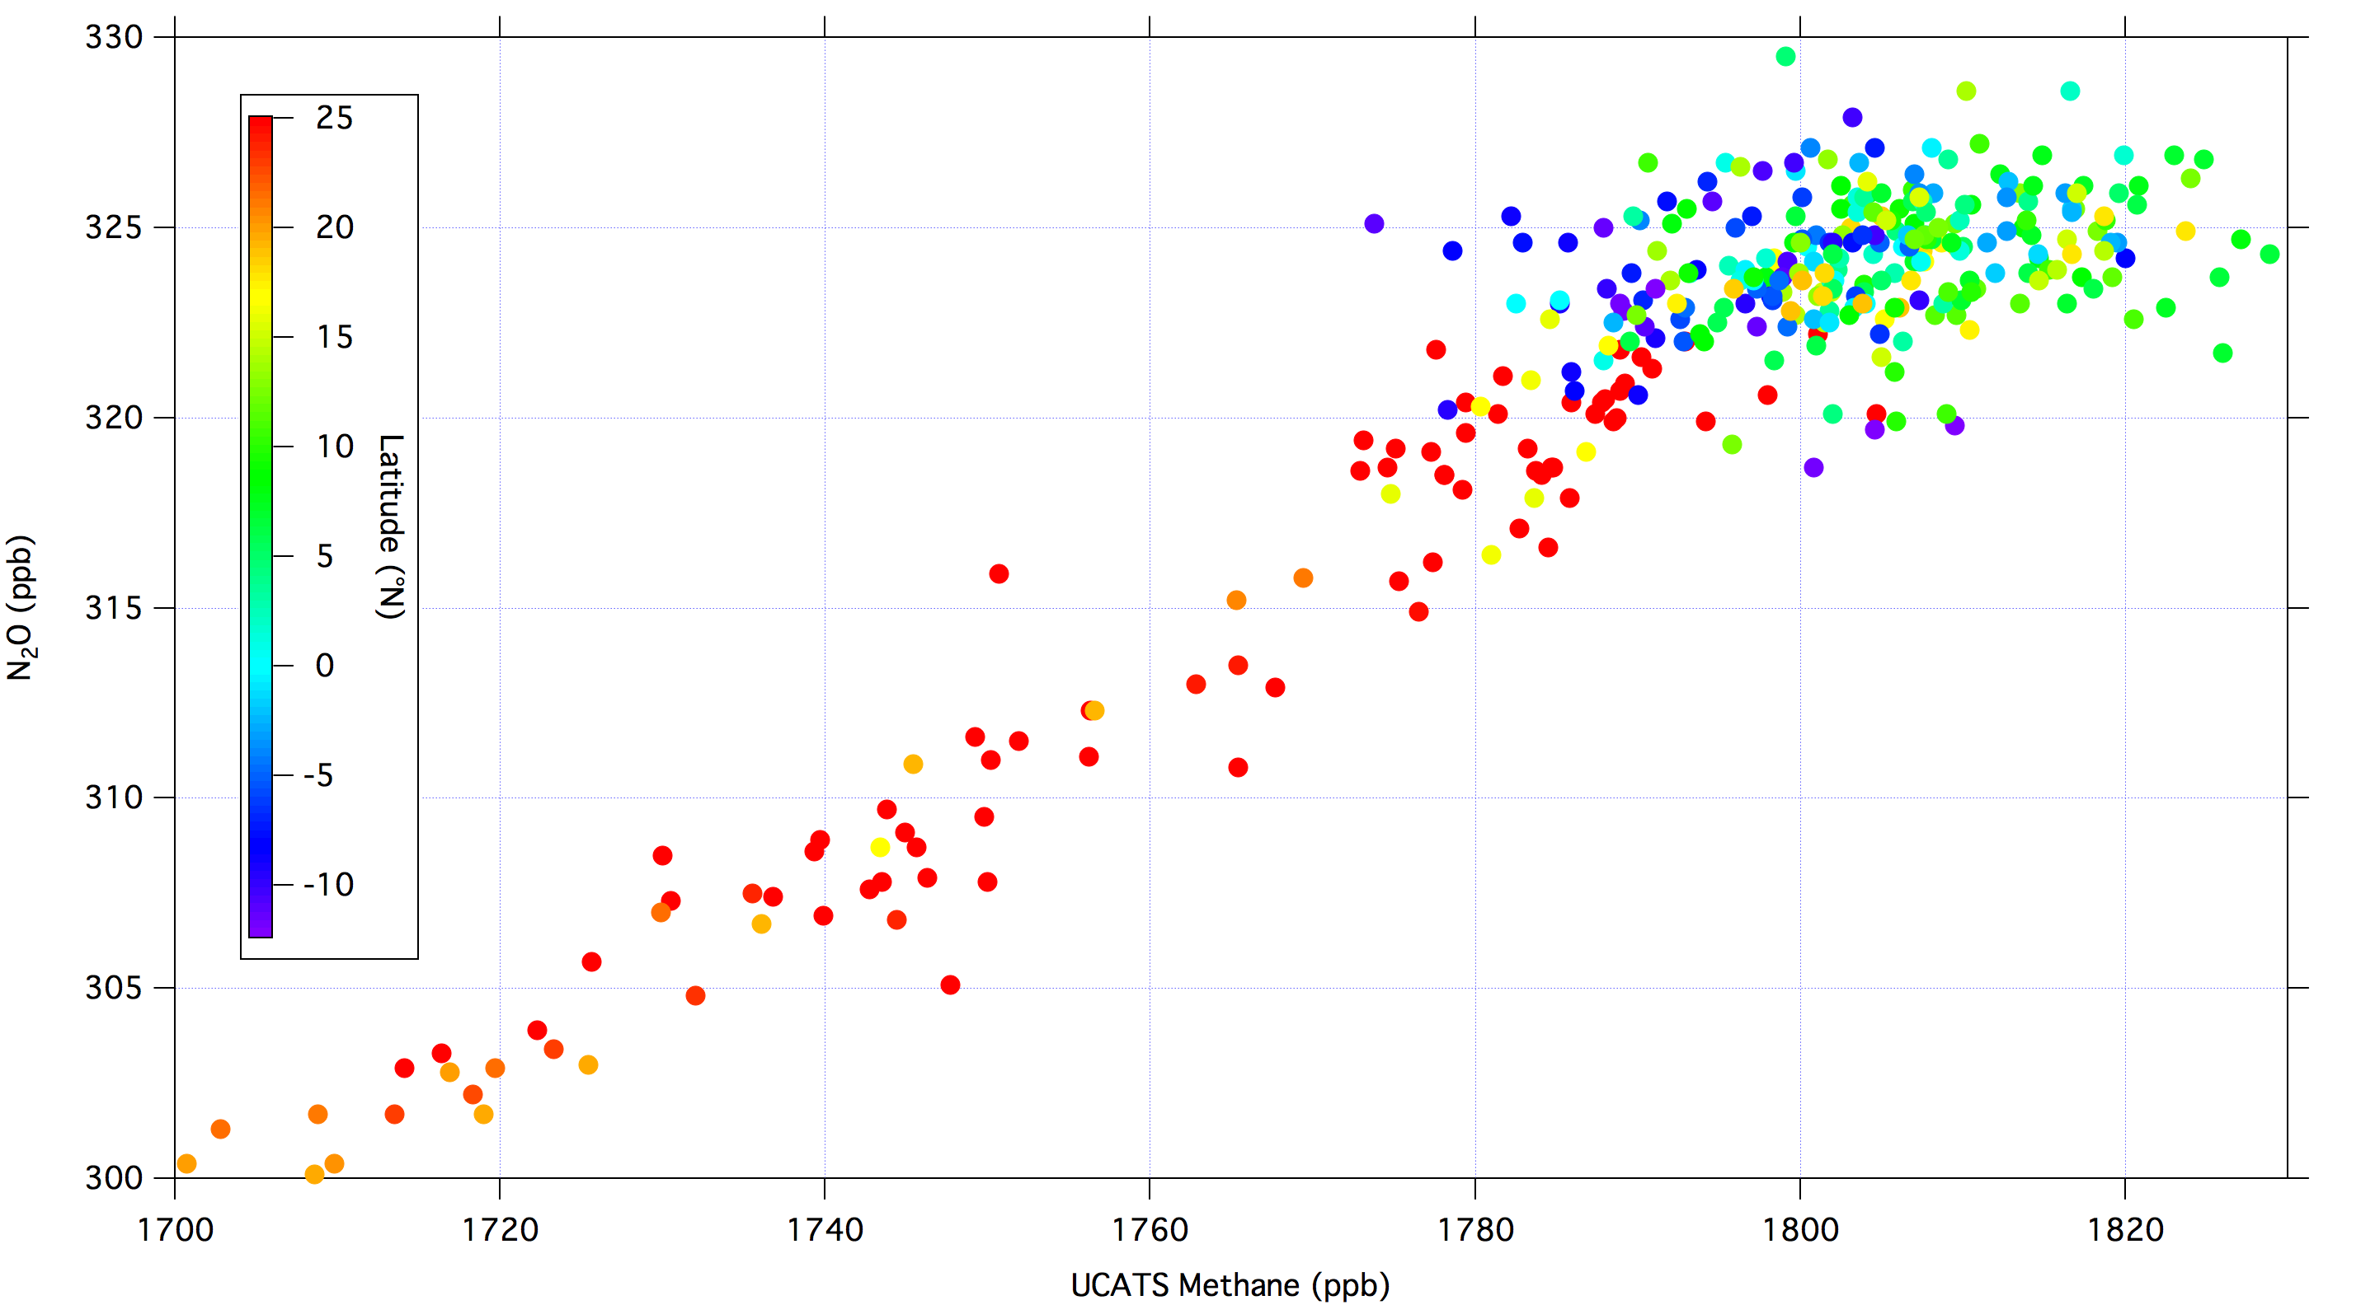
Feb. 21, 2013, Color-coded by Latitude

Slide 49
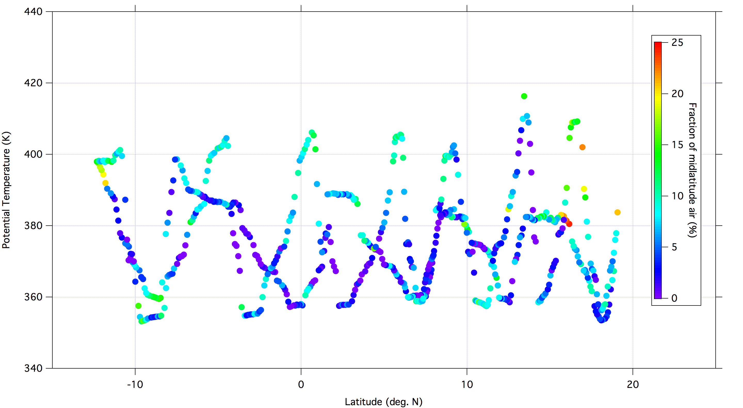
Percent of midlatitude or older air based on N₂O, February 21, 2013
Notes:
3-5%

Slide 50
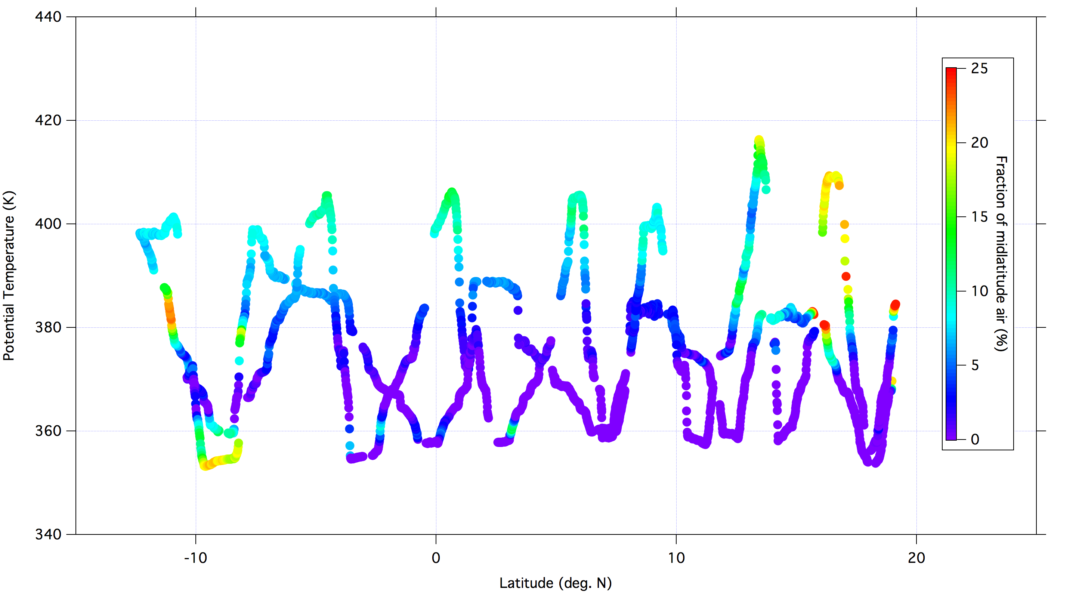
Percent of midlatitude or older air based on methane, February 21, 2013

Slide 51
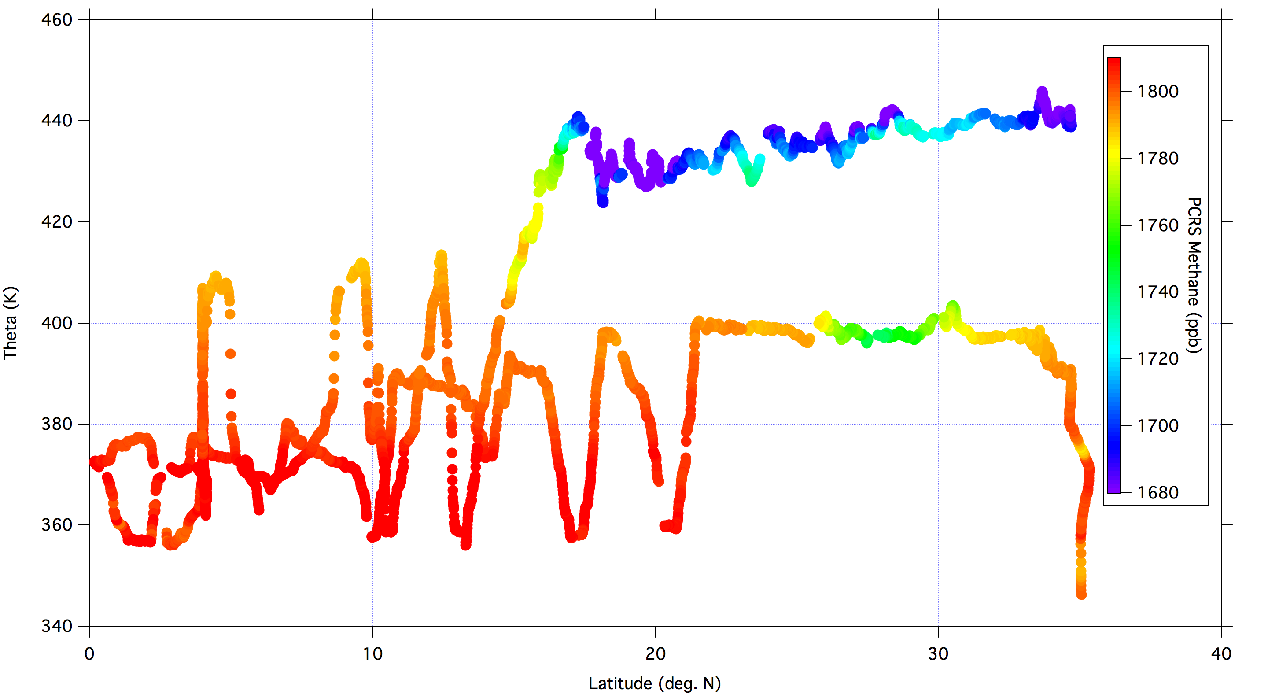
March 1, 2013, Color-coded by Methane
Notes:
Tropopause height ~ 380 K
Fraction of extratropical air = 1%

Slide 52
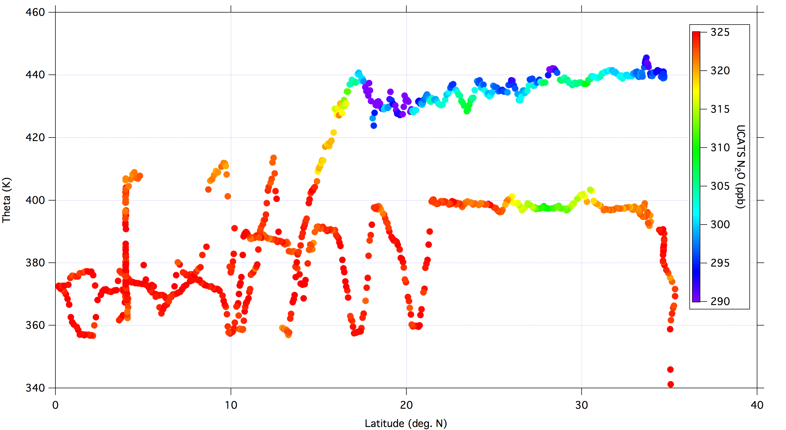
March 1, 2013, Color-coded by N₂O
Notes:
Fraction of extratropical air = 3%

Slide 53
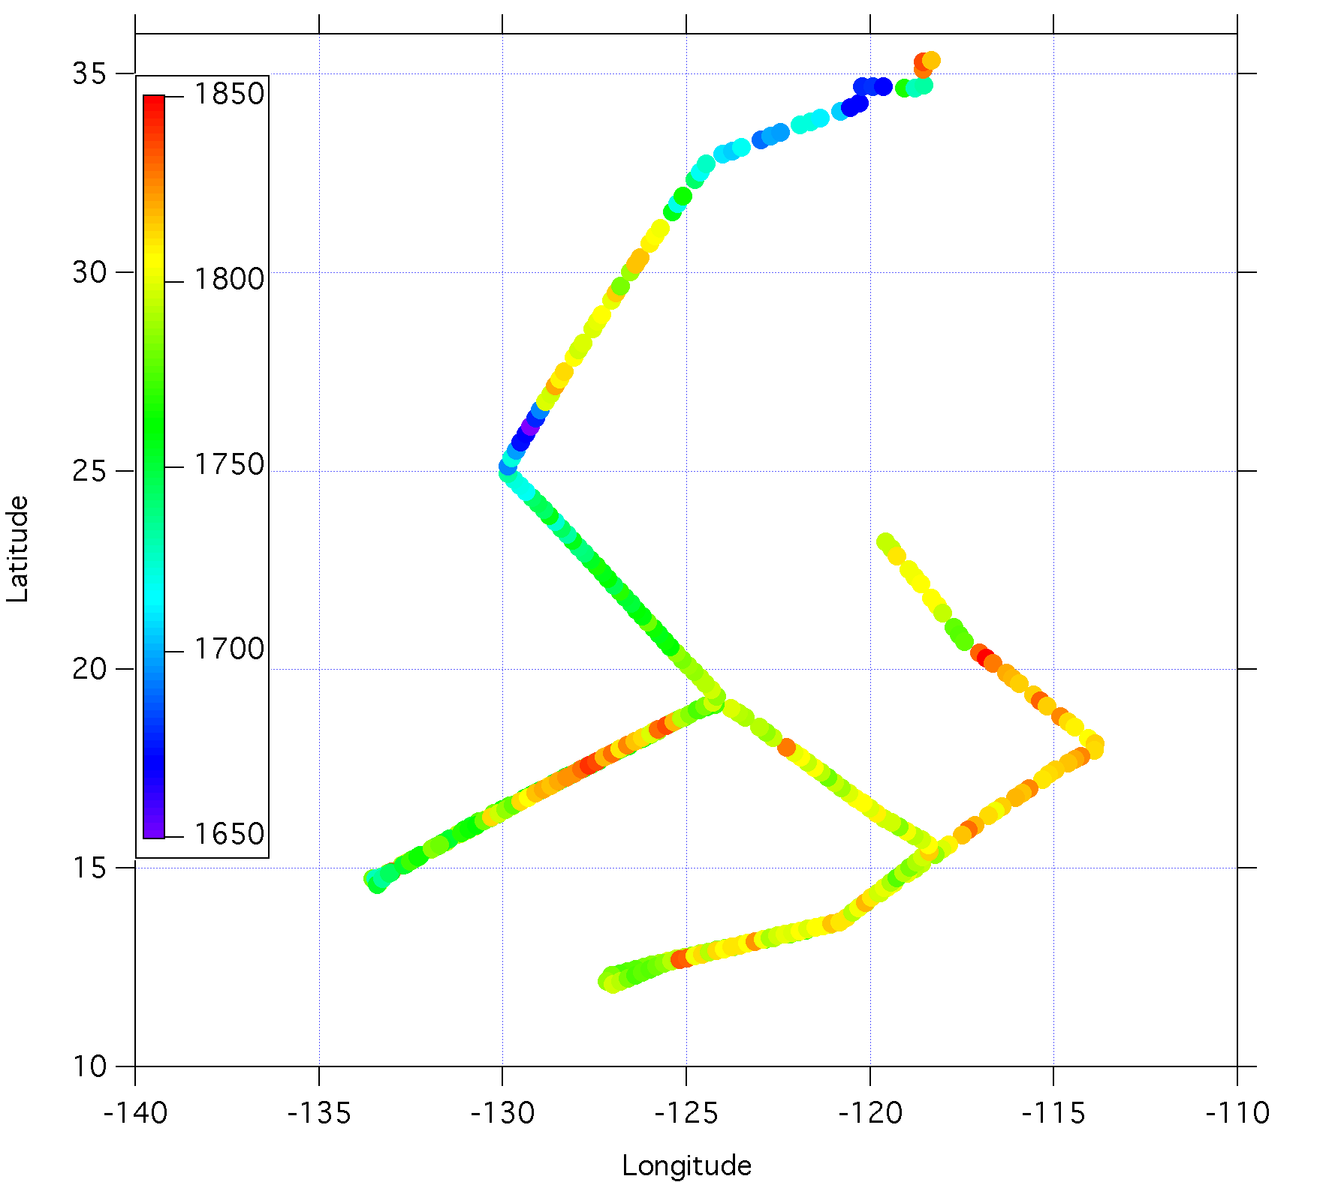
Notes:
November 9th flight track, color-coded by methane

Slide 54
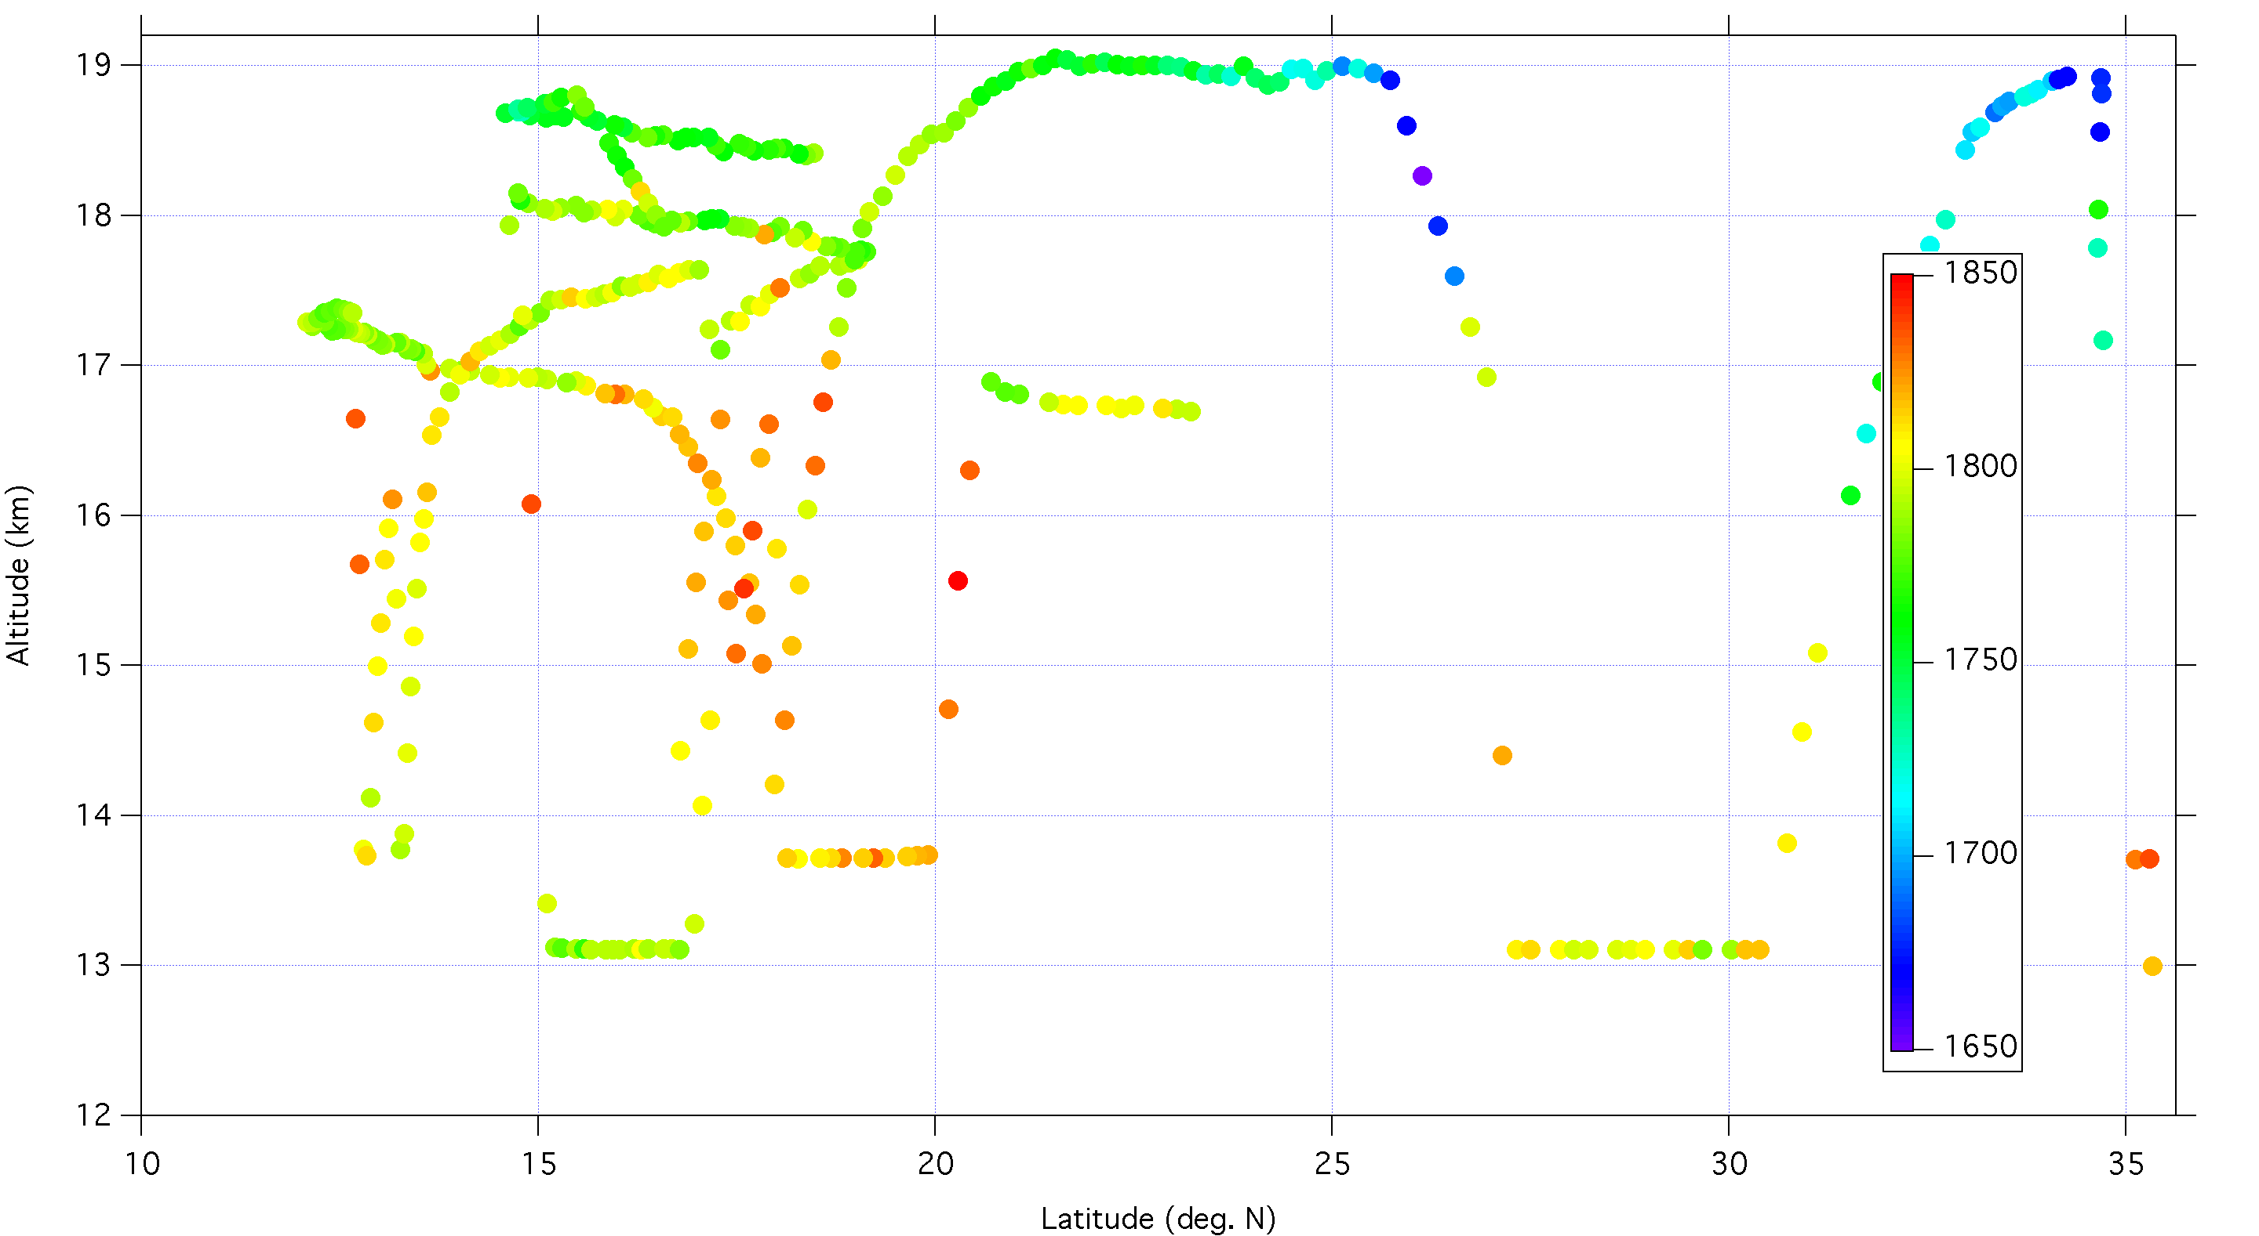
Altitude vs. latitude, color-coded by methane, Nov. 9

Slide 55
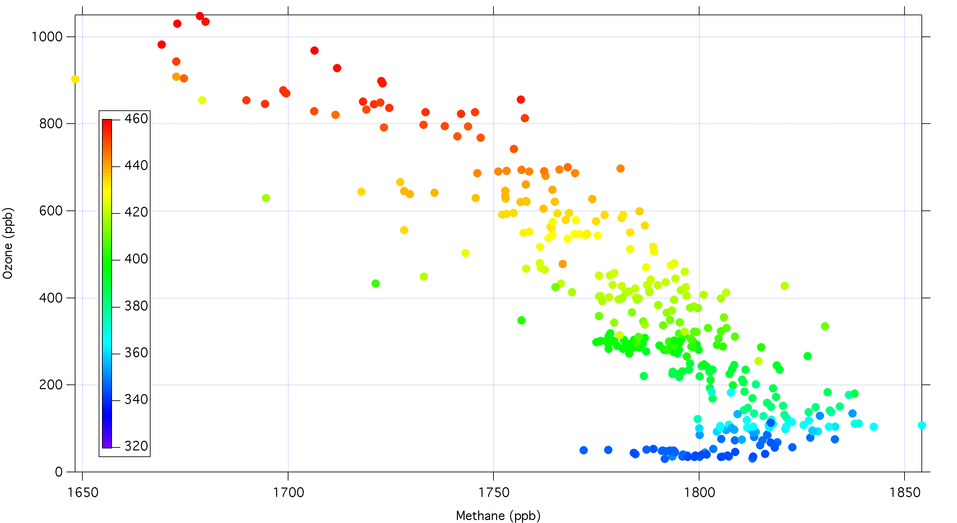
Ozone vs. Methane, binned by theta, November 9, 2011

Slide 56
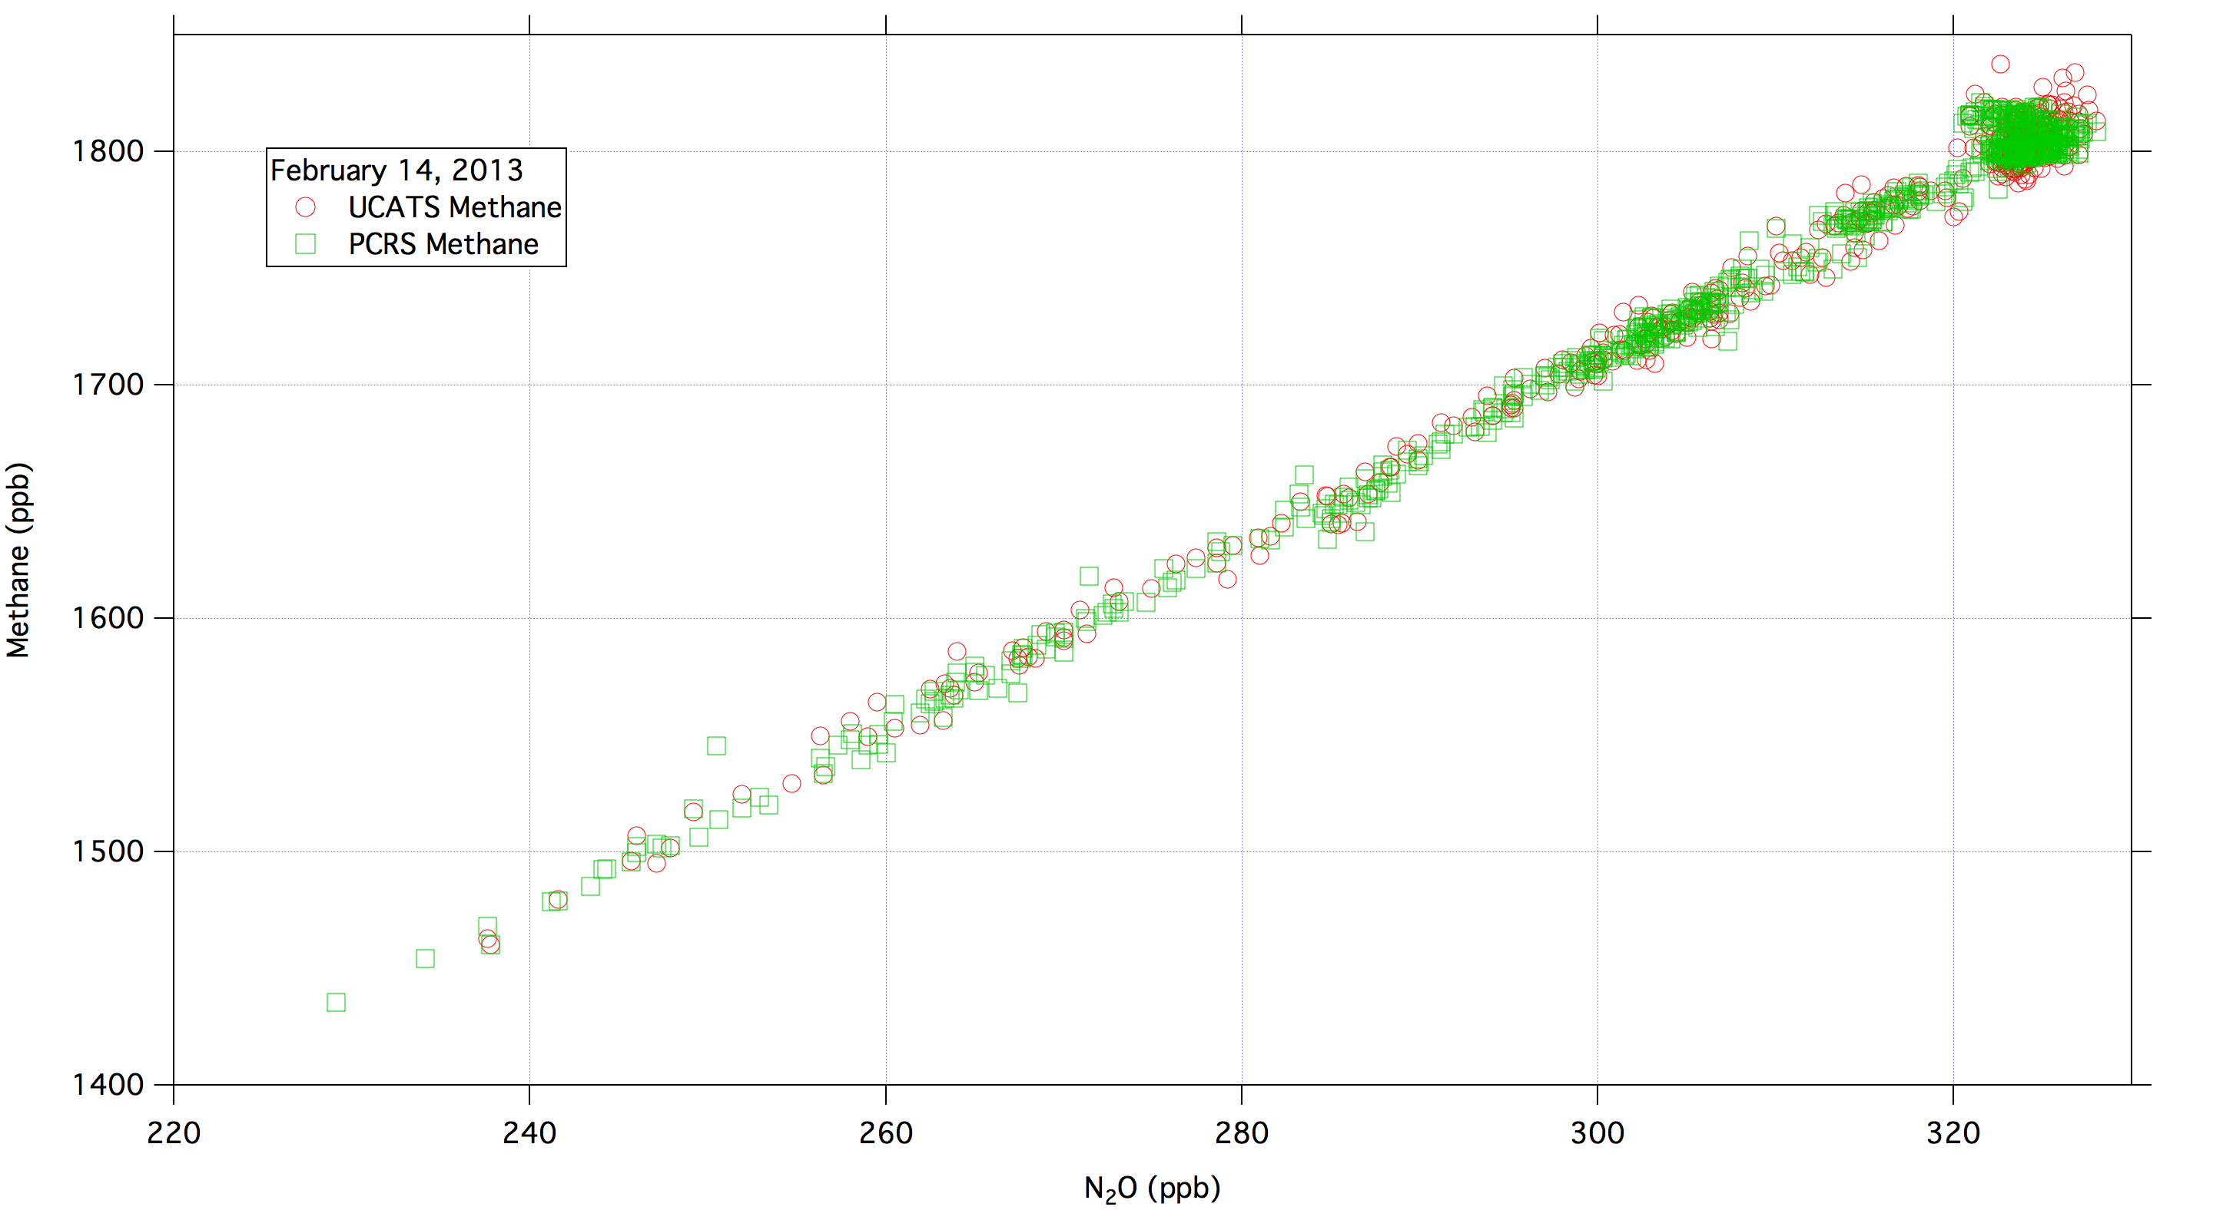
Methane-N₂O Correlation Plot

Slide 57
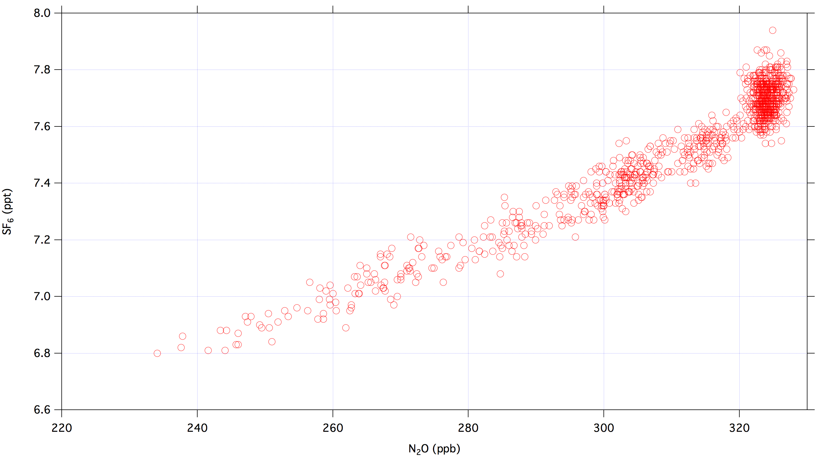
SF₆ vs. N₂O, February 14, 2013

Slide 58
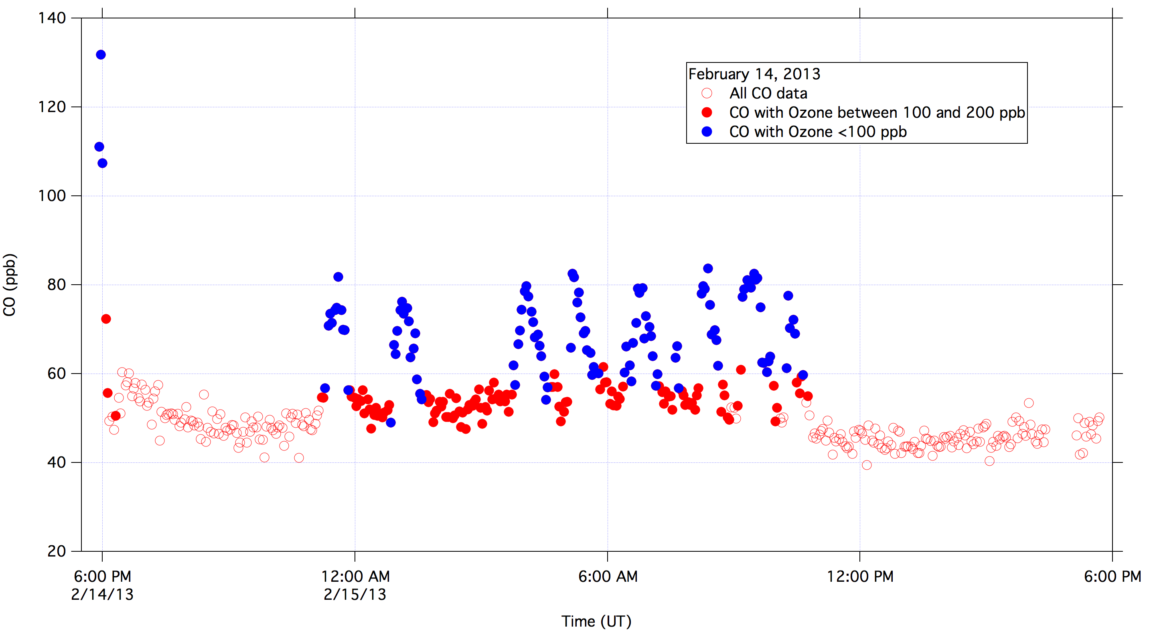
UCATS CO data sorted by Ozone

