Slide 1
3D Vortex and Warm Core Structure for Selected HS3 Cases Using NCAR-NOAA Dropsonde Data
Jeffrey B. Halverson, P.I. UMBC
Alex Martin, UMBC
Notes:
Hello, my name is Alexander Martin and I’m a grad student at UMBC. I’m here to present on behalf of Jeff Halverson.
Today I will be discussing vortex and warm core structures incorporating dropsonde data from numerous cases during the 2013 and 2014 missions

Slide 2
Study Objectives
Consistent, precision analysis methodology applied to all storms > mesoscale structural analysis of vortex winds, vorticity, warm/cold anomaly, RH fields
Constant pressure level analyses and vertical sections along transects
Data source: Final QC version, NCAR-NOAA dropsonde data
Will be used for further process studies related to intensity change, extratropical transition, aborted development cases
Interest in pursuing comparisons with Scanning-HIS
Notes:
Today I would like to present some consistent, precision analysis methodology applied to mesoscale analysis of wind, vorticity, temperature anomaly and relative humidity fieds
To do this, I created constant pressure level analyses and height-longitude cross sections of these fields
I took advantage of the final qc’ed dropsonde data and re-ran the codes to make these plots
Will be used for further process studies related to intensity change, extratropical transition, aborted development cases
Interest in pursuing comparisons with Scanning-Hi res inferometer

Slide 3
Storms Analyzed
T.D. Gabrielle (5 Sept 2013; failed to develop)
T.S. Humberto (17 Sept 2013; failed to develop)
Hurricane Cristobal (27 & 29 Aug, 2014) Cat 1 and early ET phases
Edouard (14, 16, 18 Sept, 2014) RI, steady state and rapid weakening phases
Notes:
T.S. Gabrielle (5 Sept 2013; failed to develop)
T.S. Humberto (17 Sept 2013; failed to develop)
Hurricane Cristobal (27 & 29 Aug, 2014) Cat 1 and early ET phases
Edouard (14, 16, 18 Sept, 2014) RI, weakening and rapid weakening phases

Slide 4
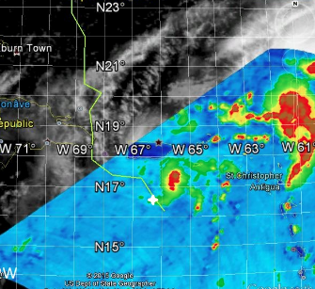
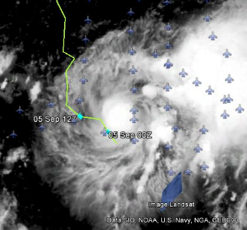
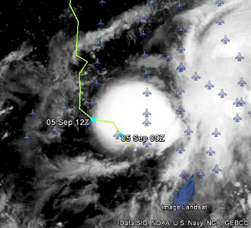
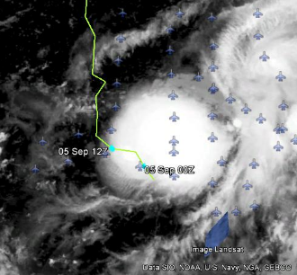
T. D. Gabrielle
2201 Z
TD stage w/ expanding convective burst
Very asymmetric structure; convection E-NE of center
convective
band
center
burst
2345 Z
0515 Z
0645 Z
burst
burst
burst
Notes:
A low level circulation was found around Gabrielle the same day this mission took place
A tropical wave that had been trailing Gabrielle reached the low when it was just south of Puerto Rico, a few hours before the HS3 flight began.
By 1200 UTC on the fifth, three hours after the last drop, the low level circulation ended up fully separating from the mid level circulation to the east-northeast
As you can see here, there is a convective band associated with the secondary tropical wave located to the east-northeast along with some convective bursts occurring in the area of Depression Gabrielle

Slide 5
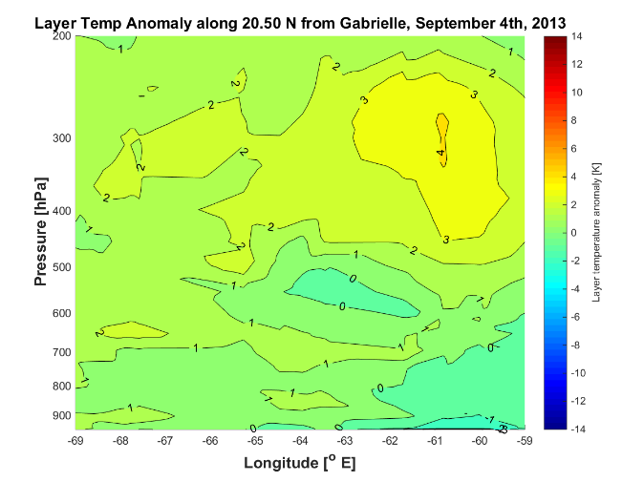
T.D. Gabrielle
Diffuse, weak warm anomaly over center
Main warm anomaly aloft displaced well east, associated with banded convection
convective
band
vortex
center
evaporative
cooling
center
Notes:
Longitude height cross section of Gabrielle along 20.50 north,
The temperature anomalies are computed using Dunions revised Jordan mean
you can clearly see the warm anomaly and evaporative cooling associated with the mid-level circulation convection to the east, as well as a weak warm anomaly north of the low level center of Gabrielle associated with the convective bursts.

Slide 6
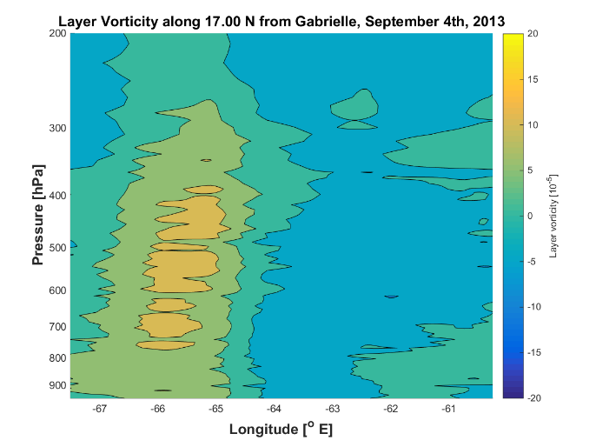
T.D. Gabrielle
Vertically contiguous, upright, but weak vort column
center
Notes:
You can see that vorticity associated with TD Gabrielle was relatively weak, but nonetheless worthy of Tropical depression status given its vertically expansive and upright structure

Slide 7
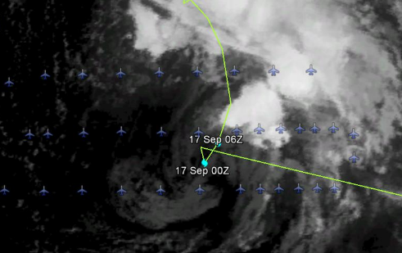
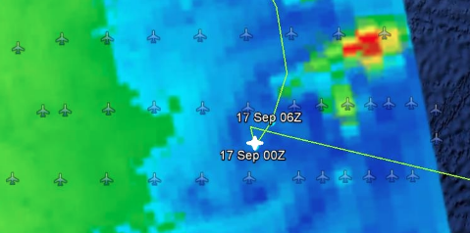
T. S. Humberto
2345 Z
TS stage w/ high asymmetric, sheared structure
Sparse convection
Very dry mid-upper tropospheric air
Evidence for cold trough aloft – hybrid system?
center
burst
0032 Z
Notes:
Now we move on to our second case, Tropical Storm Humberto, from which data was taken during a flight beginning on September 16th, 2013.
you can see a highly sheared asymmetric structure due to interaction with a mid-upper level cyclone from the northwest.
The mid-upper level low moved above Humbertos low level circulation and indicates a potential hybrid system with a cold trough aloft

Slide 8
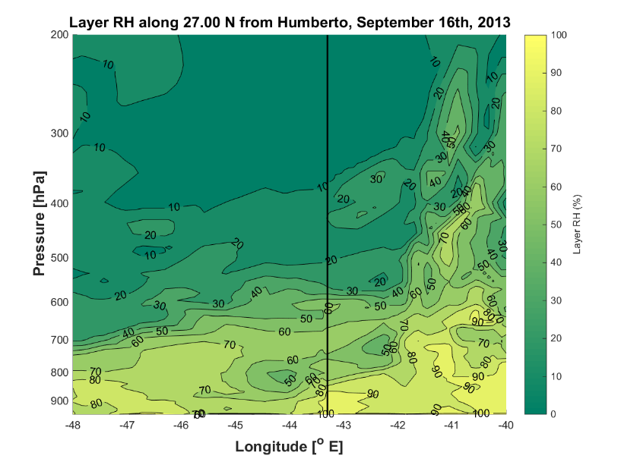
T.S. Humberto
center
DRY!
convective
band
vortex
center
evaporative
cooling
center
Notes:
You can clearly see a dry air aloft associated with the upper level circulation, which most resulted in the highly asymmetric structure and lack of convection around the low level circulation

Slide 9
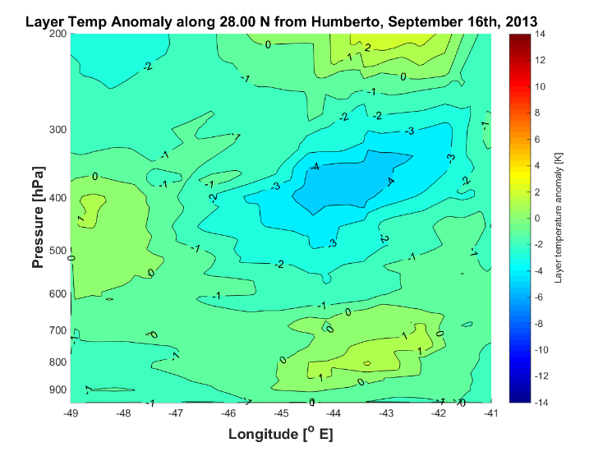
T.S. Humberto
Essentially a cold core vortex
center
convective
band
vortex
center
evaporative
cooling
center
Notes:
You can see an expansive cold core vortex above Humberto’s low level vortex

Slide 10
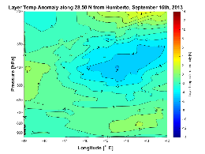
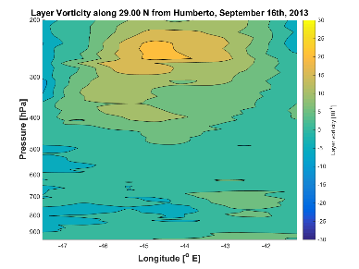
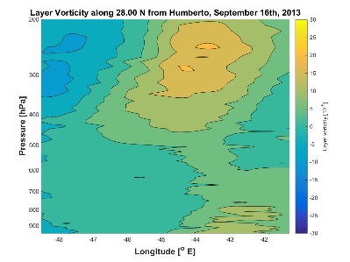
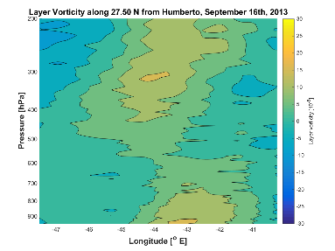
T.S. Humberto
Significant cold core aloft
Upper level vort associated with trough, decoupled from surface vort
Weak, low-level vort associated with surface circulation
Notes:
These plots show the vorticity associated with the upper level trough, clearly decoupled from the surface vorticity maximas of Humberto.
You can very clearly discern the upper level trough moving over the low level circulation in these plots.

Slide 11
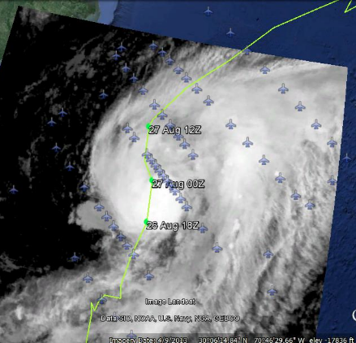
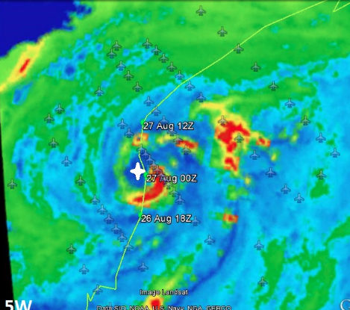
Cristobal – Hurricane Stage
Asymmetric structure; dry air impinging on western semicircle
Partial eyewall seen in microwave
2300 Z
0000 Z
center
burst
Notes:
Onward to 2014, I figured I would start with Cristobal, the first flight being August 27th.
You can see via the satellite imagery that there was an asymmetric structure, with dry air impinging on the western side of the storm
Dry air intrusion

Slide 12
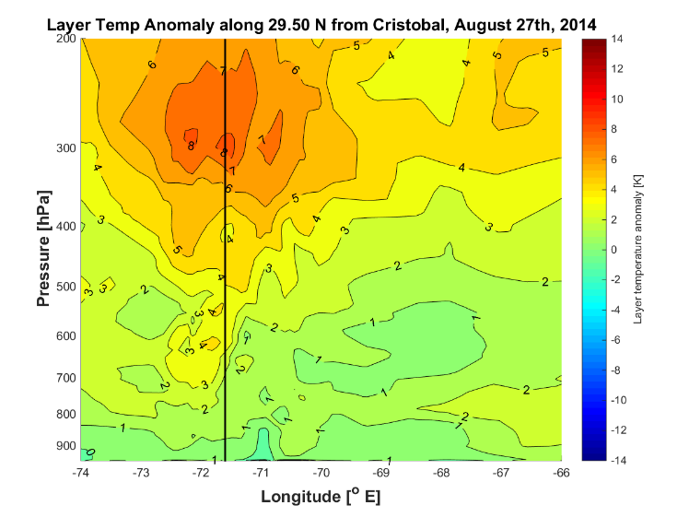
Cristobal – Hurricane Stage
Healthy warm core aloft, +8 C
center
convective
band
vortex
center
evaporative
cooling
center

Slide 13
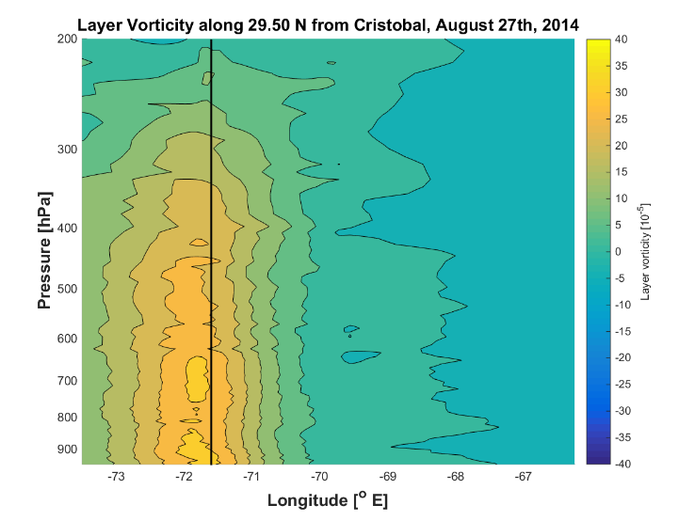
Cristobal – Hurricane Stage
Deep, vertical vort column
center
convective
band
vortex
center
evaporative
cooling
center

Slide 14
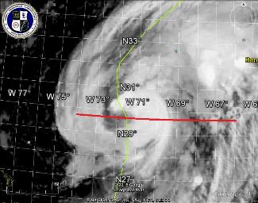
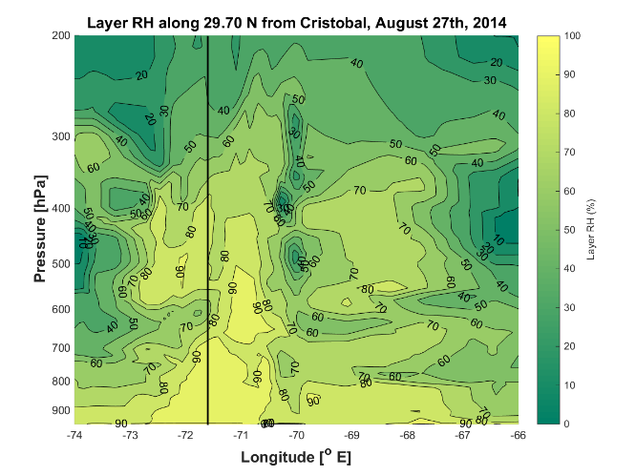
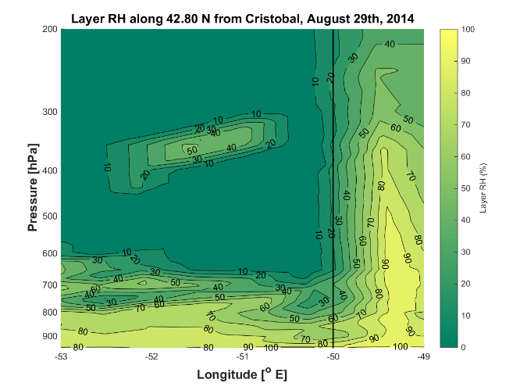
Cristobal – Hurricane Stage
center
DRY PUSH
Dry air seen around inner core
DRY PUSH
center
Notes:
You can clearly see the dry air wrapping around the storm from the west and south of storm center, associated with the frontal boundary which began wrapping around.

Slide 15
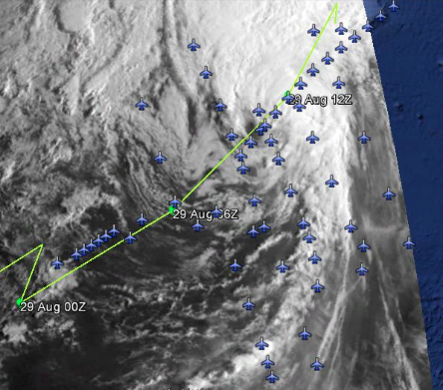
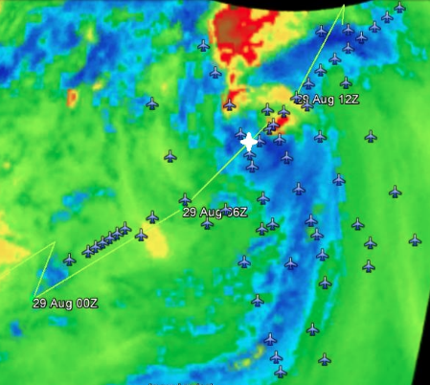
Cristobal – Cat 1 to T.S./ET
Increasing shear exposed low level center
Heavy rain shifting north & west
Frontal-like structure evolving
center
burst
1045 Z
1005 Z
Notes:
A frontal boundary wrapped around Cristobal by 12 UTC on the 29th, as you can see from the satellite images.
The low level circulation became exposed and a frontal like structure became evident

Slide 16
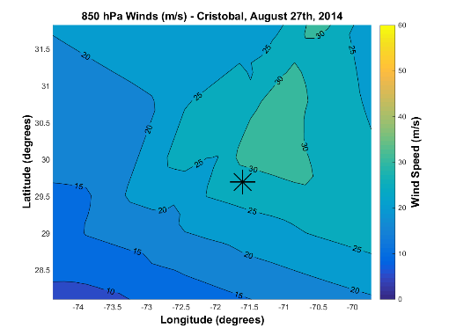
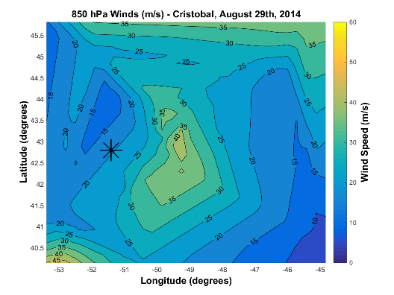
Cristobal – Expansion of Core
RMW expansion
Amplification of cross-core asymmetry
Wind max ROT
CAT 1
1005 Z
111 km
center
center
burst
111 km
INCIPIENT ET
Notes:
These plots show plan views of the 850 mb wind speed field – as you can see, the wind field expands during the northward propagation and ET transition of Cristobal
And the cross core asymmetry is much more prevalent
Note the scale differences in the plots

Slide 17
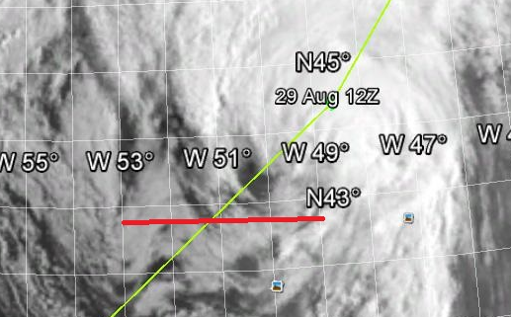
Cristobal Early ET – Dry Air Impingement
center
DRY PUSH
DRY PUSH
center
Notes:
You can clearly see the dry air wrapping around the storm from the west and south of storm center, associated with the frontal boundary which began wrapping around.

Slide 18
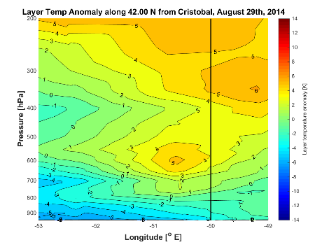
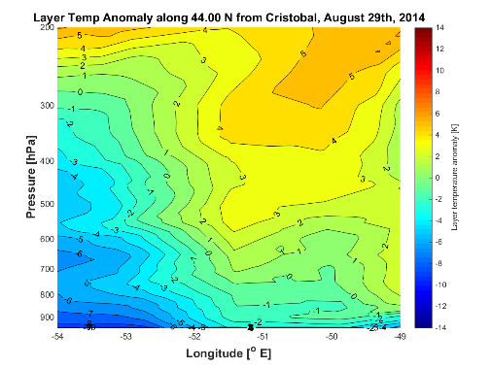
Cristobal – Early ET
Disruption of warm core due to strong shear
center
convective
band
vortex
center
evaporative
cooling
center
Notes:
You can clearly discern the shearing of the vortex by looking at the warm core structure, tilting downshear
Also note the cooler air associated with the frontal boundary at the surface

Slide 19
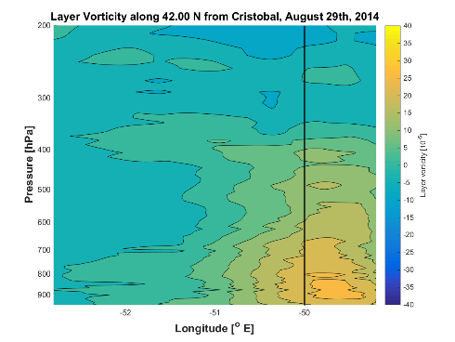
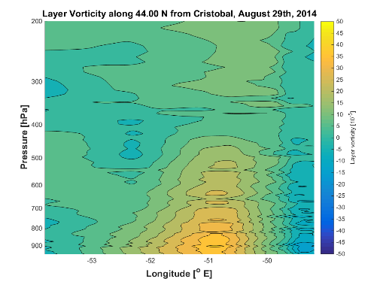
Cristobal – Early ET
Pronounced low-level vort
Vort column tilting downshear
center
convective
band
vortex
center
evaporative
cooling
center
Notes:
Also seen in these plots of the vorticity, you can see a low level vort column tilting downshear as well, with a noncontiguous structure

Slide 20
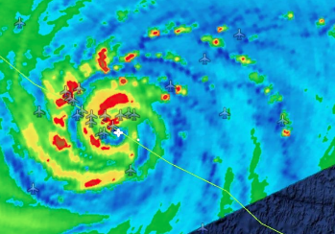
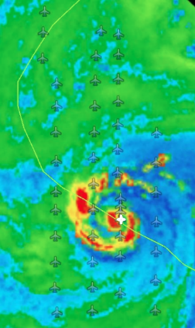
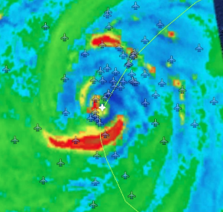
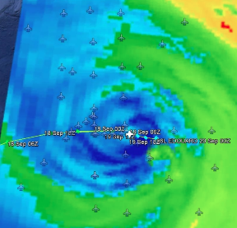
Hurricane Edouard Evolution
Full evolution of TC lifecycle
Rapid intensification
Cat 3 at peak
Eyewall Replacement?
15 Sept
0749 Z Butterfly
Cat 1 > 2 RI
14 Sept
2119 Z Lawnmower
Cat 1 > 2 RI
center
burst
19 Sept
0445 Z
Cat 1 > T.S.
16 Sept
2017 Z
Cat 2
Notes:
As we have heard and will continue to talk about, Hurricane Edouard was by far the most impressive Atlantic storm of the past few years.
As seen via microwave imagery, the storm went through a vigorous structural evolution over the last three flights, including a period of rapid intensification, possible eyewall replacement and weakening

Slide 21
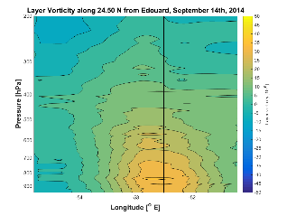
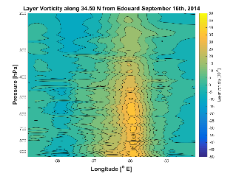
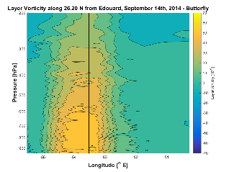
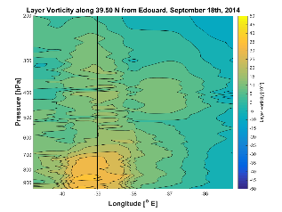
Edouard Vorticity Evolution
14 Sept
2119 Z Lawnmower
Cat 1 > 2 RI
Vort tower starts in low levels, builds upward during R.I.
Weakening proceeds from top-down w/ mid-level disruption/shearing
16 Sept
2017 Z
Cat 2
center
burst
19 Sept
0445 Z
Cat 1 > T.S.
15 Sept
0749 Z Butterfly
Cat 1 > 2 RI
Notes:
On the 14^{th,} during the first pattern, a composite height-longitude cross section of interpolated vortex center showed vort max confined to lower levels, which expanded rapidly both in terms of vertical and horizontal expanse.
On the 16th, Edouard was considered to be steady state at a Category 2, with a more confined vorticity column but still vertically contiguous
On the 19th, the vorticity column was disrupted by midlevel shearing the storm became disorganized and rapidly weakened to tropical storm status

Slide 22
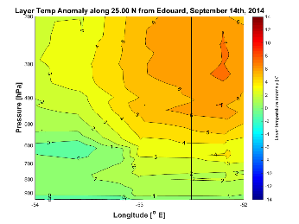
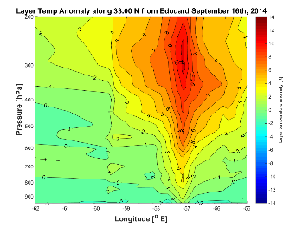
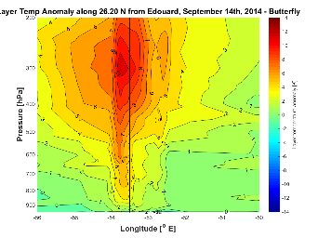
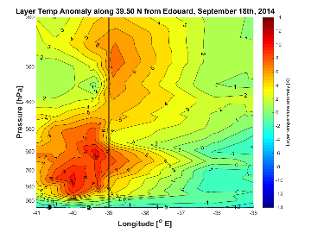
Edouard Warm Core Evolution
Warm core builds top > down during R.I.
Surprisingly strong low level core during weakening
Weakening: Split warm core
14 Sept
2119 Z Lawnmower
Cat 1 > 2 RI
16 Sept
2017 Z
Cat 2
center
burst
19 Sept
0445 Z
Cat 1 > T.S.
15 Sept
0749 Z Butterfly
Cat 1 > 2 RI
Notes:
He we can see the evolution of the warm anomaly – becoming stronger and more expansive during the flight on September 14th, during RI, remaining strong and expansive during the flight on the 16th and becoming displaced and split during rapid weakening on the 19th.
Here we can note the surprisingly strong low level warm core during the weakening phase.

Slide 23
Summary
Our mesoscale analysis of structures is starting point for more detailed process studies/examination of multi-scale interactions
A variety of vortex core structures and evolution sampled
Structural trends largely consistent with gross satellite and intensity evolution (confidence in quality of dropsonde data)
Edouard: During R.I. vortex column builds upward, as warm core builds downward; dissipation more complex in terms of inner-core evolution
We are grateful for NASA HS3 and Dr. Ramesh Kakar’s continued support!
Special thanks to the NCAR/NOAA dropsonde team!

