Slide 1





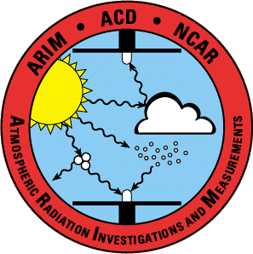

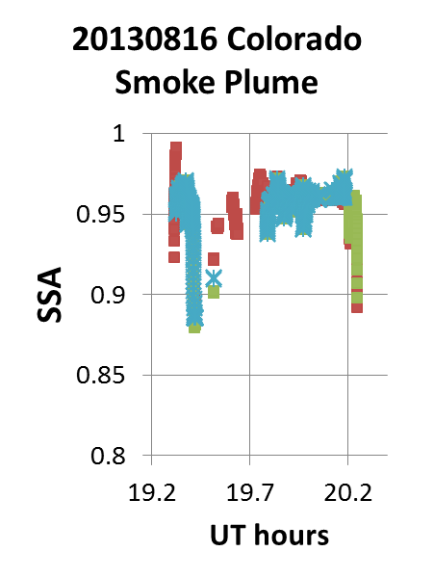
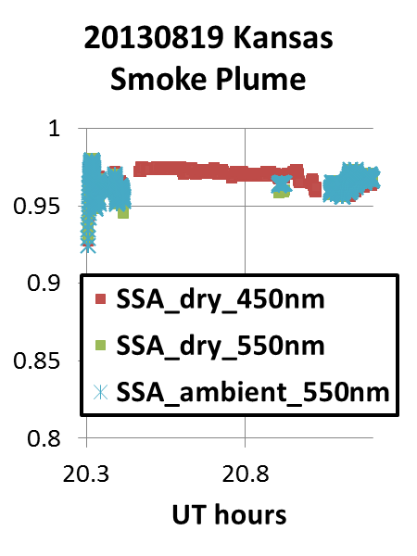
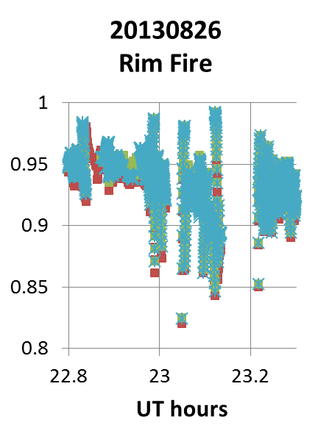
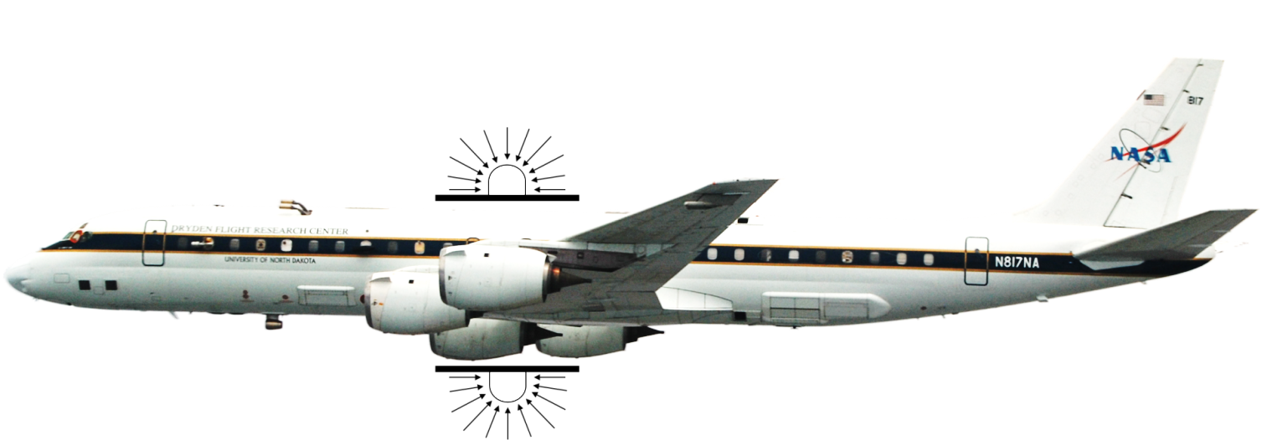
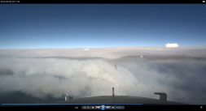
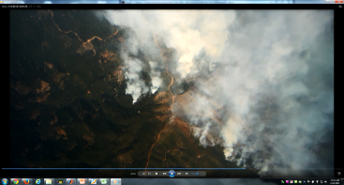
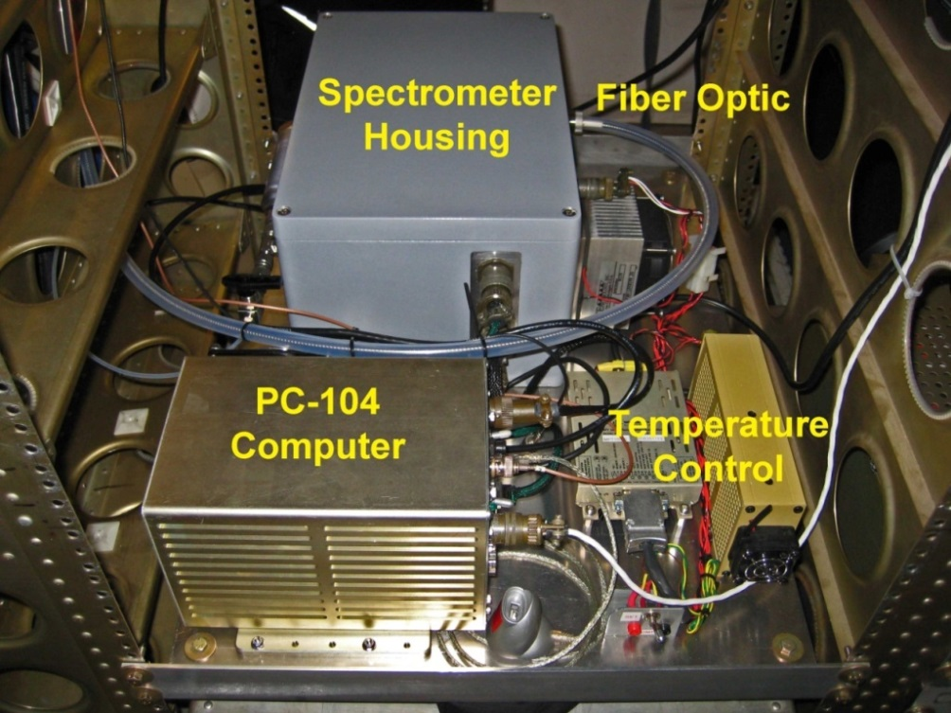
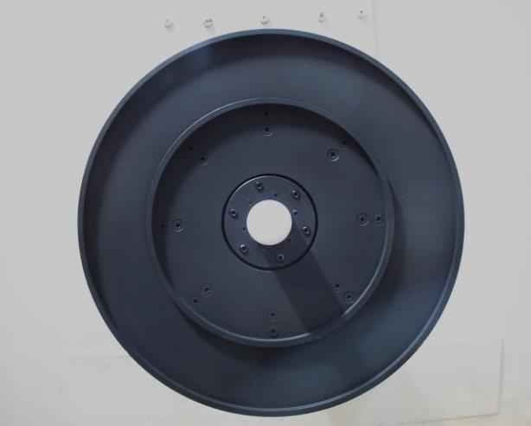
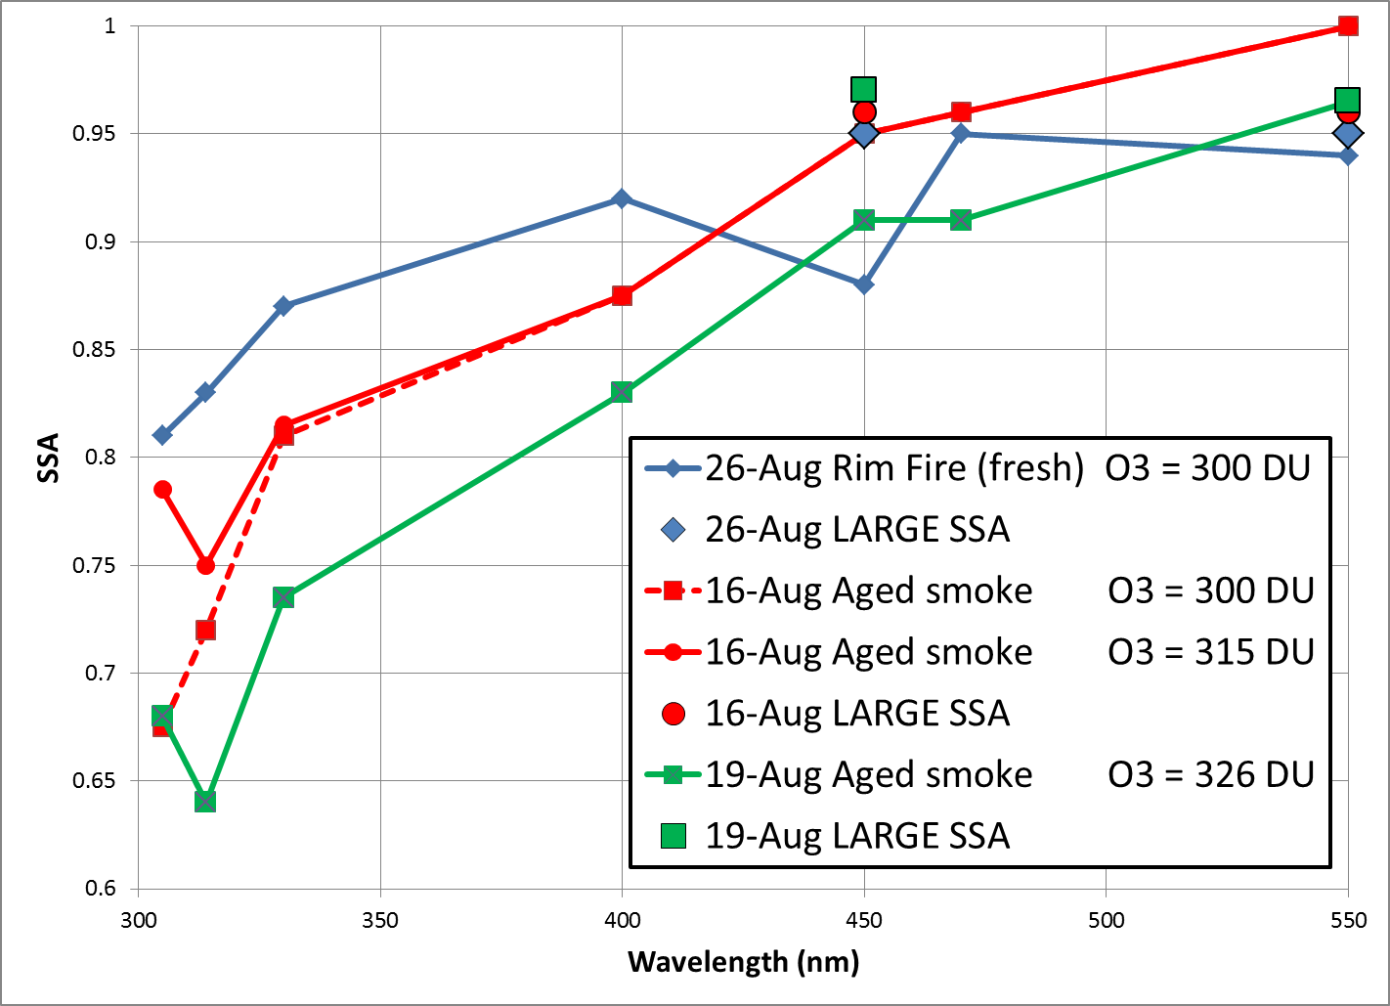
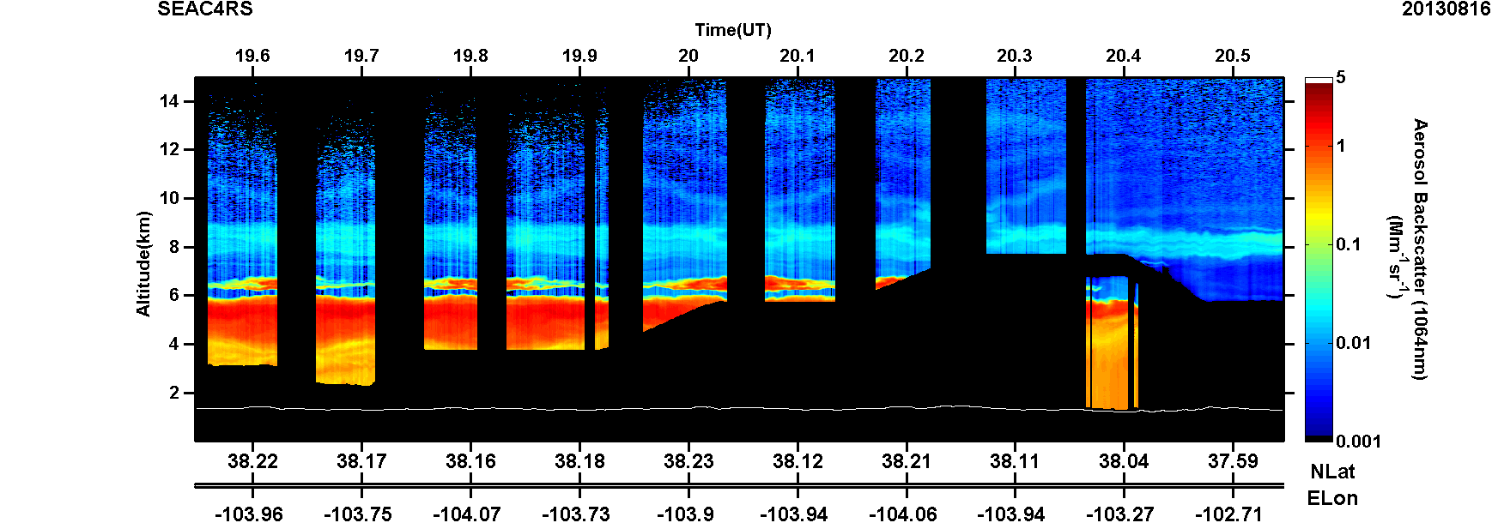
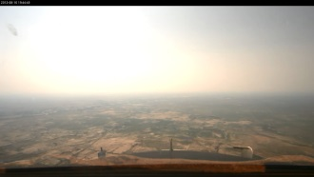
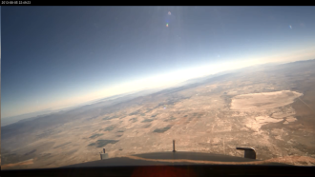
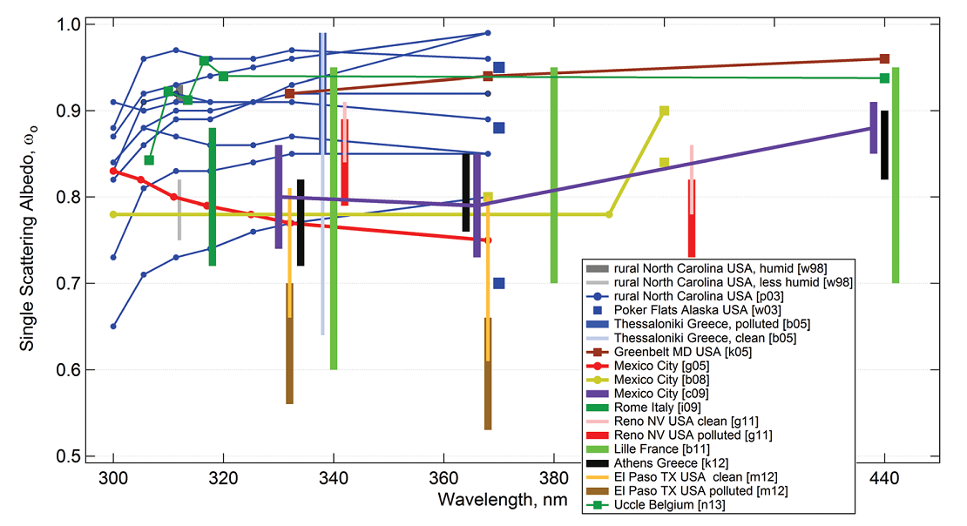
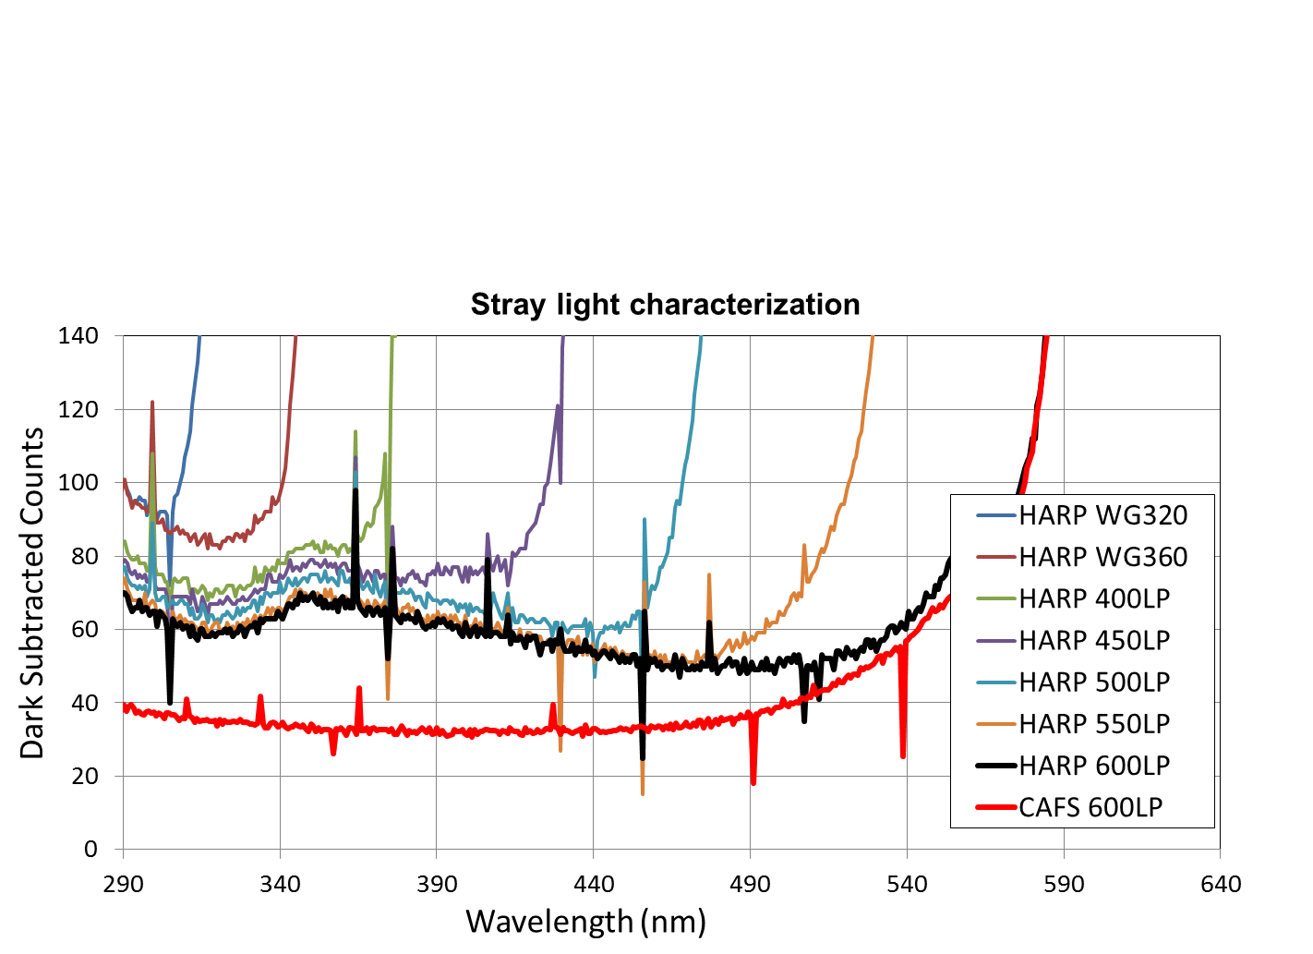
Biomass burning plume impacts on photolysis frequencies
and UV single scattering albedo during SEAC4RS
S. R. Hall¹, K. Ullmann¹, S. Madronich¹, J.W. Hair², M.A. Fenn², C.F. Butler² , Bruce Anderson², L. Ziemba², A. Beyersdorf²
1. National Center for Atmospheric Research (NCAR), Boulder, CO 2. NASA Langley Research Center, Hampton, VA
Abstract
The Studies of Emissions and Atmospheric Composition, Clouds and Climate Coupling by Regional Surveys (SEAC4RS) campaign during the summer of 2013 was strongly impacted by biomass burning (BB) from western U.S. fires. Scattering and absorption by particles in the plume directly impact spectral actinic flux which drives the photochemistry. Near the fire, high absorption results in reduced UV-B flux. In combination with strong plume convection (including pyro-convection), this permits injection of volatile, normally short-lived species to the free troposphere and beyond. Measurements from the Charged-coupled device Actinic Flux Spectroradiometers (CAFS) onboard the NASA DC-8 aircraft show penetration of the California Rim fire reduced in situ jO¹D by as much as 95% and jNO₂ by 80%. Above the plume, jO¹D was decreased while jNO₂ increased. Calculation of UV single scattering albedo (SSA) suggests organic carbon aerosols increase absorption in the UV-B in a wide variety of BB plumes. Downstream, the aged plume may contain more strongly scattering particles due to hygroscopic growth. Enhanced photolysis has been theorized, but conclusive evidence is elusive.
Biomass burning absorption
UV-SSA determined from actinic flux
Fresh Rim fire
aerosol loading
Detector and Electronics
Photolysis Frequencies
Optical Collector
j [O₃ → O₂+O(¹D)]
j [NO₂ → NO+O(³P)]
j [H₂O₂ → 2OH]
j [HNO₂ → OH+NO]
j [HNO₃ → OH+NO₂]
j [CH₂O → H+HCO]
j [CH₂O → H₂+CO]
j [CH₃CHO → CH₃+HCO]
j [C₂H₅CHO → C₂H₅+HCO]
j [CHOCHO → H₂+2CO]
j [CHOCHO → CH₂O+CO]
j [CHOCHO → HCO+HCO]
j [CH3COCHO → CH3CO+HCO]
j [CH₃COCH₃ → CH₃CO+CH₃]
j [CH₃OOH → CH₃O+OH]
j [CH₃ONO₂ → CH₃O+NO₂]
j [CH₃COCH₂CH₃ → CH₃CO+CH2CH₃]
j [CH₃CH₂CH₂CHO → C₃H₇+HCO]
j [CH₃CH₂CH₂CHO → C₂H₄+CH₂CHOH]
j [HO₂NO₂ → HO₂+NO₂]
j [HO₂NO₂ → OH+NO₃]
j [CH₃CH₂ONO₂ → CH₃CH₂O+NO₂]
j [Br₂ → Br+Br]
j [BrO → Br+O]
j [Br₂O → products]
j [BrCl → Br+Cl]
j [HOBr → HO+Br]
j [BrONO₂ → Br+NO₃]
j [BrONO₂ → BrO+NO₂]
j [Cl₂ → Cl+Cl]
j [ClO → Cl+O(³P)]
j [ClONO₂ → Cl+NO₃]
j [ClONO₂ → ClO+NO₂]
j [BrNO → Br+NO]
j [BrONO → BrO+NO]
j [BrONO → Br+NO₂]
j [BrNO₂ → Br+NO₂]
j [CHBr₃ → Products]
j [ClNO₂ → Cl+NO₂]
j [ClONO → Cl+NO₂]
j [N₂O₅ → NO₃+NO₂]
j [CH₃CO(OONO₂) → CH₃CO(OO)+NO₂]
j [CH₃CO(OONO₂) → CH₃CO(O)+NO₃]
j [CH₂=C(CH₃)CHO → Products]
j [CH₃COCH=CH₂ → Products]
Upwelling
Clear Below
Rim Fire Below
Upwelling impact +35%
Total jNO2 impact +10%
Search for aerosol enhanced scattering
Upwelling impact -12%
Total jO3 impact -5%
Upwelling jNO₂ and jO¹D as the DC-8 aircraft transitions from clear skies below to Rim Fire BB plume overflight. Note the opposing trend of the photolysis frequencies.
Three BB plume flights with SSA determined by NASA LARGE and spectrally with TUV regression to match the CAFS actinic flux
Bais et al., 2014, doi:10.1039/c4pp90032d
Actinic flux was modeled using a modified NCAR Tropospheric Ultraviolet and Visible (TUV) radiative transfer model version 5.1. CAFS and TUV were processed for photolysis frequencies using identical calculations to ensure the same geographic, thermal and molecular parameters were applied to the measured and modeled spectra.
BB plume from NASA DIAL (above) indicating high aerosol below 6 km and (right) comparison with a clean air profile shaded with the CAFS/TUV jNO₂ ratio. Hygroscopic scattering enhancement above the aged plume is not evident in the dry, clear conditions
Low Aerosol
j(O¹D)
j(NO₂)
Aged BB plume
This study SEAC4RS CAFS 8/16/2013
Corr ARCTAS CAFS 4/17/2008 (selected points)
Corr ARCTAS CAFS 6/29/2008 (selected points)
Corr et al., doi:10.5194/acp-12-10505-2012
Aged biomass burning SSA in comparison with UV ground station and ARCTAS/CAFS determinations
CAFS Instrument Characterization
Discussion
SEAC4RS provided a rich database for study of photolysis frequencies in the presence of BB aerosols. While actinic flux measurements are not ideal for aerosol characterization, CAFS provided the opportunity to determine extinction trends in the UV-B where few other measurements exist. UV-B deviations have strong implications for photochemistry, aerosol lifetimes (photofragmentation) and human health and agriculture.
The TUV—CAFS determined SSA trend provides strong evidence for higher absorption in the UV-B. Black carbon is expected to have relatively flat or decreasing absorption in the UV. Thus the decreasing SSA is most likely due to absorption by plentiful organic carbon in the plumes.
Evidence of enhanced photolysis above aged BB plumes due to hygroscopic growth was not clearly established. However, small enhancement is difficult to detect due to variability in SSA, AOD, albedo, humidity, ozone columns and, most significantly, clouds.
Further study:
Additional case studies to determine aerosol optical properties above, within and below aerosol layers.
Apply the determined UV-B SSA dependence to the TUV model to assess flux and photolysis profiles.
Apply results in regional chemistry models to assess the regional photochemical impact.
Spectral upwelling actinic flux over clear and smoke regions of the Rim Fire. The flux ratio indicates enhanced UV absorption by brown carbon aerosols in the biomass burning plume.
NEW REACTIONS
Determination of instrument wavelength offsets by comparison to features in the extraterrestrial solar flux spectrum (Slaper et al., GRL 22, 1995).
Angular response of the zenith optic optimized for a hemispherical response. Azimuthal response not shown.
SZA ~ 78°
Demonstration of combined nadir and zenith angular response quality of the optics at high solar zenith angle (low sun). Roll maneuvers have minimal effect on the total actinic flux, except when the sun approaches 90° relative to the optics. jO₃ is less directionally impacted due to a higher sensitivity to diffuse, scattered light.
Laboratory stray light characterization by long pass filter analysis to assign spectral corrections. Note the structure in HARP is not evident in the CAFS system.
CAFS field spectral response calibration history demonstrating instrument stability throughout the campaign.
Acknowledgements: NCAR is operated by the University Corporation for Atmospheric Research under the sponsorship of the National Science Foundation (NSF). The SEAC4RS research was funded by NASA under award No. NNX12AB82G S01 and NSF. Special thanks to all SEAC4RS collaborators and logistic team members.
Ratio of clear/smoke or clear/cloud under varying conditions indicating consistency in the brown carbon enhanced UV absorption in BB and clouds dominated by scattering.

