Slide 1



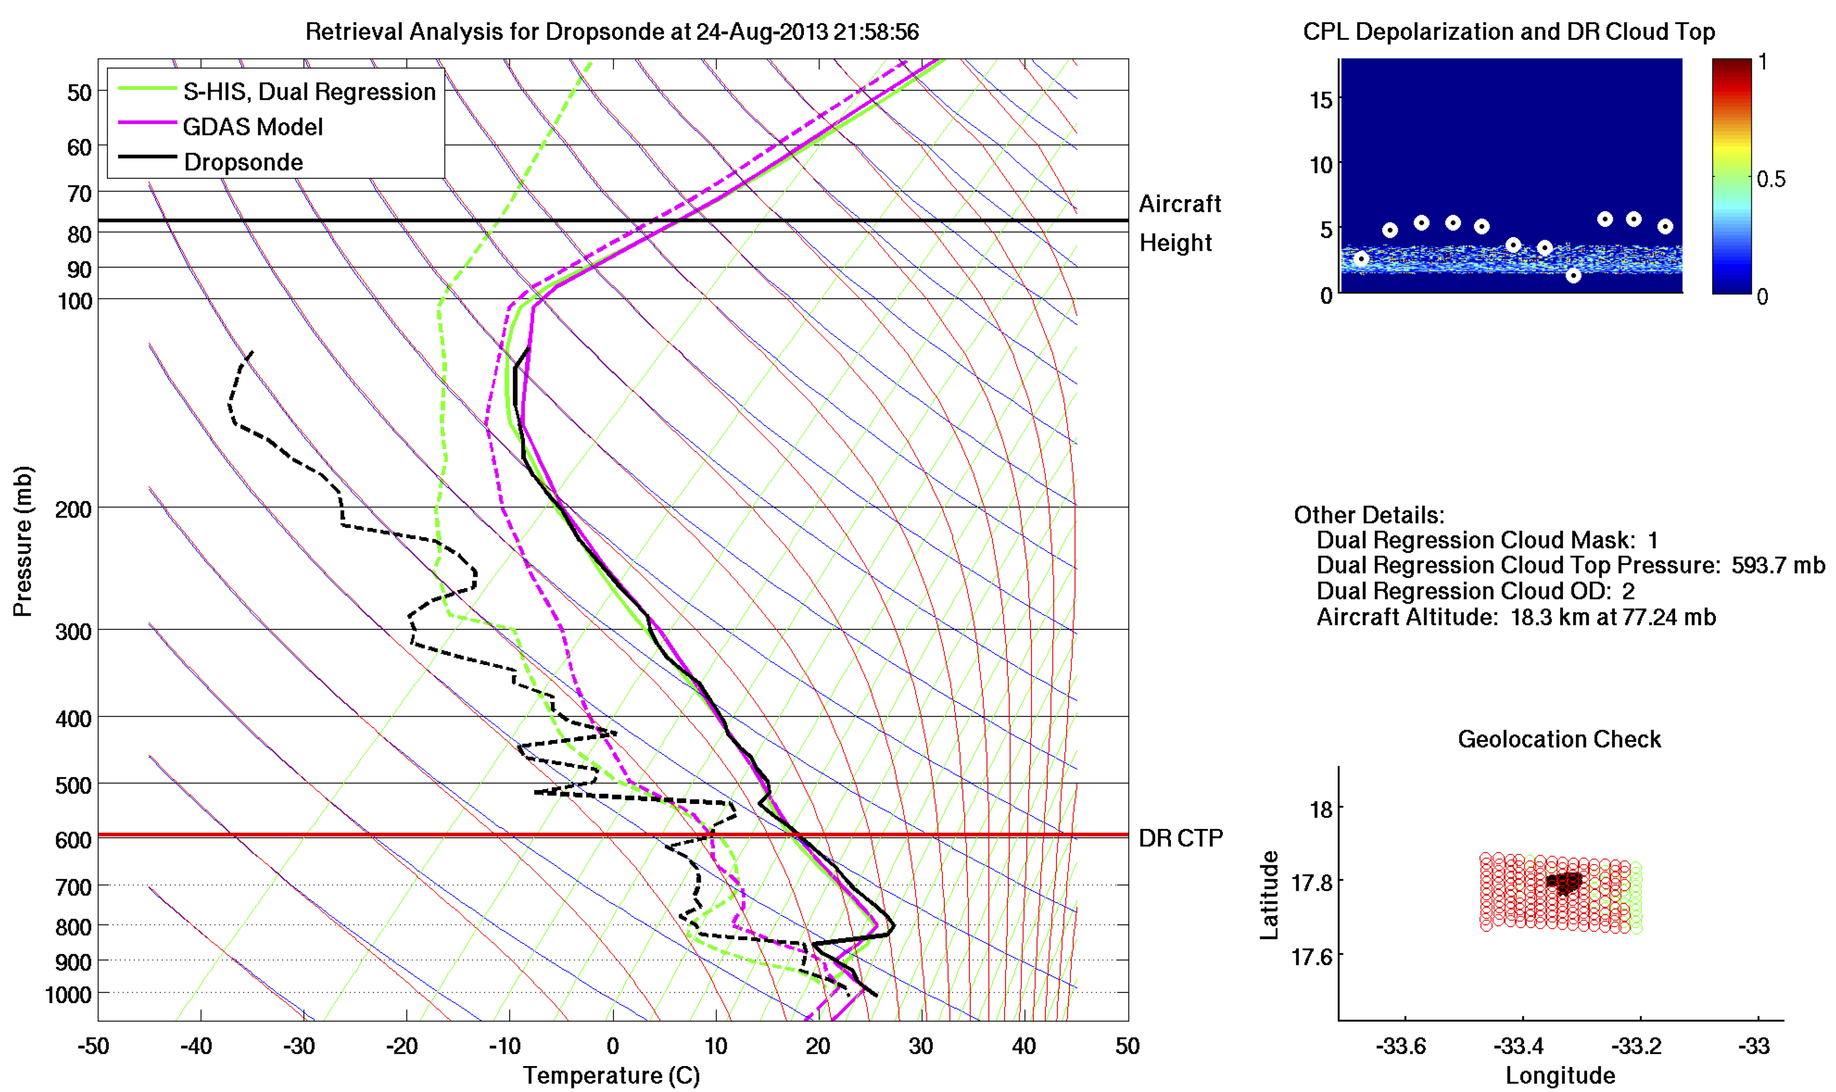
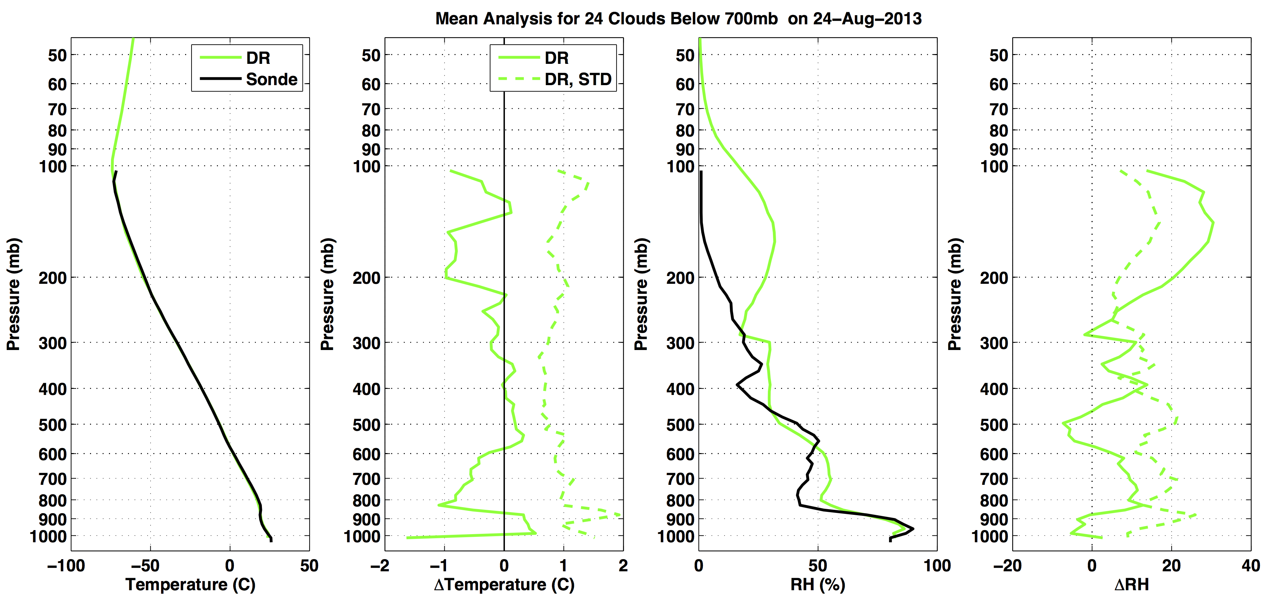
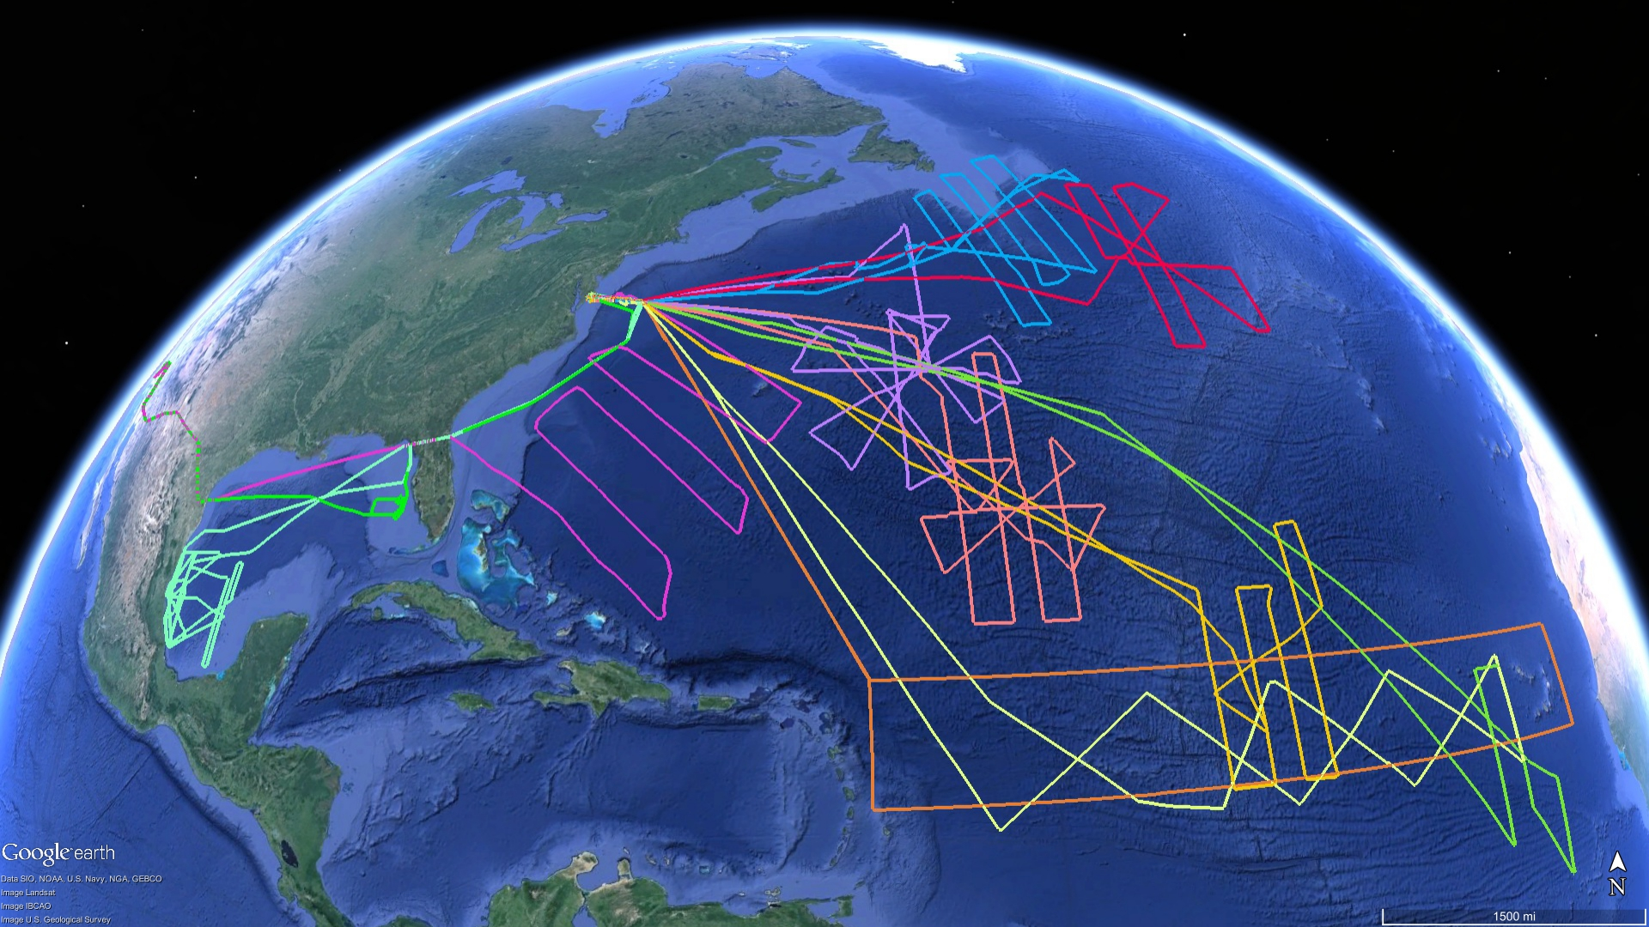
Three-year analysis of S-HIS dual-regression retrievals
using co-located AVAPS and CPL Measurements
D. H. DeSlover, H. E. Revercomb, J. K. Taylor, F. Best, D. C. Tobin
R. O. Knuteson, W. L. Smith, Sr., E. Weisz, R. K. Garcia, D. Hoese
Cooperative Institute for Meteorological Satellite Studies,
Space Science and Engineering Center, University of Wisconsin-Madison
Abstract
A multi-year NASA Hurricane and Severe Storm Sentinal (HS3) aircraft field campaign was designed to better understand the life-cycle of hurricanes. It was conducted off the Eastern Coast of the U.S. during the 2012 through 2014 hurricane seasons. Measurements were acquired by the Scanning High-resolution Interferometer Sounder (S-HIS), Advanced Vertical Atmospheric Profiling System (AVAPS) and Cloud Physic Lidar (CPL) from the Global Hawk. The Global Hawk is an uninhabited aircraft vehicle that flies at an altitude 16.5 km for durations in excess of 26 hours.
The S-HIS, developed at the University of Wisconsin-Madison, is a Michelson Fourier Transform Spectrometer that measures the upwelling thermal radiation between 3.3 and 18 μm at 0.5 cm⁻¹ resolution. A dual-regression retrieval technique [Smith, et al., (2012)] was applied to the measured radiances to produce high quality atmospheric state profiles in addition to surface and cloud properties along the aircraft flight track. These products were directly compared to AVAPS dropsonde profiles and CPL measured cloud heights in our analysis.
NOTE: We are still awaiting delivery of final, quality-controlled data products for CPL from the 2014 HS3 campaign. Therefore, we only present results from 2012 and 2013. We plan to publish the final results after final analysis.
Daily Analysis
Mission Analysis
Top image Each HS3 mission science flight may contain as many as 89 AVAPS dropsondes. We create a S-HIS retrieval analysis image for each dropsonde, corresponding to a two-minute mean S-HIS retrieval profile (60 seconds on either side of the dropsonde release time).
The figure includes an atmospheric state profile on a skew-T diagram, a collocated S-HIS/CPL image during the two-minute interval, and the two-minute S-HIS footprint with an overlay of the dropsonde trajectory. The aircraft height and S-HIS retrieved cloud top pressure (CTP) are also indicated on the skew-T.
The given case on 24 Aug 2013 targeted the Saharan Air Layer (SAL). There are two features of note in the individual skew-T image in the top figure:
(1). An upper air dry bias (above 250 mb) in the AVAPS dropsondes exists. It’s a feature that is apparent in the majority of AVAPS water vapor profiles throughout the HS3 mission.
(2). The SAL structure is quite obvious (600-800 mb), seen as a strong dry layer that resides above the lower level marine layer. The CPL image (top right) confirms the SAL.
Middle image A daily mean is also applied to the data, resulting in a single, mean atmospheric state profile comparing S-HIS retrieved T and T_{d} versus the AVAPS dropsonde measurements. We filter out cases where high cloud contamination could affect the comparison, using only cases where CTP < 700 mb.
AVAPS measured and S-HIS retrieved T compare to within 1 K throughout the profile. RH profiles are generally within 10% absolute RH below the confirmed dry bias above 250 mb.
2012
2013
Contact Information: Daniel DeSlover, deslover@ssec.wisc.edu
References:
Smith et al. 2012, Dual-Regression Retrieval Algorithm for Real-Time Processing of Satellite Ultraspectral Radiances, DOI: 10.1175/JAMC-D-11-0173.1
The upper panel, to the right, shows S-HIS measured upwelling brightness temperature (T_{b}) with AVAPS and DR calculations using Line-by-Line Radiative Transfer Model (LBLRTM). Retrieved surface temperature, T_{surf}, was used in both calculations and a fixed water vapor mixing ratio (first observed AVAPS measurement below aircraft) was used to fill in the AVAPS data gap between the aircraft and first AVAPS measurement.
2013 HS3 science flights
We compiled cloud-top statistics independently for the entire 2012 and 2013 HS3 missions. We apply this analysis in an attempt to determine the effects of cloud optical depth for cases where the S-HIS DR did not discern the presence of cloud. Data was further broken down to clouds above (or below) 5 km. Mean collocated CPL data were used for both OD and cloud top height in this study. The left panels reflect 2012 HS3 campaign measurements, while right panel shows results for 2013.
The pie charts show a rigorous breakdown of aircraft observations for all cases. Roughly half of the S-HIS retrievals do not infer cloudy conditions. The histogram directly below the pie charts shows that the majority of these cases are optically thin.
The bottom two panels show the distribution of cloud top height for cases where both CPL and S-HIS measured a cloud top. The histogram indicates cloud top height differences between S-HIS and CPL, while the bottom panel illustrates a density plot showing the distribution of cloud top. The histogram tail to the left of the distribution suggests problems in the S-HIS retrieval at defining cloud tops for high, thin cirrus.

