Slide 1
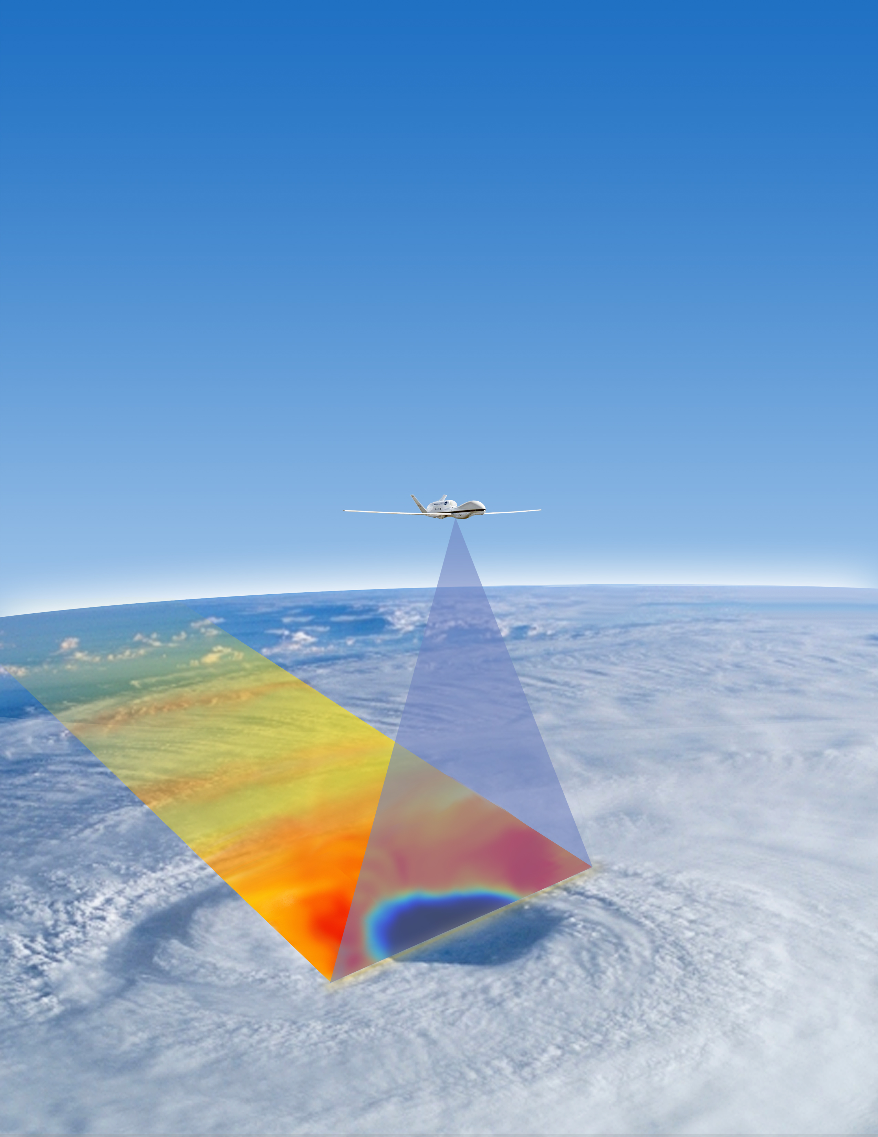
Hurricane Imaging Radiometer (HIRAD)
Daniel J. Cecil (PI), Carl Benson (LSE)
NASA Marshall Space Flight Center
Sayak K. Biswas
Universities Space Research Association
W. Linwood Jones, James Johnson,
Saleem Sahawneh and UCF CFRSL team
University of Central Florida
Christopher S. Ruf, Mary Morris
University of Michigan
Peter G. Black
Science Applications International Corporation, Inc.

Slide 2
NOT HIRAD observations from yesterday

Slide 3
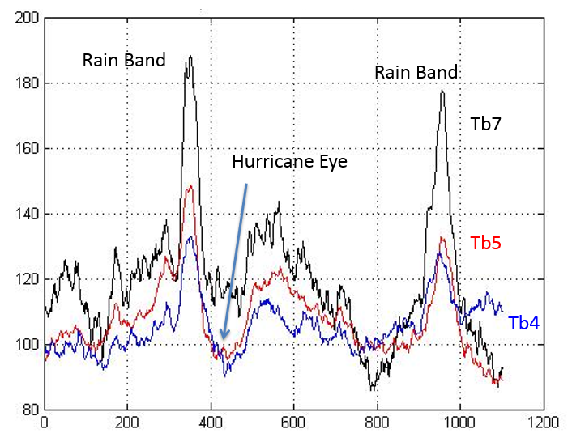
HIRAD Background
C-band (4, 5, 6, 6.6 GHz) radiometer with retrieval concept similar to SFMR
Retrieve Wind Speed and Rain Rate over ocean
C-band frequencies have varying sensitivity to rain but ~equal sensitivity to wind speed (emission from foam on wind-roughened ocean surface)
From Hurricane Karl (2010), at 40° incidence angle, multiple passes across storm

Slide 4
HIRAD Background
STAR antenna technology allows observation of wide swath below aircraft – swath width about 2.5 x aircraft altitude
  ~50 km swath from NASA Global Hawk and WB-57
Flights from Global Hawk in HS3 (2012-14) and WB-57 in GRIP (2010)
Re-calibration of previous data is underway. Plots here use old data that will be corrected this spring / summer.

Slide 5
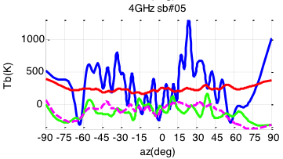
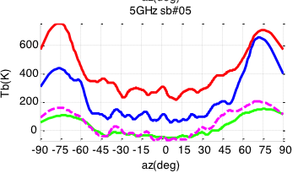
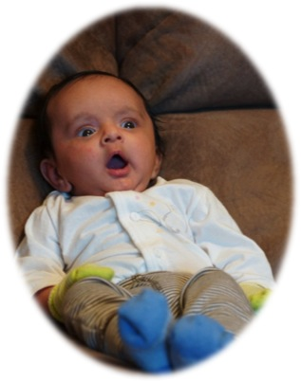
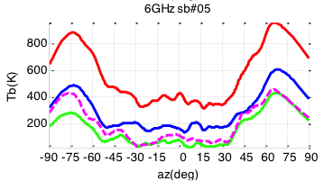
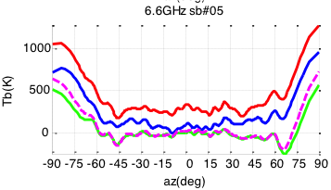
4 GHz interference on Global Hawk
Ocean scene from Global Hawk flight
Chamber wall in lab test
Sky cal before flights
Sky cal after flights
4 GHz channel was well behaved on WB-57 flights and in lab tests
Problem has only shown up while mounted on AV-1
Will test for interference sources during integration at AFRC
Hope to identify interference source, but do not expect to mitigate it this year
Retrievals can still be made with 3 remaining good channels

Slide 6
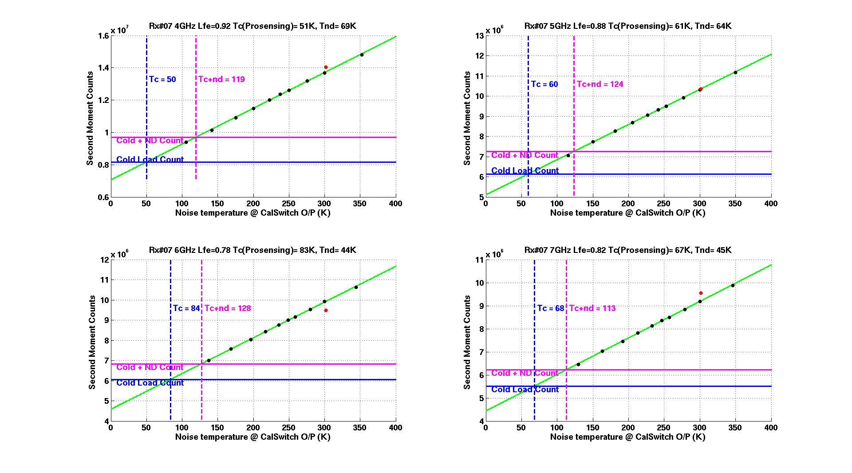
HIRAD Calibration
The 10 HIRAD receivers were recently calibrated using precise external noise sources at 10 different signal strengths.
The test shows linear agreement between input noise temperature and the instrument’s output second moment counts.
Warm Load (red dot) is inconsistent with the rest of the data. It is now ignored in new calibration. New calibration relies on Cold Load and Noise Diode.
4 GHz
6 GHz

Slide 7
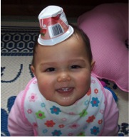
HIRAD Calibration
A front end loss of the receiver along with internal cold load noise temperature and noise diode excess brightness were also estimated from this dataset.
This resulted in an accurate estimation of the HIRAD antenna loss using sky calibration data.
Re-analysis of the anechoic chamber data using the new calibration model and coefficients is in progress.
5 GHz
6.6 GHz

Slide 8
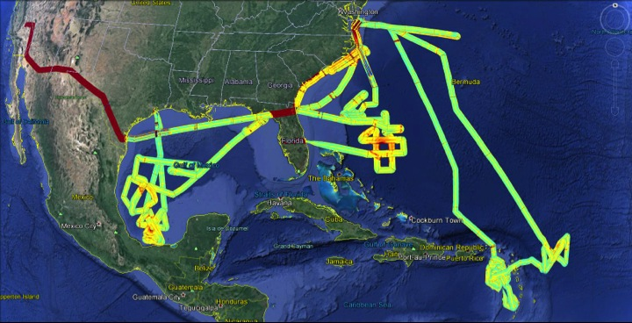
Flights in 2010 & 2013 - HIRAD 6.6 GHz TB
Transit flights between NASA Dryden and NASA Wallops
Hurr Ingrid (2013 – HS3)
Pre- TD Gabrielle (2013 – HS3)
Hurr Earl (2010 -GRIP)
Hurr Karl (2010 - GRIP)
Earl and Karl (2010) flights from WB-57; Remaining flights are from Global Hawk in 2013. 2012 Pacific flight not shown.
Note size difference between Hurricane Earl and Hurricane Karl

Slide 9
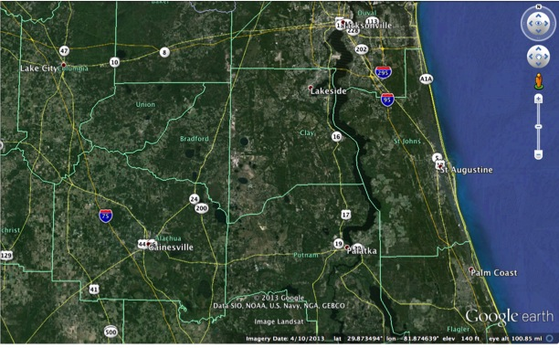
Cross-Scan structure
Synthetic Thinned Array Radiometer (STAR) antenna technology
The antenna is not mechanically scanning across discrete scenes
Instead the swath is derived based on combination of signals from many antenna patches
Want to confirm that real spatial structures are represented in the swath

Slide 10
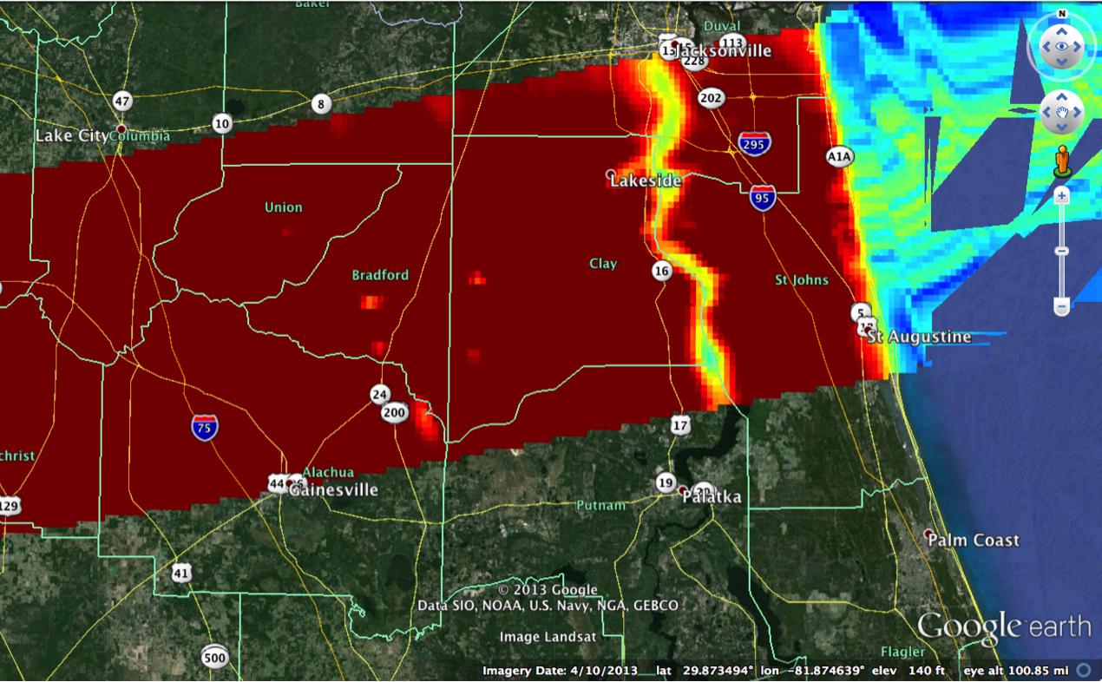
Cross-Scan structure
Synthetic Thinned Array Radiometer (STAR) antenna technology
The antenna is not mechanically scanning across discrete scenes
Instead the swath is derived based on combination of signals from many antenna patches
Comparisons with rivers, lakes, barrier islands confirms that real spatial structures are represented in the swath
5 GHz TB Aug 14 transit south of Jacksonville, FL
Seeing horizontal variability in land surface features is a sanity check that we should be able to see horizontal variability in eyewall wind structure.
Plot has -60° - +60° incidence angle. Left (north) edge of swath shows low bias.

Slide 11
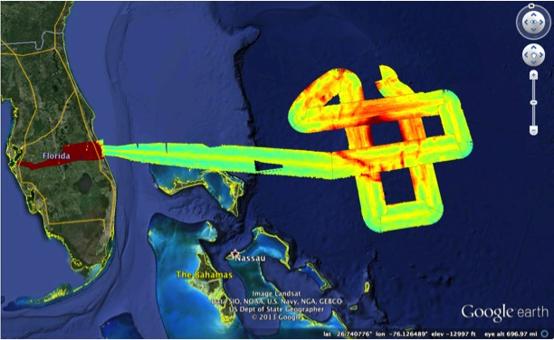
Hurricane Earl (2010) Brightness Temp
6.6 GHz TB
Note: This plot does not account for storm motion.
Primary eyewall is near edge of swaths
Secondary eyewall most noticeable on SW side

Slide 12
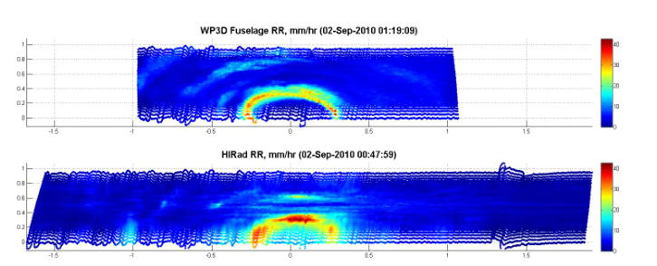
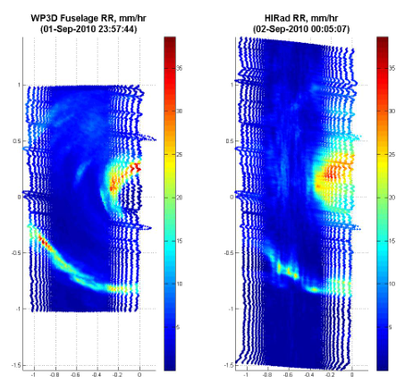
HIRAD rain rates vs re-mapped radar rain rates
P-3 LF radar-derived rain rates
HIRAD retrieved rain rates
With eye near the edge of the swath (as in Hurricane Earl flight), simplest HIRAD algorithms will mis-assign some eyewall rain from the slant path to the surface in the eye.
Mary Morris and Chris Ruf (UMich) working on Coupled Retrieval Algorithm to account for this. (not shown in this presentation)
Retrievals in this presentation use uncoupled algorithms from UCF group (Linwood Jones et al.)

Slide 13
Hurricane Earl (2010) retrievals
Aircraft track was outside the eyewall, but eyewall was mostly mapped within the swath
There are across-track biases to clean up
-50 m/s
Rain Rate
-40
Wind Speed
-40 m/s
-30
-30 m/s
-20
mm/h
-20 m/s
“Quick-look Retrieval”: Empirical algorithm, based on SFMR colocations
5 GHz linear relationship with Wind Speed
6.6 GHz second-order relationship with Rain Rate

Slide 14
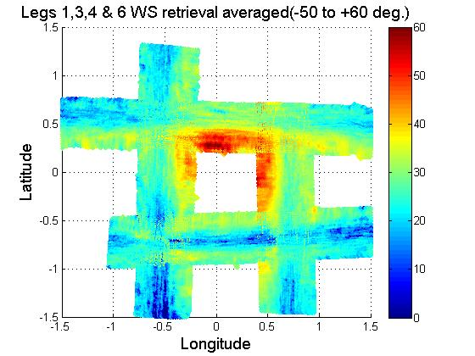
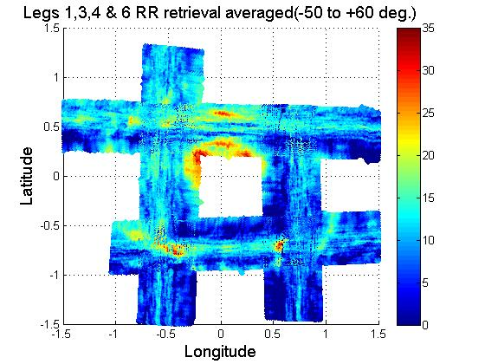
Hurricane Earl (2010) retrievals
Aircraft track was outside the eyewall, but eyewall was mostly mapped within the swath
There are across-track biases to clean up
Wind Speed
50-
Rain Rate
-30
mm/h
40-
-20
mm/h
30-
20-
-10
mm/h
“Maximum Likelihood Estimate (MLE)”: Physical algorithm, based on radiative transfer model
4.0, 5.0, and 6.6 GHz channels used
6.0 GHz channel was noisy in GRIP

Slide 15
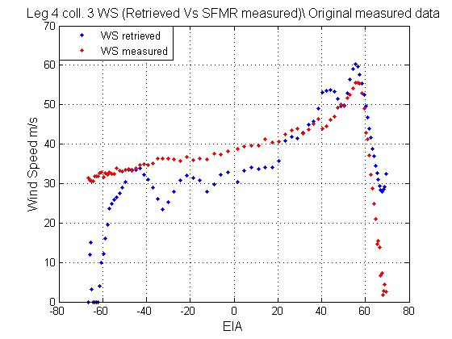
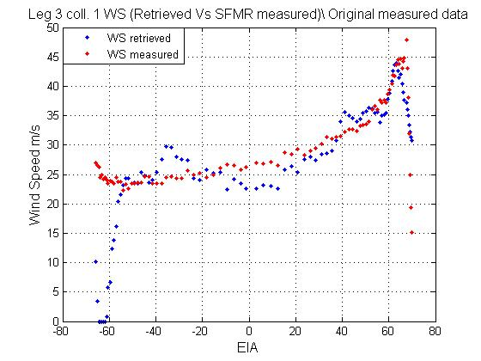
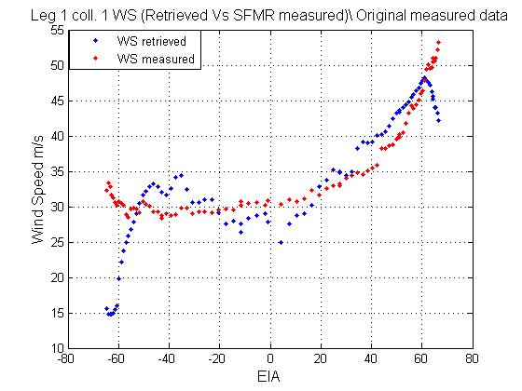
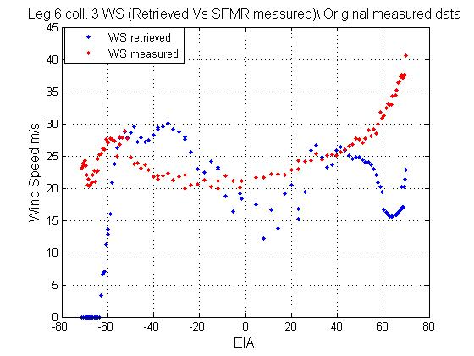
Hurricane Earl (2010) HIRAD vs SFMR
HIRAD retrievals (blue) mostly match up well with SFMR retrievals (red) in places where SFMR flew through the HIRAD swath.
HIRAD data appears good between -50° - +60° azimuths. Large biases on left edge of swaths.
Some differences due to tens of minutes offset between observations.
X-axis Earth Incidence Angle (EIA) corresponds to about 300 m per degree of EIA
North
Wind Speed
West
East
Large differences on south side: HIRAD sees secondary eyewall further north than SFMR, does not see peak eyewall winds near edge of swath
South

Slide 16
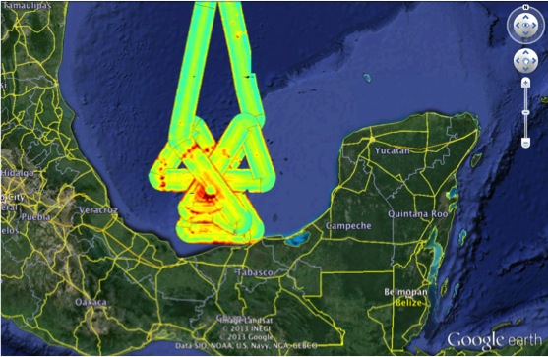
Hurricane Karl (2010) Brightness Temp
6.6 GHz TB

Slide 17
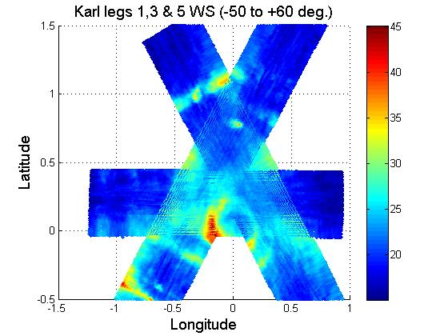
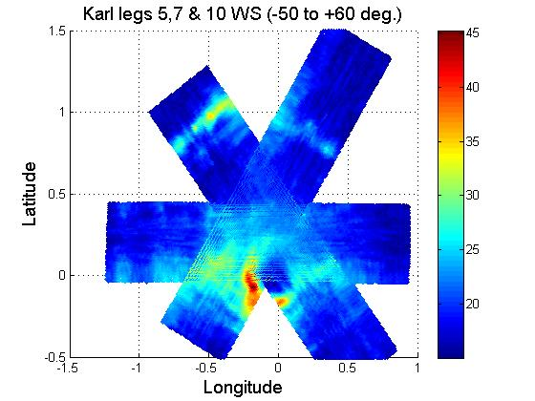
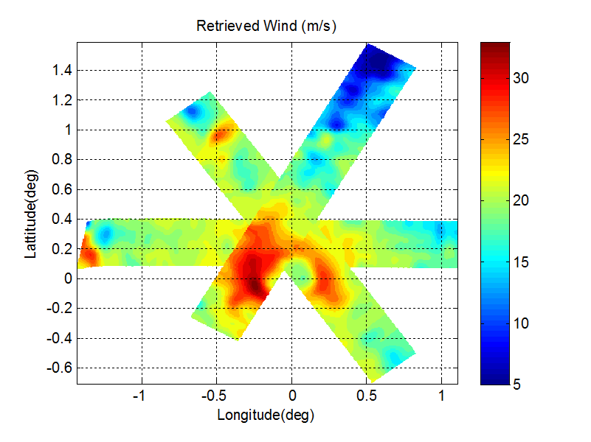
Hurricane Karl (2010) wind speed
“Quick-look Retrieval”: Empirical algorithm, based on SFMR colocations
trained with Hurricane Earl (no re-tuning)
5 GHz linear relationship with Wind Speed
-40 m/s
Repeated patterns near the center, mapping storm structure
Legs 1, 3, 5 on left
Legs 5, 7, 10 on right
-40 m/s
Wind Speed
-30 m/s
-30 m/s
-20 m/s
-20 m/s
Bottom : Additional smoothing of TBs for legs 5, 7, 10.
Removes some noise, but decreases wind speed too much.
-30 m/s
-20 m/s

Slide 18
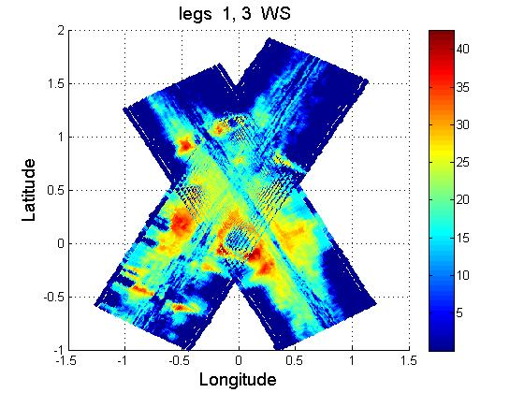
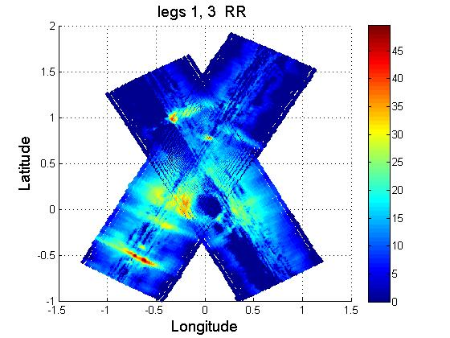
Hurricane Karl (2010) retrievals
“Maximum Likelihood Estimate (MLE)”: Physical algorithm, based on radiative transfer model
4.0, 5.0, and 6.6 GHz channels used
6.0 GHz channel was noisy in GRIP
Wind Speed
-40 m/s
Rain Rate
40-
mm/h
-30 m/s
30-
mm/h
-20 m/s
Clearly more noise in this retrieval than in the quicklook
MLE is more sensitive to relative calibrations of each channel; improvements to calibrations are in progress
These plots include large incidence angles, where performance is worst (edge of swath)
20-
mm/h

Slide 19
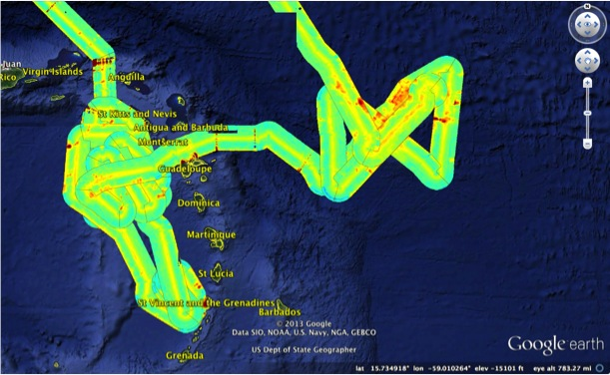
Pre-TD Gabrielle (2013) Brightness Temp
6.6 GHz TB
TS Gabrielle formed the next day from the westernmost of the disturbed areas.
There was a trailing area to the east that had broader rain and convection.
Not expecting interesting retrievals since winds were likely weak.

Slide 20
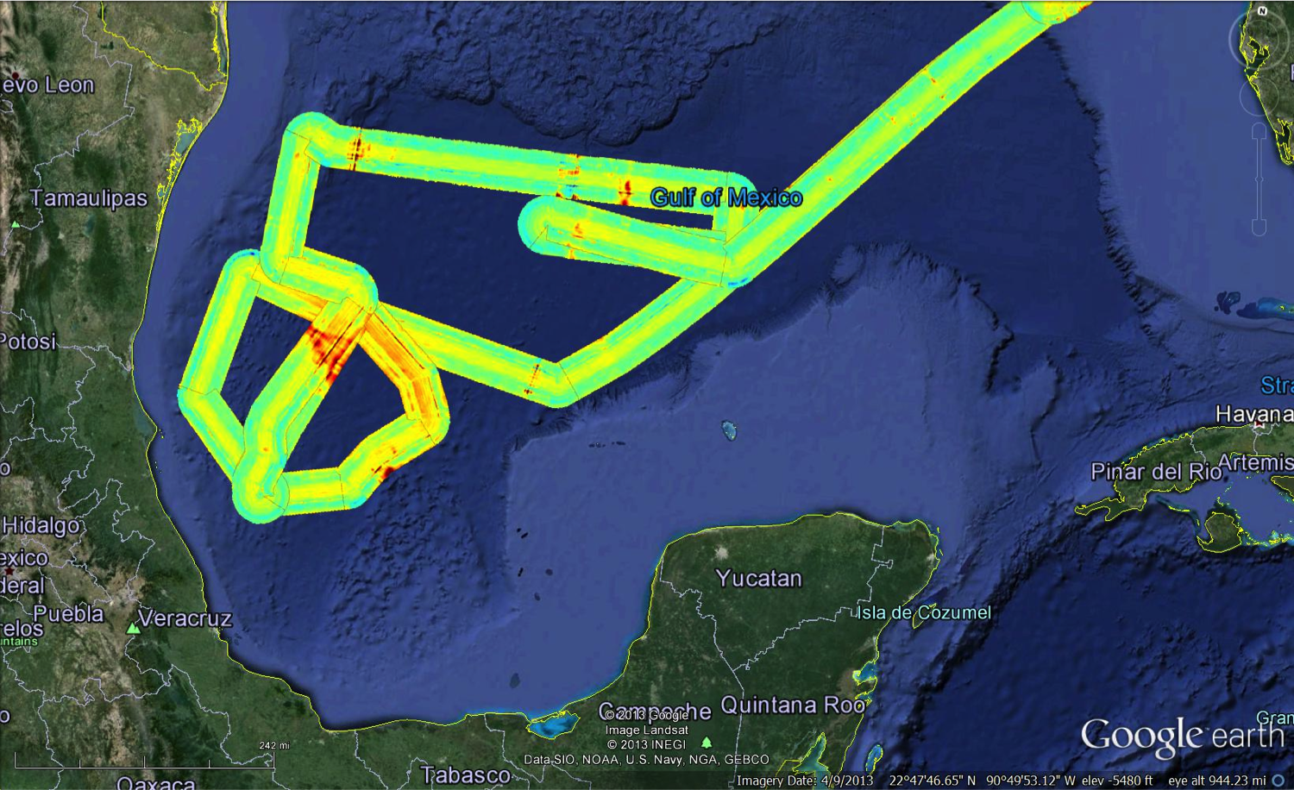
Hurr Ingrid (2013) Brightness Temp
6.6 GHz TB
Asymmetric storm just before landfall
Flight pattern was limited
Retrievals not good from initial TB calibration; expecting improvements in next version of calibrations

Slide 21
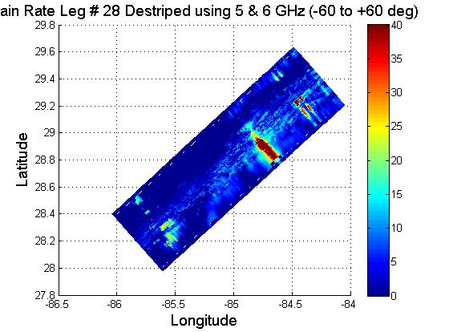
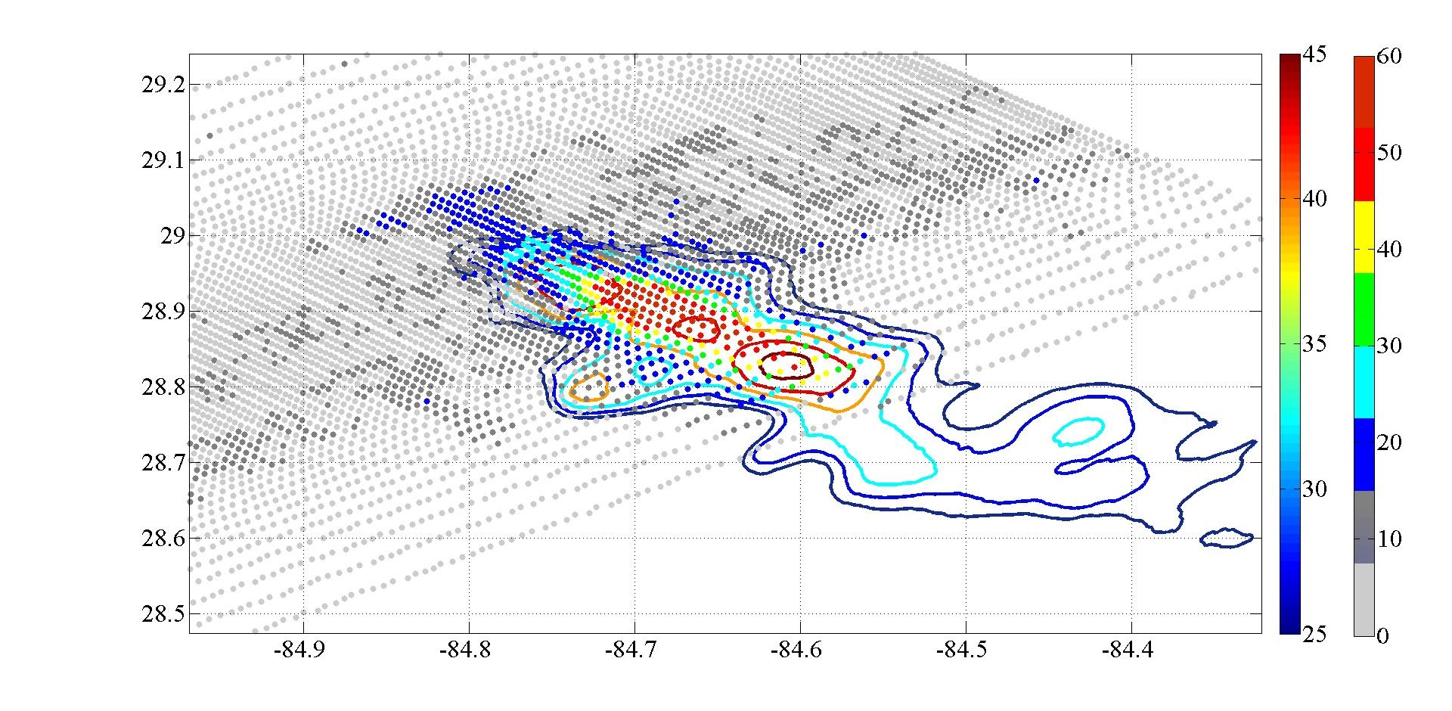
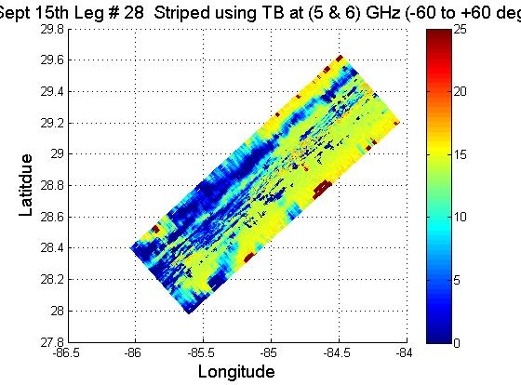
Rain case near Tampa 88D
On the return from H. Ingrid, we sampled rain bands near the Tampa WSR-88D. Retrievals of heavy rain match up well with 88D reflectivity contours.
MLE
Rain Rate
HIRAD Rain Rate (shaded)
vs WSR-88D (contours)
MLE
Wind Speed
Wind retrievals (bottom) are below 15 m/s – below HIRAD’s ability to detect anything meaningful.
That is good – this is far from Hurricane Ingrid, and we expected wind speeds to be below our detectability here.

Slide 22
Summary
HIRAD is designed to make SFMR-like retrievals of surface wind speed over a wide swath from high-altitude aircraft
Hurricane flights so far:
Earl (2010) from WB-57 (GRIP)
Karl (2010) from WB-57 (GRIP)
Ingrid (2013) from Global Hawk (HS3)
Improved calibration procedures currently being implemented. Plots shown here are all from old calibration.
Robust spatial structure is seen across the swath
Signal degrades at incidence angles > ~50°
Empirical (quicklook) and physical (MLE) retrieval algorithms both show promise, but depend on accurate TB calibration
Biases as a function of incidence angle require further smoothing / filtering

Slide 23
Upcoming work
Improved calibration procedures for brightness temperatures currently being implemented; will be applied to the data that has already been collected
New wind and rain retrievals late this spring or summer
Better thermal control of instrument in future flights

