Slide 1
Impact of environmental moisture on intensification of Hurricane Earl (2010)
Longtao Wu, Hui Su, and Robert Fovell
HS3 Science Meeting 2014
1 May 2014

Slide 2
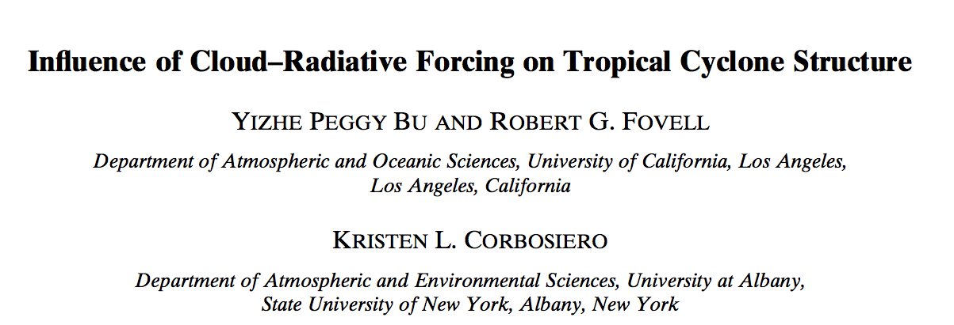
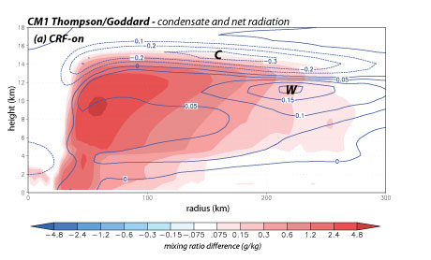
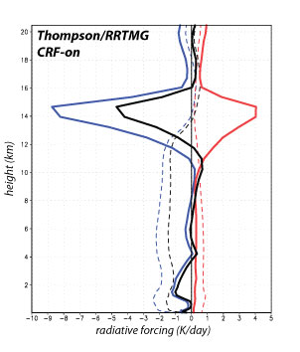
300 km
HWRF

Slide 3
Goal and outline
Environmental moisture appears to have a complex impact on tropical cyclone (TC) intensity and size
Helps, hurts, or has no effect, depending on the case, storm-relative location of the moisture, and other factors
Dunkerton and collaborators have introduced the “wave pouch” concept… which might help explain some ostensibly contradictory results
Investigate impact of environmental moisture perturbations, on a case that exhibited:
Rapid intensification
A weakly closed or partially open wave pouch

Slide 4
Experimental design
WRF v.3.3.1
9 km outer domain
3 km domain moving nest
YSU, Thompson, RRTMG, Kain-Fritsch (9 km only)
ERA-Interim
8/29 at 00Z
48 h simulations
5 members for each run (temperature, moisture perturbations)
Outer domain

Slide 5
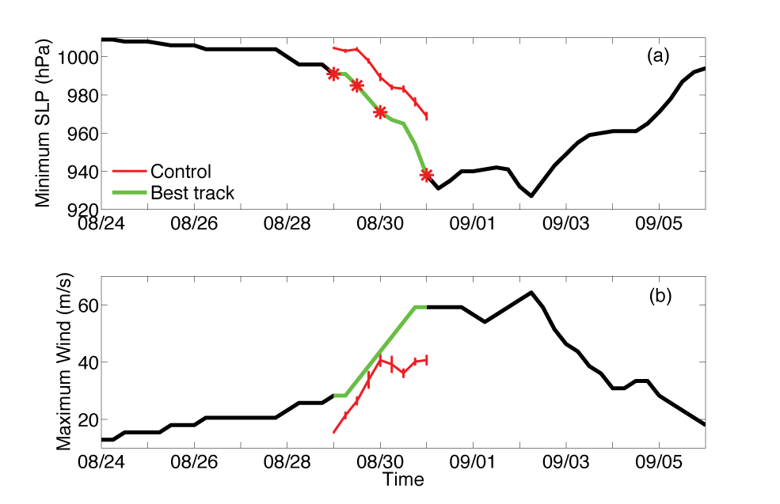
WRF performance
Notes:
WRF’s Earl is weaker than actual storm and its wind intensification ceases too early

Slide 6
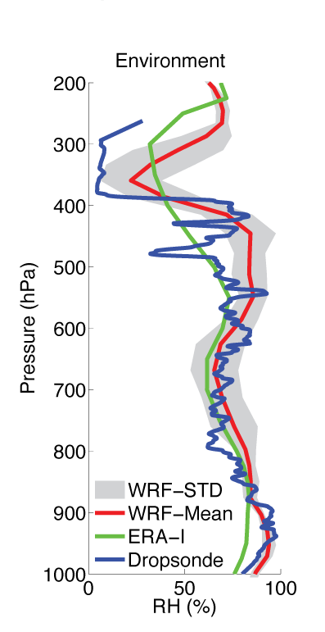
WRF performance
ERA-Interim
12 hour forecast
700 mb
RH & wind
WRF Control
Notes:
ERA-Interim: moist air to south and east, dry air to west and north.
WRF 12 h forecast appears to be losing some of the moisture to the south. If the TC is enclosed in a pouch, however, should this matter?
Unfortunately, apparently no dropsondes to south of Earl

Slide 7
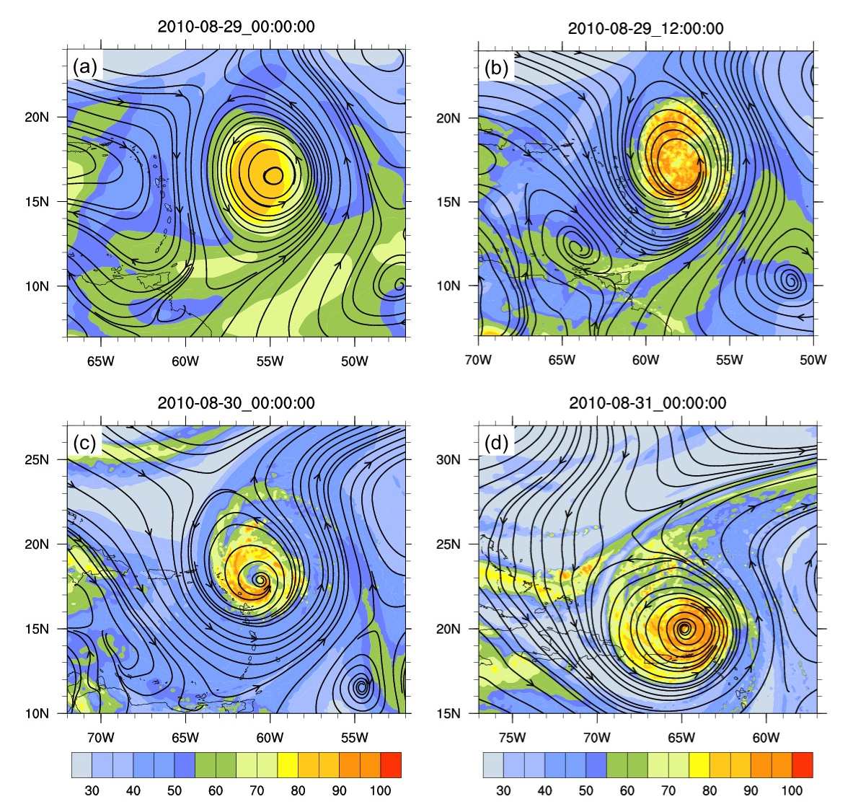
WRF Control
700 mb RH & storm-relative streamlines (Hovmoller method).
“Pouch” (cf. Dunkerton et al. 2009) not completely closed at any time… or openable via environmental disturbance.
T+0
T+12
T+24
T+48
Notes:
Co-moving streamlines calculated by subtracting motion of Earl computed at 700 mb level
At each time, there appears to be a closed streamline surrounding Earl, tho one might argue that the pouch is partially open, or just weakly closed.
If pouch is closed, should environmental moisture variations really matter? Not directly, but possibly indirectly?

Slide 8
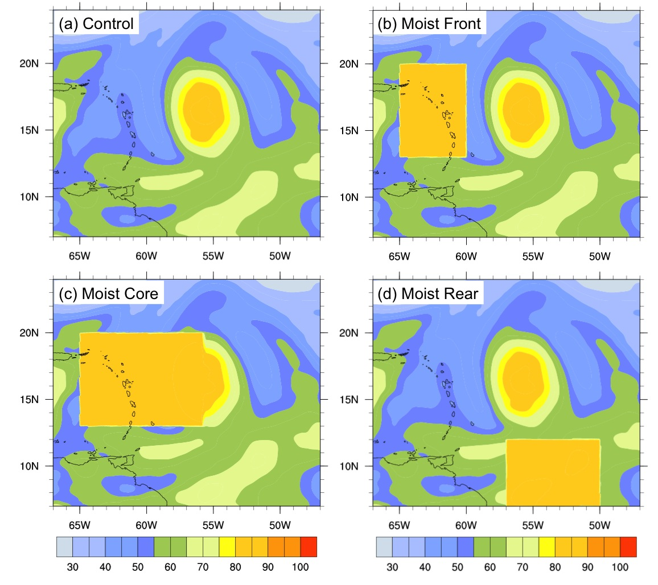
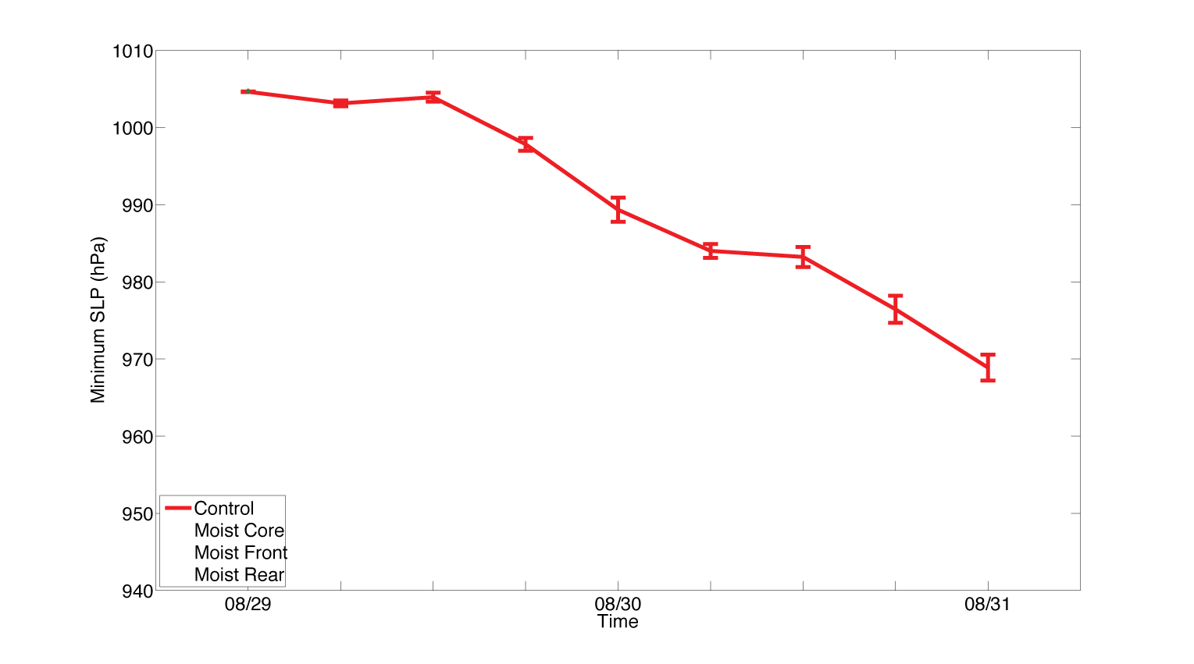
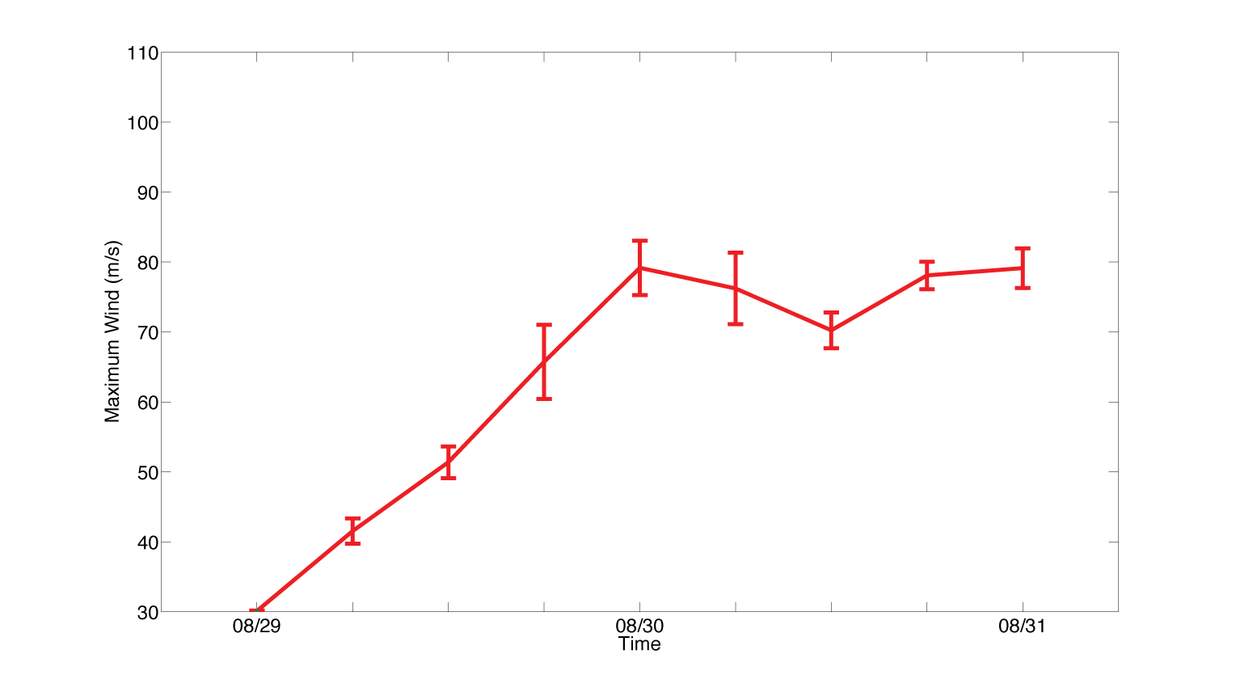
Moisture impacts on hurricane
700 mb RH
SLP
Wind speed (kt)

Slide 9
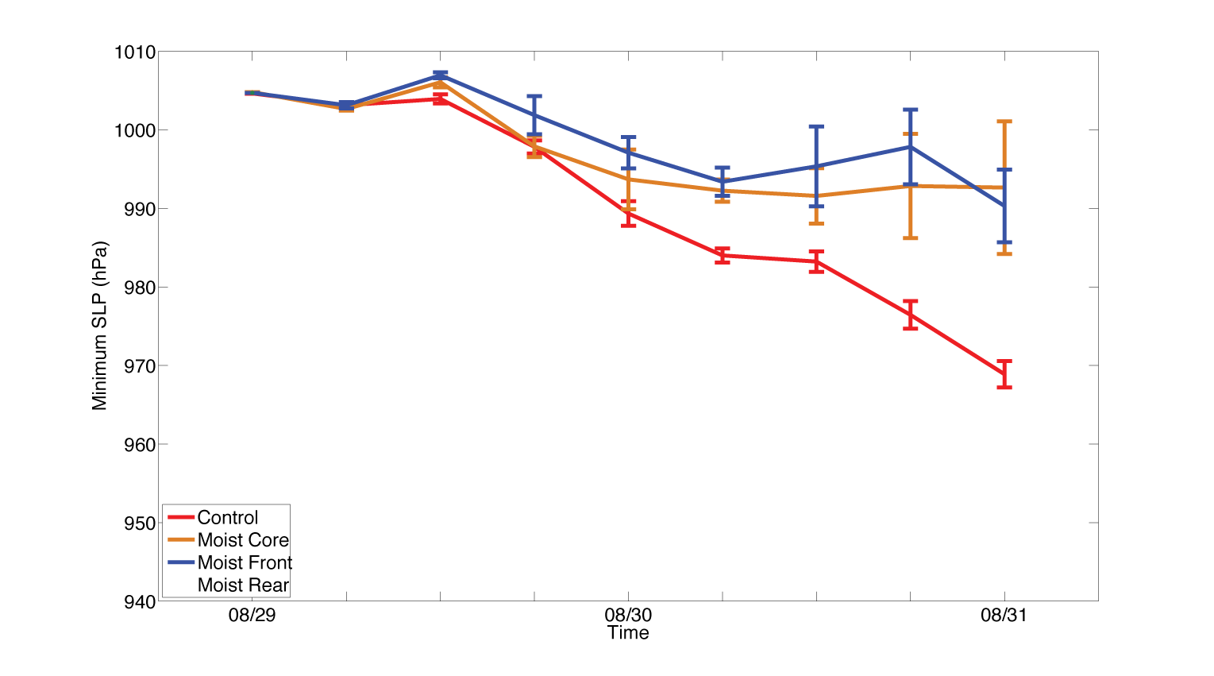
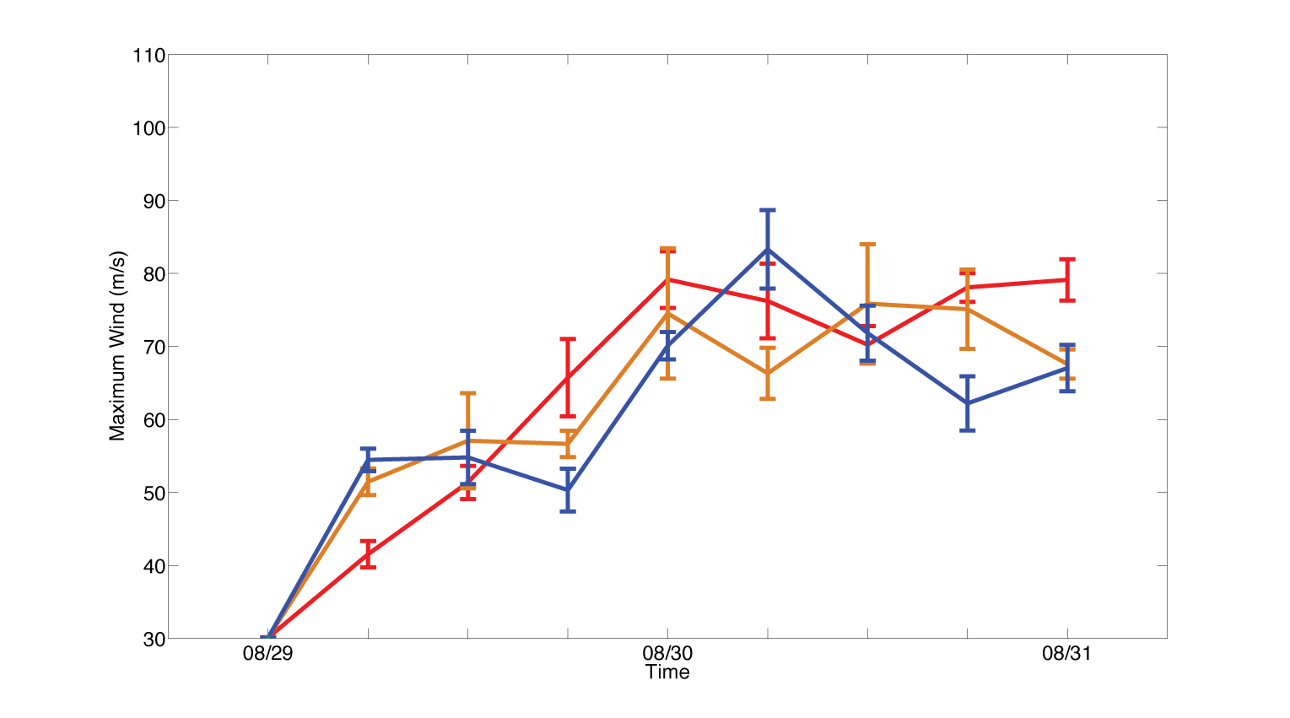
Moisture impacts on hurricane
700 mb RH
SLP
Wind speed (kt)

Slide 10
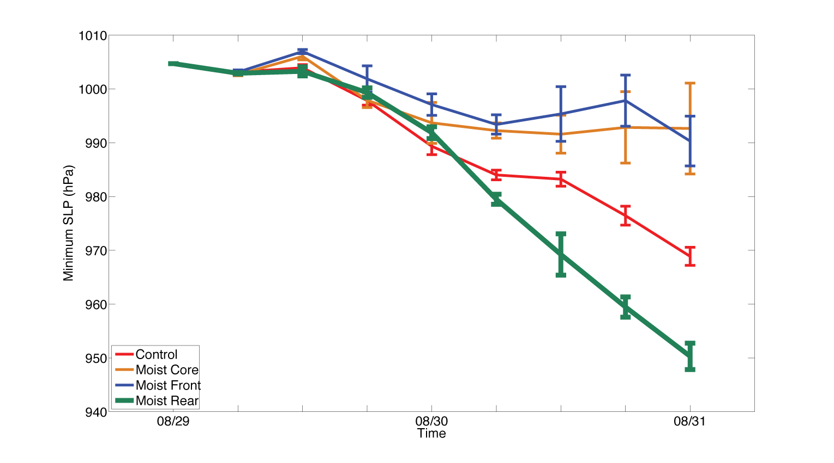
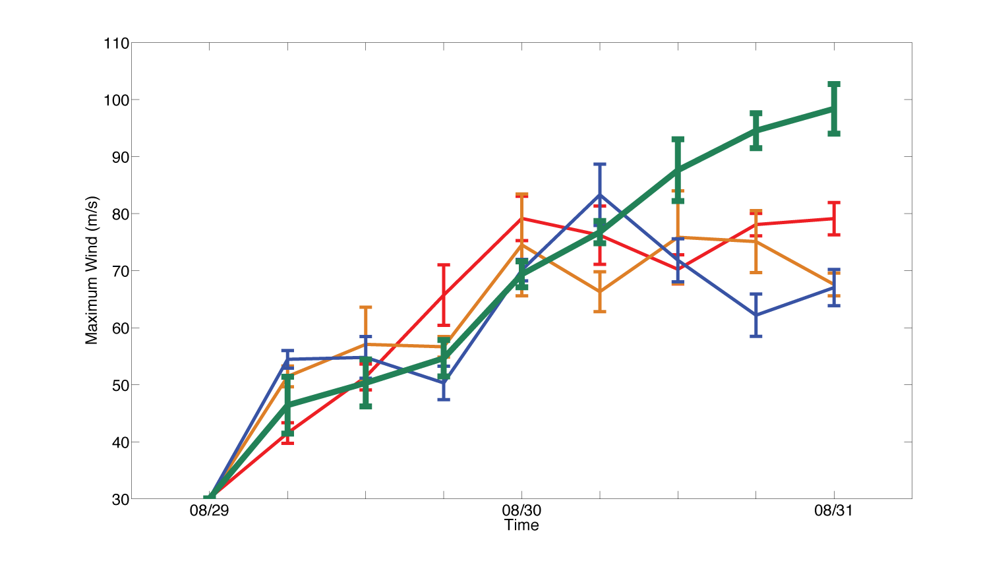
Moisture impacts on hurricane
700 mb RH
SLP
18 mb
Wind speed (kt)
20 kt
Notes:
Even MR run still weaker than observed (115 kt, 938 mb) by 8-31-00Z.

Slide 11
Control vs. Moist Rear
Vortex-following composites
during 42-48 h

Slide 12
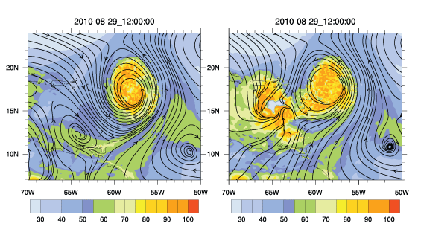
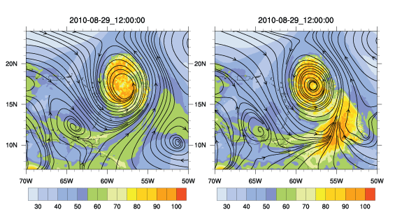
T + 12 h
Control Moist Rear
Convective activity south of storm deforms wave pouch…
providing path for moist air into inner core???

Slide 13
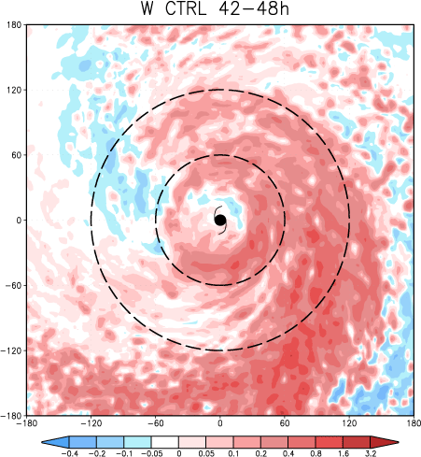
850-200 mb shear
360 km
Control run Moist Rear
Mass-weighted vertical velocity
(surface-7 km)

Slide 14
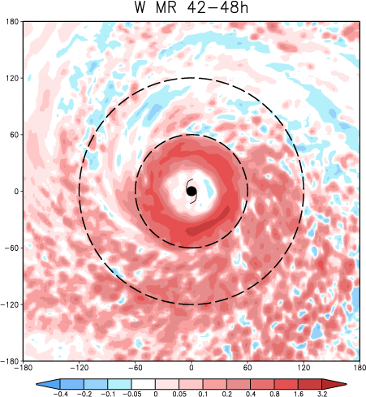
850-200 mb shear
Control run Moist Rear
Mass-weighted vertical velocity
(surface-7 km)
360 x 360 km

Slide 15
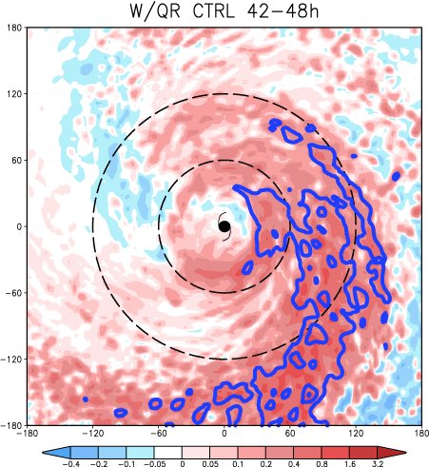
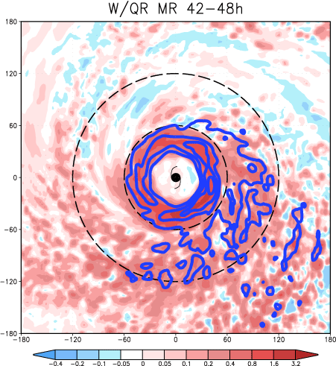
Control run Moist Rear
Mass-weighted vertical velocity
(surface-7 km)
and surface rainwater mixing ratio
(0.6 g/kg contours)
360 x 360 km

Slide 16
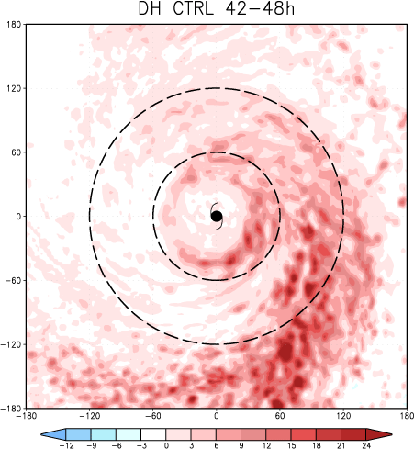
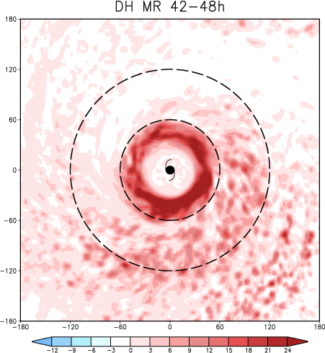
Control run Moist Rear
Vertically integrated microphysics diabatic heating
(surface-7 km)
360 x 360 km

Slide 17
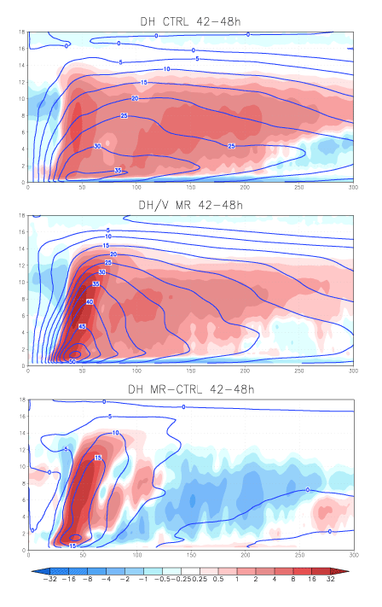
Symmetric components of
Microphysics diabatic heating
Tangential wind
Control
Moist Rear
Moist Rear – Control difference
300 km

Slide 18
Evolution of Moist Rear (MR) simulation

Slide 19
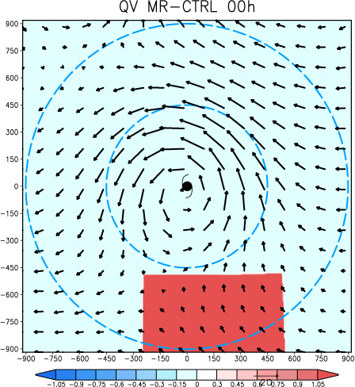
Vapor difference field
(surface-7 km)
Moist Rear wind field
(surface-4.25 km)
450 km
MinSLP difference:
0.0 mb
900 km

Slide 20
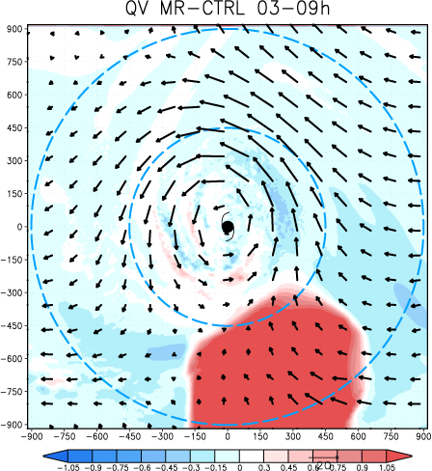
Vapor difference field
(surface-7 km)
Moist Rear wind field
(surface-4.25 km)
MinSLP difference:
+0.8 mb (MR weaker)
900 km

Slide 21
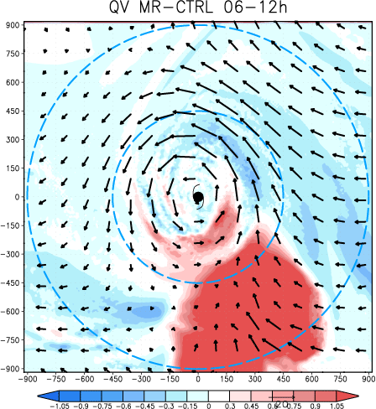
Vapor difference field
(surface-7 km)
Moist Rear wind field
(surface-4.25 km)
MinSLP difference:
+1.2 mb
900 km

Slide 22
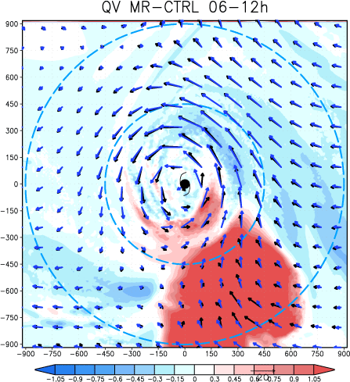
Vapor difference field
(surface-7 km)
Moist Rear wind field
(surface-4.25 km)
and Control wind field
900 km

Slide 23
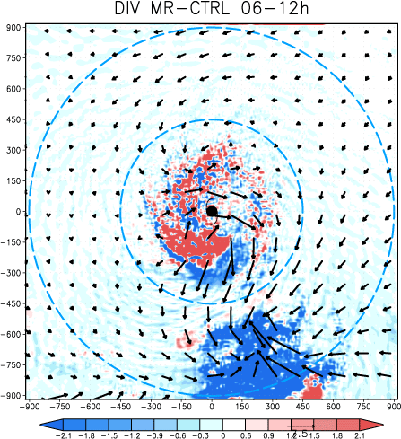
Divergence difference field
(surface-4.25 km)
Wind difference field
(surface-4.25 km)
900 km
Notes:
Blue is convergence diff

Slide 24
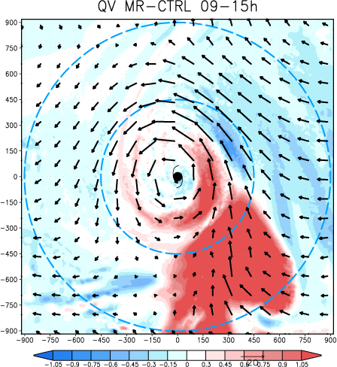
Vapor difference field
(surface-7 km)
Moist Rear wind field
(surface-4.25 km)
MinSLP difference:
+0.8 mb
900 km

Slide 25
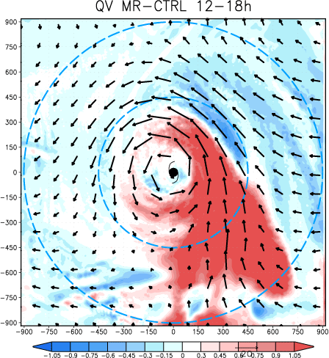
Vapor difference field
(surface-7 km)
Moist Rear wind field
(surface-4.25 km)
MinSLP difference:
+1.6 mb
900 km

Slide 26
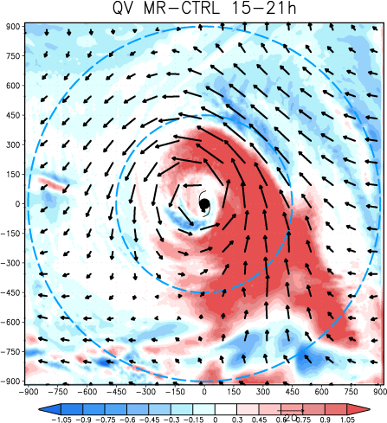
Vapor difference field
(surface-7 km)
Moist Rear wind field
(surface-4.25 km)
MinSLP difference:
+2.2 mb
900 km

Slide 27
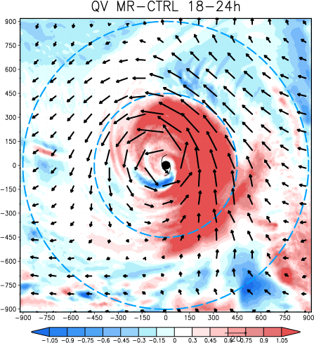
Vapor difference field
(surface-7 km)
Moist Rear wind field
(surface-4.25 km)
MinSLP difference:
+2.5 mb
900 km

Slide 28
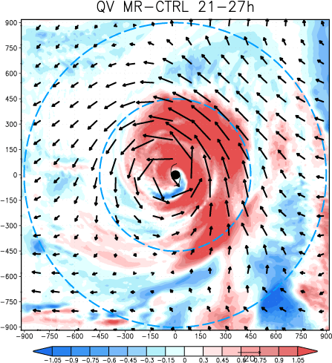
Vapor difference field
(surface-7 km)
Moist Rear wind field
(surface-4.25 km)
MinSLP difference:
+2.0 mb
900 km

Slide 29
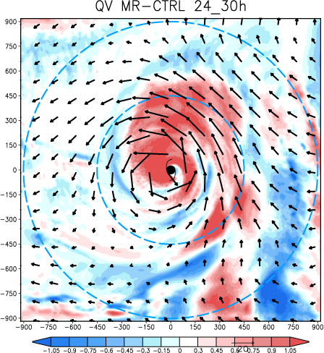
Vapor difference field
(surface-7 km)
Moist Rear wind field
(surface-4.25 km)
MinSLP difference:
+0.5 mb
900 km

Slide 30
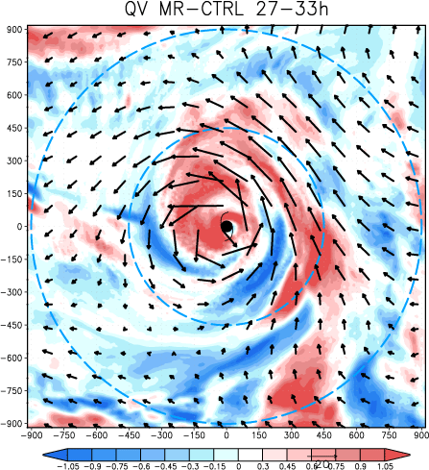
Vapor difference field
(surface-7 km)
Moist Rear wind field
(surface-4.25 km)
MinSLP difference:
-2.5 mb
900 km

Slide 31
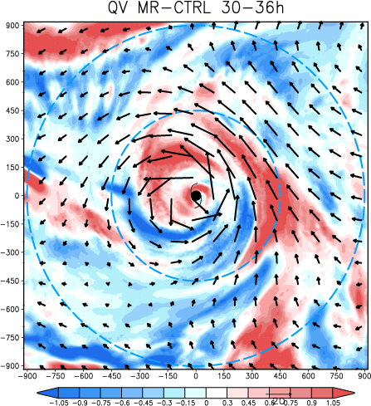
Vapor difference field
(surface-7 km)
Moist Rear wind field
(surface-4.25 km)
MinSLP difference:
-6.0 mb
900 km

Slide 32
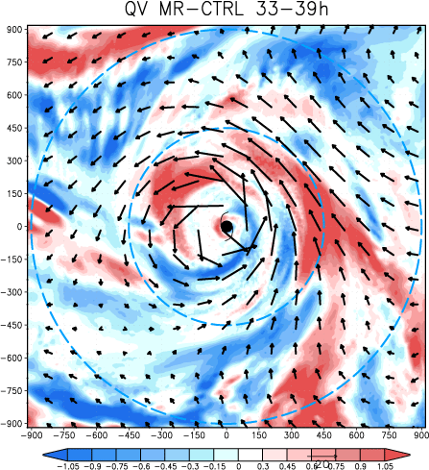
Vapor difference field
(surface-7 km)
Moist Rear wind field
(surface-4.25 km)
MinSLP difference:
-8.5 mb
900 km

Slide 33
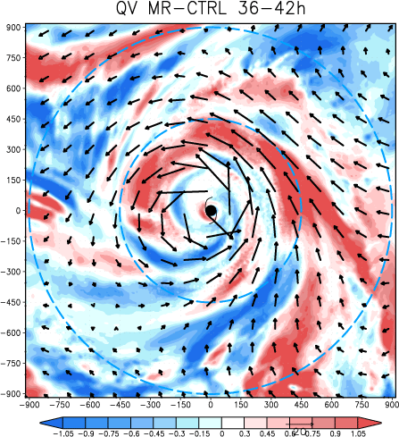
Vapor difference field
(surface-7 km)
Moist Rear wind field
(surface-4.25 km)
MinSLP difference:
-12.0 mb
Final MinSLP difference:
-18.3 mb
900 km

Slide 34
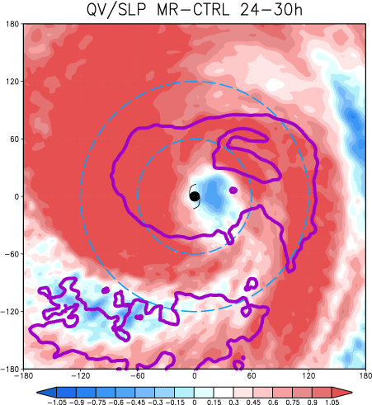
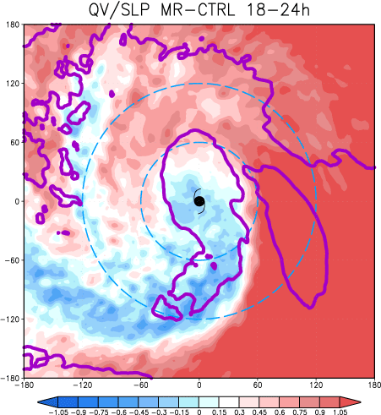
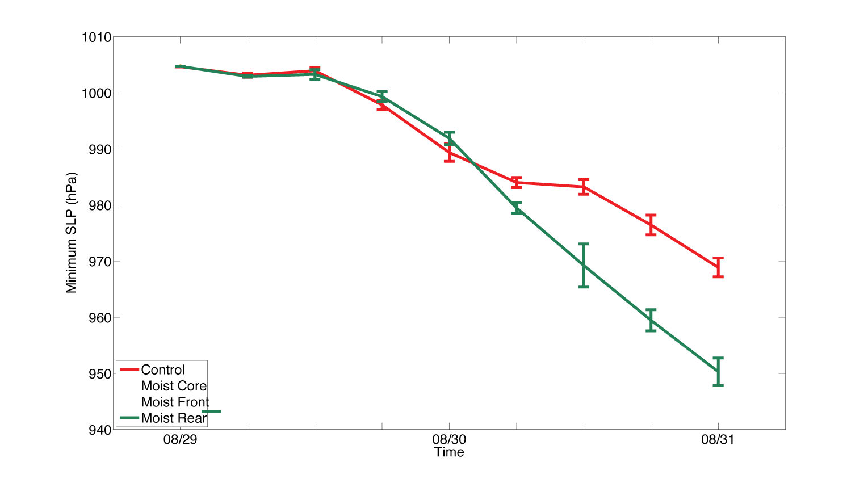
Water vapor difference
SLP difference
120 km
MinSLP difference:
+3.0 mb (Control is deeper)
+2 mb
0 mb
CTRL
MR
360 km

Slide 35
Water vapor difference
SLP difference
MinSLP difference:
+0.5 mb
0 mb
CTRL
MR
360 km

Slide 36
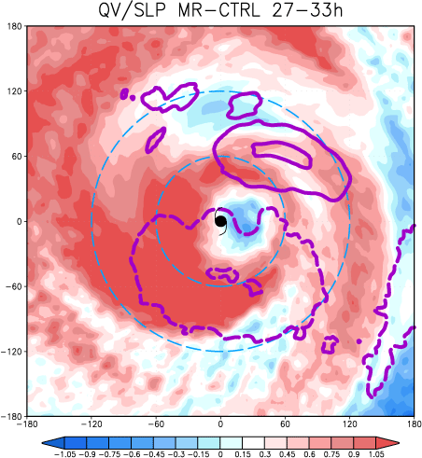
Water vapor difference
SLP difference
MinSLP difference:
-4.0 mb
0 mb
-4 mb
CTRL
MR
360 km

Slide 37
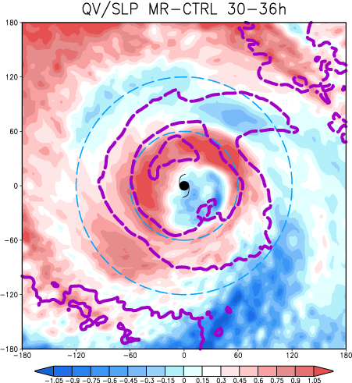
Water vapor difference
SLP difference
MinSLP difference:
-6.0 mb
-6 mb
CTRL
MR
360 km

Slide 38
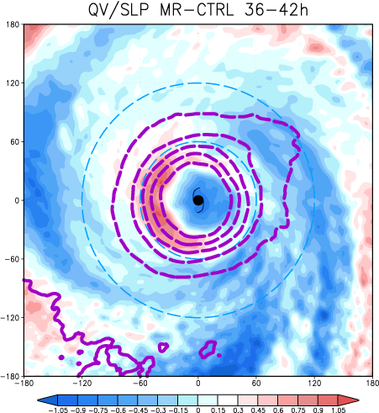
Water vapor difference
SLP difference
MinSLP difference:
-12.0 mb
-10 mb
CTRL
MR
360 km

Slide 39
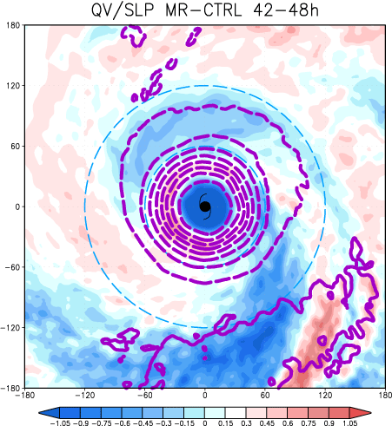
Water vapor difference
SLP difference
MinSLP difference:
-16.0 mb
-16 mb
CTRL
MR
360 km

Slide 40
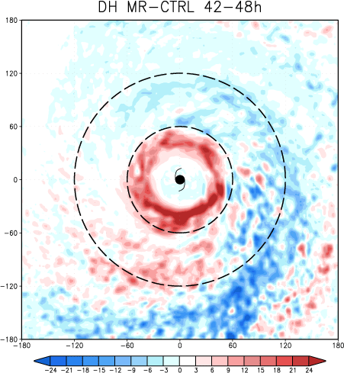
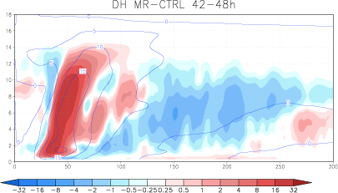
Microphysics diabatic heating
difference
-16 mb
360 km

Slide 41
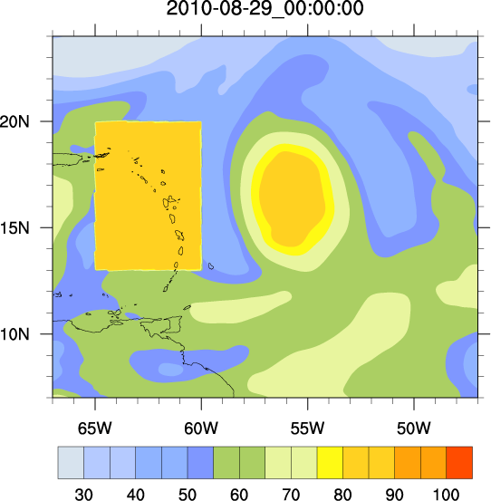
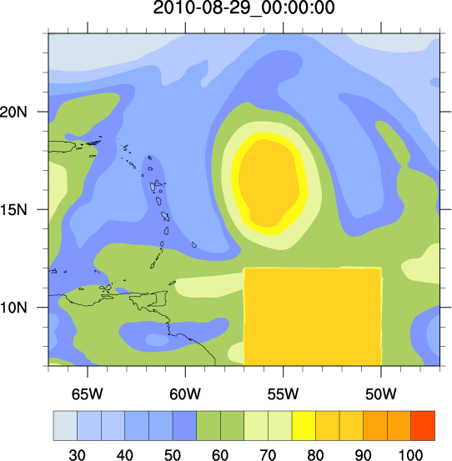
Moist Front vs. Moist Rear

Slide 42
T + 12 h
Control Moist Front
Convective activity ahead of storm deforms wave pouch…
ultimately permitting dry air to enter inner core….

Slide 43
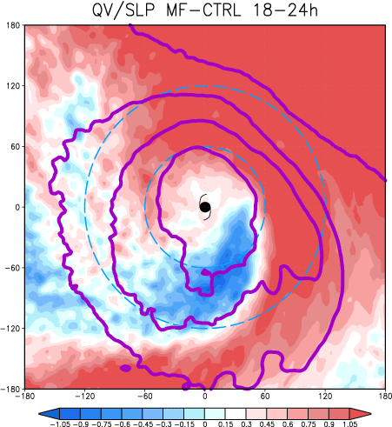
+7.5 mb
+3.0 mb
360 km
Moist Front Moist Rear
Vapor difference field
(surface-7 km)
SLP difference field

Slide 44
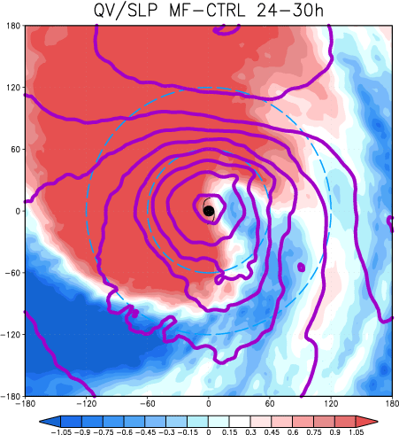
+12.0 mb
+0.5 mb
Moist Front Moist Rear
Vapor difference field
(surface-7 km)
SLP difference field

Slide 45
+11.0 mb
-4.0 mb
Moist Front Moist Rear
Vapor difference field
(surface-7 km)
SLP difference field

Slide 46
+9.0 mb
-6.0 mb
Moist Front Moist Rear
Vapor difference field
(surface-7 km)
SLP difference field

Slide 47
+14.0 mb
-12.0 mb
Moist Front Moist Rear
Vapor difference field
(surface-7 km)
SLP difference field

Slide 48
Control vs. Moist Front 2
Smaller amplitude moisture perturbation
Notes:
If the moisture perturbation does not forcibly open the wave pouch, then the moisture addition should have little effect

Slide 49
T + 12 h
Control Moist Front2
Smaller amplitude moisture perturbation in the dry front environment…
does not deform pouch

Slide 50
Vapor difference fields
Notes:
SLP of MF2 virtually same as control… not deeper, not weaker…

Slide 51
Summary
ERA-Interim and WRF simulations suggest Earl was surrounded by a closed, or nearly closed, wave pouch
Convective activity outside the pouch can open it
Augmented moisture to south resulted in a significantly stronger storm
Augmented moisture to west (ahead) helped usher dry air into inner core

