Slide 1





Using high-resolution eMAS data from SEAC4RS to study aerosols near clouds
Robert Levy¹
Leigh Munchak^{1,2}, Shana Mattoo^{1,2}, Alexander Marshak¹, Eric Wilcox³, John Yorks^{1,2} and Steven Platnick¹
¹NASA/GSFC, ²SSAI, ³DRI

Slide 2
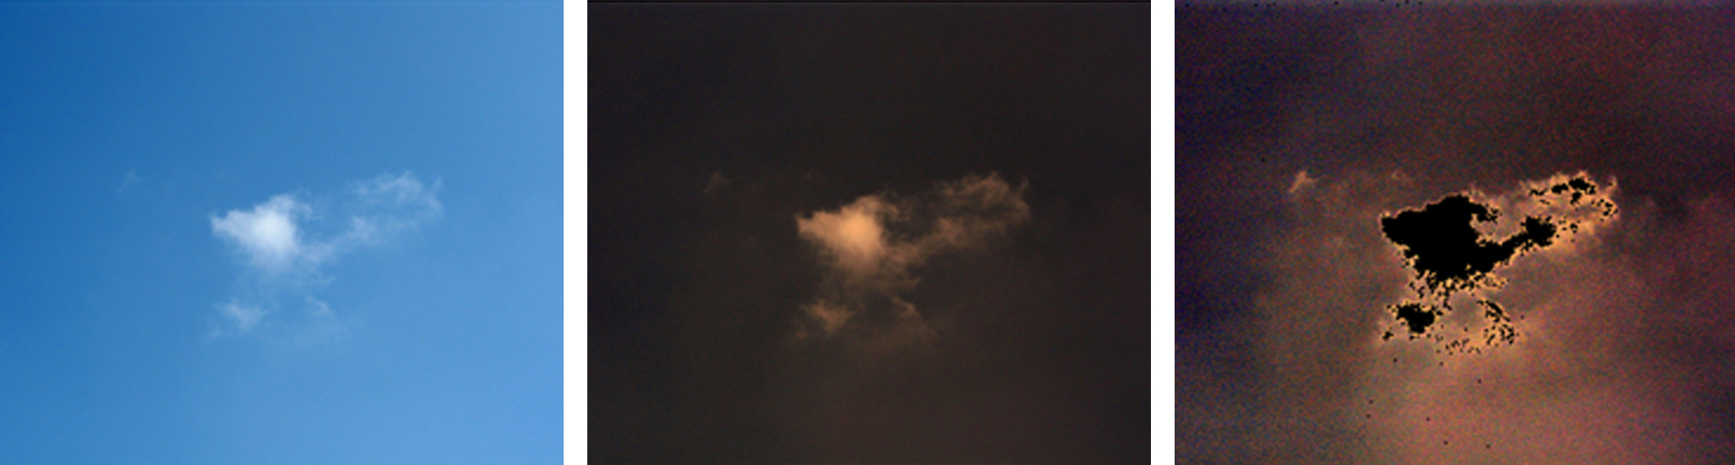
The “twilight” around clouds
What appears as clear sky around a cloud as seen from the ground through a digital camera (left) actually has a twilight zone of light-reflecting particles around it (right).
The blue light from the atmosphere in the original image is first subtracted (middle). The twilight zone is revealed after the darker parts of the image are enhanced (right).
So what is this twilight stuff?
NASA’s Earth Observatory, and Koren et al., 2008

Slide 3
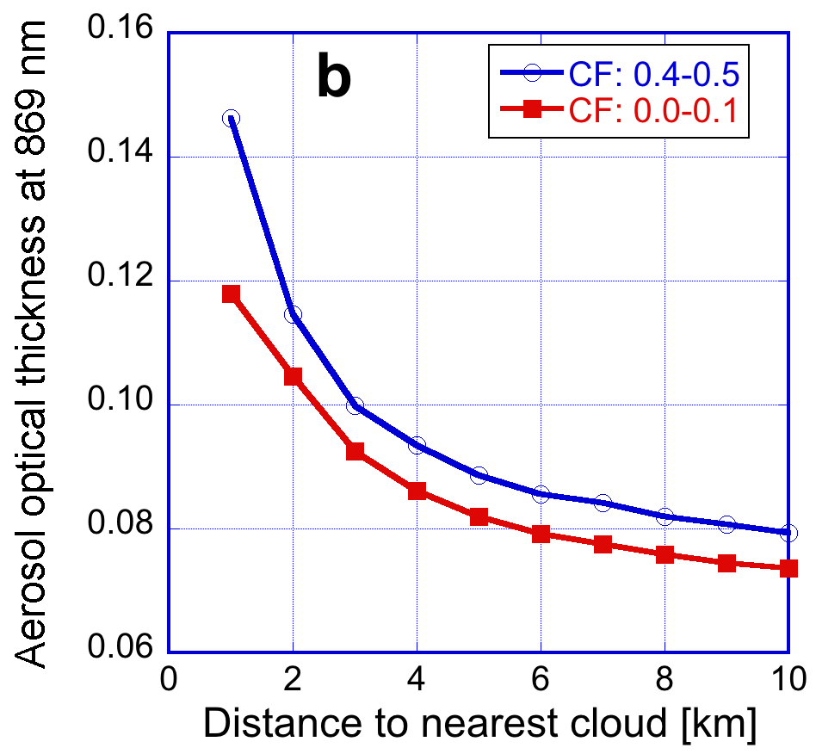
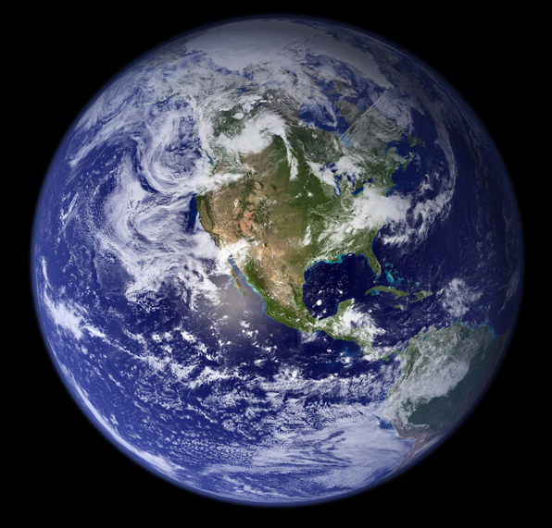
Motivation
from MODIS or CALIPSO: 50-60% of all clear sky pixels are located 5 km or less from all clouds
Regardless of “cloud fraction”
AOT increases closer to cloud
Marshak, Várnai, Wen, Wang et al.,

Slide 4
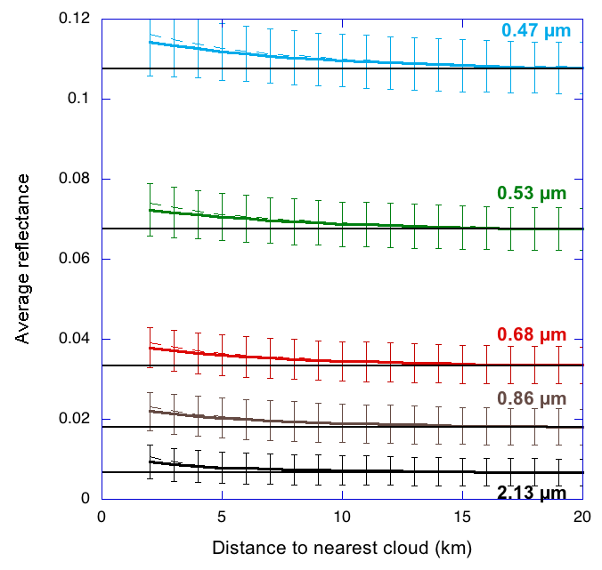
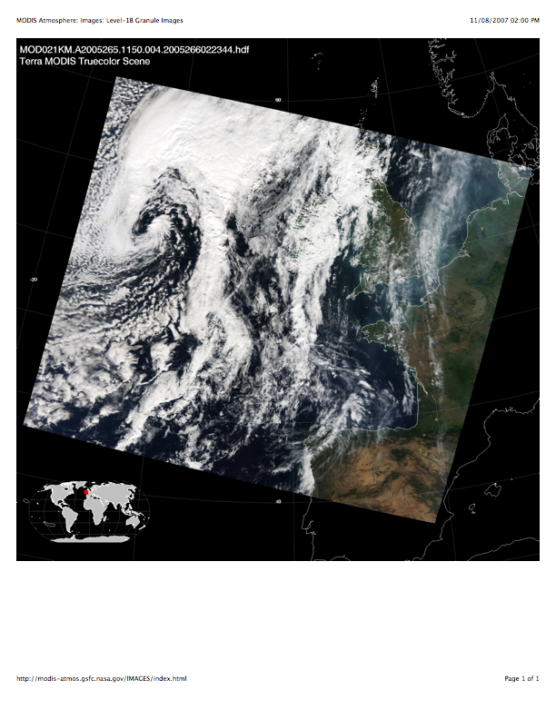
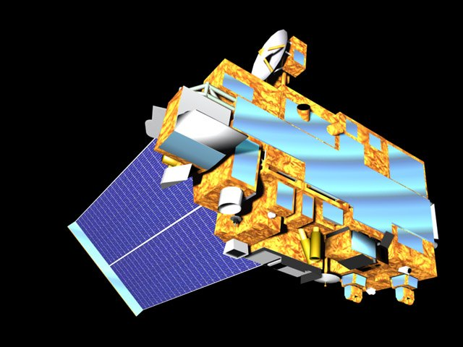
MODIS reflectance increases near clouds
NE Atlantic Ocean, MODIS Terra
2000-2007, September 14-29
Reflectance increase may come from:
Aerosol changes (e.g., swelling in humid air)
Undetected cloud particles
Instrument imperfections
3D radiative effects
0.12
0.10
0.08
0.06
0.04
0.02
0.00
Average Reflectance
0 5 10 15 20
Distance to nearest cloud (km)
Várnai and Marshak (2009)

Slide 5
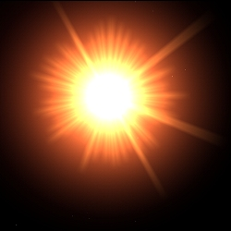
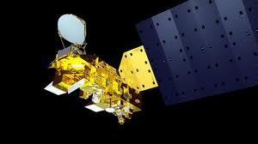

Efforts to account for 3D effects in MODIS
Cloud/Molecular
Pure Aerosol
Cloud/Aerosol
Cloud/Surface
Work led by Marshak, Várnai, Wen, Wang et al.,

Slide 6
Clearly, retrieved AOT is greater near clouds
However, it is not clear yet how much the enhancement comes from:
“real” microphysics, e.g.
  increased hydroscopic aerosol particles,
  new particle production or
  other in-cloud processes.
“artificial” effects, e.g.
  cloud contamination (sub-pixel clouds),
  extra illumination from clouds (a clear pixel in the vicinity of clouds)
  sampling issue
The “artificial” effects may lead to significantly overestimated AOT.
The “real” effects may never be sampled from MODIS, especially within 1-2 km.
Enter: eMAS and SEAC4RS!
Notes:
Also different meteorology
Instrumental issues

Slide 7
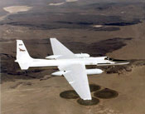
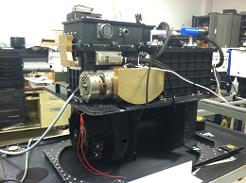
Band | λ (µm) | Δλ (µm)
1 | 0.47 | 0.040
2 | 0.55 | 0.044
3 | 0.66 | 0.053
4 | 0.70 | 0.042
5 | 0.75 | 0.041
6 | 0.83 | 0.042
7 | 0.87 | 0.042
8 | 0.91 | 0.033
9 | 0.95 | 0.046
10 | 1.61 | 0.052
11 | 1.66 | 0.052
12 | 1.72 | 0.050
13 | 1.78 | 0.049
14 | 1.83 | 0.046
15 | 1.88 | 0.045
16 | 1.93 | 0.045
17 | 1.98 | 0.048
18 | 2.03 | 0.048
19 | 2.08 | 0.047
20 | 2.13 | 0.047
21 | 2.18 | 0.047
22 | 2.23 | 0.047
23 | 2.28 | 0.046
24 | 2.33 | 0.047
25 | 2.38 | 0.047
M1 | 3.74 | 0.183
L1 | 6.72 | 0.253
L2 | 7.33 | 0.260
L3 | 8.28 | 0.264
L4 | 8.55 | 0.264
L5 | 9.73 | 0.262
L6 | 10.20 | 0.261
L7 | 11.03 | 0.260
L8 | 12.02 | 0.258
L9 | 12.60 | 0.255
L10 | 13.34 | 0.263
L11 | 13.64 | 0.259
L12 | 13.94 | 0.253
NASA ESD facility imager maintained and operated by the NASA Ames Airborne Sensor Facility.
38 spectral channels (VNIR-LWIR), 50 m nadir spatial resolution and 37 km swath from 20 km altitude (ER-2).
Onboard 2-point blackbody IR cal.
Recently upgraded with a new Stirling-cooled infrared spectrometer.
PI cloud product suite (masking, cloud-top, optical properties) produced with MODIS-like Collection 6 algorithms.
Long history as MAS, back into the 1990s!
Further information: http://mas.arc.nasa.gov
Notes:
.

Slide 8
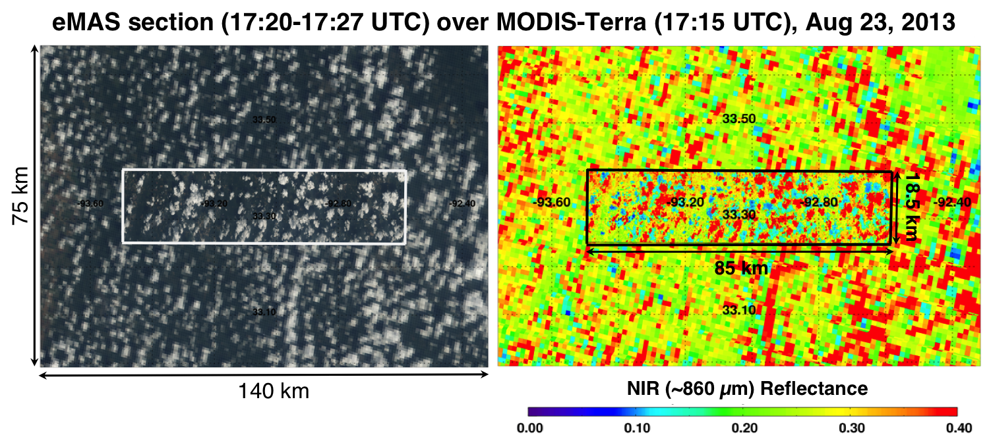
High resolution cloud features in eMAS (under flying MODIS)
Notes:
Left is RGB: Right is NIR channel reflectance.

Slide 9
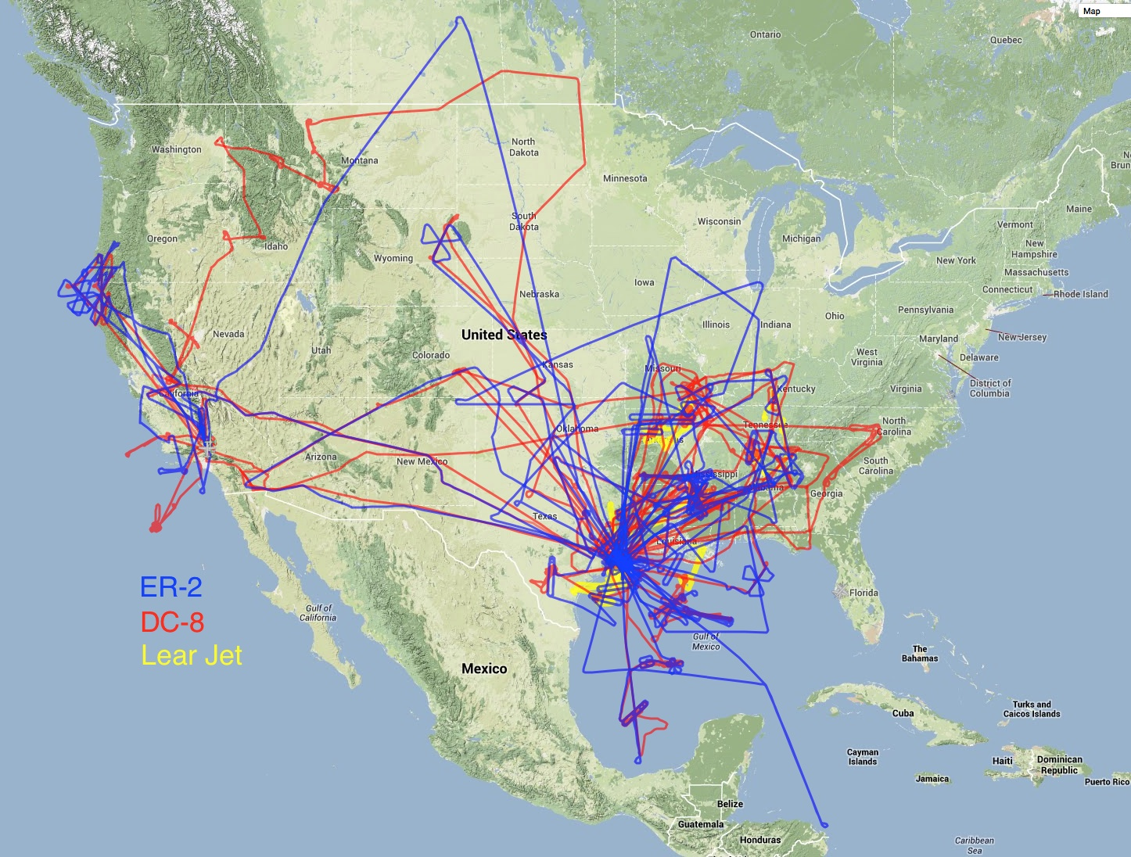
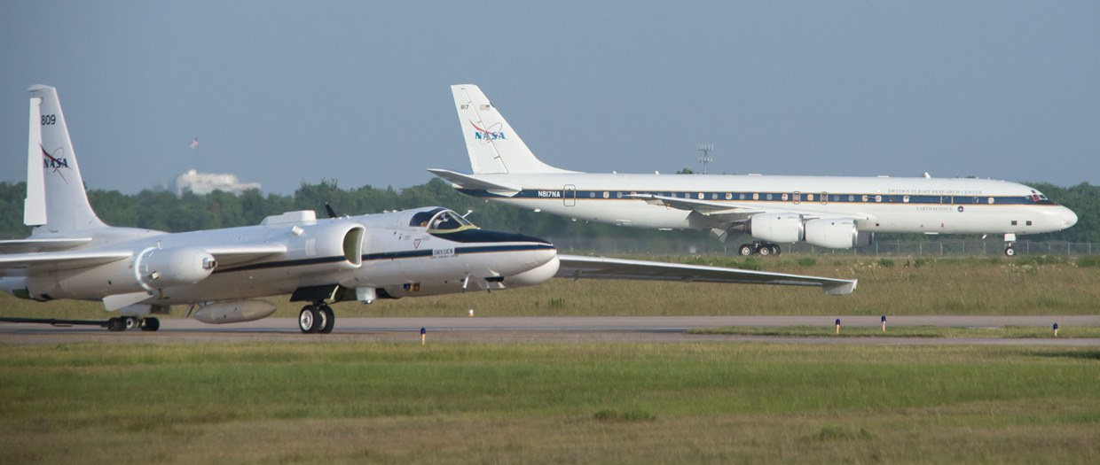

Studies of Emissions & Atmospheric Composition, Clouds and Climate Coupling by Regional Surveys (SEAC⁴RS): August-September 2013
3 Aircraft (including high flying ER-2 with eMAS )
Lots of ground measurements
NASA/NOAA/etc
Lots of lots of science objectives
Co-incident with DISCOVER-AQ (Houston)
http://espo.nasa.gov/missions/seac4rs/

Slide 10
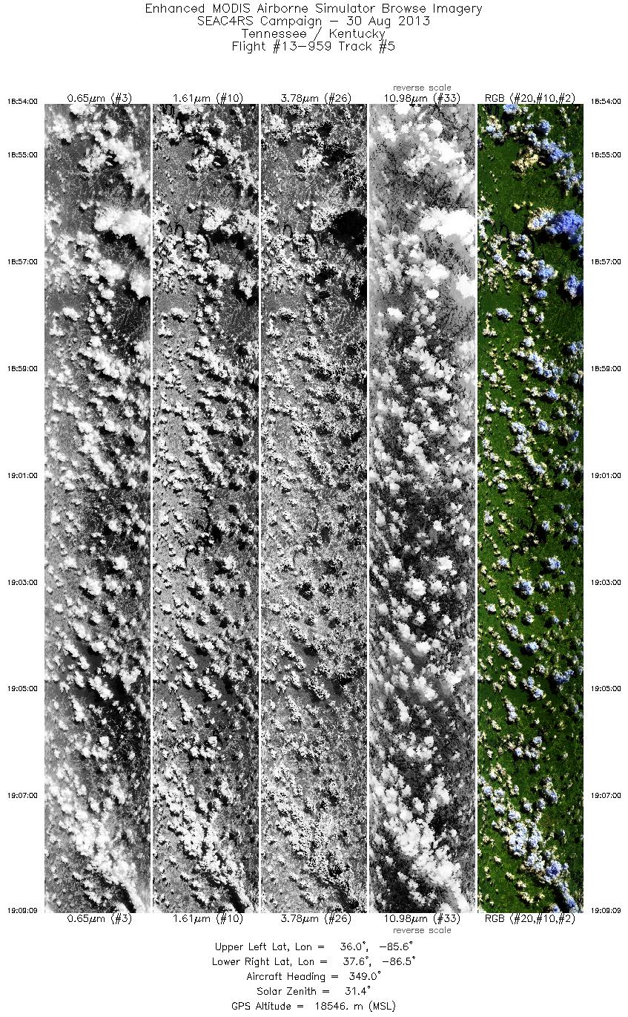
eMAS L1B Browse Imagery (http://mas.arc.nasa.gov)
Many previous campaigns (since 1990’s) including TARFOX, CLAMS, TC4, Milagro, etc

Slide 11
Our ACCDAM project
  MODIS is great for global aerosol/cloud studies, but we miss stuff, especially within 2 km of clouds.
Can we study aerosols and cloud fields at high resolution?
eMAS/MAS has been flying for 20+ years
  Platnick/Arnold/Holz cloud team has performed cloud retrievals
  MAS was used for MODIS aerosol retrieval development (1997)
  But no MAS aerosol retrieval since CLAMS experiment (2001)
  → resurrect aerosol retrieval for MAS
SEAC4RS, with its wealth of corroborative data, is the place to start
Platnick/Arnold/Holz/ARC groups have worked hard on calibration
Aerosol retrievals will be added to SEAC4RS and eMAS archives
Validate/interpet using other SEAC4RS data (AERONET, 4-STAR, CPL, etc), along with MODIS/VIIRS/etc satellite overpasses
With aerosol retrieval, we can do research at high resolution (co-Is = Marshak: 3D and Wilcox: Aerosol/Cloud)
If successful for SEAC4RS, can we go back and reprocess 20+ years?

Slide 12
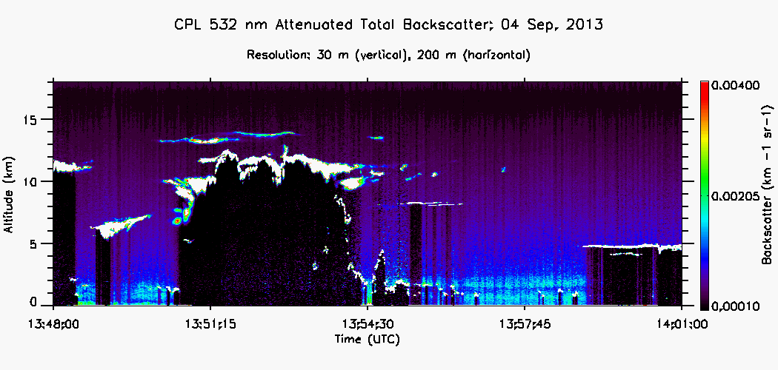
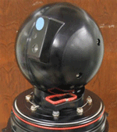
Examples of collaborative and validation data
Cloud Physics Lidar
(CPL)
also flying on ER-2
Can help evaluate cloud mask, aerosol and cloud layers
CPL
John Yorks
AERONET / 4STAR sunphotometers
Including high-density DRAGON over Houston
AERONET
Holben et al.,

Slide 13
MODIS Dark target (DT) retrieval
eMAS ≈ MODIS bands used for DT aerosol
  Yes: 0.47, 0.55, 0.65, 0.86, 1.6 and 2.1 μm.
  No: 1.24 μm
  Slight differences in filter functions to account for
eMAS ≠ MODIS bands used for DT cloud mask
  Cirrus detection: 1.38 μm MODIS / 1.88 μm on eMAS
Otherwise, eMAS algorithm ≈ MODIS algorithm
  For now, we assume all mask thresholds are the same.
  Instead of grouping 500 m / 1 km pixels for 10 km resolution, we group 50 m pixels for 500 m resolution
Data processed locally at GSFC, using latest (Apr 2015 Calibration)
Note: No 0.41 μm channel (cannot do Deep Blue), and no consistent surface target sampling (cannot do MAIAC)
so DT is what we can do.

Slide 14
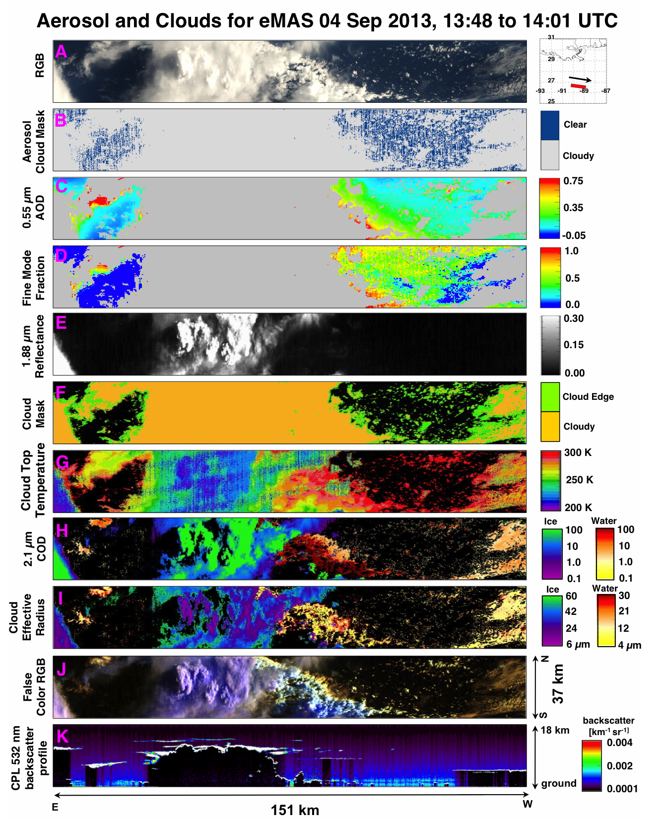
Our product goal: Example: Sep 4, 2013
Cloud AND Aerosol retrievals!
Notes:
The panel on the left is from Cloud Physics Lidar (CPL also flying on ER-2). The next five panels are from Platnick cloud retrievals, the panels on the right are aerosol retrieval, with RGB on the right.

Slide 15
Some examples from SEAC⁴RS
The following examples represent some interesting cases/issues
For images, pieces of flight segments have been split into approx 5 minute sections, or approximately 120 x 37 km sections.
CPL cloud detection drawn along nadir (either in white or black)
Aerosol cloud mask uses 3x3 spatial variability.
Very little validation yet. But it is time to get started!

Slide 16
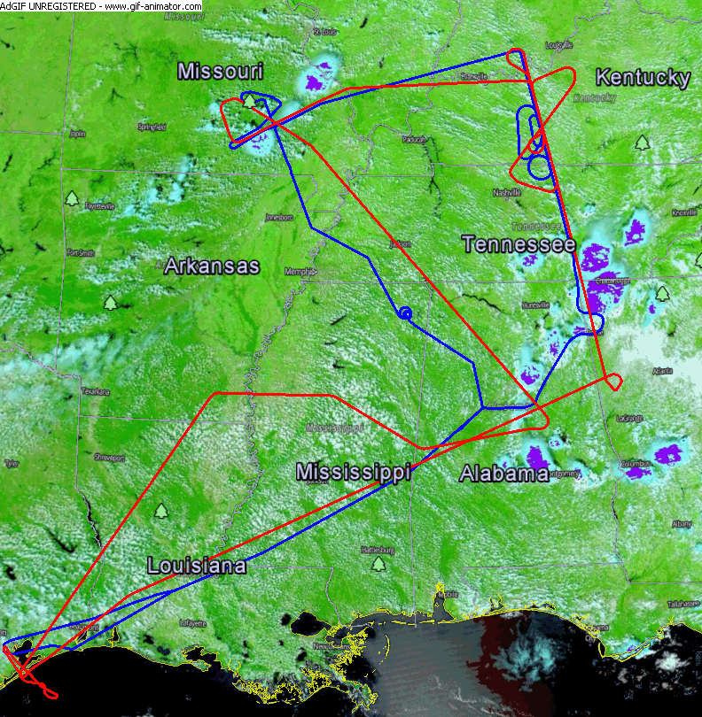
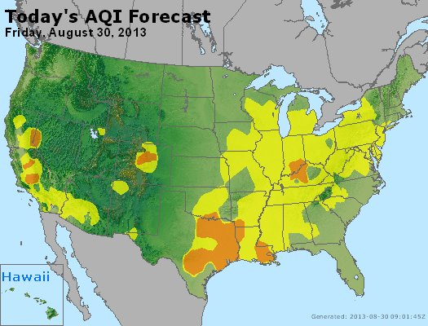
August 30, 2013 w/AOTs
Cumulus and Pollution
Mammoth Cave (0.24)
Mingo (0.13)
Huntsville (0.47)
Yorkville (0. 5)
Leland (0.5)
Birmingham (4star-)
Centreville x2
(0.4-0.5)
From Jeff Reid
Notes:
This slide is from Jeff Reid’s “pollution day”. Red tracks are ER-2.

Slide 17
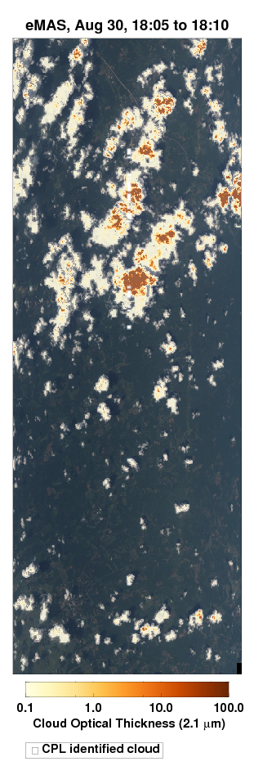
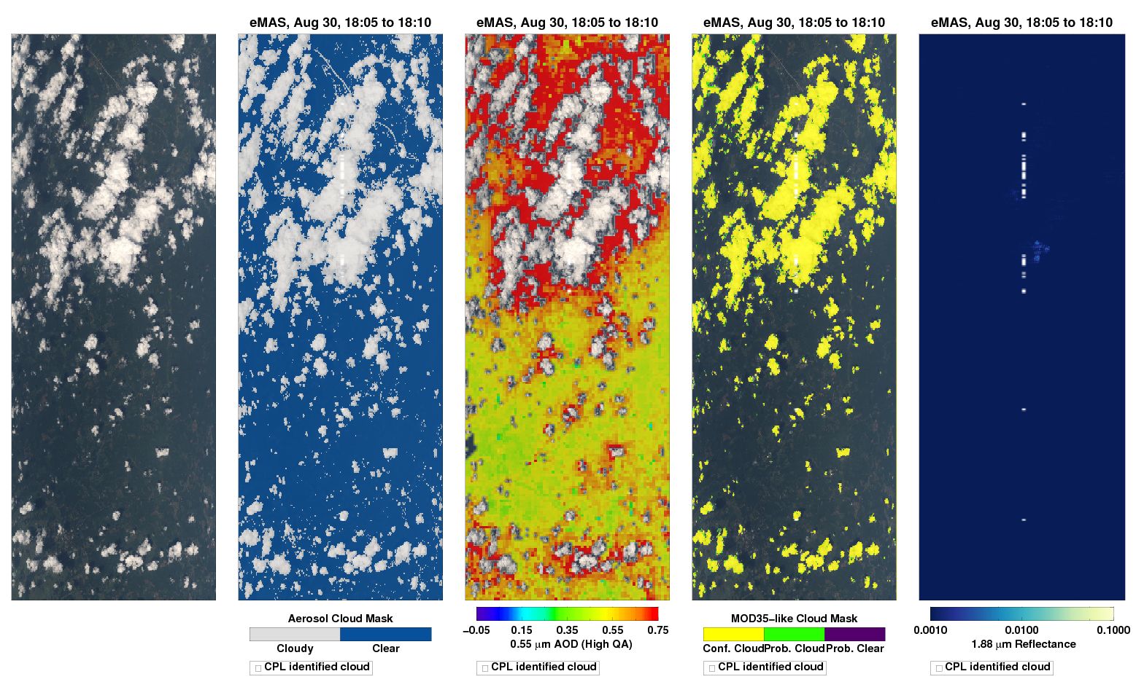
Retrieval near Centerville (Aug 30 @ 18:08)
AERONET observed 0.4-0.5
RGB Aerosol Cloud Mask AOD COD 1.88 μm Reflect
CPL cloud
Segment is 18:05-18:10
0.0 0.35 0.75
Notes:
Greenish yellow color is 0.4 AOD. Note huge enhancement near bigger clouds,

Slide 18
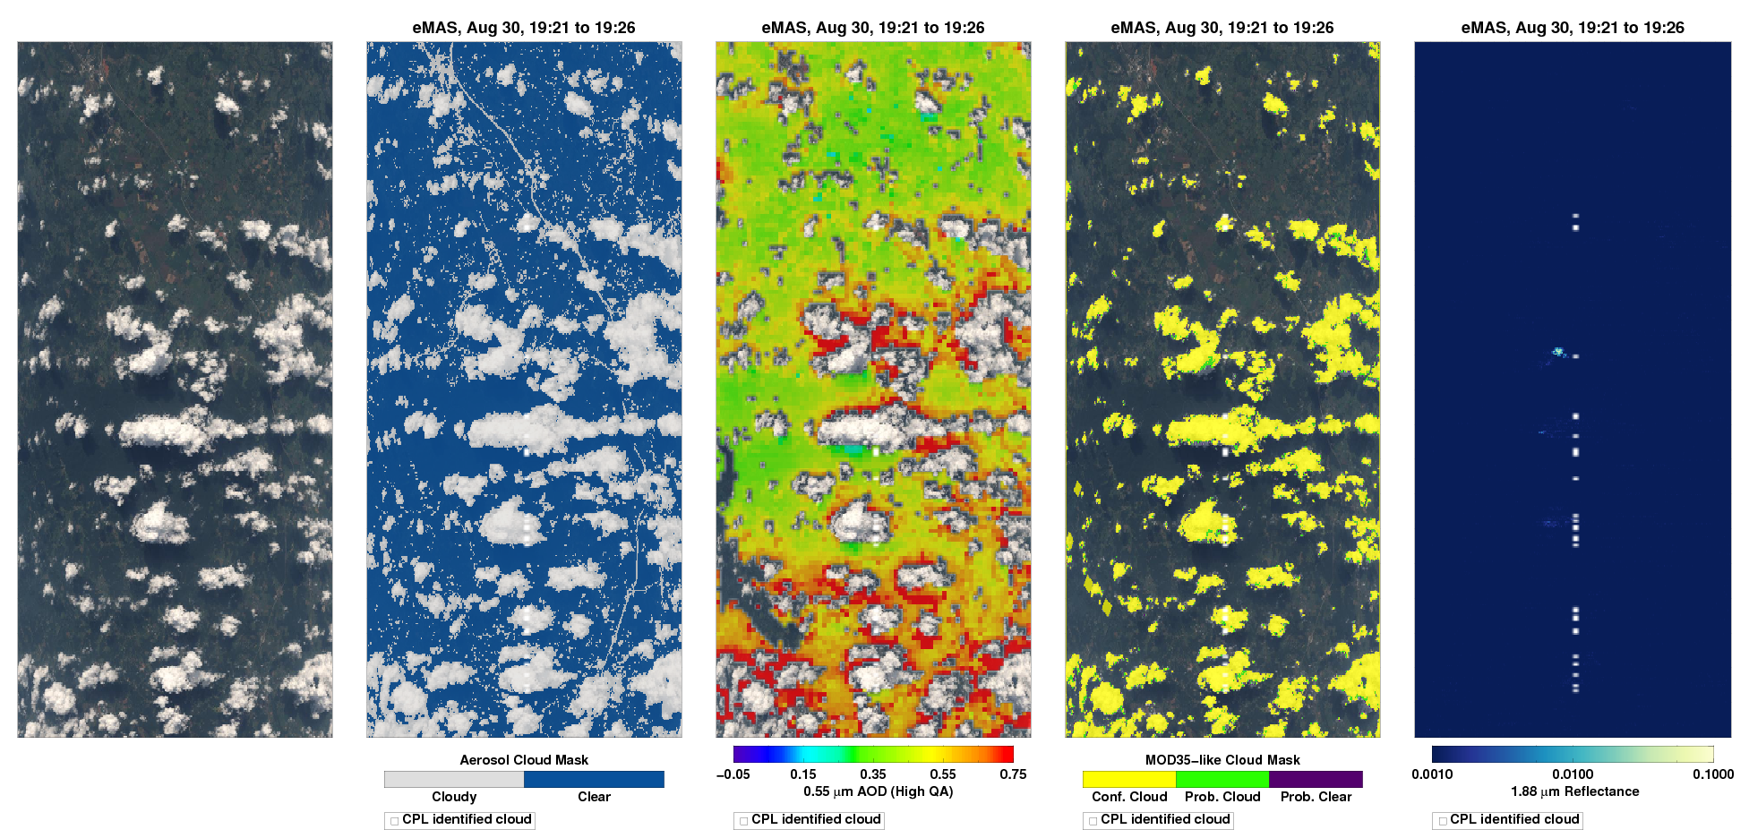
Retrieval near Mammoth Cave (Aug 30 @ 19:24)
AERONET observed 0.25
RGB Aerosol Cloud Mask AOD Wisc. Cloud Mask 1.88 μm Reflect
Segment is 19:21-19:26
0.0 0.35 0.75
Notes:
Green color is 0.3 AOD. Mammoth Cave should be closer to top image. Note huge enhancement near bigger clouds, BUT THESE ARE NOT CLOUDS!

Slide 19
More cases

Slide 20
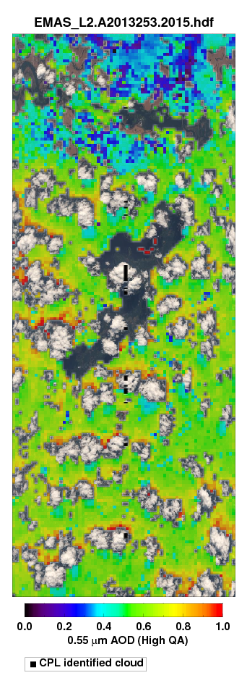
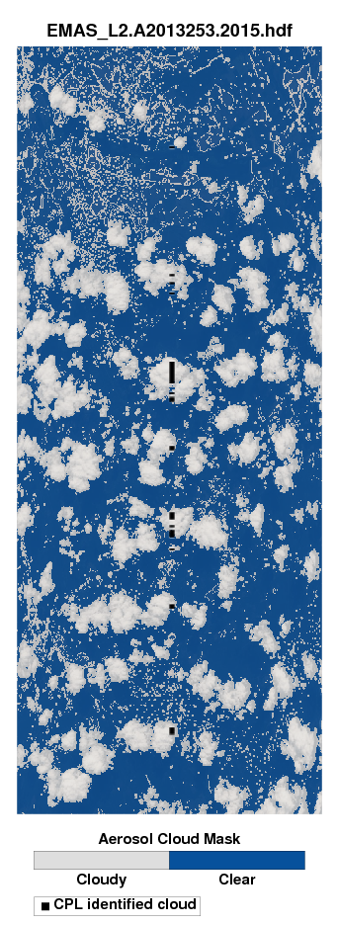
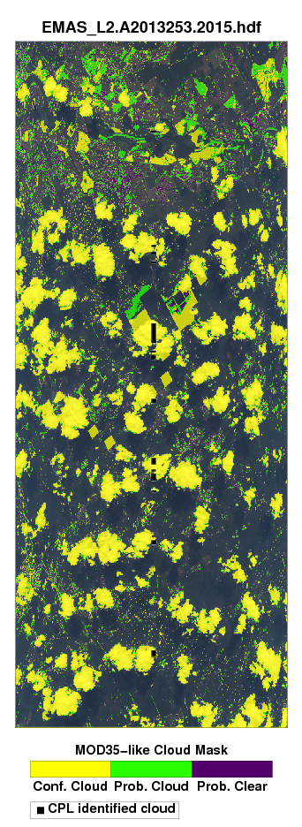
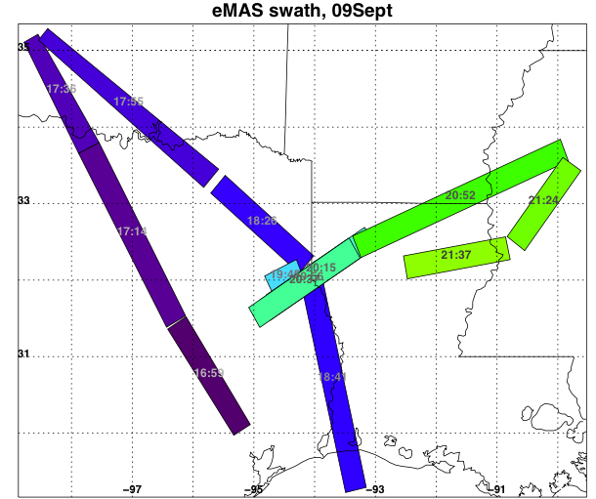
Popcorn clouds from Sep 9
AOD Aerosol/Cloud Wisc Cloud Mask
Sep 09
Note sun direction and 3D effects?
0.0 0.5 1.0
Notes:
Note, only a few CPL identified clouds.

Slide 21
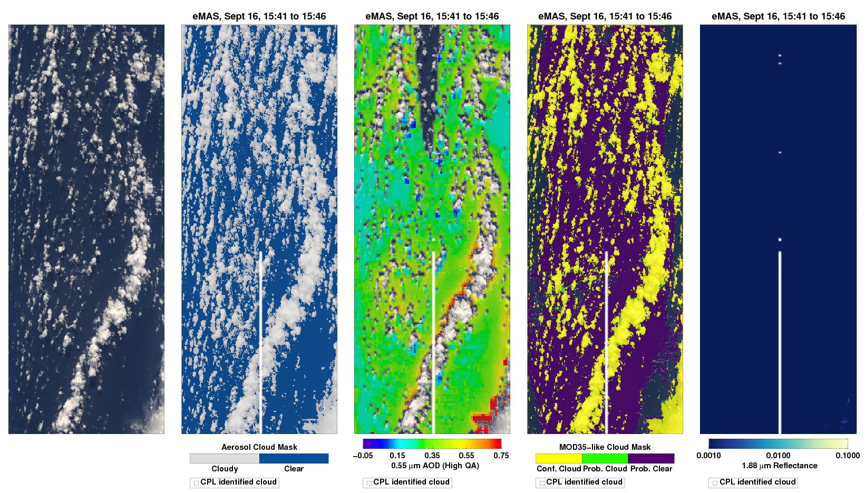
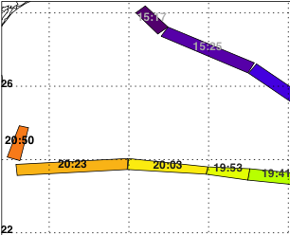
Cloud fields on Sept 16, Over the Gulf (Water)
RGB Aerosol Cloud Mask AOD Wisc. Cloud Mask 1.88 μm Reflect
Sep 16
0.0 0.35 0.75
Notes:
Sep 16th, over water. The missing AOD is due to glint mask.

Slide 22
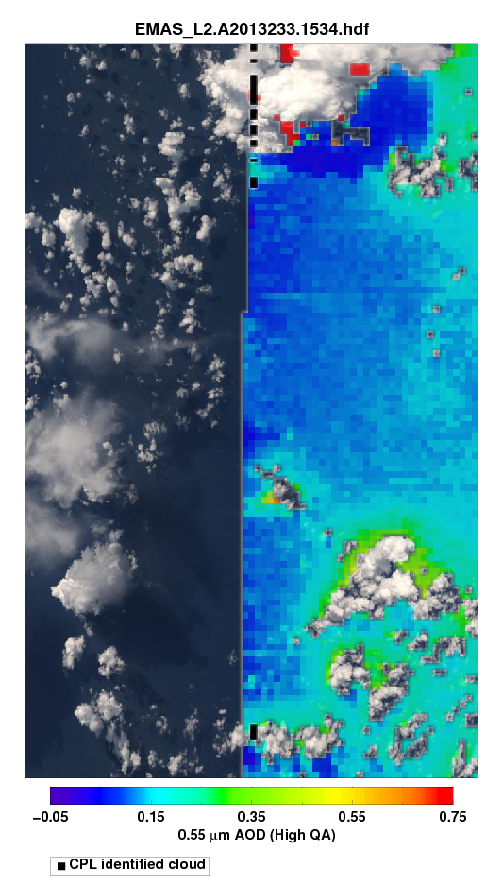
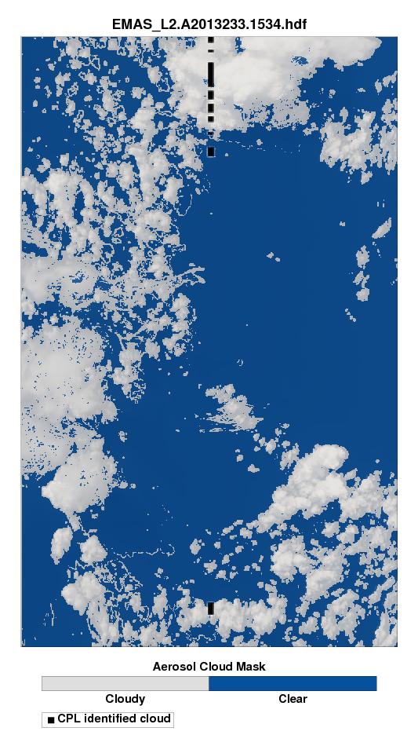
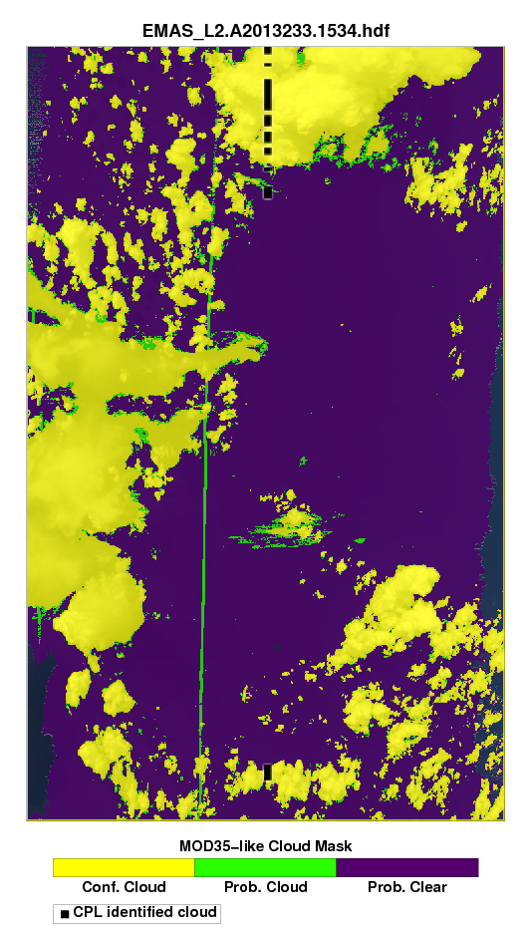
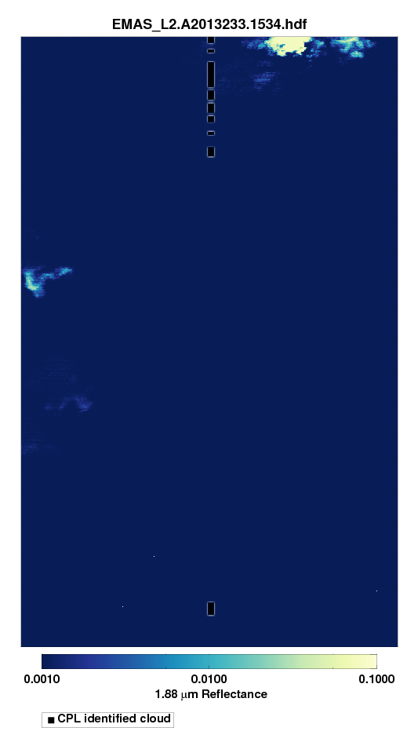
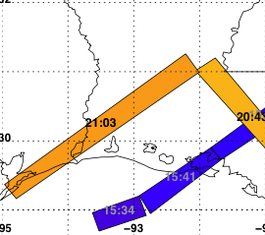
Aug 21, Over the Gulf (Water)
RGB/AOD Aerosol Cloud Mask Wisc. Cloud Mask 1.88 μm Reflect
Aug 21
0.0 0.35 0.75
Notes:
Aug 21, over water, glint mask so no AOD retrieval

Slide 23
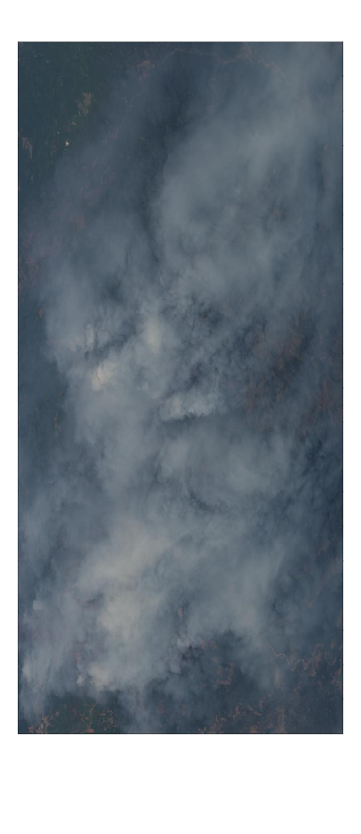
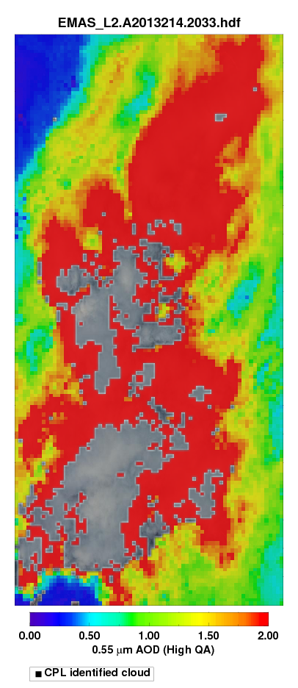
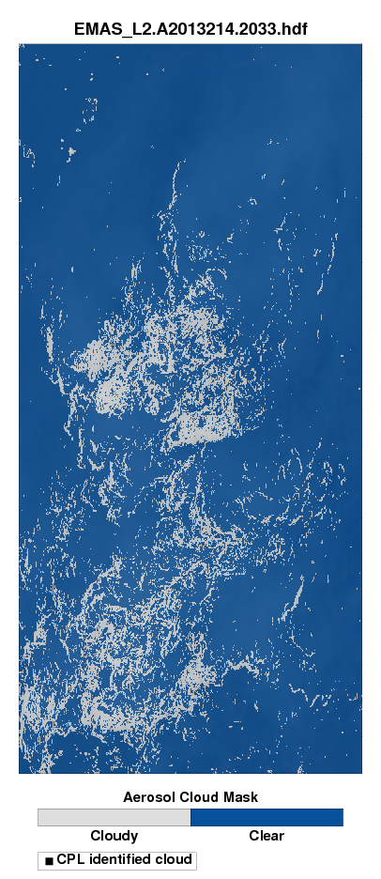
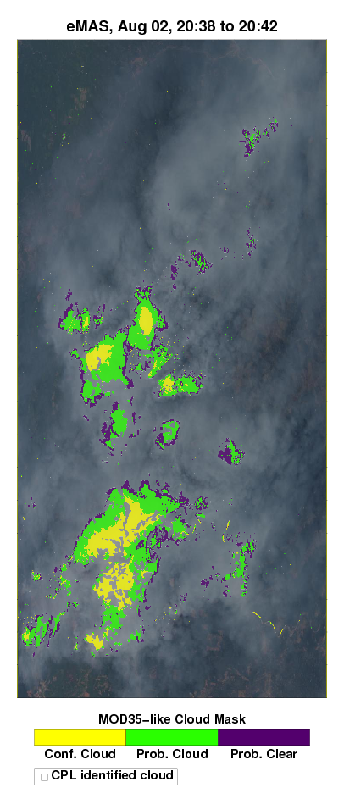
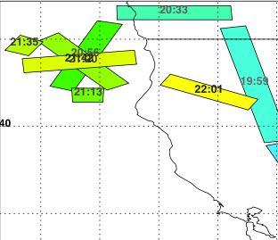
Aug 2, Fire over CA/OR (around 21 UTC)
RGB AOD Aerosol Cloud Mask Wisc. Cloud Mask
Aug 2
0.0 0.5 1.0 1.5 2.0
Notes:
AOD > 2.0.

Slide 24
Interesting things/caveats, etc

Slide 25
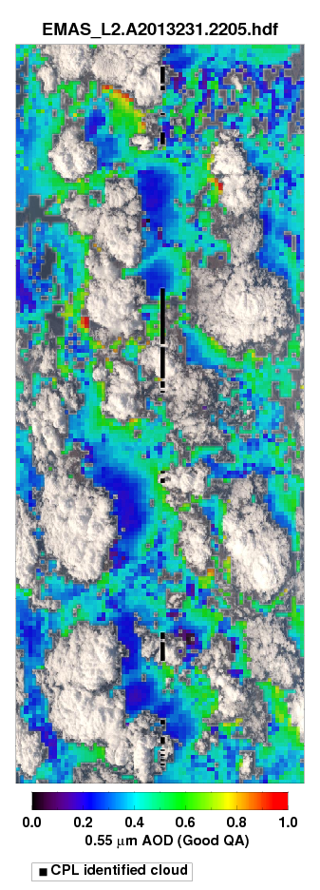
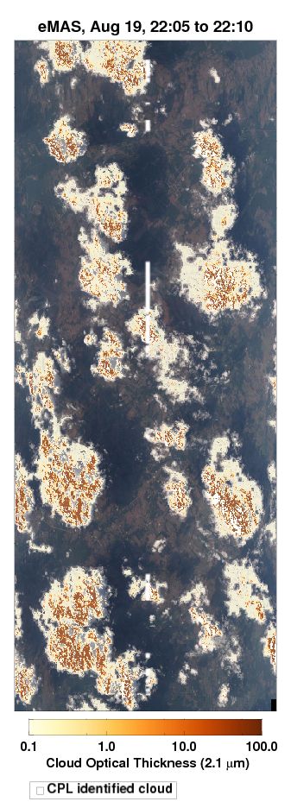
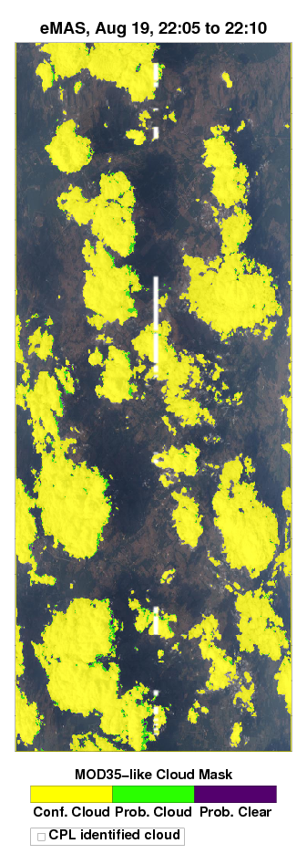
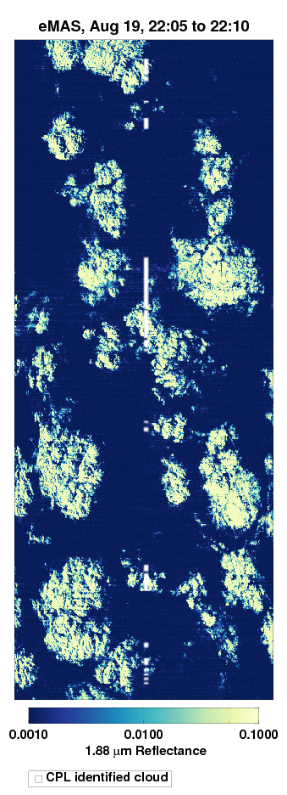
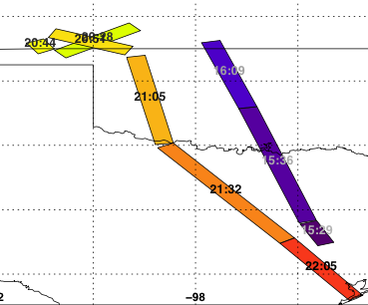
Impressive Cloud Shadows from Aug 19
AOD COD Wisc Cloud Mask 1.88 reflectance
Aug 19
0.0 0.5 1.0
Notes:
Aug 19, 2015. Bigger cumulus day, images taken late in day (3pm local time). Note cloud shadows! Large cloud optical depths

Slide 26
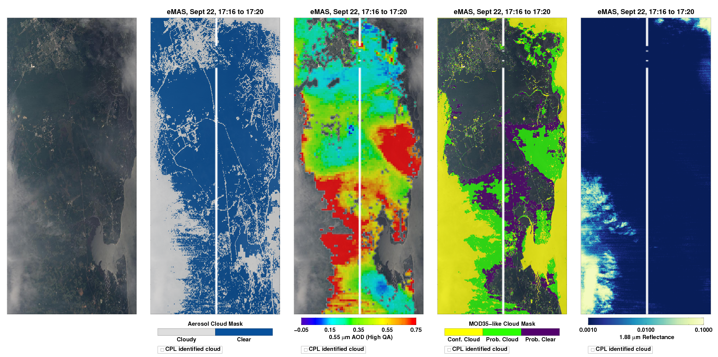
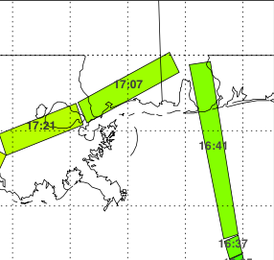
Cirrus contamination (Sep 22)
RGB Aerosol Cloud Mask AOD Wisc. Cloud Mask 1.88 μm Reflect
Sep 22
Segment is 17:16 – 17:20
0.0 0.35 0.75
Notes:
Sep 22, over land and water. Wisc cloud mask shows probably cloud, and we are retrieving enhanced AOD.

Slide 27
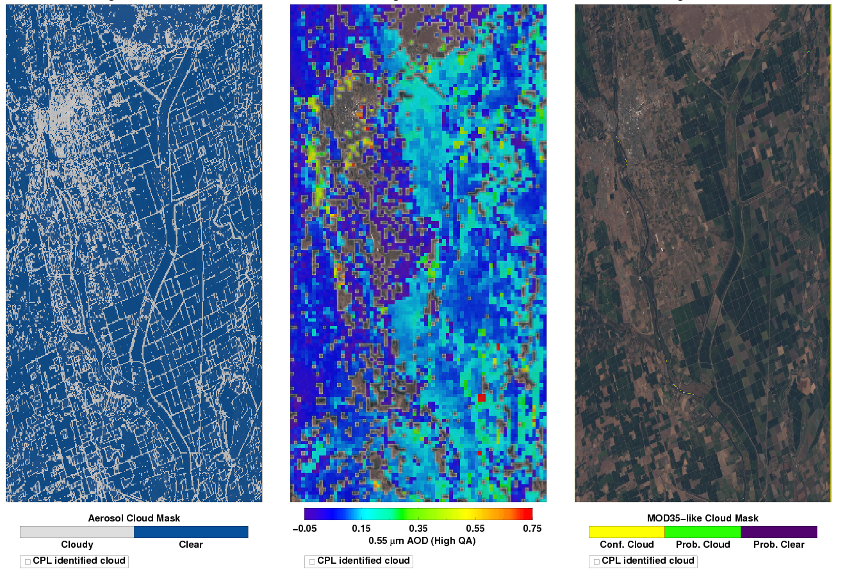
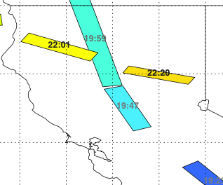

August 2 Fresno and ‘burbs and farms: Note 3x3 aerosol cloud mask finds roads
Aerosol Cloud Mask AOD Wisc. Cloud Mask over RGB
Aug 2
0.0 0.35 0.75

Slide 28
A “validation” of sorts

Slide 29
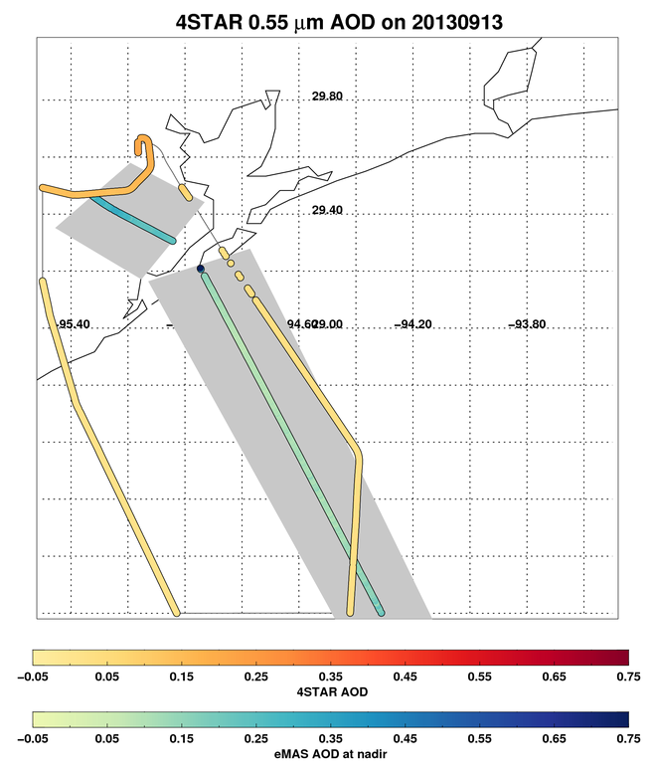
Comparison with 4-STAR and AERONET: Sept 13
4-STAR
-0.05 0.05 0.15 0.25 0.35 0.45 0.55 0.65 0.75
eMAS at Nadir

Slide 30
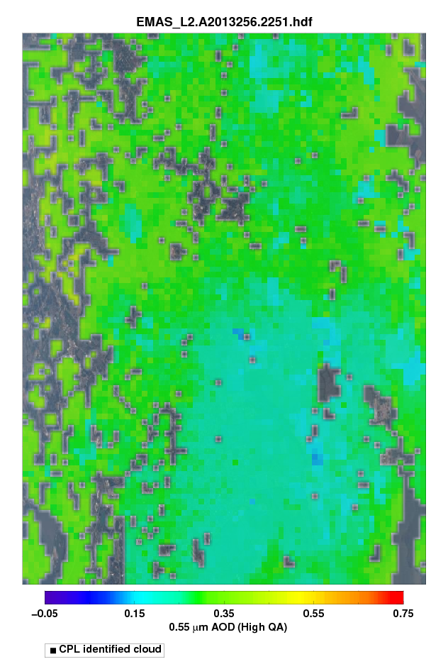
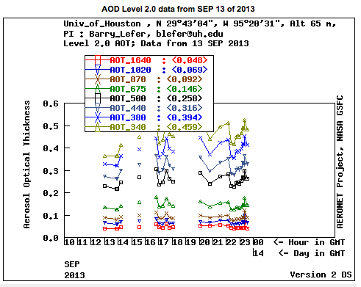
eMAS AOD at 22:51 UTC
Extrapolated AOD = 0.26
eMAS mean AOD = 0.28
AERONET at Houston = 0.25
0.0 0.35 0.75
Notes:
550 nm Aeronet AOD at 22:51 = 0.205

Slide 31
Summary/So far
MODIS/VIIRS satellite data are limited in quantifying aerosols close to clouds due to ~1km spatial resolution.
After more than a decade of dormancy, the MODIS Dark-target algorithm has been ported to process MAS at ~50 m resolution.
We applied to well-calibrated eMAS data during SEAC⁴RS, and have derived AOD
We see large AOD enhancements close to clouds (<5 km, and especially <2 km).
Although we still have issues in relating to cirrus cloud and surface masking, these AOD enhancements are consistent with expectation
Comparison with AERONET/4-STAR, far from clouds, suggests that eMAS AODs are “in the ball park”

Slide 32
Summary/Next steps (1)
Develop quick-looks and data that will be added to eMAS and SEAC4RS archives (including co-location, state boundary, etc)
Collocate with AERONET and other sunphotometer data. Also with Terra/Aqua/VIIRS data – and attempt to “validate” within expected error envelopes.
Evaluate other DT-derived aerosol properties (e.g. Angstrom, size, quality assurance)

Slide 33
Summary/Next steps (2)
Marshak/Varnai/Wen team will do magic as related to 3D corrections, especially in cumulus fields.
Wilcox/student team will do magic in regards to modeling and analyzing the aerosol-cloud interactions for specific cases
Participate/collaborate with other SEAC4RS teams, such as Aug 19 case studies.
Think about applying the algorithm to previous campaigns, but knowing the MAS calibrations are likely not as good.

