Slide 1

Modelling global atmospheric iodine.
Tomás Sherwen, Mat Evans, Lucy Carpenter
Wolfson Atmospheric Chemistry Laboratories, University of York, UK
CAST Science team.
Rainer Volkamer^{(c)}, Theodore Koenig^{(c)}, Barbara Dix^{(c)}, Carlos Ordonez^{(d)}, Alfonso Saiz-Lopez^{(d)}
b National Centre for Atmospheric Science (NCAS) , Department of Chemistry, University of York, UK
c Cooperative Institute for Research in Environmental Sciences (CIRES), Department of Chemistry and Biochemistry, University of Colorado, CO, USA
d Atmospheric Chemistry and Climate Group (AC2), Instituto de Química Física Rocasolano, CSIC, Madrid, Spain

Slide 2
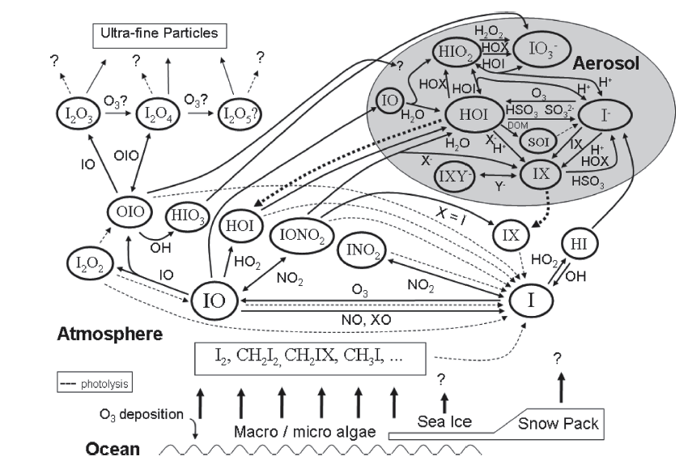
Tropospheric Iodine
Image: Saiz-Lopez et al., 2012
HOI
Notes:
Talk through the system
Emission of I containing species
Photolysed to I
Steady state
2nd’dy reactions
Het loss and deposition.

Slide 3
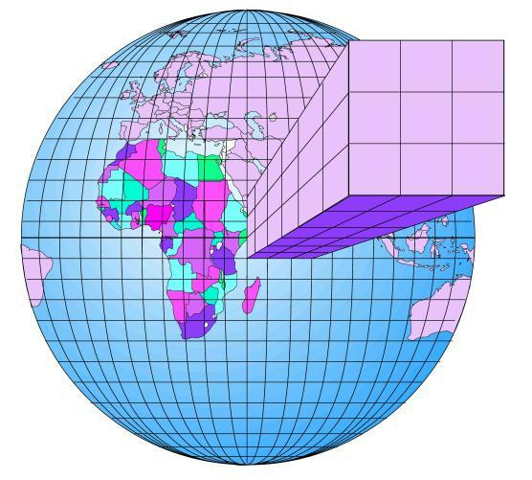
GEOS-Chem
GEOS-Chem v9-2
Standard 66 tracers
Chemistry ~270 reactions
47 Levels up to ~80 km
Bromine chemistry scheme (Parrella, 2012)
NB Not with Johan’s updates
New work included emissions, chemistry, deposition of I

Slide 4
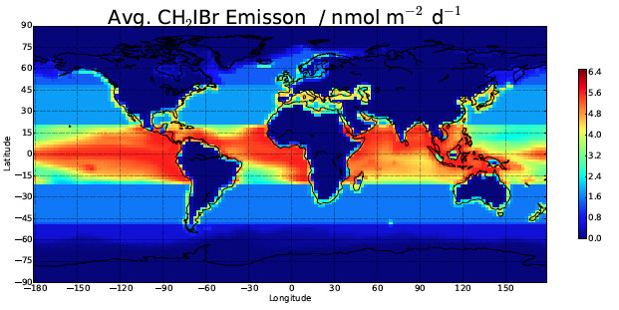
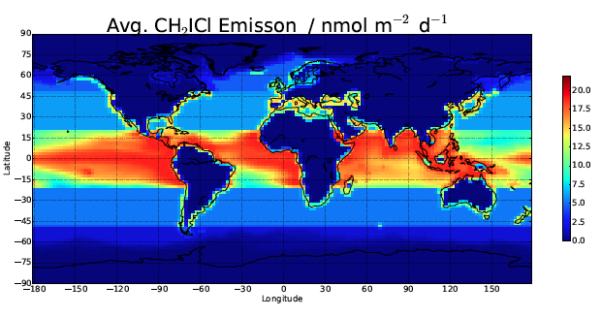
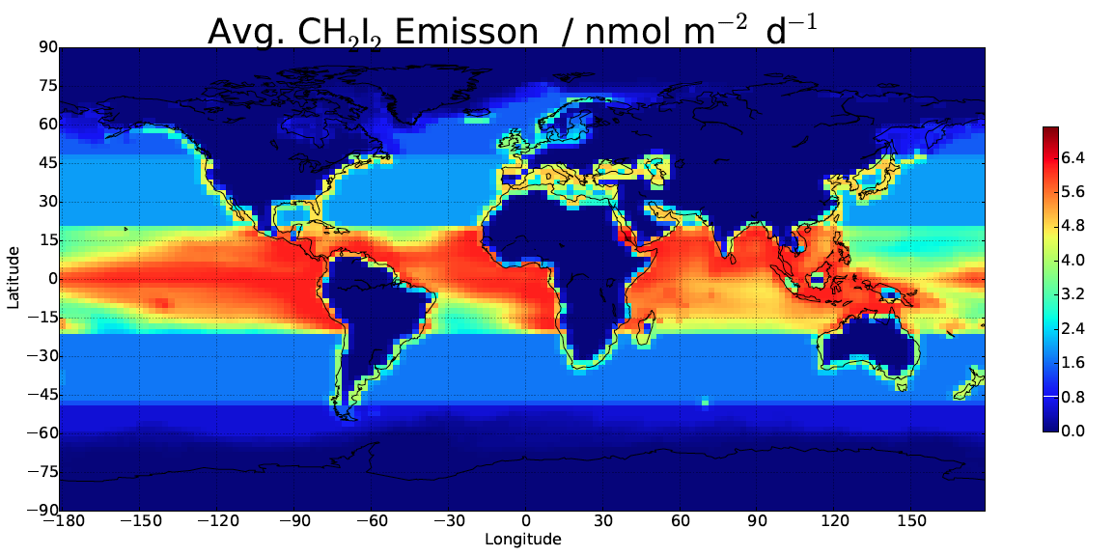
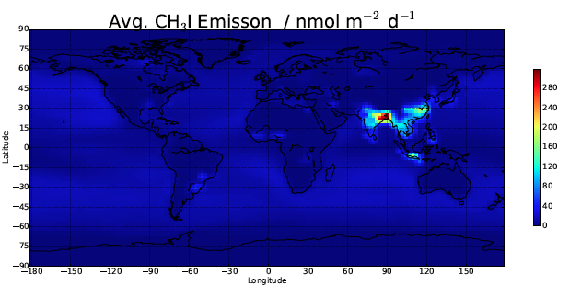
Organic emissions
Ordonez et al., 2012

Slide 5
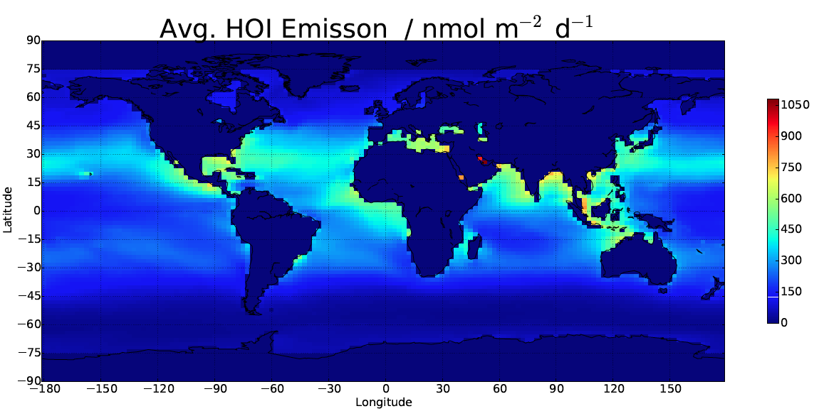
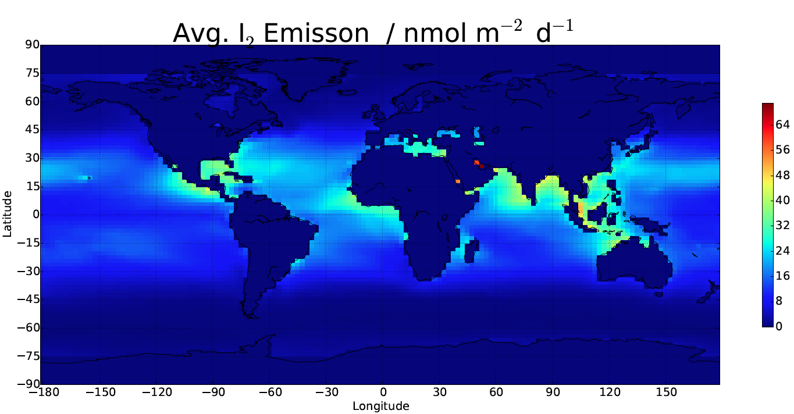
Inorganic emissions
Ocean emission of HOI and I₂
(Carpenter et al., 2013)
Parameterized using O₃, 10m wind, oceanic iodide from SST
(Chance et al., 2014)
HOI
(nmol m⁻² day⁻¹)
I₂
(nmol m⁻² day⁻¹)

Slide 6
Chemistry
HOI

Slide 7
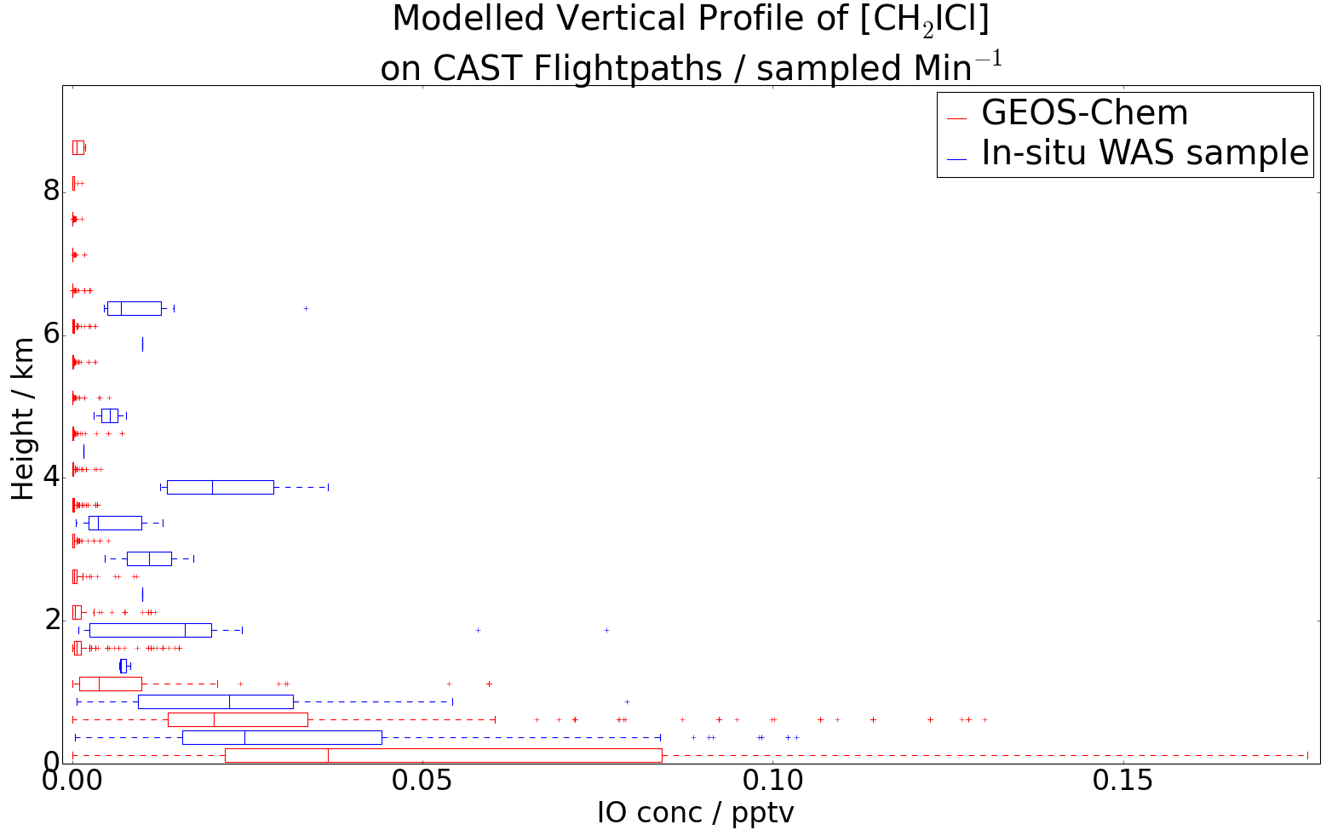
Precursor gases: CH₂ICl
CH₂ICl

Slide 8
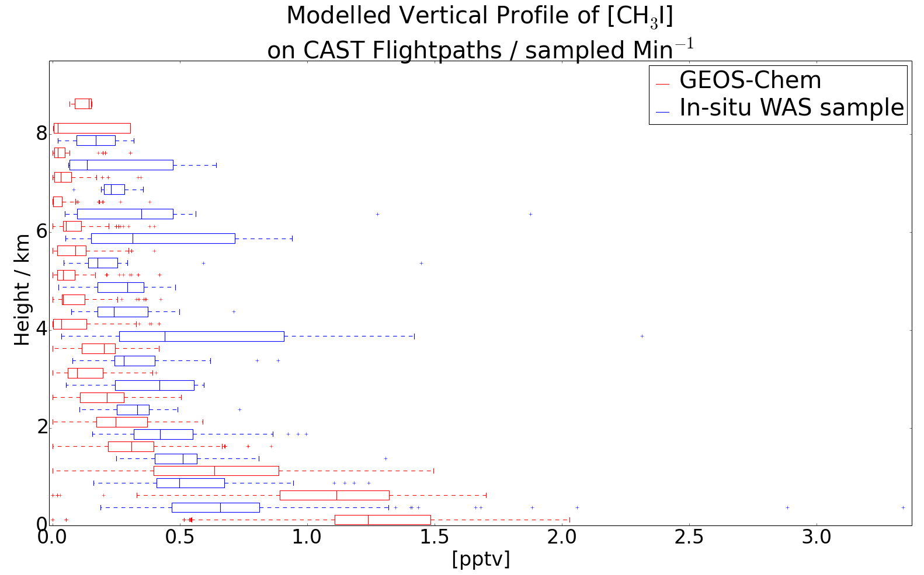
Precursor gases: CH₃I
CH₃I

Slide 9
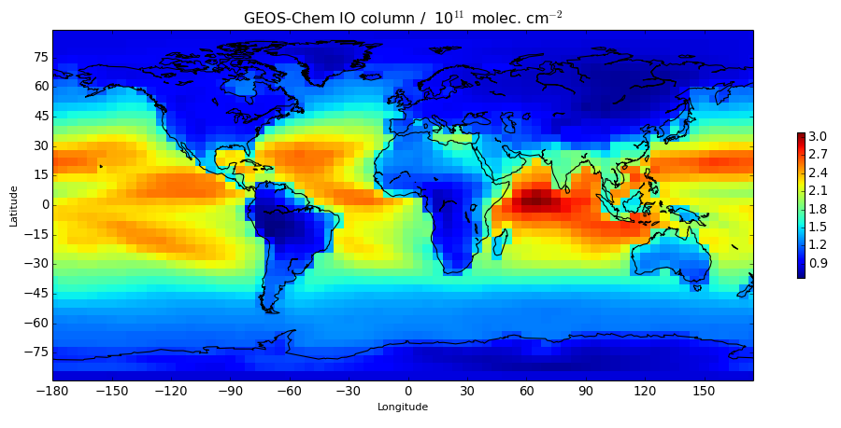
Column IO

Slide 10
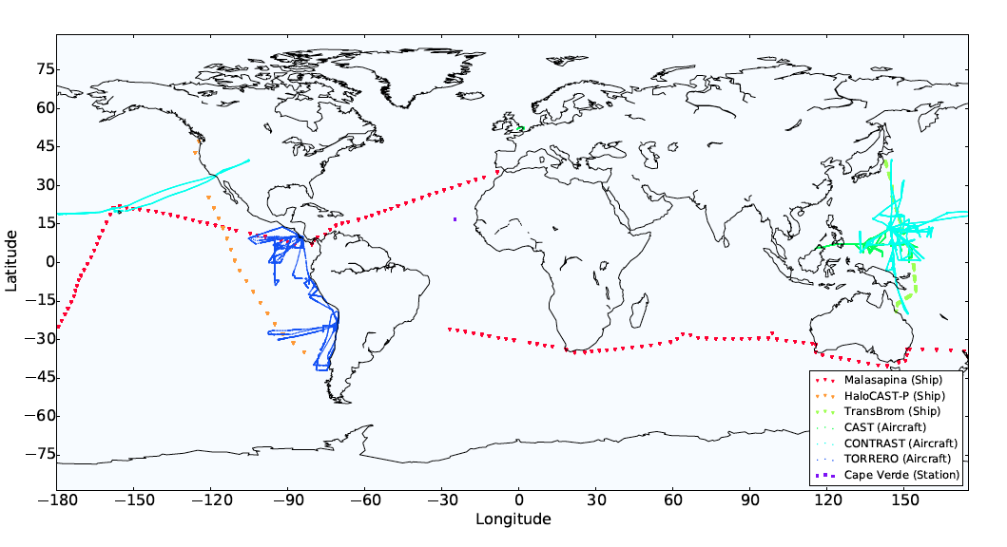
Observations Reactive Iodine

Slide 11
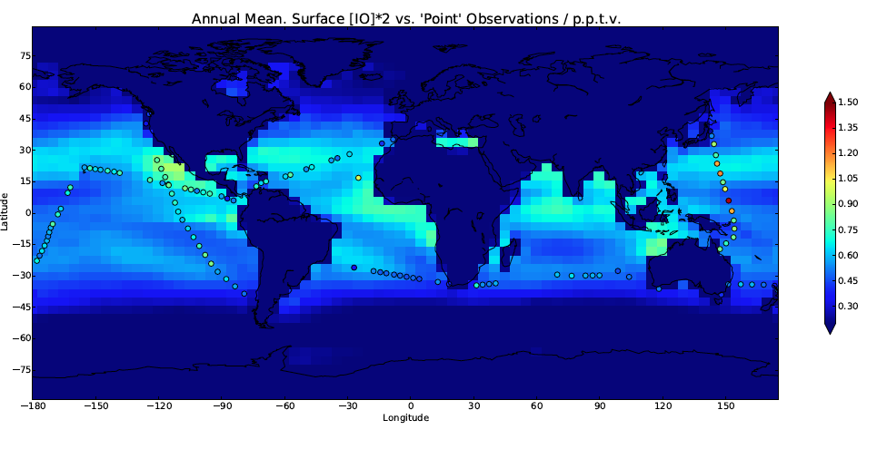
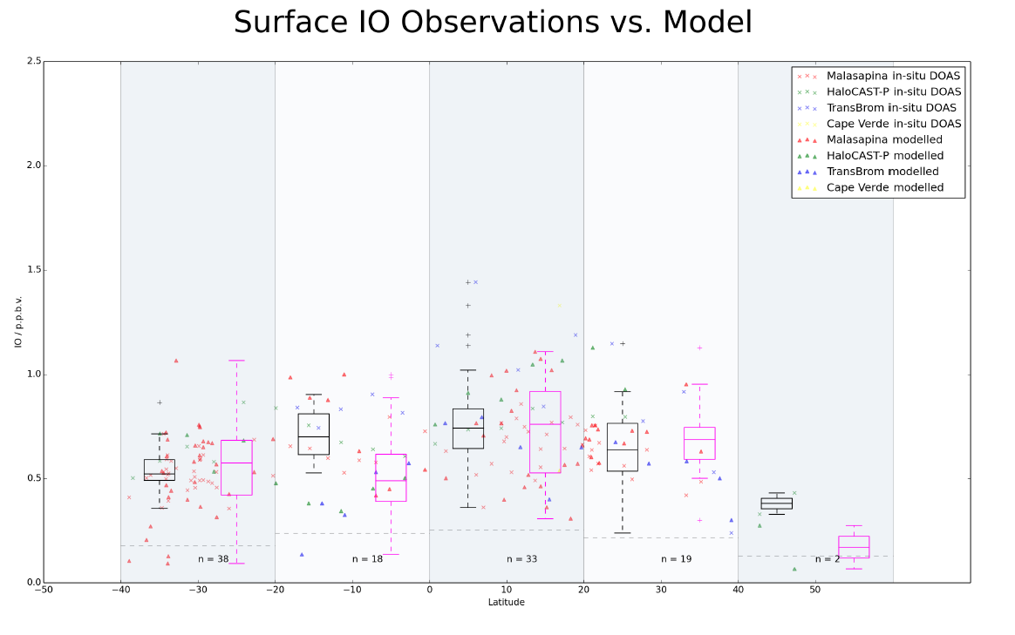
Surface IO
2
Model
Model
Model
Model
Model
Measurements
Measurements
Measurements
Measurements
Measurements
IO (pptv)
1
0
Latitude
Notes:
- Atlantic: we do ~okay on these comparisons… with 0.6-7 pptv at Cape Verde (observations of order ~1pptv) => use larger CV dataset… couple of weeks?
- LARGER LABELS

Slide 12
Vertical IO TORERO

Slide 13
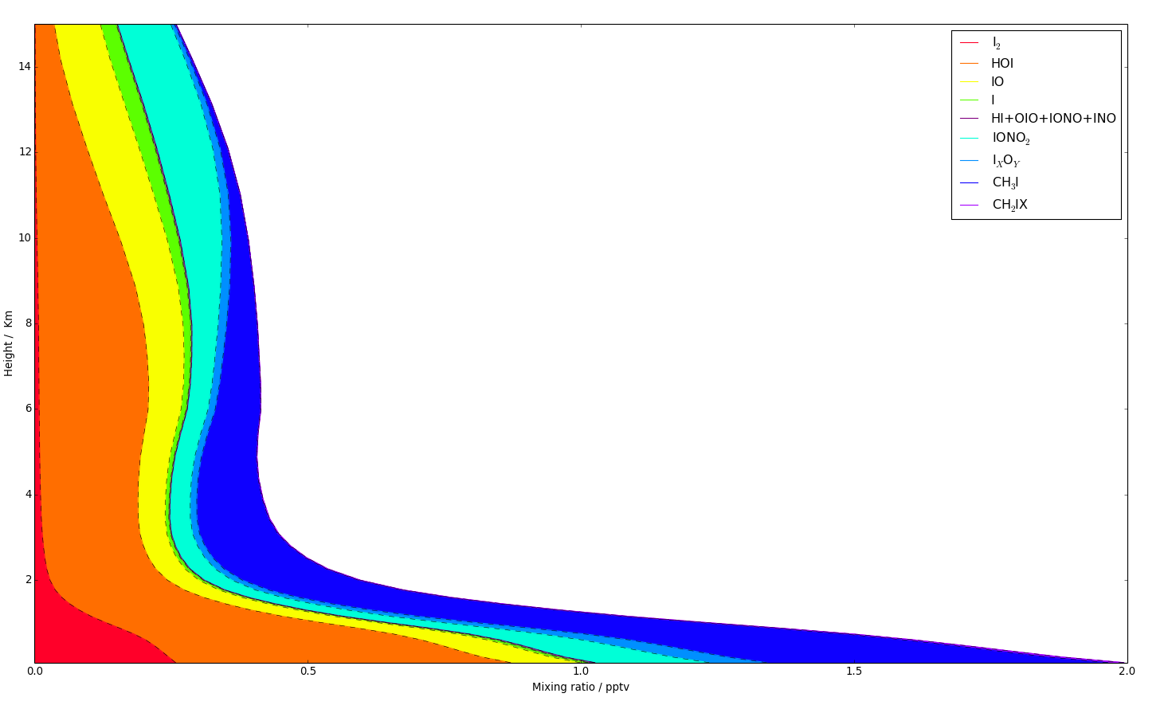
Vertical iodine composition
IONO2
IO
HOI
CH₃I
I₂

Slide 14
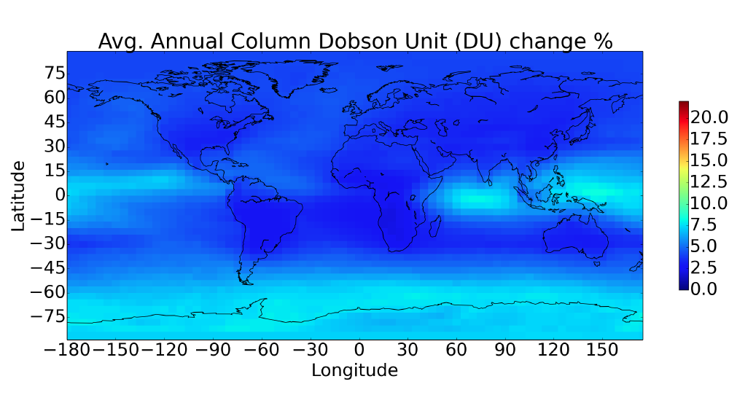
O₃ Change with just iodine
Screenshot 2014-10-17 20.30.19
Notes:
greatest O3 DU loss in the mid latitudes and greatest fractional O3 DU column loss in the tropics excluding the southern pole.

Slide 15
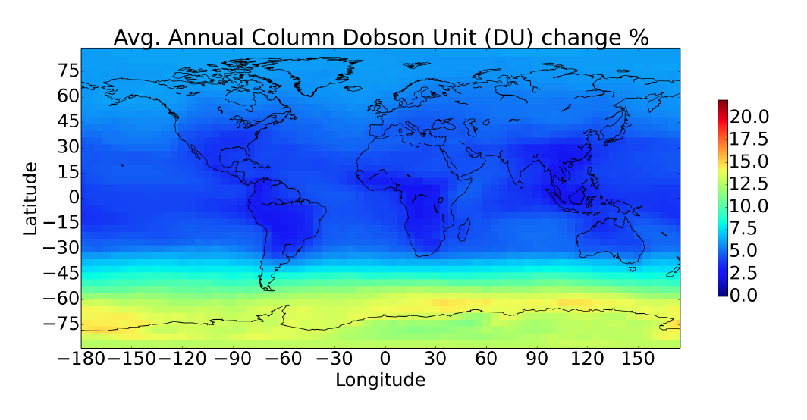
O₃ Change with just bromine
Notes:
greatest O3 DU loss in the mid latitudes and greatest fractional O3 DU column loss in the tropics excluding the southern pole.

Slide 16
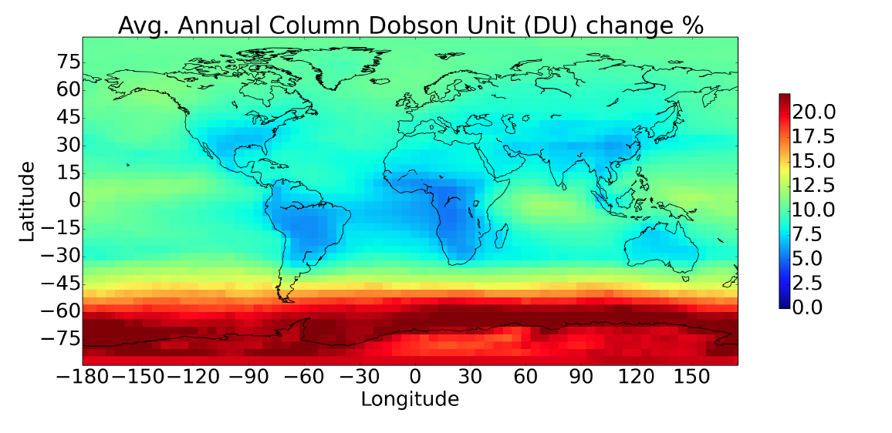
O₃ Change with halogens
Notes:
greatest O3 DU loss in the mid latitudes and greatest fractional O3 DU column loss in the tropics excluding the southern pole.
A decrease of 8% is observed in the burden
383, 354, 348 Tg for (I+,Br+), (I-,Br+), (I-Br-) respectively
5% soley on additioan of bromine , (I-,Br+)
3.2 DU O3 loss (~ 10%)
comparable % loss to CAM-Chem study

Slide 17
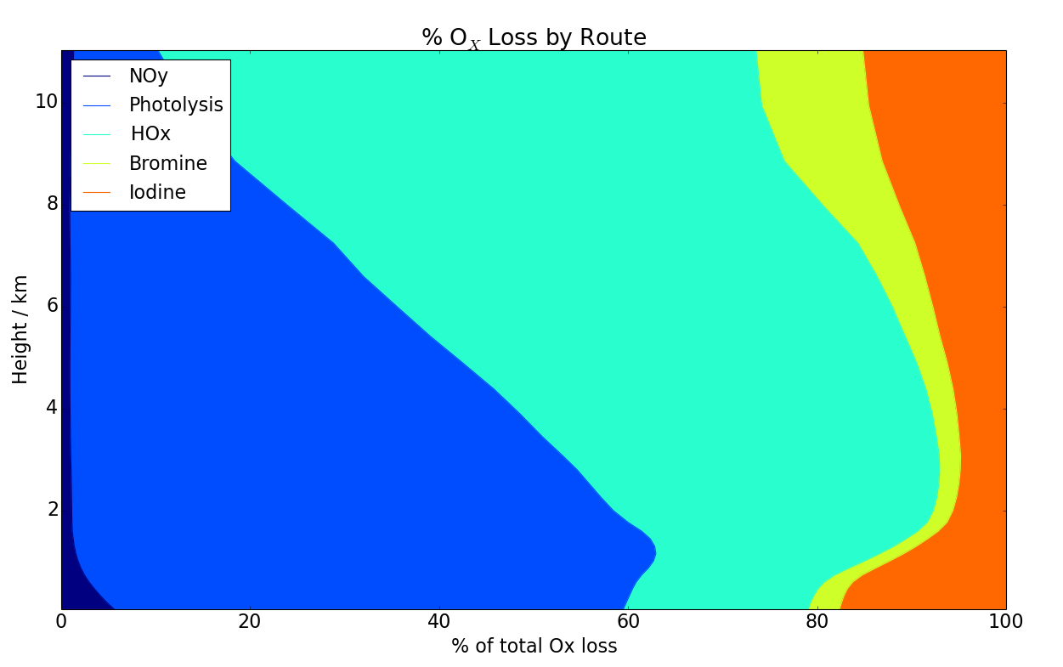
Global ozone loss
Bromine
Iodine
HO₂+O₃
OH+O₃
O₃+hv+H₂O

Slide 18
Impact of halogens on global oxidation
Two influencers
O₃ ⬇ OH⬇
XO+HO₂→HOX+hν→OH+X OH⬆
OH Mass weighted global
Just Br -2.7%
Just I +0.1%
Both -2.5%
CH₄ lifetime
Just Br +2.8%
Just I -0.04%
Both +2.6%

Slide 19
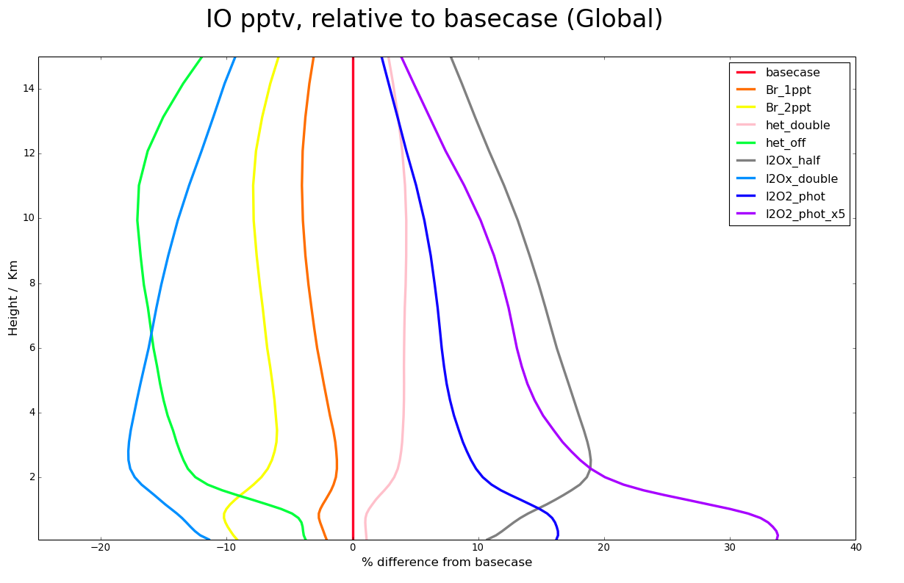
Chemical uncertainties: IO

Slide 20
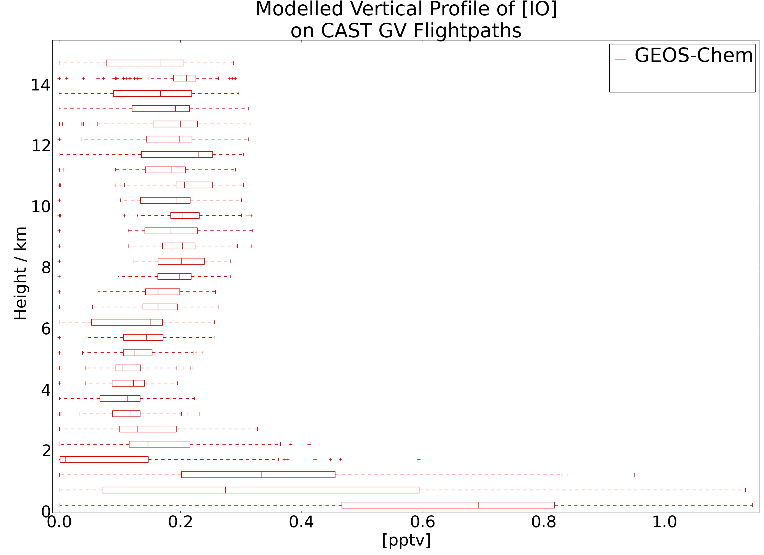
CONTRAST / CAST

Slide 21
Conclusions
Building a reactive iodine simulations
Very poorly constrained by observations
Often poorly defined kinetics
Rather suprisinly IO concentrations calculated are consistent with observations
Iodine alone ~2-7% change in O₃ column
Iodine has almost no impact on OH
Halogens ~10% change in O₃ column

