Slide 1
Hurricane Karl’s Structure and some thoughts for 2014 strategy
Dan Cecil, NASA MSFC
Ken Leppert II, Univ. Alabama-Huntsville

Slide 2
Why Karl?
Pros:
Karl is the only hurricane so far sampled with the flight patterns we want for HIRAD, HIWRAP, HAMSR
Karl was rapidly intensifying from TS to Cat-3 Hurricane while crossing the Bay of Campeche
Cons:
They were not on the same aircraft (HIRAD on WB-57, HIWRAP and HAMSR on AV-6), so did not have coincident measurements
Only a few hours of overlap between WB-57 and Global Hawk
Retrievals from all instruments are slow to come out
Bottom Line:
This case has interesting data, but far below the standards we should be able to achieve in HS3

Slide 3
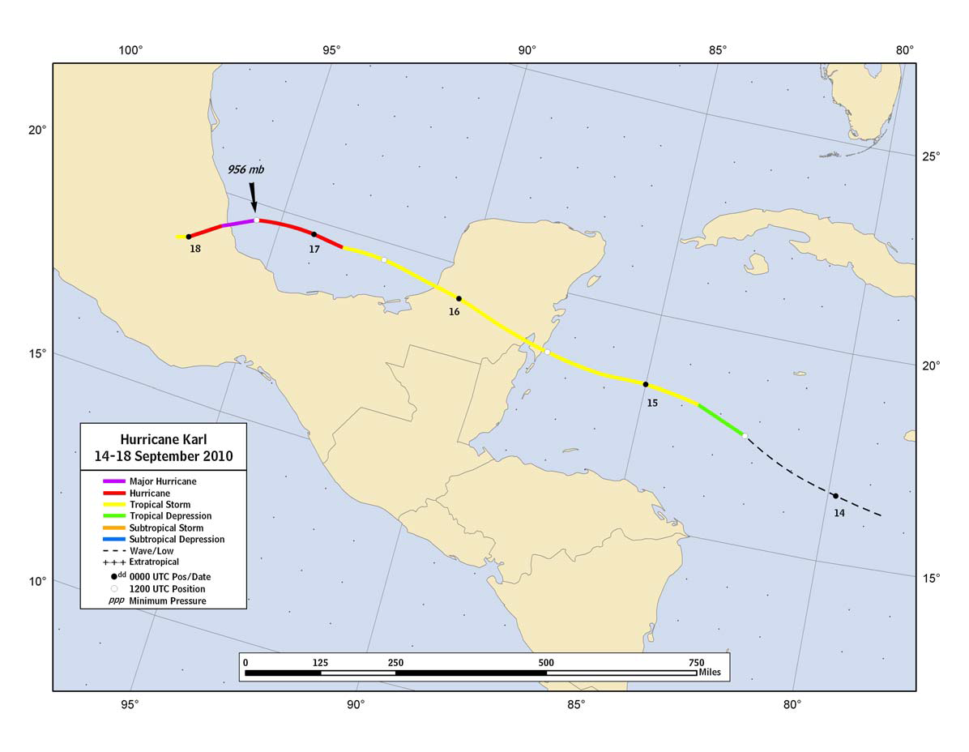
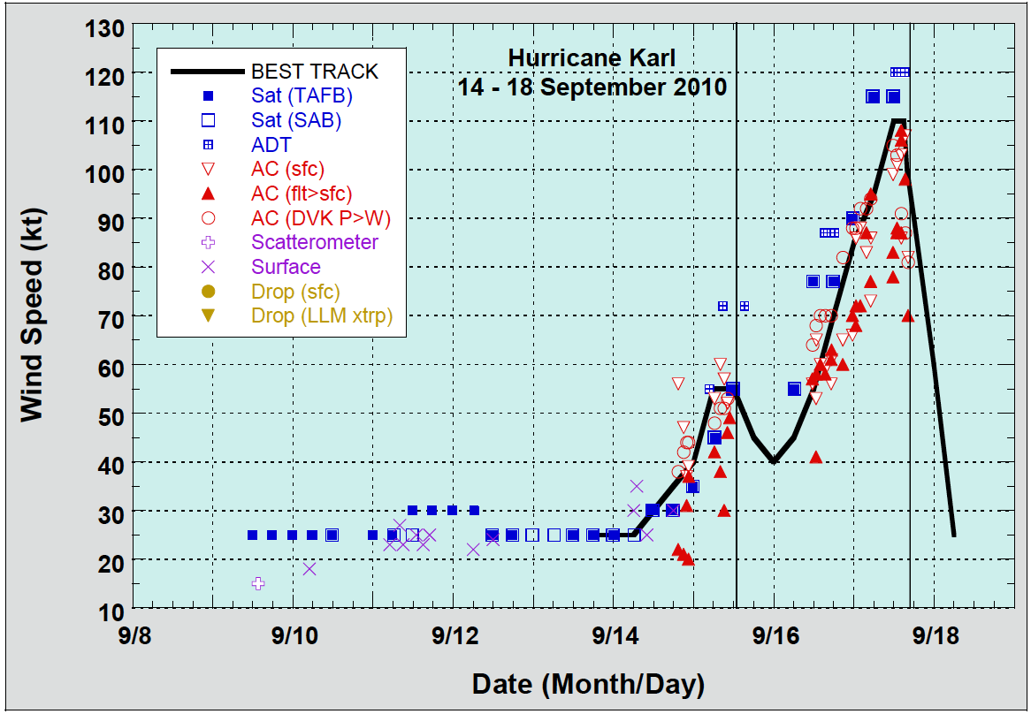
Best Track
GH on station 1845 – 0830 UTC 16-17 Sep 2010
WB-57 (with HIRAD) on station only late 16 Sep
The few hours of overlap are probably the best we have so far for the HS3 Over-Storm payload (HIWRAP, HIRAD, HAMSR)

Slide 4
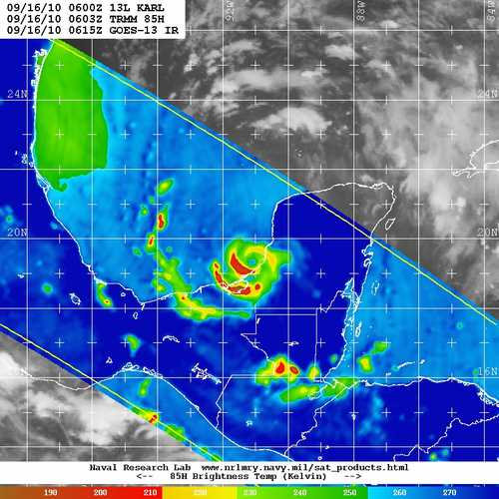
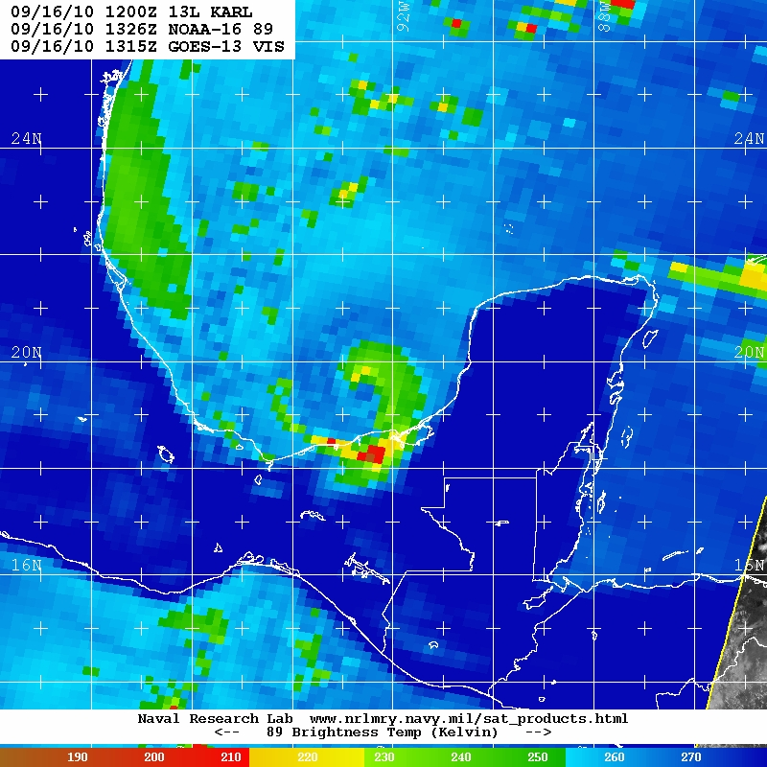
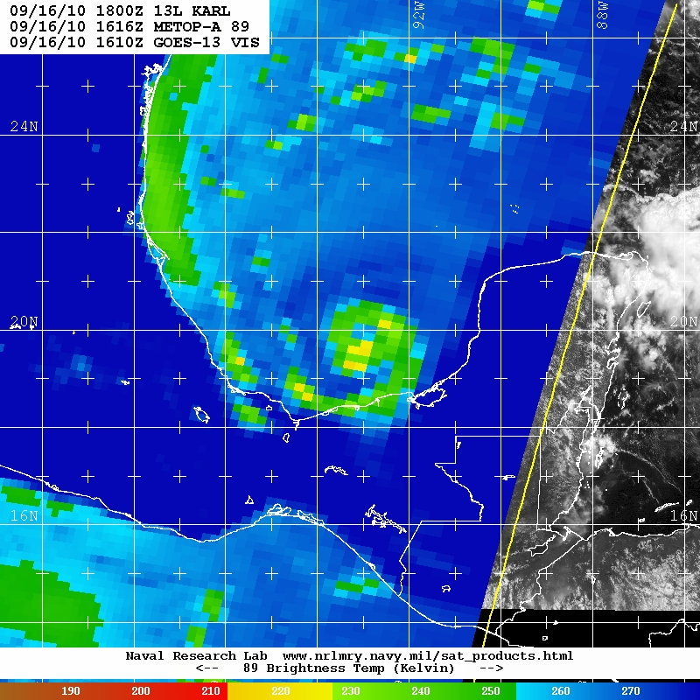
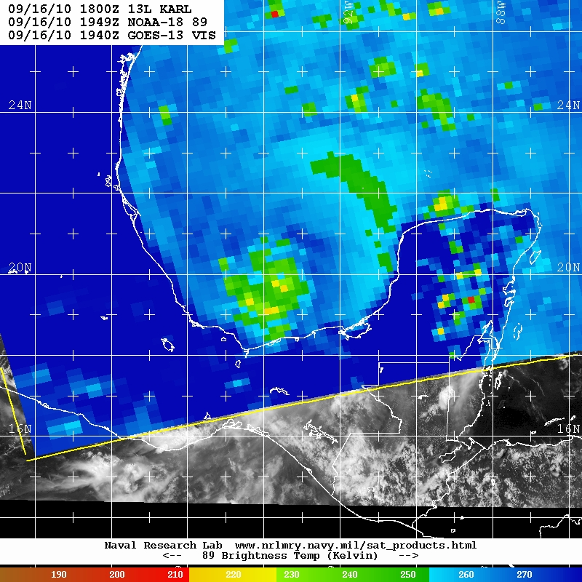
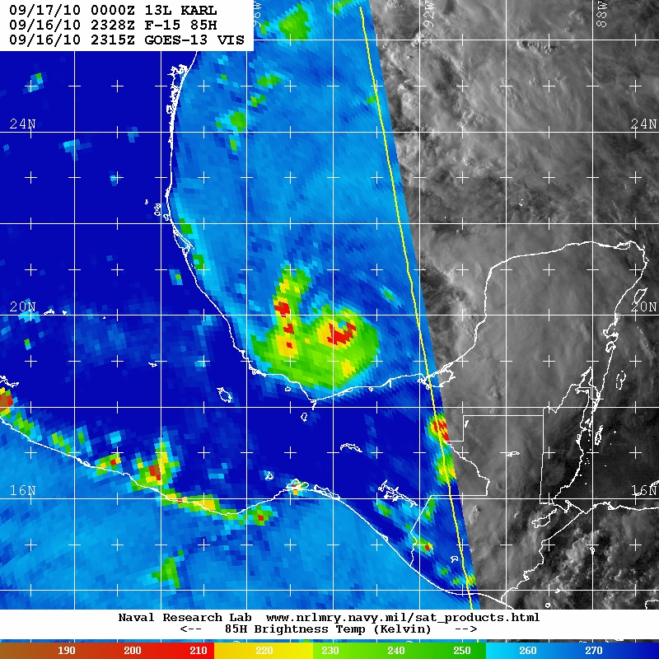
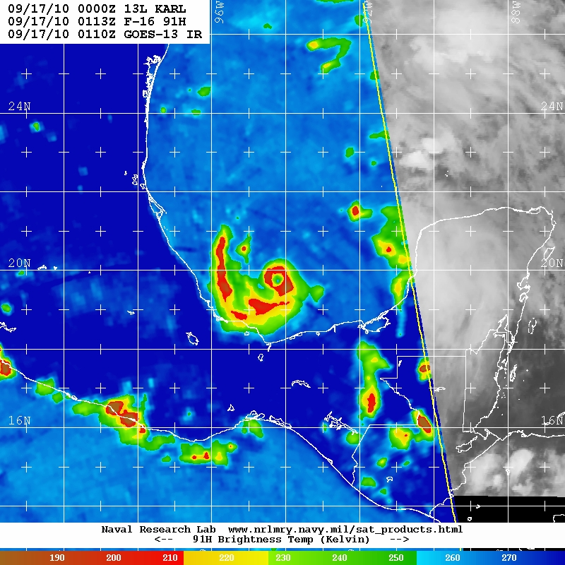
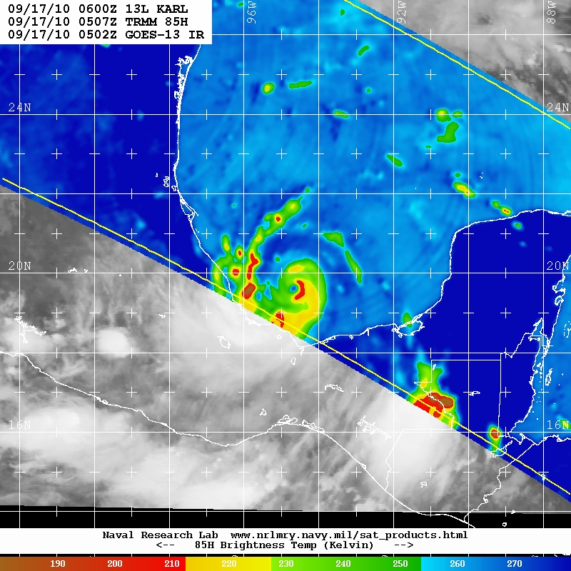
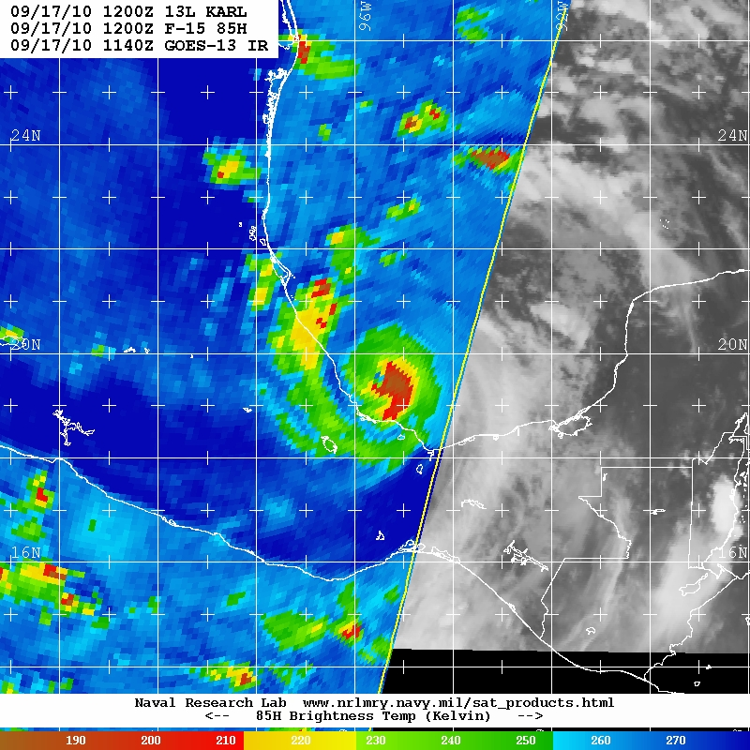
Satellite MI Snapshots from NRL MRY TC Web Page
09/16 0603 TMI
09/16 1326 N16
09/16 1616 METOPA
09/16 1949 N18
09/16 2328Z F-15
09/17 0113 Z F-16
09/17 0507 Z TMI
09/17 1200 Z F-15
Karl was re-organizing / rapidly intensifying after crossing the Yucatan. Karl re-gained hurricane intensity just before the aircraft arrived, and peaked (110 kt) shortly after Global Hawk departed.

Slide 5
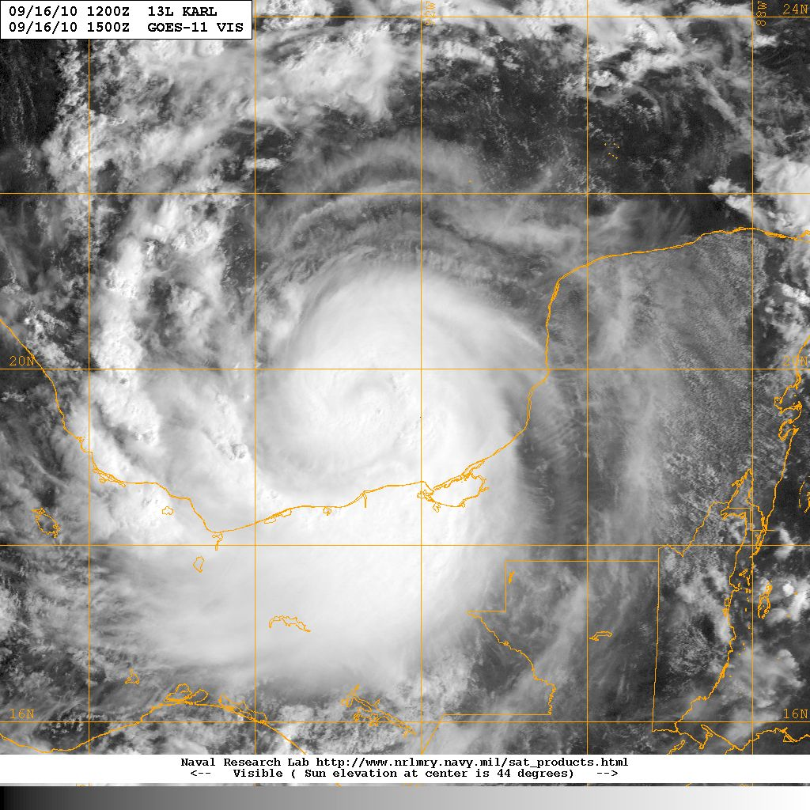
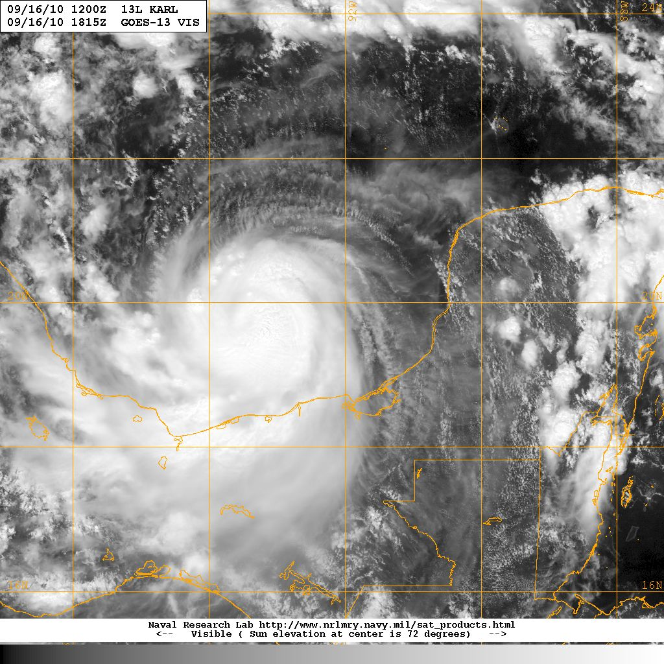
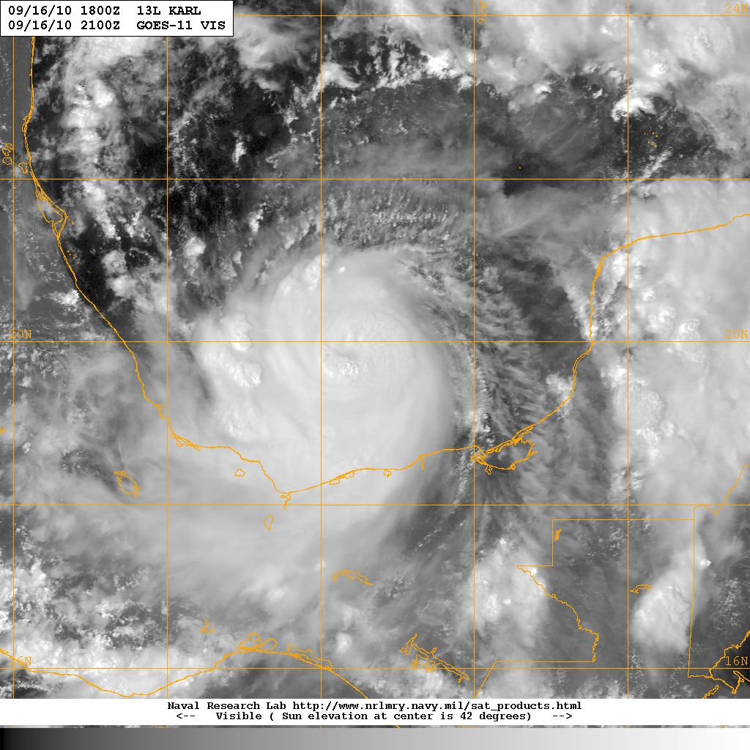
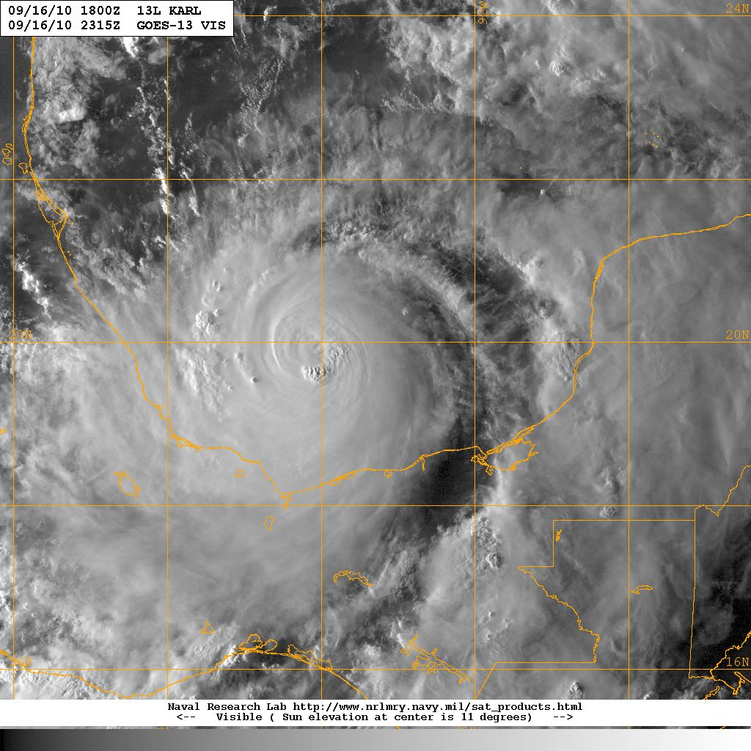
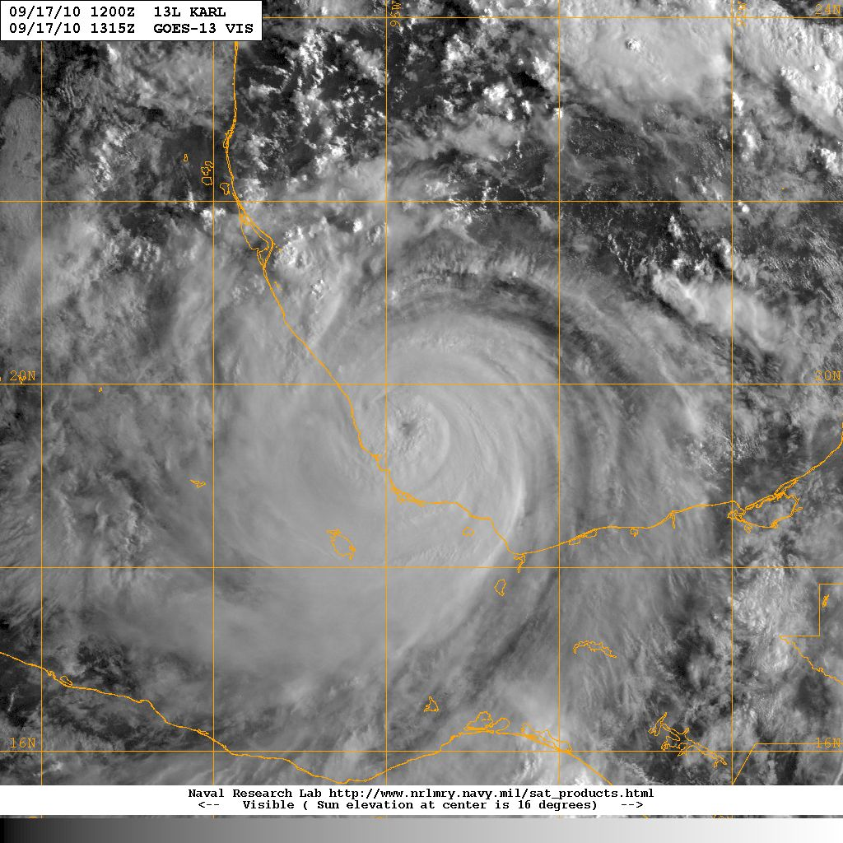
Satellite Vis Snapshots from NRL MRY TC Web Page
09/16 1500 UTC
09/16 1815 UTC
09/16 2100 UTC
09/16 2315 UTC
09/16 1315 UTC

Slide 6
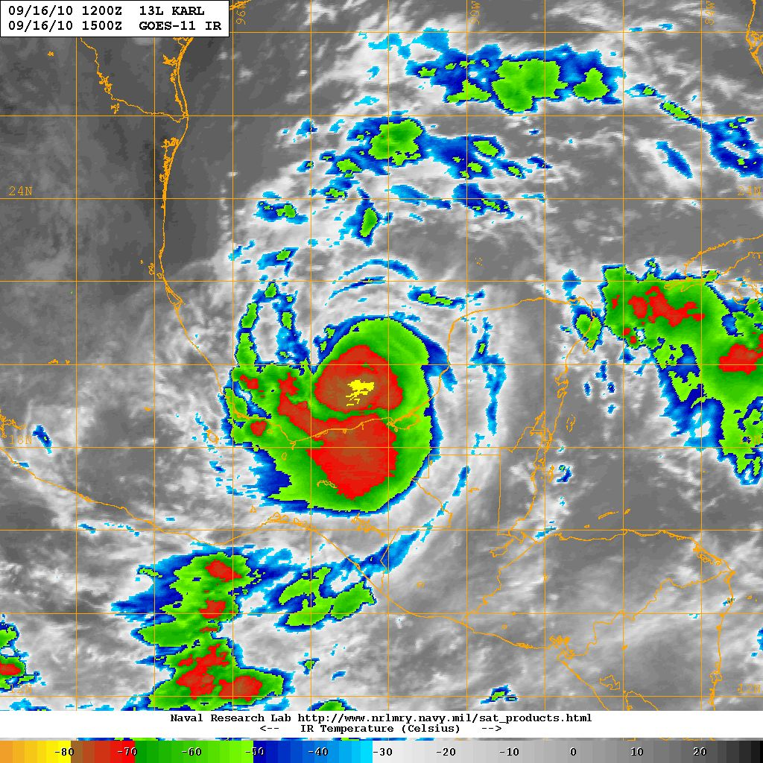
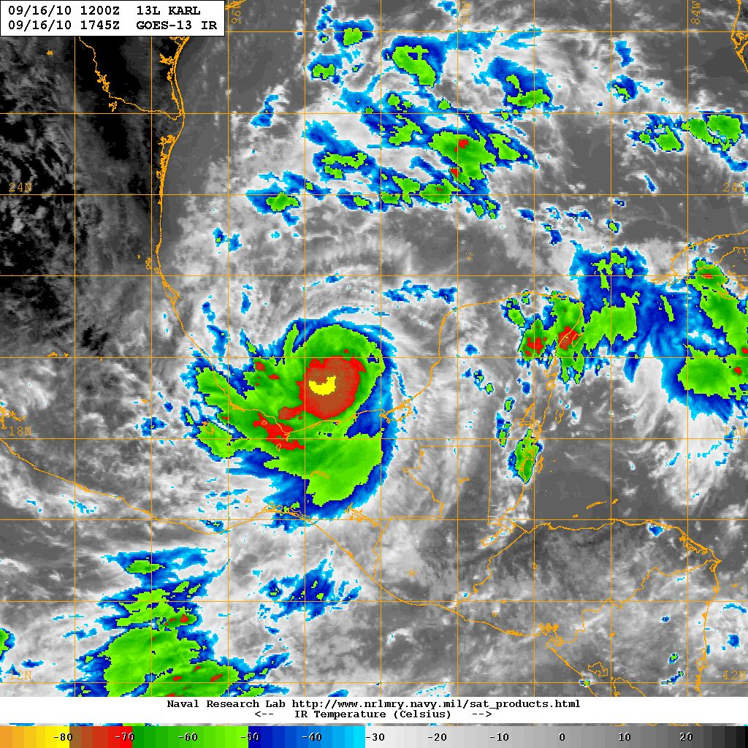
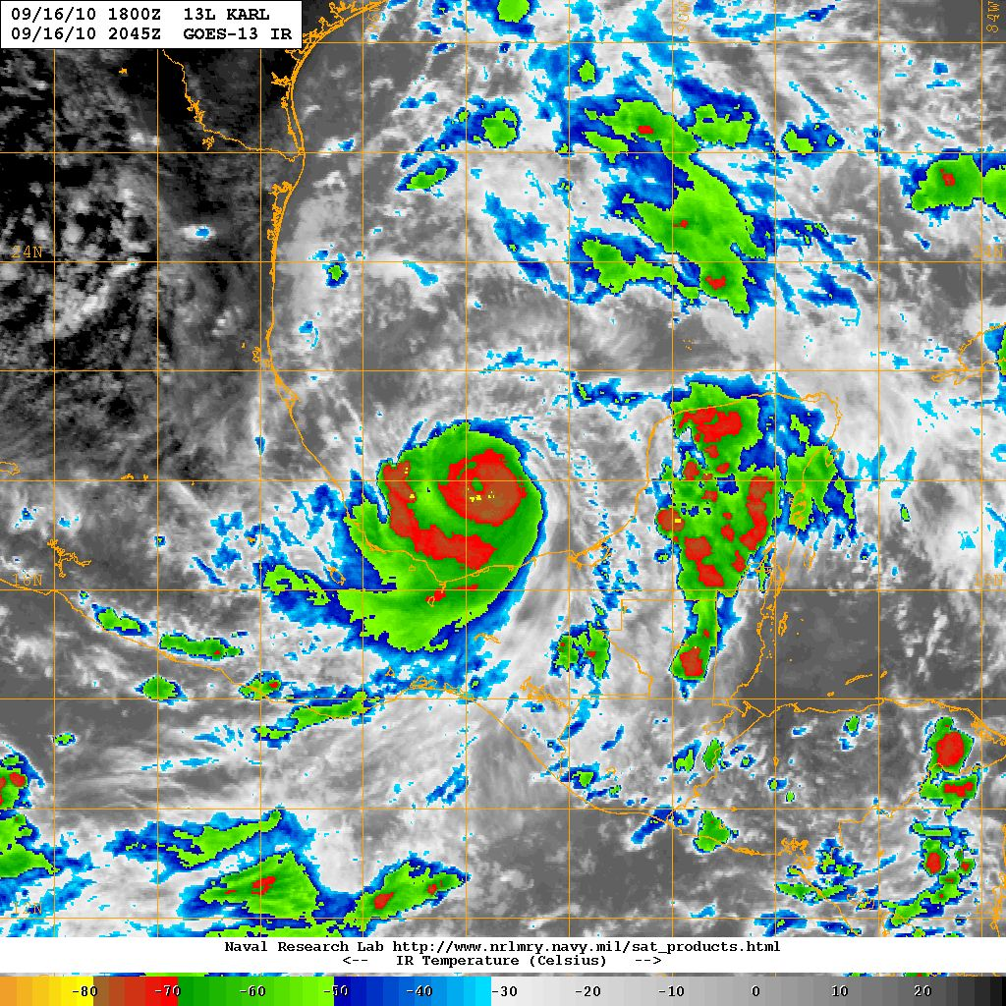
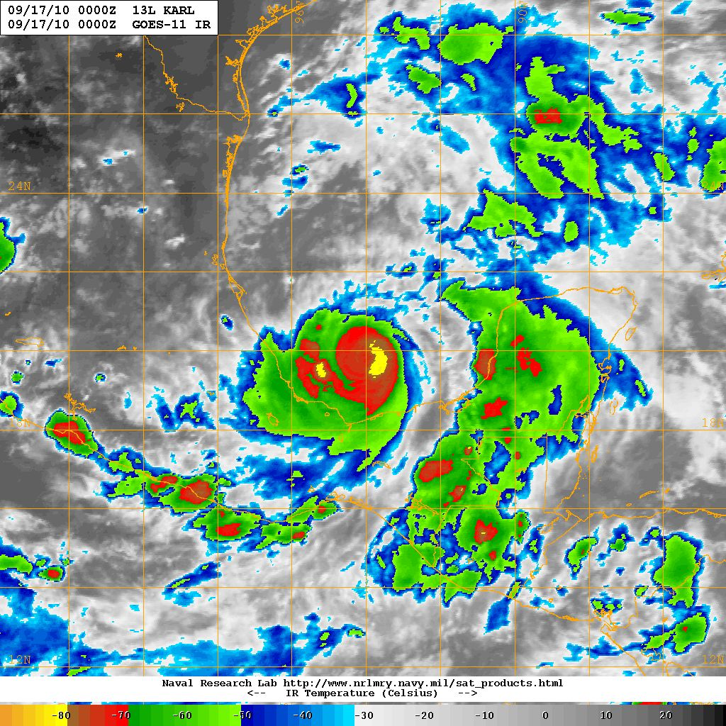
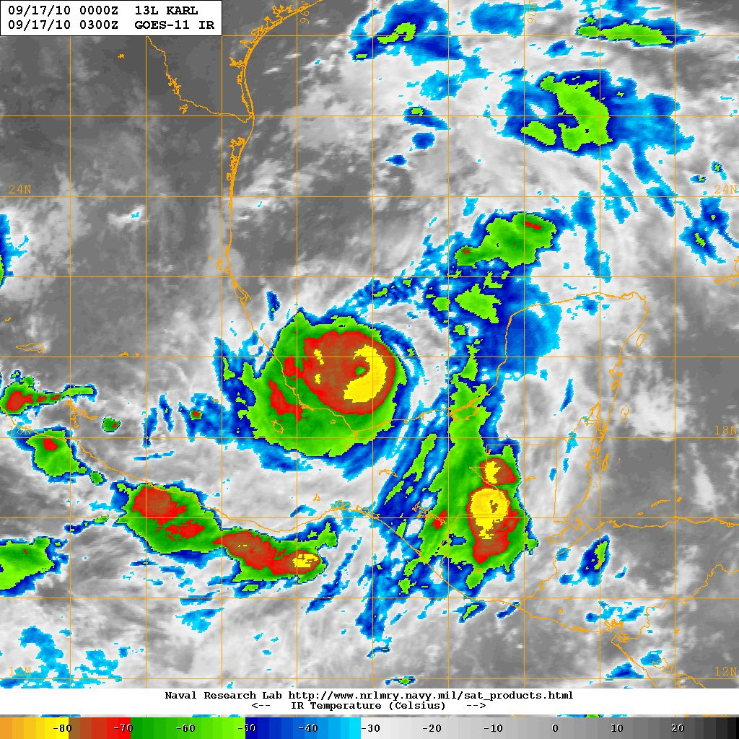
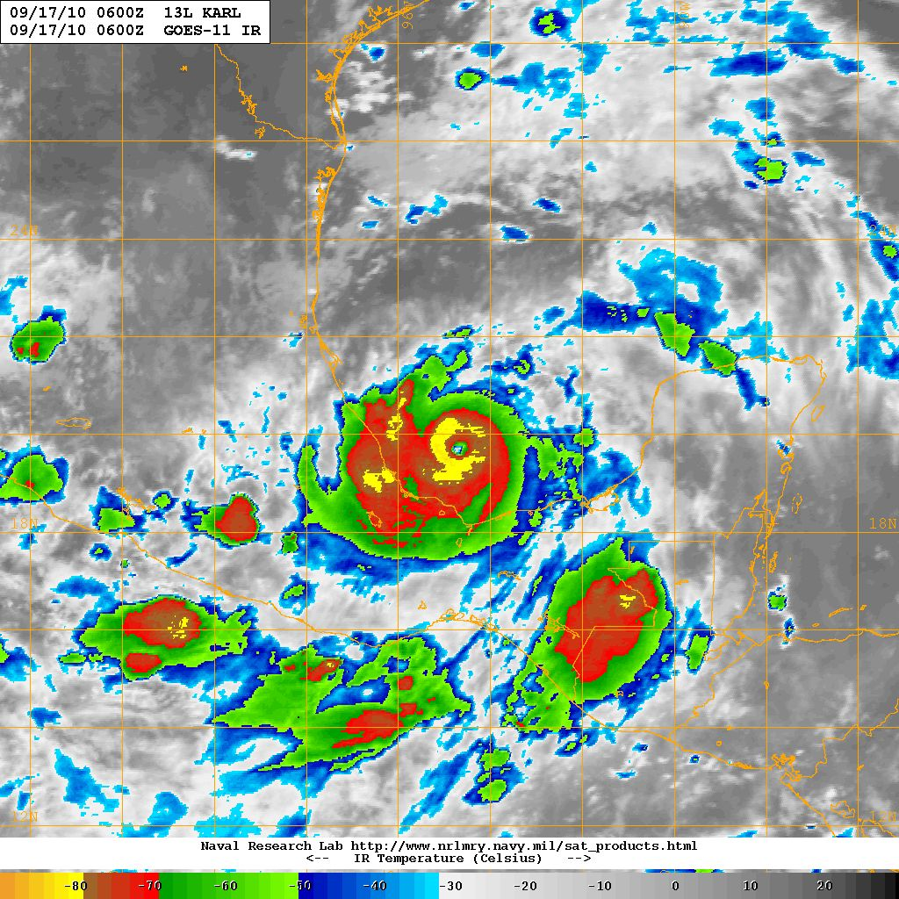
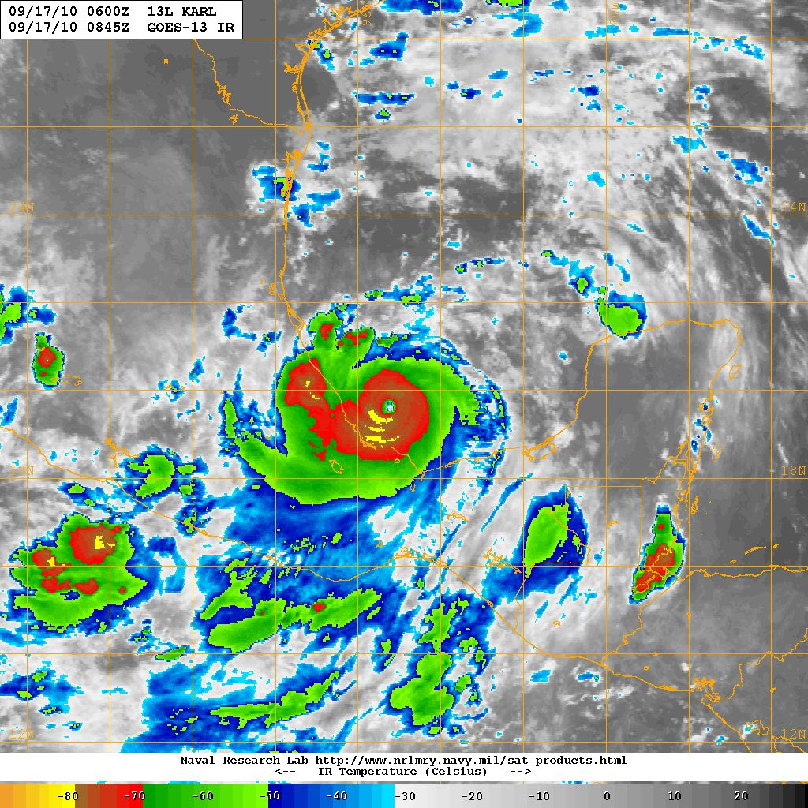
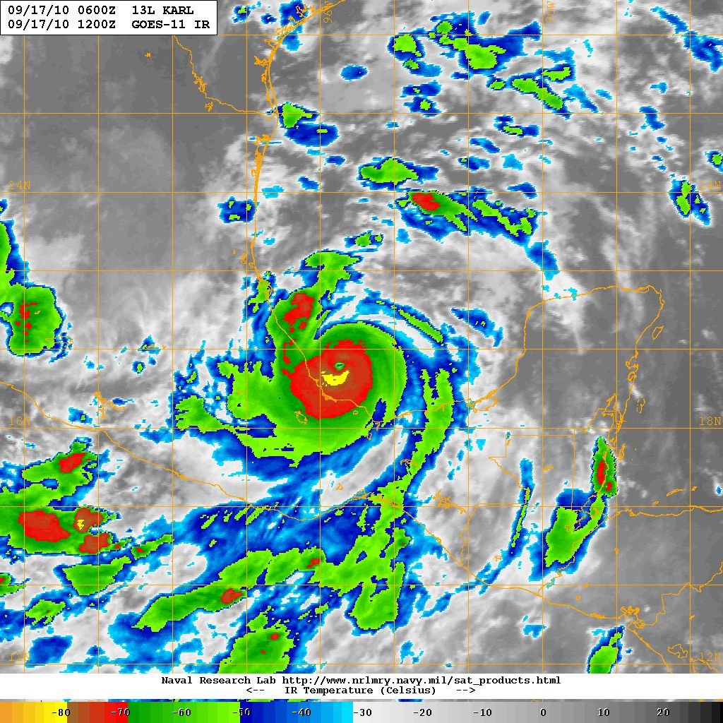
Satellite IR Snapshots from NRL MRY TC Web Page
09/16 1500 UTC
09/16 1745 UTC
09/16 2045 UTC
09/17 0000 UTC
09/17 0300 UTC
09/17 0600 UTC
09/17 0845 UTC
09/17 1200 UTC

Slide 7
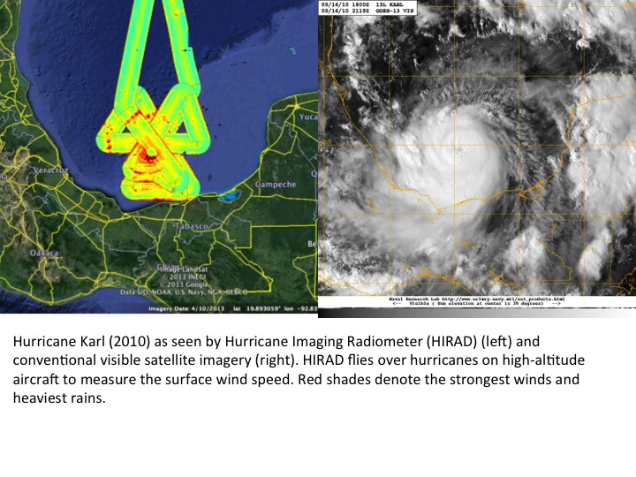
HIRAD Composite

Slide 8
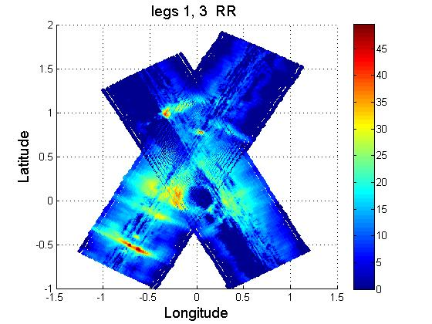
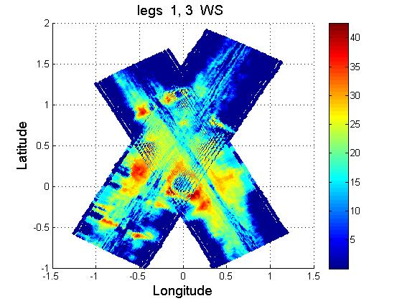
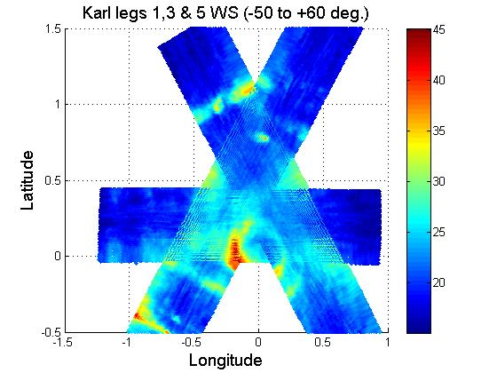
HIRAD Legs 1, 3, 5
Rain Rate
From UCF MLE Algorithm
Wind Speed
3
1
1
3
HIRAD depicts strongest winds, heaviest rain from NW side cyclonically around to S / SE side

Slide 9
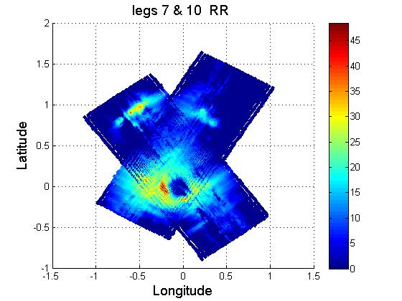
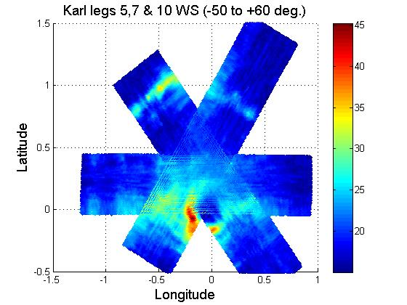
HIRAD Legs 5, 7, 10
Rain Rate
From UCF MLE algorithm
Wind Speed
10
7
10
7
5
HIRAD depicts strongest winds, heaviest rain from NW side cyclonically around to S / SE side

Slide 10
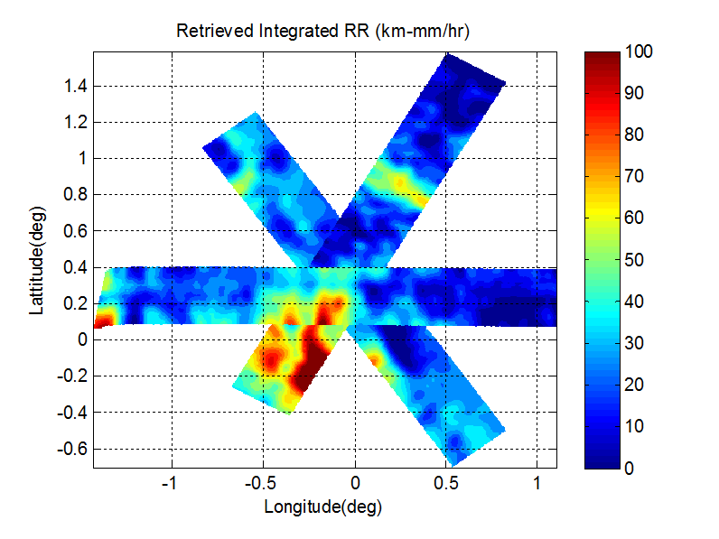
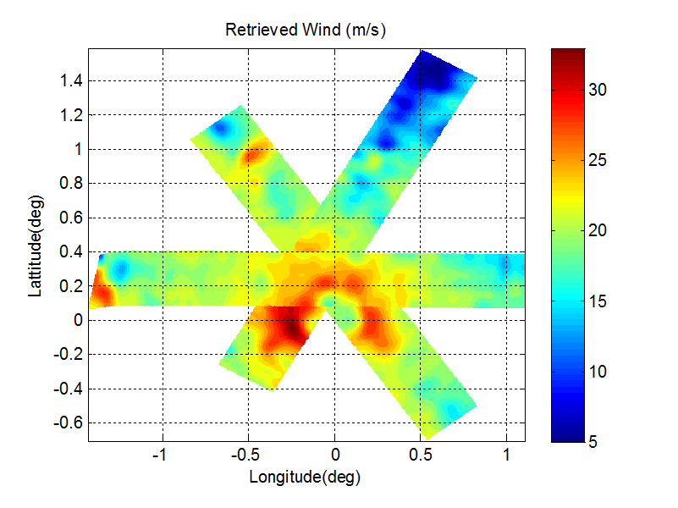

HIRAD Legs 5, 7, 10
5 GHz Quicklook Algorithm
Leg 6 on top IRR (km mm/hr)
Leg 5 on top WS (m/s)c
7
7
5
5
10
10

Slide 11
HIWRAP Composite at 2 km
From Steve Guimond
Also shows heaviest rain, strongest winds from NW around through SE sides

Slide 12
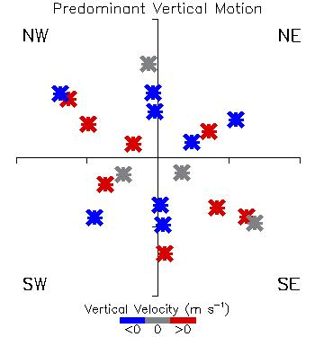
Inner core vertical motion
From HIWRAP vertical velocity cross-sections, qualitatively depicting whether eyewall / inner core had predominantly upward motion (red) or downward motion (blue)
Azimuths depict the quadrants sampled, but plotted radius depicts duration of time into flight

Slide 13
How do we get better over-storm cases in HS3 2014?
Dan’s Soapbox
Fly the Over-Storm aircraft over the storm
  • Do not approach thunderstorms within 25 nm during flight at FL500 or below.
  • Aircraft should maintain at least 5000 ft vertical separation from significant convective cloud tops except:
  a) When cloud tops above FL500: Do not approach reported significant lightning activity or indicators of significant overshooting tops within 25 nm.
  b) When cloud tops are below FL500, maintain 10000 ft separation from reported significant lightning or indicators of significant overshooting tops.
  • No flight into forecasted or reported icing conditions
Open the East Pacific as an option
We have 3+ months until science flights – there should be time to work it out.
NHC has a Mexican Air Force representative during the summer to coordinate clearances
Potential El Nino favors East Pac over Atlantic
Even without El Nino, HS3 2013 would have been better served by flying the East Pacific

Slide 14
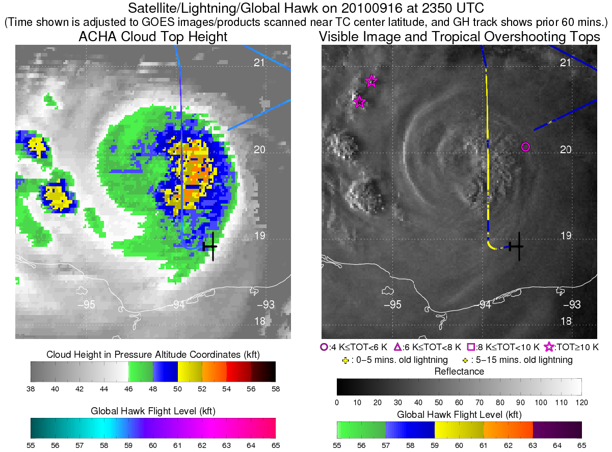
Karl and the flight rules
Cloud tops 50-54 kft
Overflown by AV-6 with no problems
Recall from Zipser, Houze presentations (and several papers) that convection occupies a small percentage of the area under the hurricane’s cloud shield
Figures from Sarah Monette and Chris Velden, from the 2013 flight rules white paper

Slide 15
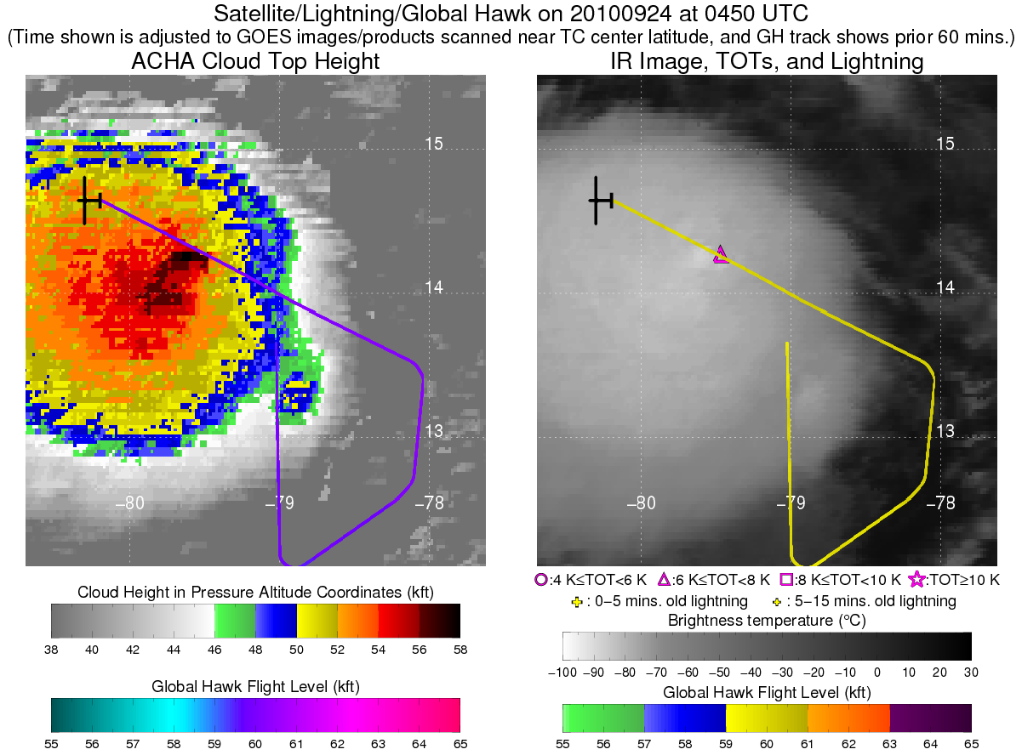
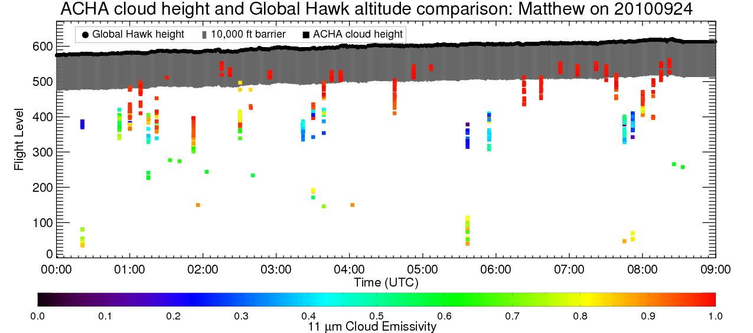
Matthew (2010) and the flight rules
Cloud tops 52-58 kft
Overflown at 58-61 kft with no problems
• Aircraft should maintain at least 5000 ft vertical separation from significant convective cloud tops except:
a) When cloud tops above FL500: Do not approach reported significant lightning activity or indicators of significant overshooting tops within 25 nm.
b) When cloud tops are below FL500, maintain 10000 ft separation from reported significant lightning or indicators of significant overshooting tops.

Slide 16
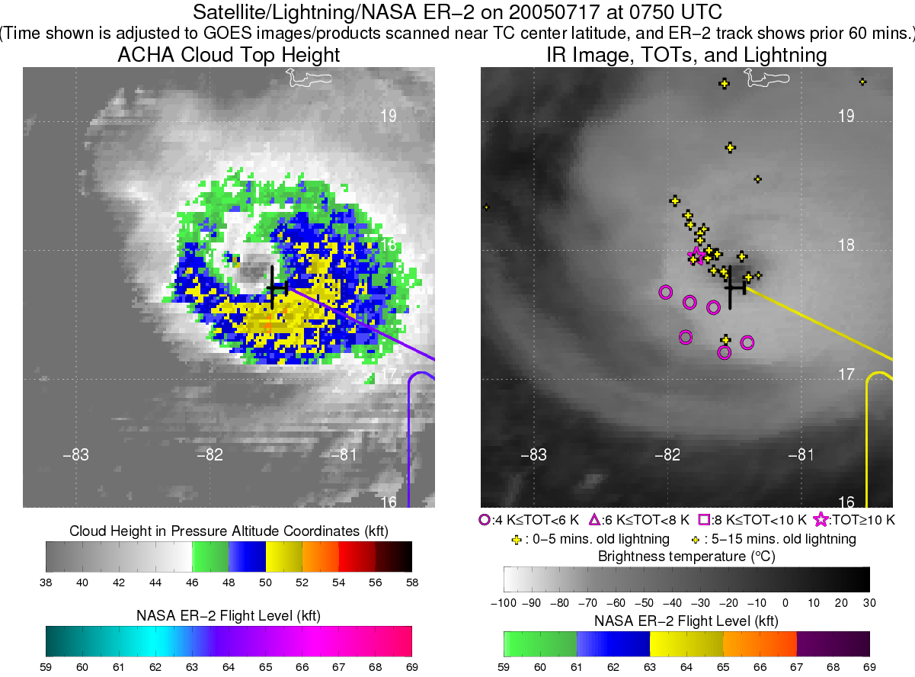
Emily and the flight rules
(ER-2 case, GH rules don’t apply)
ER-2 overflew broad area of high cloud tops on SE side with no problem
Turbulence when overflying a new cell that emerged on inner edge of the western eyewall
Several lightning flashes, beginning just before the ER-2 got to the wrong place at the wrong time

Slide 17
Emily box pattern
After the turbulence, we flew a box pattern just outside the eyewall.
No problems, pilot edged closer to the eyewall as he grew more comfortable
If we cannot overfly a given eyewall due to significant convection, we should be able to fly the adjacent region
Significant convection is rare there, even under very high cloud shield – think Molinari, Corbosiero, Cecil, Houze, etc

Slide 18
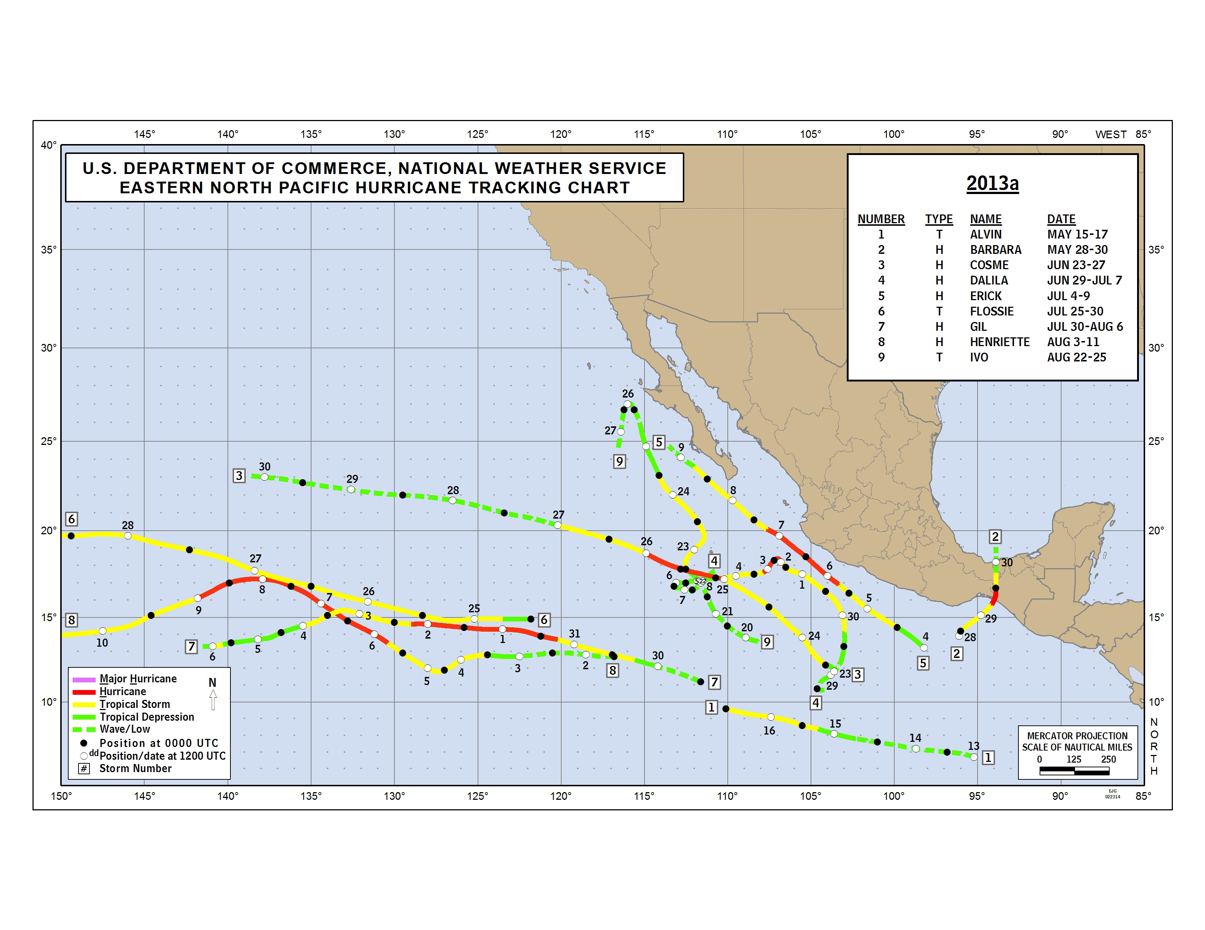
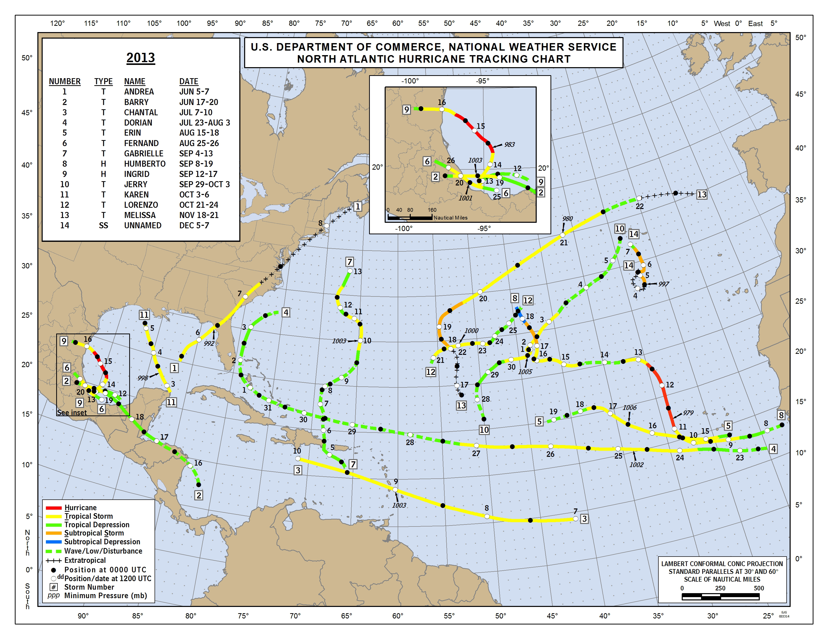
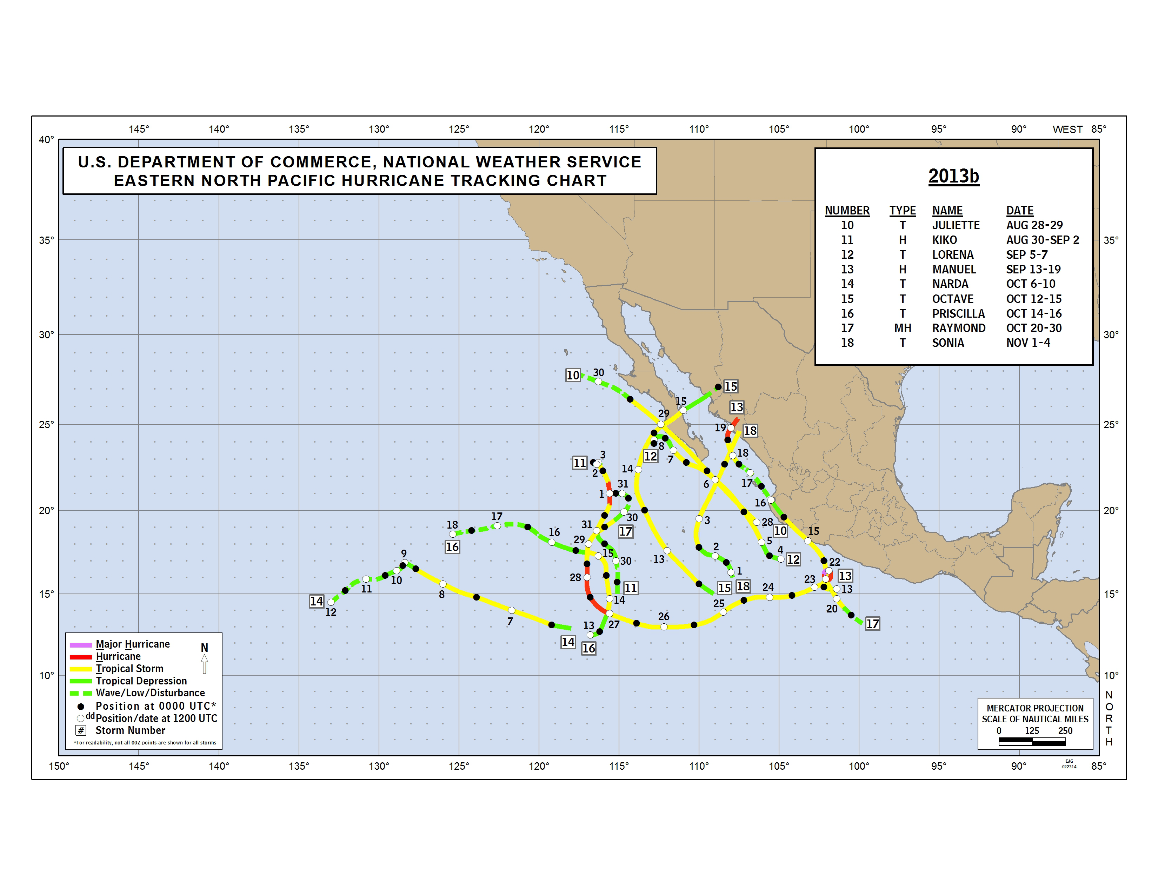
2013
May 15 – Aug 25
Aug 28 – Nov 4

Slide 19
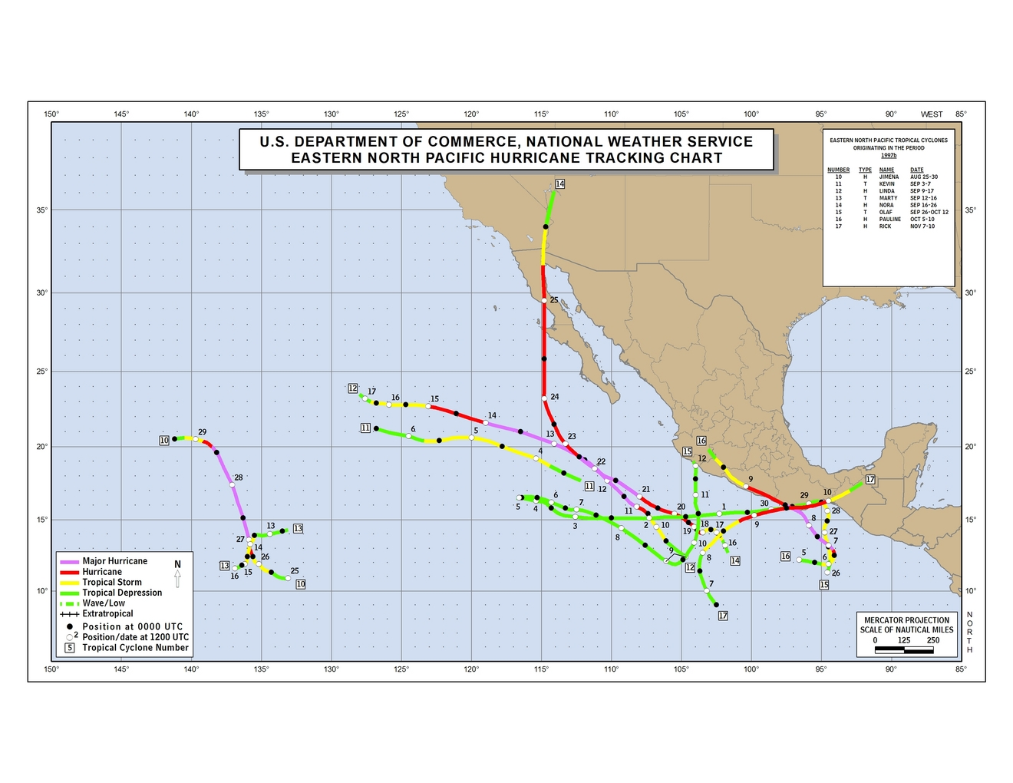
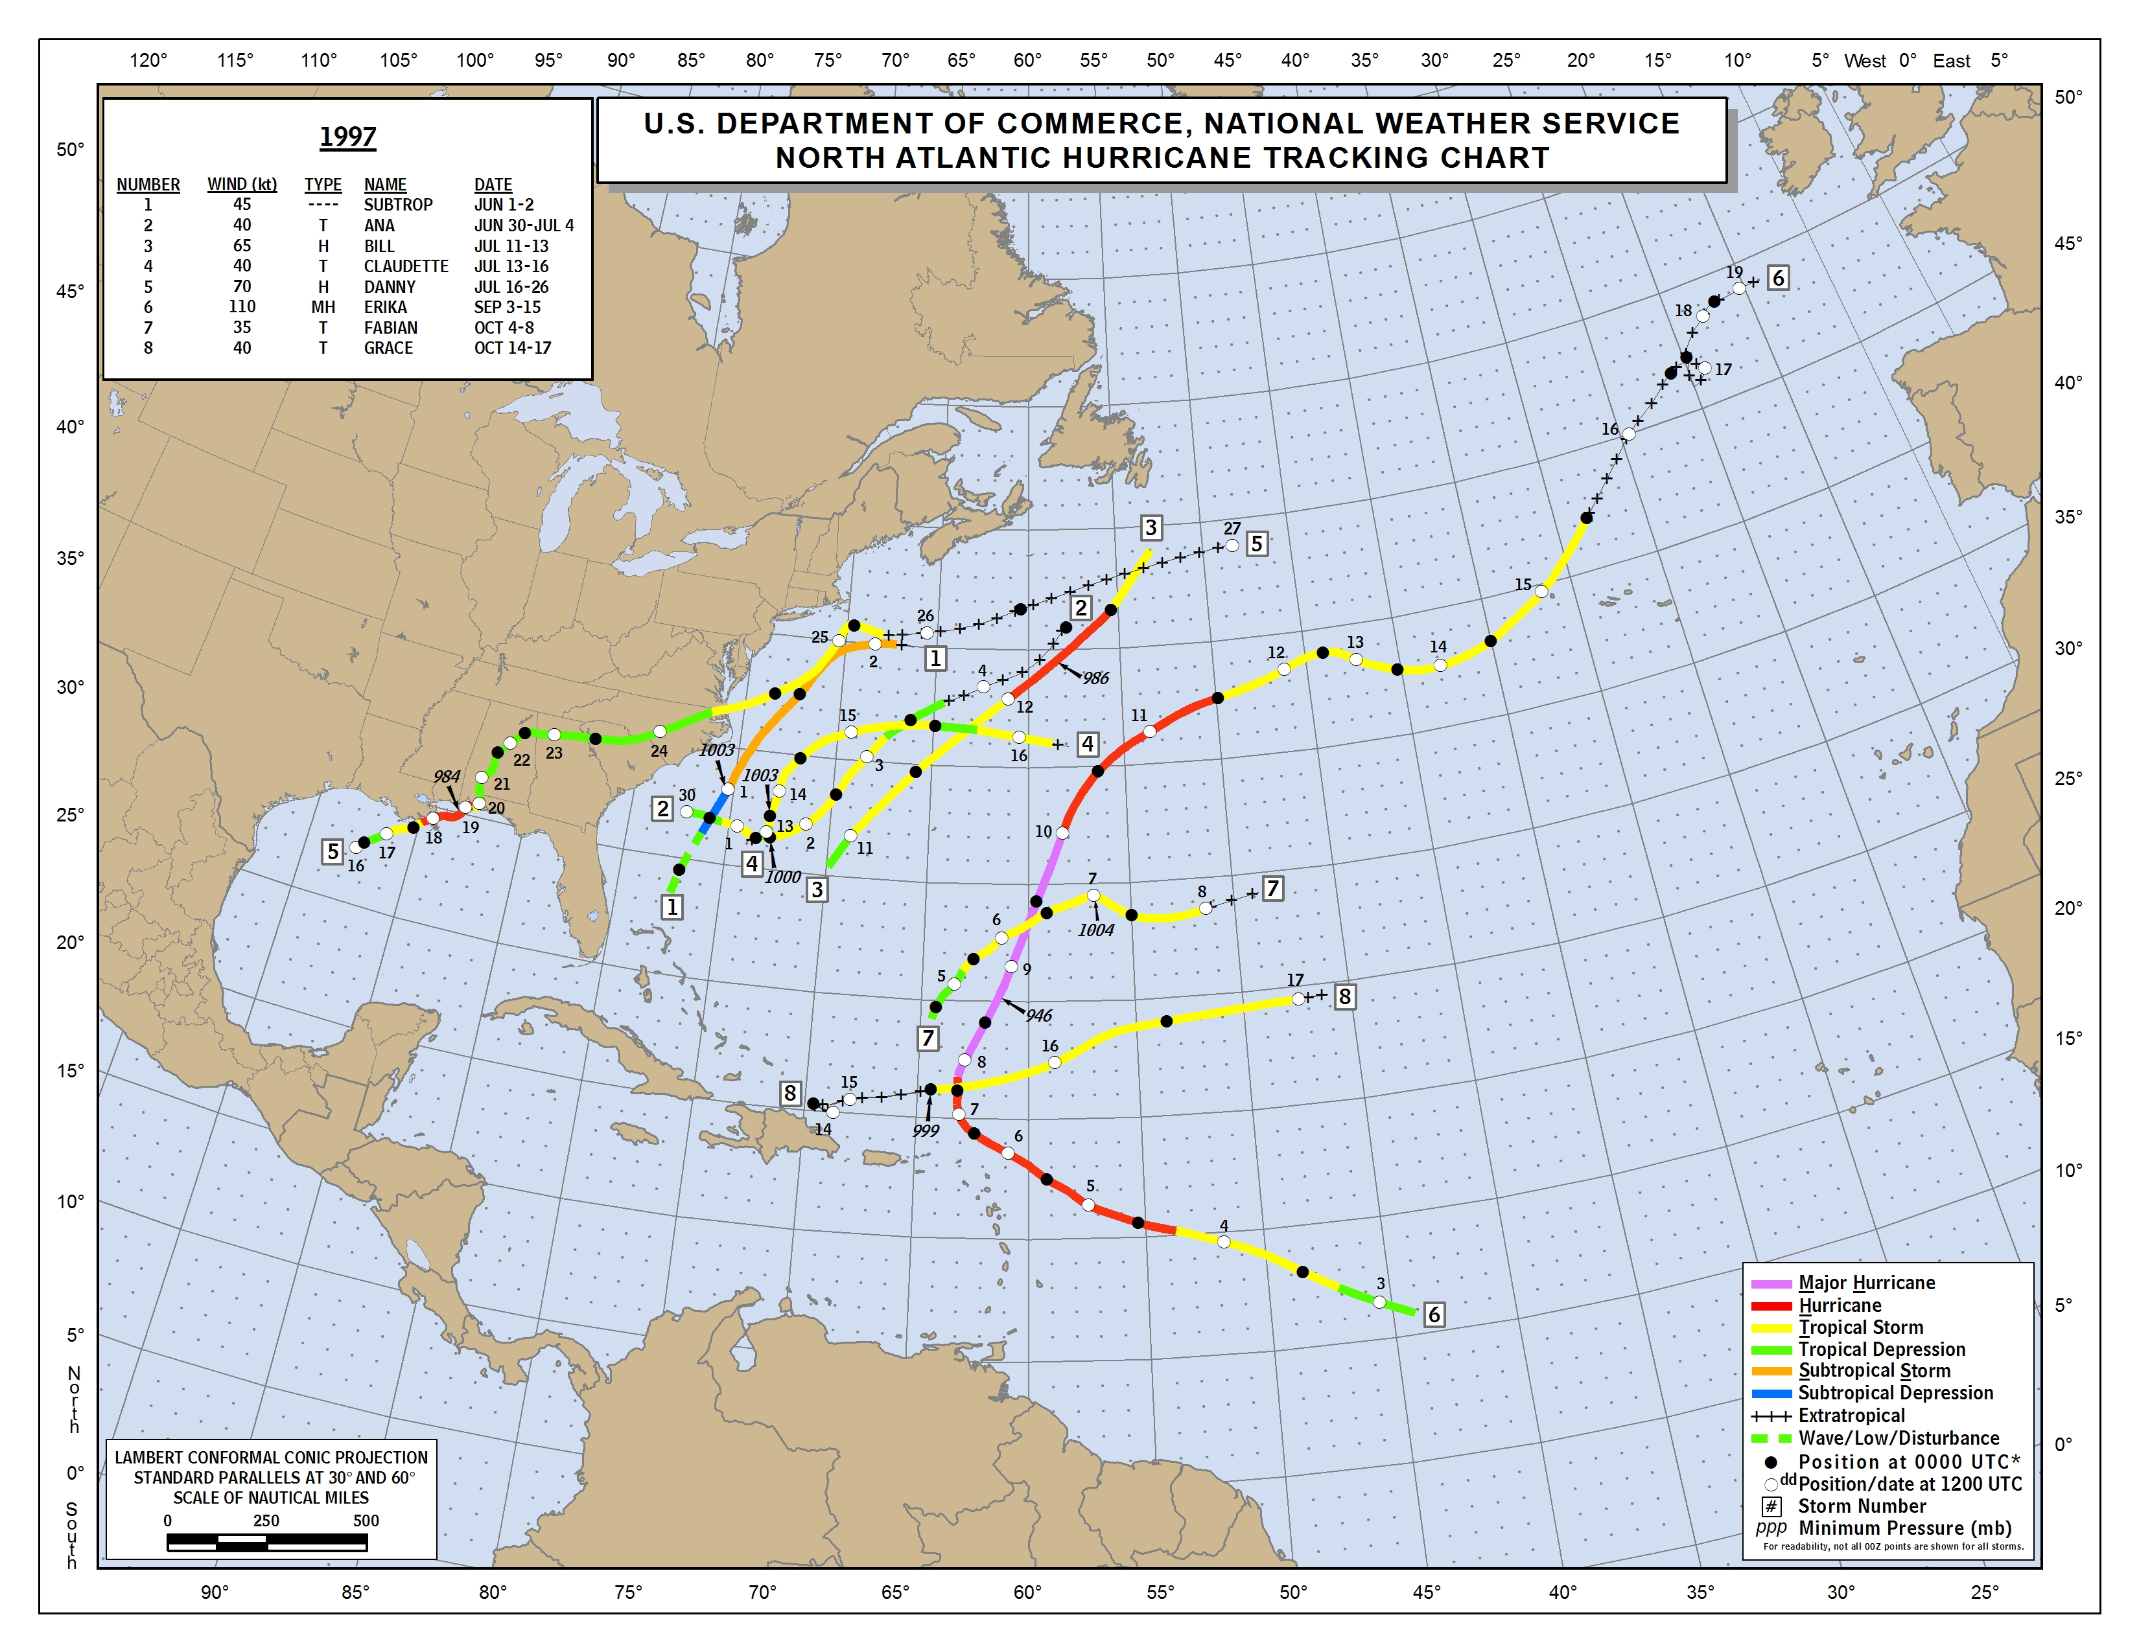
1997 (El Nino)
Aug 25 – Nov 10
3 Major Hurricanes + 2 TS
Aug 25 – Sep 26 in E. Pac.
5 W. Atlantic storms in June-July
0 for August
1 C. Atlantic Hurricane (Erika) in Sept
2 TS in October

Slide 20
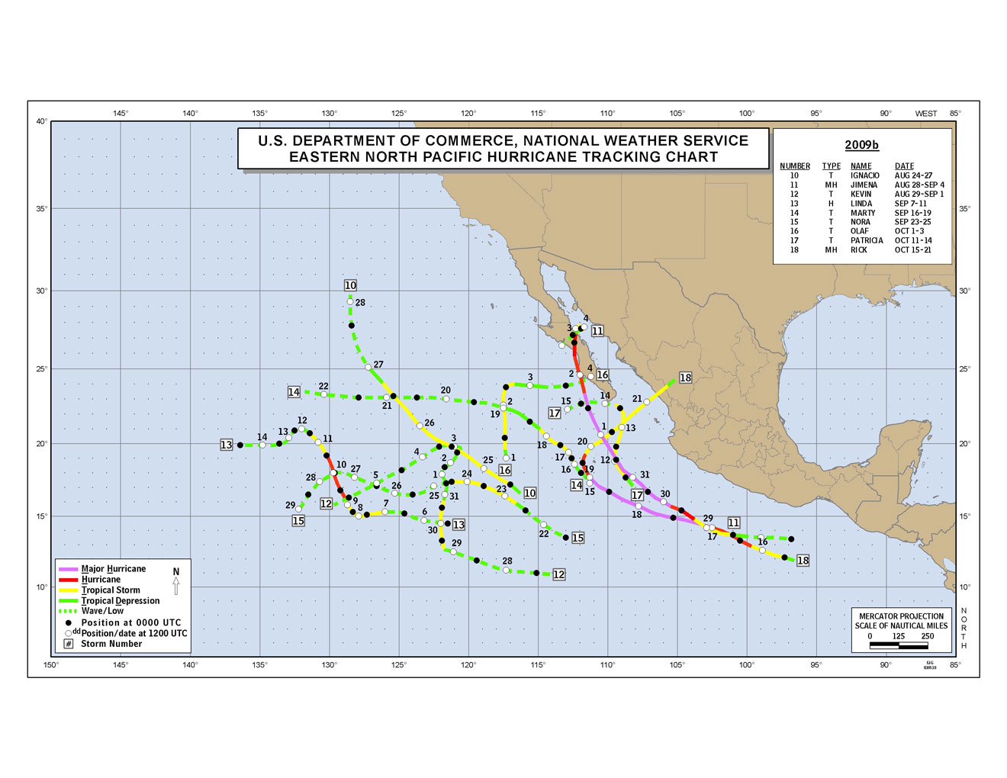
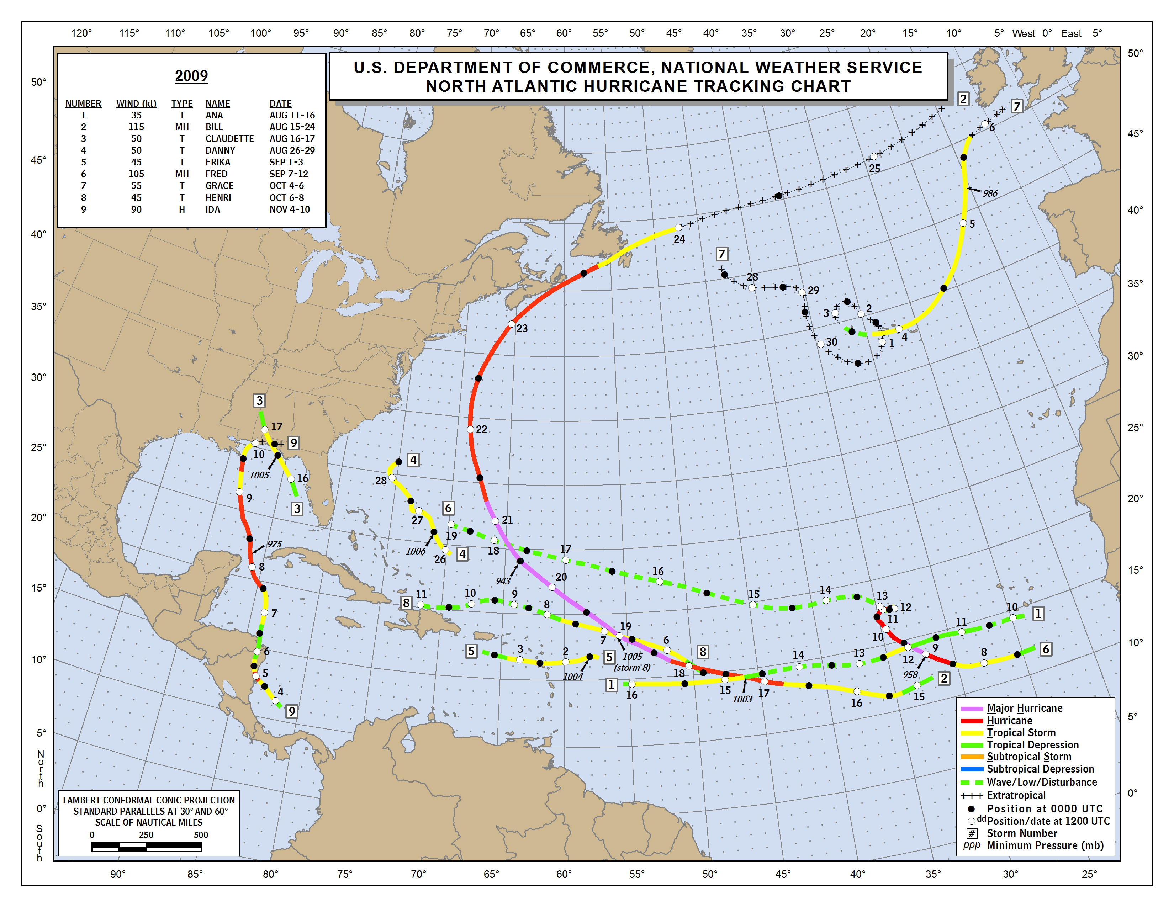
2009 (El Nino)
Aug 24 – Oct 21
E. Pac: 3 TS and 2 Hurricanes (1 major, Jimena) Aug 26 – Sep 29
Atlantic: 2 short-lived TS and 1 Major Hurricane (Fred, east of 35°) Aug 26 – Sep 29

Slide 21
Summary
Karl has interesting data, but far below the standards we should be able to achieve in HS3
We need to fly AV-1 over hurricanes in 2014
Most of the cold cloud shield in the inner core of hurricanes should be safe for AV-1 to fly. Significant convection occupies a small region, but we sometimes unnecessarily apply the 5000-ft separation rule to the entire cold cloud shield.
We should make the East Pacific a viable option. There are 3+ months to work out clearances, which NHC should be able to facilitate.
I am not advocating that we give up on the Atlantic, just that we should be prepared to fly across Mexico to East Pacific targets

