Slide 1
Behavior of dry layers in GFS analyses
Bill Randel¹ and Louis Rivoire²
¹NCAR
²École Normale Supérieure, Paris

Slide 2
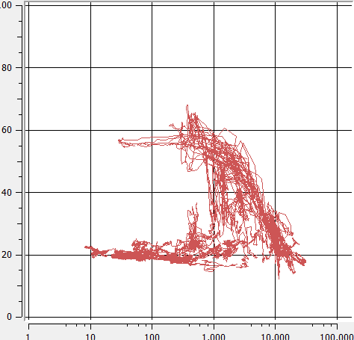
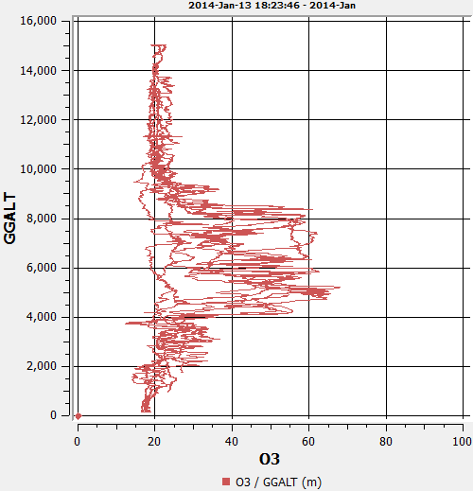
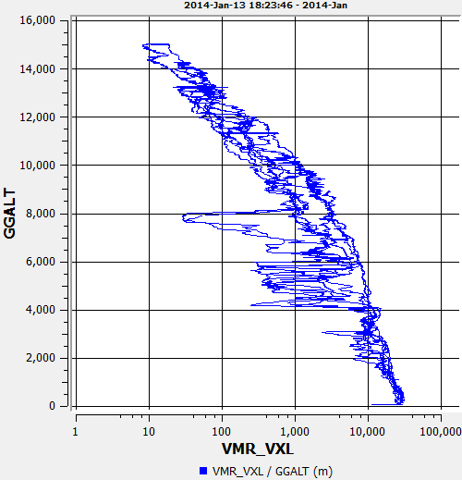
Intro:
Ubiquitous dry, high ozone layers observed during CONTRAST
Comparisons of CONTRAST H₂O profiles with GFS analyses
Climatology of dry layers in GFS data
Origin of dry layers: high resolution RDF results
RF03
16 km
RF03
H₂O
ozone
10 km
ozone
4 km
0
H₂O

Slide 3
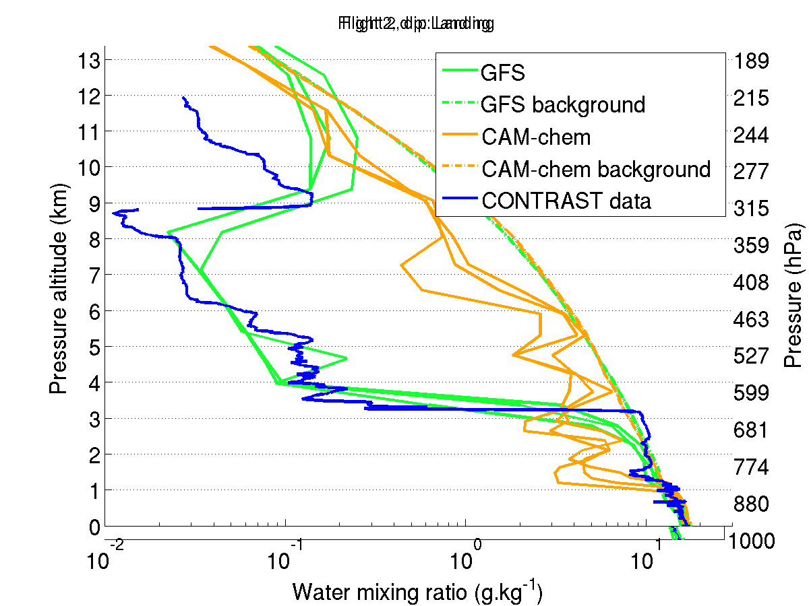
Comparisons of CONTRAST profiles with nearby GFS (and CAM-Chem)
background
= 80% RH
RF02

Slide 4
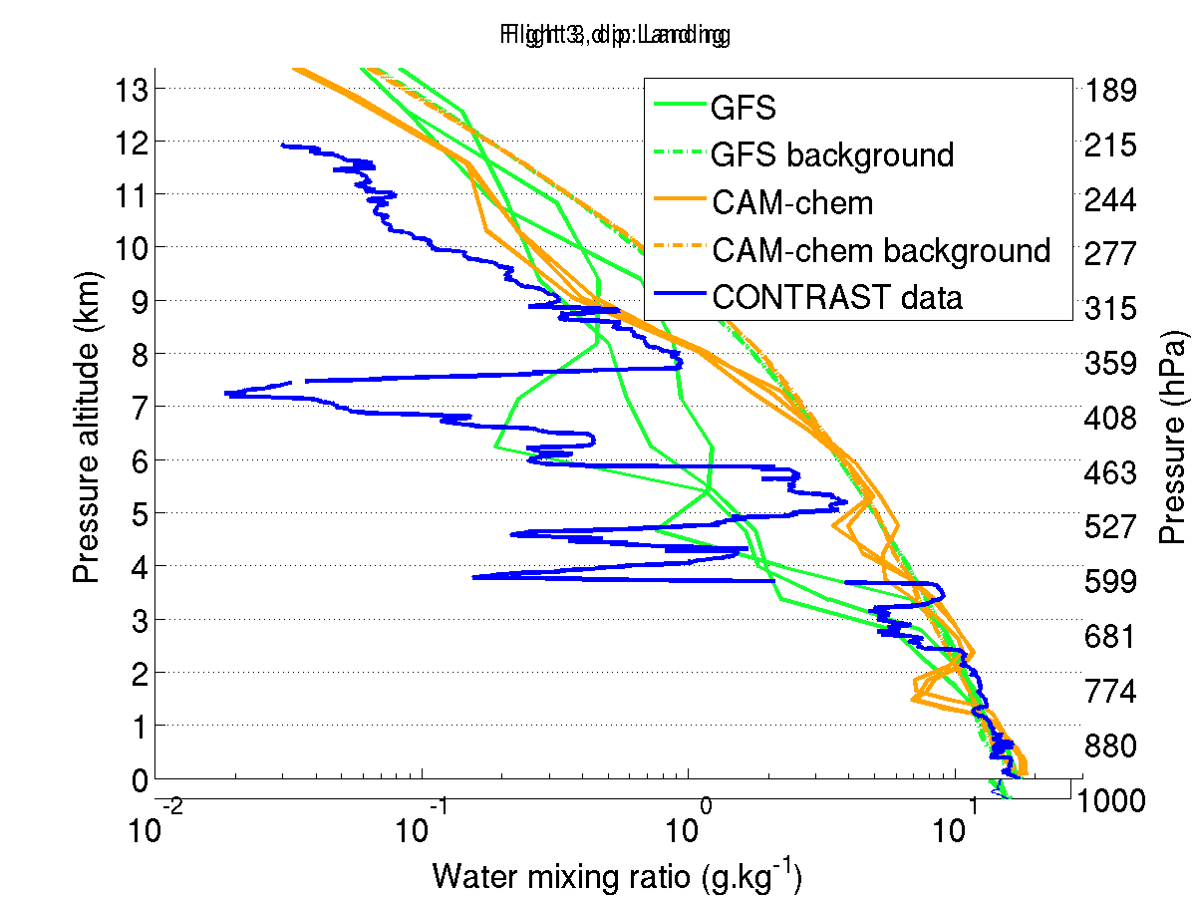
RF03

Slide 5
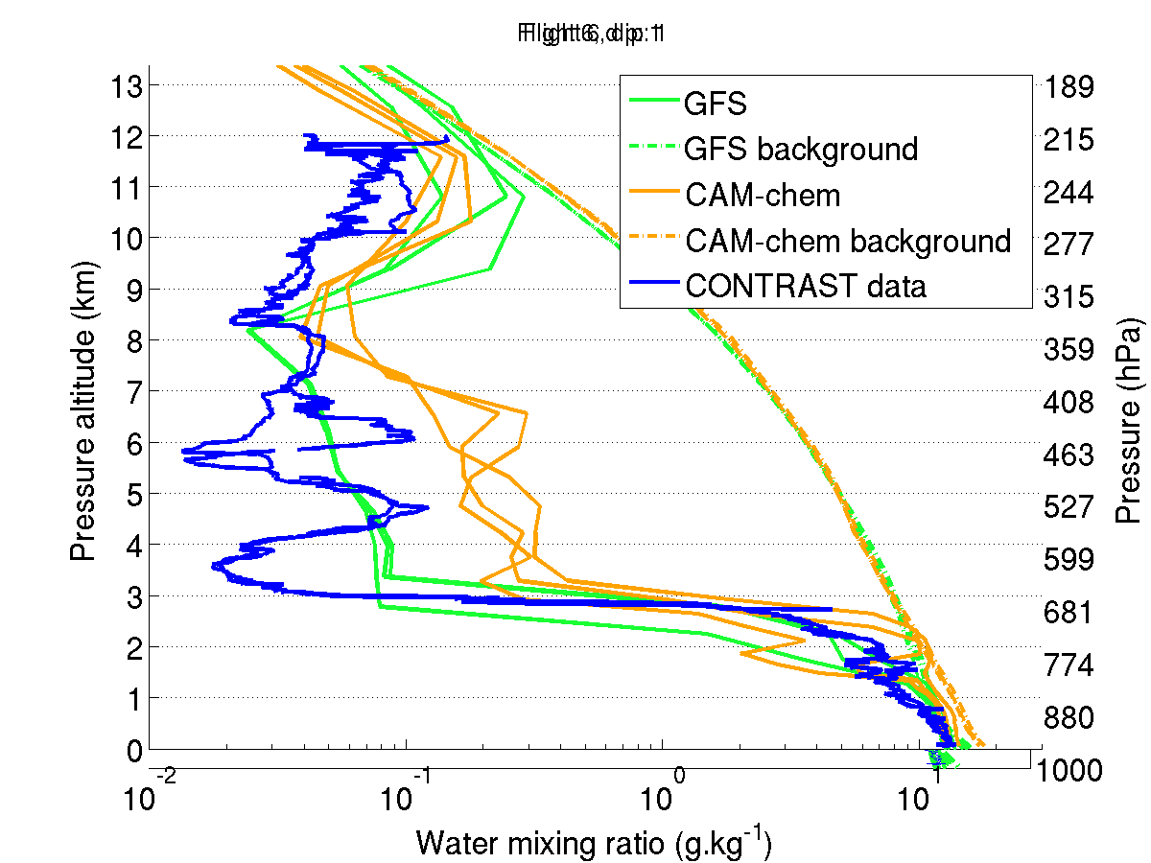
RF06

Slide 6
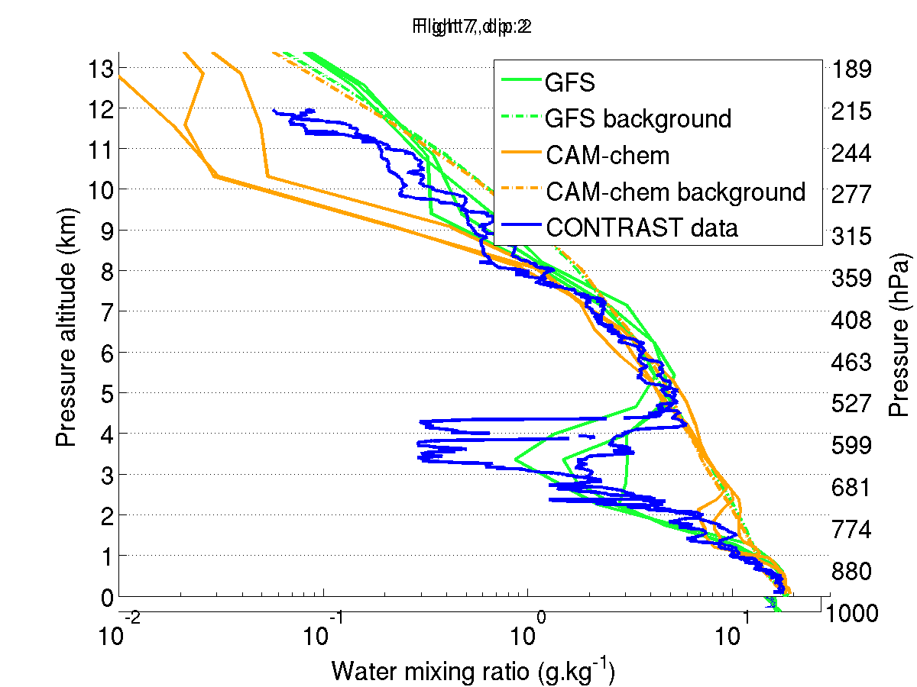
RF07

Slide 7
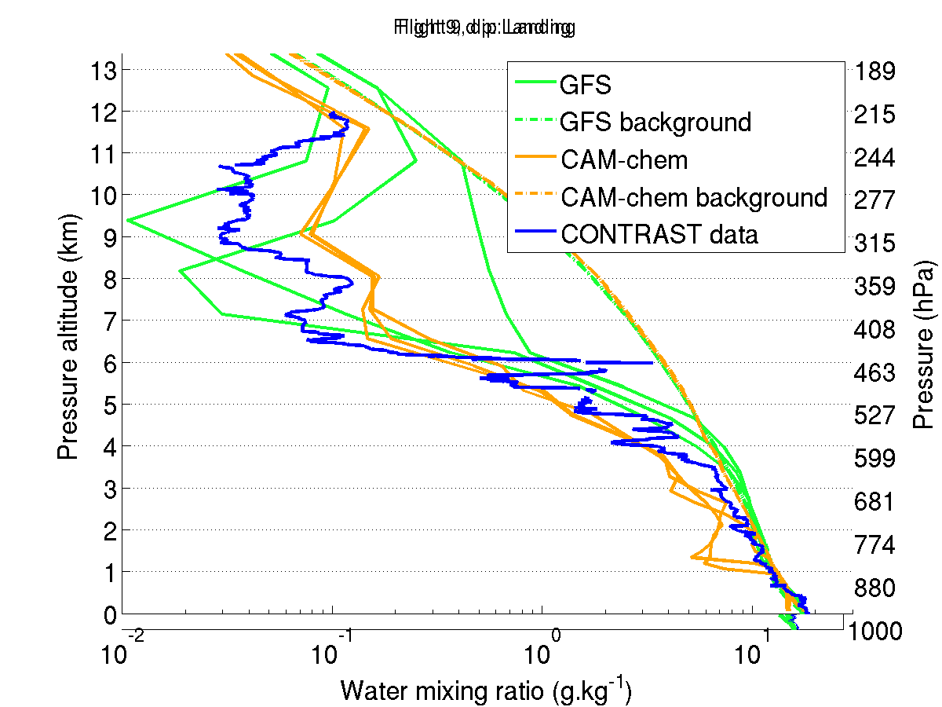
RF09

Slide 8
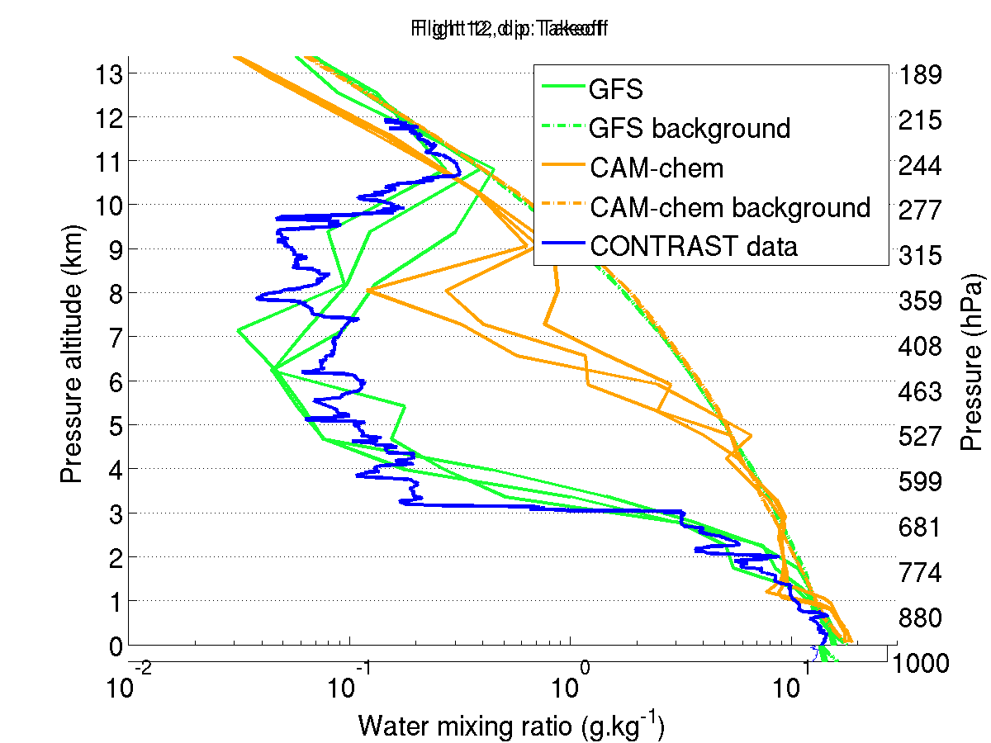
RF12

Slide 9
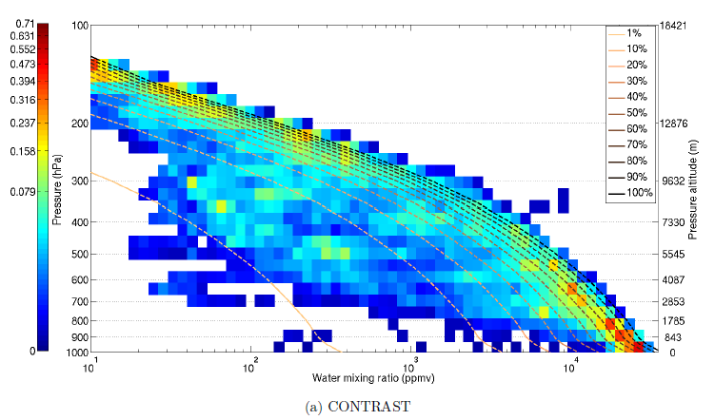
PDF’s of H₂O vs. altitude
CONTRAST

Slide 10
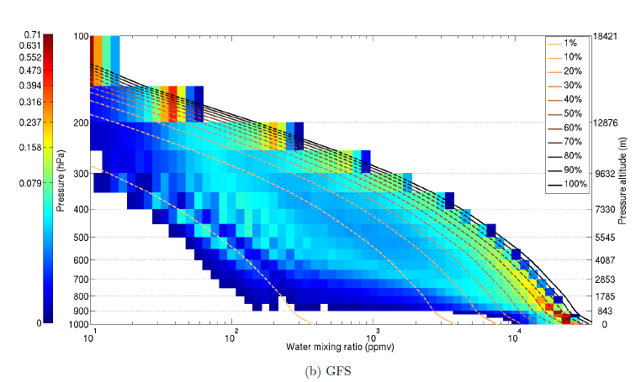
PDF’s of H₂O vs. altitude
in a region near Guam
CONTRAST
GFS

Slide 11
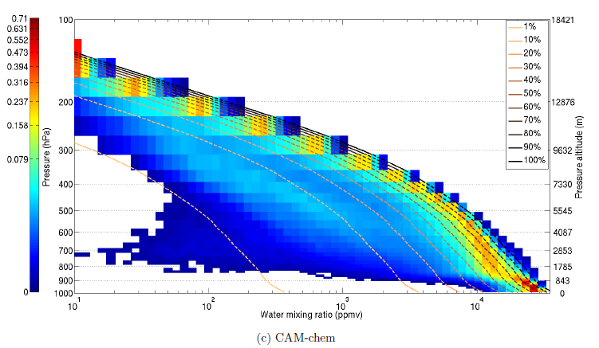
PDF’s of H₂O vs. altitude
CONTRAST
CAM-Chem

Slide 12
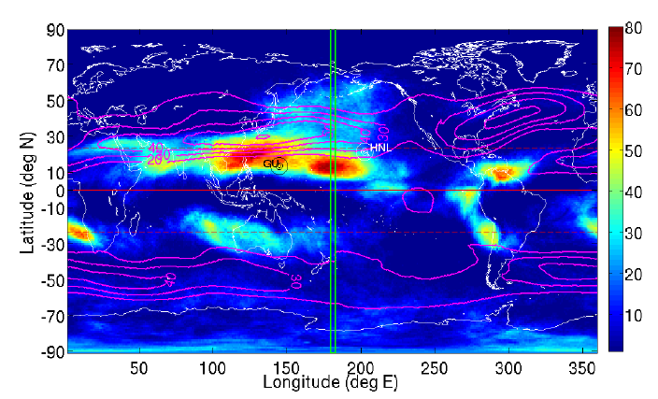
GFS frequency of very dry layers (<8% RH)
January – February 2014
340 K

Slide 13
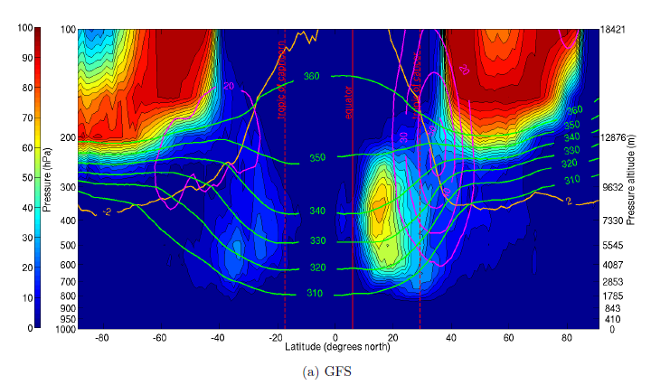
GFS frequency of very dry layers (<8% RH)
January – February 2014
Guam

Slide 14
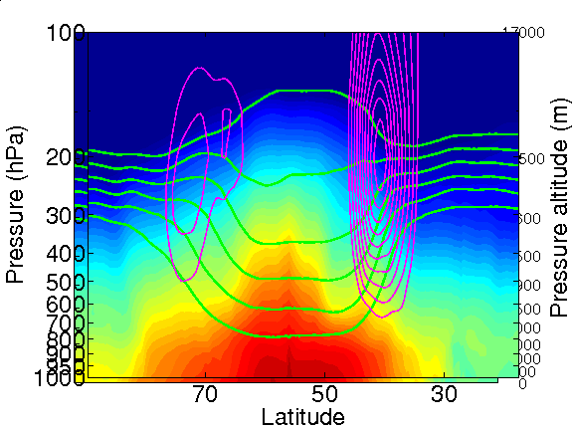
frequency of
very dry layers
background
H₂O structure

Slide 15
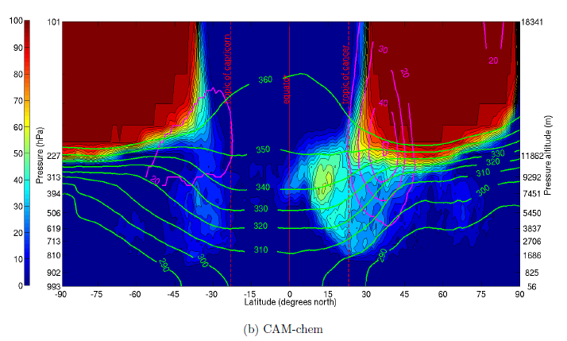
GFS
CAM-Chem

Slide 16
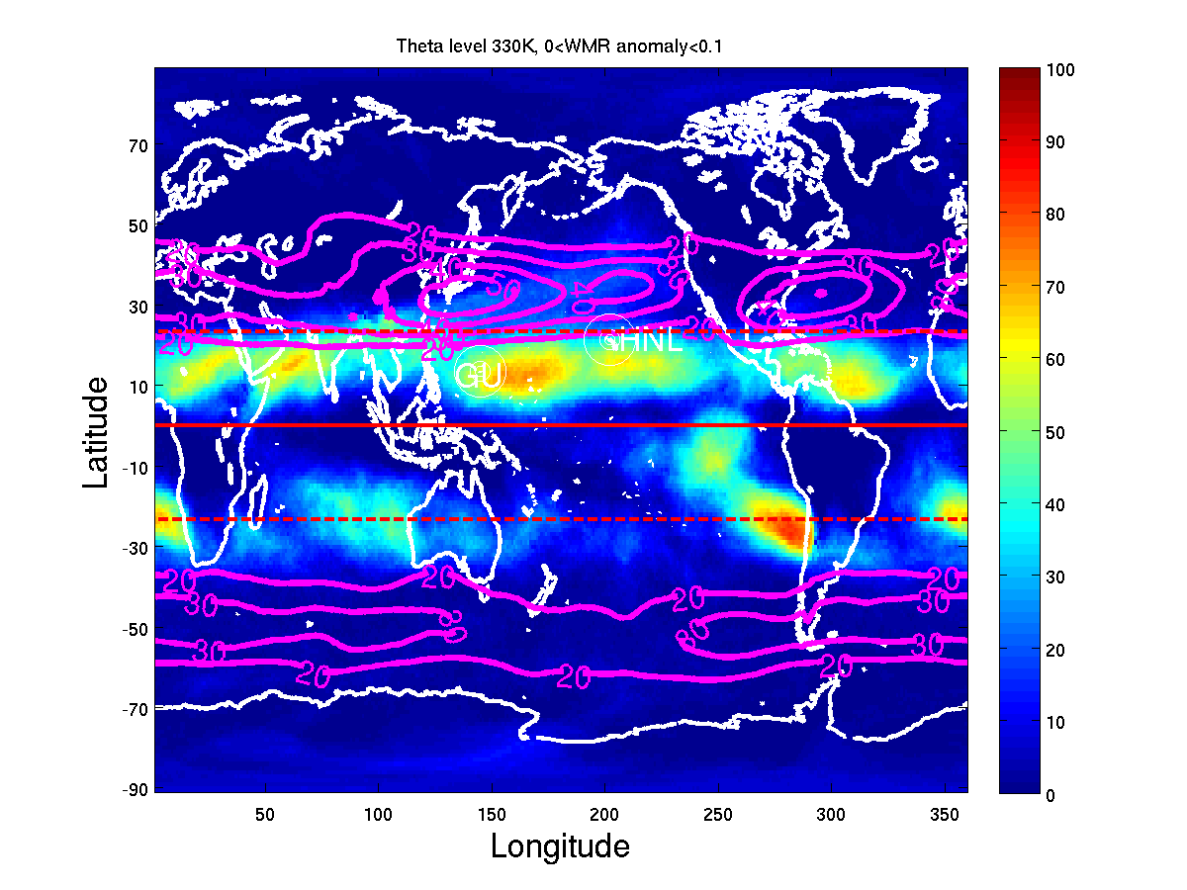
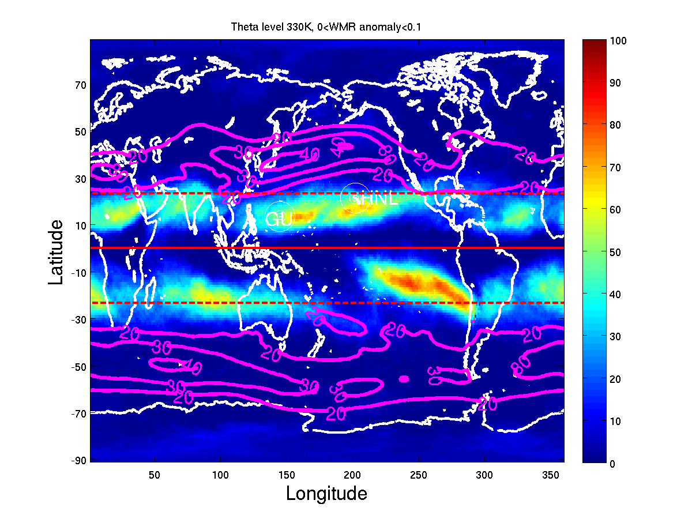
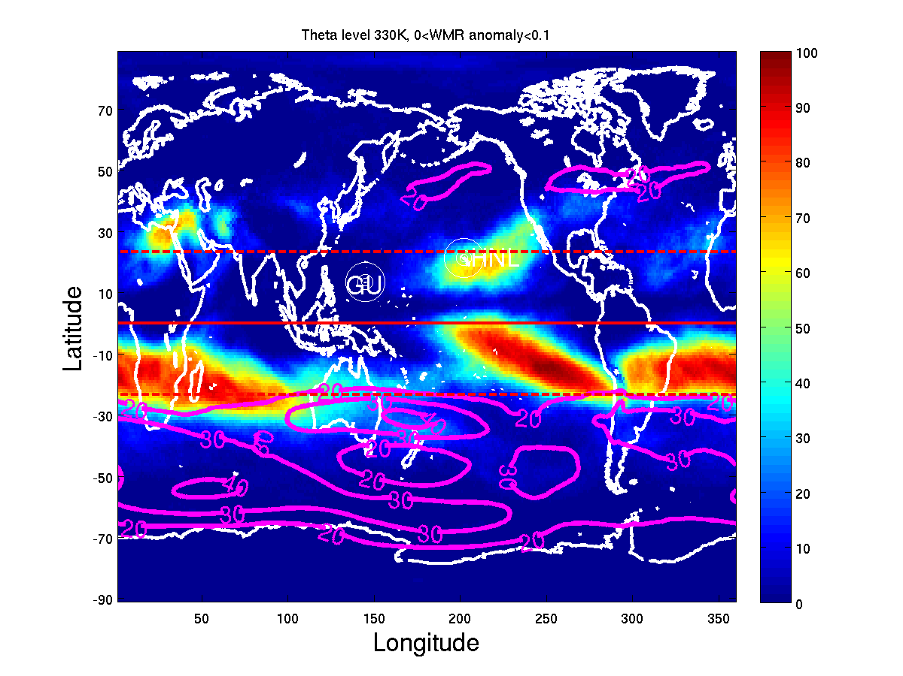
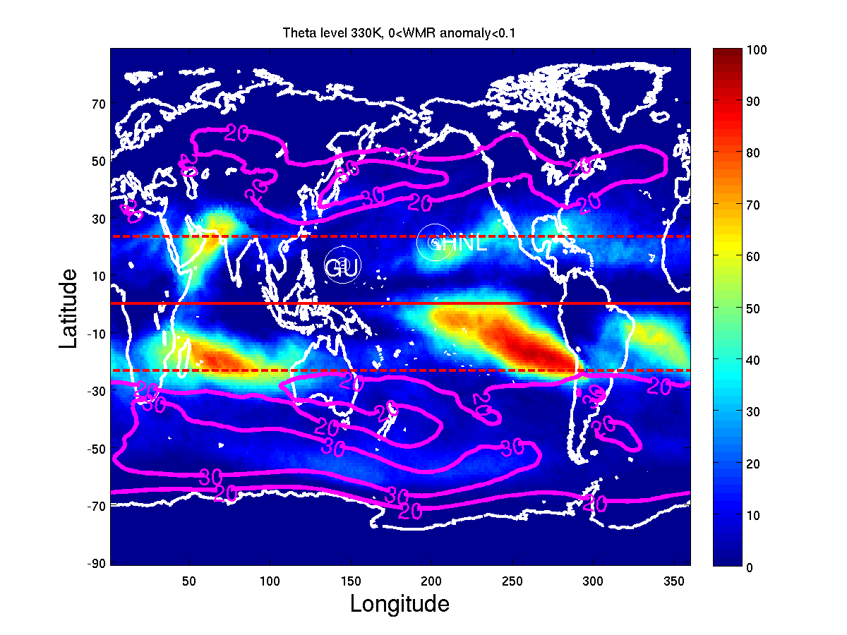
Global climatology from GFS at 330 K
DJF
MAM
JJA
SON

Slide 17
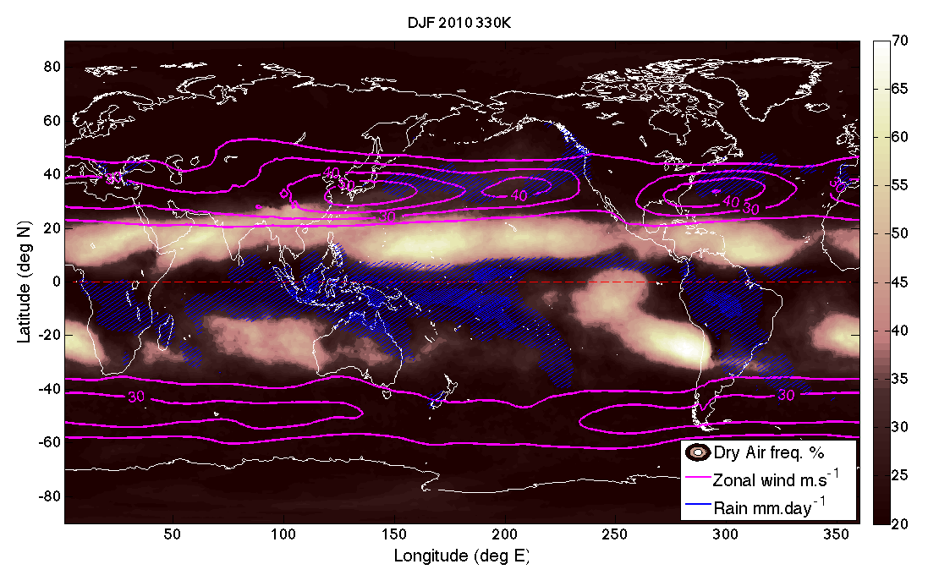
Frequent dry layers fill tropical regions outside of precipitation
DJF
dry layers
climatological precip
Note dry regions are also regions of downwelling Hadley circulation

Slide 18
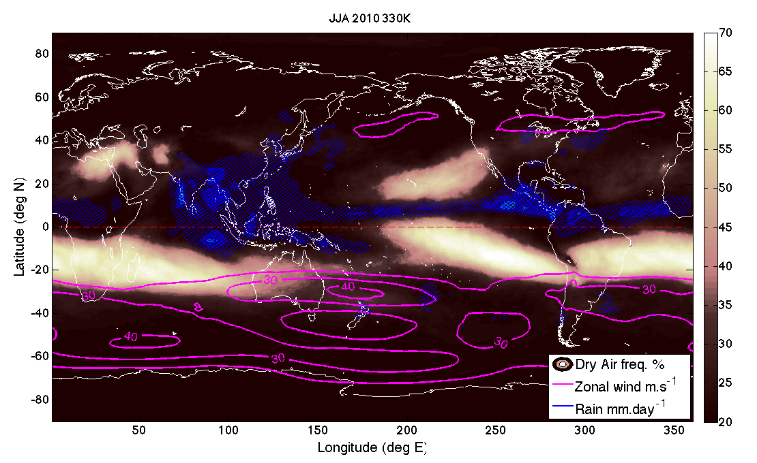
JJA
precip
dry layers

Slide 19
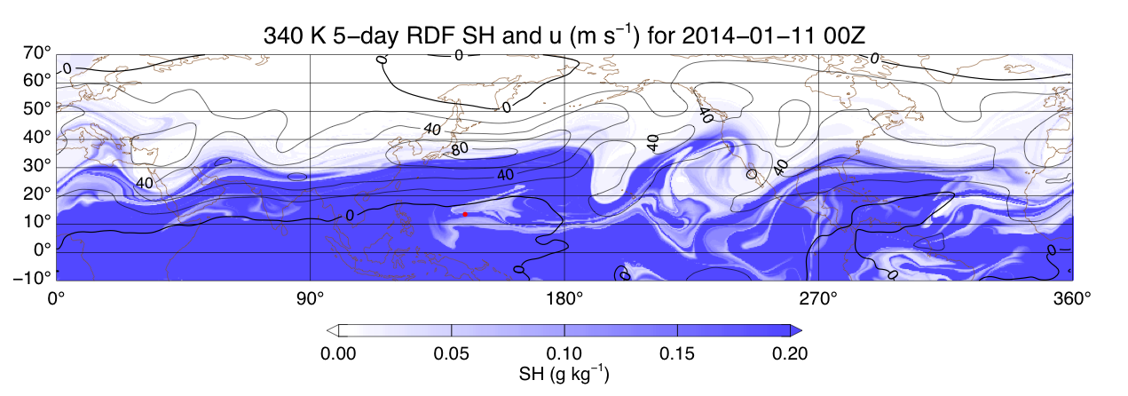
High resolution Reverse Domain Filling (RDF) calculations
from Ken Bowman, Texas A&M

Slide 20
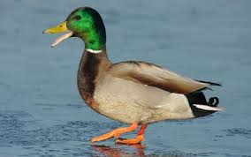
High resolution Reverse Domain Filling (RDF) calculations
from Ken Bowman, Texas A&M
westerly duct

Slide 21
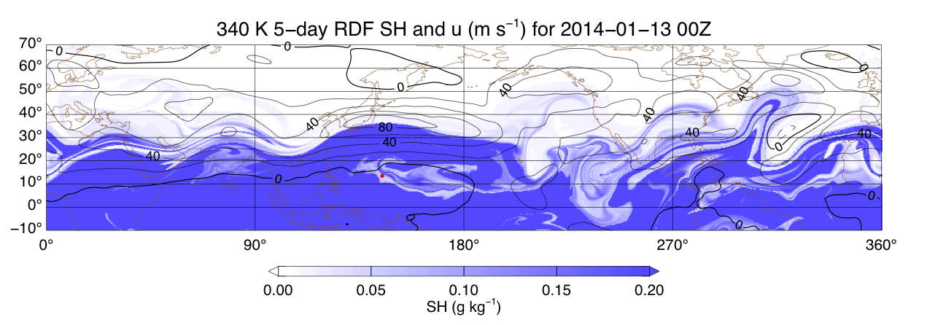

Slide 22
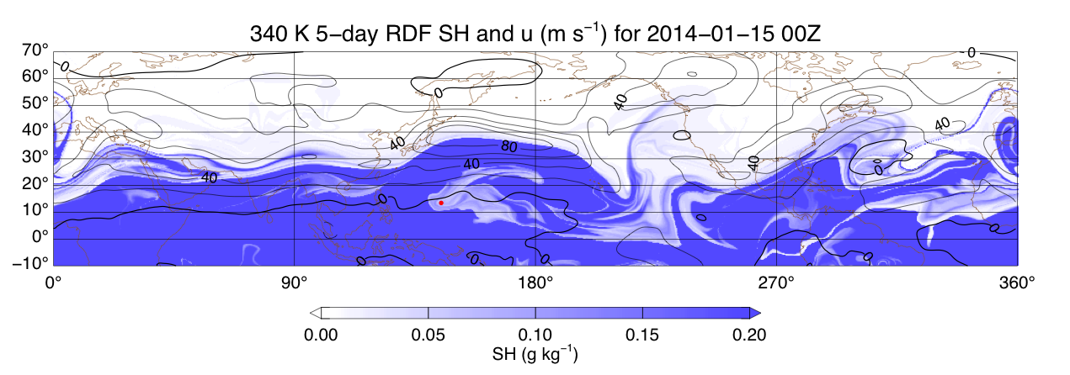

Slide 23
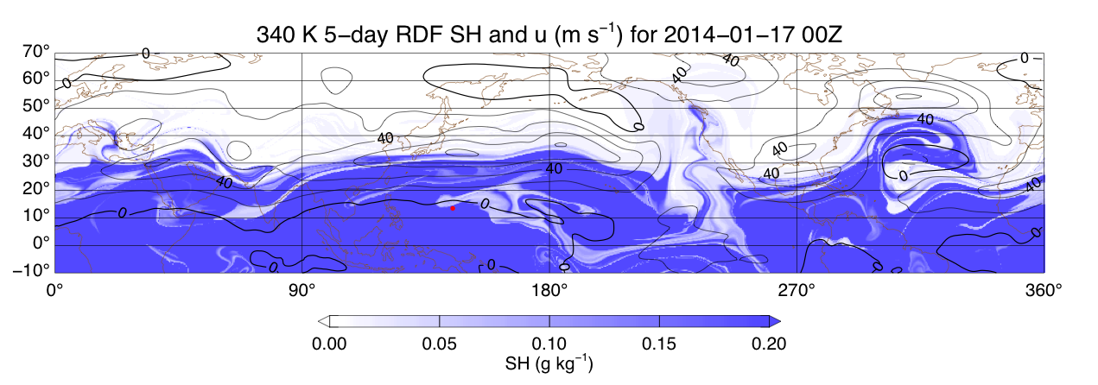

Slide 24
January – February 2014

Slide 25
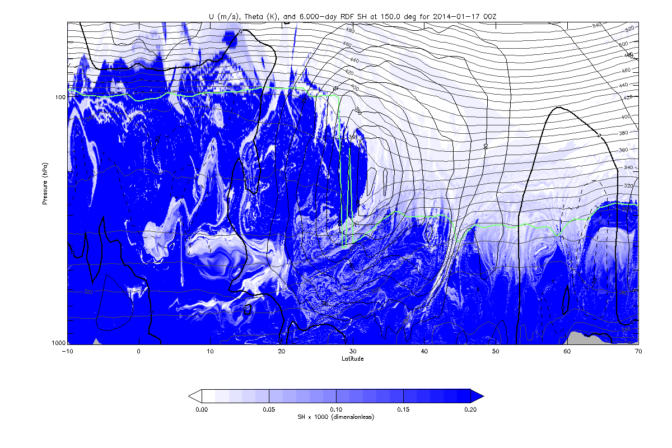
Vertical slice at longitude near Guam
January 17
100
16 km
Height / Pressure
10 km
300
1000
0
Latitude

Slide 26
January 17
100
RF03
Jan 17
300
1000
Latitude

Slide 27
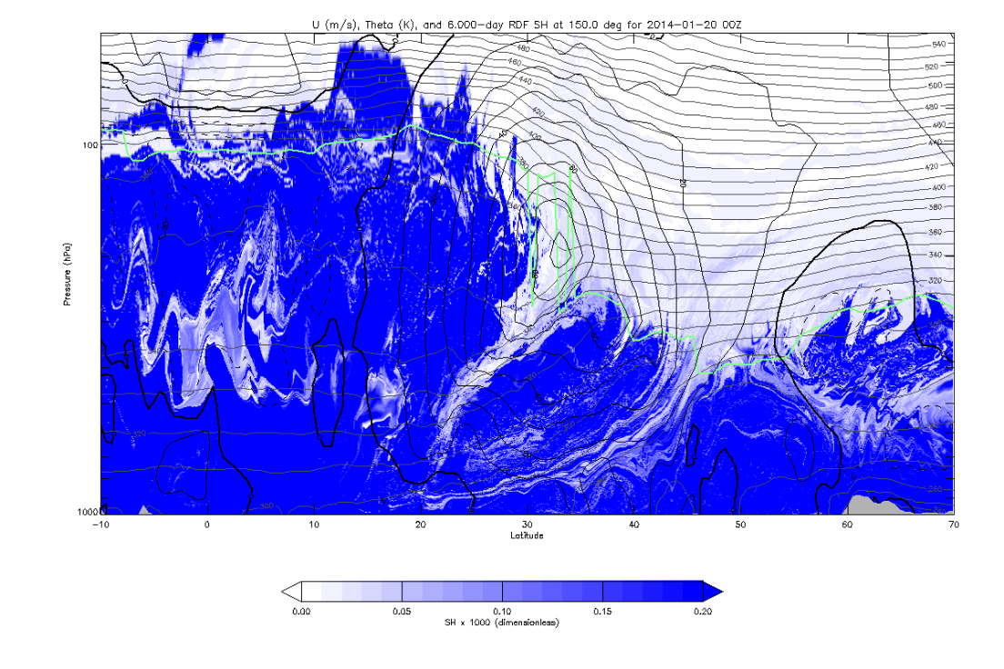
January 20
100
300
1000
Latitude
transport past equator
fine-scale structures
induced by large-scale transport

Slide 28
Key points:
GFS analyses agree well with dry profiles in CONTRAST
Dry layers are ubiquitous in subtropics in all seasons, max near 330-340 K
Trajectory calculations suggest quasi-horizontal transport from
extratropical UTLS (through westerly duct for CONTRAST)
Not a new result: extensive literature on dry layers and mechanisms
January – February 2014
340 K

Slide 29
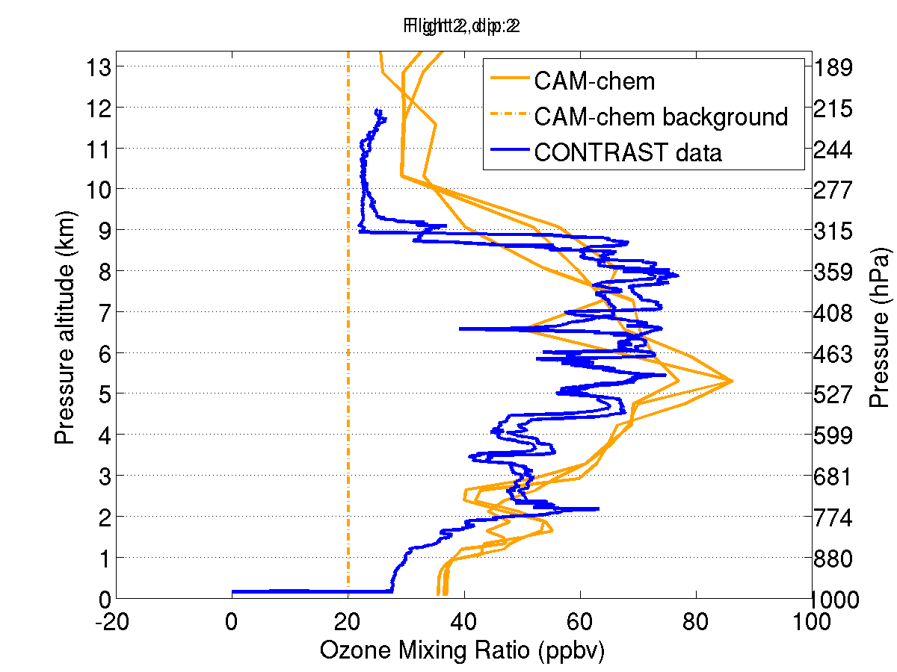
Extra slides
RF02

Slide 30
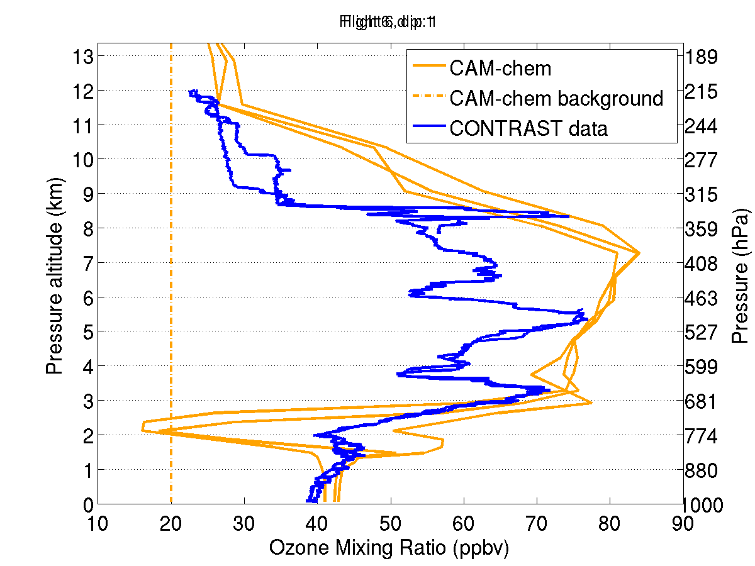
RF06

Slide 31
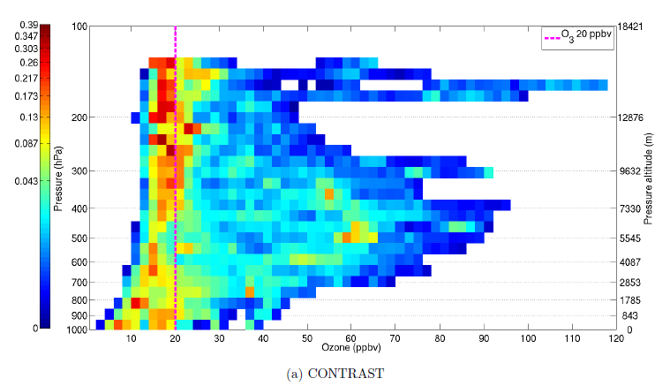
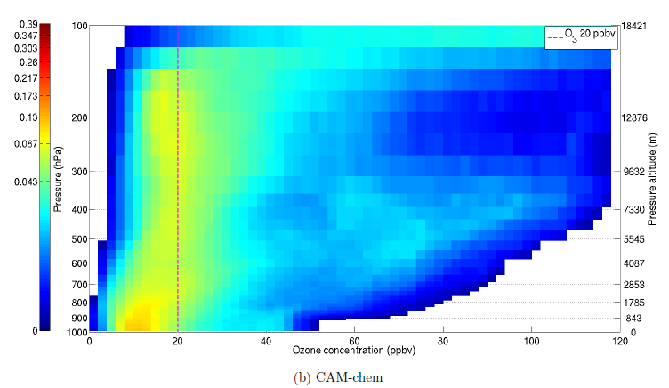
CONTRAST
CAM-Chem

