Slide 1
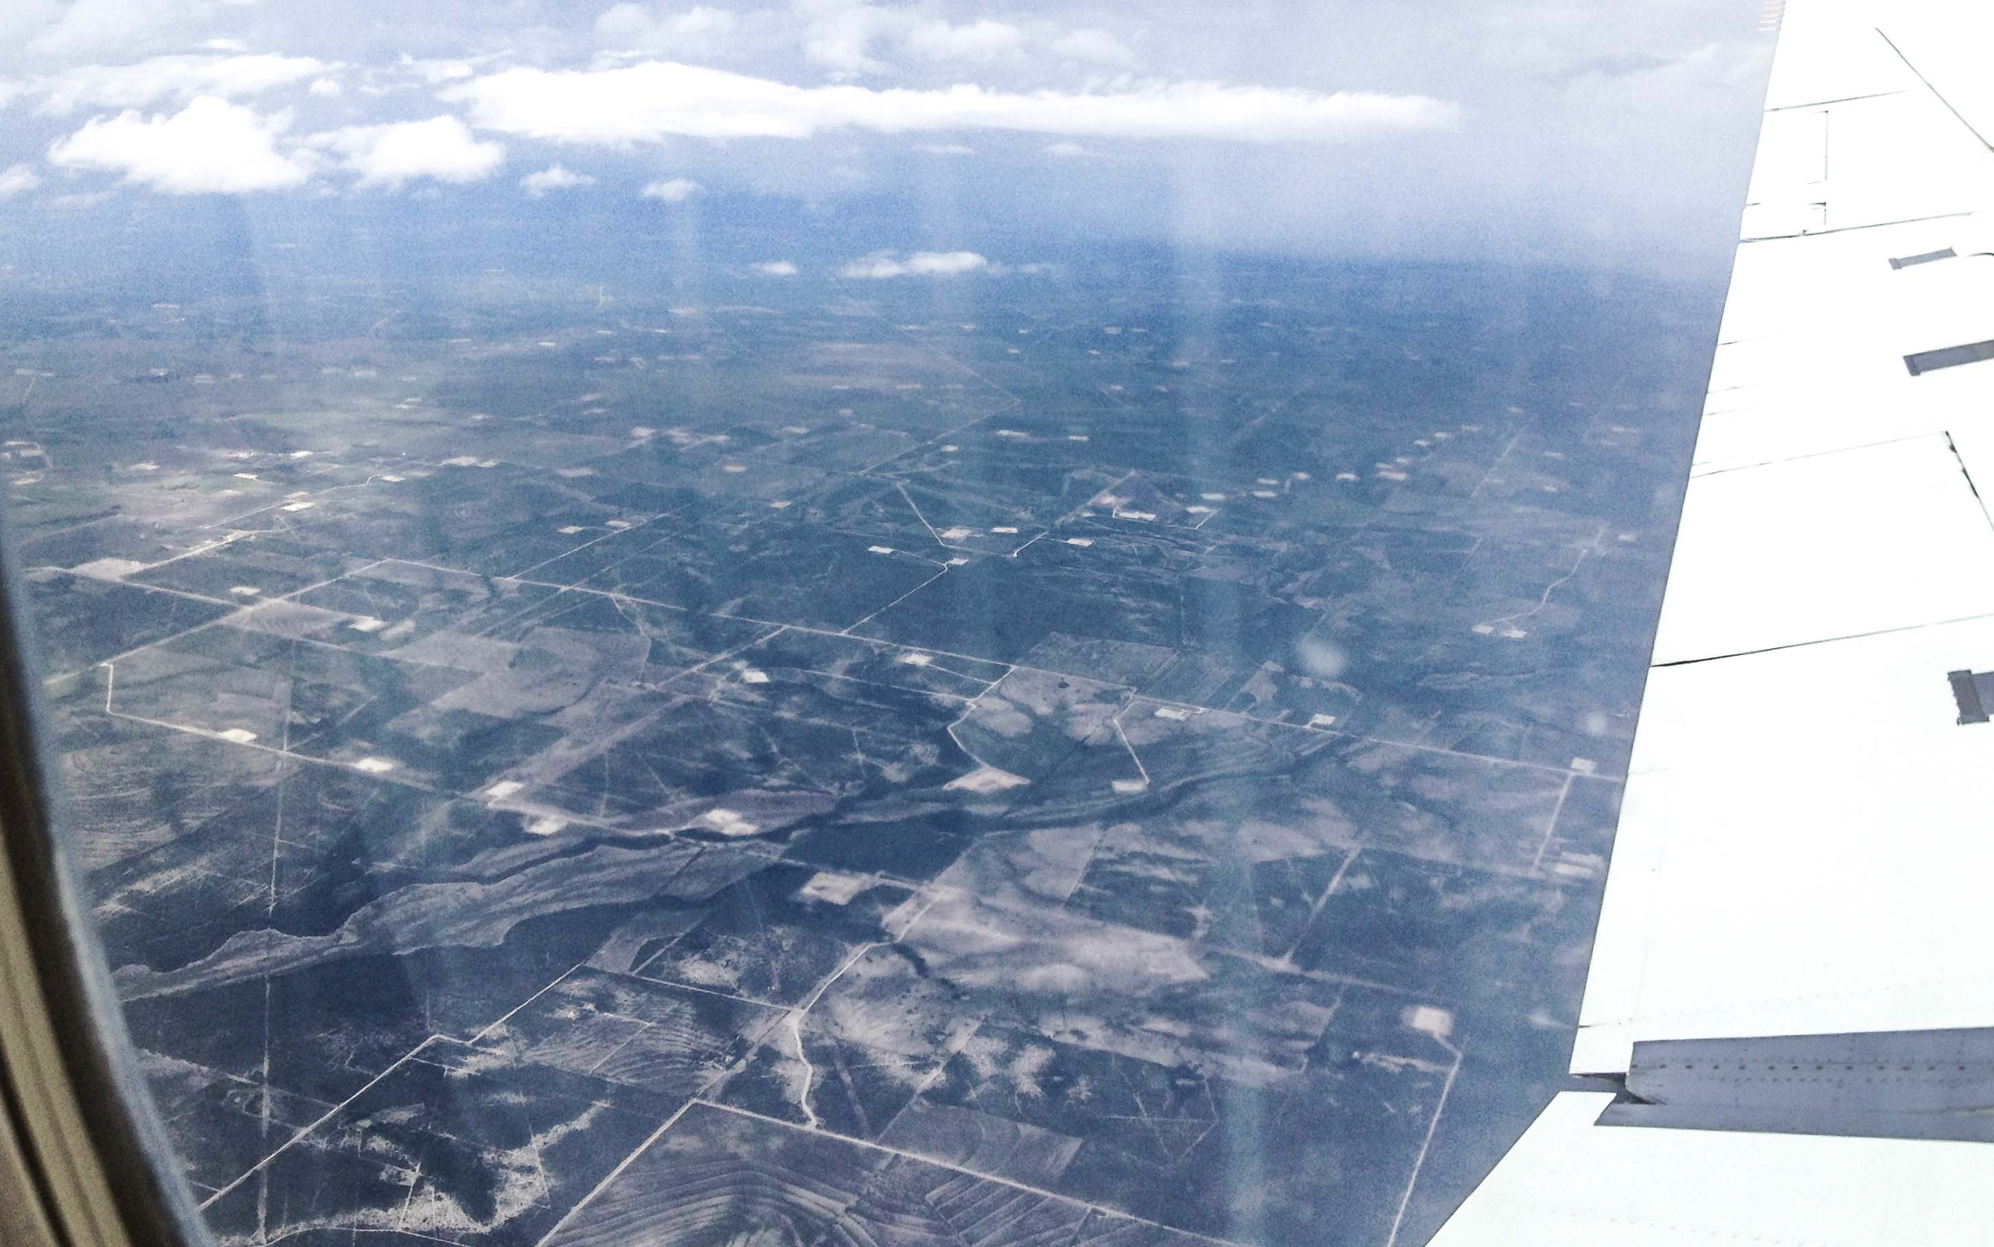
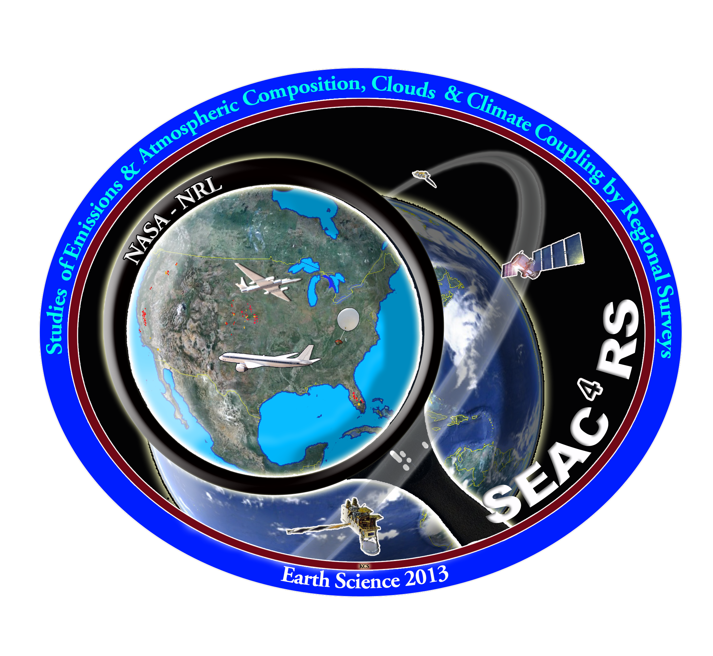

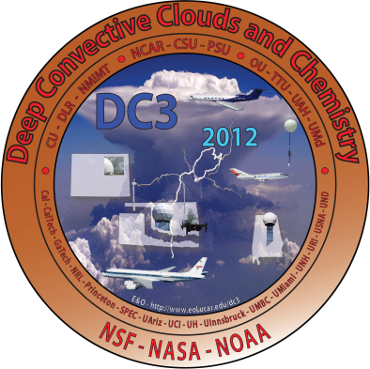

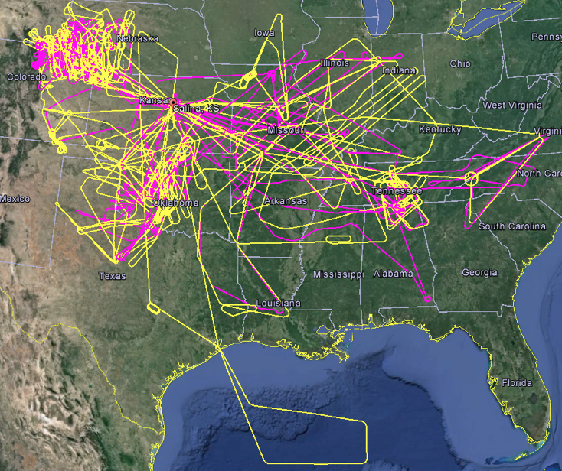
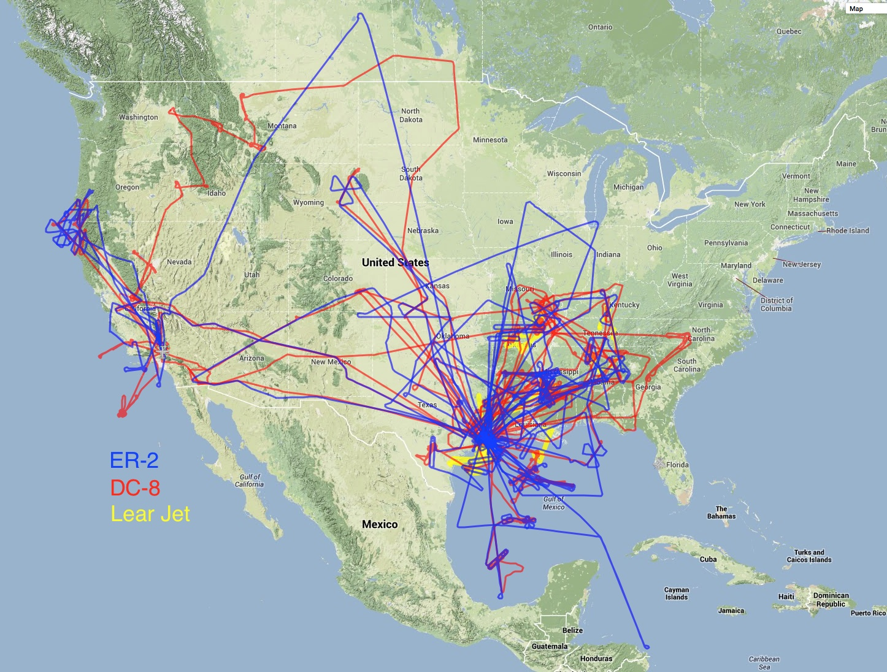
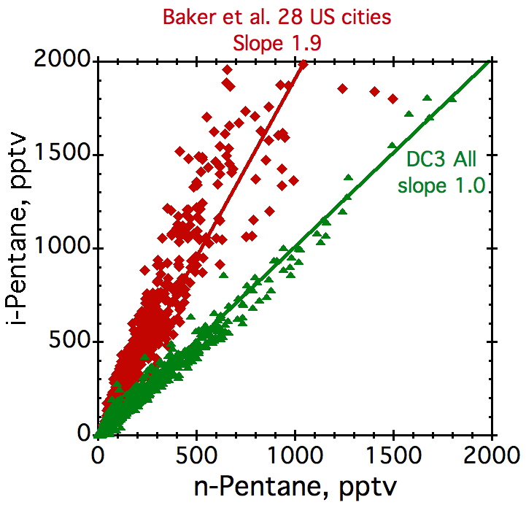
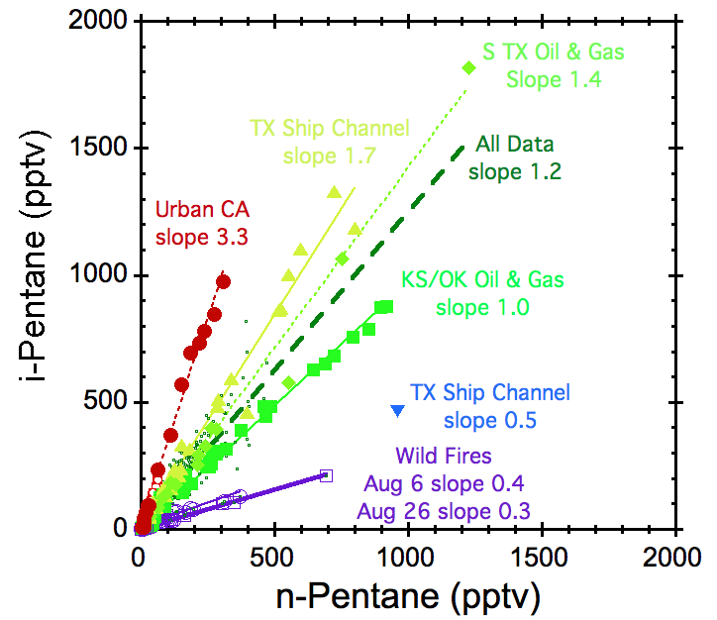
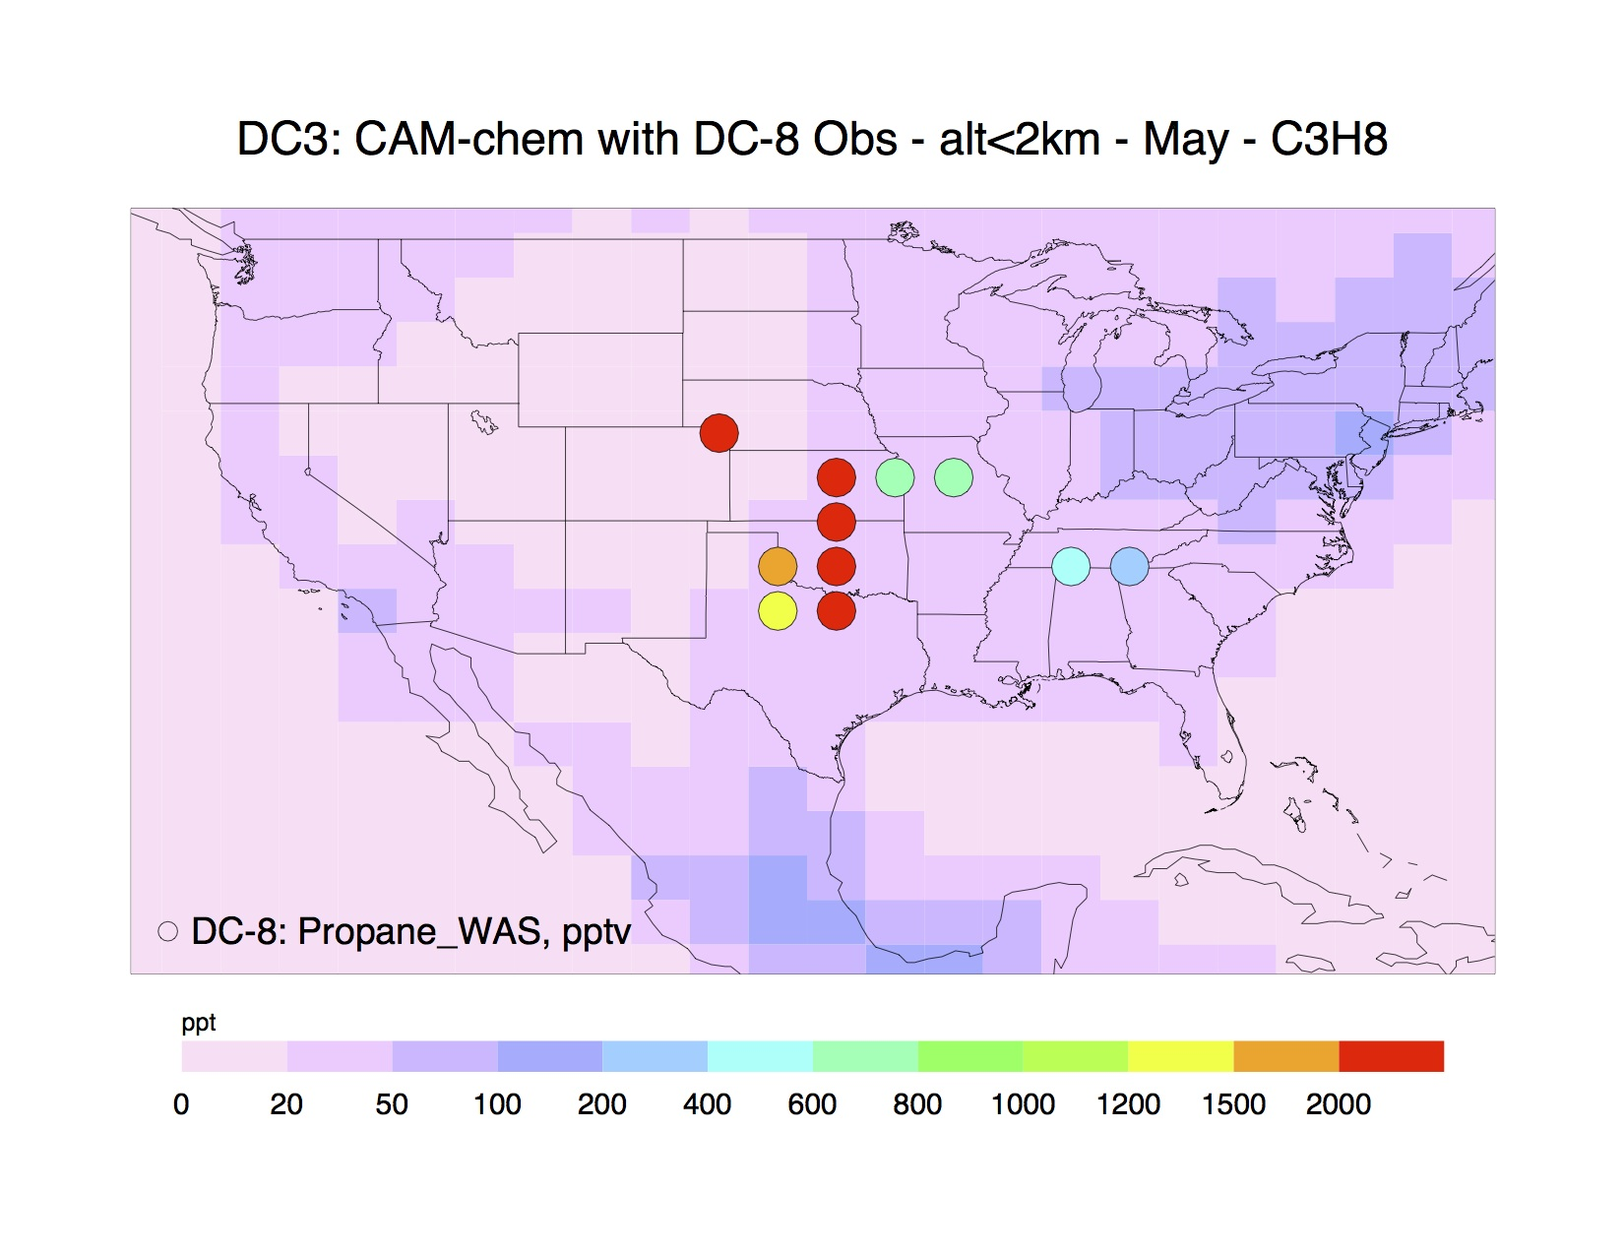
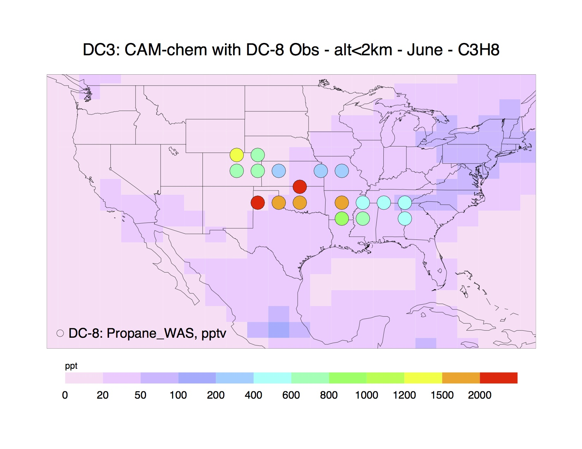
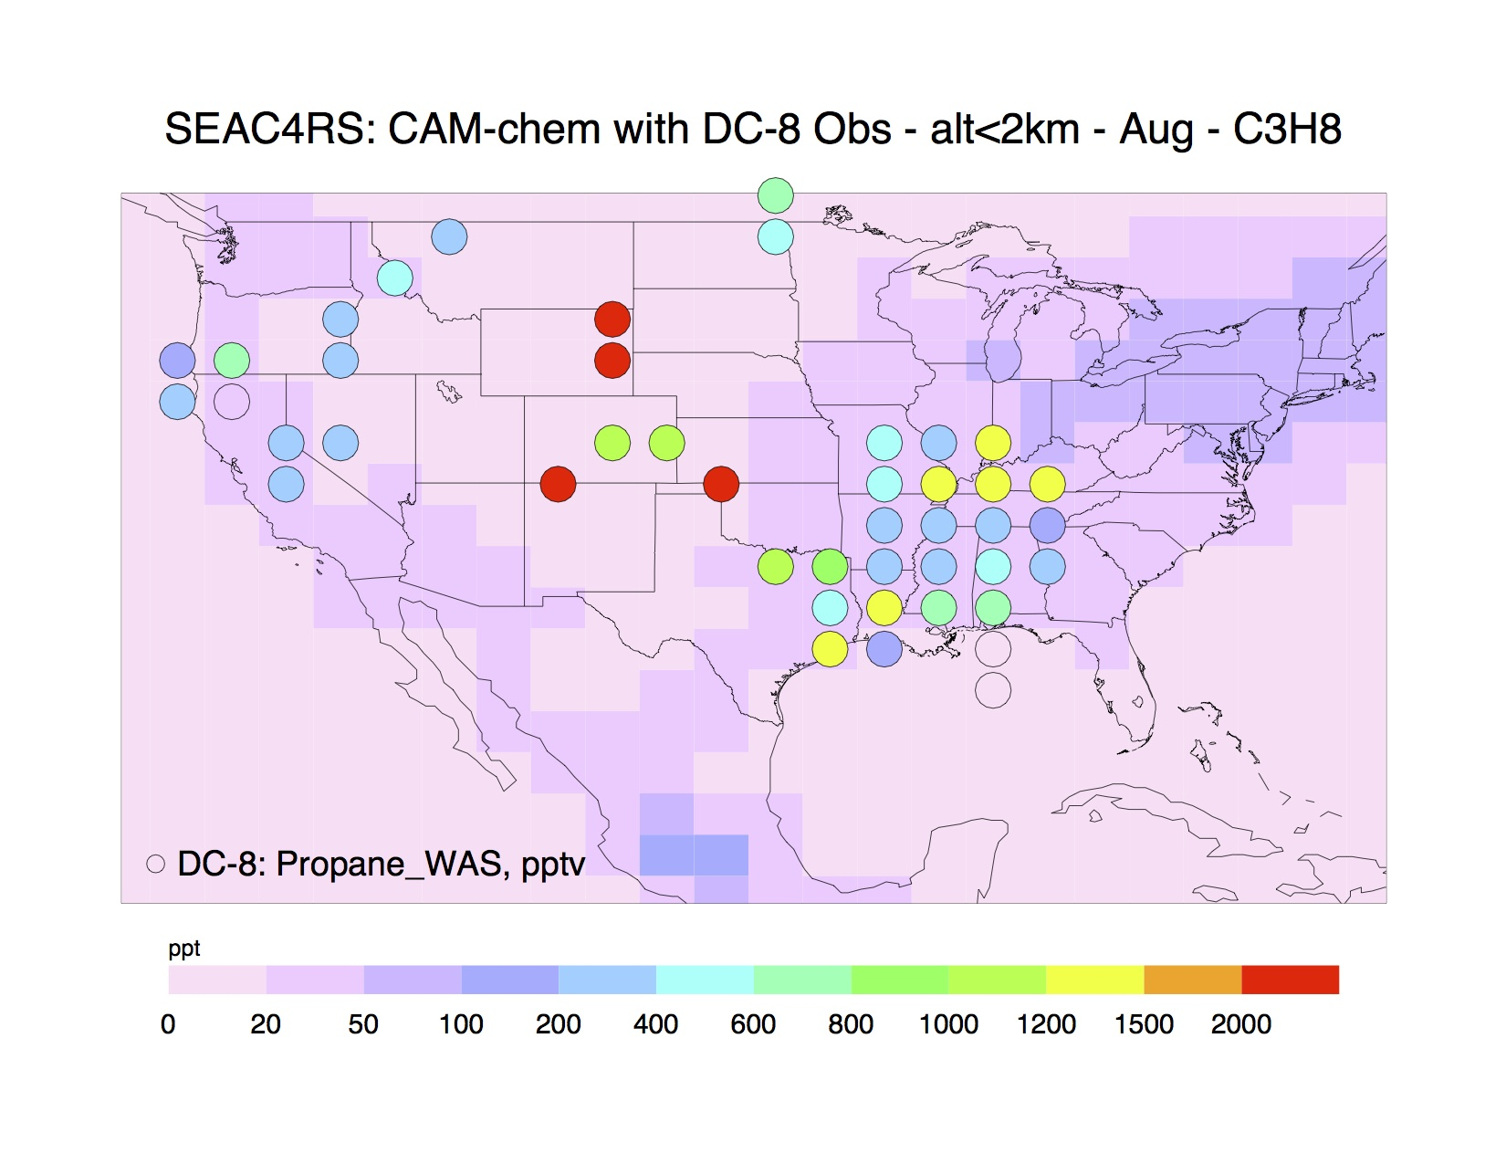
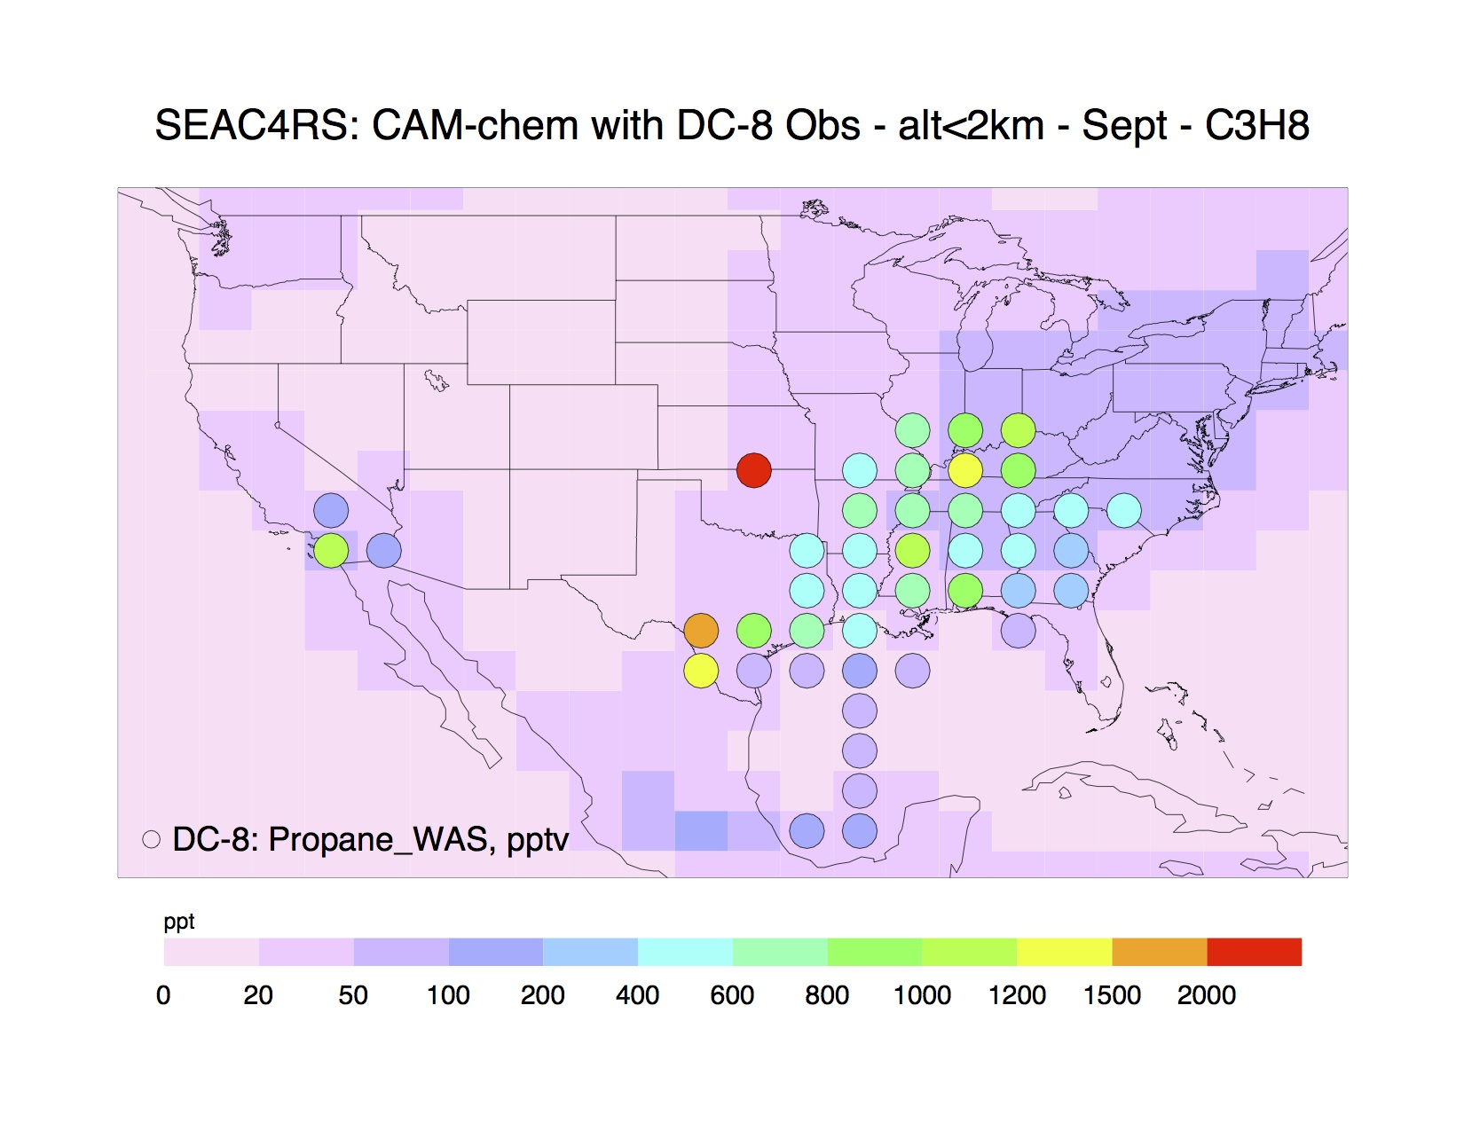
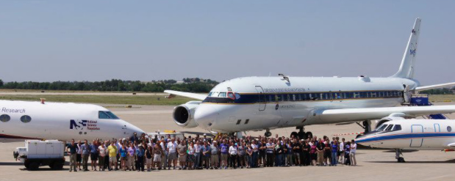
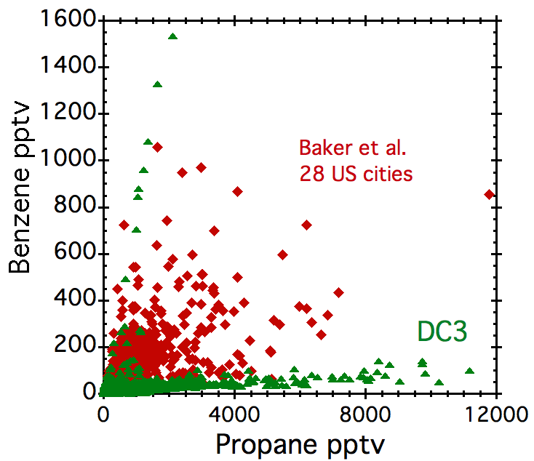
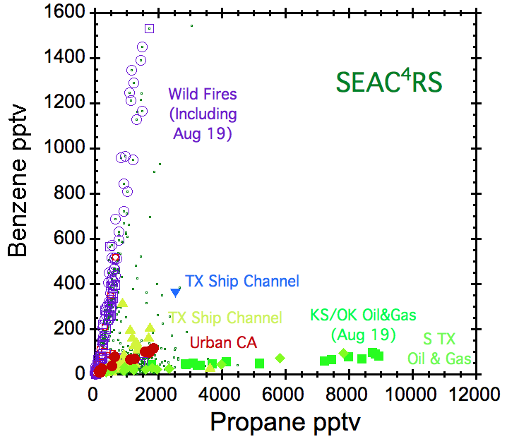
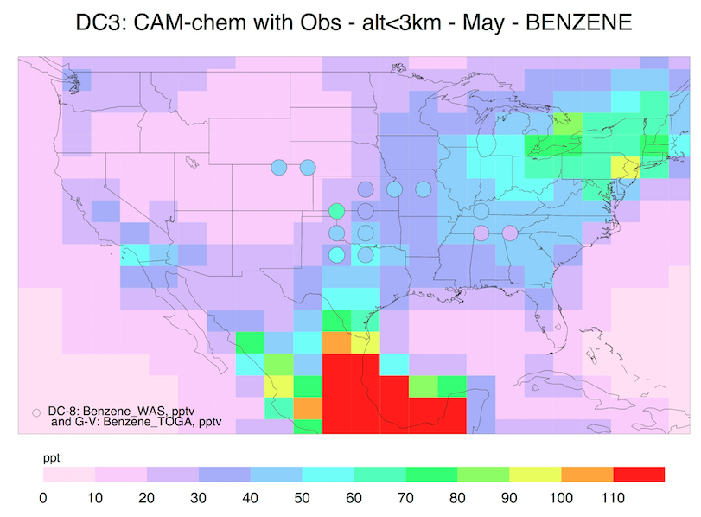
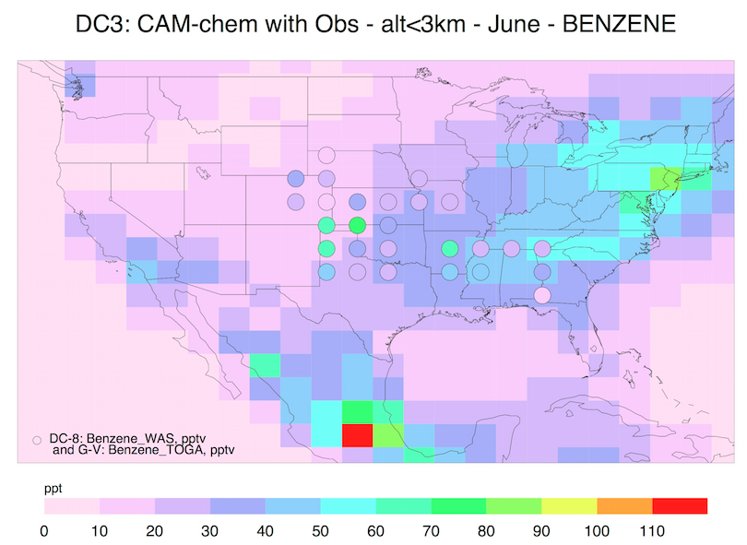
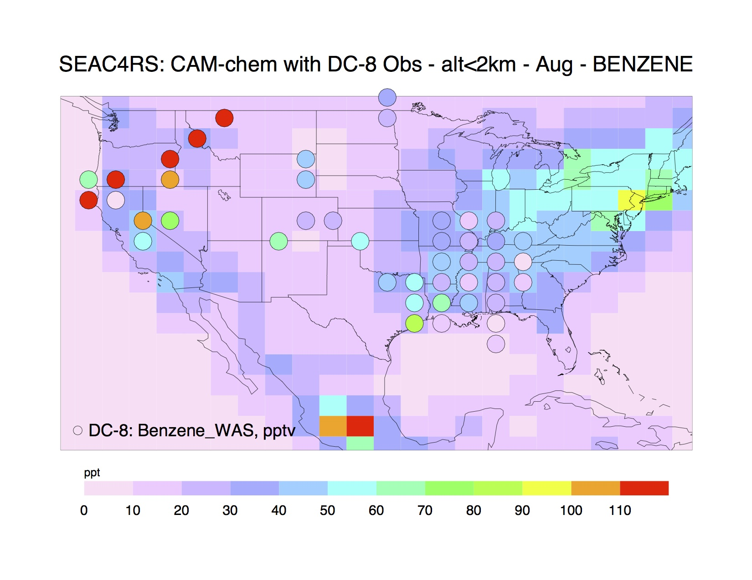
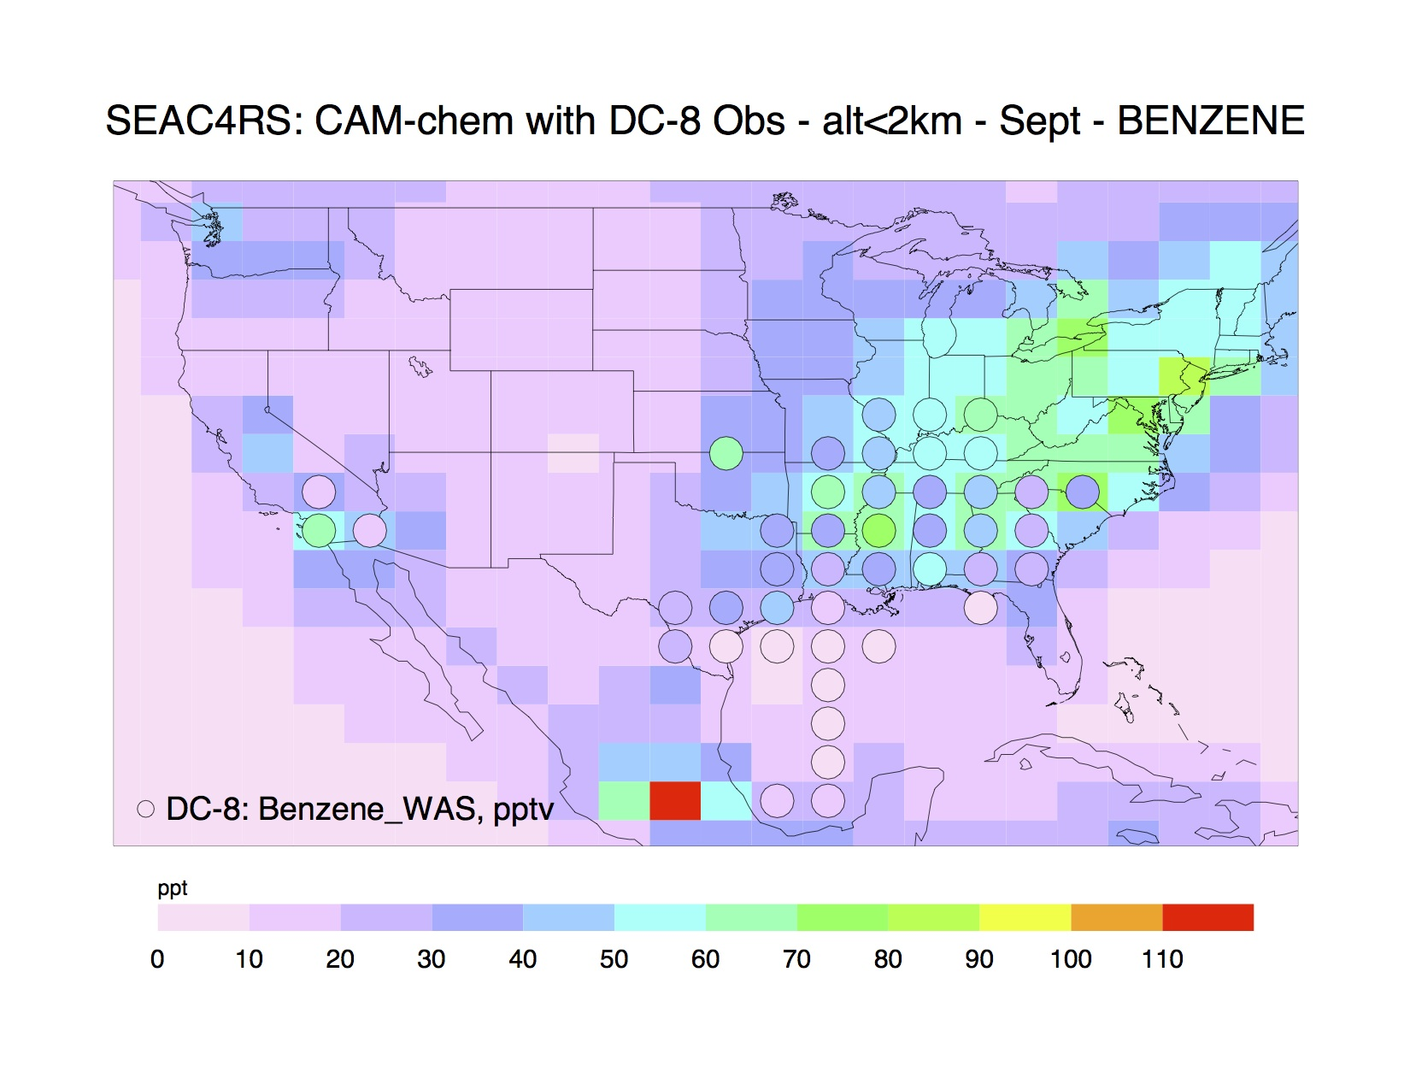
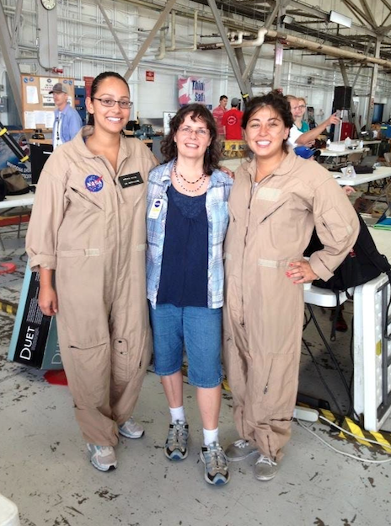
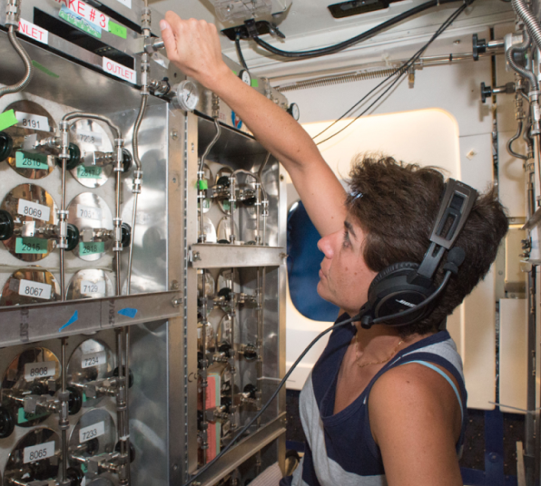
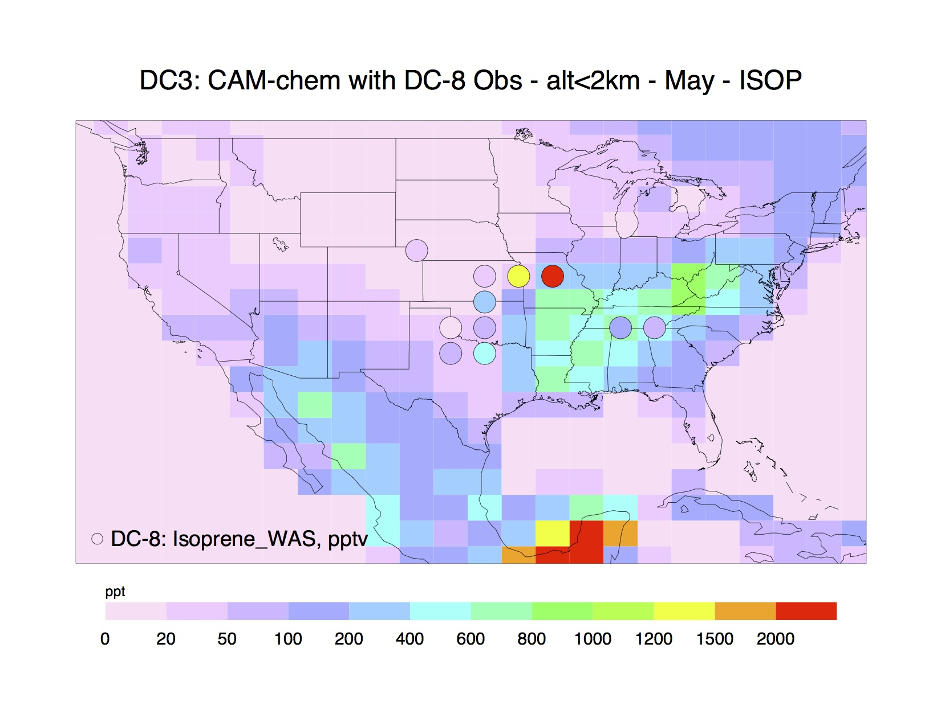
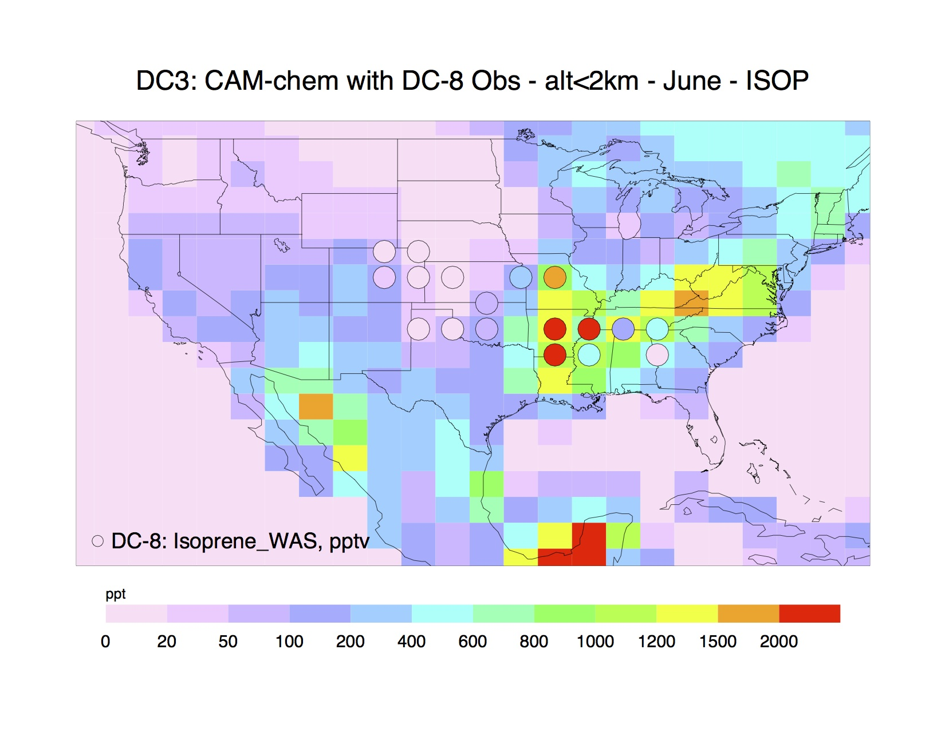
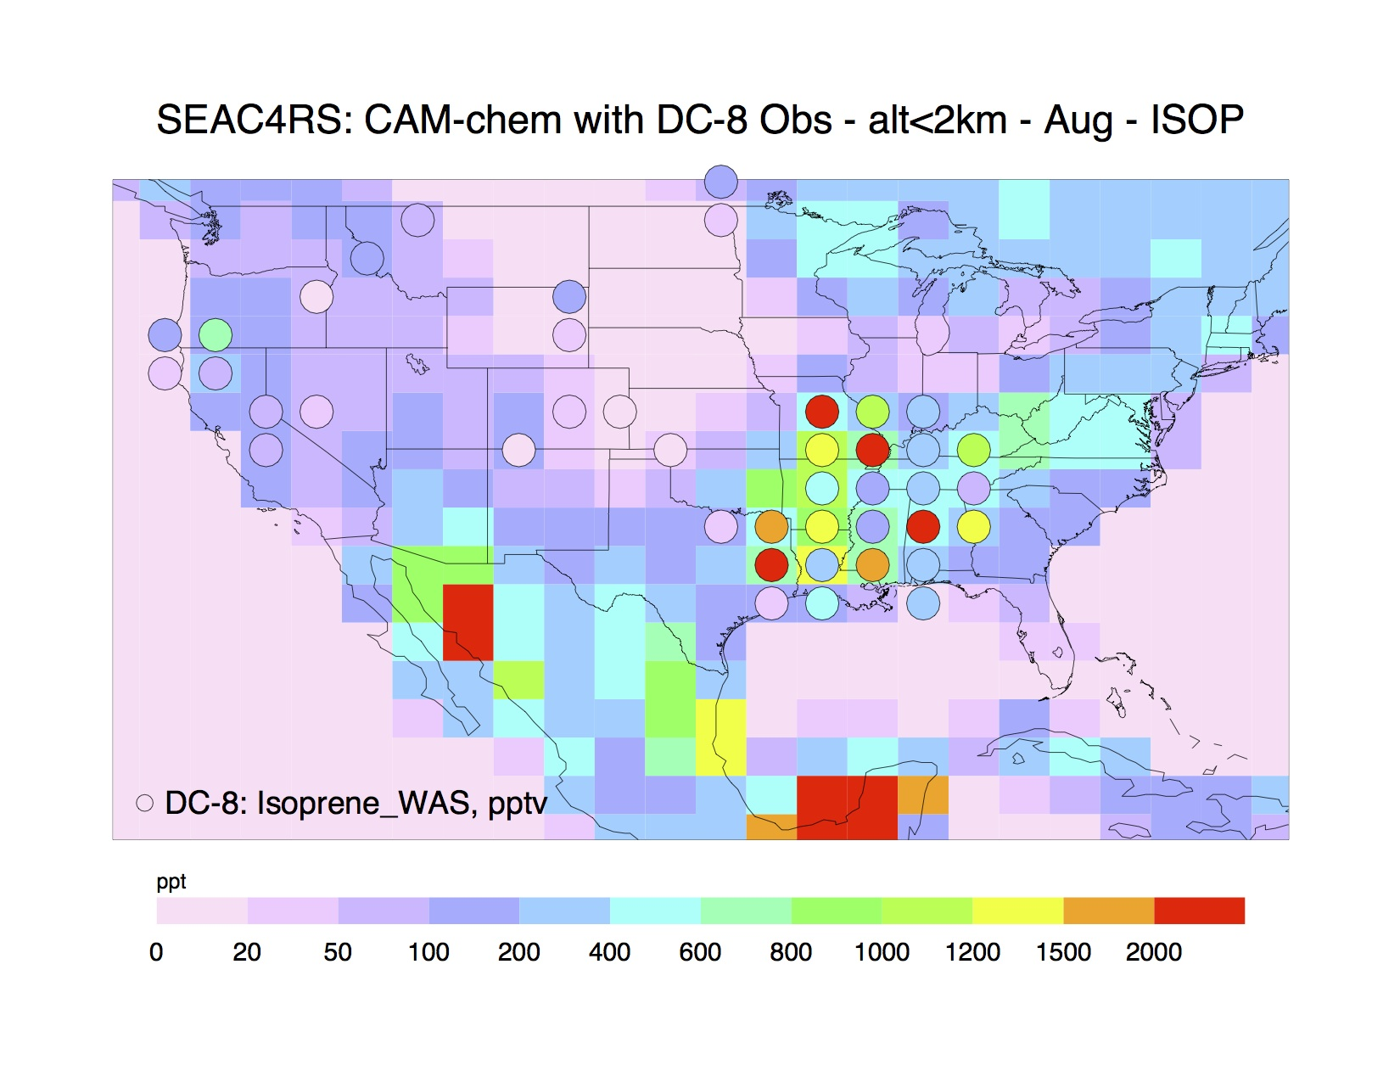
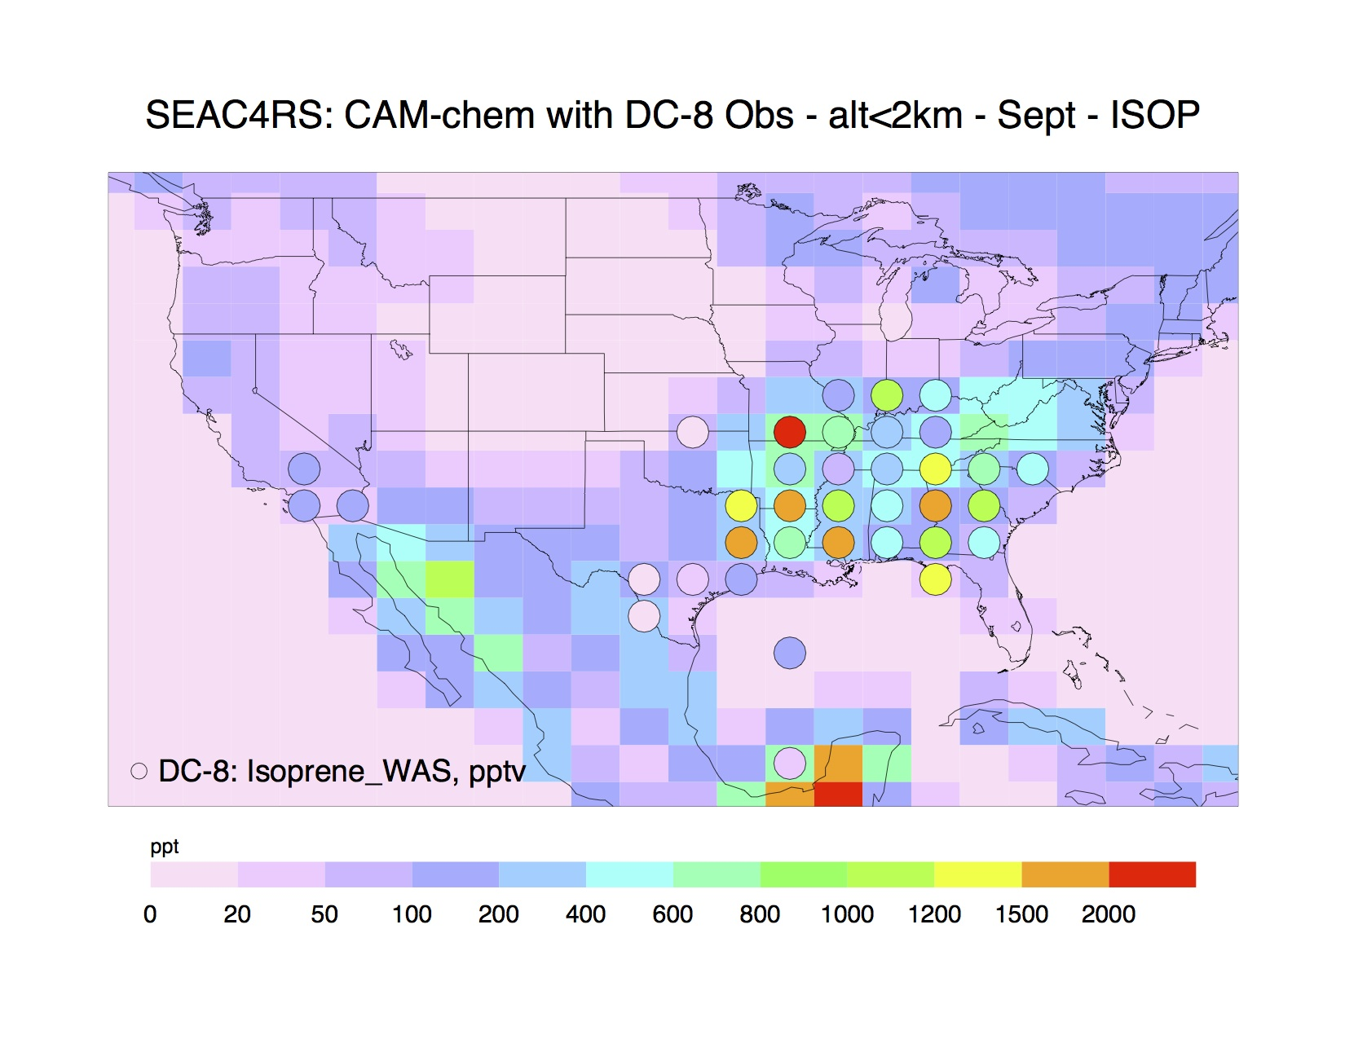
Spatial Distributions and Source Characterization of Trace Organic Gases during SEAC⁴RS and comparison to DC3
Nicola J Blake^{1*}, Isobel J Simpson¹, Barbara Barletta¹, Jason Schroeder¹, Josette Marrero¹, Stacey Hughes¹, Gregory Hartt¹, Simone Meinardi¹, Donald R Blake¹
Louisa K Emmons², Rebecca S Hornbrook², and Eric C Apel²
1. Department of Chemistry, University California Irvine, Irvine, CA, United States. 2. Atmospheric Chemistry Division, National Center for Atmospheric Research, Boulder, CO, United States.
Introduction
NASA’s Studies of Emissions and Atmospheric Composition, Clouds and Climate Coupling by Regional Surveys (SEAC⁴RS) campaign was based out of Houston, TX during August and September, 2013. DC3 was based out of Salina, KS during May and June, 2012.
A wide variety of volatile organic compounds (VOCs) and other species were measured during both SEAC⁴RS and DC3 to examine atmospheric chemistry and transport across a range of reactivity.
Flight Tracks for DC3
Flight Tracks for SEAC⁴RS
Source Signature Ratios
CAM-chem Model Comparison
Monthly average model results compared to average observations for each grid.
Hydrocarbon ratios are useful tools to differentiate between air mass types.
i-Pentane and n-pentane are co-emitted from different sources.
The pentanes have similar reaction rate constants so the ratio is preserved as they age.
Pentane source emission ratios have been studied.^{1,2,3} Ratios for oil and natural gas fugitive emissions are in the range 0.8-1.2^{4,5} but urban sources typically have a higher ratio and biomass fires have a lower ratio.
Benzene is a combustion tracer, propane is a similarly long-lived oil & gas tracer⁶, so these also make a useful pair for source characterization.
DC3 had an i-/n-pentane slope of 1.01±0.01 consistent with oil and gas as the dominant source.
SEAC⁴RS was characterized by much more diverse hydrocarbon sources, especially biomass burning (BB) and some urban influence.
Propane
SEAC⁴RS
DC3 May
DC3 Jun
SEAC⁴RS
Aug
SEAC⁴RS
Sep
The U.S. is a rich environment for such studies with its extensive biogenic emissions, especially in the SE US that mix with air pollution from large urban areas, smoke from agricultural and wild fires, emissions from oil and gas operations, and clean air from the Gulf of Mexico. All of these chemicals are subject to processing and transport by deep convection.
The model averages are lower than the measurements especially in central and western US where there is a strong oil and gas signal (regions where propane is high and pentane ratio was close to 1 in Figure 4) that is not picked up by model.
SEAC⁴RS
Benzene
DC3 May
DC3 Jun
SEAC⁴RS
Aug
SEAC⁴RS
Sep
Setting the Scene
More than 50 Hydrocarbons were measured during both SEAC⁴RS and DC3. The UCI Whole Air Sampler (WAS) collected hydrocarbon samples on board the NASA DC-8 aircraft. The NCAR Trace Organic Gas Analyzer (TOGA) measured a wide range of VOCs on board the NSF/NCAR GV aircraft during DC3.
Figure 2. Trace gas ratios for DC3 and SEAC⁴RS showing various sources/air mass types – color coded by i-pentane/n-pentane ratio from top panels.
The model averages are generally slightly higher than the measurements over the eastern continent – consistent with long-term trend of lower emissions. There is a strong wild fire signal in the NW US (high benzene/low propane) during SEAC⁴RS that not picked up by the model, which is not surprising as specific fires were targeted – i.e., not representative of monthly average conditions.
SEAC⁴RS Source Signatures Case Study – DC-8 August 19, 2013
Oil & gas
at low alt
BB
Isoprene
BB
BB at
mid alt
BB at
mid alt
DC3 May
DC3 Jun
SEAC⁴RS
Aug
SEAC⁴RS
Sep
Hydrocarbon Vertical Distributions
Oil & gas
at low alt
Propane
n-Pentane
Urban
DC3
SEAC⁴RS
DC3
SEAC⁴RS
Figure 3. Map and time series plots for the DC-8 SEAC⁴RS flight of August 19, 2013.
Urban
There is generally good agreement considering that the model results represent a 24-hour average – so can not be expected to represent the high daytime peaks often sampled by the aircraft over areas with high isoprene emitting vegetation. The expected seasonal trend of isoprene, with a peak in summer (June and August here), is generally well captured by the measurements and the model.
The SEAC⁴RS August 19 flight targeted aged smoke from wildfires in Idaho and Wyoming, sampling it over WY and again at 5-6 km over KS/OK (low i/n-pentane ratios and elevated benzene relative to propane). The low altitude leg over KS/OK sampled air with a strong oil and gas signature (i/n-pentane ratios close to 1 and elevated propane relative to benzene). Some urban influence (elevated i/n-pentane) was noted on the aproach into Houston TX.
Conclusions/Take Home
NMHC ratios are useful for characterizing/filtering for different sources.
SEAC⁴RS was much less dominated by oil and gas alkane emissions compared to DC3.
Model simulations supported this oil/gas signature to be much higher than predictions.
Benzene
Isoprene
Spatial Distributions of Sources
DC3
SEAC⁴RS
DC3
SEAC⁴RS
References
¹ Baker et al.: Measurements of nonmethane hydrocarbons in 28 United States cities, Atmos. Environ. 42, 170–182, 2008.
² Simpson et al., Characterization of trace gases measured over Alberta oil sands mining operations: 76 speciated C₂-C1₀ volatile organic compounds (VOCs), CO₂, CH₄, CO, NO, NO₂, NO_{Y}, O₃ and SO₂, Atmospheric Chemistry and Physics, 10, 23, 11931-11954, 2010.
³ Simpson et al., Boreal forest fire emissions in fresh Canadian smoke plumes: C₁-C₁₀ volatile organic compounds (VOCs), CO₂, CO, NO₂, NO, HCN and CH₃CN, Atmos. Chem. Phys., 11, 6445-6463, 2011.
⁴ Gilman et al. Natural Gas Operations in Northeastern Colorado, 47, 1297−1305, Environ. Sci. Technol., 2013.
⁵ Pétron et al., Hydrocarbon emissions characterization in the Colorado Front Range: A pilot study, J. Geophys. Res., 117, D04304, 2012.
⁶ Katzenstein et al., Extensive regional atmospheric hydrocarbon pollution in the southwestern United States, PNAS, 100(21):11975–11979, 2003.
Figure 1: Vertical distribution of selected hydrocarbons during DC3 and SEAC⁴RS.
Figure 4. WAS and TOGA (DC3) and WAS (SEAC⁴RS) measurements color coded by i-pentane/n-pentane ratio for each sample. The largest markers indicate higher mixing ratios of n-Pentane
ACKNOWLEDGMENTS
This work was funded by: NSF and NASA Award NNX12AB76G. The authors would like to thank NASA for supporting the SEAC⁴RS program and the staff, crew, and aircraft support personnel for their unrivaled professionalism, also Brent Love, Gloria Liu and Barbara Chisholm for their excellent technical support at UC Irvine.
Short-lived compounds can only reach the upper atmosphere via fast transport through deep convection.
A range of gases from oil & gas tracers propane and n-pentane to the combustion tracer benzene and short-lived vegetation tracer are shown in Figure 1.
DC3 found a very similar pattern of high mixing ratios at low as well as high altitude for all the alkanes – from methane through hexane, indicating strong influence from oil and gas.
SEAC⁴RS showed less marked oil and gas influence, particularly at high altitude but the influence of combustion (benzene) and emissions from vegetation, including isoprene, was much stronger.
The plots illustrate the almost ubiquitous influence of oil and gas emissions during DC3 (larger green markers). Oil and gas emissions in the boundary layer were lofted by convection and carried far to the east in the storm outflow.
SEAC⁴RS also encountered oil and gas emission over the central US (KS/OK/TX are densely populated by oil and unconventional natural gas extraction, or “fracking” operations – larger green and orange markers) but the pentane ratios also reflect the many more diverse source types sampled during the campaign, including the Rim Fire over the western US (blue/purple squares) and urban emissions in California and the eastern US (red markers).
* For Further Information Contact
Nicola Blake: nblake@uci.edu

