Slide 1
Organic Halogen and Related Trace Gases in the Tropical Atmosphere: Results from Recent Airborne Campaigns over the Pacific
Elliot Atlas¹, Maria Navarro¹, Valeria Donets¹, Sue Schauffler², Rich Lueb¹, Roger Hendershot², Steve Gabbard², Rebecca Hornbrook², Eric Apel², Dan Riemer¹, Laura Pan², Ross Salawitch³, Julie Nicely³, Steve Montzka⁴, Ben Miller^{4,5}, Fred Moore^{4,5}, James W. Elkins⁴, Eric Hintsa^{4,5},Teresa Campos², Birgit Quack⁶, Xiaorong Zhu¹, Leslie Pope¹ + SHIVA, ATTREX and CONTRAST teams
¹ RSMAS, University of Miami, Miami, FL
² Atmospheric Chemistry Division, NCAR, Boulder, CO
³ University of Maryland, College Park, MD
⁴ ESRL, NOAA, Boulder, CO
⁵ CIRES, NOAA, Boulder, CO
⁶ GEOMAR Helmholtz-Zentrum für Ozeanforschung Kiel, Kiel, Germany

Slide 2
Motivation
How does tropical convection in the West Pacific influence the composition of air entering the stratosphere?
  CONTRAST: define vertical distributions, variations, sources; transport to/into the base of the TTL
  ATTREX: evaluate variation and transport through TTL and into lower stratosphere.

Slide 3
AWAS Sample Locations

Slide 4
Focus on AWAS tracers
Organic Halogen Distribution/Budget
  Distribution/Composition
  Comparisons to recent studies
    HIPPO (H1: January, 2009), SHIVA (S. China Sea, Nov, 2011 – Sala et al., ACP, 2014), TC4 (August,2007)
Tracer/Tracer correlations
  relationships from lower troposphere to UT/LS
Example TTL tracer profiles
  relation to clouds/convective outflow

Slide 5
Tracer Selection
Organic Halogen (VSLS)
  Br: CHBr₃, CH₂Br₂, CHBrCl₂, CHBr₂Cl, CH₂BrCl, + ?
  I: CH₃I
  Cl: CHCl₃, C₂Cl₄
Organic Nitrates
  Methyl nitrate (CH₃ONO₂)
Hydrocarbons
  C2: Ethane (C₂H₆), Ethyne (C₂H₂)

Slide 6
Bromine signal (79,81) NICI GC/MS
Bromoacetone (tentative i.d.)
Halon 1301
Halon 2402
CH₃Br₃
Indian Ocean
MBL, near Madagascar
July, 2014
Halon 1211
CH₂Br₂
CHBrCl₂
CHBr₂Cl
?
CH₃Br
CH₂BrCl
?
?
?
?
Halon 1202
C₂H₄Br₂
Halon 1301
Halon 2402
RSMAS
Ambient Working
Standard
August, 2013
Halon 1211
CH₂Br₂
CHBrCl₂
CHBr₂Cl
CH₃Br₃
CH₃Br
CH₂BrCl
?
Halon 1202
Halothane
C₂H₄Br₂

Slide 7
Bromine signal (79,81) NICI GC/MS
Halon 1301
Halon 2402
Indian Ocean
MBL
July, 2014
Halon 1211
CH₂Br₂
CHBrCl₂
CHBr₂Cl
CH₃Br₃
CH₃Br
CH₂BrCl
?
?
?
?
Halon 1202
C₂H₄Br₂
Halon 1301
Halon 2402
ATTREX RF07
16.6N
15.8 km
Halon 1211
CH₂Br₂
CHBrCl₂
CHBr₂Cl
CH₃Br₃
CH₃Br
CH₂BrCl
?
?
?
?
Halon 1202
Halothane
C₂H₄Br₂

Slide 8
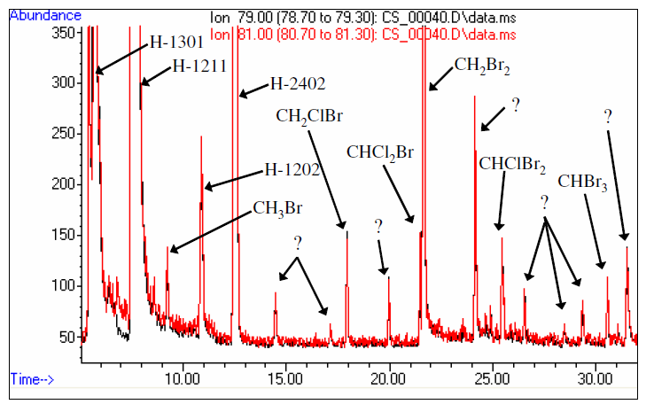
Bromine signal (79,81) NICI GC/MS
(from Laube et al., ACP, 2008)
C₂H₅Br,
Halothane
C₃H₇Br
C₂H₄Br₂
Cryogenic air sample, 15.2 km,
Teresina, Brazil (5.4° S), 8 June 2005

Slide 9
Organic Bromine over the Eastern Pacific (TC4)
65% CH₂Br₂
20% CHBr₃
MeBr=47%
Halons=46%
S.Lived=7.5%
WB-57 (UMiami)
TTL transport
MeBr=38%
Halons=41%
S.Lived=20%
Convective transport
MeBr=31%
Halons=34%
S.Lived=35%
DC8 (UCI)

Slide 10
Organic Bromine – CONTRAST/ATTREX

Slide 11
Organic Bromine + SHIVA

Slide 12
Organic Bromine + SHIVA +TC4

Slide 13

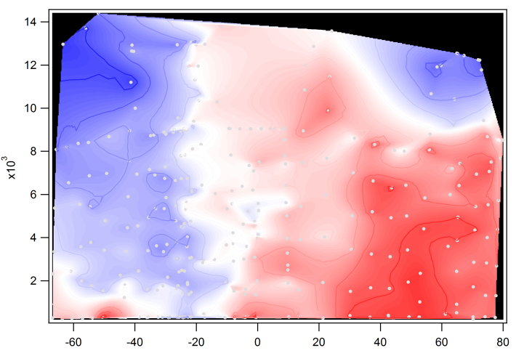
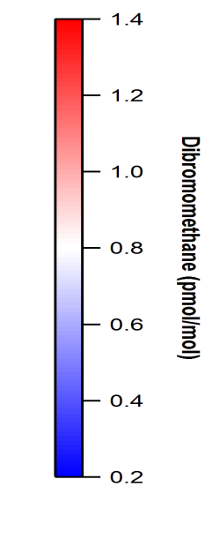
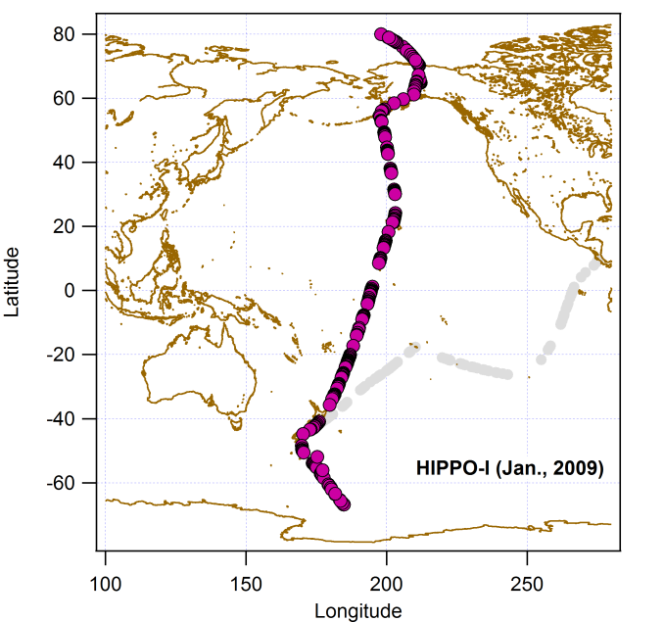
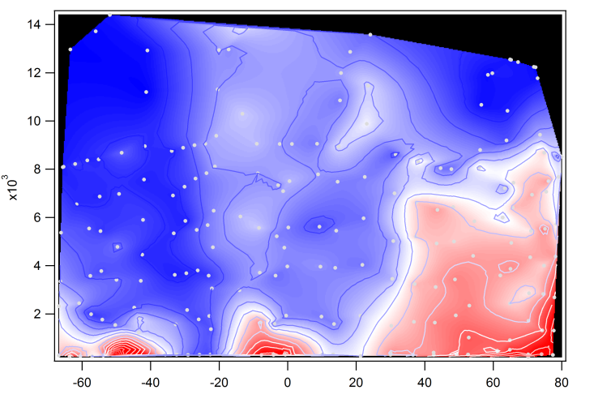
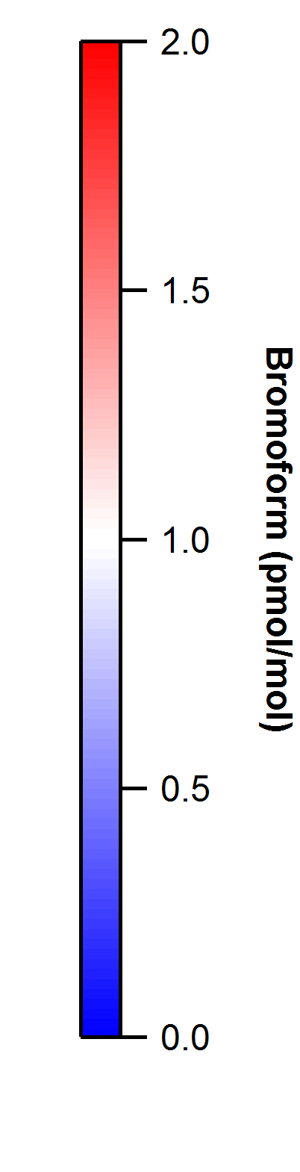
HIPPO-1 (Jan)

Slide 14
CHBr₃:CH₂Br₂ Correlation

Slide 15
CHBr₃:CH₂Br₂ Correlation + HIPPO

Slide 16
CHBr₃:CH₂Br₂ Correlation + SHIVA

Slide 17
Ethane: Ethyne Correlation

Slide 18
Ethane: Ethyne Correlation

Slide 19
Ethane: Ethyne Correlation

Slide 20
GWAS SAMPLES RF_02 (Circle Flight)

Slide 21
Ethyne C₂H₂(RF02)

Slide 22
Tetrachloroethene C₂Cl₄ (RF02)

Slide 23
Methyl Iodide CH₃I (RF02)

Slide 24
Methyl Nitrate CH₃ONO₂ (RF02)

Slide 25
Ethyne C₂H₂(RF02)

Slide 26
Vertical Distribution + v
Clouds
Tropical

Slide 27
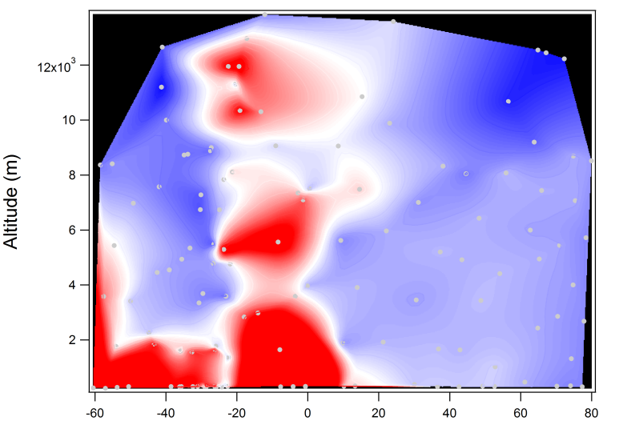
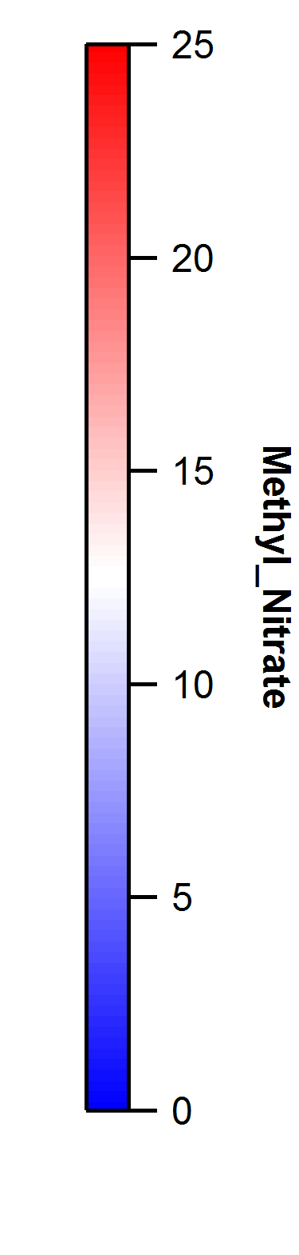
HIPPO1 Methyl Nitrate

Slide 28
Methyl Nitrate: C₂Cl₄ Correlation (RF02)

Slide 29
Methyl Nitrate: C₂Cl₄ Correlation ATTREX (all)

Slide 30
Methyl Nitrate: C₂Cl₄ Correlation
ATTREX + CONTRAST

Slide 31
ATTREX RF03 (Faxai)
Methyl Iodide
Methyl Nitrate

Slide 32
ATTREX RF03 (Faxai)
Methyl Iodide
Methyl Nitrate

Slide 34
SUMMARY
Organic bromine budget well constrained in TTL; consistent with larger scale distributions
Tracer-tracer correlations identify links between CONTRAST/ATTREX measurement
Gradients in TTL often complex in this region; impact of clouds/variable sources/layers.

