Slide 1
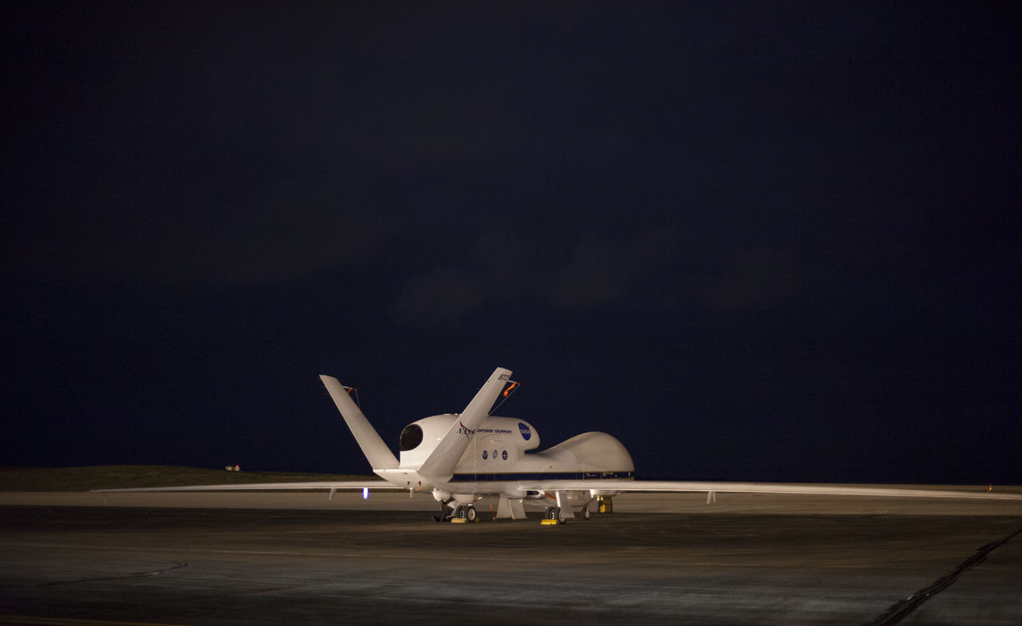
Using ATTREX Data to Improve Ice Microphysics in CAM5
C. G. Bardeen, A. Gettelman, C. Maloney, O. B. Toon, E. J. Jensen
ATTREX/CAST/CONTRAST Science Team Meeting
October 21, 2014

Slide 2
Methodology
Used SD-CAM5 (1.9˚ x 2.5˚, 56 levels)
Nudge to GEOS-5 Assimilated Meteorology
Sample Simulations Along Aircraft Flight Tracks
Compare Model to ATTREX3 Observations
2 Different Ice Microphysics Schemes
MG (Standard; Morrison & Gettelman, 2008)
Two Moment (Mass and Number)
Ice and Snow
CARMA (Bardeen et al., 2013)
Sectional (28 Size Bins)
In Situ Ice and Detrained Ice

Slide 3
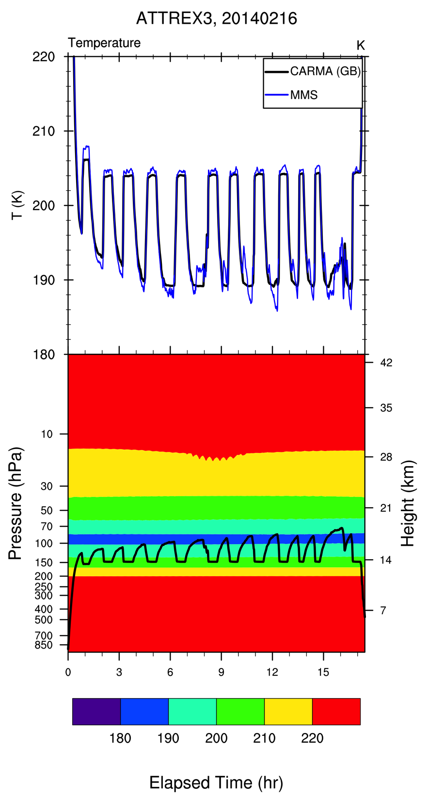
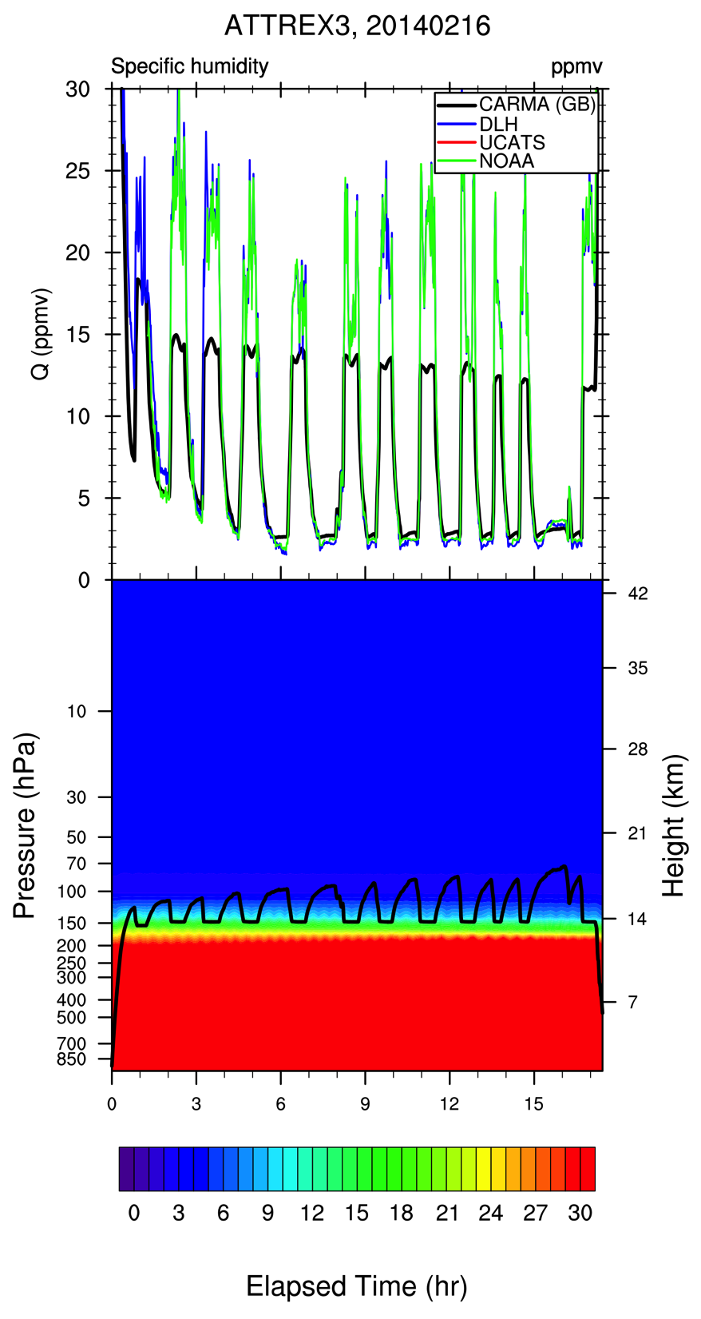
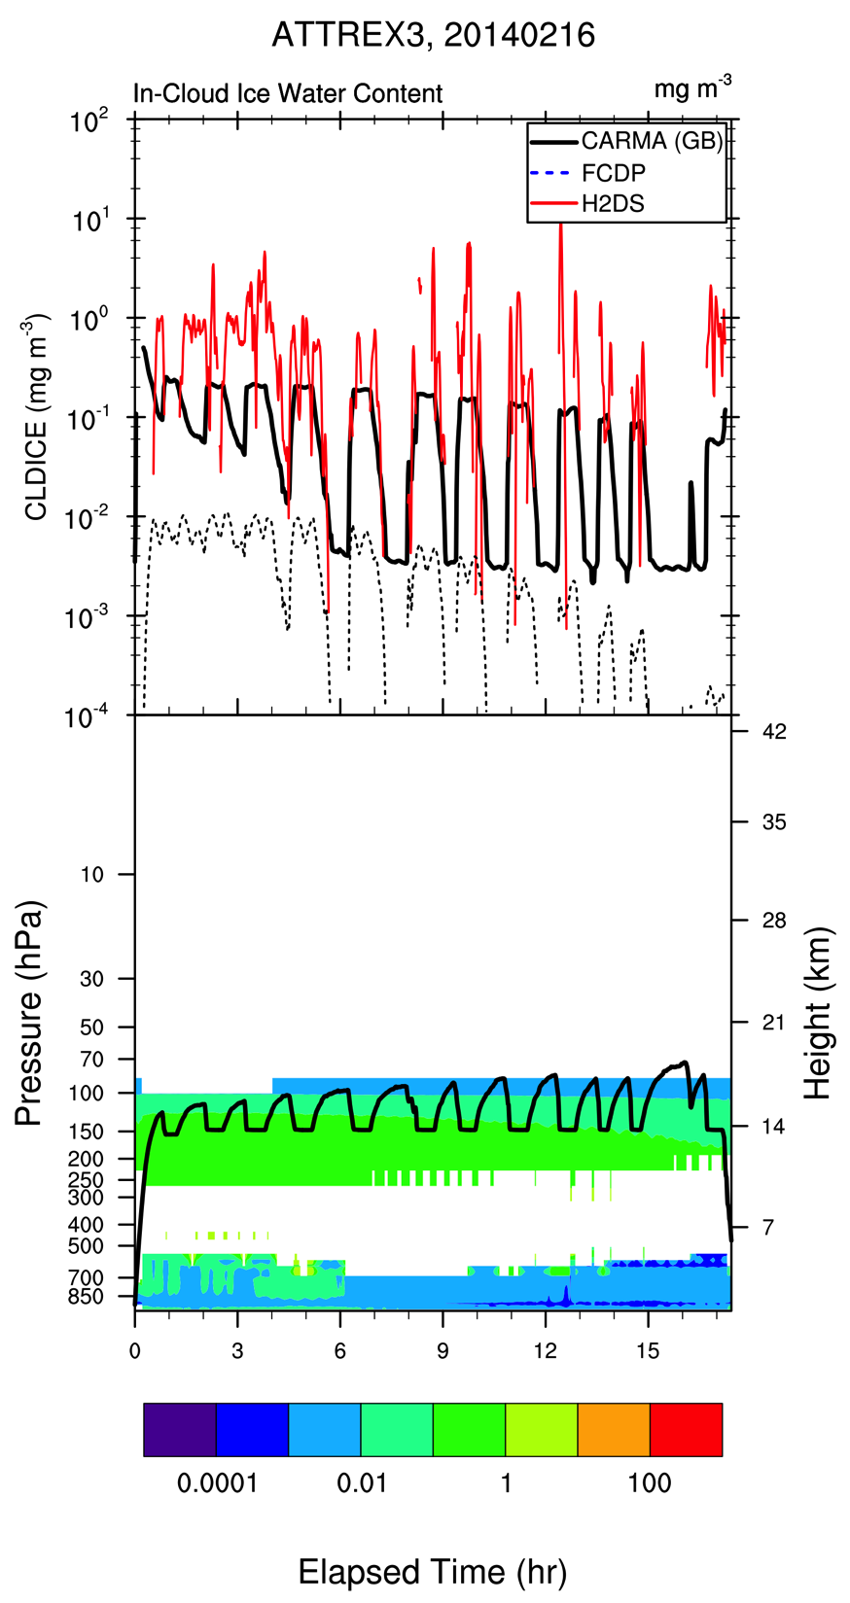
ATTREX3, 20140216
Temperature
Specific Humidity
Ice Water Content
Missing Double Tropopause
Missing Convection?
Notes:
This is CAM/CARMA Base simulation. Should I show model data comparisons along the flight track to give an example of how the model does or just skip this? I would say that the differences between the model and data seem larger for ATTREX3 than for the other deployments. More complex meteorology? In this case, GEOS-5 doesn’t seem to capture the double tropopause that develops and RH is low in the UT perhaps because of convection over GUAM that was not well represented.

Slide 4
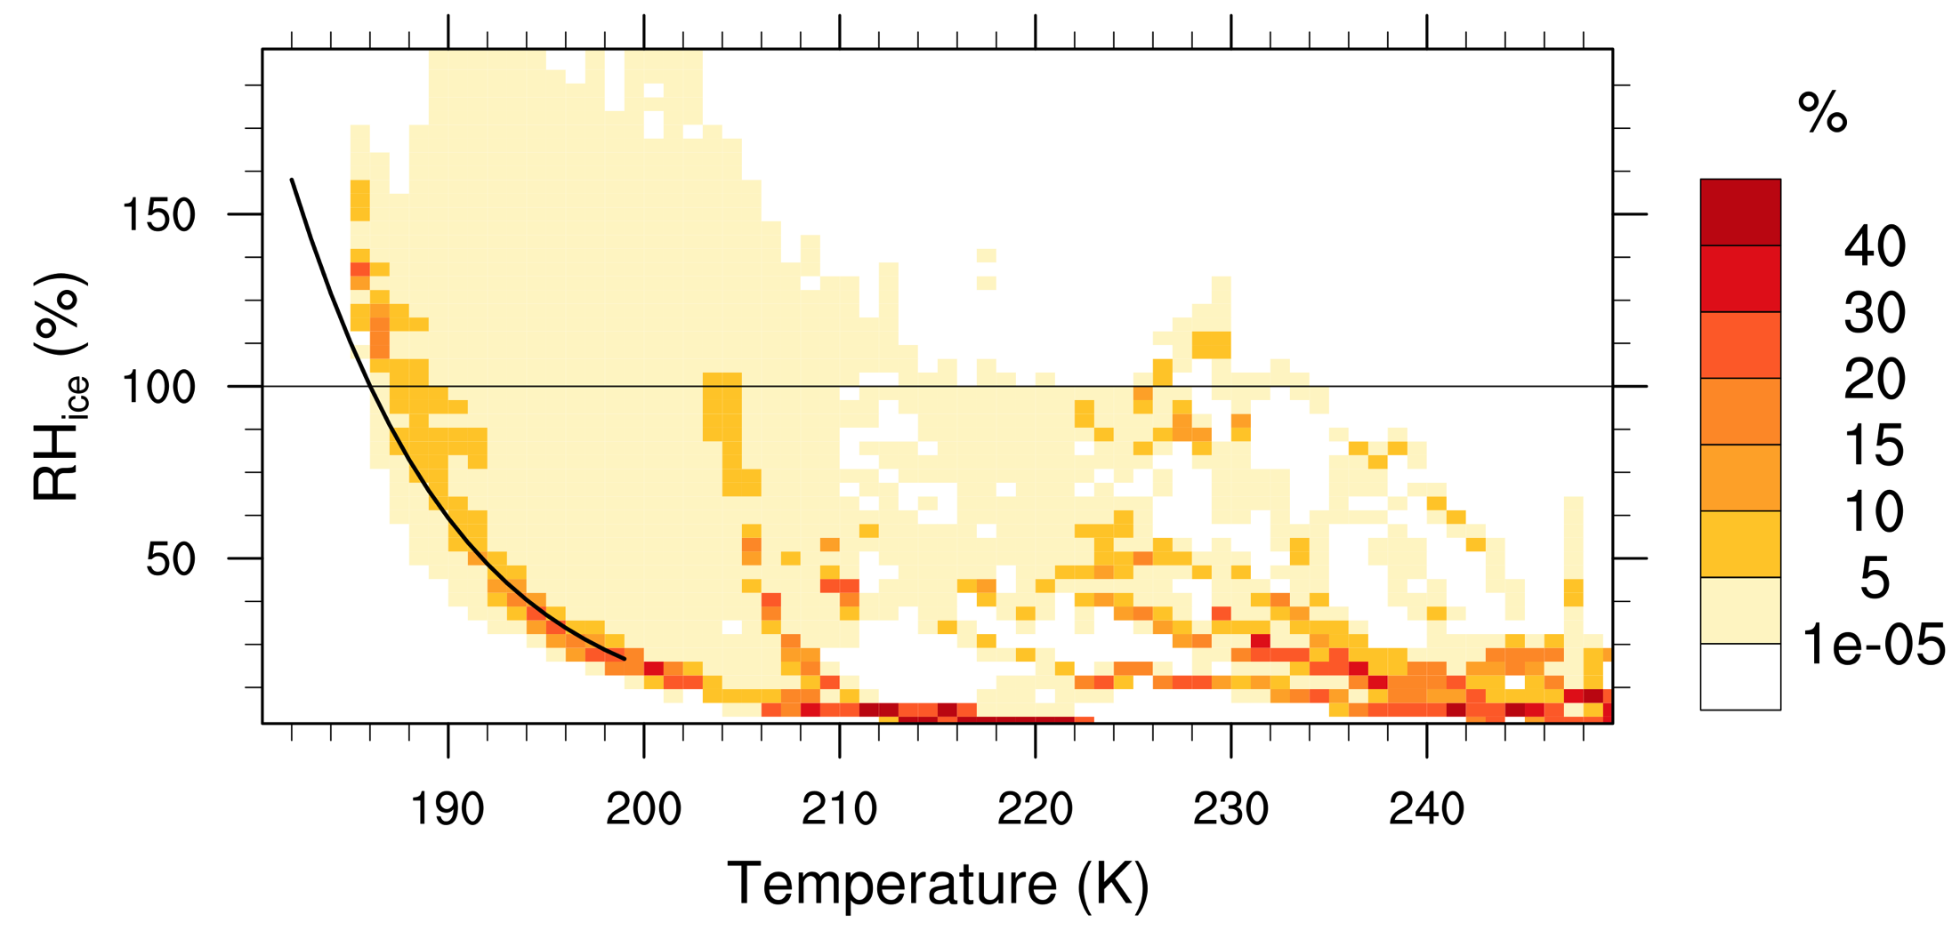
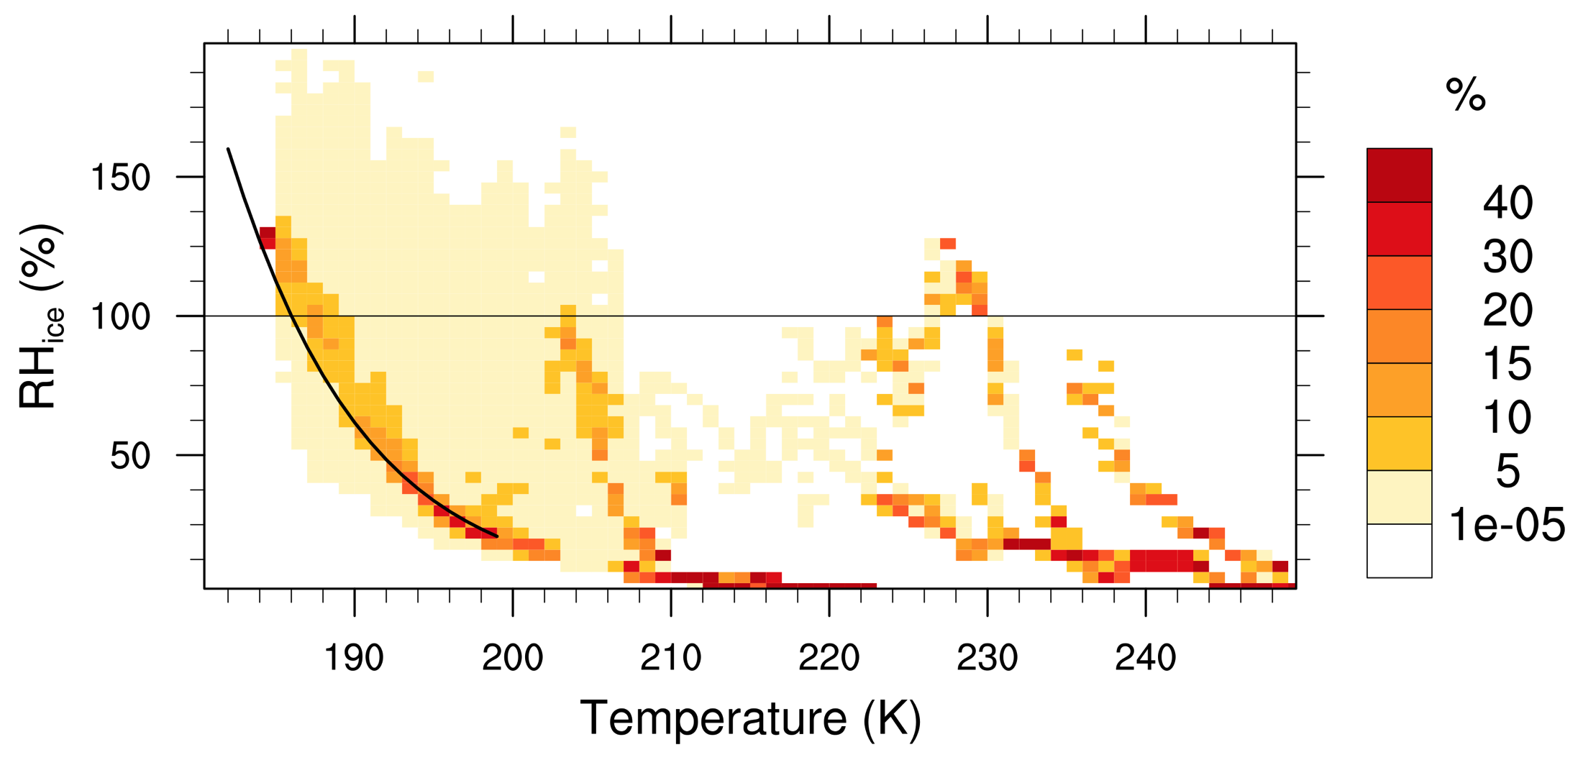
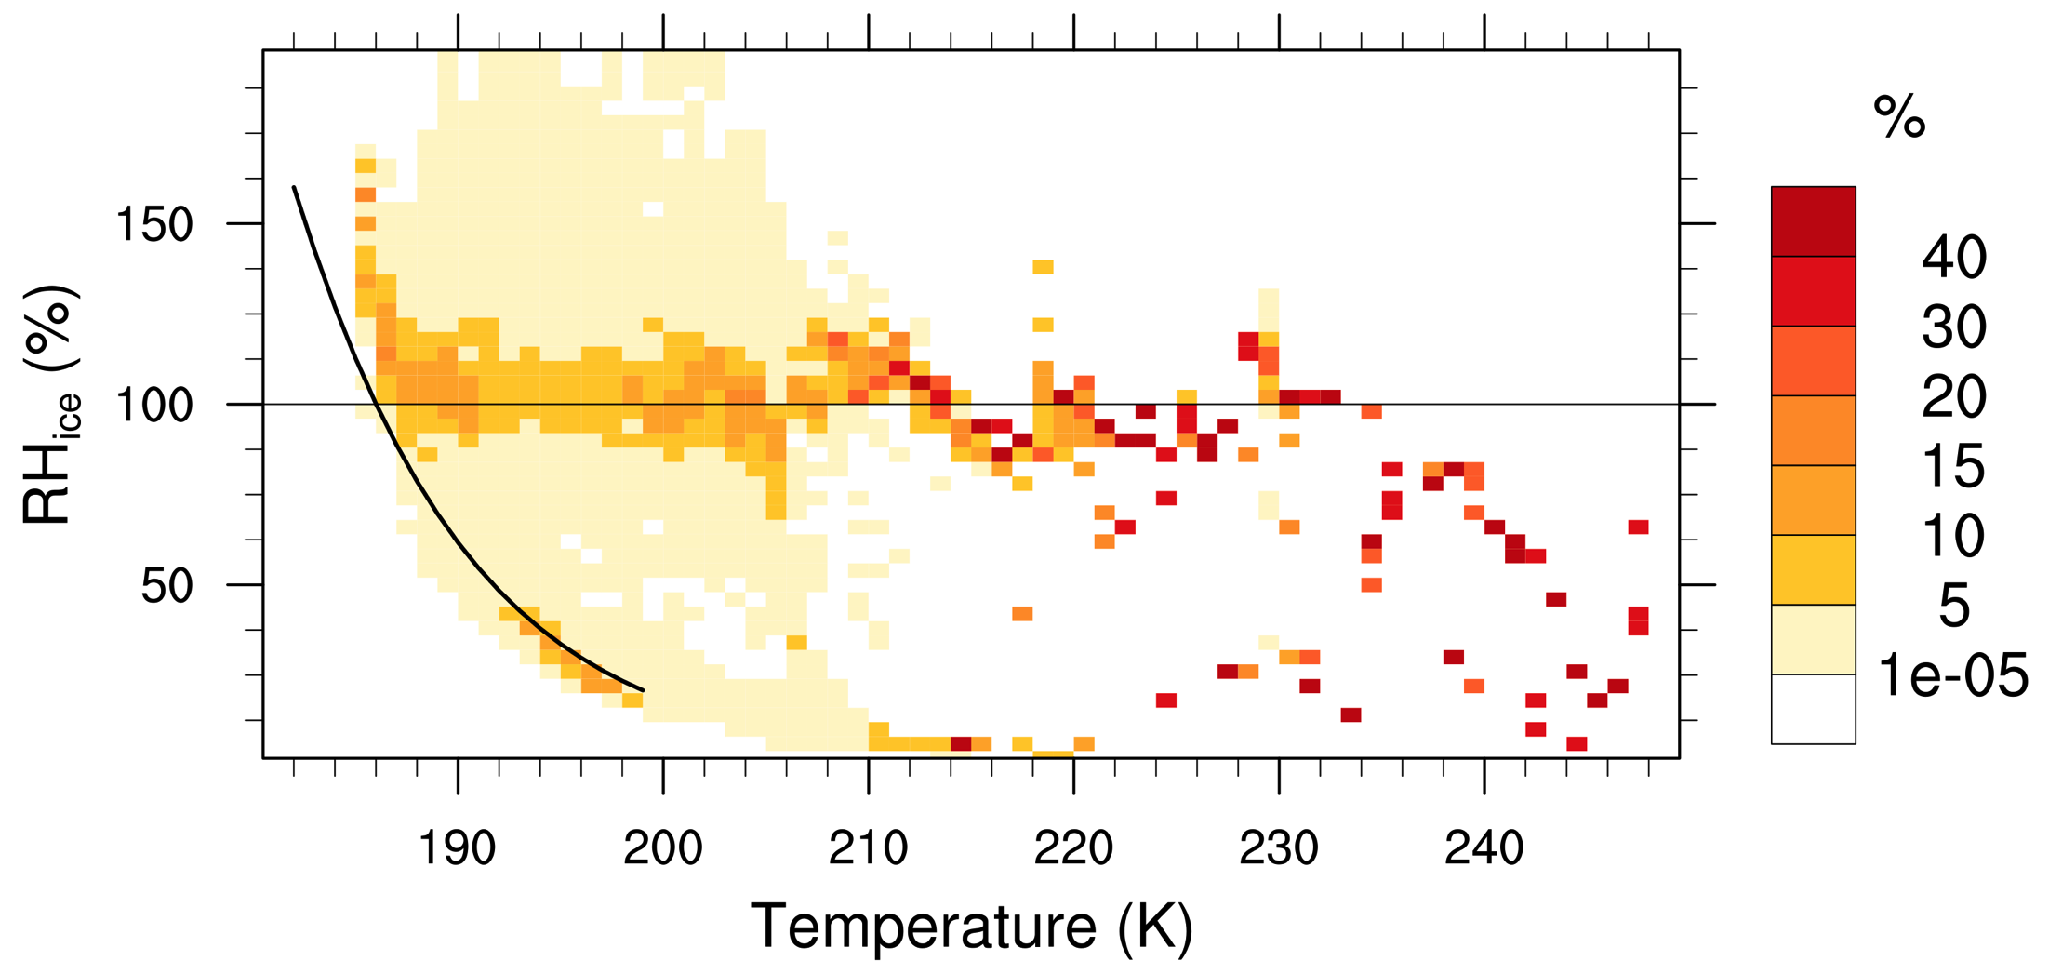
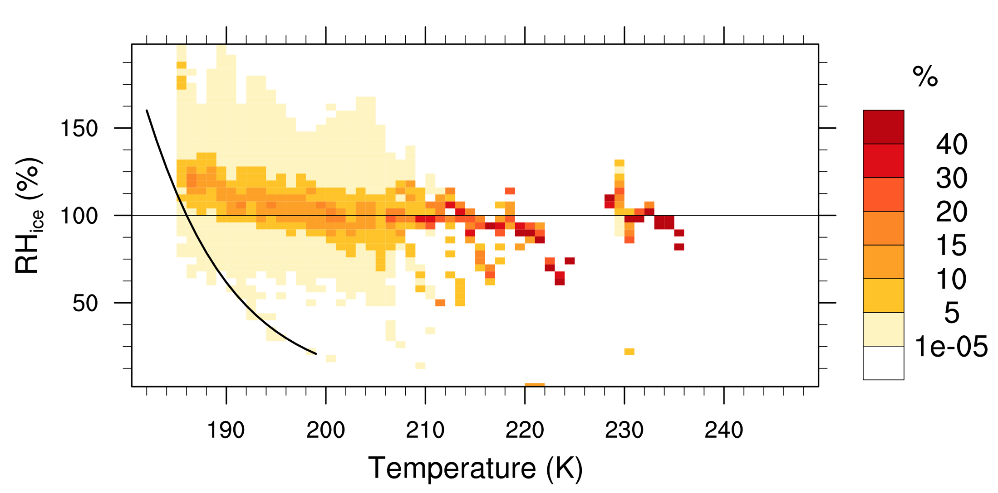
Krämer Plots : RH vs T
DLH
NOAA
Higher RH,
Purging?
Clear Sky
Slanted?
Not like Krämer
Cloudy
Notes:
DLH has higher RH, some of it could be from need to purge early in flight. NOAA has increasing RH with decreasing T in cloud, but that is not as evident in the DLH plot.

Slide 5
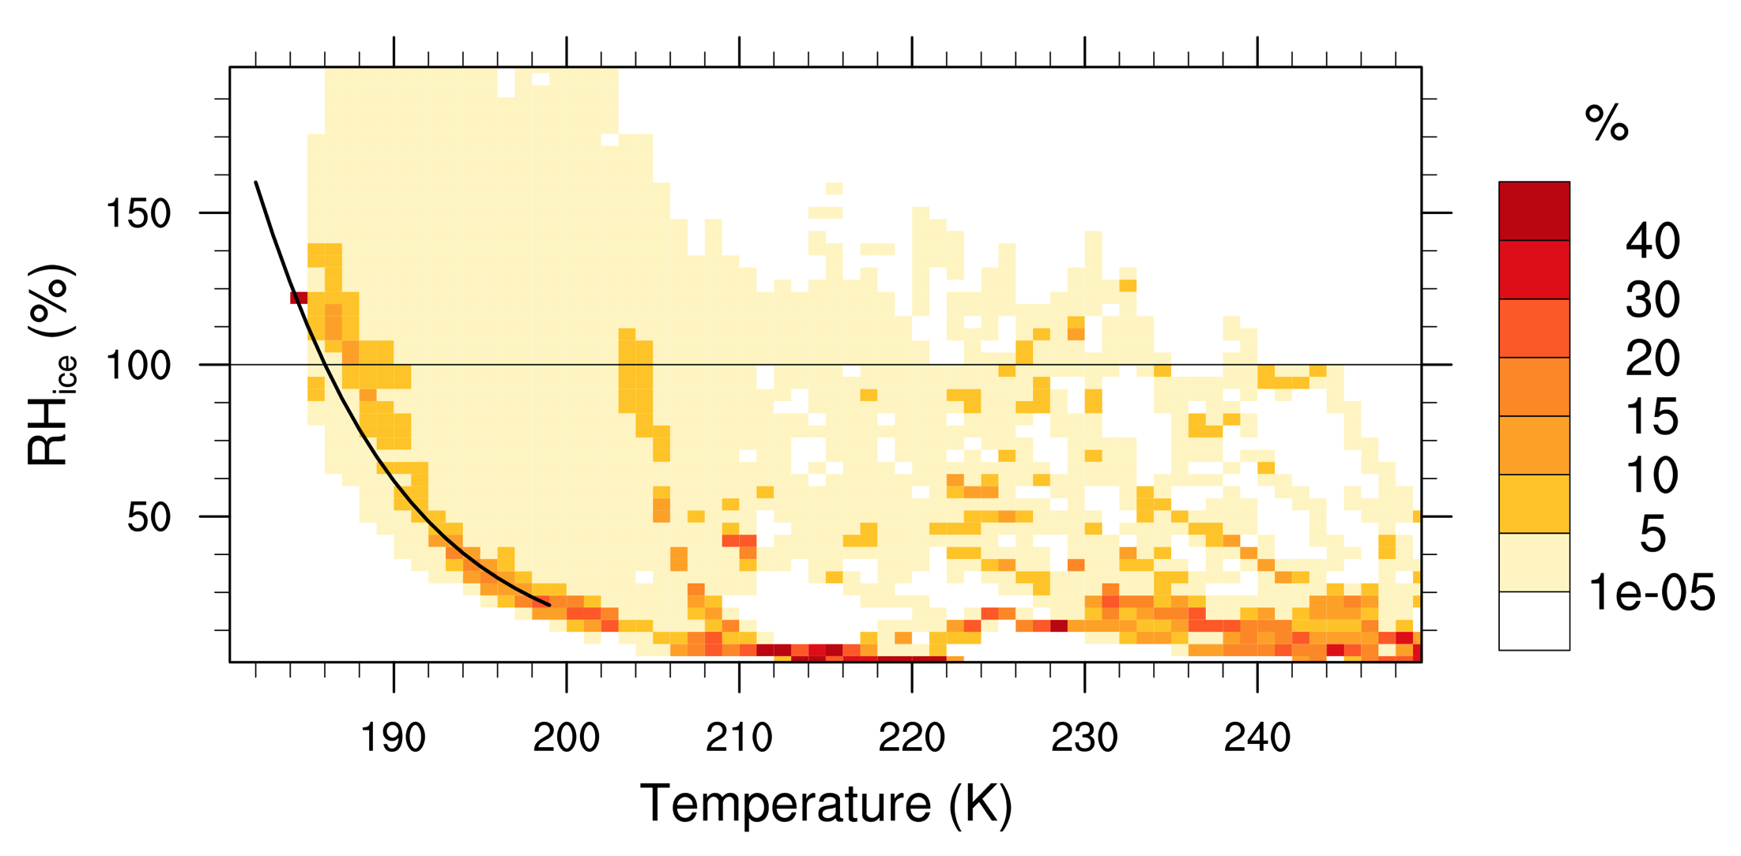
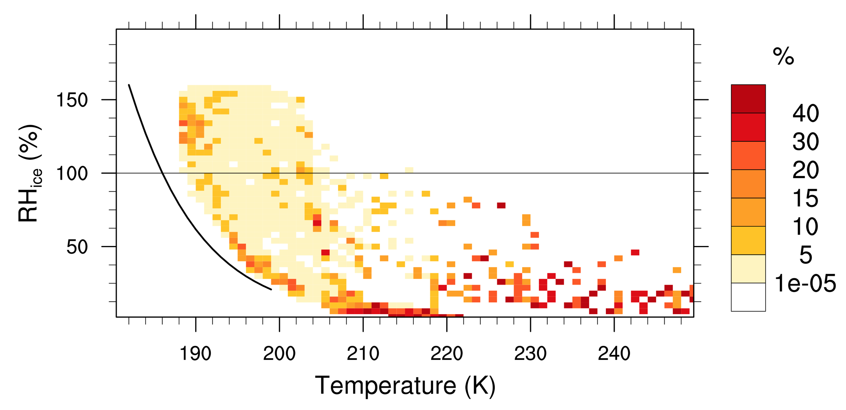
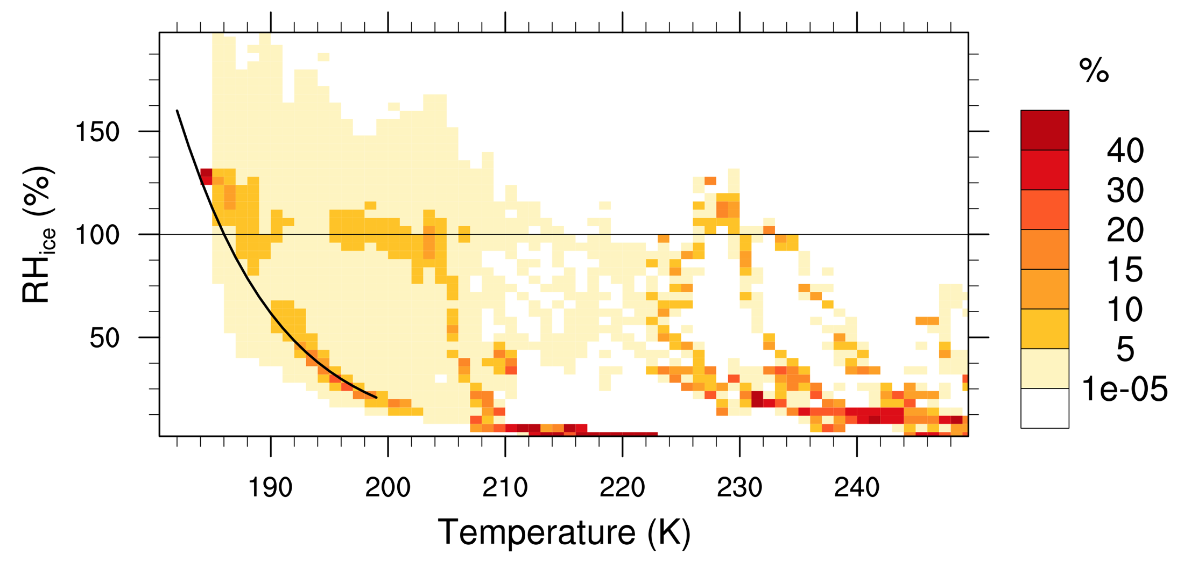
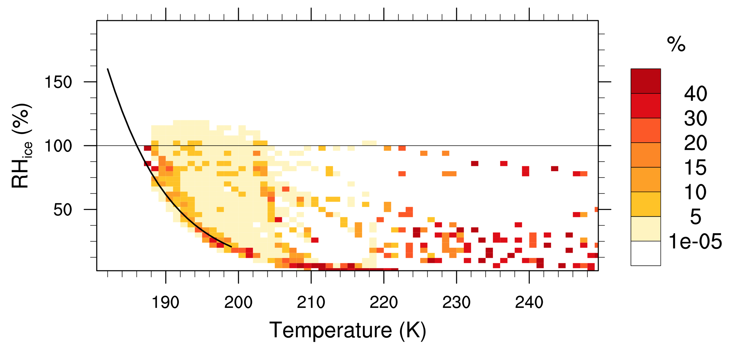
Krämer Plots : RH vs T
DLH
MG
Too Wet
All Sky
NOAA
CARMA
All Sky
Notes:
Models only have gridbox average RH, but MG RH is too high, because it uses gridbox average. CARMA doesn’t have enough variability in RH, but not surprising given scale differences.

Slide 6
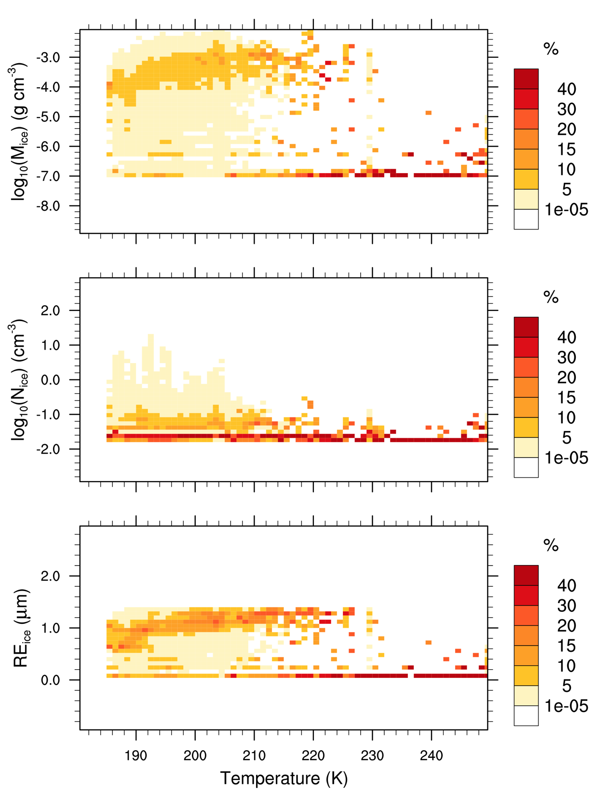
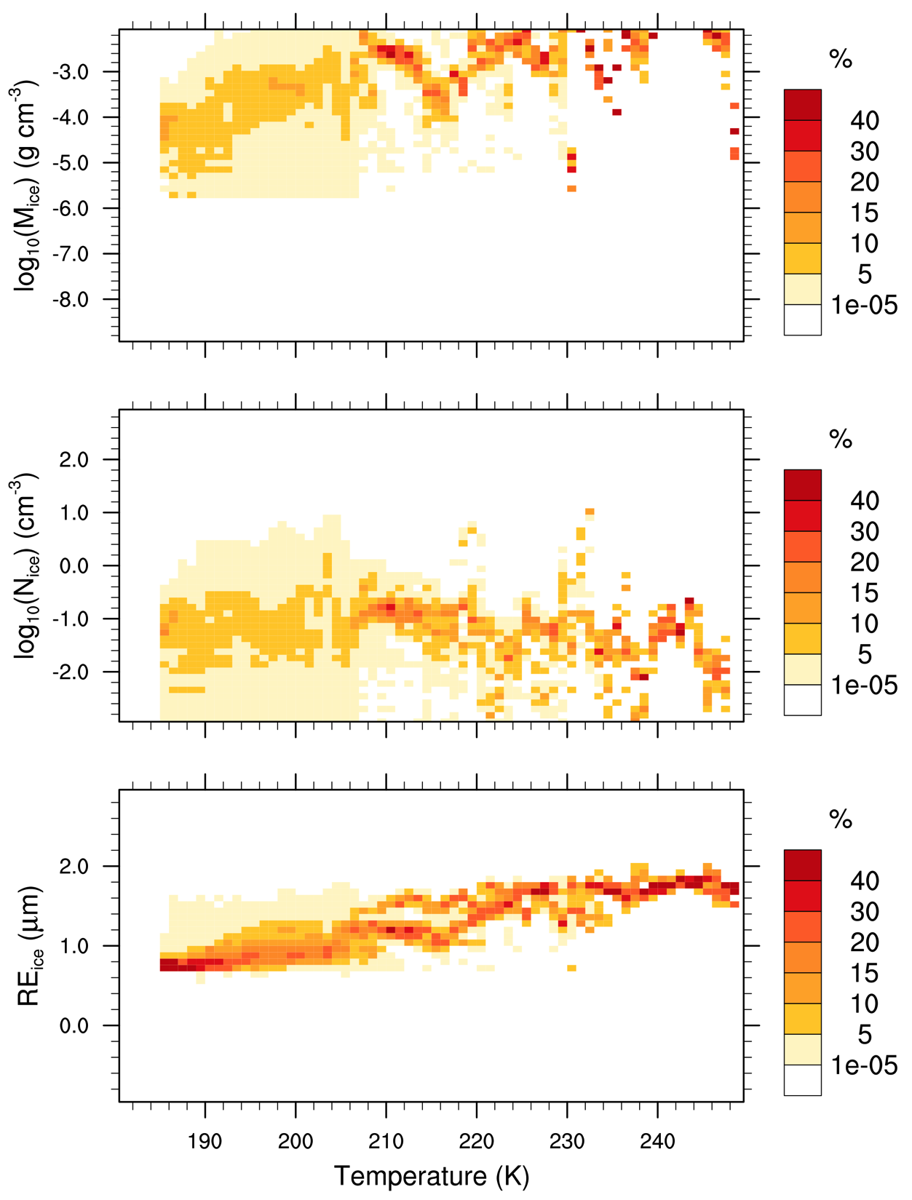
Kramer Plots : M, N, Re vs T
Hawkeye FCDP
Hawkeye 2DS
Mass
Why banding ?
Number
Radius
Notes:
FCDP detects smaller mass and has higher number and lower Re than 2DS. Are some of the lower bands noisy?

Slide 7
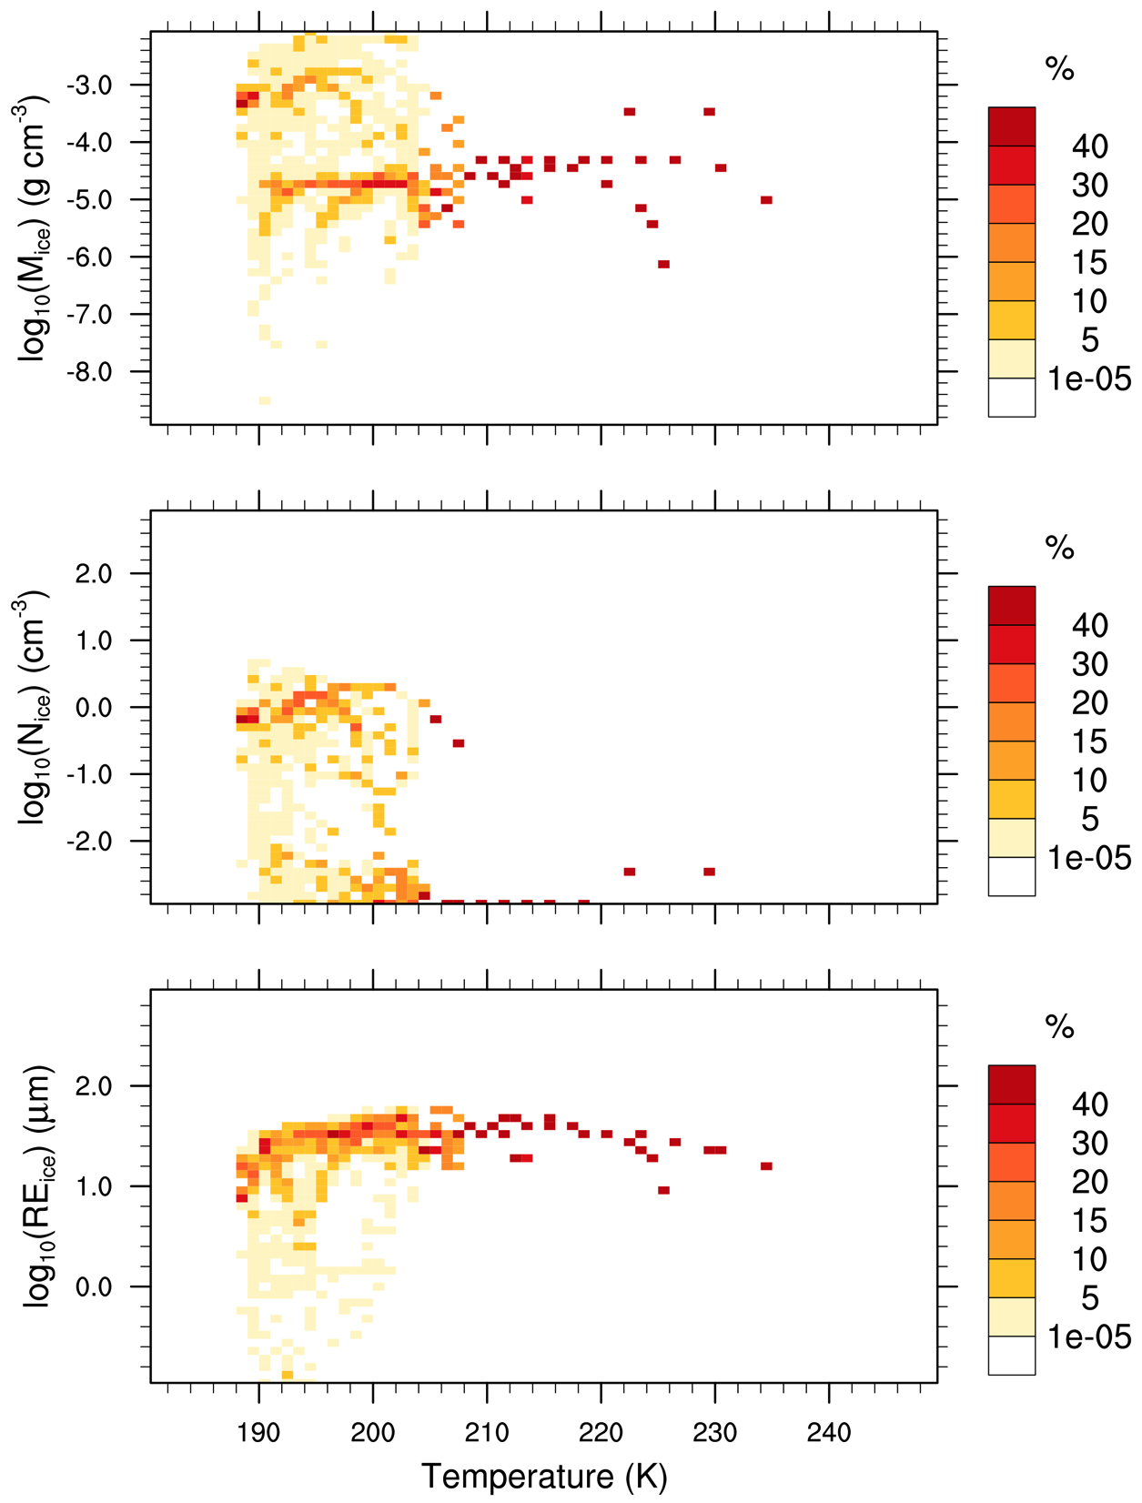
Kramer Plots : M, N, Re vs T
Hawkeye 2DS
MG
Mass
Two Modes?
Number
Radius
Notes:
Mass from CARMA looks more like observations than MG, CARMA low on number, both high on RH. MG has broad range in number (snow and ice?), looks bimodal.

Slide 8
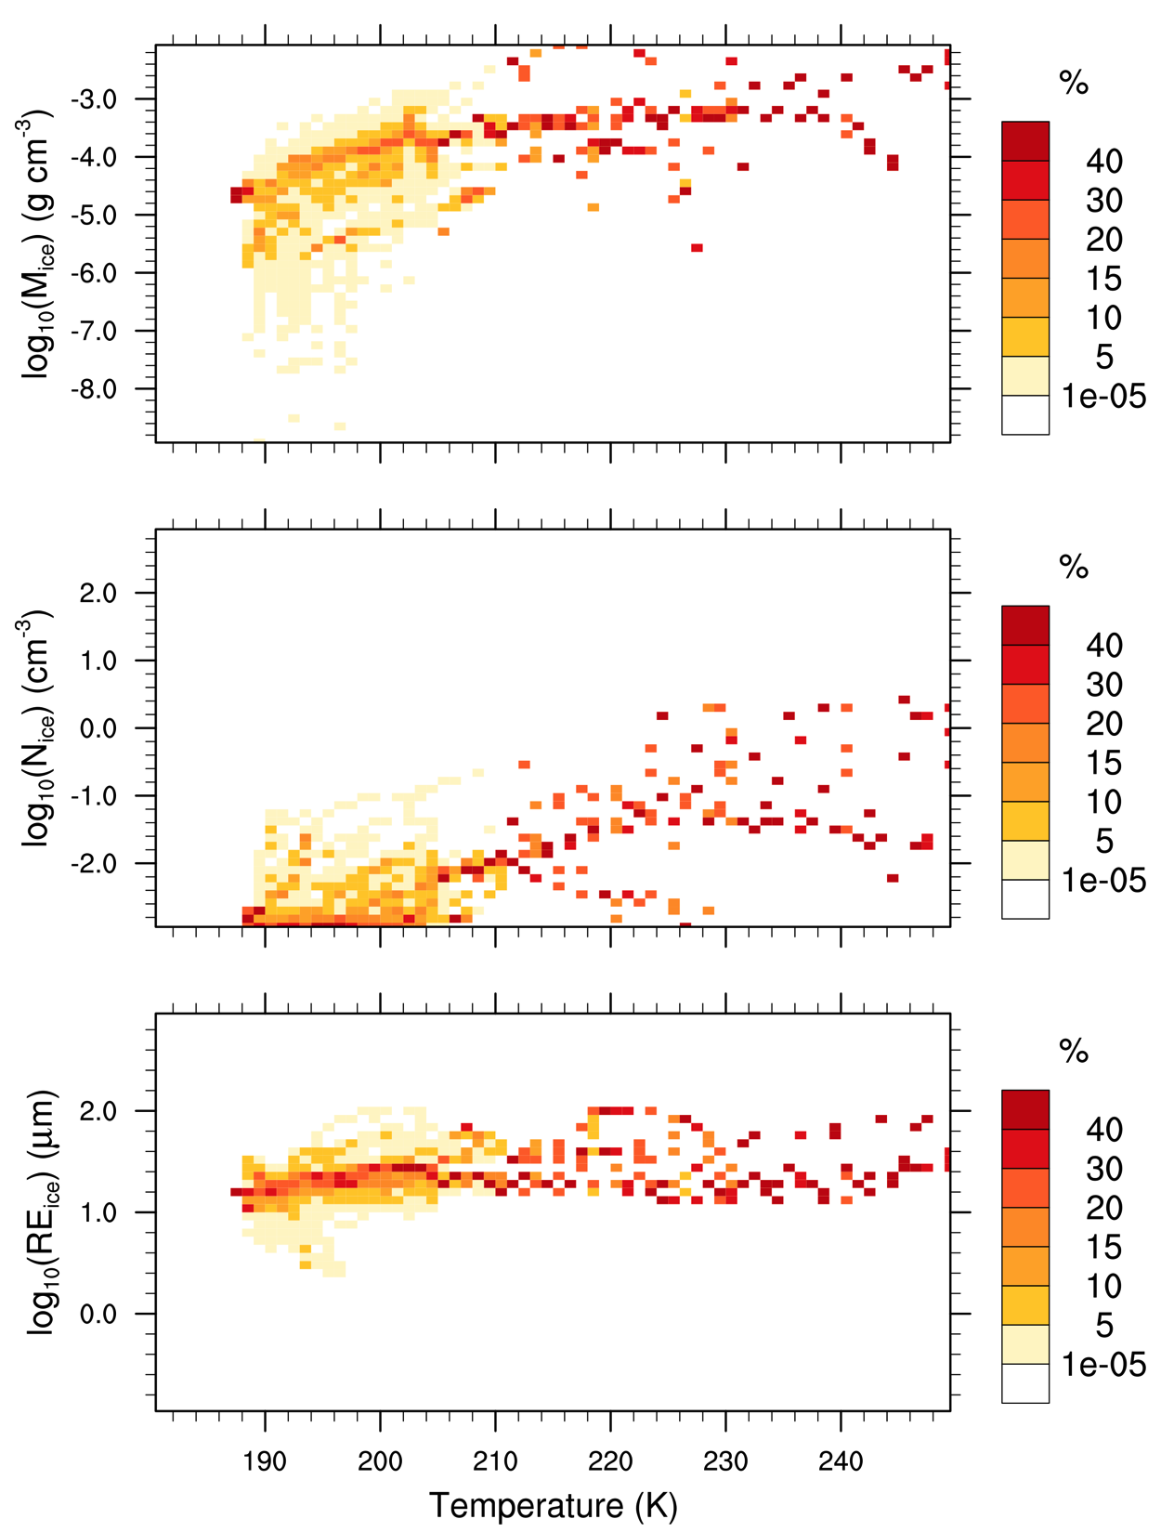
Kramer Plots : M, N, Re vs T
Hawkeye 2DS
CARMA
Mass
Too Few
Number
Radius
Notes:
Mass from CARMA looks more like observations than MG, CARMA low on number, both high on RH. MG has broad range in number (snow and ice?), looks bimodal.

Slide 9
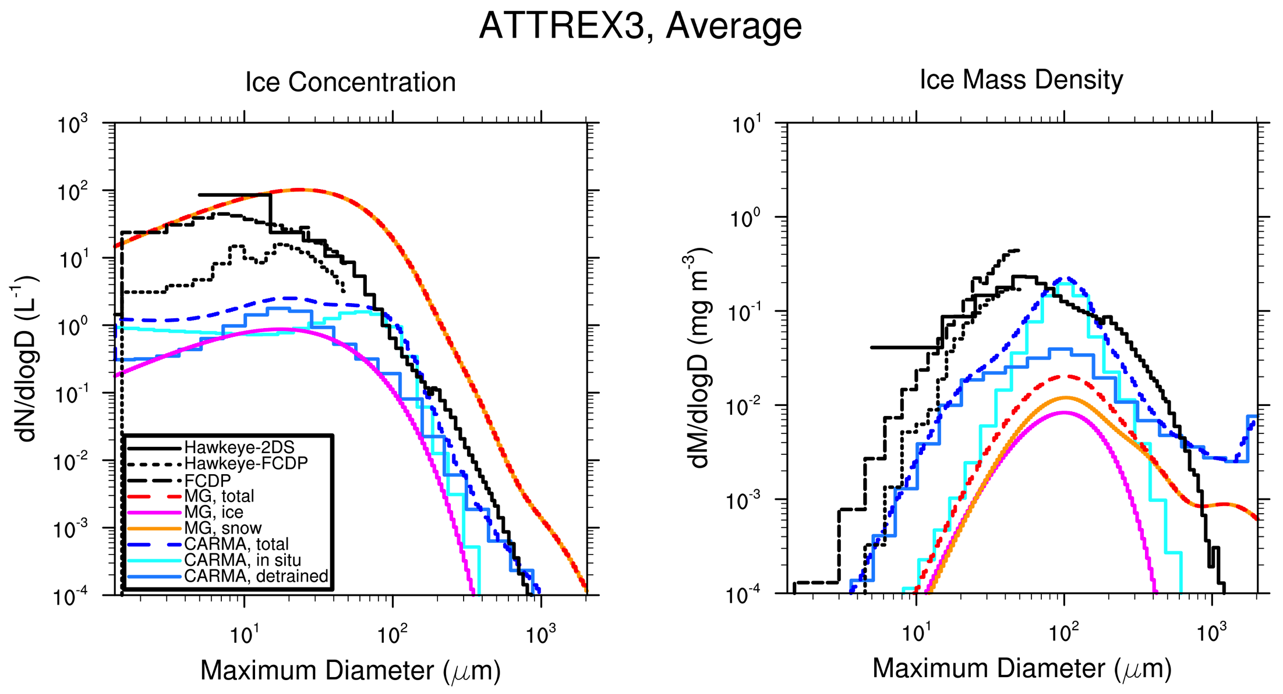
Ice Size Distribution
Notes:
MG : Why is there any snow? Autoconversion threshold is too low. Causes lower densities (0.1 snow, 0.5 ice) and thus underprediction of mass density
CARMA: Missing small particles. Expected more in situ particles.

Slide 10
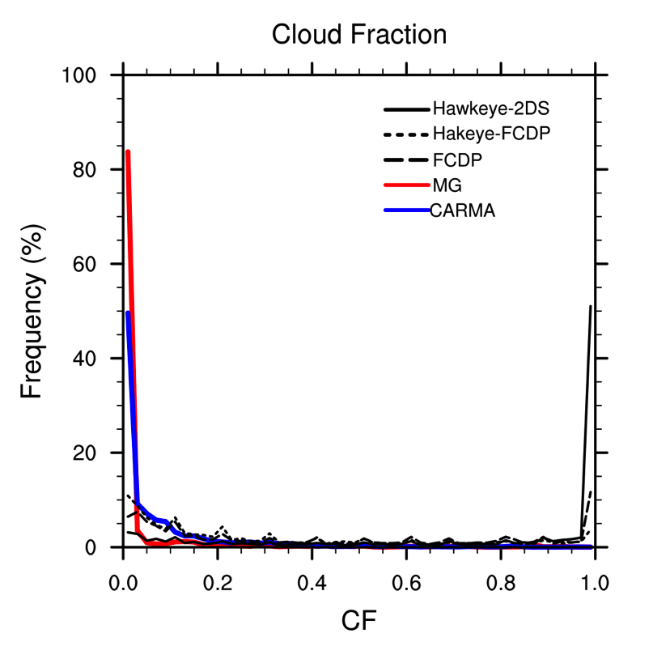
Ice Cloud Fraction
Notes:
These are all in-cloud (above threshold IWC) and are from minute data along aircraft track (averaged for data, interpolated for model). Cloud fraction is always small for the model. Since microphysics done in-cloud, this means large scalings of gridbix ice to in cloud ice which favors detrained ice. Also means that for radiation you have small mass in small area and maximum random overlap will likely cause any cloud formed to have cloud underneath it, further reducing any heating from the cloud.

Slide 11
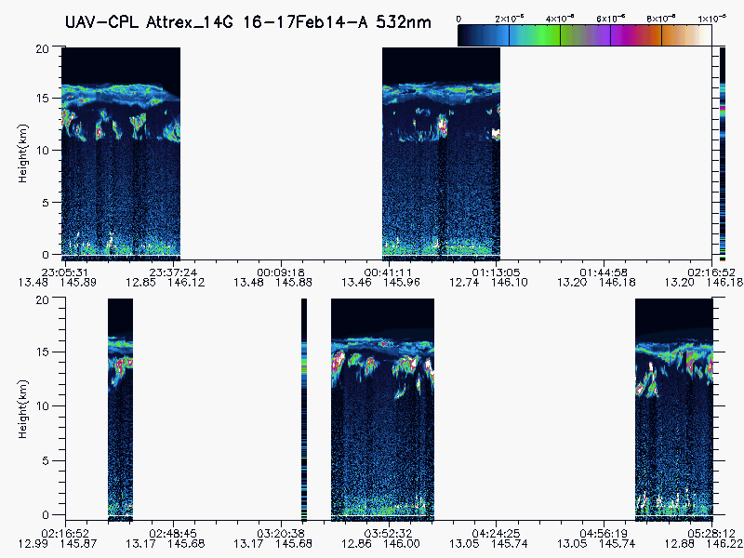
CPL, ATTREX3, 20140216
Notes:
Notice long lasting high optically thin cloud layer. This is expected to be extensive and overlays are with patchier cloud. There is very little vertical separation between layers, so it is hard to resolve in the model. Upper layer should be CF=1 (or at least large) but won’t happen with current macrophysics that assumes CF is proportional to IWC. CARMA uses subgrid saturation when CF < 1, further enhancing advantage for detrained ice and growing ice too fast.

Slide 12
Modified Cloud Macrophysics
Assume 2 Stratiform Cloud Regimes
Tropospheric Region (P > 140 hPa)
Subgrid scale
Patchy T, H2O, Saturation, Clouds
Use subgrid saturation : S α 1/CF
Ice Cloud Fraction : CF α IWC
TTL Region (P < 120 hPa)
Large scale
Uniform T, H2O, Saturation, Clouds
Gridbox average saturation
Ice Cloud Fraction : CF=1, if IWC > IWCmin
Notes:
I don’t necessarily think that these levels are the optimal choice, nor do I think the using P is the best way to split. Just an easy way to test the concept and see the impact.

Slide 13
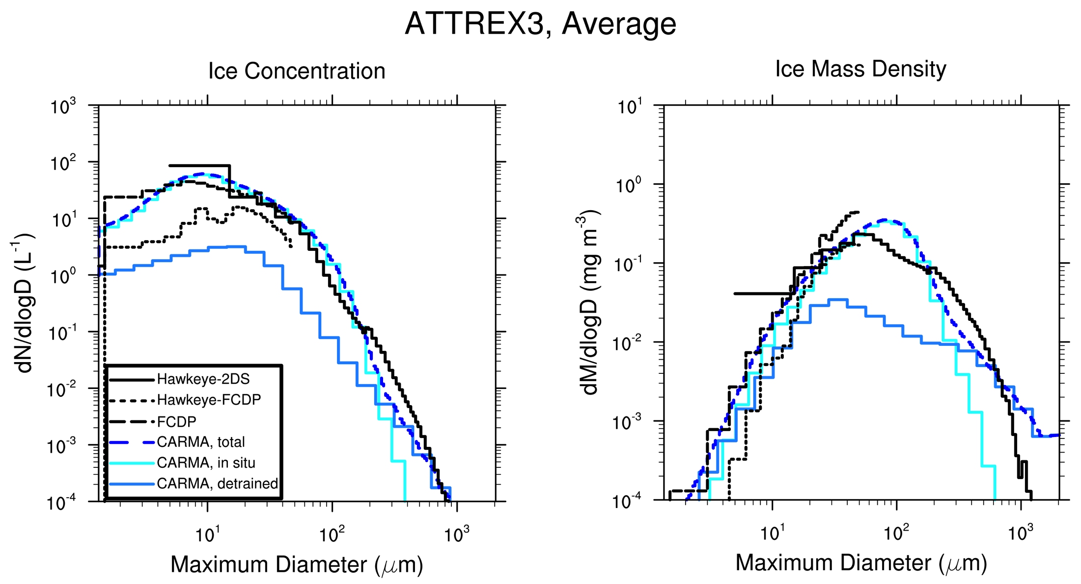
Improved Size Distribution
Notes:
More small particles formed in situ.
Differences in large particle tail in mass density could be differences in mass-diameter assumptions between model and 2DS retrieval.

Slide 14
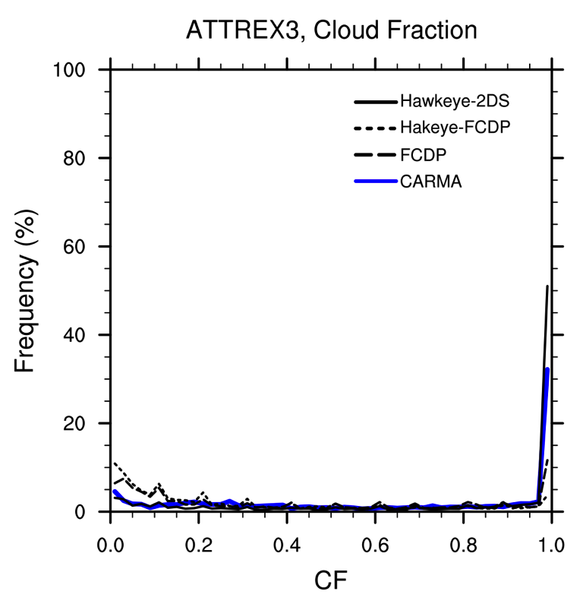
Improved Cloud Fraction
Notes:
CF PDF now matches 2DS
Are low cloud fraction values from FCDP and HFCDP real or noise?

Slide 15
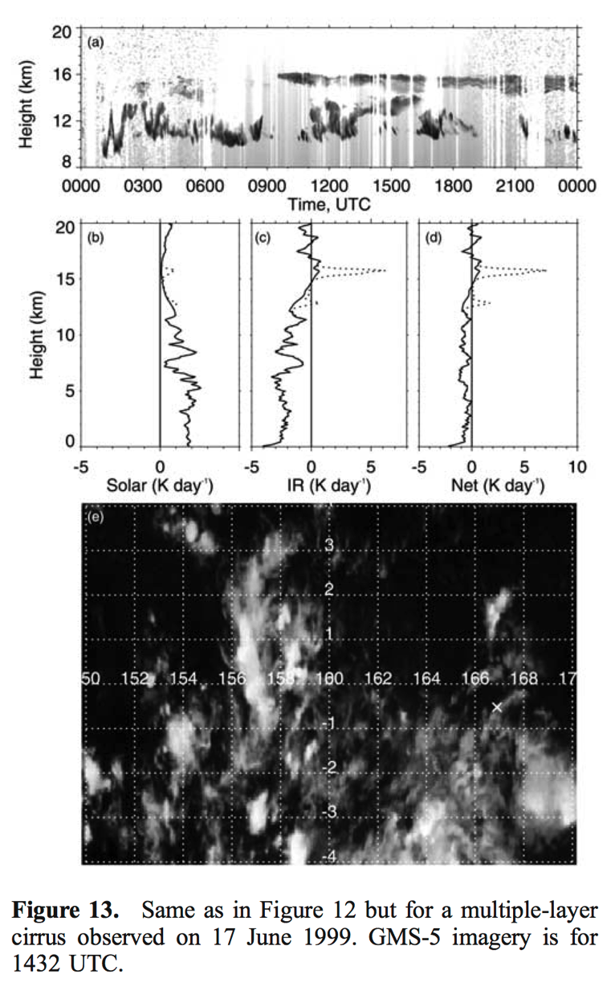
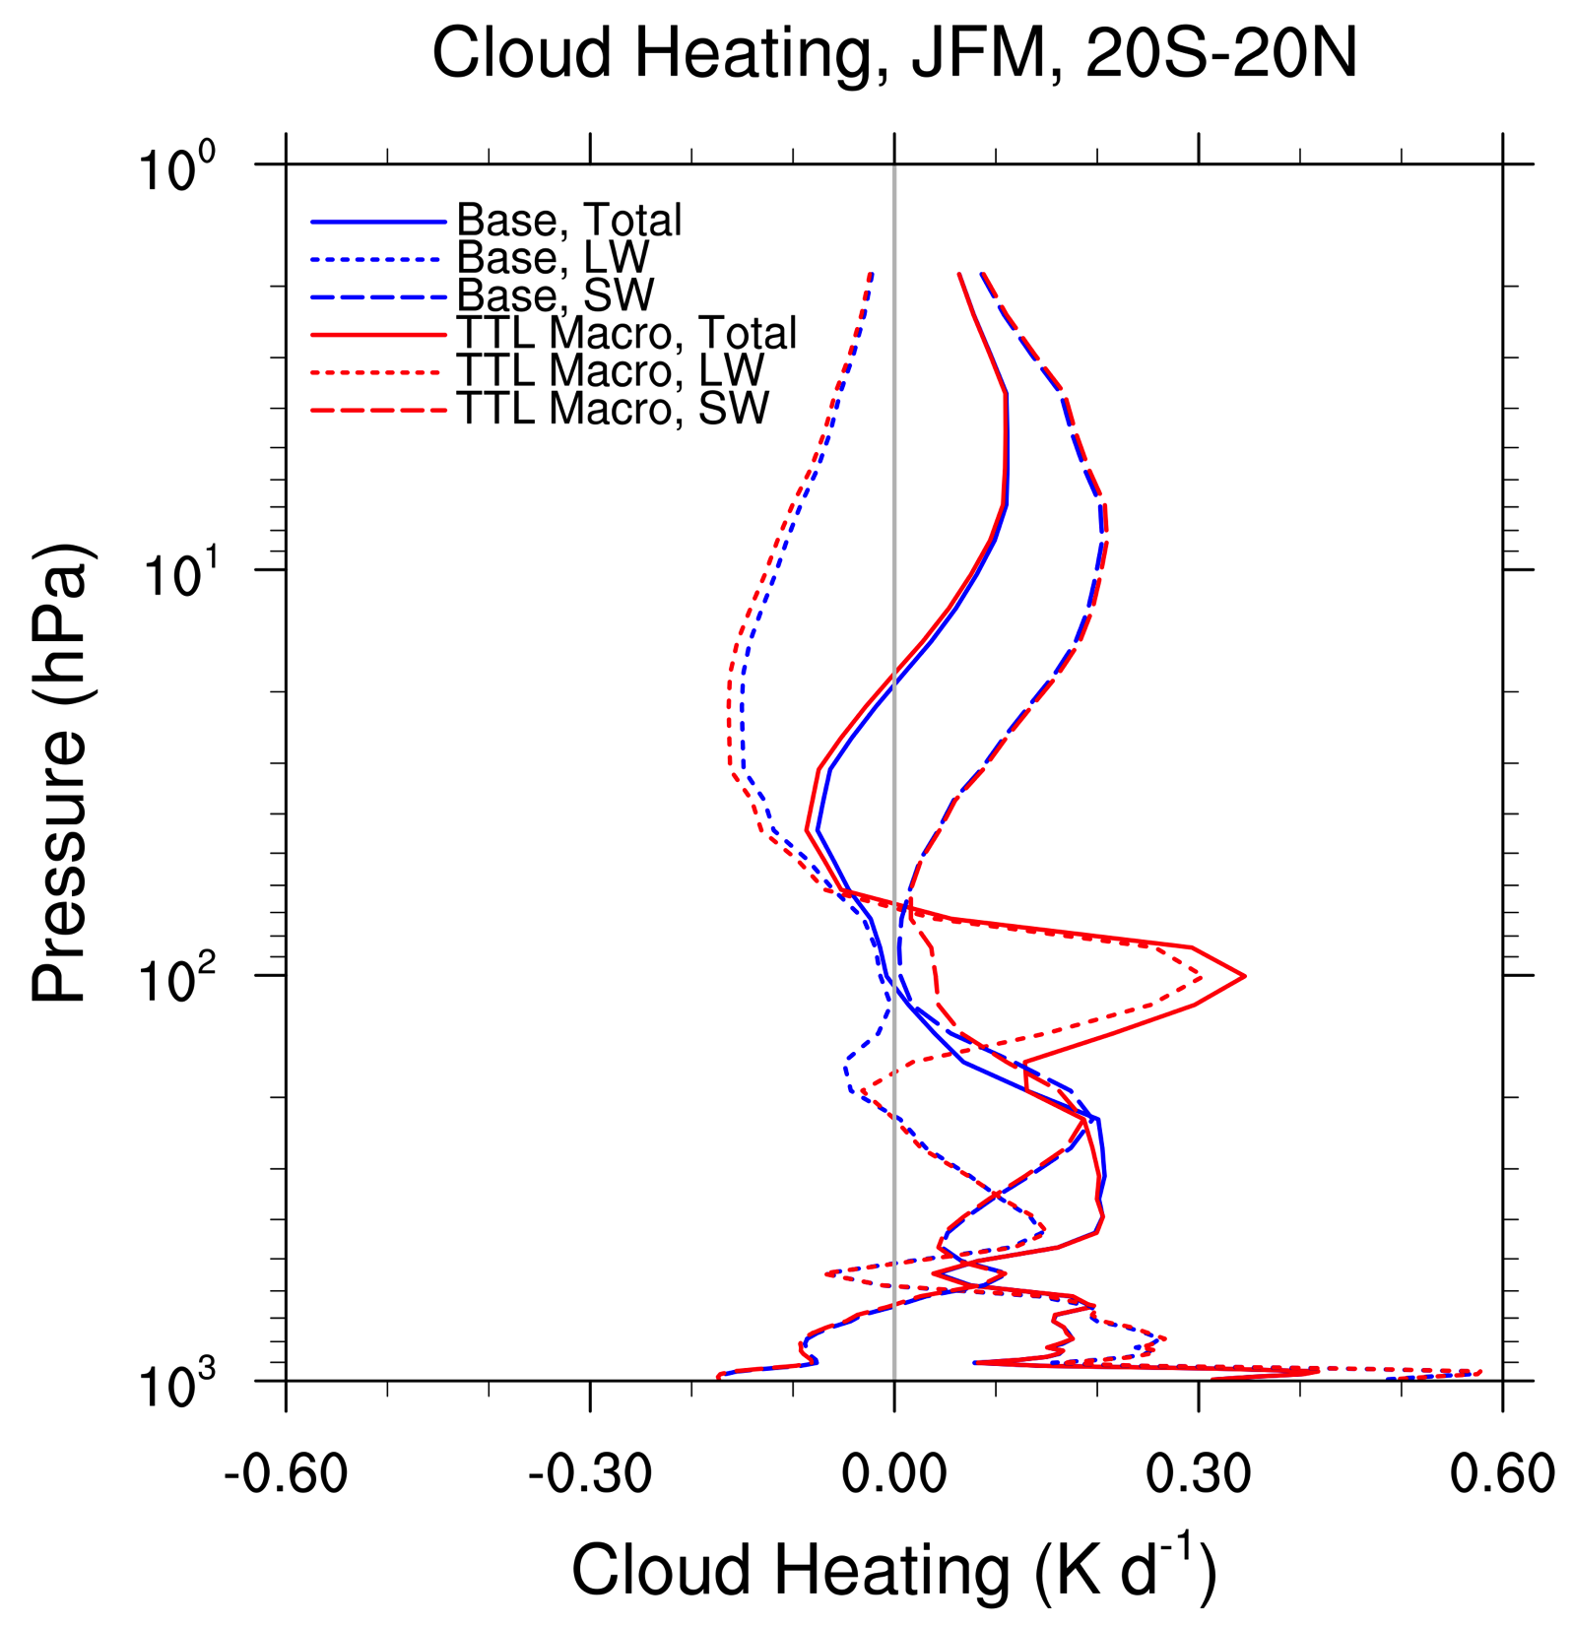
Significant Cloud Heating
[Comstock et al., 2002]
Notes:
Notice large heating rate at 100 hPa from changed microphysics. This is similar to the effect shown by Comstock for isolated thin cirrus. Lookup OD for Comstock cloud.

Slide 16
Conclusions
ATTREX has been important in understanding and improving the simulation of ice clouds and water vapor in CAM5.
MG Microphysics
RH too high
Too much “snow”, concentrations too large and mass densities too low.
Ice (0.5 g/cm3) and snow (0.1 g/cm3) densities inappropriate for TTL.
Cloud fraction too small in the TTL
CARMA Microphysics
Too few small in situ particles
Cloud fraction too small in the TTL
With changes to the cloud macrophysics consistent with large scale clouds in the TTL, campaign and flight averages from CARMA simulation agree well with Hawkeye data, but RH too high.
Cloud heating in the TTL may be significantly underestimated in CAM5, which may affect model biases (IWC, LWCF, Tropopause T, …).

Slide 17
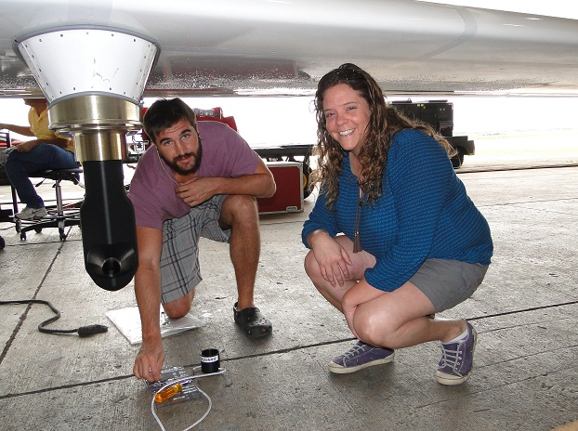
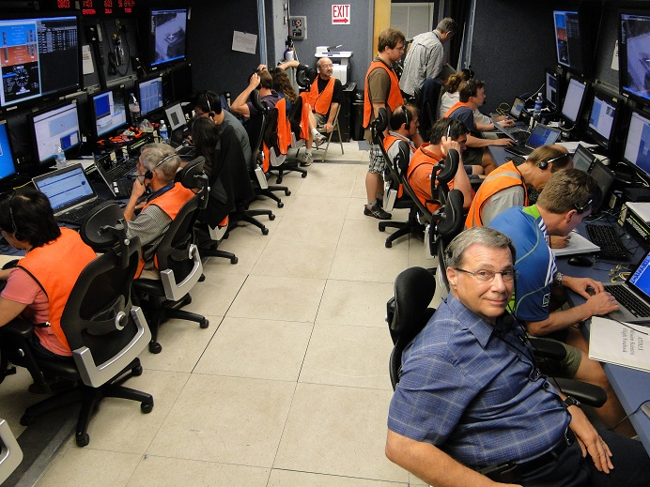
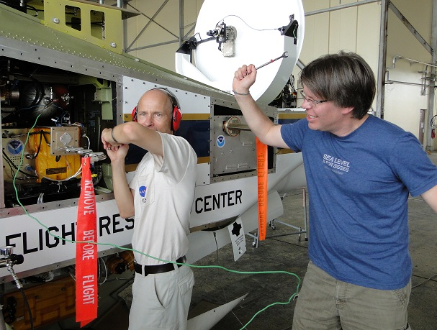
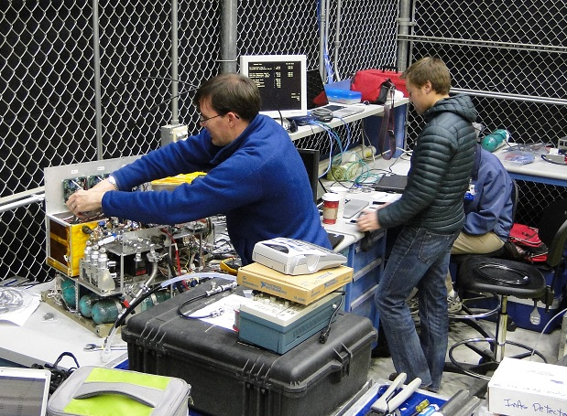
Thank You For The Great Data!
Photos Courtesy Dave Fratello
Notes:
Pictures from ATTREX

Slide 18
Future Work
Continue to evaluate and refine this alternate representation for TTL macrophysics, including CAM5/MG and free running CAM5/CARMA.
Identify a diagnostic field (e.g. stability, eddy diffusivity, …) to define the large scale region rather than arbitrary pressure levels. Might affect regions other than just the TTL and could move with climate change.
Use SSFR data to validate ice cloud heating rates?
Evaluate role of TTL cirrus in troposphere-stratosphere exchange (Corti et al., 2006).
Notes:
Think this was too much detail, so plan to leave this out.

Slide 19
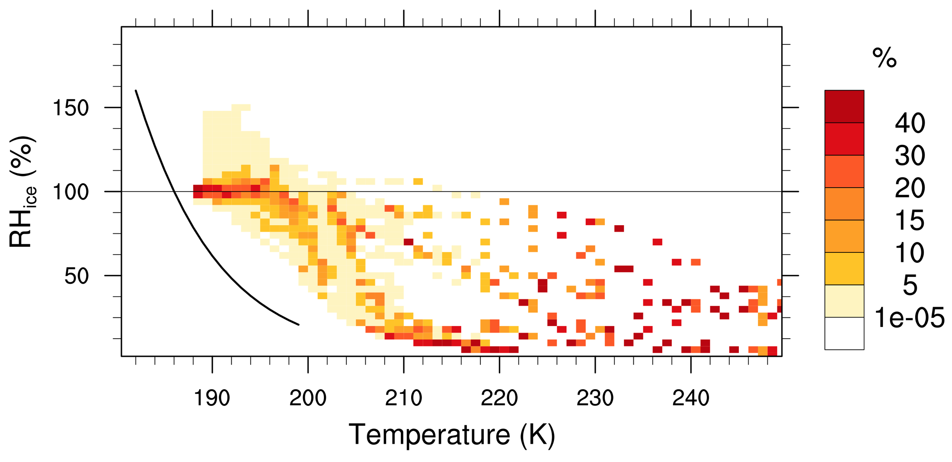
Krämer Plots : RH vs T
DLH
CARMA – Base Macrophysics
All Sky
NOAA
CARMA – Modified Macrophysics
Too Wet
All Sky
Notes:
Models only have gridbox average RH, but MG RH is too high, because it uses gridbox average. CARMA doesn’t have enough variability in RH, but not surprising given scale differences.

Slide 20
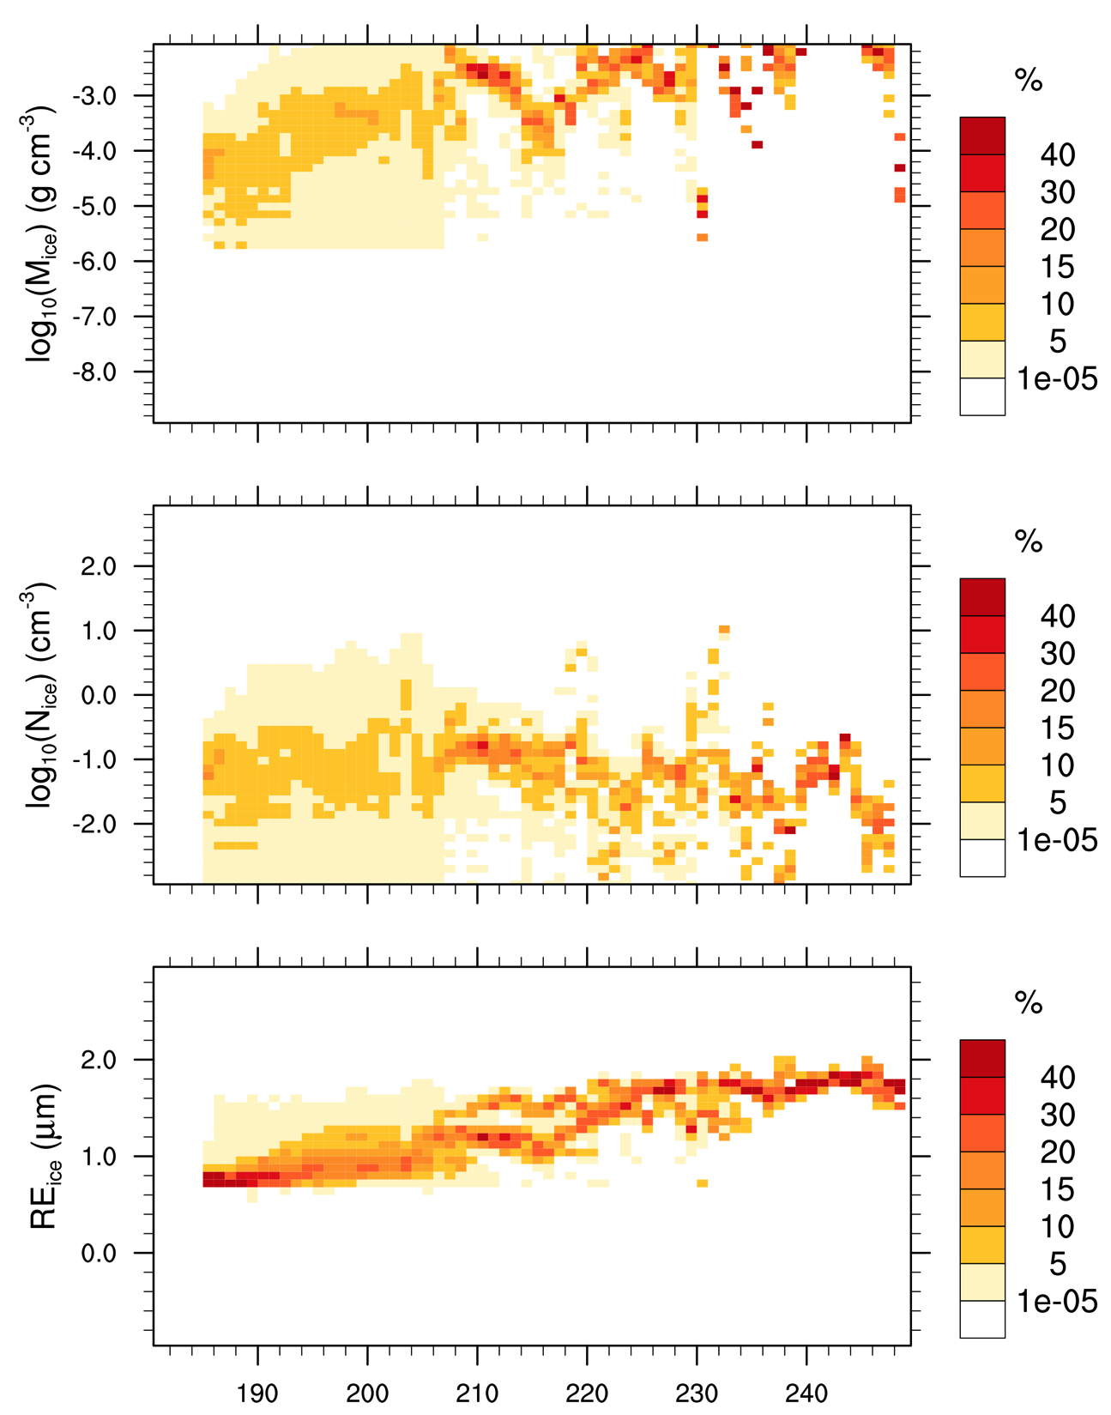
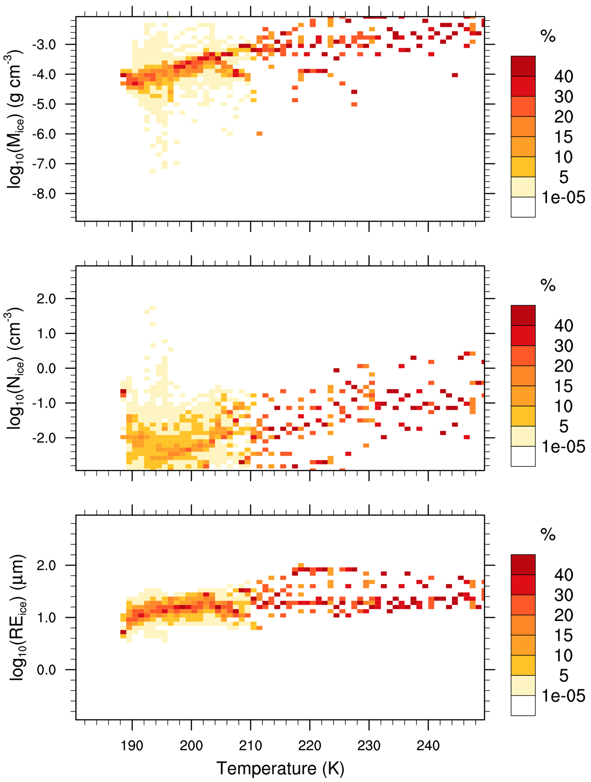
Kramer Plots : M, N, Re vs T
Hawkeye 2DS
CARMA – Modified Macrophysics
Mass
Number
Radius
Notes:
Mass is similar, but N is still low. Re is still a little high and too flat. Should I have 2DS vs. CARMA or old CARMA vs new CARMA?
Should I even show this slide?

