Slide 1
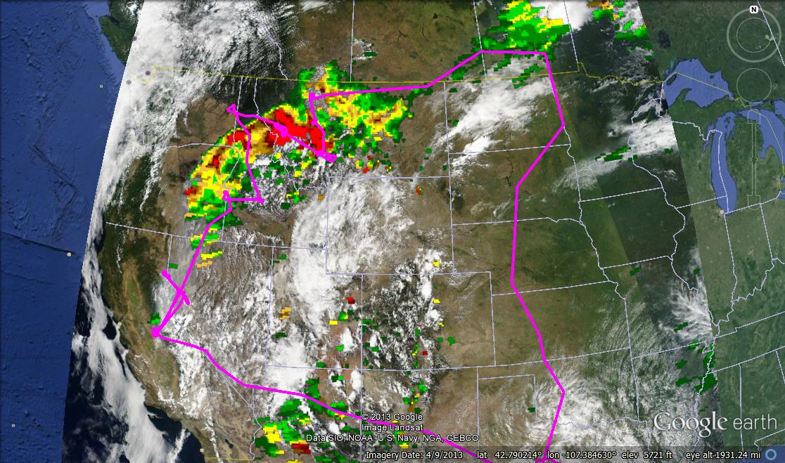
Rim Fire Suitcase

Slide 2
Correlations (r²) with NH₄⁻
All WF Rim Rim
w/o 2 w/o 2 all
NO₃⁻ 0.83 0.96 0.99
K⁺ 0.78 0.84 0.87
BC 0.77 0.79 0.98
CH₃CN 0.77 0.79 0.96
OA 0.76 0.86 0.96
CO 0.76 0.88 0.94
WSOC 0.70 0.77 0.81
HCN 0.56 0.67 0.94
CO₂ 0.28 0.64 0.91

Slide 5
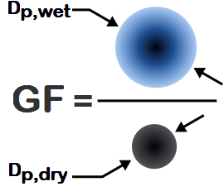
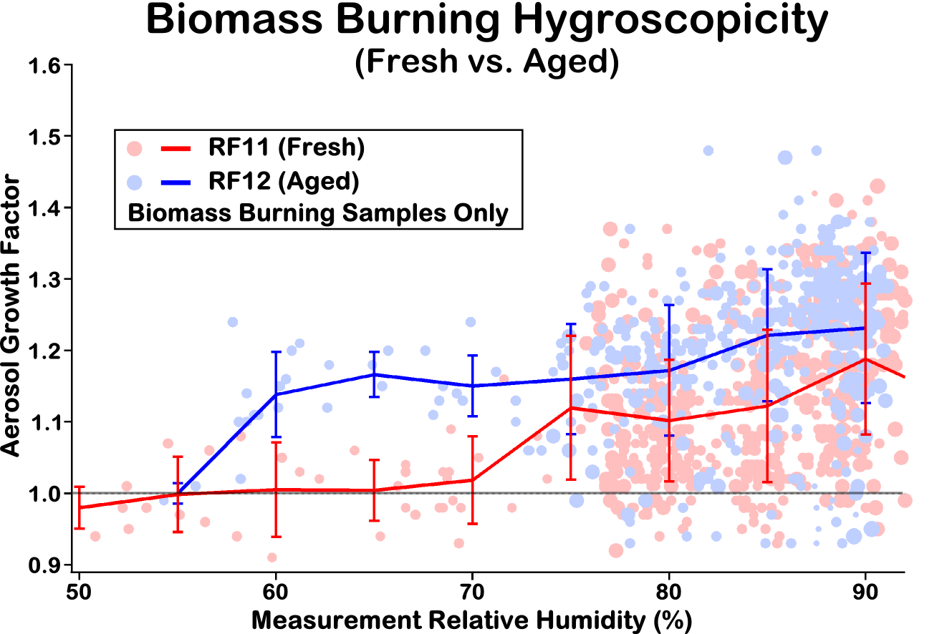
Size-Resolved, Subsaturated, Aerosol Water Uptake
(Biomass Burning Events)
Differential Aerosol Sizing and Hygroscopicity Spectrometer Probe (DASH-SP)
DC-8 / Taylor Shingler, Ewan Crosbie, and Armin Sorooshian / University of Arizona
Research Directions
Instrument: Differential Aerosol Sizing and Hygroscopicity Spectrometer Probe (DASH-SP)
Growth
Factor
Fire Type: Average growth factors are much higher in agricultural fires vs. wildfires, likely due to fuel composition and combustion condition differences.
=
Combustion Aging: Hygroscopic growth increases with age in biomass burning plumes as aerosols become increasingly photo-oxidized, resulting in higher O:C ratios.
This is seen nicely during RF11 and RF12 (Figure).
Restructuring: Potentially seeing restructuring in fresh biomass burning sources.
Notes:
Initial comparison of wild fires and agricultural fires shows suppression of growth from both sources, but greater suppression in wild fires compared to ag fires (likely due to combustion conditions and fuel source differences).
Hygroscopic growth significantly increases with age of biomass burning emissions (Rim fire example of average growth factors as a function of sampling RH).
Restructuring of fresh biomass burning emissions possibly being seen but needs further confirmation.

Slide 6
Water uptake of biomass burning BC
Water uptake for biomass burning BC is low despite thick coatings.
Variation seen between fresh emissions (no uptake) and aged emissions (slight uptake).
Shift in humidified scattering signal between fresh and aged BB BC
see poster by Perring et al.

Slide 7
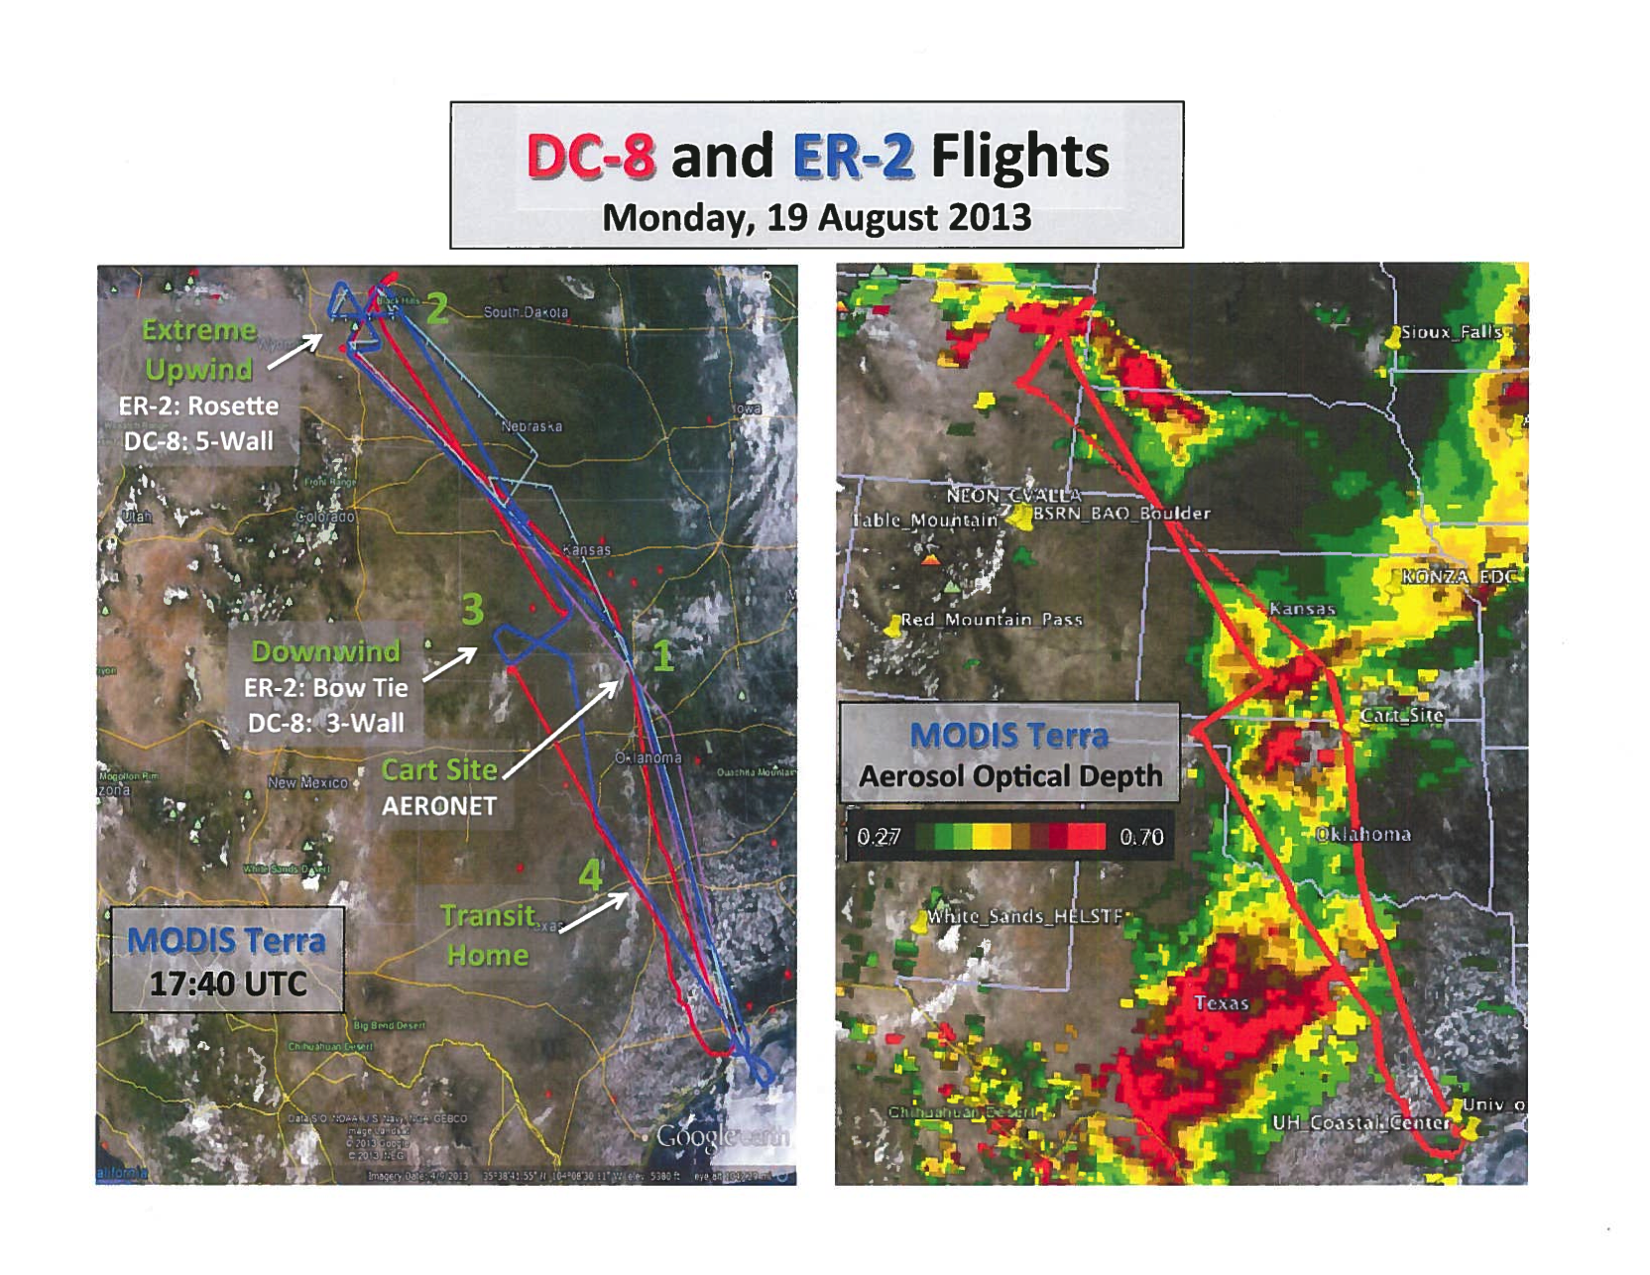

Slide 8
Aged Smoke Over SEUS
0.40 8/14 65100-65520
0.36 8/16 72060-72540
0.15 9/6 67500-67800
0.13 9/6 63720-64020
0.11 8/14 71040-71880
0.22 8/14 65100-65520
0.30 8/16 72060-72540
0.33 9/6 67500-67800
0.24 9/6 63720-64020
1.32 8/14 71040-71880
0.18 8/14 65100-65520
0.29 8/16 72060-72540
0.13 9/6 67500-67800
0.11 9/6 63720-64020
0.18 8/14 71040-71880

Slide 9
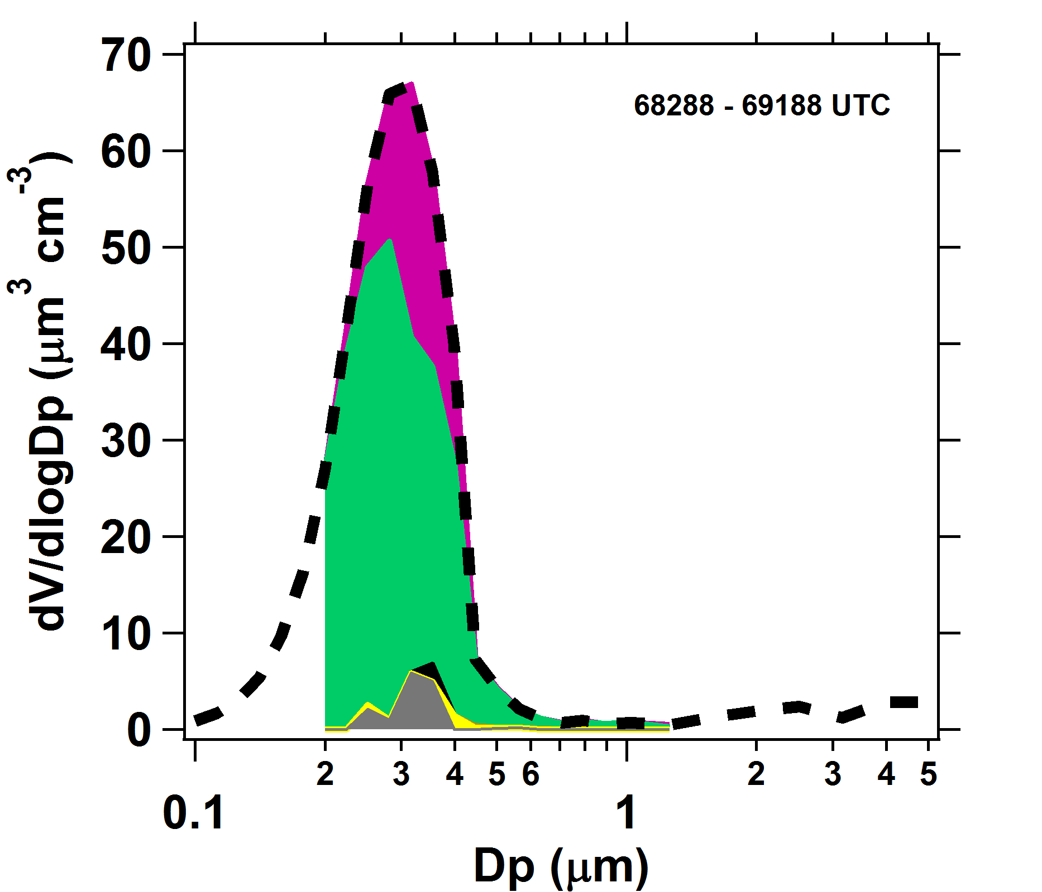
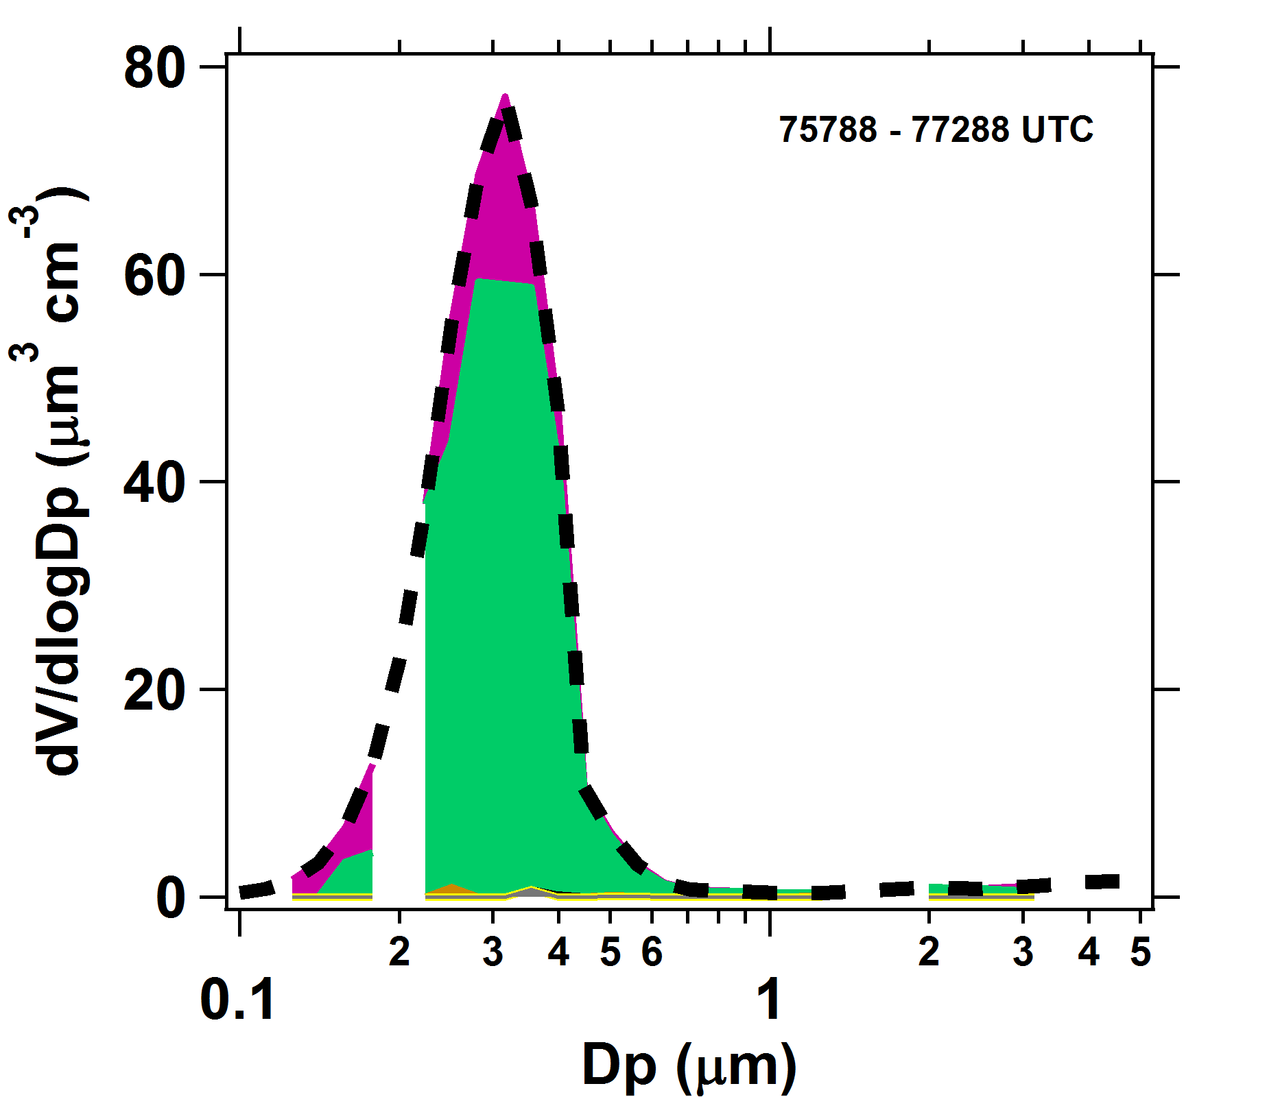
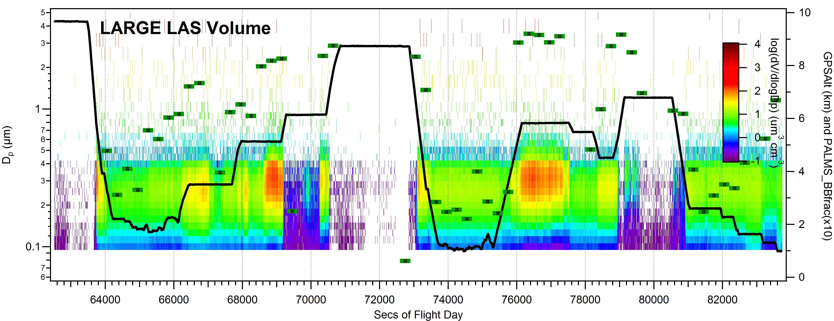
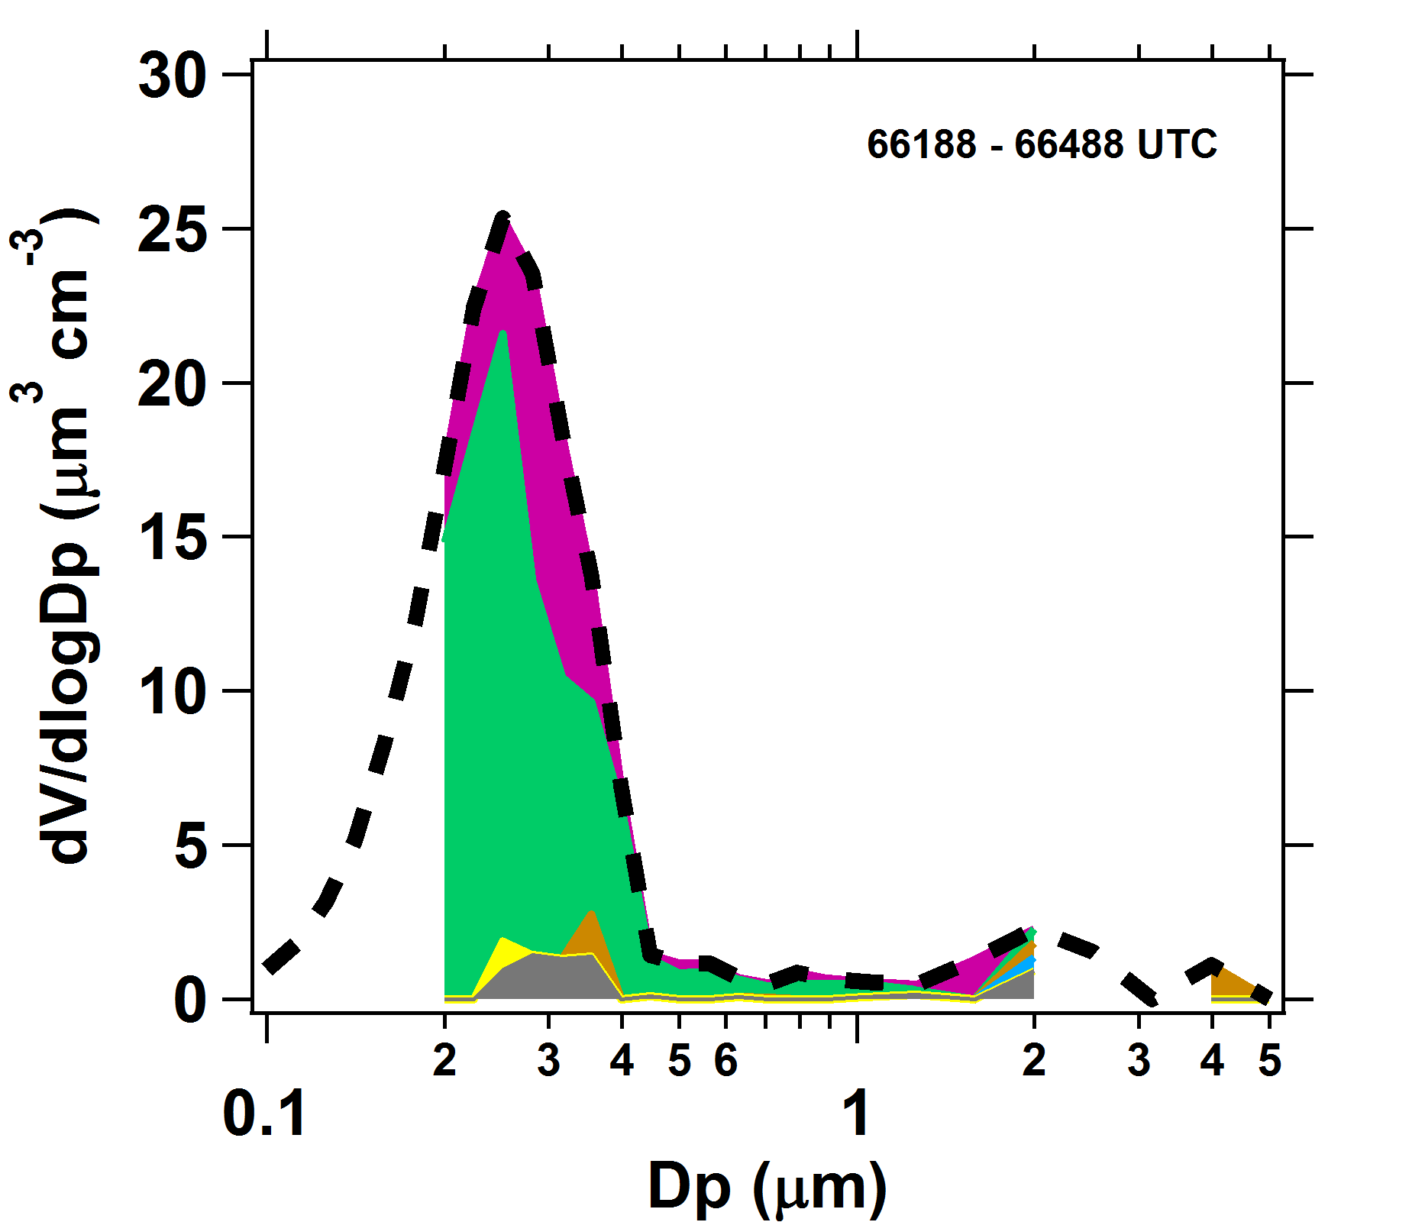
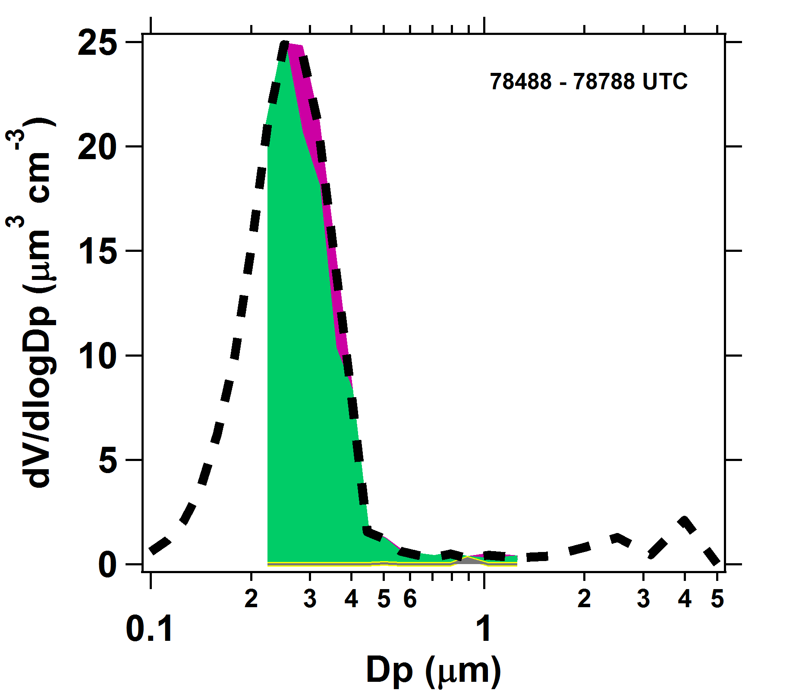
8/19 PALMS + LARGE in situ aerosol
PALMS: Froyd & Liao
Plumes from 3-6 km alt, higher plumes are thicker
Mostly BB particles, some non-BB (background) particles mixed into plume
Very little mineral dust lofted with smoke
PALMS particle types
Sulfate/Organic
Biomass Burning
Mineral Dust
PALMS # fraction of particles that have BB material (0-10 right scale)
PALMS + LAS avg size distributions: General compositional makeup is similar for 4 plumes
Detailed compositional analysis shows some differences (not shown), eg., older plumes have lower nitrate, higher organic content

Slide 10
8/19 ID/WY fire plume identification
These segments show similar BB particle chemistry, except for variations in SO4, NO3, NH4. Same plume (?).
These segments show similar BB particle chemistry, different than for higher alt segments. The high alt segment at 20.3 is mysteriously different than the other high alt plumes.

Slide 11
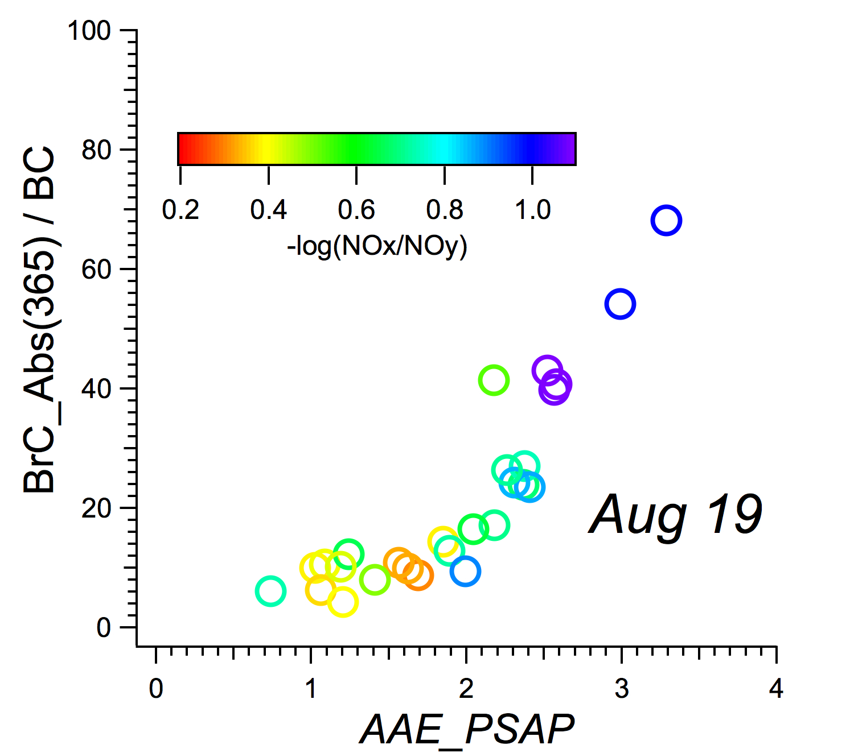
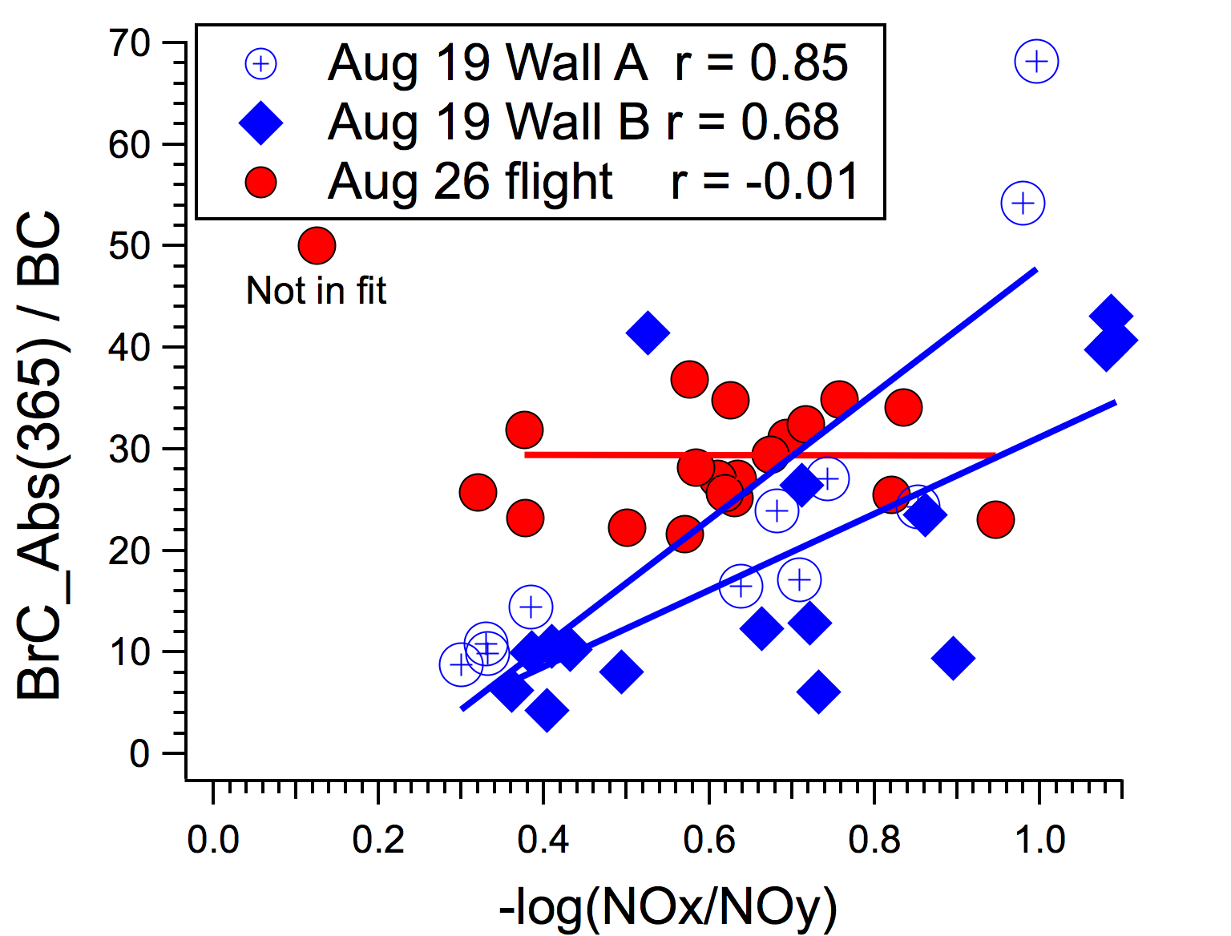
SEAC4RS: BrC & Biomass Burning Plumes
BrC/BC vs Absorption Ångstrom Exp
BrC/BC vs Plume Age:
Comparison of Two Plumes
BrC fraction increases with AAE above 1
(AAE ~ 1 for BC)
Possible evidence for BrC increase wrt BC with age for some plumes

Slide 12
Big differences between wild fire and agriculture fire smoke.

Slide 13
Agricultural Fires,
Some challenges
(especially for filters)

Slide 14
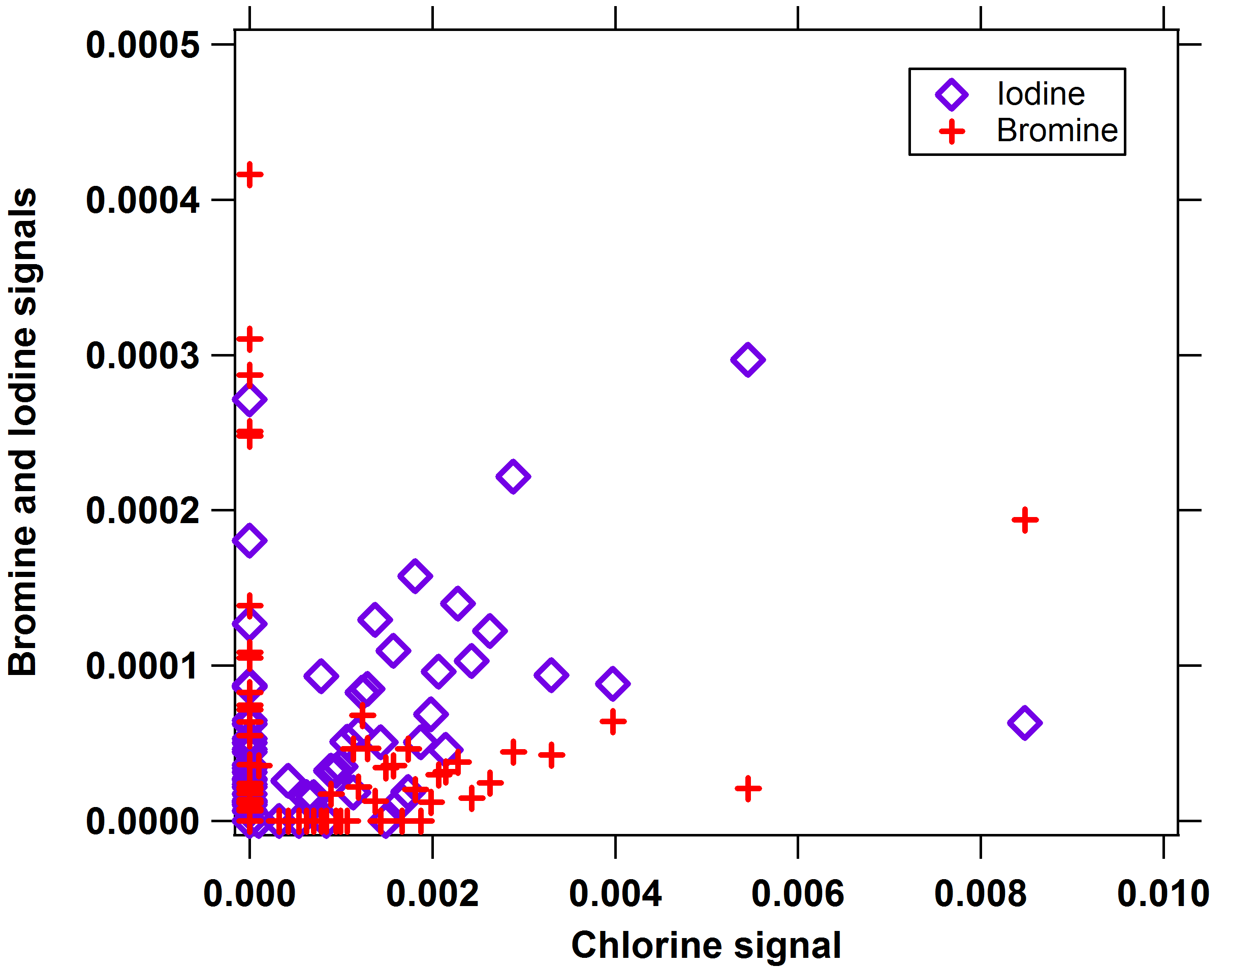
PALMS: Halogens in BB plumes
~x3 higher Chloride signal in Ag fire vs Wild fire aerosol
Inside Ag fire plumes…
Other halogens correlate with Chloride in individual particles
No evidence of enhanced Phosphate from pesticides
Case example: 9/23 Mississippi Valley Ag fires
Inside plumes
particles from BB: 15% have I, 42% have Cl
background particles: 6% have I, 14% have Cl
Outside plumes: 3% have I, 7% have Cl

