Slide 1


FSU’s Website for SEAC4RS Weather Data
Henry Fuelberg, Sean Freeman, Tristan Hall, Nick Heath, Max Marchand, and Daniel Allison

Slide 2
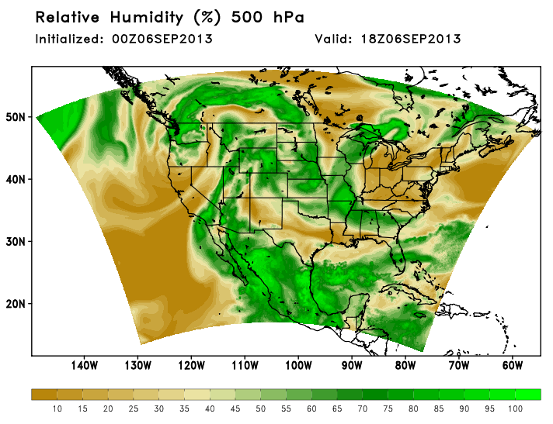
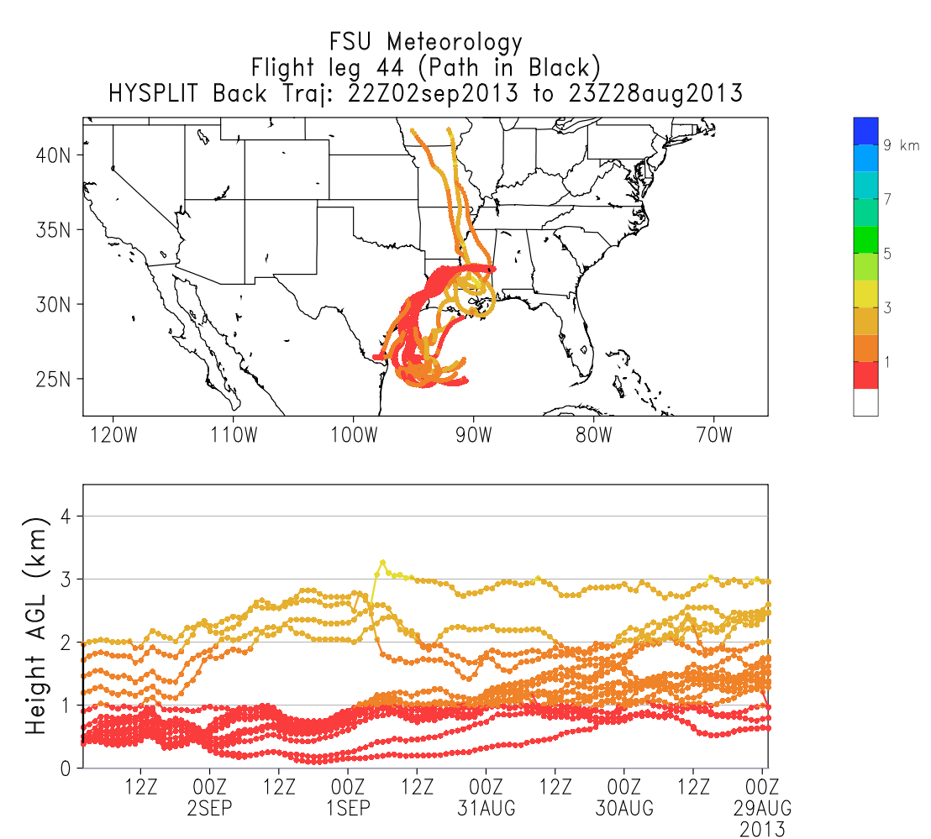
Overview
1. WRF simulations made for the entire SEAC4RS period
2. HYSPLIT back trajectories from the flight track
Quick Looks
Trajectories

Slide 3
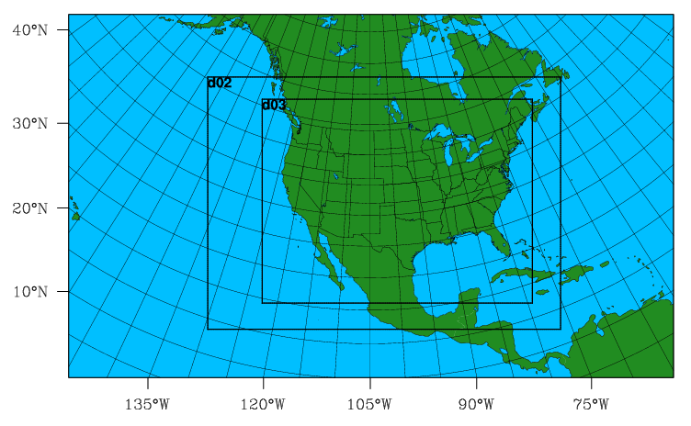
WRF Simulations
4 km
12 km
36 km
Simulations from 01 Aug – 26 Sept
Domains: 36 – 12 km
Met reinitialized every 5 days

Slide 4
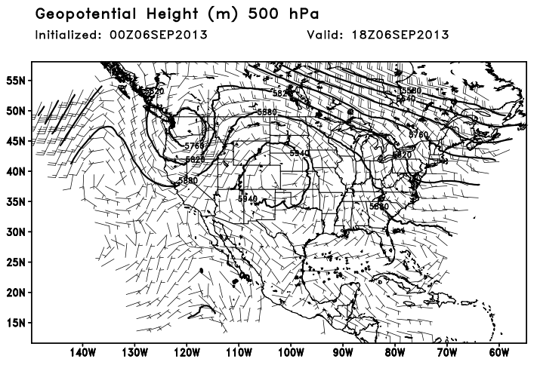
“Quick Look” Plots
MET variables from hourly WRF output:
MSLP and 10 m Winds
Geopotential Height (850, 500, 200, 100 hPa)
Relative Humidity (850, 500, 200, 100 hPa)
Potential Vorticity (200, 100 hPa)

Slide 5
Flight Track Trajectories
Flight track points binned into 10 minute intervals – LEG XX
5-day back trajectories were released from that LEG XX at temporal midpoint
Release at time centerpoint
12 UTC
12:10 UTC
12:05 UTC
Bin all points over 10 min interval -> Flight Leg

Slide 6
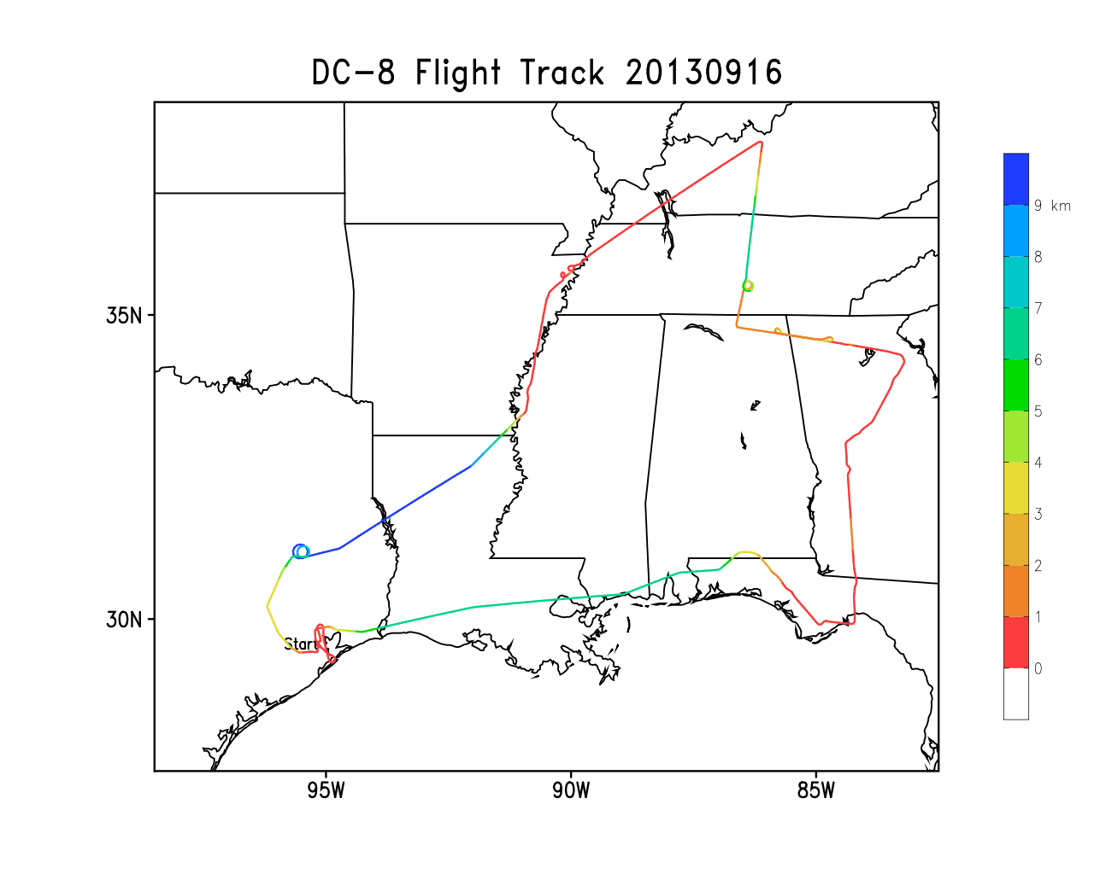
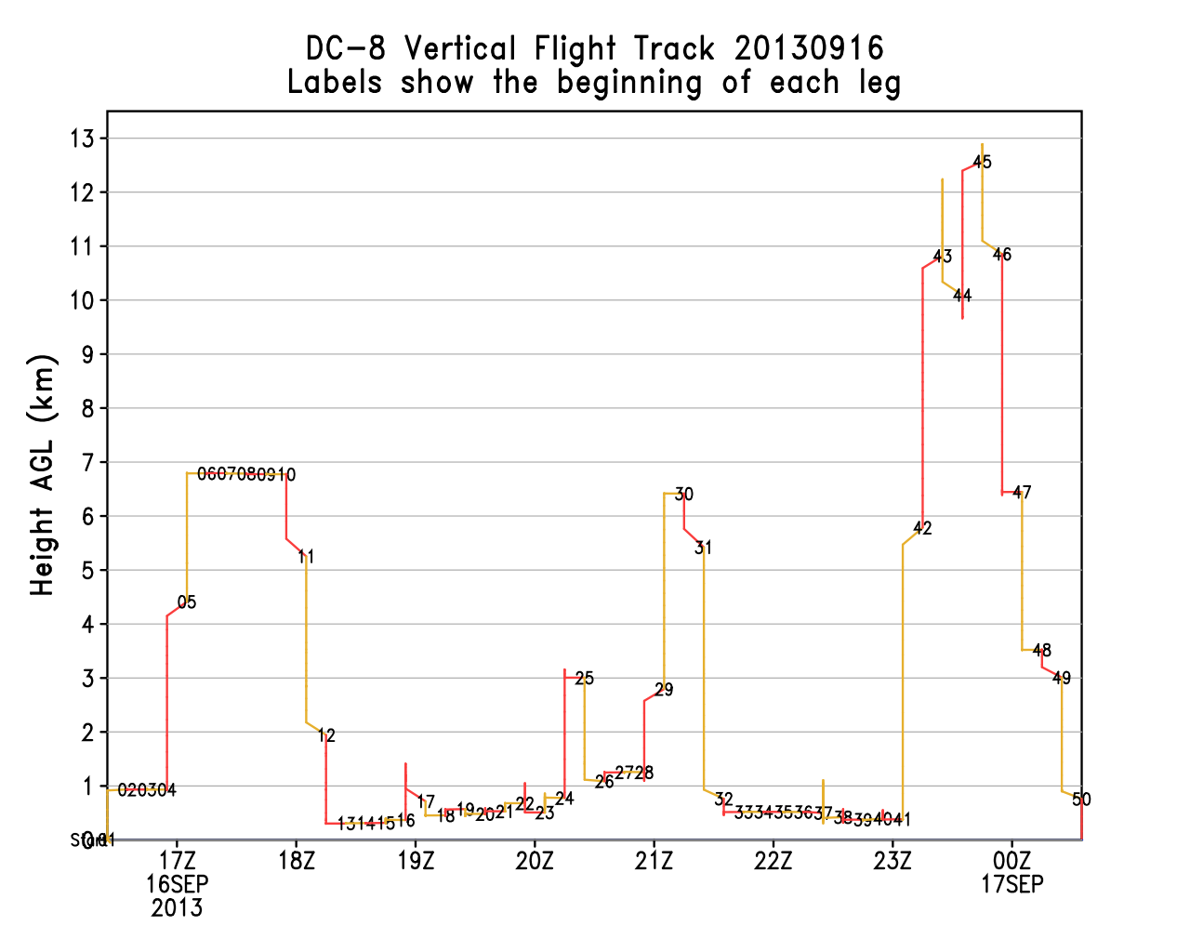
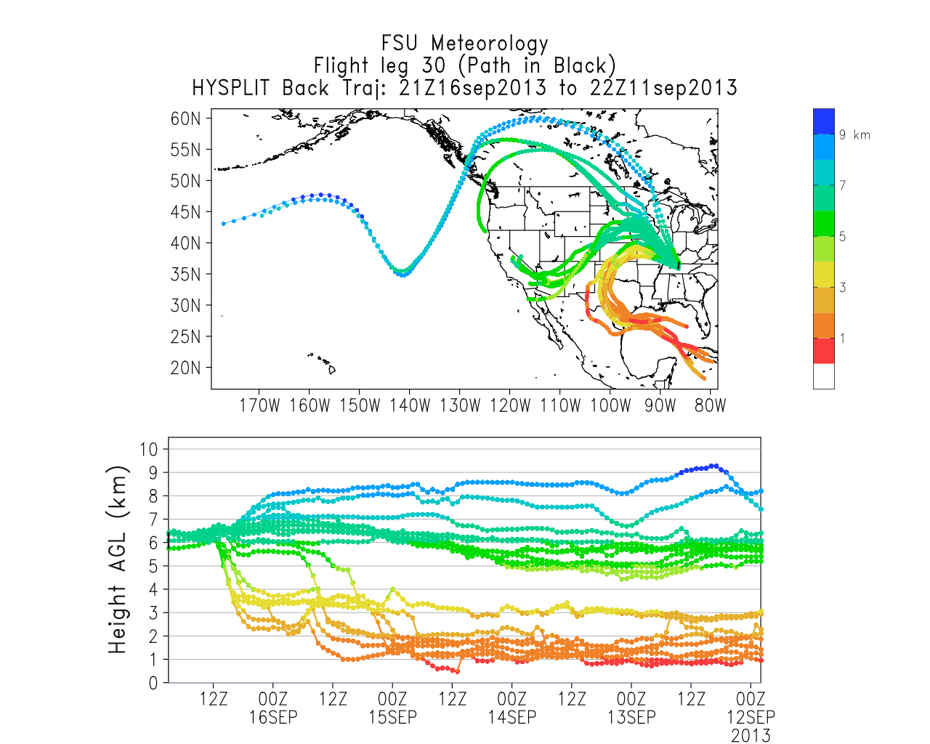

Slide 7


Pressure Altitude Releases
Trajectories released at specified pressure altitudes for each flight leg
Where air above and below the plane came from
Remote sensing applications
100 hPa
300 hPa
500 hPa
850 hPa

Slide 8
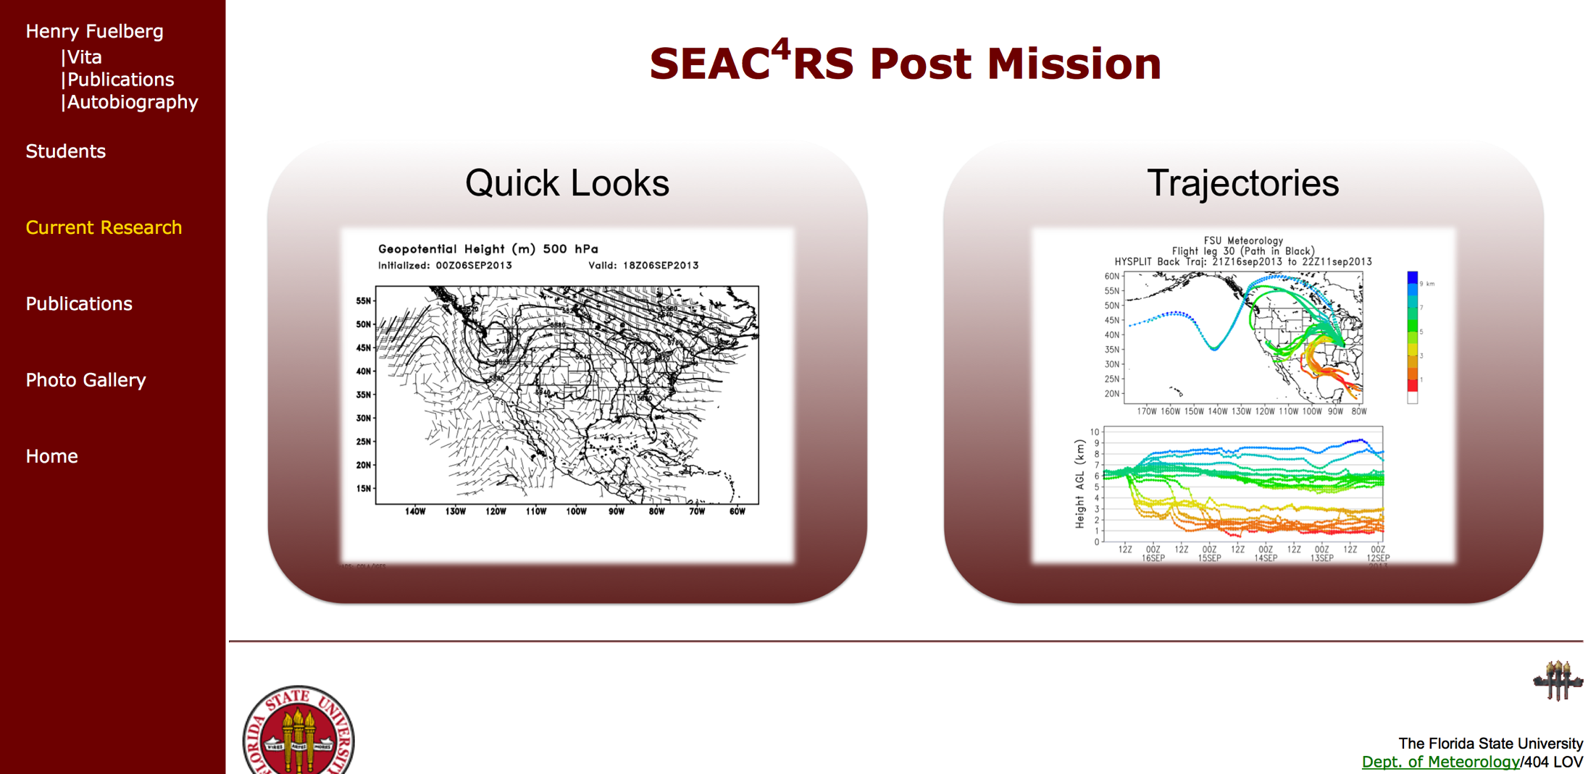
Website Walkthrough
http://fuelberg.met.fsu.edu/research/seac4rs/post-mission.php

Slide 9
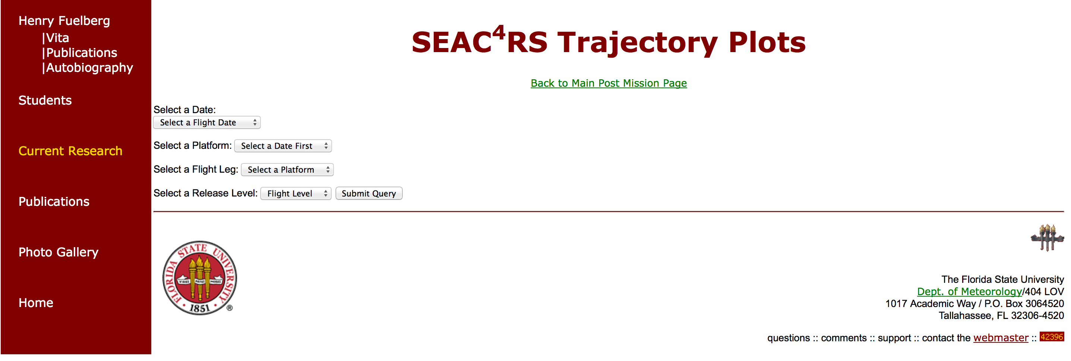
Website Walkthrough

Slide 10
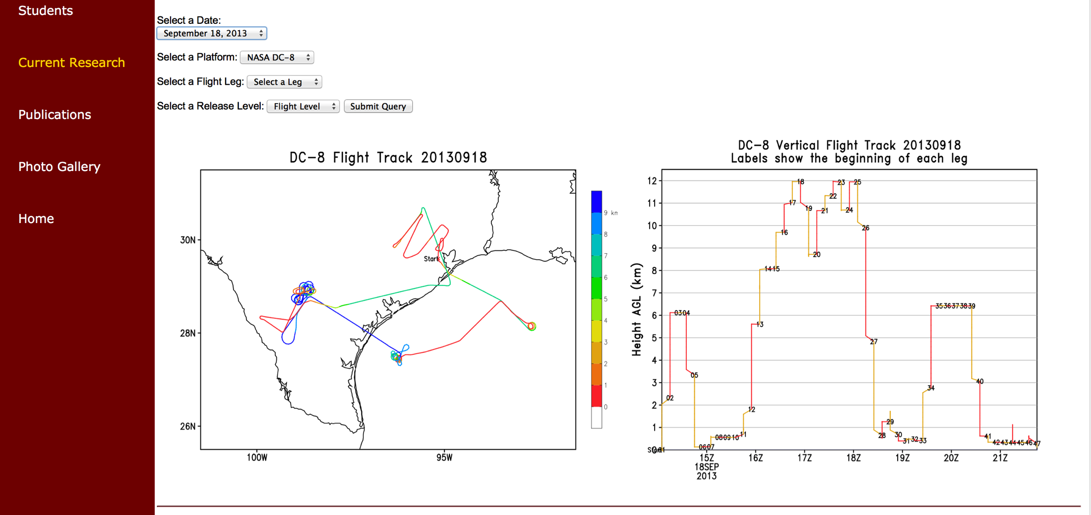
Website Walkthrough

Slide 11
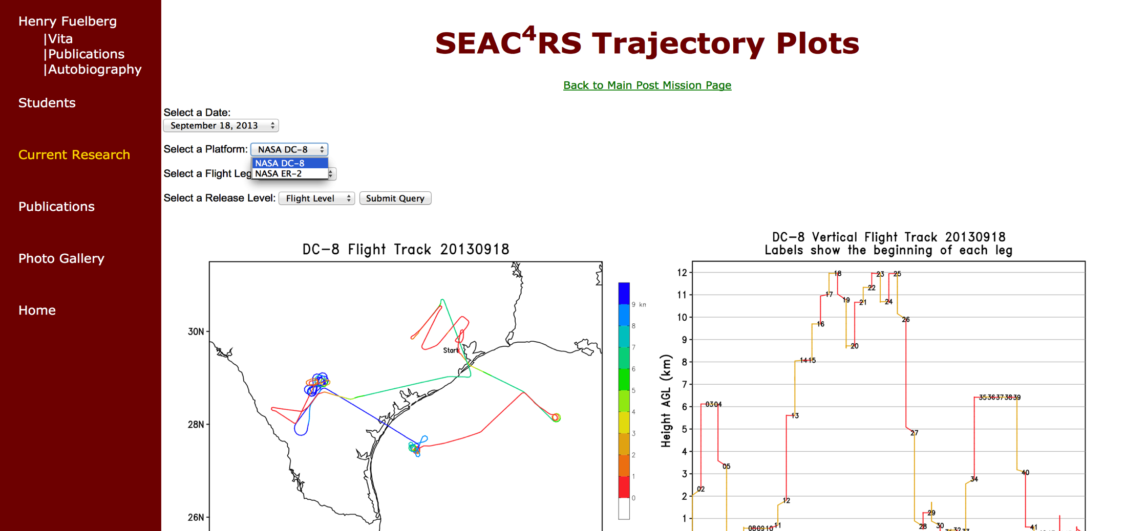
Website Walkthrough

Slide 12
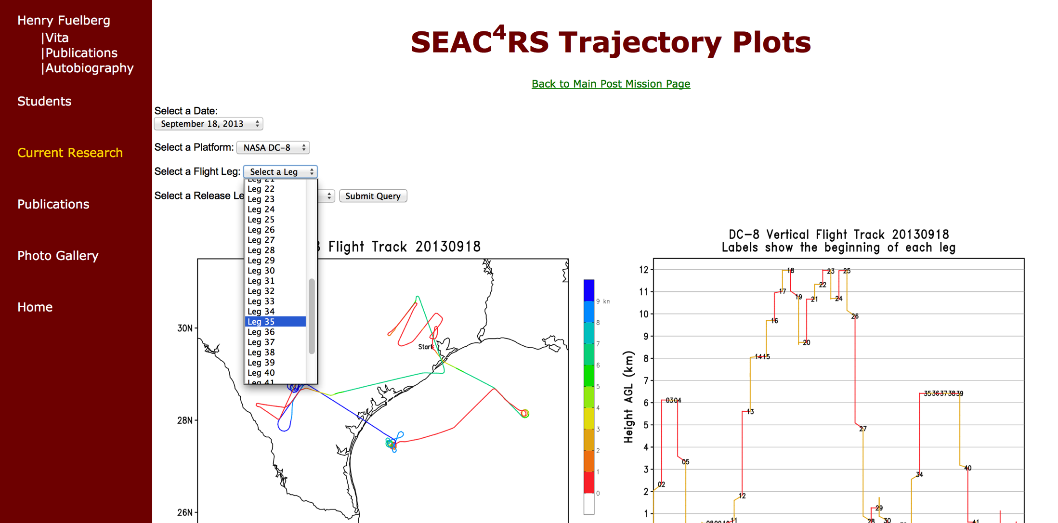
Website Walkthrough

Slide 13
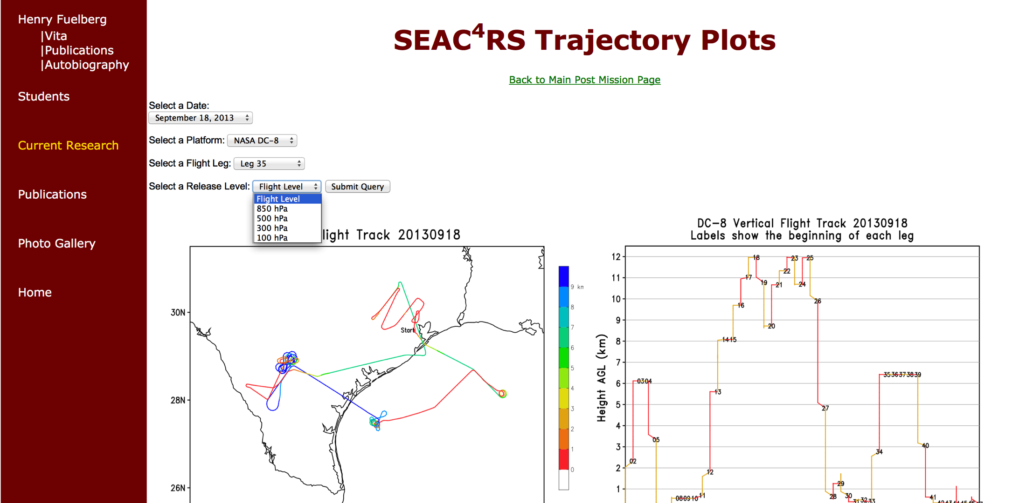
Website Walkthrough

Slide 14
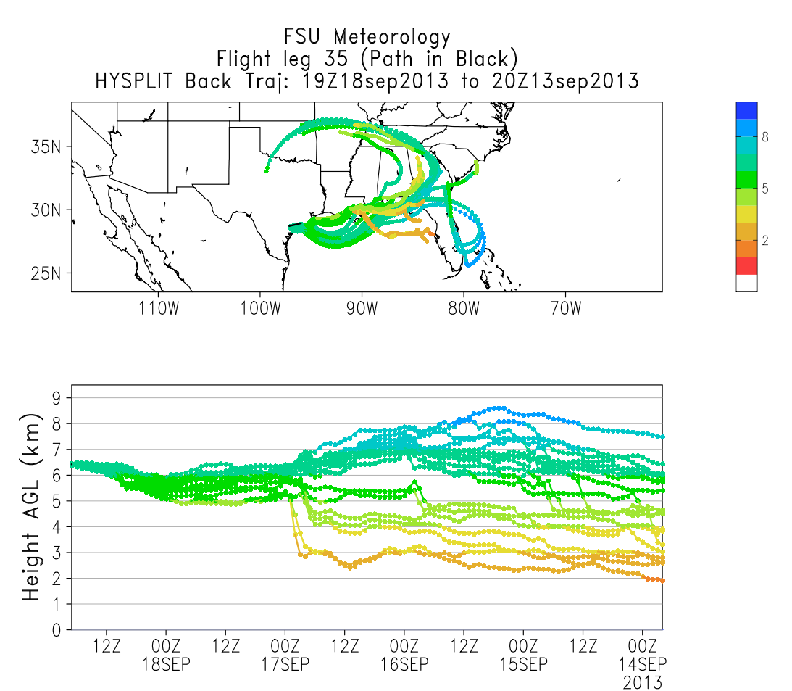
Website Walkthrough

Slide 15
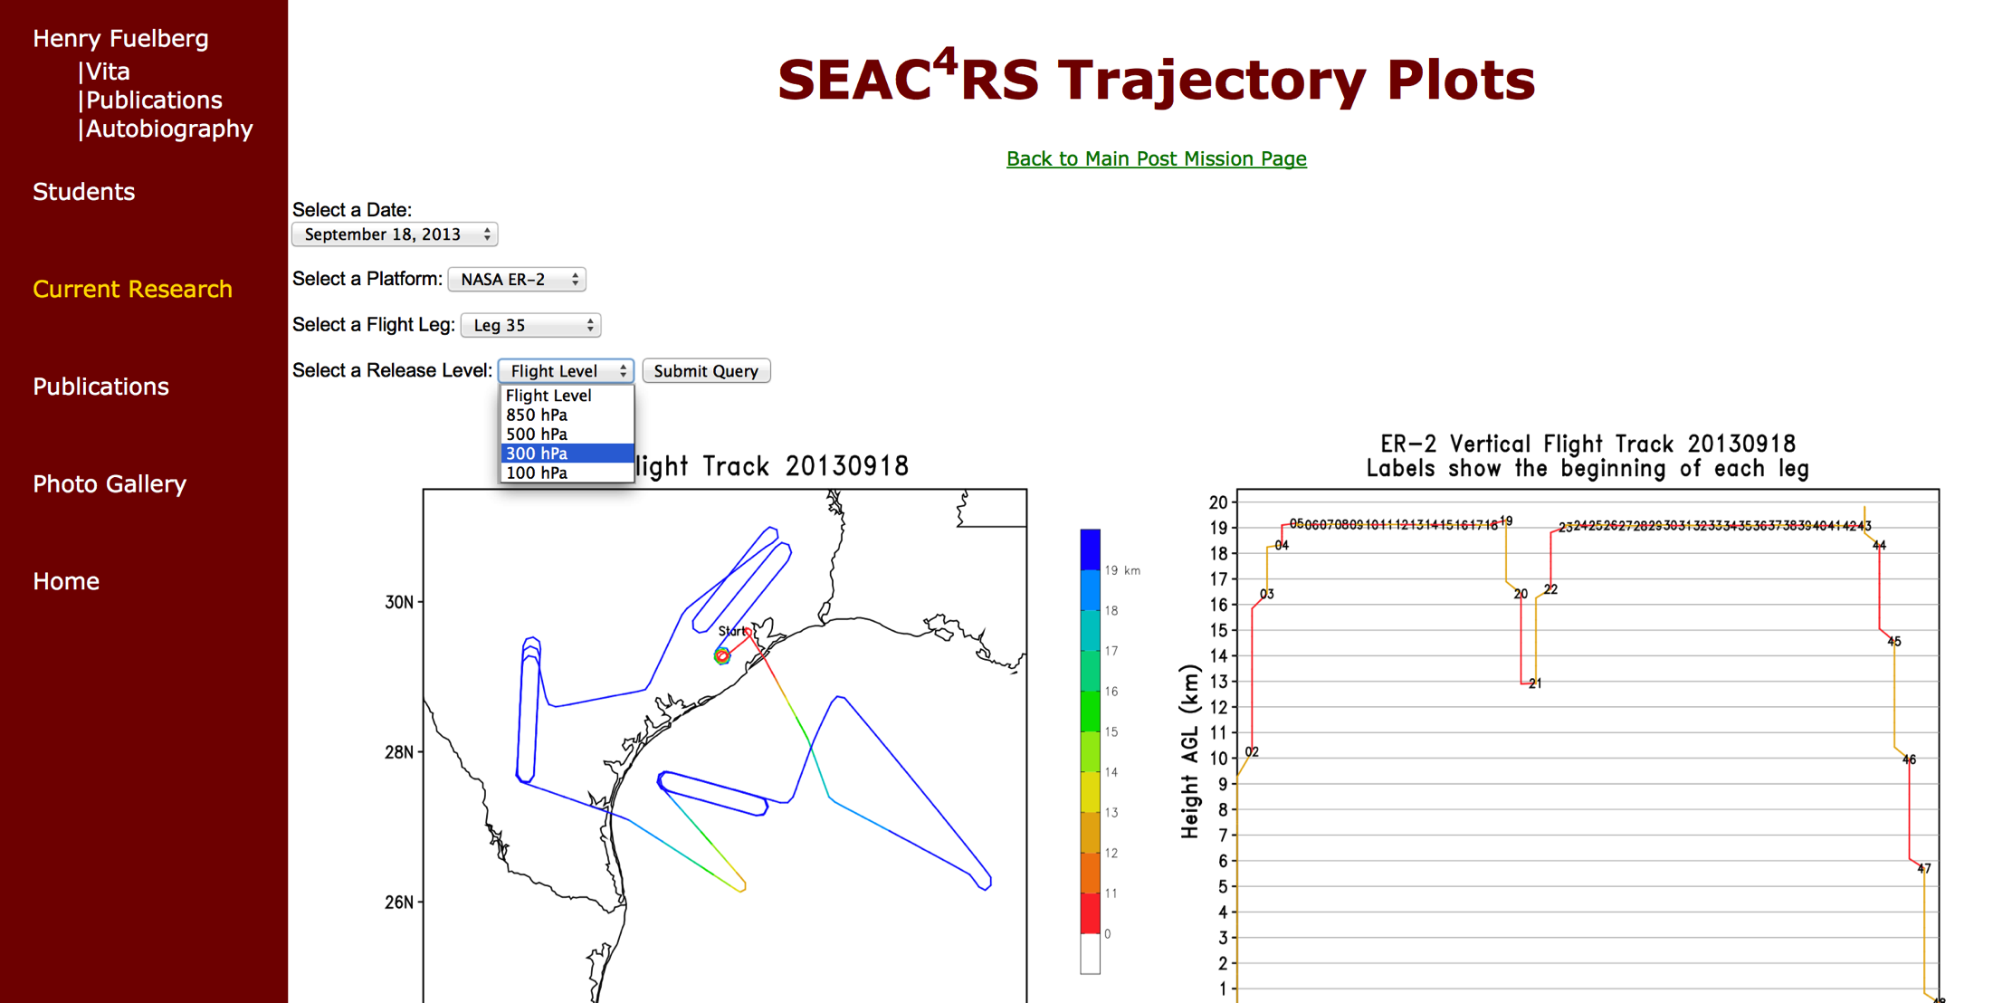
ER-2 saw something interesting at 300 hPa….

Slide 16
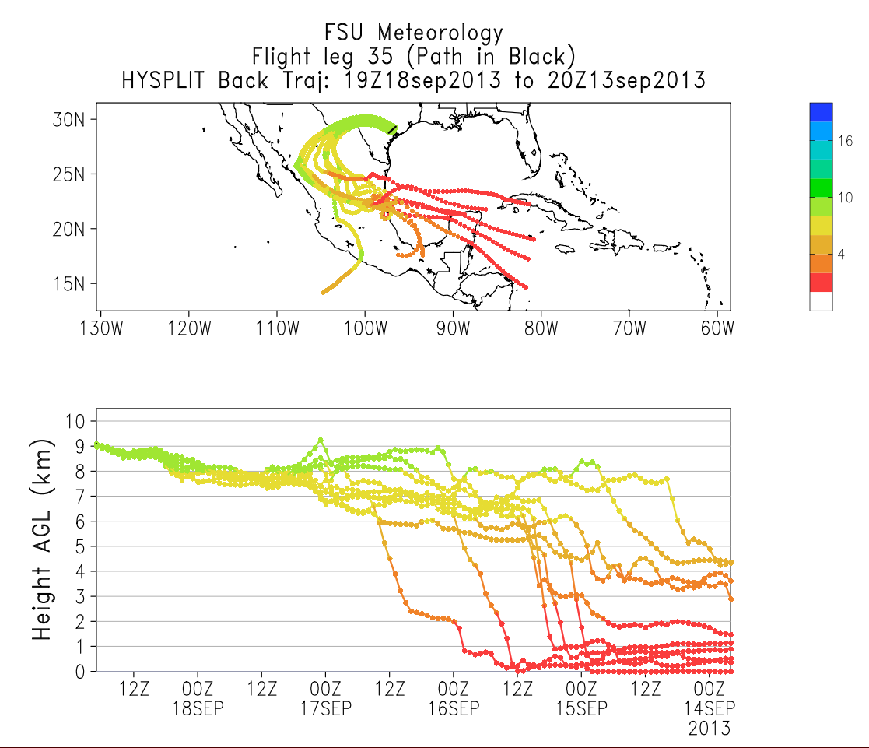
300 hPa release for ER-2 flight leg

Slide 17
We’re here to help!
Special requests?
Specific variables?
Contact us!

Slide 19
 | WRF Option
Microphysics | WSM 6
PBL | YSU
Cumulus | Kain-Fritsch
Radiation | RRTMG

Slide 20
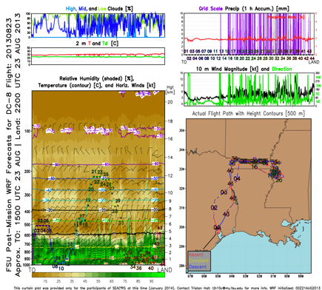
Overview
WRF simulations made for the entire SEAC4RS period
2. HYSPLIT back trajectories from the flight track
3. Curtain Plots
Quick Looks
Trajectories
Curtains

Slide 21
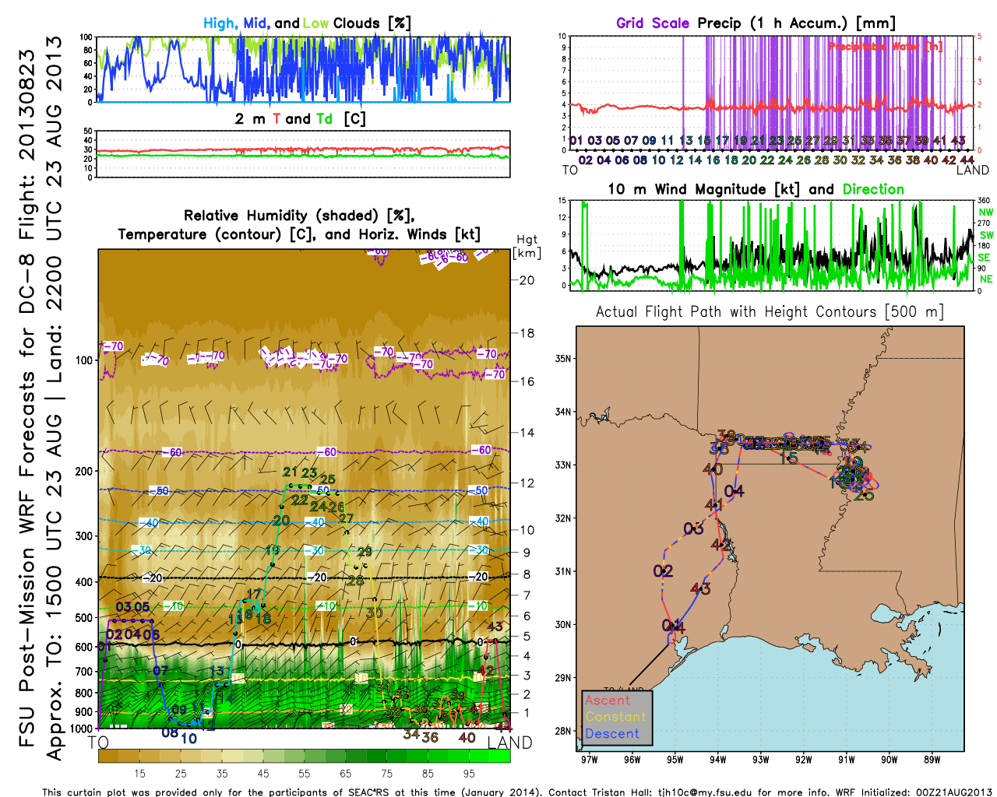
Curtain Plots from WRF Output

