Slide 1
Southeast US air chemistry: early results from SEAC⁴RS
Daniel J. Jacob for the SEAC⁴RS Science Team
Central question: How do biogenic and anthropogenic emissions combine to affect atmospheric composition with implications for air quality and climate?
- How does the system respond to changing emissions?
- How can the changes and responses be monitored from space?

Slide 2
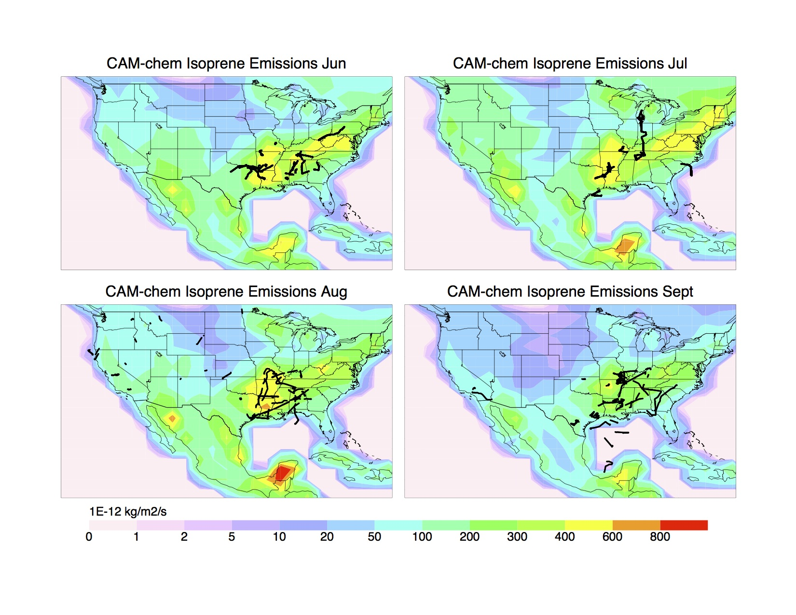
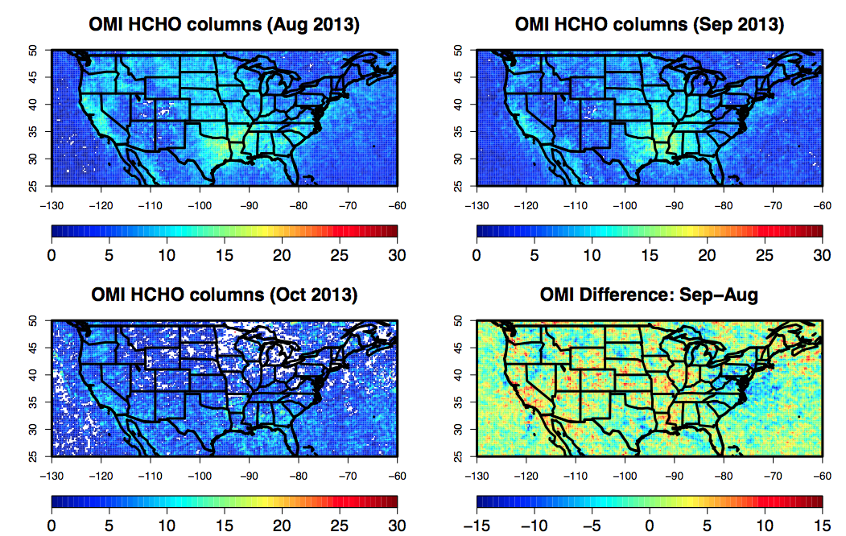
Understanding isoprene emission and chemistry is critical
O₃
hν
NO₂
Formaldehyde (HCHO)
Other carbonyls
Isoprene nitrates
NO
Ozone
Aerosol
OH
HCHO
OH
HO₂
ISOPOO
Peroxides
Isoprene
Isome-
rization
Carbonyls
MEGAN emissions during SEAC⁴RS
(L. Emmons)
OMI HCHO columns during SEAC⁴RS
(I. de Smedt, L. Zhu)
GOME-2B HCHO columns during SEAC⁴RS
(I. de Smedt, L. Zhu)

Slide 3
SEAC⁴RS intercomparisons for two stars of our show
(Hanisco)
(Cohen)
Low-NO_{x}
HCHO
NO₂
Continental
BL
High-NO_{x}
(Fried)
(Ryerson)
HCHO in good agreement down to 100 ppt background
NO₂ measurements consistent, but noise below 0.5 ppb
G. Chen

Slide 4
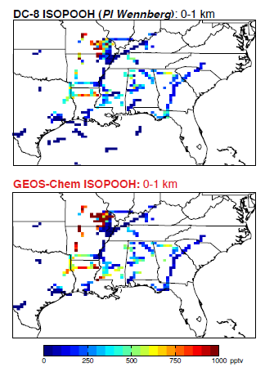
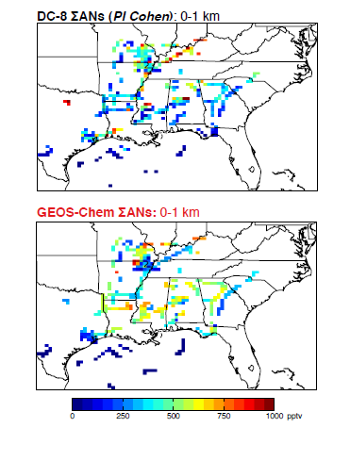
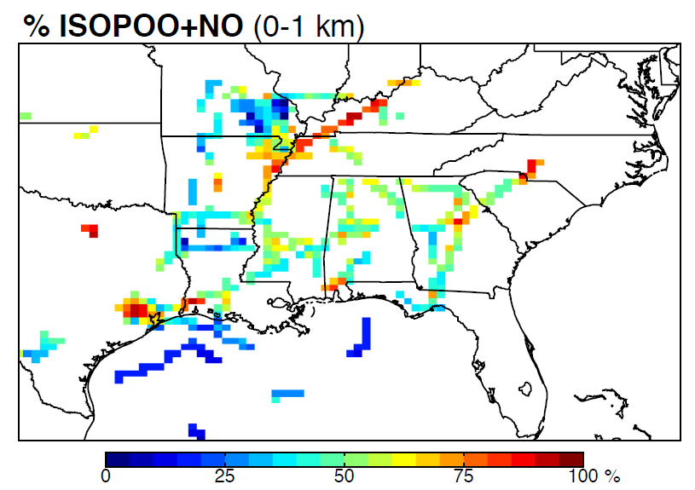
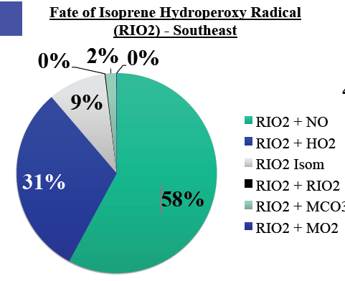
SEAC⁴RS observations of isoprene oxidation products enable better understanding of isoprene oxidation
Isoprene peroxides Isoprene nitrates
% high-NO_{x} pathway
(GEOS-Chem)
SEAC⁴RS sampled both high-NO_{x} and low-NO_{x} regimes
P. Wennberg, R. Cohen, J. Fisher, K. Travis

Slide 5
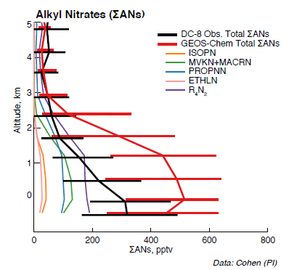
GEOS-Chem overestimate of isoprene nitrates
Likely problem with nighttime ISOP+NO₃ chemistry; do the resulting nitrates condense to aerosol?
First-generation isoprene nitrates are well simulated but second-generation isoprene nitrates are too high; again, could this reflect uptake by aerosol?
Need to integrate with SOAS ground-based observations
Correcting model mechanisms for organic nitrates using SEAC⁴RS data will improve NO_{x} chemistry with implications for simulating ozone, aerosol, and N deposition
P. Wennberg, R. Cohen, J. Fisher

Slide 6
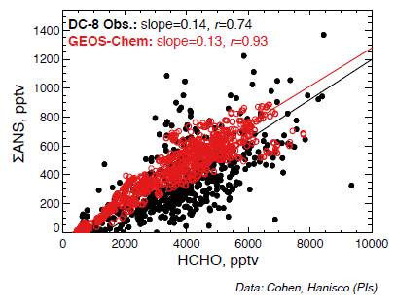
Strong correlation between HCHO and isoprene nitrates
Suggests that HCHO production is mainly from the high-NO_{x} branch of isoprene oxidation
Better understanding of the HCHO yield from isoprene will increase value of HCHO observations from space
R. Cohen, T. Hanisco, J. Fisher

Slide 7
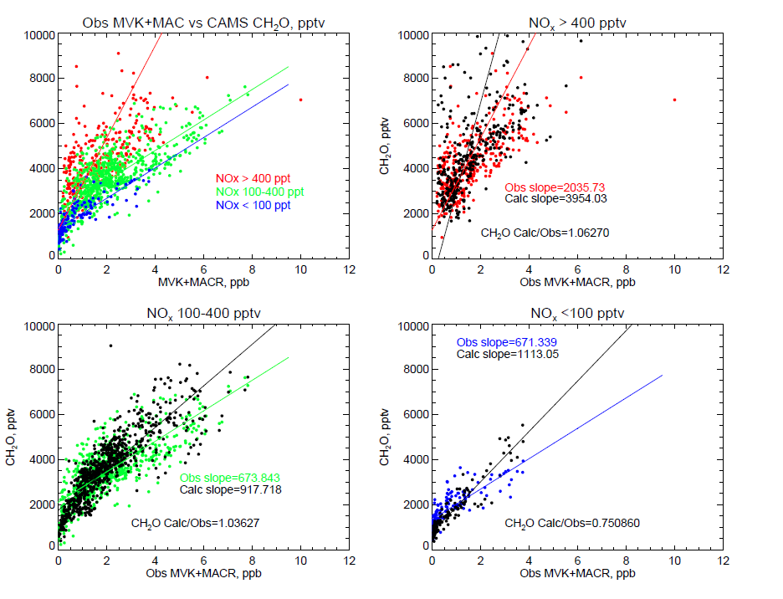
Relationship of HCHO with isoprene oxidation products
High-NO_{x} regime
Implies much larger HCHO yields from isoprene oxidation
under high-NO_{x} conditions
Low-NO_{x} regime
A. Fried, A. Wisthaler, J. Olson

Slide 8
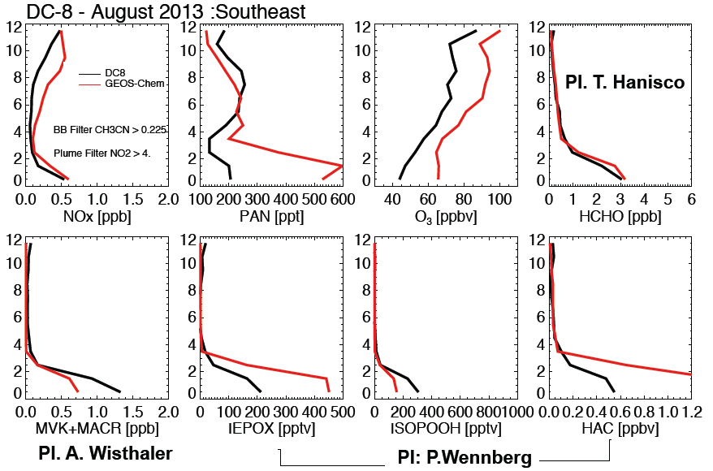
Mean vertical profiles of low-NO_{x} isoprene oxidation products: large overestimates in GEOS-Chem
Deposition and uptake by aerosol of these products is likely underestimated
DC-8 GEOS-Chem
Ryerson
Huey
Ryerson
K. Travis

Slide 9
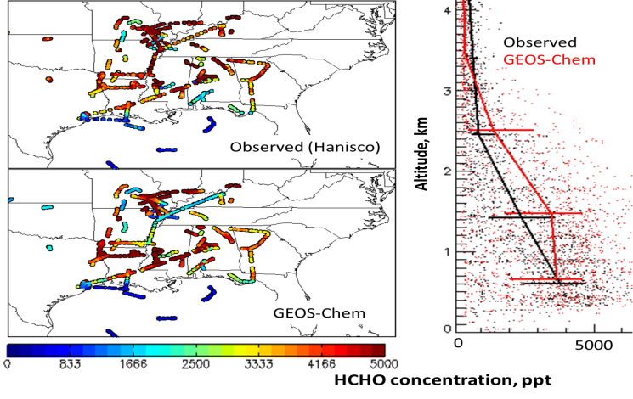
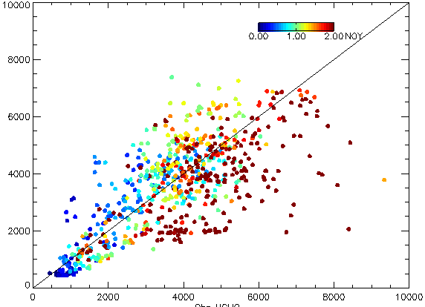
Indirect validation of satellite HCHO with SEAC⁴RS data using model as common intercomparison platform
HCHO at 0-1 km
colored by observed NO_{y} (0-2 ppb)
Model
Observed
HCHO columns
Preliminary results suggest that GOME-2B and aircraft show consistency in comparisons to model
GEOS-
Chem
GOME-2B
GOME-2B
L. Zhu, J. Fisher,
I. de Smedt, T. Hanisco
GEOS-Chem

Slide 10
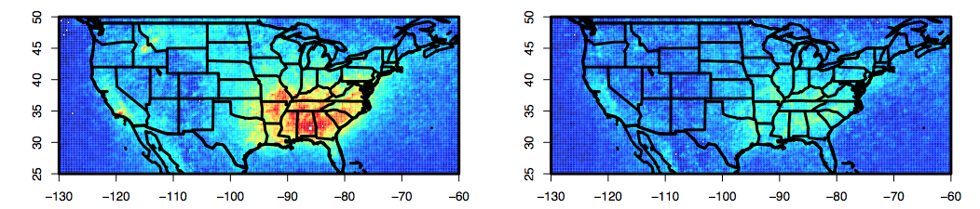
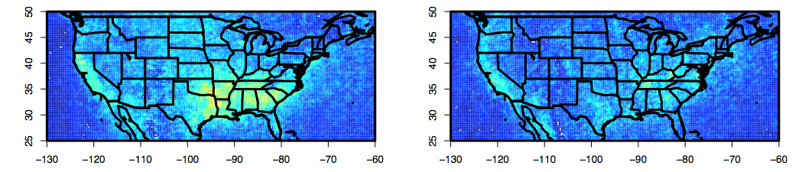
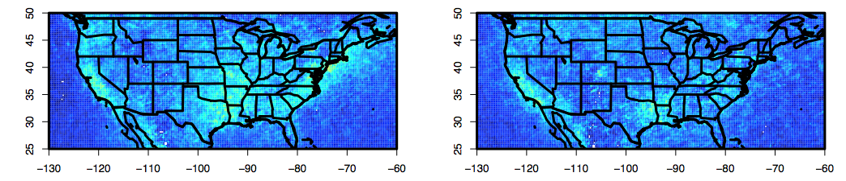
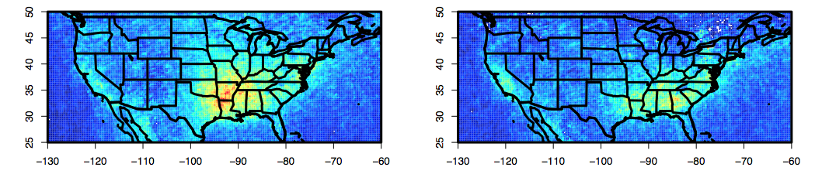
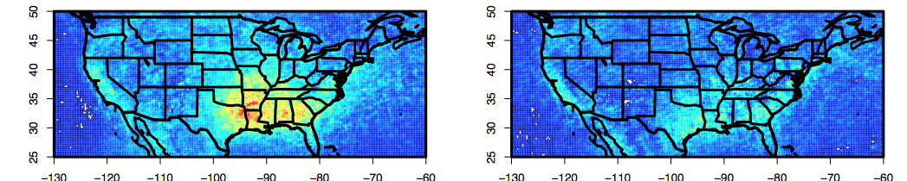
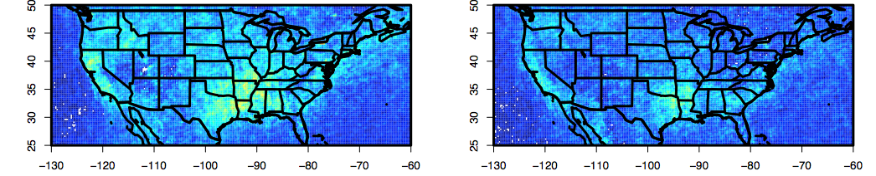
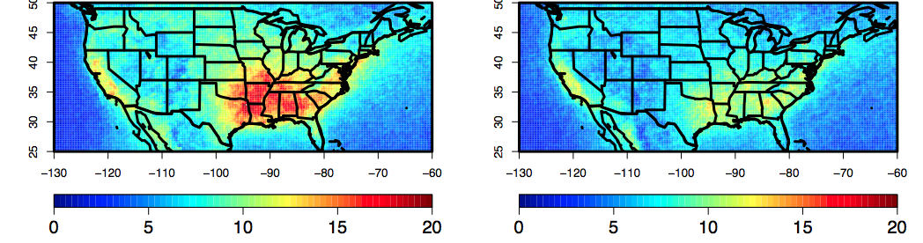
2007-2013 OMI HCHO data (I. De Smedt)
2007
August September
2008
August September
2009
2010
2011
2012
2013
2007-2012 average
Large IAV presumably driven by temperature
2013 is unusual lack of Aug-to-Sep decrease
L. Zhu

Slide 11
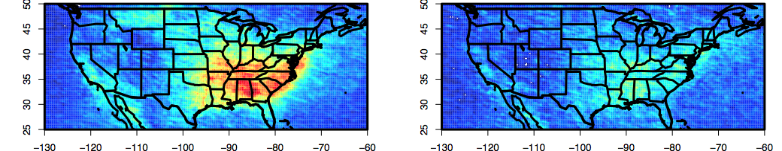
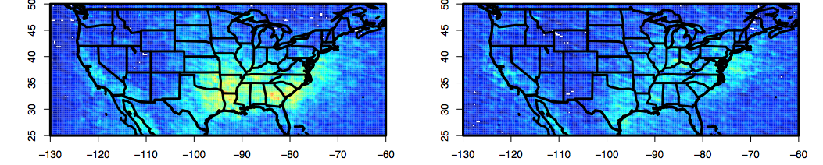
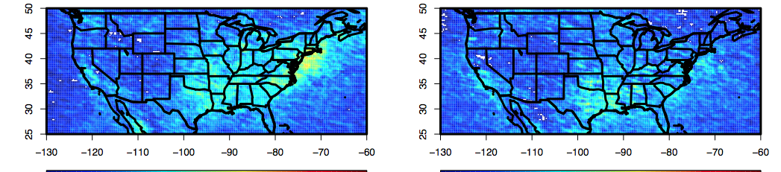
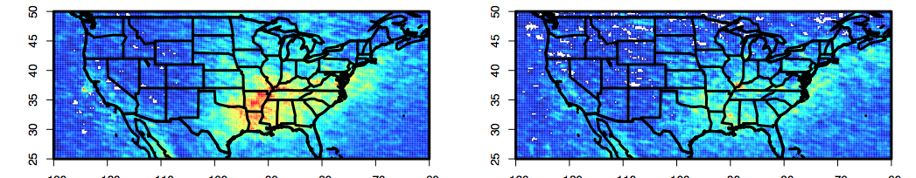
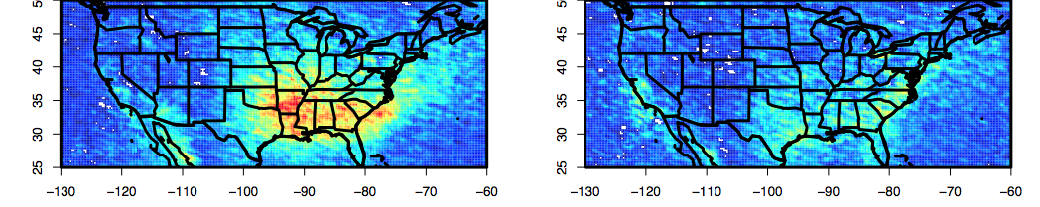
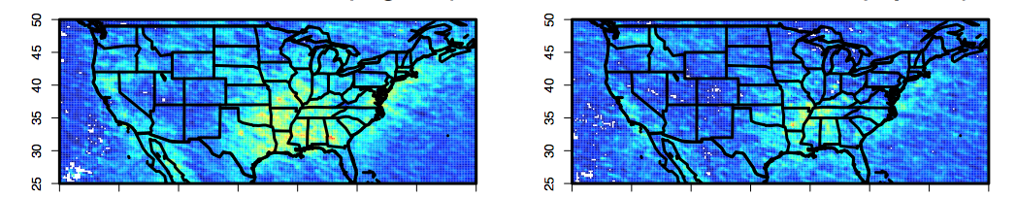
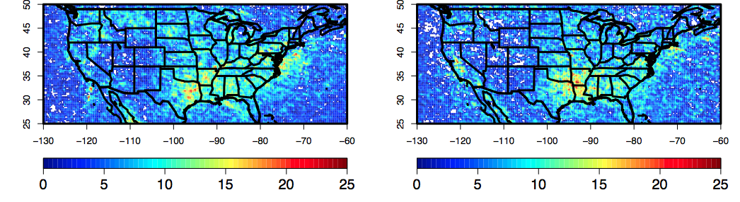
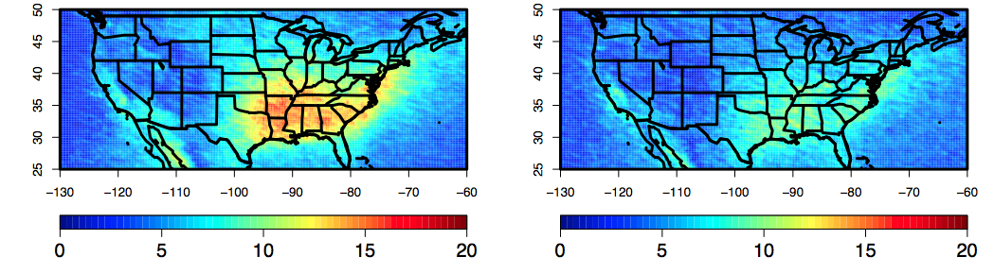
2007-2013 GOME-2A HCHO data (I. De Smedt)
2007
August September
2008
August September
2009
2010
2011
2012
2013
2007-2012 average
Large IAV presumably driven by temperature
2013 is unusual in lack of Aug-to-Sep decrease
L. Zhu

Slide 12
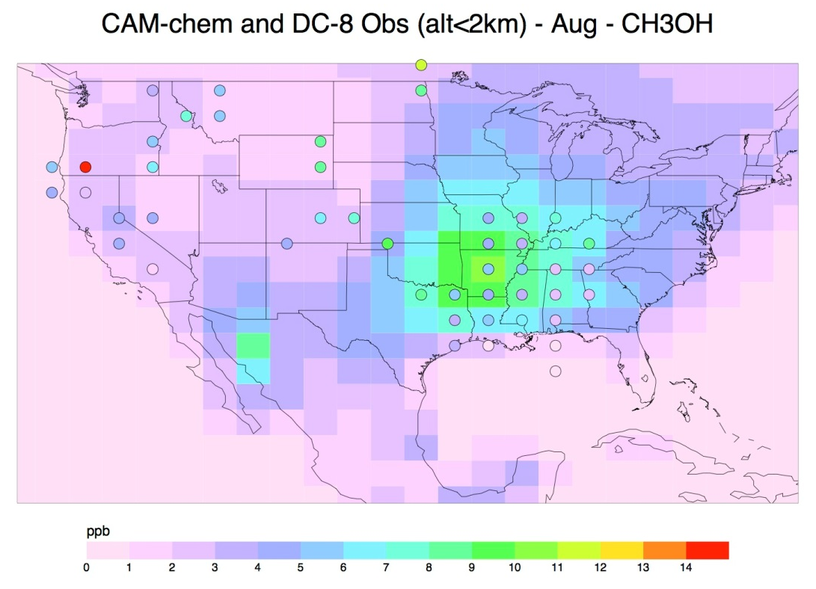
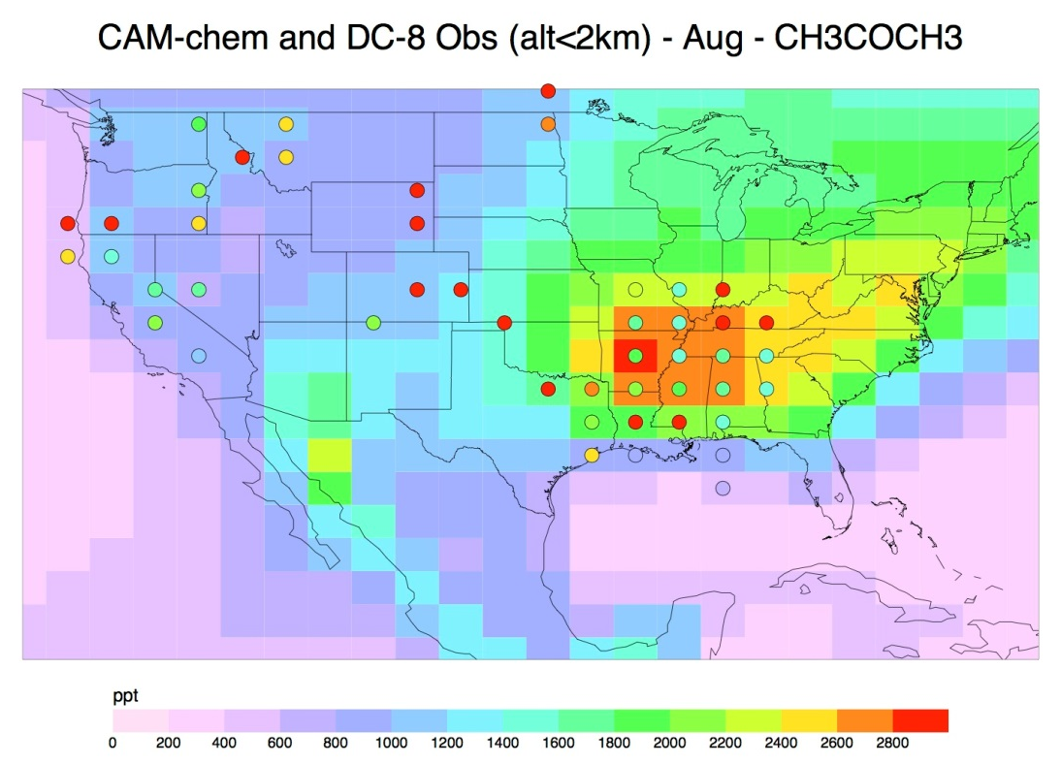
Boundary Layer Comparisons – to evaluate emissions
CAM-chem with online MEGAN-v2.1 biogenic emissions, GEOS-5 dynamics
  Monthly mean averages
  Error in this simulation results in too high OH, so VOC lifetimes are a little too short
DC-8 Observations – PTRMS, Armin Wisthaler
  Averaged to the model grid, all flights for each month (circles)
Circles: DC-8 PTRMS Methanol (Wisthaler)
Circles: DC-8 PTRMS Acetone+Propanal (Wisthaler)
MEGAN emissions of Methanol and Acetone appear high in SE U.S. during August
Fire emissions in western U.S. may be under-estimated, or just a result of monthly average
L. Emmons, NCAR

Slide 13
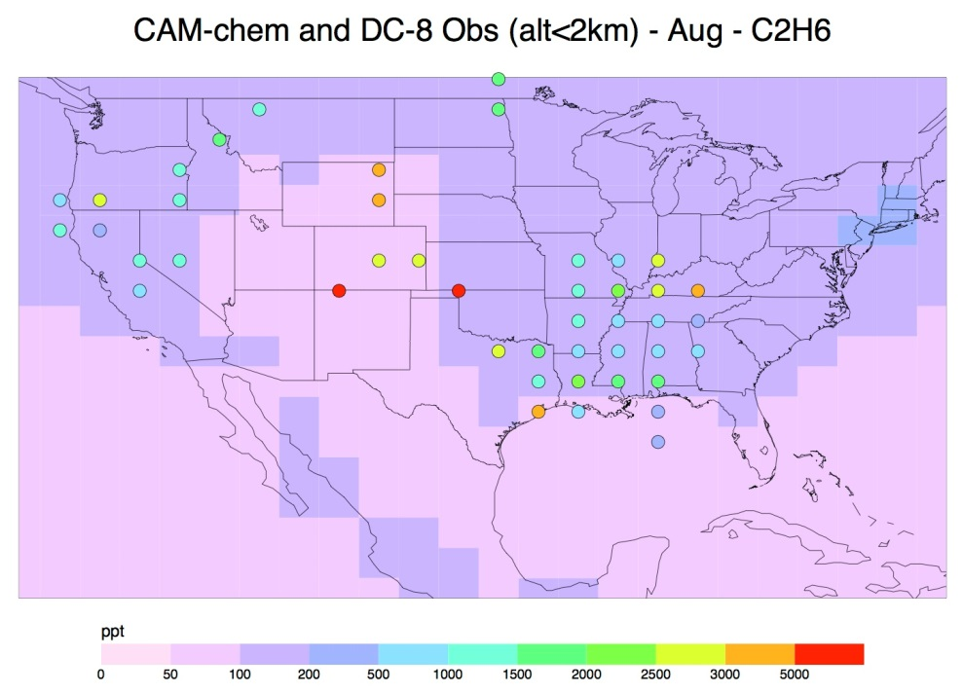
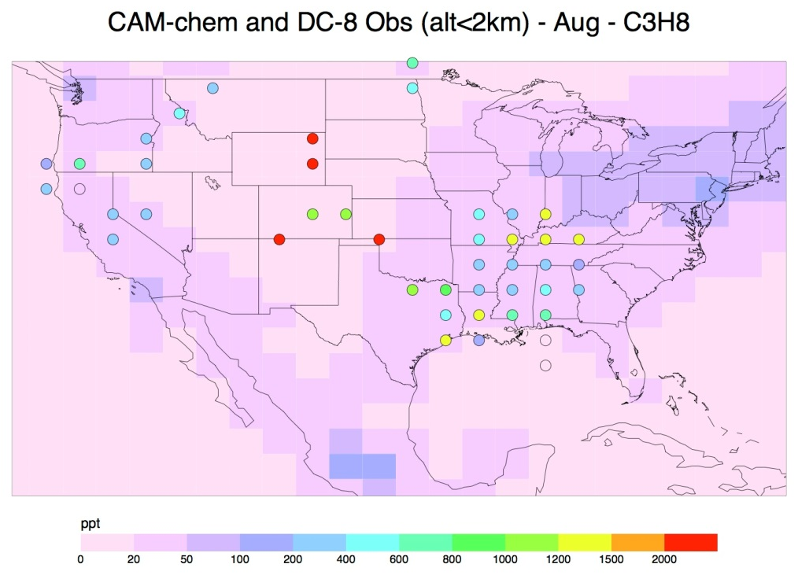
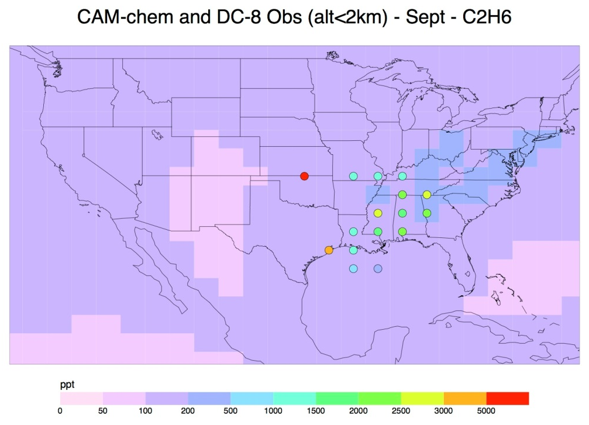
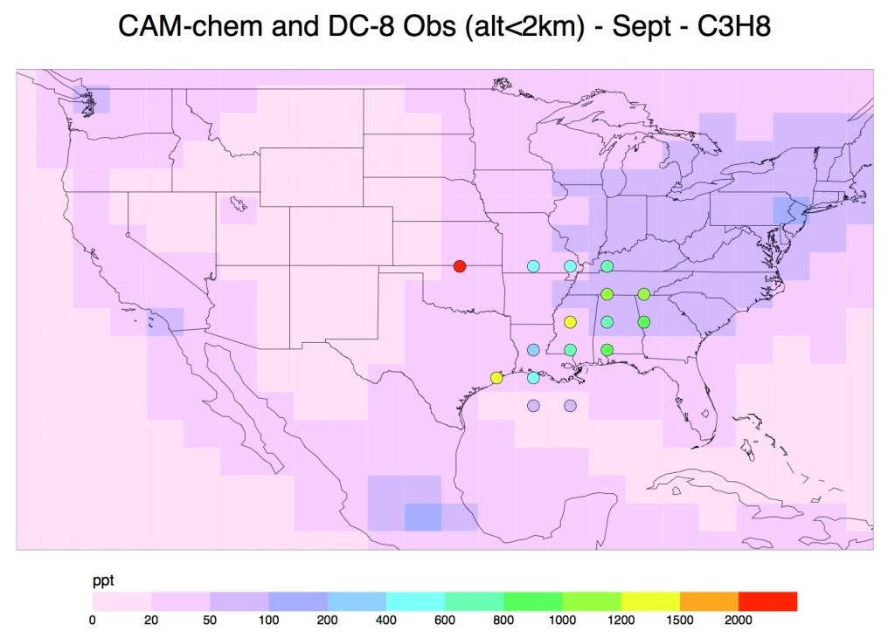
Comparison to DC-8 Whole Air Sampler HCs (Blake)
  Sources missing from emissions inventory – Oil&Gas, Fires, …
L. Emmons, NCAR

Slide 14
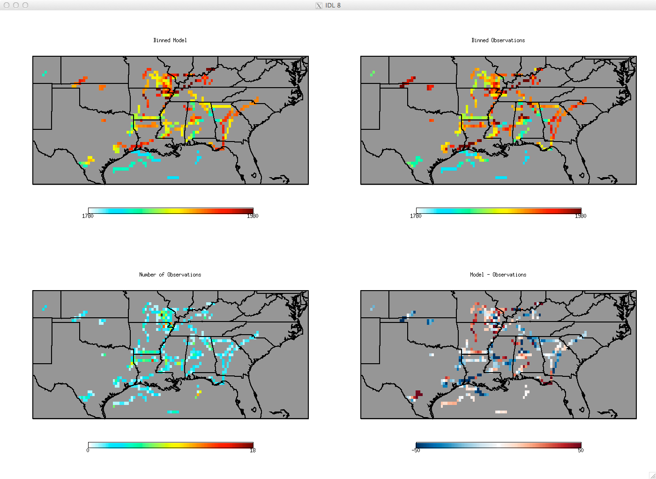
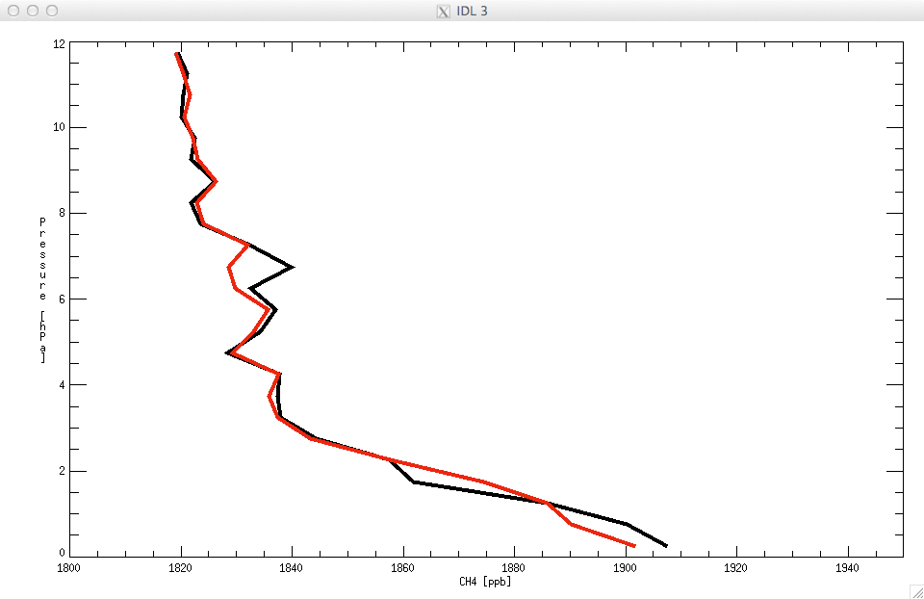
Constraining US sources of methane using SEAC⁴RS data
GEOS-Chem sources from inversion of SCIAMACHY data [Wecht et al., 2014]:
EPA livestock + 40%, EPA oil/gas OK but distributions changed
GEOS-Chem below 1 km (K. Wecht)
Observations below 1 km (D. Blake)
1780 1980
1780 1980
Observations
10
# Observations
Model
Model - Observations
8
Altitude [km]
6
4
2
1820
1860
1900
1940
CH4 [ppb]
-50 0 +50

Slide 15
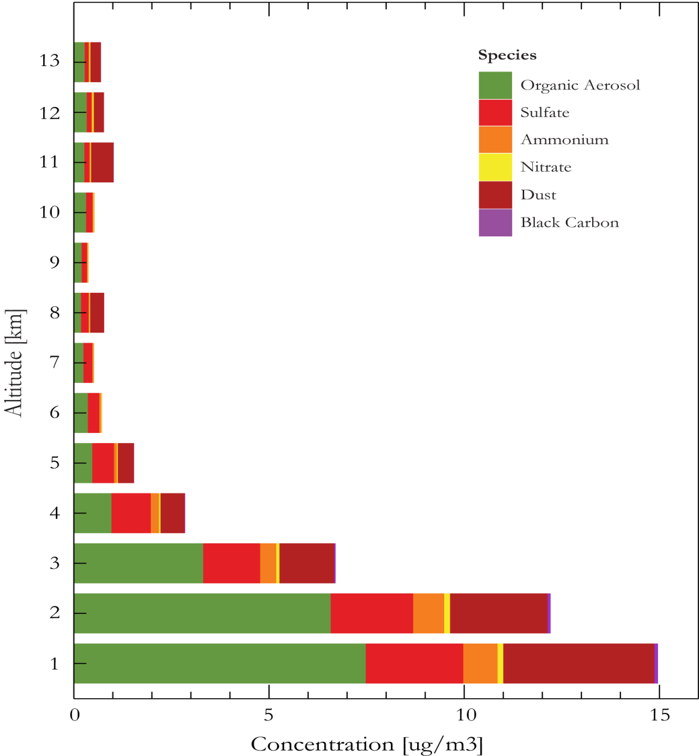
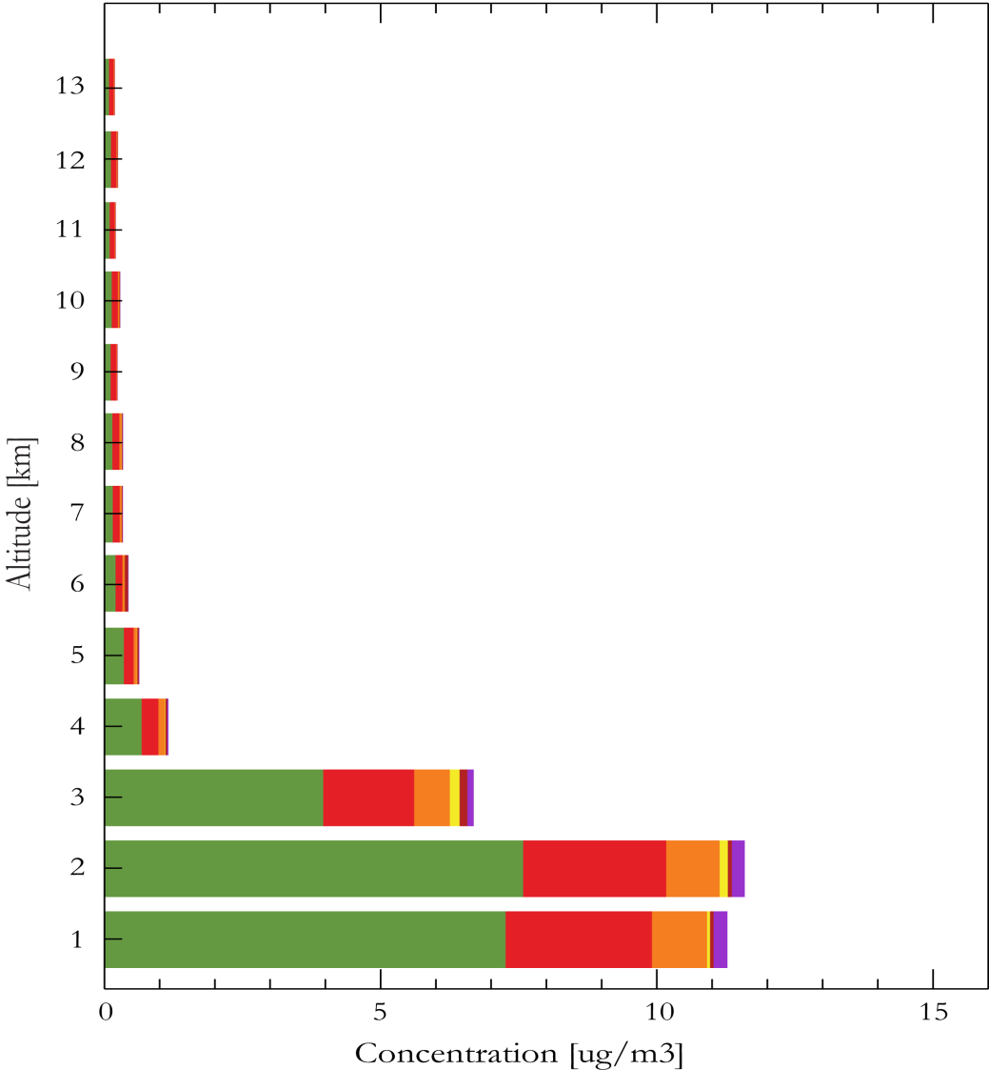
Mean aerosol composition over Southeast
Observed (AMS, SAGA)
GEOS-Chem
No evidence of a lower free tropospheric bump in organic aerosol
Large contribution from dust, not reproduced by model
Model underestimate at 4-5 km; smoke enhancement of both OC and sulfate?
J. Jimenez, J. Dibb, P. Kim
Notes:
Showing the difference in the median profile for the lowest 4 km of the profile – this is where the largest discrepancy is with our extinction compared to DIAL (next slide). Back of the envelope calculation suggests that we need dust to explain the difference in extinction (or we have an error in aerosol size distribution, optics, growth factor…). Daily MODIS AODs (not shown) suggest Saharan dust plumes were more frequent than simulated. Will connect with people on this at the meeting.
Djj: Interesting. So you think that the dust in the SAGA data is real? I’m surprised it’s so large, see Figure 6 of Fairlie et al. (2007) for mean IMPROVE dust data. That same figure and related discussion shows model underestimate of Saharan dust influence (though the observations are much lower than SAGA).

Slide 16
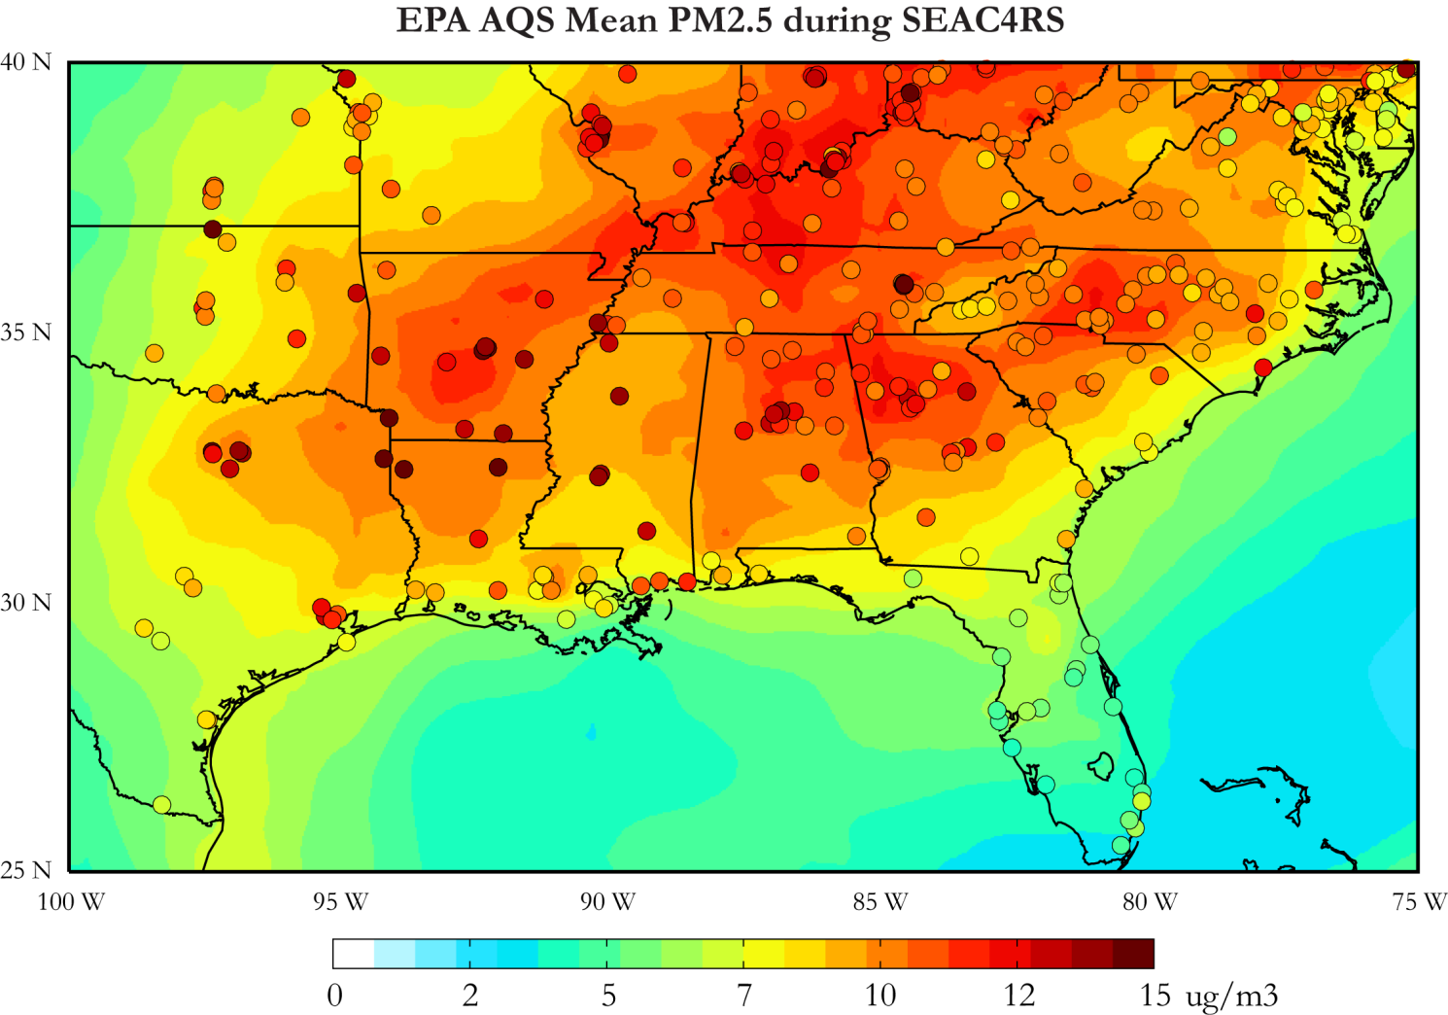
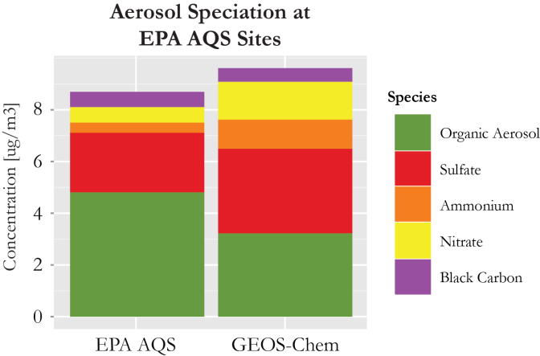
Placing SEAC⁴RS in context of EPA/AQS aerosol composition data
Circles: EPA
Background: GEOS-Chem
SEAC⁴RS and surface data consistent (assuming dust is coarse)
Observed AR/LA/MS max driven by biogenic organic aerosol
P. Kim
Notes:
Remade the figure without the seasalt contribution and changed the color bar scale.
Djj: AQS max over LA/AR/MS is interesting. Is that from OC? Does it have BC too? Fires?

Slide 17
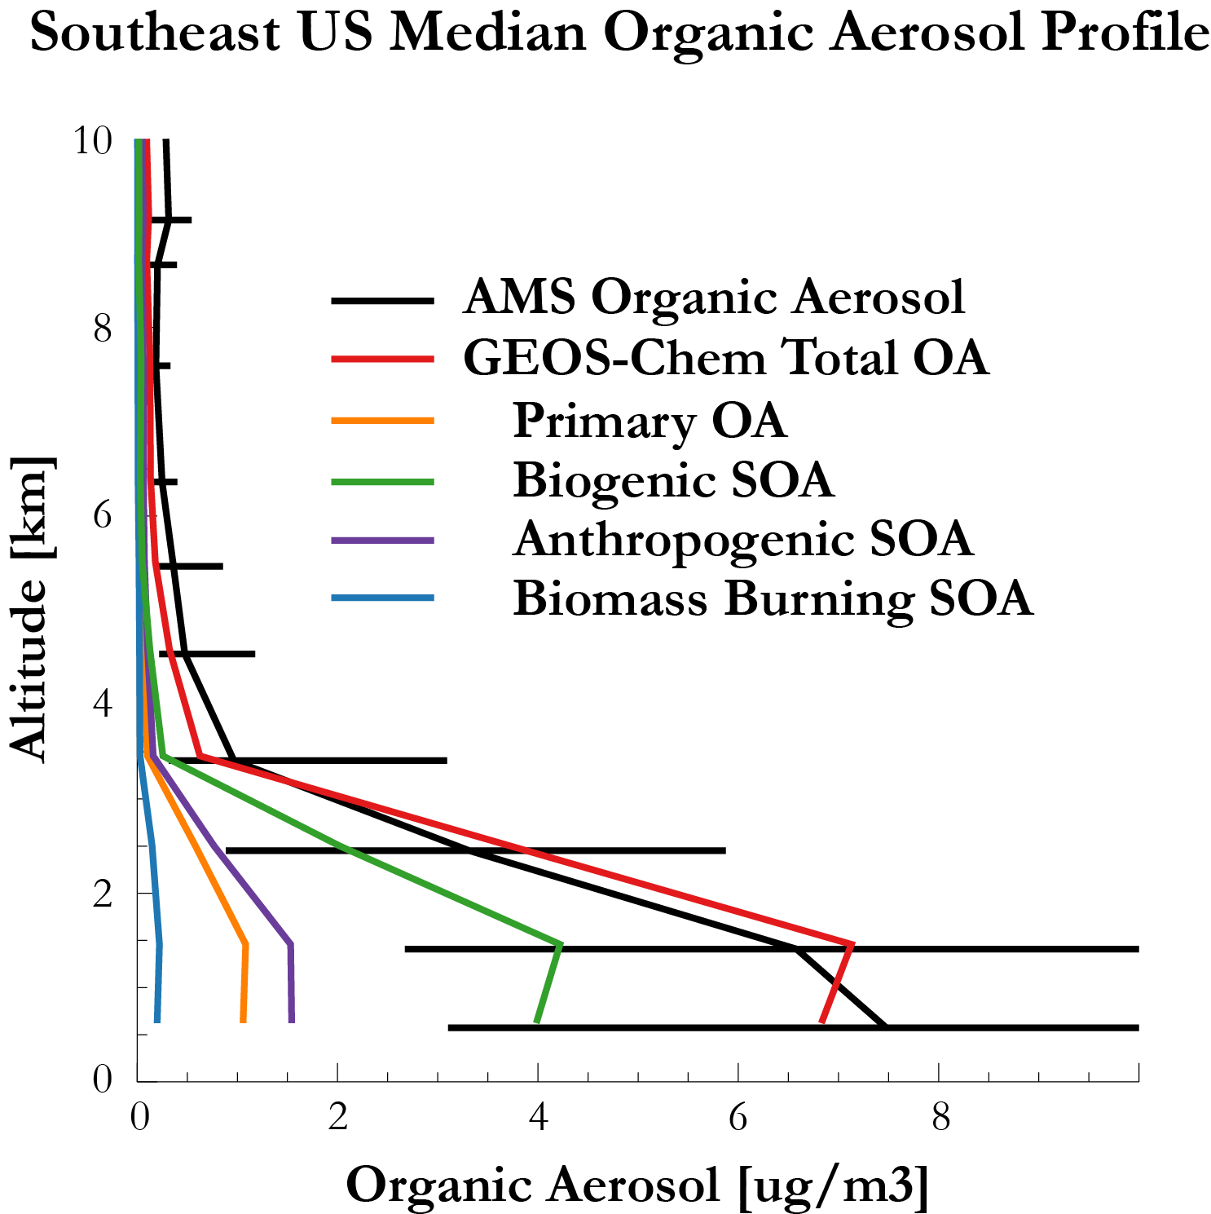
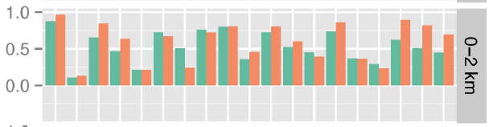
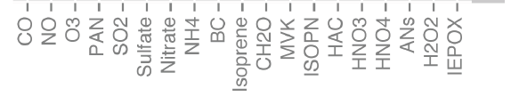
Source attribution of organic aerosol
Correlation coefficients of organic aerosol
w/other species in AMS and GEOS-Chem
Biogenic SOA accounts for 50%, anthropogenic SOA + POA for most of the rest
Strong correlations with chemical species point to both combustion and biogenic sources
P. Kim, J. Jimenez, Science Team

Slide 18
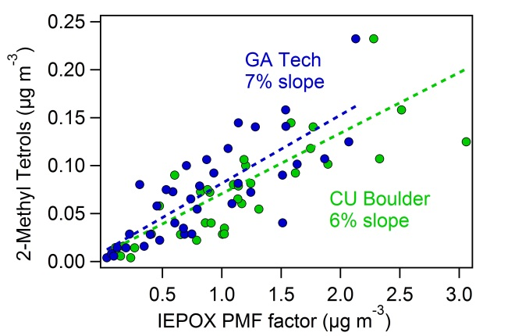
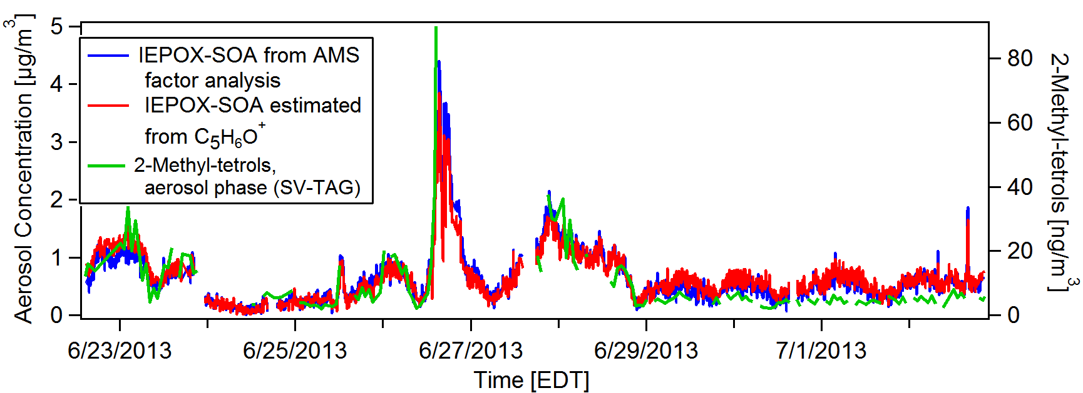
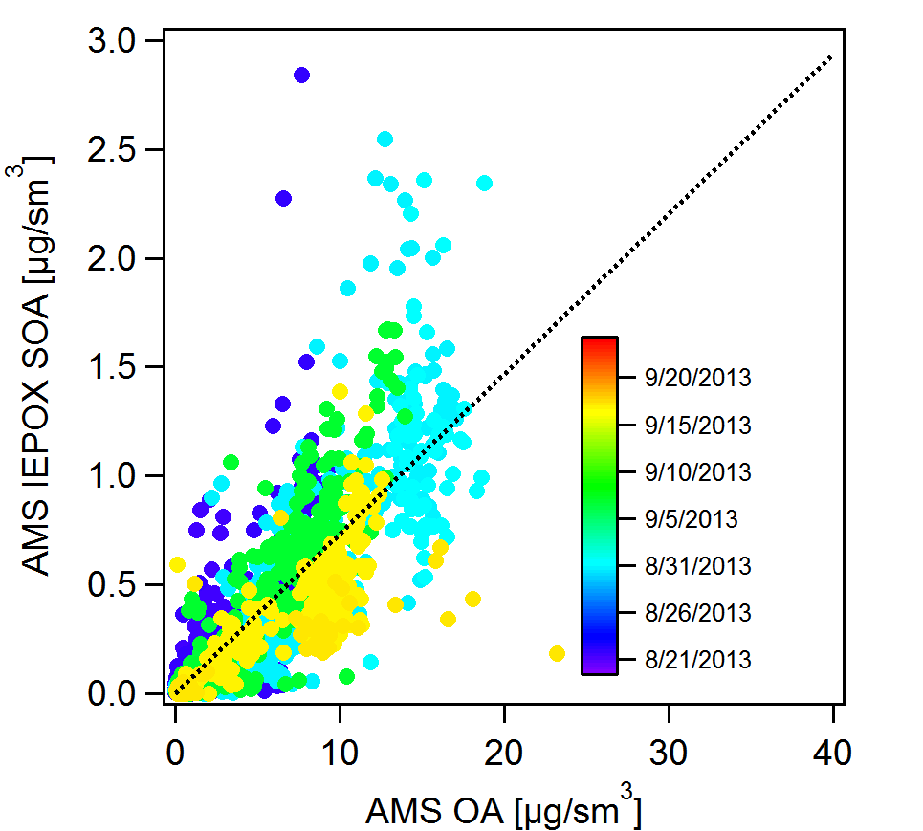
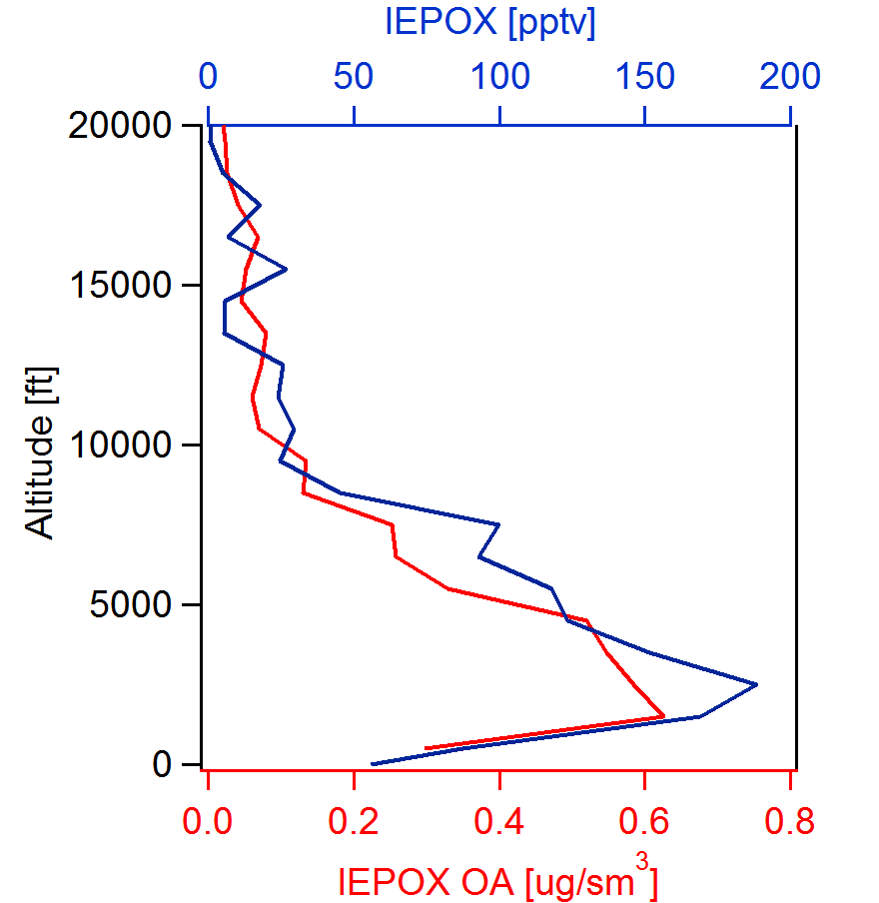
IEPOX-SOA as detected/quantified by the CU HR-AMS
SOAS,
Centreville, AL
June 2013
Maximum above ground
7% of Total OA
SEAC⁴RS
August/Sep
2013
IEPOX-SOA
estimated
from marker
Pedro Campuzano-Jost, Doug Day, Jose Jimenez and coworkers

Slide 19
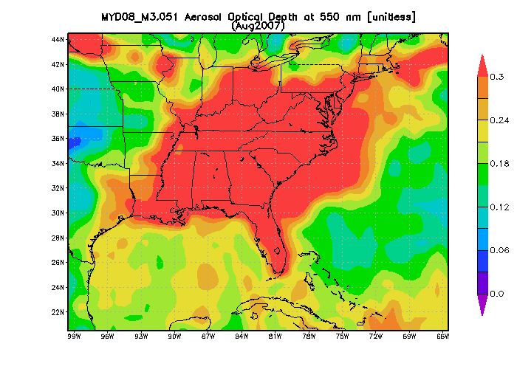
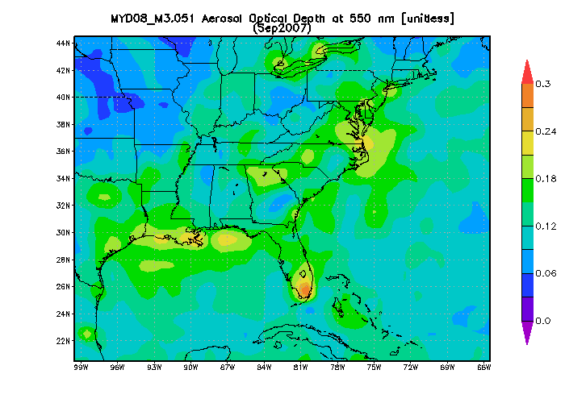
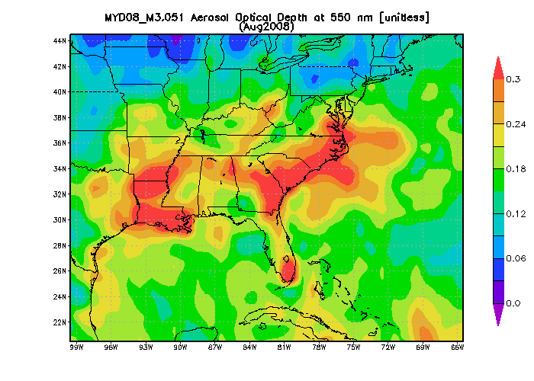
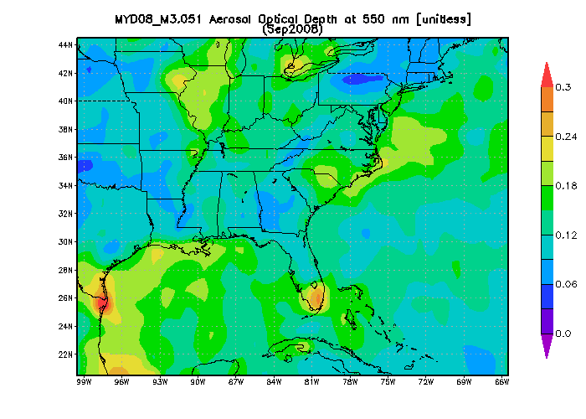










2007-2013 MODIS Aqua AOD data
2007
August September
2008
August September
2007
August September
2009
2010
2009
2011
2012
2011
2013
General correlation with HCHO columns implies large biogenic contribution to AOD
AOD in 2013 decreases from Aug to Sep while HCHO does not; decline in sulfate?
P. Kim

Slide 20
2007-2013 GOME-2A HCHO data
2007
August September
2008
August September
2009
2010
2011
2012
2013
2007-2012 average
Large IAV presumably driven by temperature
2013 is unusual in lack of Aug-to-Sep decrease
L. Zhu

Slide 21

MODIS AOD in 2013: sharp seasonal transition in mid-Sept.
P. Kim
Notes:
Remade this figure using the medians in the region to match the AERONET figure. The MODIS median AOD goes to zero at the end of September and October because MODIS begins reported AODS that are slightly negative. It’s suggested that this data is kept in for analysis by the MODIS science team. I checked with the interactive figures online and the MODIS AOD really bottoms out in October. I also plotted all of the model variables that could explain the model decline in AOD – the only two that showed a noticeable trend was biogenic emissions and diffuse radiation. I didn’t plot them here because we really need to extend the simulation out longer to show the trend.
Djj: I think this must be due to biogenic emissions, particularly if the model manages to reproduce it. The other possibility (but more convoluted) would be a shutdown of H2O2 and hence of sulfate formation – see Jacob et al. JGR 1995 on group website. We can of course tell from the model. What about the AQS sites? Do they also show the seasonal transition and if so what species drive it? I remember that the Ford paper made a point that the transition was not seen at the surface sites.

Slide 22

Mid-Sep transition in AOD is seen by AERONET and reproduced by GEOS-Chem;
driven by both organic and sulfate aerosol in the model
P. Kim

Slide 23


Sulfate decline in September driven by H₂O₂ seasonal drop
Model vs. observed H₂O₂
GEOS-Chem H₂O₂ time series
Sharp seasonal decline of photochemical source of HO_{x} radicals (UV-B)
Transition even shaper for H₂O₂ due to NO_{x} competition for HO_{x} radicals
P. Wennberg, P. Kim

Slide 24
Some major stories on Southeast US chemistry emerging from SEAC⁴RS
New observational constraints on isoprene oxidation products in the low-NO_{x} regime: major implications for models of ozone, NO_{x}, OH, HCHO, aerosols. May explain general model overestimate of ozone in Southeast
Major loss of NO_{x} to organic aerosol nitrates – implications for ozone, aerosol, N deposition
First (Indirect) validation of HCHO measurements from space
Improved understanding of HCHO yields from isoprene: increased confidence in interpreting HCHO measurements from space
Constraints on emissions of biogenic and anthropogenic VOCs
Explanation of seasonal transition of AODs seen from space as driven by both organic and sulfate aerosol
New constraints on US methane sources

Slide 26

AURA MODIS AOD @ 550 nm

Slide 27


Distributions of NO_{x,} isoprene, HCHO, OH below 2 km
NO_{x} (Ryerson)
Isoprene (Wisthaler)
HCHO (Fried)
Model OH (Olson)
Very high isoprene in Ozarks appears to reflect low NO_{x}, OH depletion

Slide 28







DIAL measurements in Southeast
Latitude Distributions:
O₃ and Backscatter
Ozone, ppbv
Frequent smoke at ~4 km in northern part of region
Low ozone in surface air
Hint of an upper tropospheric maximum
Aerosol Backscatter
J. Hair
Longitude Distributions (Median):
Extinction, Aerosol Depolarization, Lidar Ratio
MCS (Clouds)
Aerosol Backscatter
Lidar intensive products highlight various aerosol types in composited longitudinal profiles (e.g.)
Dust (higher depolarization and color ratio, lidar ratio ~ 40)
Smoke mid altitudes (lower depolarization, higher lidar ratio)
Dust
Smoke
Dust
Dust
Dust

Slide 29

Mean enhancement at 3-5 km from fire influence?
J. Hair, S. Kim
Notes:
Djj: is this consistent with the 4STAR comparison? In the ACCDAM proposal the model AOD was larger than observed by 4STAR.

