Slide 1
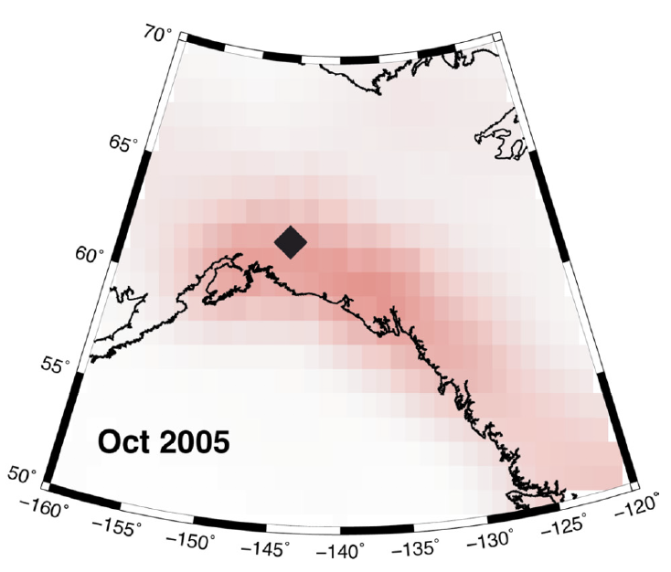
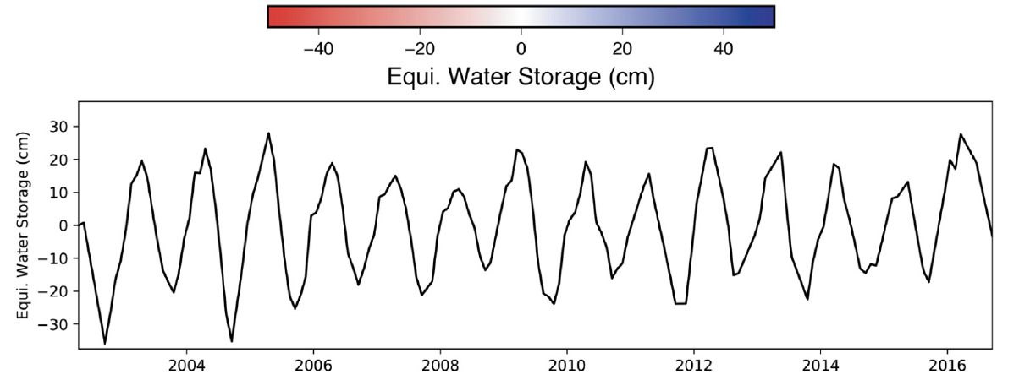
Hydrosphere modulates shallow seismicity in Alaska
Johnson, C.W., Scripps; Fu, Y., BGSU; Bürgmann, R., UC Berkeley
ESI-NNX17AE01G
Background:
Strong seasonal hydrological loading is observed with GPS and GRACE.
We investigate seismicity modulation by surface mass load changes in southern Alaska.
Analysis:
JPL’s GRACE mascon solution is used to quantify seasonal surface loads and to compute stress changes in the crust.
Shallow (≤40 km) and low magnitude (M≥2.0) seismicity in southern Alaska shows seasonal variation.
Findings:
~25% increase in seismicity rate that correlates with ~3-month time lag following failure-encouraging annual stress changes.
Published: Johnson, C. W., Y. Fu and R. Bürgmann (2019), Earth Planet. Sci. Lett., 10.1016/j.epsl.2019.115904.

Slide 2
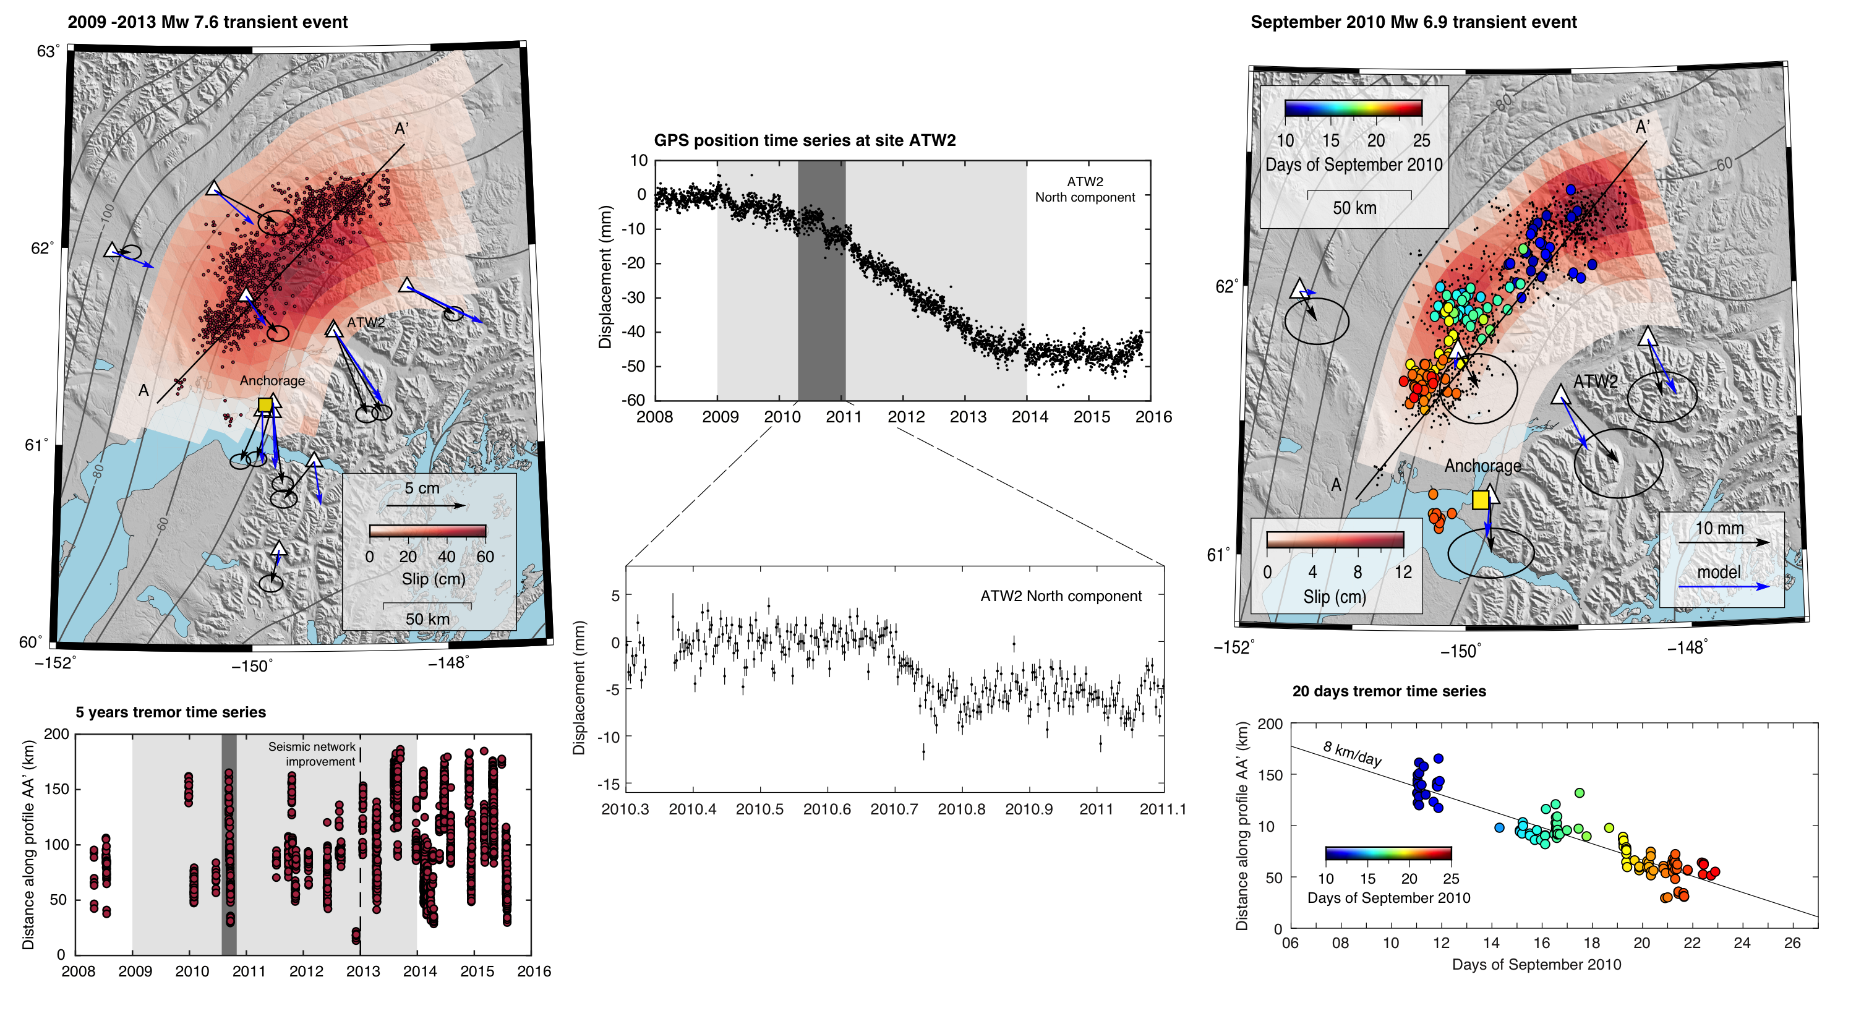
Poster
Slow slip and tremor episodes in Alaska
Rousset, B., UC Berkeley, Fu, Y., BGSU, Bartlow, N., UC Berkeley, Bürgmann, R., UC Berkeley
ESI-NNX17AE01G
Background:
Years-long slow slip events have been characterized with GPS measurements in South-central Alaska.
Seismic tremor catalogues reveal episodic pulses during these long-lasting transients.
Analysis:
Joint analysis of GPS observations and tremors, including time dependent slip inversions and GPS time series decompositions.
Findings:
Most slip occurs during weeks-long episodic tremor and slip episodes.
Tremor and slip episodes occur both during and in between long-term slow slip events.
In Review: Rousset, B., Fu, Y., Bartlow, N., and Bürgmann, R., Slow slip and tectonic tremor episodes on south-central Alaska megathrust (2019), J. Geophys. Res.

Slide 3
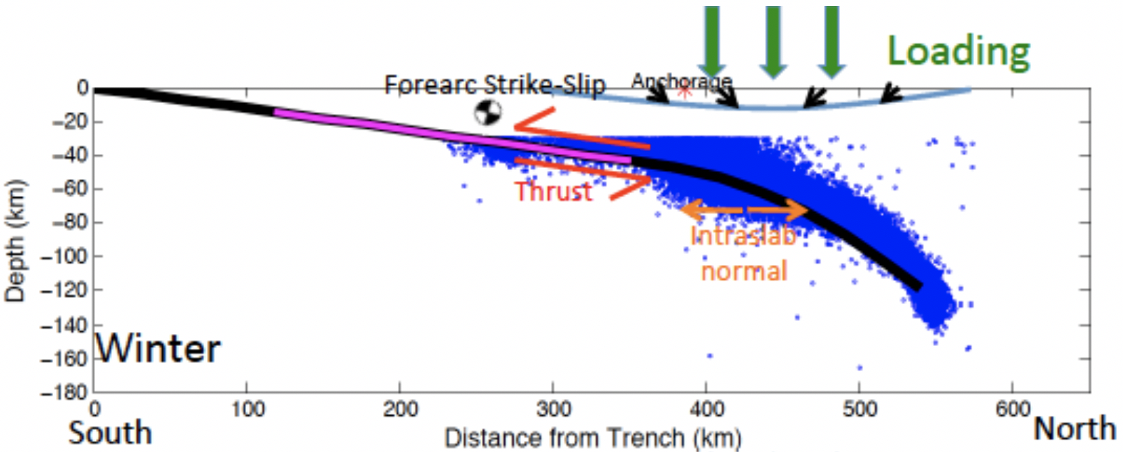
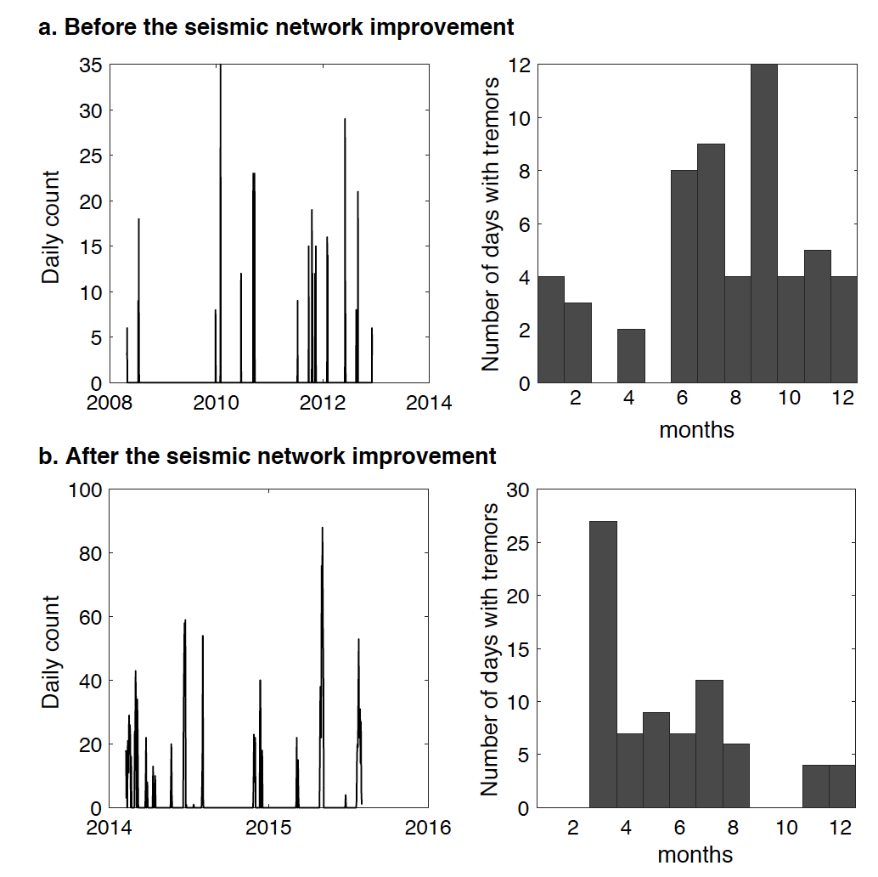
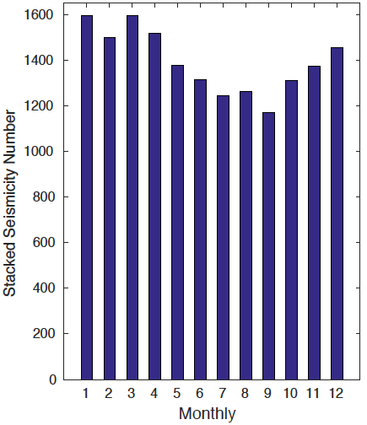
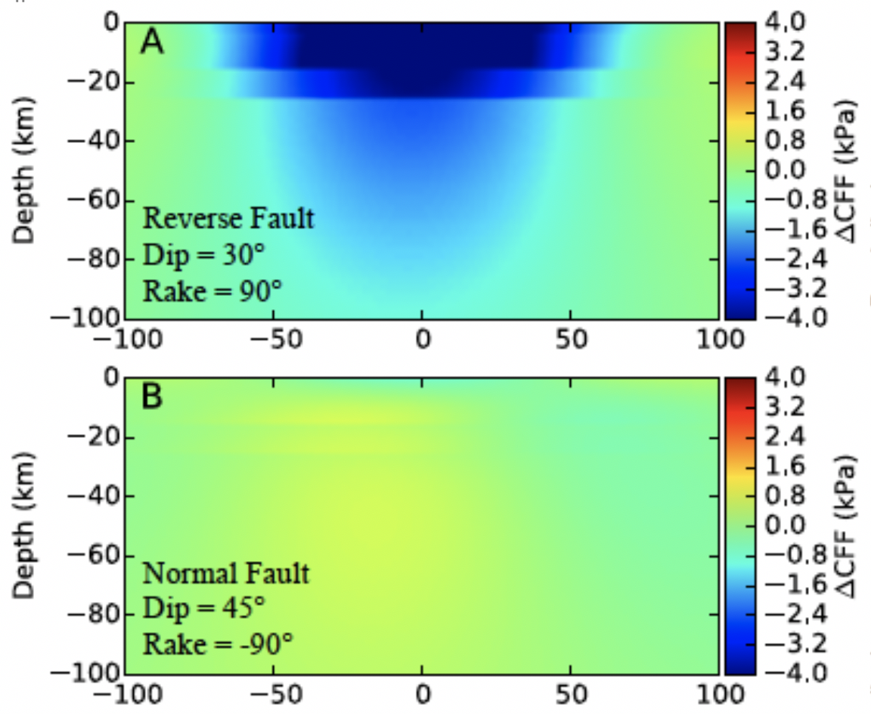
Poster
Space-geodetic exploration of linkages between time-dependent surface loads, slow slip events and seismicity in southcentral Alaska (ESI-NNX17AE01G)
Exploring linkages:
Slab seismicity is dominantly normal faulting with an apparent seasonal peak in winter.
Tremors on megathrust appear to be more frequent in summer and fall, but total numbers are low.
Slab seismicity
Winter

