Slide 1


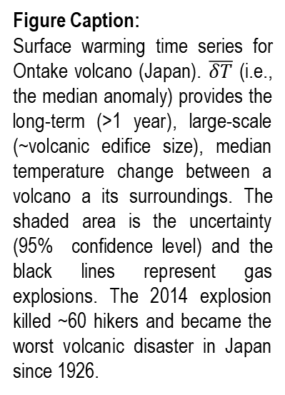
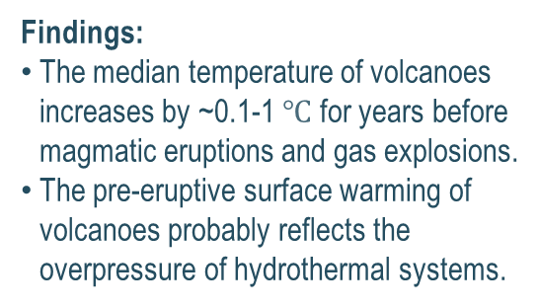
Volcanoes Get Hot For Years Prior To Eruption
(Make sure the title grabs the reader’s attention. The title does not have to be full paper title, if published)
Girona, T., Jet Propulsion Laboratory – California Institute of Technology
Poster
Background:
Heat exchange processes within volcanoes remain unknown.
We explore the long-term (>1 year), large-scale (~volcanic edifice size), thermal emissions of volcanoes.
Figure Caption:
Surface warming time series for Ontake volcano (Japan). $\overline{δT}$ (i.e., the median anomaly) provides the long-term (>1 year), large-scale (~volcanic edifice size), median temperature change between a volcano a its surroundings. The shaded area is the uncertainty (95% confidence level) and the black lines represent gas explosions. The 2014 explosion killed ~60 hikers and became the worst volcanic disaster in Japan since 1926.
Analysis:
16.5 years of radiance data for five volcanoes (>25 TB) from the MODIS instruments (Terra and Aqua satellites).
Findings:
The median temperature of volcanoes increases by ~0.1-1 $℃$ for years before magmatic eruptions and gas explosions.
The pre-eruptive surface warming of volcanoes probably reflects the overpressure of hydrothermal systems.
Significance:
The surface of volcanoes gets warm before erupting. Pre-eruptive surface warming can be detected from space.
Our findings open new horizons to better constrain the thermal budget of active volcanic systems, explore the coupling between thermal emissions and surface deformation, and improve the forecasting of eruptions.
© 2019 California Institute of Technology. Government sponsorship acknowledged.

