Slide 1
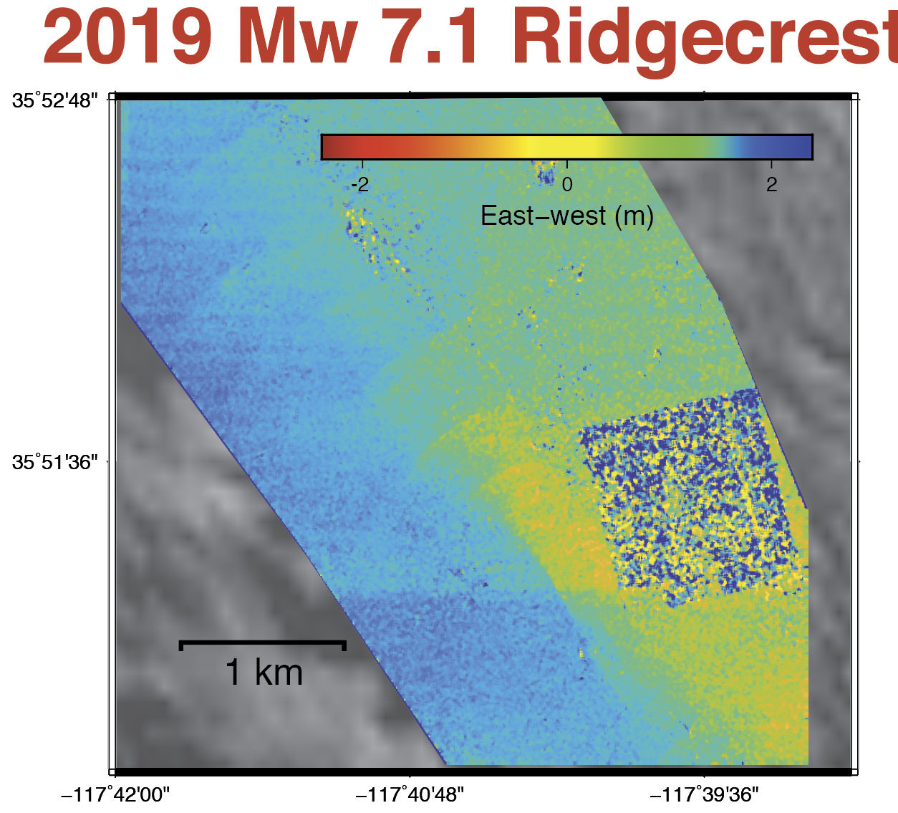
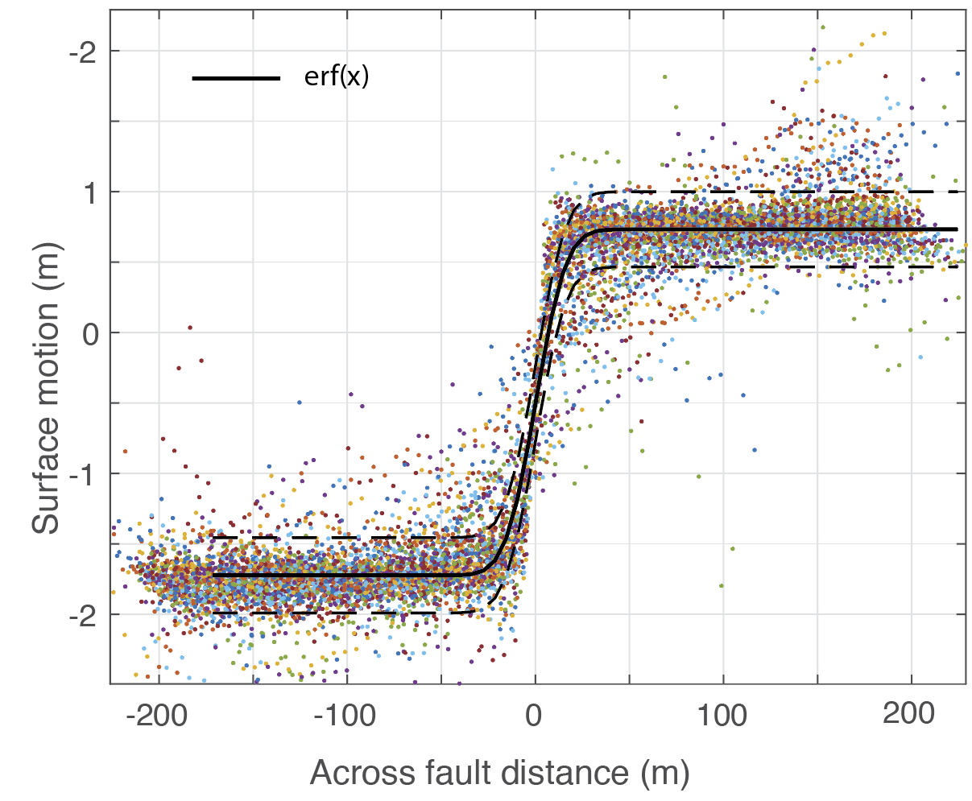
Geodetic Imaging Data
for Probabilistic Fault Displacement Hazard Assessment (PFDHA)
Milliner, Chris, JPL, Caltech
Poster
Background:
What is the distribution of inelastic strain across surface ruptures?
Current probabilistic hazard models of distributed rupture are constrained with field survey observations, can we do better with geodetic imaging data?
Left. Optical image correlation of the Ridgecrest earthquake (east-west component)
Right. Across fault displacement profiles, with fault displacement prediction equation (black) used to define exceedance probability
Analysis:
Sub-pixel image correlation of optical satellite imagery of numerous strike-slip (Mw > 7) earthquakes.
Findings:
Fault strain appears to be more distributed under extension than compression.
Thousands of strain profiles reveal we can distinguish between elastic vs inelastic deformation.
Significance:
Development of a new geodetic-based Probabilistic Fault Displacement Hazard (PFDHA) methodology.
Assessment of how fault strain is affected by lithology, fault geometry and degree of compression, will reduce epistemic uncertainty and improve hazard calculations (annual exceedance) of distributed rupture to nearby infrastructure.

