Slide 1
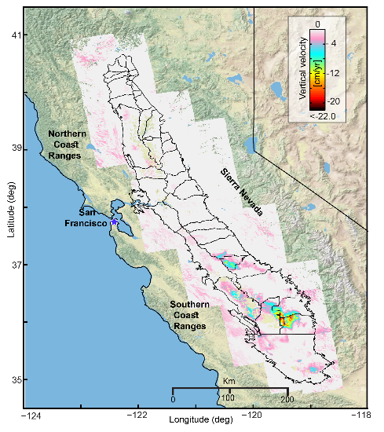
Remote Sensing of Water Mass Budget Variations in California
Water Resources Research, 54, 2018, https://doi.org/ 10.1029/2017WR022250
Deformation (InSAR, ALOS)
Groundwater level
2007-2009
-25 cm/yr
<-30m
Drought-related dynamics of the aquifer-system & water volume changes across the valley are investigated using InSAR deformation and groundwater level data.
Total loss: -22 +/- 7 km³
Notes:
Paper key points:
Time-dependent vertical land motion in California’s Central Valley reflects the evolution of groundwater stocks during 2007–2010
Drought-related dynamics of the aquifer-system across the valley are investigated using deformation and groundwater level data
Regional-scale distribution of mechanical properties of the aquifer-system is resolved.
2007-2010 drought
Maximum Land Subsidence :
20 - 25 cm/yr (San Joaquin Valley)
GWL volume loss: -21.3 ± 7.3 km3
Aquifer storage loss: ~2%

Slide 2
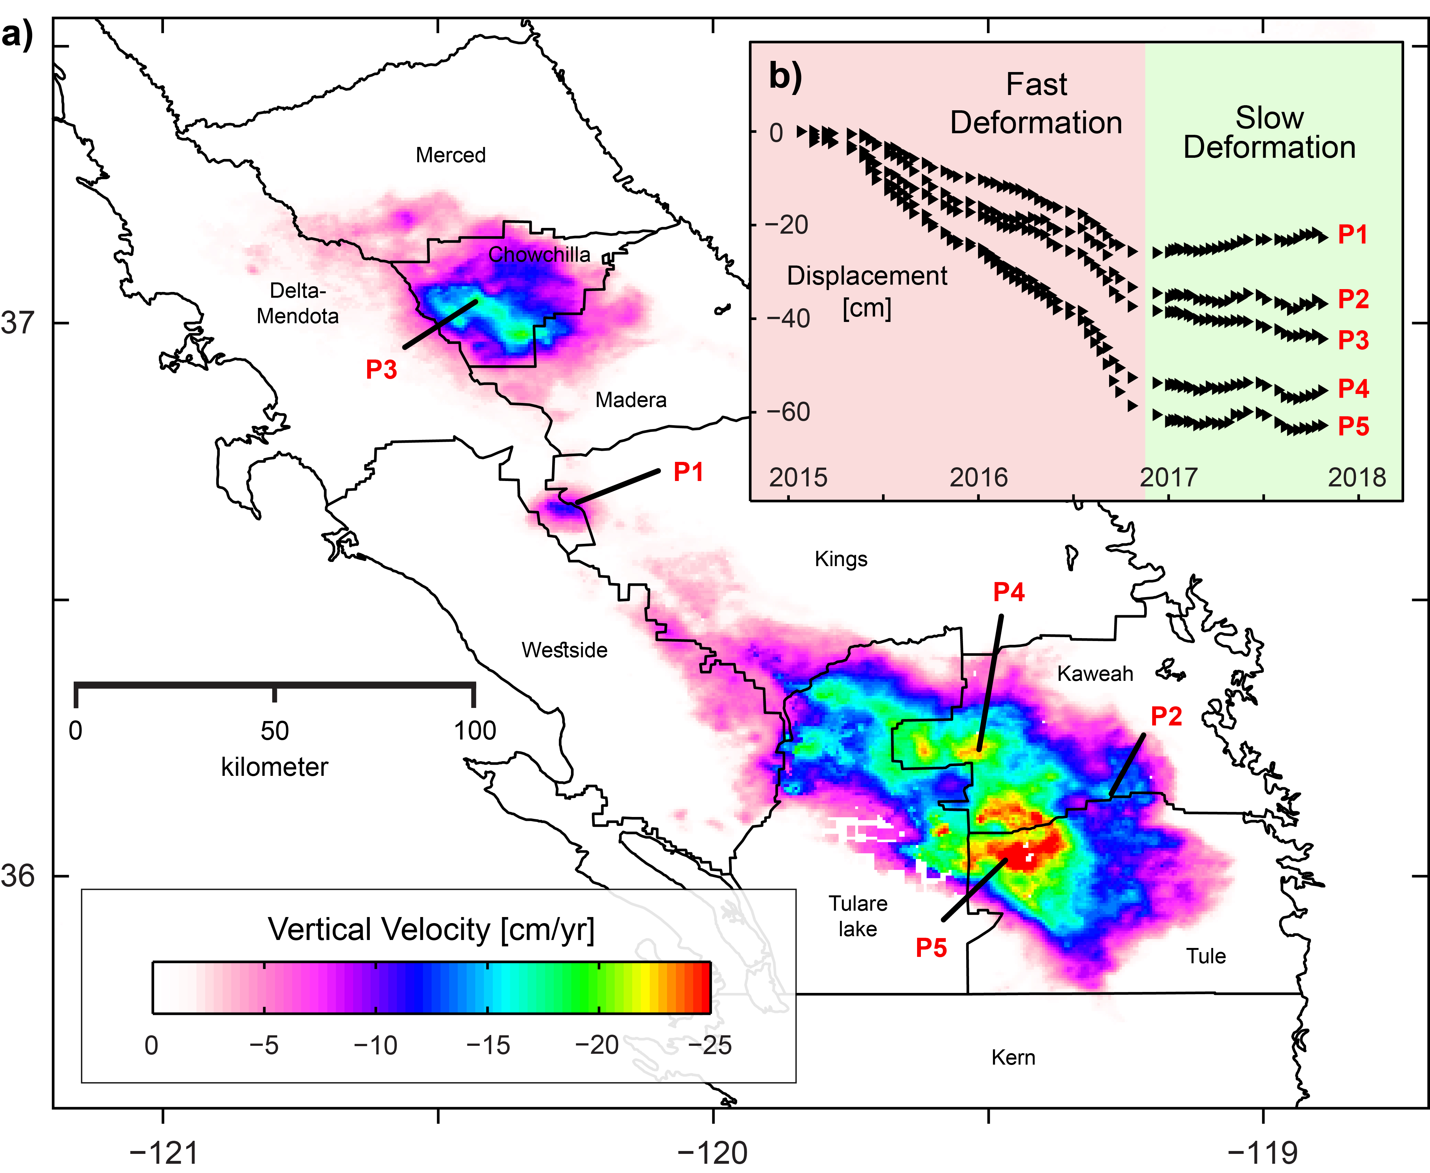
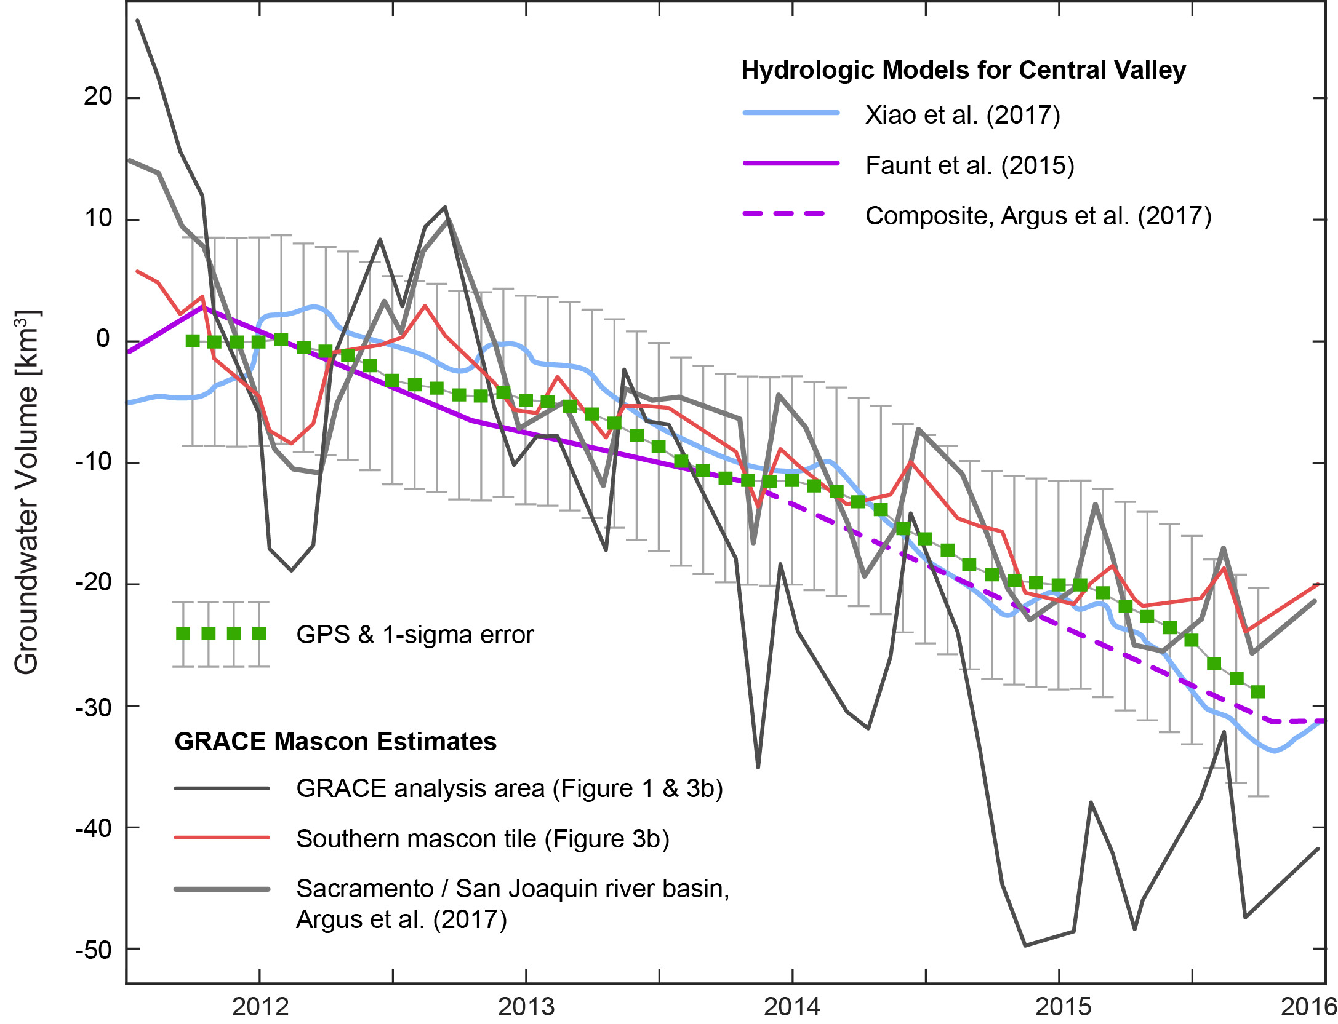
Remote Sensing of Water Mass Budget Variations in California
JGR Solid Earth, 124, 2019, https://doi.org/10.1029/2018JB016083
Deformation
(InSAR, Sentinel)
1/2015-4/2017
Total loss: -29 +/- 9 km³
Groundwater storage changes (GPS)
2010-2016
GPS measurements of aquifer compaction in San Joaquin Valley are analyzed to quantify groundwater loss during 2012–2015.
Notes:
Paper key points:
GPS measurements of aquifer compaction in San Joaquin Valley are analyzed to quantify groundwater loss during 2012–2015
The GPS‐based estimate of groundwater loss is consistent with that obtained from satellite gravimetry, given uncertainties
The San Joaquin Valley aquifer system permanently lost up to 3% of its storage capacity due to overdraft during drought
2012-2015 drought
Maximum Land Subsidence :
> 30 cm/yr (San Joaquin Valley)
GWL volume loss: -29.25 ± 8.9 km3
Aquifer storage loss: ~3%
Cumulative aquifer storage loss (both droughts) ~5 %

Slide 3
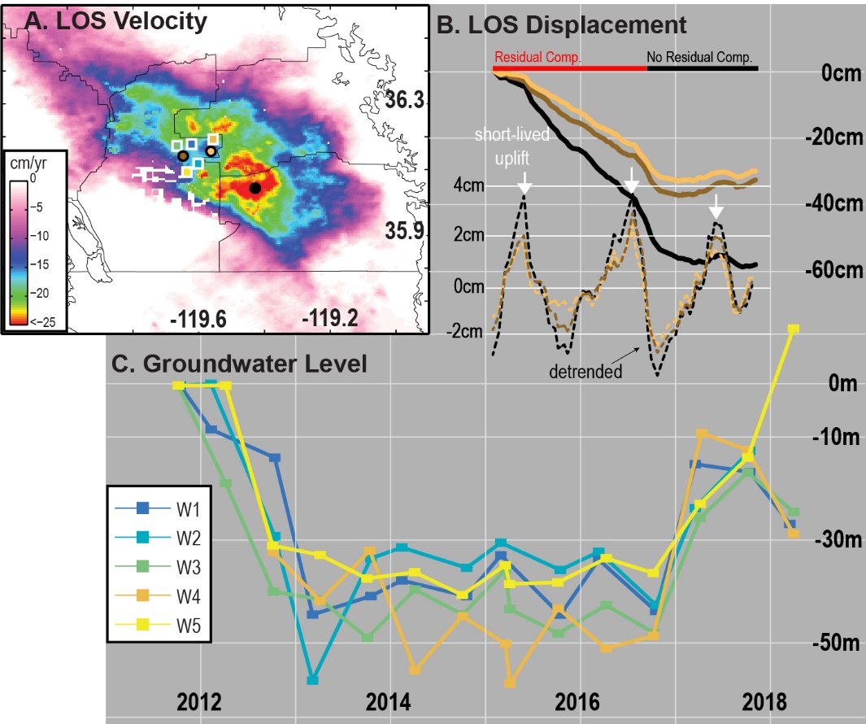
Remote Sensing of Water Mass Budget Variations in California
Science Advances, 5(6), 2019, https://doi.org/10.1126/sciadv.aav8038
Winter rains do not recharge deep aquifers in California
Subsidence can continue after end of drought
Subsidence does not always mean groundwater vol. loss
Subsidence data have to be interpreted in combination with groundwater level data
Post-drought Phase
Post-drought Phase
Drought Phase
Drought Phase
Notes:
Winter rains do not recharge deep aquifers in California
Subsidence can continue after end of drought
Subsidence does not always mean groundwater volume loss
Subsidence data have to be interpreted in combination with groundwater level data
Understanding of exact relationship between groundwater storage change and
poroelastic surface displacement is important for a successful combination of
gravimetric and deformation data.

