Slide 1
Numerical Models
Unsung linkage between Earth observations and interpretations
Earth Observations
Interpretations
Conclusions
Support
NASA Mission
Drive advances in science, technology, aeronautics, and space exploration to enhance knowledge, education, innovation, economic vitality and stewardship of Earth
Drive advances in science, technology, aeronautics, and space exploration to enhance knowledge, education, innovation, economic vitality and stewardship of Earth

Slide 2
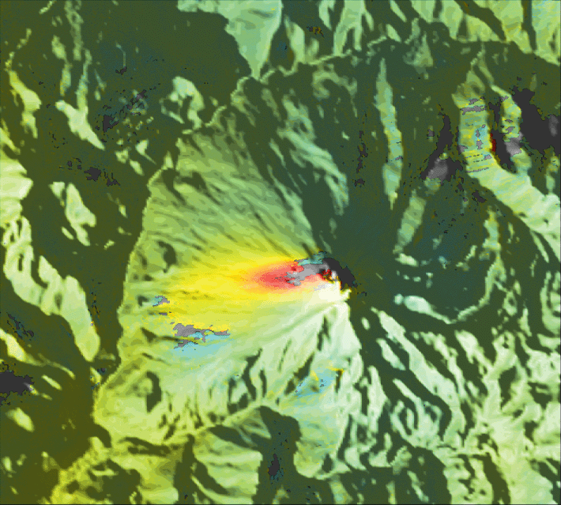
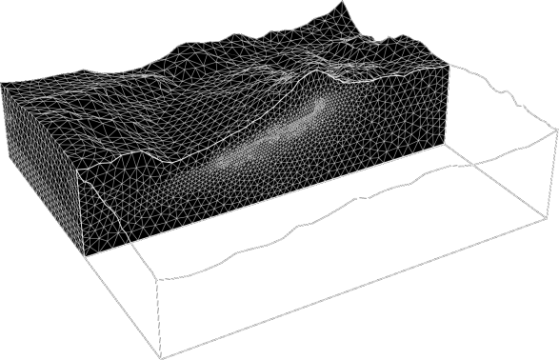
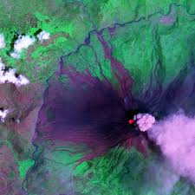
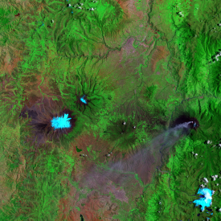
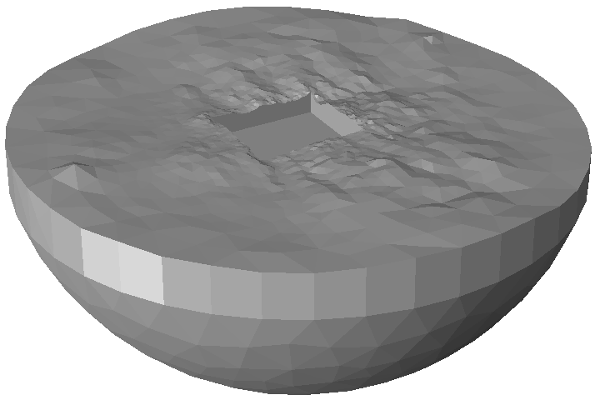
Numerical Models
Unsung linkage between Earth observations and interpretations
Earth Observations
Interpretations
Conclusions
Support
NASA Mission
Drive advances in science, technology, aeronautics, and space exploration to enhance knowledge, education, innovation, economic vitality and stewardship of Earth
model
magma
injection

Slide 3
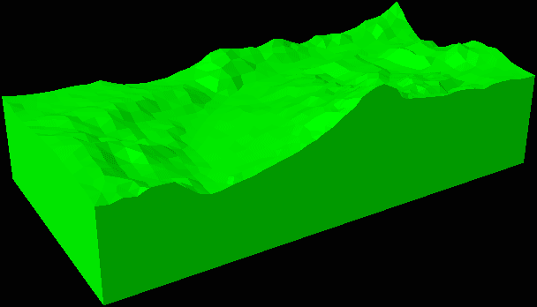

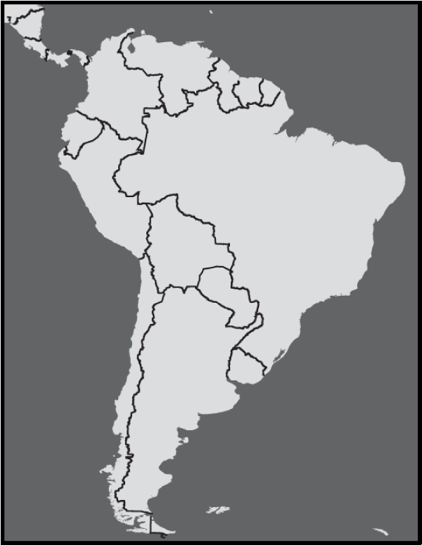
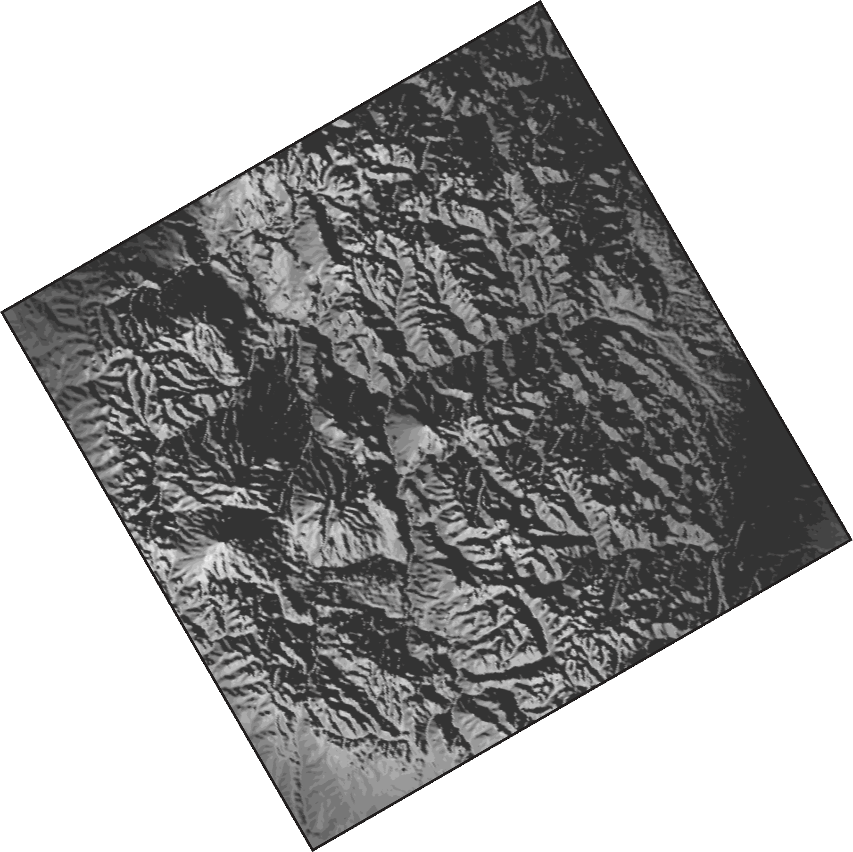
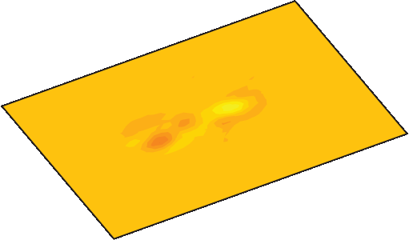
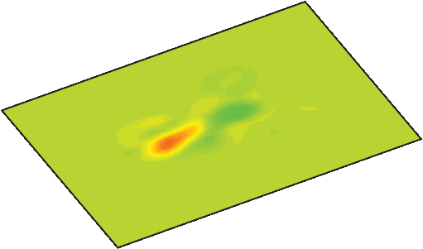
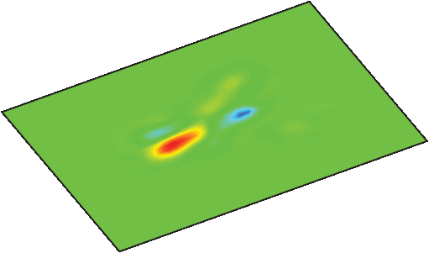

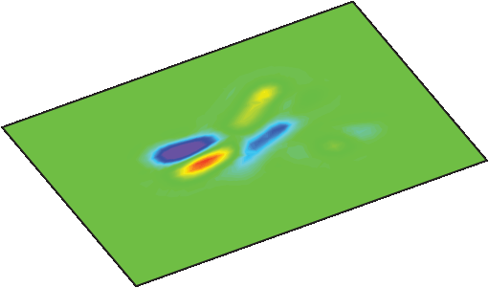
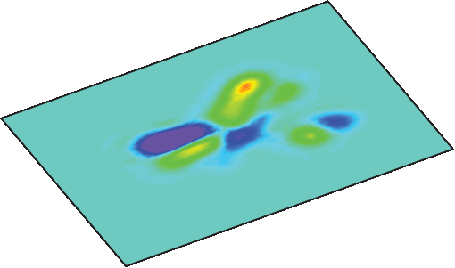

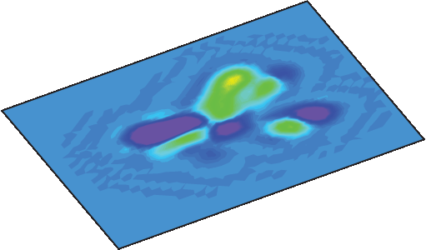
Numerical Models
Unsung linkage between Earth observations and interpretations
Earth Observations
Interpretations
Conclusions
Support
NASA Mission
Drive advances in science, technology, aeronautics, and space exploration to enhance knowledge, education, innovation, economic vitality and stewardship of Earth
displacement
InSAR
reservoir geometry
displacement, cm
-20 -10 0 10 20
Tungurahua
Volcano
?
seismic
tomography
magma
injection
weak
strong
20km
20km
20km
20km

