Slide 1
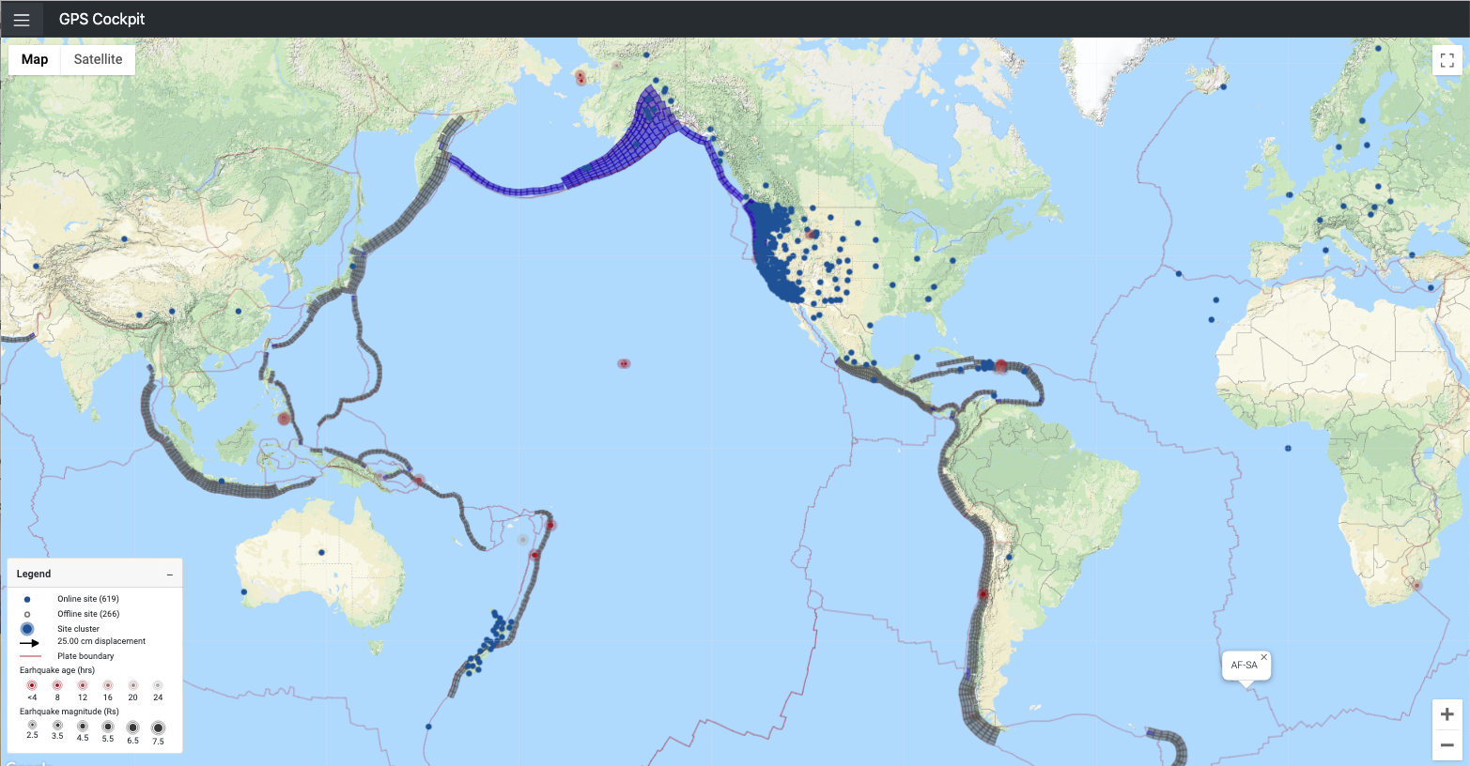
Headshot of yourself to help identify you during the SET meeting
GNSS Global Seismic Monitoring
Melbourne, T. I., Central Washington University
Monday
Poster
Background:
GNSS can uniquely characterize large earthquakes extremely quickly
Thousands of stations are available globally, many in tectonic regions
Sub-second point positioning latency at ~cm accuracy is now routine for >1,000 global stations
Figure Caption:
Instantaneous position offset computed at 1 Hz with subsecond latency from ~800 global GNSS stations. Nominal position in ITRF is updated weekly by extrapolating long-term trajectory models to the current epoch. Resulting offsets are fed into downstream geophysical estimation routines to compute earthquake magnitude, coseismic slip distributions along prespecified fault geometries, and for offshore earthquakes, sea floor uplift.
Analysis:
Point positioning in ITRF
Phase-only positioning (no pseudorange)
IGS satellite clock and orbit corrections
Findings:
Global NEV position accuracy of 2, 4 7 cm
Global latency of 0.9 seconds
NOAA is now using these GNSS offsets to inform local tsunami warning
Significance:
Coseismic offsets of M7.1 7/6/19 Ridgecrest CA earthquake were measured on 12 stations within 25 seconds of rupture nucleation, or before S-waves had reach the Los Angeles Basin.
As this system expands to include many thousands of stations, few societally-relevant earthquakes will escape measurement

