Slide 1


PACE-PAX dry run assessment
September 15, 2023
Remember to record!
pace.gsfc.nasa.gov

Slide 2
Why are we doing this?
Ensure we all understand PACE-PAX objectives
Test logistics & clarify individual roles and responsibilities
Devise a practical means to prepare for and conduct the campaign
Identify potential problems early
1st dry run
Sept. 11-15, 2023
PACE Launch
Jan. 9, 2024
Team meeting and 2nd dry run
early 2024
Integration and test flights
Aug. 5-29, 2024
Field campaign
Sept. 3-27, 2024
Preliminary data due
Dec. 31, 2024
Final data due
Mar. 31, 2025

Slide 3
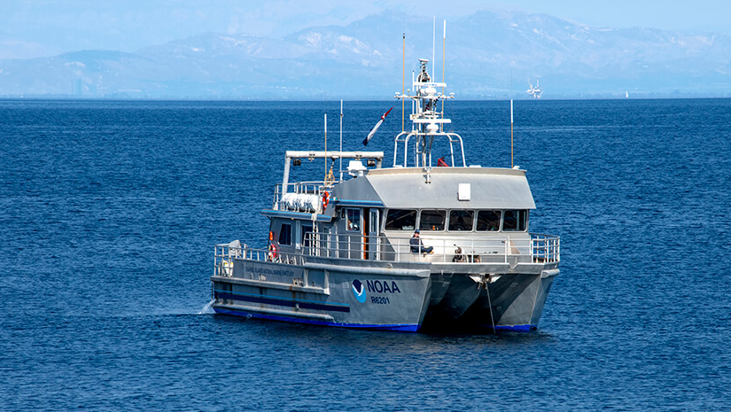
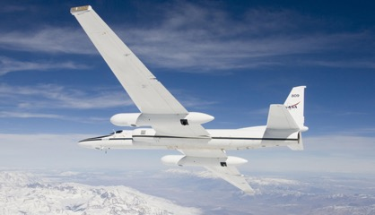
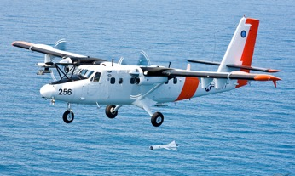
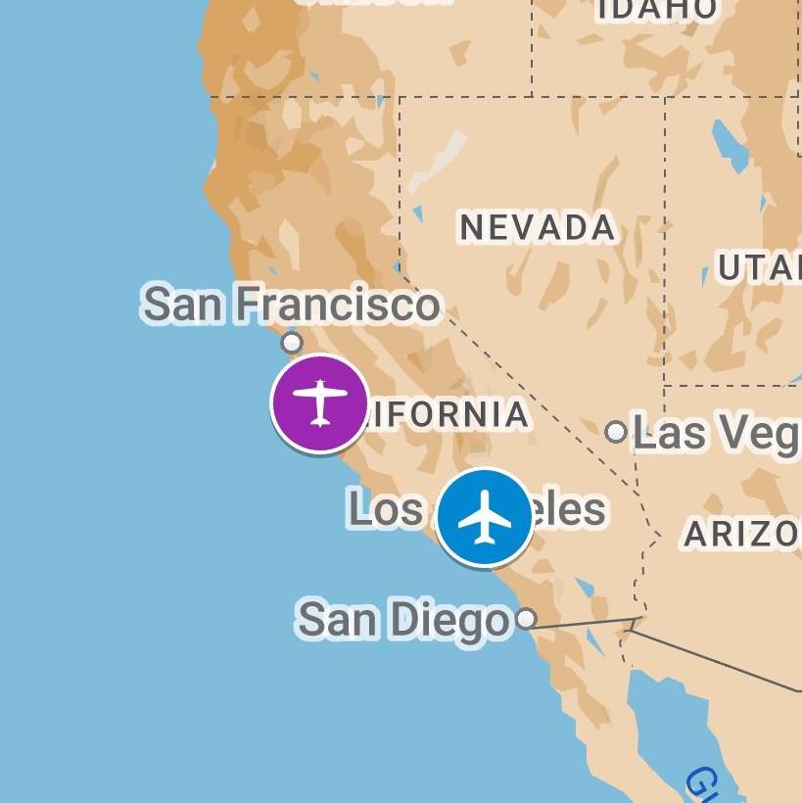

An airborne field mission devoted to validation of NASA PACE observations
CIRPAS Twin Otter (Marina, CA) – Direct (in situ) aerosol, cloud measurements
NASA ER-2 (Palmdale, CA) – Remote and PACE Proxy measurements
NOAA R/V Shearwater for ocean measurements and management of HyperNAV floats
Coordination of ground & ocean target overflights and satellite underflights. Planning guided with a weather forecasting team, Validation Traceability Matrix (VTM) and Bayesian search theory
3-27 September 2024, 60 flight hours
NASA
ER-2
NOAA R/V Shearwater
CIRPAS Twin Otter (TO)
Instrument/Team | Platform | Role | Lead PI | Institution
AirHARP | ER-2 | PACE/HARP2 polarimetry proxy | J. Vanderlei Martins | UMBC
HSRL-2 | ER-2 | Aerosol/cloud/ocean Lidar | T. Shingler / J. Hair | NASA LaRC
PICARD ARC | ER-2 | PACE/OCI spectrometer proxy | James Jacobson | NASA ARC
PICARD GSFC | ER-2 | PACE/OCI spectrometer proxy | Kerry Meyer | NASA GSFC
PRISM | ER-2 | PACE/OCI spectrometer proxy | David R. Thompson | JPL
RSP | ER-2 | Multi-angle polarimeter reference | B. Cairns / K. Sinclair | NASA GISS
SPEX Airborne | ER-2 | PACE/SPEXone polarimetry proxy | B. van Diedenhoven | SRON
Twin Otter | TO | Aerosol/cloud in situ instruments | Anthony Bucholtz | NPS
LARGE | TO | Aerosol/cloud in situ instruments | Luke Ziemba | NASA LaRC
ISARA | TO | In situ instrument synergy activity | Snorre Stamnes | NASA LaRC
LI-Nephelometer | TO | Aerosol phase functions | Adam Ahern | NOAA
R/V Shearwater | RV | Day cruises and limited overnight | Mike Ondrusek | NOAA
HyperNAV | RV | Radiometric calibration floats | Andrew Barnard | SeaBird Sci.
Weather, planning |  | Weather & aerosol, cloud forecasts | Rei Ueyama | NASA ARC
ESPO |  | Earth Science Project Office | Sommer Nicholas | NASA ARC
PACE-PAX validation objectives
1. Validate new retrieval properties
2. Assess spatial and temporal scale impact on validation
3. Validate in a narrow swath
4. Validate radiometric and polarimetric properties
5. Target specific geometries, season, and time of day
6. Focus on specific processes or phenomena
CIRPAS Twin Otter
NASA ER-2
Leadership team:
Kirk Knobelspiesse, Brian Cairns, Ivona Cetinić, NASA GSFC
pace.oceansciences.org/campaigns.htm

Slide 4
Schedule
Each ‘flight’ day will have three separate sets of flight plans
We will score each plan according to our VTM and weather predictions
At the end of each day, we will assess the success of the plans

Slide 5
PACE-PAX org chart
Leadership:
Kirk Knobelspiesse
Brian Cairns
Ivona Cetinić
Aircraft management:
Samuel Choi, John McGrath,
Fran Becker
Twin Otter:
Brian Cairns
Aircraft management:
Anthony Bucholtz
R/V Shearwater:
Ivona Cetinić
Ship management: Michael Ondrusek
Project Management:
Sommer Nicholas,
Judy Alfter
ER-2:
Kirk Knobelspiesse
Data archive:
Gao Chen, Michael Shook
Weather and flight planning:
Rei Ueyama
Samuel LeBlanc: flight planner
Mijeong Park: Forecasting
Ju-Mee Ryoo: IT support
Louis Nguyen: Satellite data
Science instruments:
AirHARP: J. Vanderlei Martins
HSRL-2: John Hair; Taylor Shingler
PICARD: James Jacobson, Kerry Meyer
PRISM: David Thompson
RSP: Ken Sinclair; Brian Cairns
SPEX Airborne: Otto Hasekamp
Science Instruments:
Facility: Anthony Bucholtz
LI Nephelometer: Adam Ahern
LARGE: Luke Ziemba
Science Instruments:
HyperNAV: Andrew Barnard
Others TBD
PACE Project Scientist: Jeremy Werdell
PACE Deputy Project Scientists: Brian Cairns, Antonio Mannino
PACE Program Scientist: Laura Lorenzoni
PACE Deputy Program Scientist: Hal Maring
PACE Applied Sciences: Woody Turner
Full list of participants: https://espo.nasa.gov/pace-pax/content/PACE-PAX_Participants group email list: pace-pax@espo.nasa.gov

Slide 6
Flight planning
Sam LeBlanc is on paternity leave – leadership and forecasting teams will do flight planning for this dry run
Focus will be on how we relate plans to our Validation Traceability Matrix (VTM), and track progress throughout the campaign
Visualization will be in Google Earth; KML posted to ESPO site
Tracking will be performed with a customized MS Excel file:
  PACE-PAX_VTM_Tracking.xlsx

Slide 7
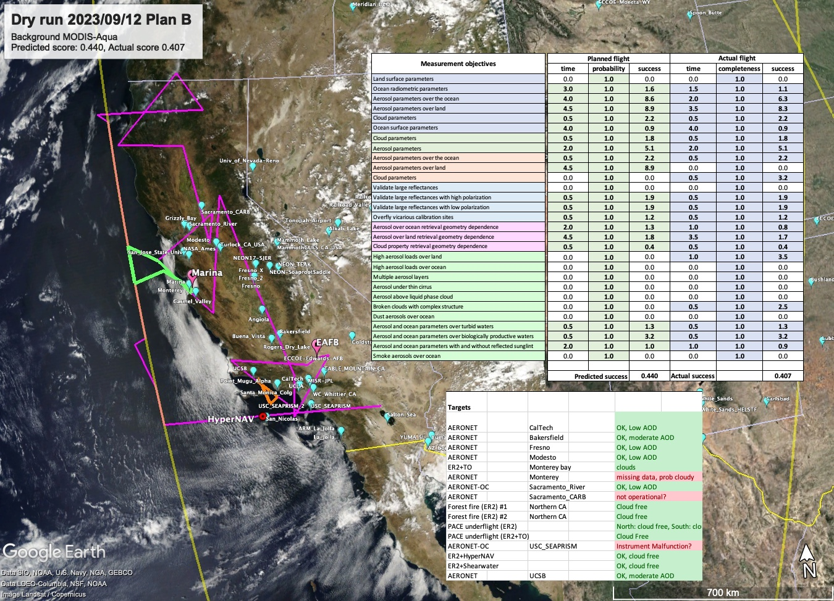

Slide 8
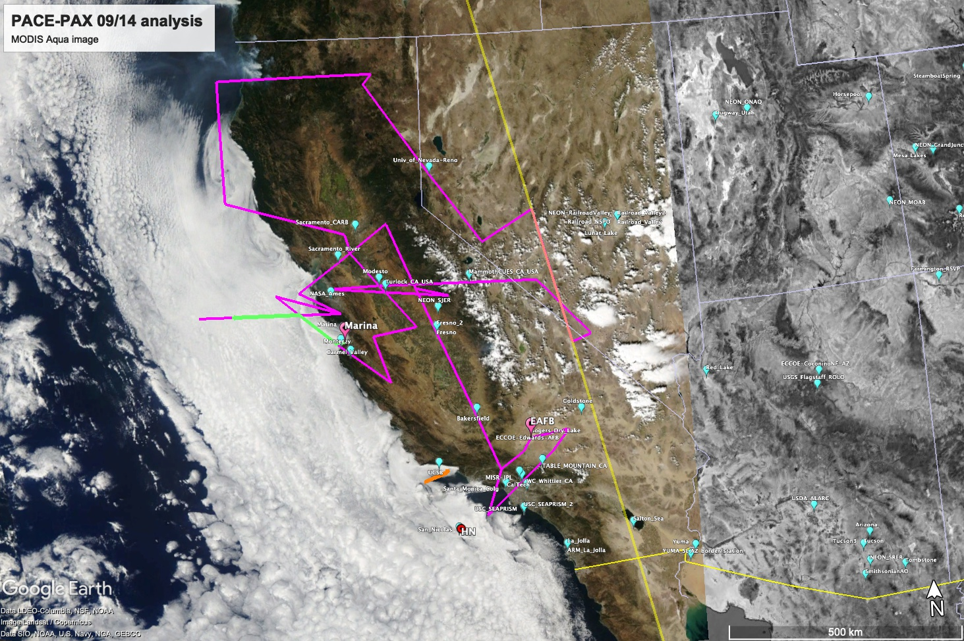
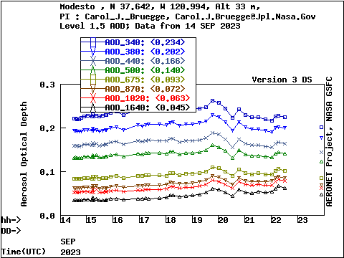
Forest fire smoke
Possibly over clouds
ER-2 on PACE track
~12 AERONET site overpasses
ER-2 + TO cloud observations
Modesto
RV shearwater with no coordination

Slide 9
Some thoughts
Next dry run will focus on timing and geometry with a real flight planner
We will update our validation traceability matrix to adjust for inclusion of R/V Shearwater and HyperNAV
PACE Validation Science team selections may affect what we deploy and nature of VTM
Please look at VTM as it pertains to your instrument – does it capture measurement needs?
We need to better develop a 3D understanding of Twin Otter flights
We need to modify our scoring scheme to consider opportunity cost of deploying vs not, and connect this to when we would decide to fly or not
Let’s follow these and more in the google sheet
Need to reach out to specific non PACE-PAX assets: AERONET, NOAA buoys, railroad valley
Logistics – we will move away from use of ESPO in the field, probably to Box

Slide 10

Feedback is crucial
  Issues and Actions spreadsheet
  Kirk.Knobelspiesse@nasa.gov, Brian.Cairns@nasa.gov, Ivona.Cetinic@nasa.gov
  Anonymous comment:
  https://forms.gle/51tVUnxVu3B21X8K7

Slide 11
Thank you!

