Slide 1
Meeting 2025 Mid-May – Mid-June
Venue Proposals Athens

Slide 2
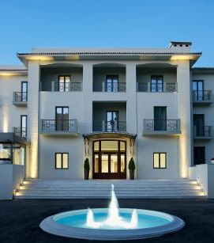
Kastri Domotel Athens

Slide 3
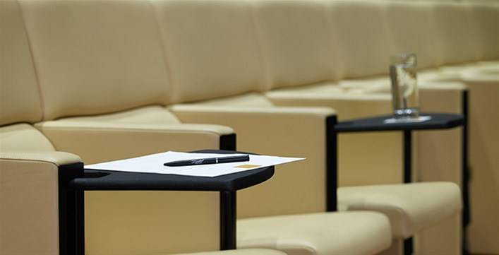
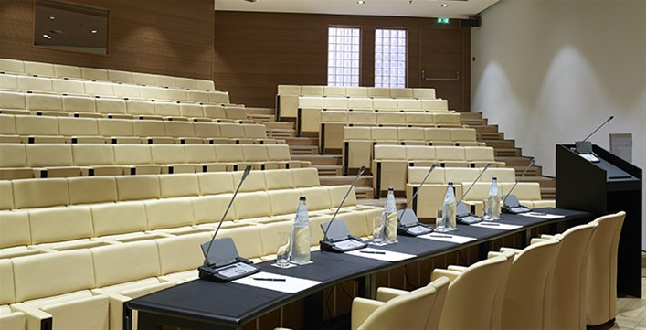
Venue
Domotel Kastri is the only Athens hotel with an in-house autidorium. The Conference Center and its advanced infrastructure, multifunctional meeting rooms, state-of-the art equipment and experienced staff, ensure the success of every event, whether a business conference, a science convention or an international cultural event.
Ultramodern auditorium with simultaneous translation cabins,
Seating capacity of 196
Natural-lighting conference room with high-tech audiovisual equipment, seating capacity of 550
Sixteen multipurpose rooms with a seating capacity of 50
Eight rooms equipped with PCs & a seating capacity of 30
Indoor and outdoor venues Business Centre
Library
Technical support
Free wireless Internet (Wi-Fi)

Slide 4
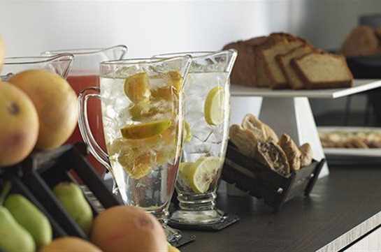
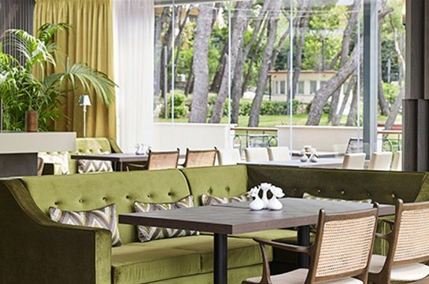
Facilities
Kastri Bistro:
The Kastri bistro providing a view of the trees and well-tended gardens, is open from early in the morning to late night offering selected Flavors of Greek and Mediterranean cuisine, as well as delicious cocktails from its bar.
Elegant coffee blends and light meals blend in harmoniously with selections from the Greek Creative Cuisine. Domotel Kastri’s chefs are inspired by Greek tradition raw materials and create original dishes that captivate the palate.

Slide 5
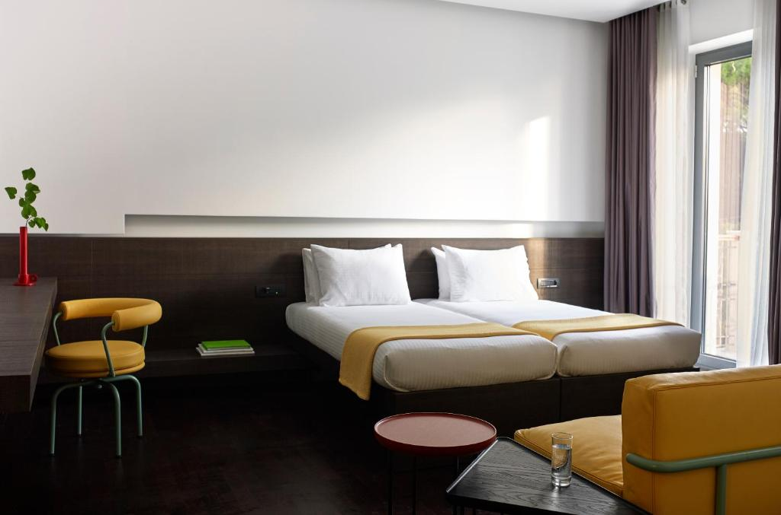
Rooms and Prices
SINGLE ROOM BB --> 160 euro /night
DOUBLE ROOM BB --> 180 euro /night

Slide 6
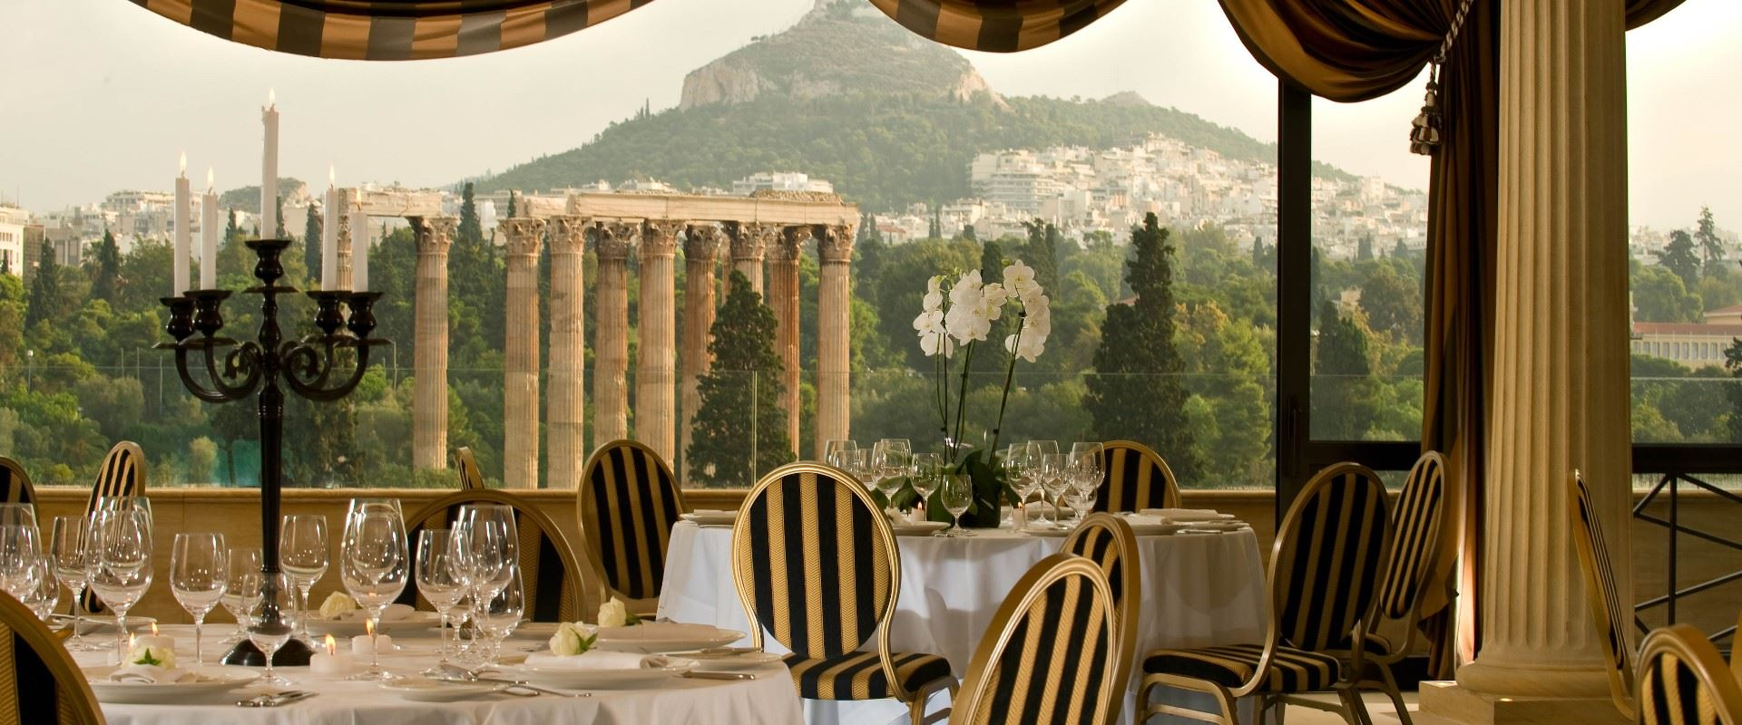
Royal Olympic Hotel

Slide 7
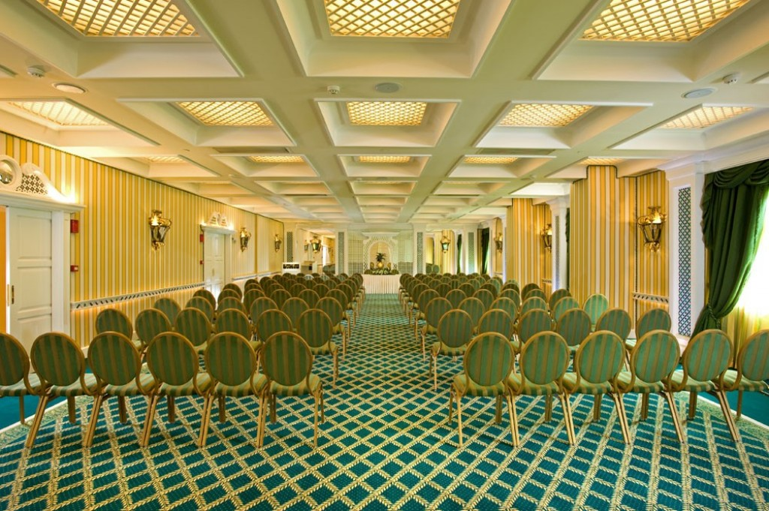
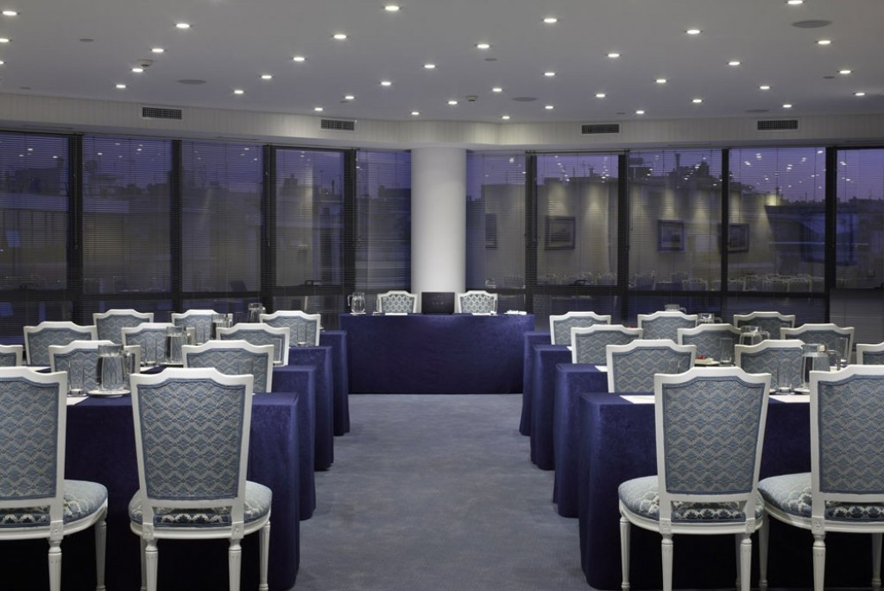
Venue
Royal Olympic is an excellent choice, as it is a modern and elegant 5-star Athens conference hotel, able to hold meetings stretching from 5 to 700 delegates. It combines outstanding conference facilities together with a very personal attendance of our experienced and very caring personnel. An ultra-high speed (optic fibres) Wi-Fi connection is available throughout the hotel complimentary, since it is of great importance and a key issue in successful business.
In 2007 the ROYAL OLYMPIC extended its conference assets by creating 5 brand new meeting rooms. All the venues are at the same wing (each floor is a meeting room on its own) and they are all identical in dimensions. They are flooded in day light and four of them have the possibility to be divided into two separate rooms that are soundproof, have separate entrances and have all audio visual and technological facilities (such as WI-FI, UPS’, etc).

Slide 8
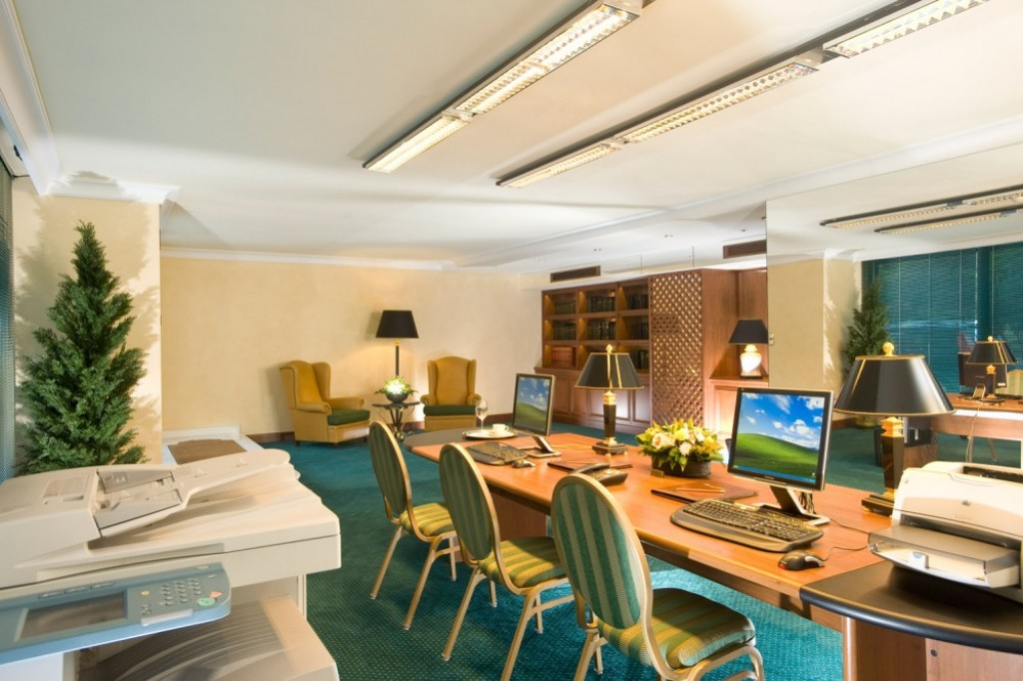
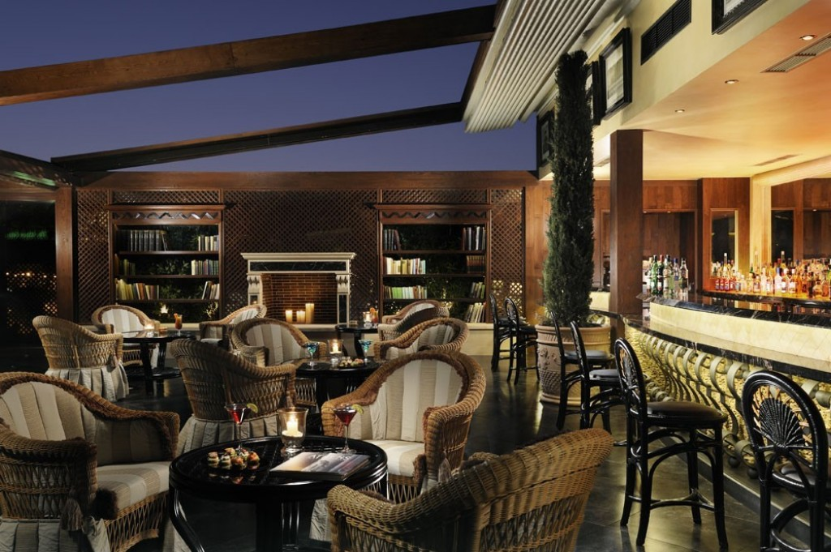
Facilities
Business Centre
Wi-Fi Internet Complimentary
Library
Conference Rooms
Meeting & Banquet Facilities
Terrace
Multilingual Staff
Outdoor Swimming Pool (Seasonal)
Fax/Photocopying
Currency Exchange
Rooms Service
Laundry & Dry Cleaning
Valet Parking
Luggage Storage
Rooms & Facilities for Disabled Guests
Non-Smoking Rooms
Sound proofed rooms
Central Heating/Cooling
Restaurant
Bars

Slide 9
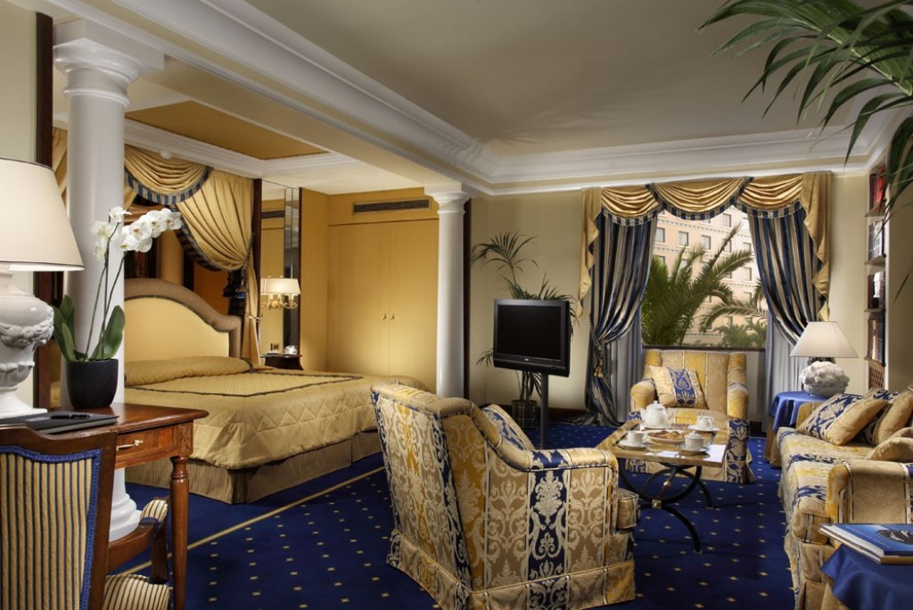
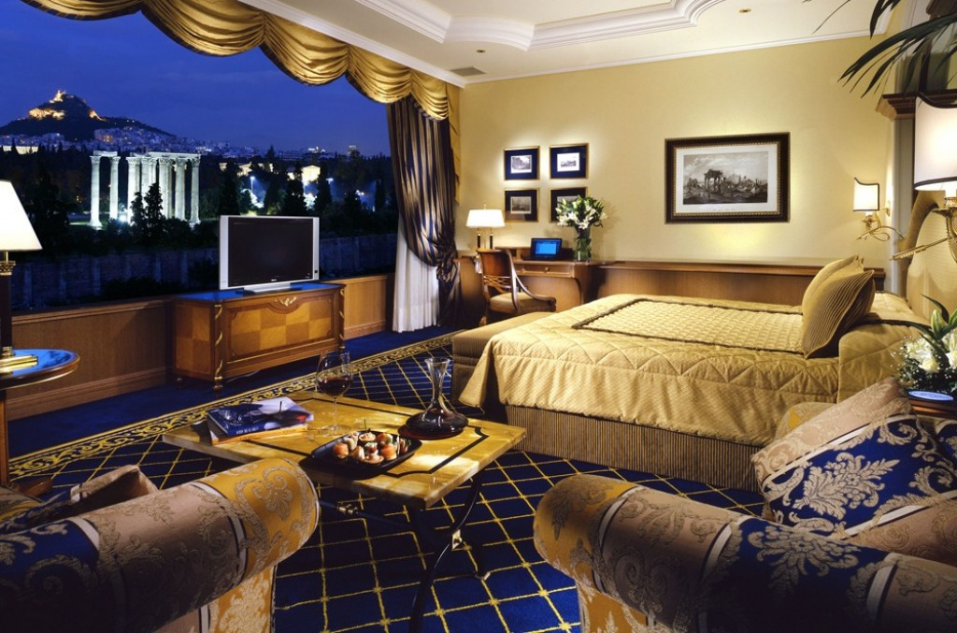
Rooms and Prices
SINGLE ROOM BB --> 210 euro /night
DOUBLE ROOM BB --> 230 euro /night

Slide 10
Venue Proposals Nafplio
Meeting 2025 Mid-May – Mid-June

Slide 11
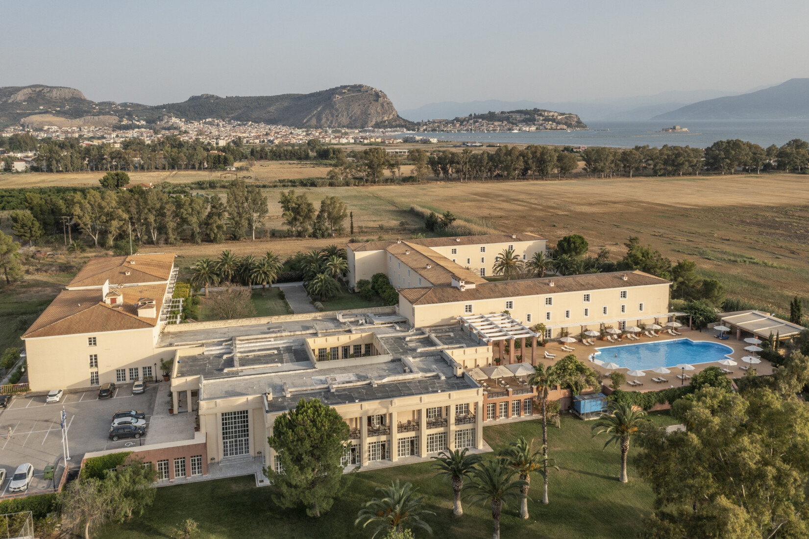
Amalia Hotel

Slide 12
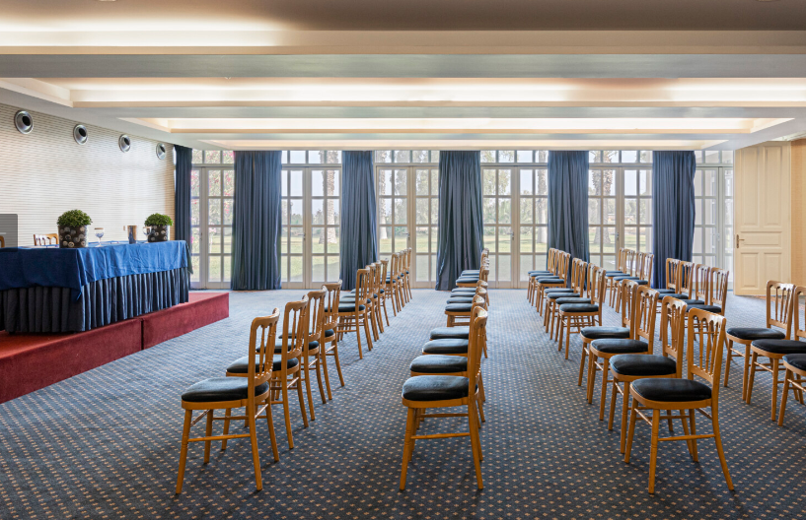
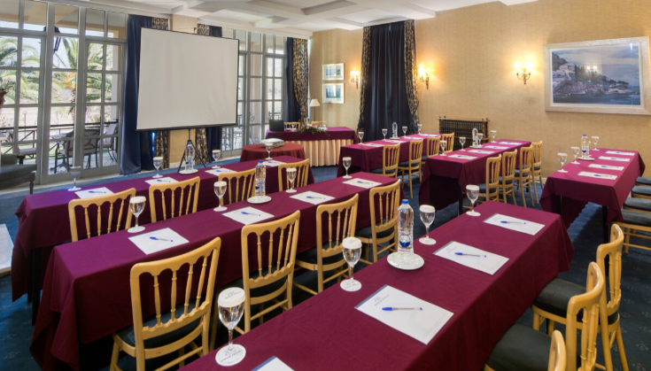
Venue
Three meeting rooms are located on the ground floor and one on the lobby level. All conference rooms have natural lighting, are soundproofed and fully air-conditioned and offer wireless internet access and the latest audiovisual equipment.
Amalia Nafplio offers small and large conference rooms that are fully equipped for various conferences. The gardens and the pool area are the perfect place for social events.

Slide 13
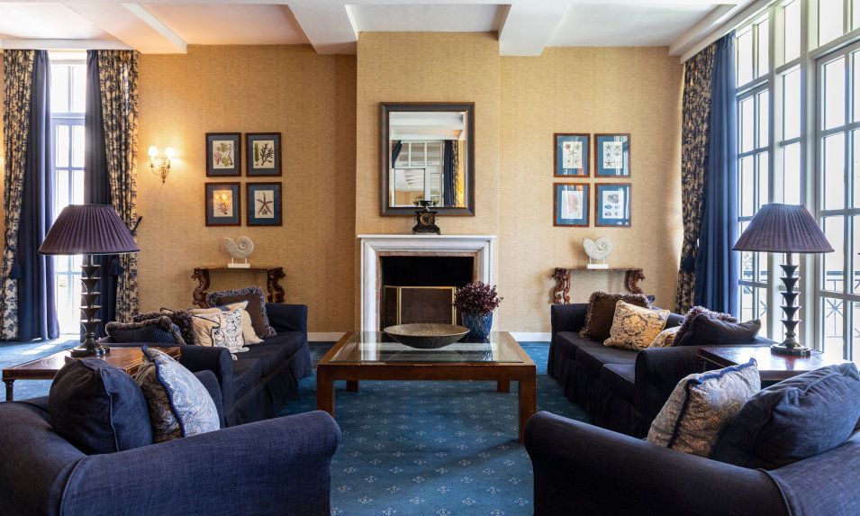
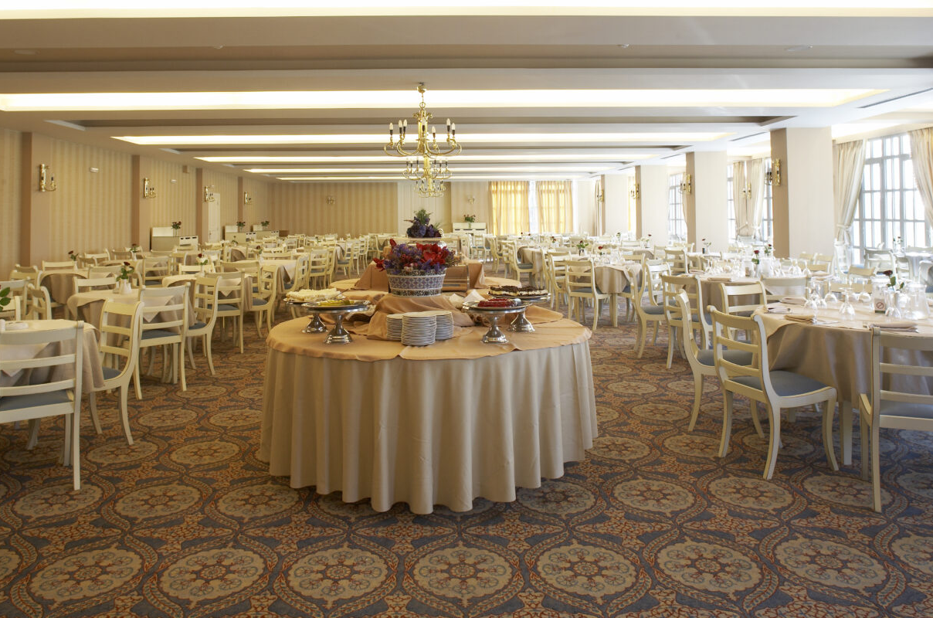
Faclities
Main Restaurant
Pool Bar & Café
Lobby Lounge bar
Summer BBQ
Outdoor Pool
Parking
Gym
24 h fully trained Hotel Staff
4 main meeting rooms

Slide 14
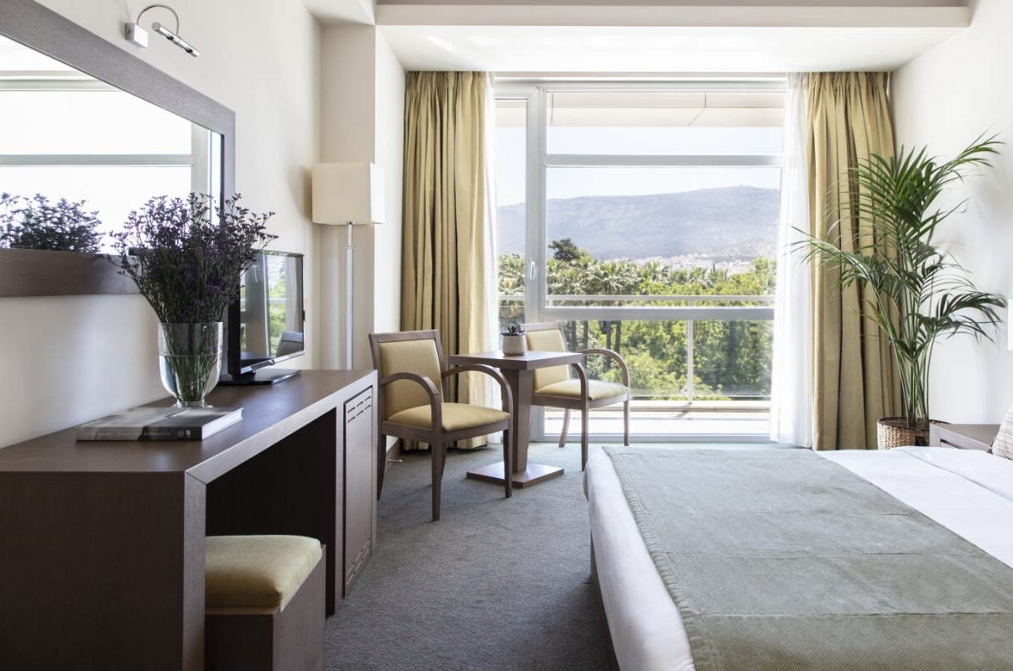
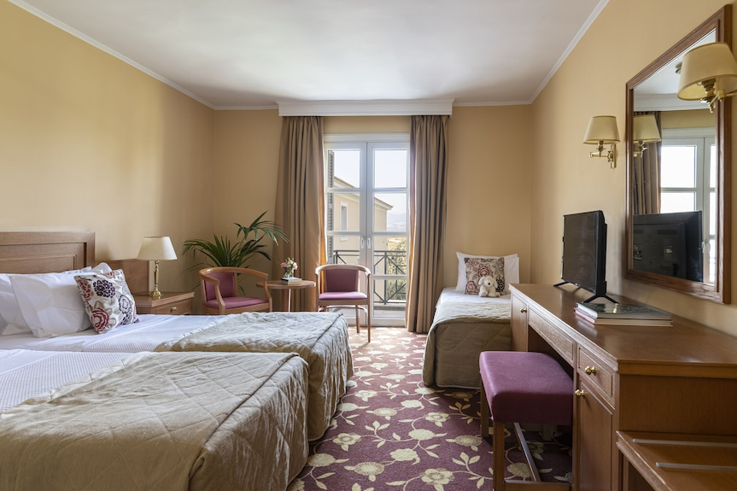
Rooms and Prices
SINGLE ROOM BB --> 130 euro /night
DOUBLE ROOM BB --> 150 euro /night

Slide 15
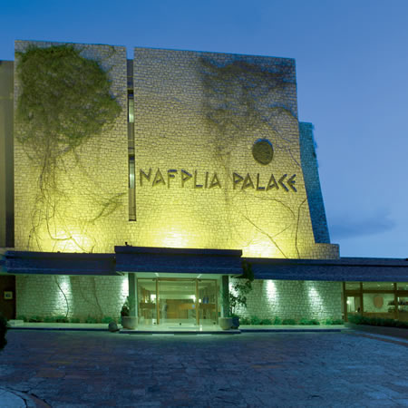
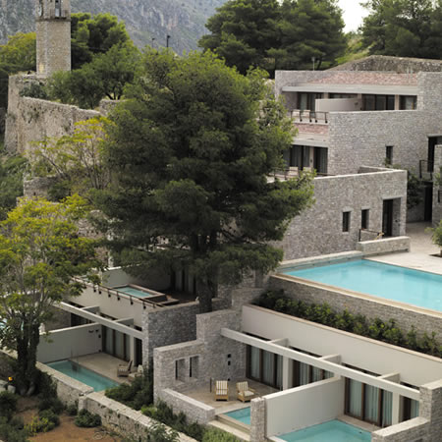
Nafplia Palace

Slide 16
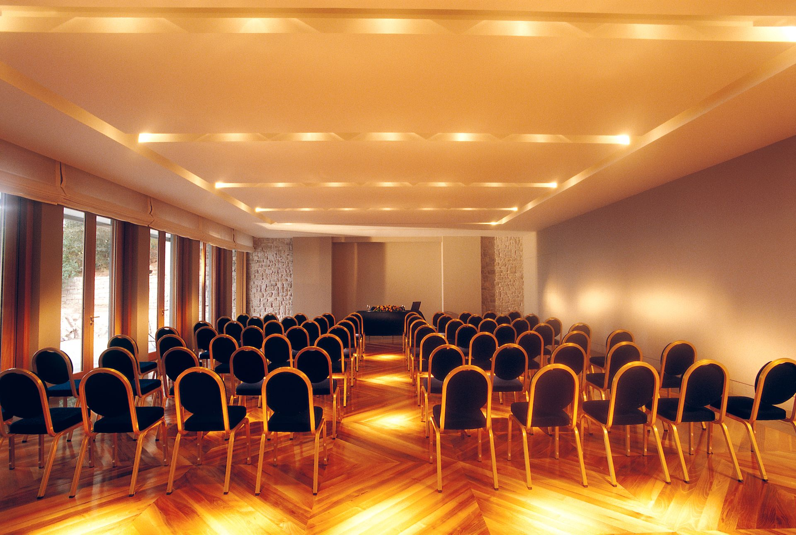
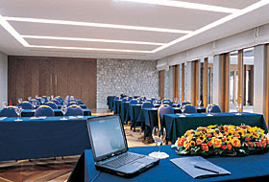
The daylight meeting facilities at Nafplia Palace & Amphitryon can cater for up to 316 guests. State-of-the-art equipment is available according to individual needs and demands, creating tailor made services. The aim is to ensure a successful, stress free, business or private function.
Spacious and contemporary event facilities, with advanced support from the dedicated staff in refined surroundings all combine to create the ideal setting for a flawless event or corporate meeting. Light and airy spaces provide for flexible environments which spill out onto the terrace enjoying the most captivating views of the bay
Venue

Slide 17
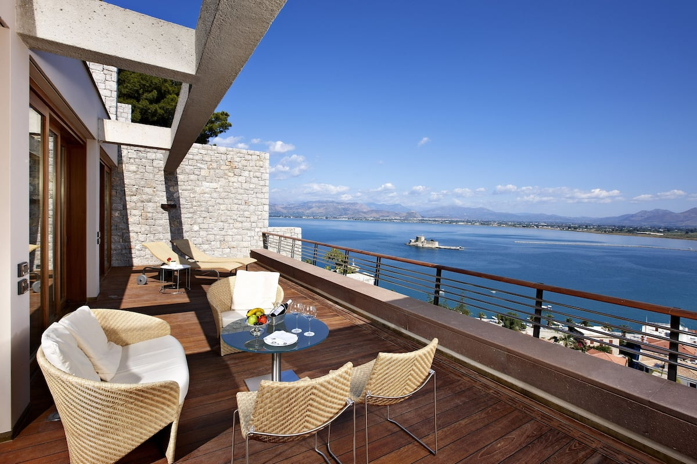
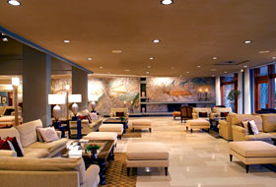
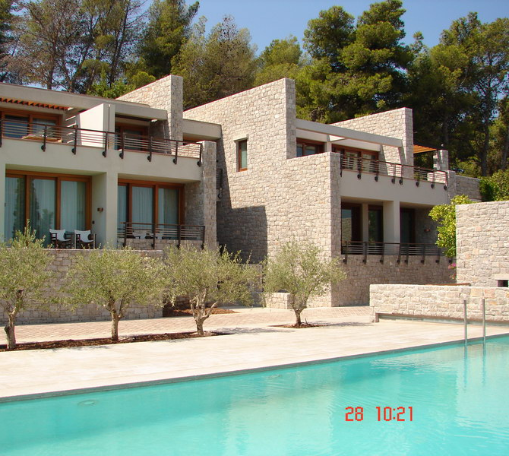
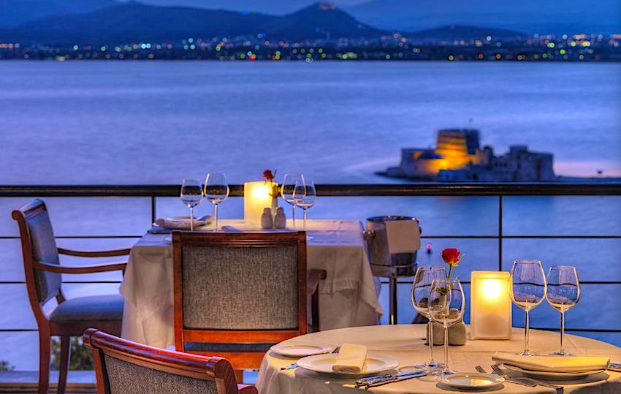
Facilities
For the business minded the hotel has three meeting rooms and offers a full concierge facility, business centre and internet access. A lift takes guests down through the ancient rock of the acropolis into the town of Nafplion.
The freshwater swimming pool at the hotel is a sparkling delight. Public beaches are easily accessible, close by around the hotel. Umbrellas and sun-beds with a pool drinks service is available. An infinity pool is available for the exclusive use of villa quests.
Ample covered car parking is available at the Hotel. A heliport has been created on the top of the acropolis just a few steps away from the hotel entrance. Transfer times from Athens International airport are about 30minutes and private helicopter transfer can be arranged.

Slide 18
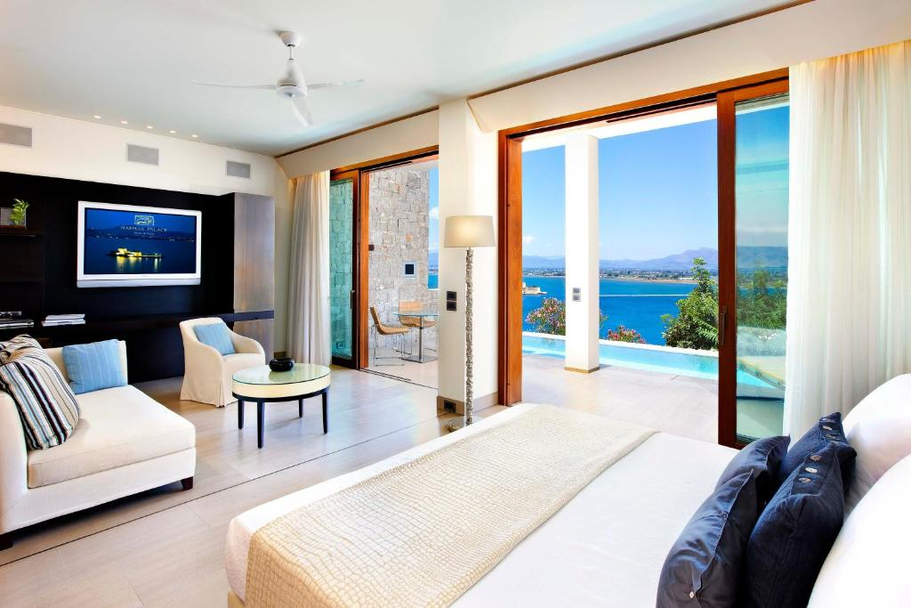
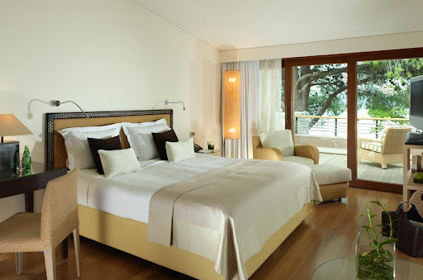
Rooms and Prices
SINGLE / DOUBLE ROOM BB --> 270 euro /night

Slide 19
NBES Events

