Slide 1
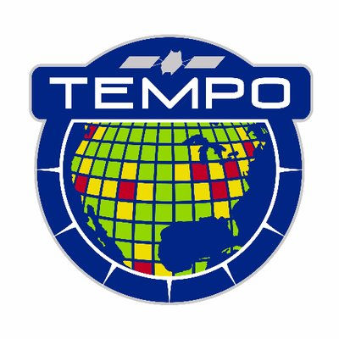
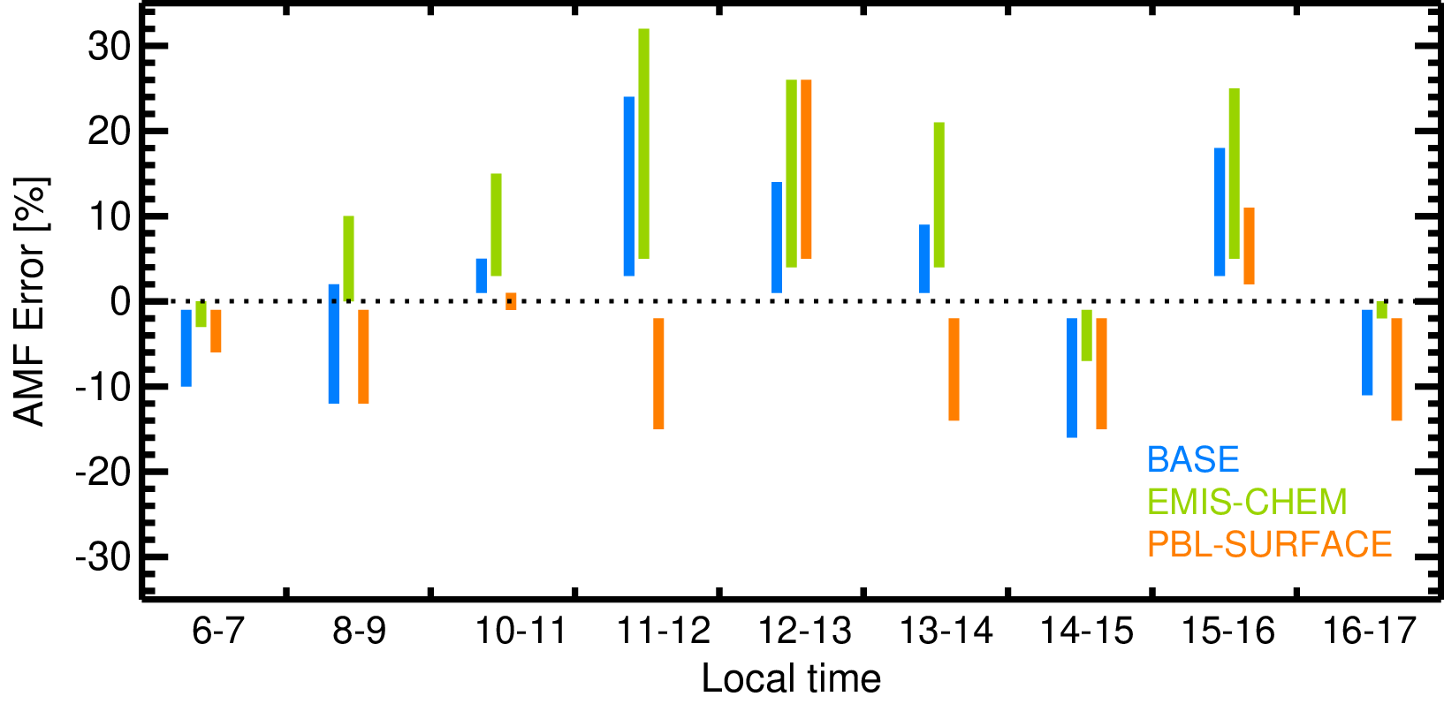
Lamsal–Sensitivity of tropospheric NO₂ retrievals to diurnal…..
Lok Lamsal (UMBC/NASA GSFC), Melanie Follett-Cook, Kenneth Pickering, Christopher Loughner, William Swartz, Sungyeon Choi, Scott Janz, Dale Allen, Nickolay Krotkov
How much error one can possibly introduce in NO₂ retrievals through model-derived a-priori NO₂ profiles?; applicable for other species as well
Conducted simulation and retrieval studies using observations and model during NASA DISCOVER-AQ campaign
Three CMAQ simulations: BASE, EMIS-CHEM (perturbing mobile NO_{x} emissions & chemistry), and PBL-SURFACE (changing PBL scheme)
Up to $±$20% model-dependent diurnal NO₂ retrieval errors
AMF (or retrieval) errors from model profiles relative to observations

