Slide 1
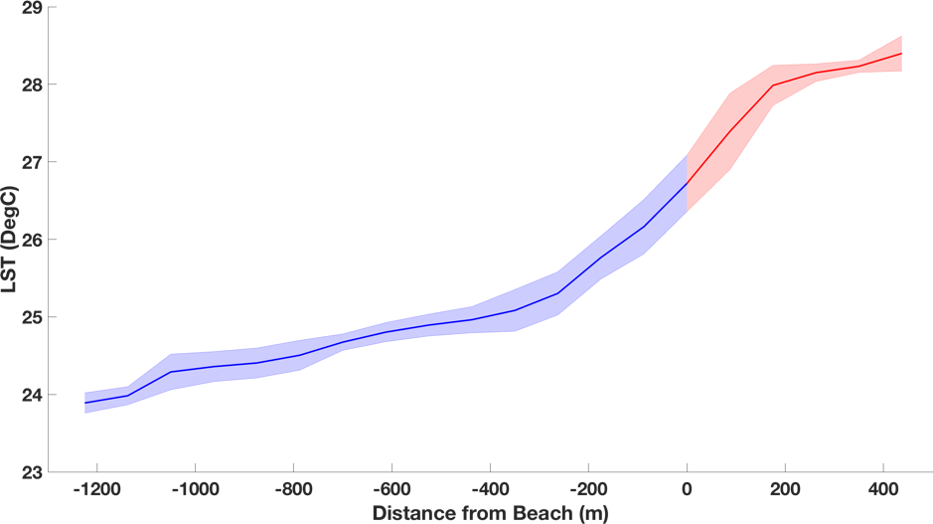
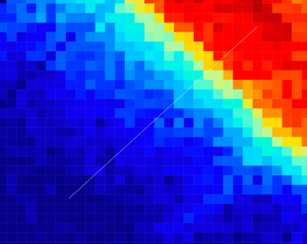
Otis–Coastal Surface Temperatures using ECOSTRESS
Daniel Otis, University of South Florida Frank Muller-Karger, University of South Florida
Motivation to use ECOSTRESS near the coast
High spatial resolution (70m)
Non-uniform sampling and re-visit times
Ability to extract data at the water-land interface
LST(DegC)
Beach
Land
VIIRS-SNPP
8/16/18 10:00 GMT
750-m pixel
Water
ECOSTRESS
8/16/18 13:04 GMT
70-m pixel

