Slide 1
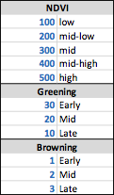
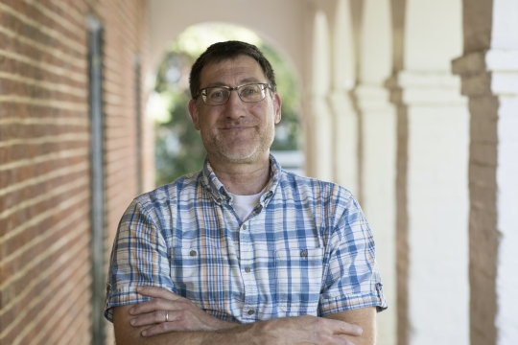
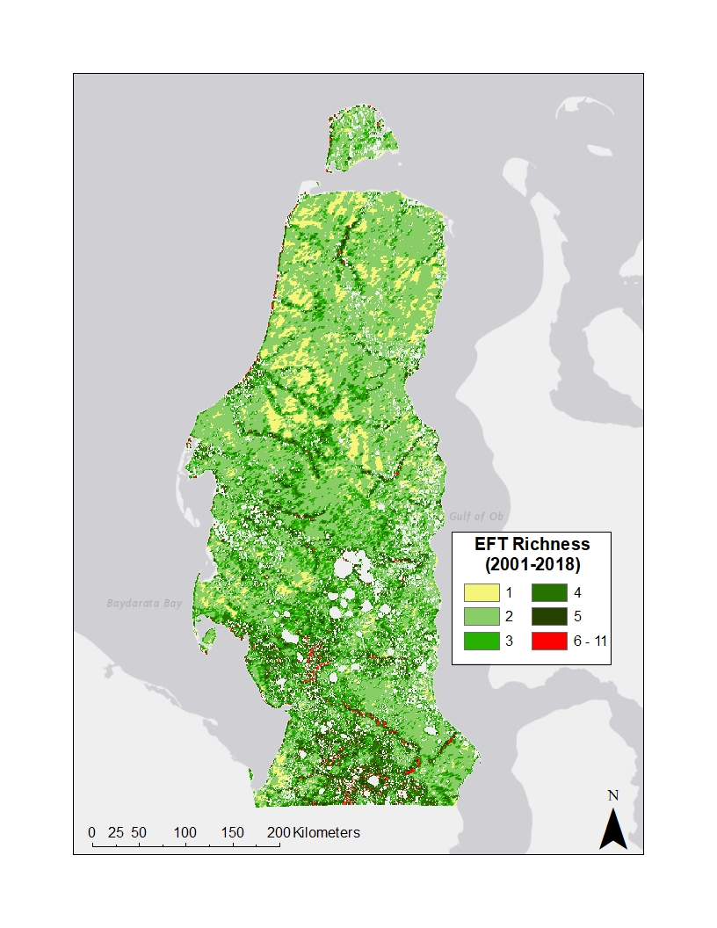
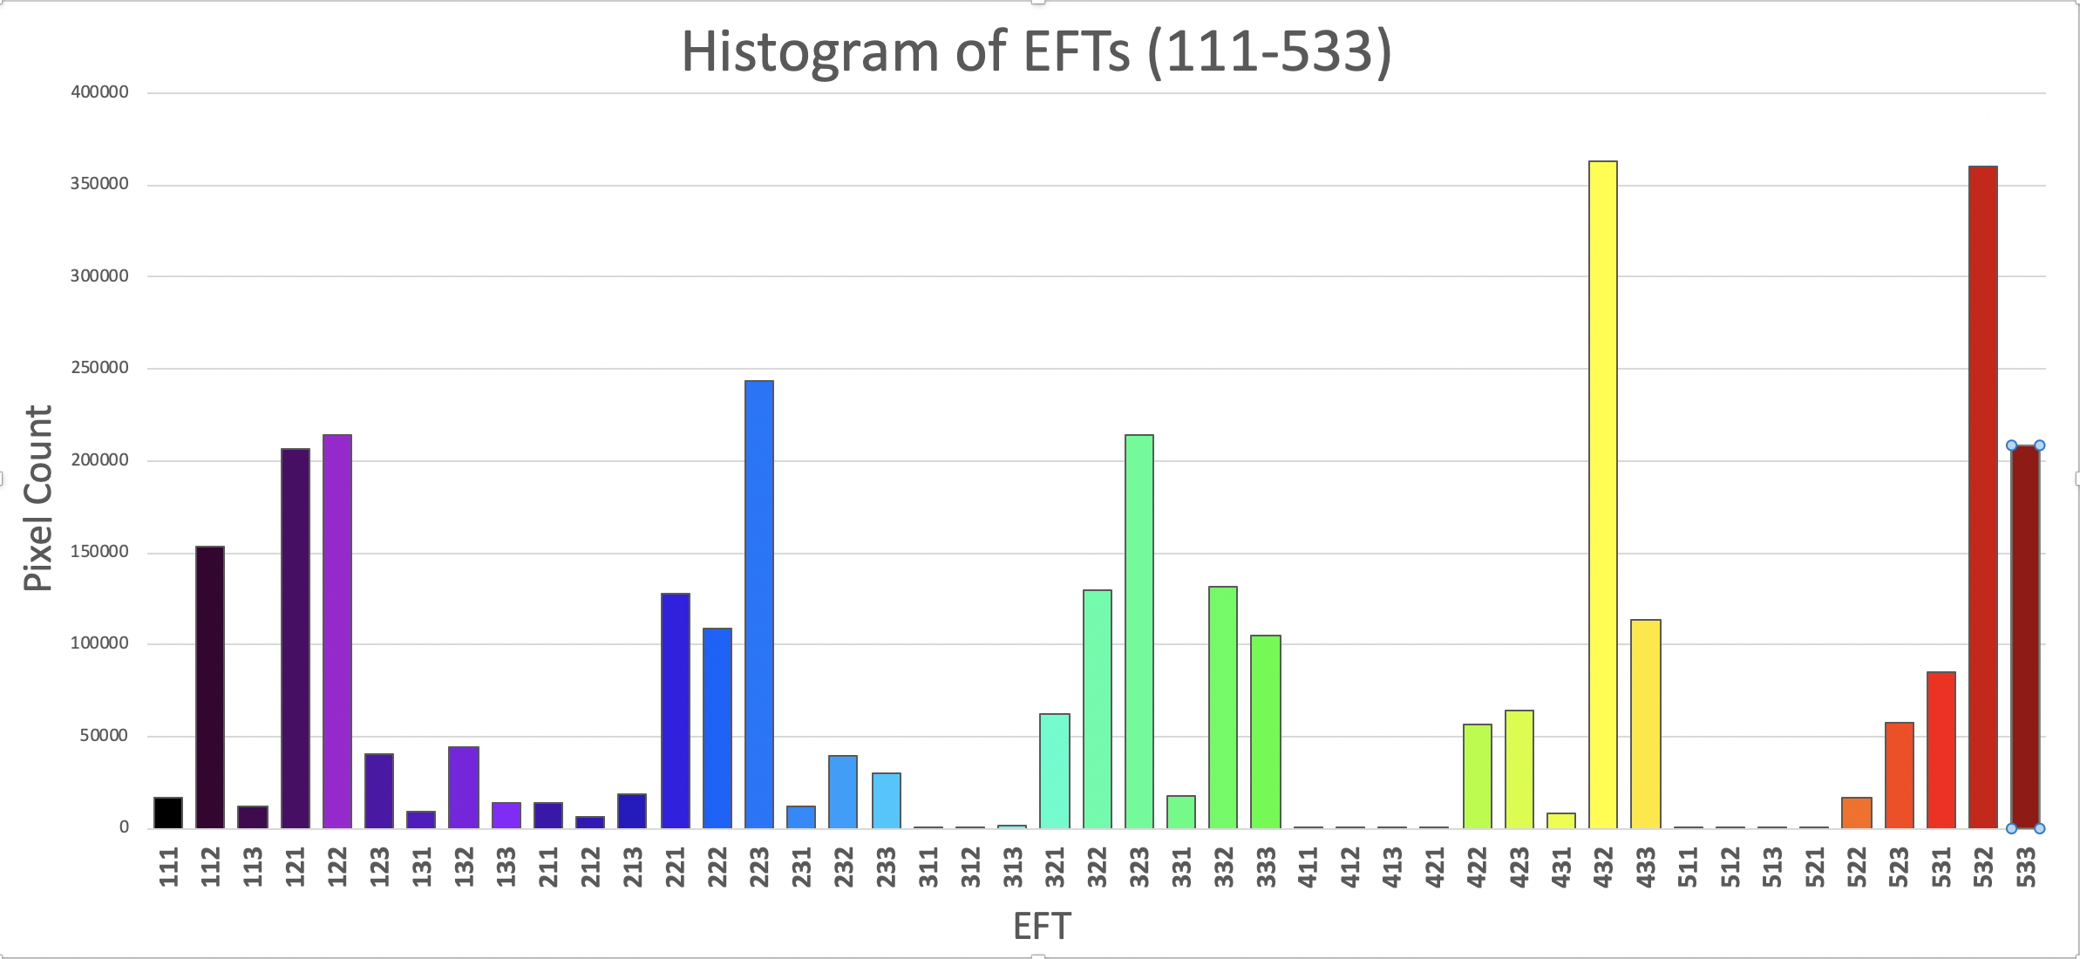
Epstein – Arctic Ecosystem Functional Diversity
Howard Epstein, University of Virginia
Amanda Armstrong, Domingo Alcaraz-Segura, Morgan Tassone, Elisa Montefiori, Martha Raynolds
MODIS 16-day composite NDVI
Three functional attributes of the mean seasonal NDVI curve – related to magnitude and phenology.

