Slide 1
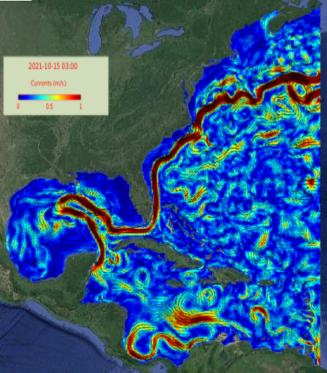
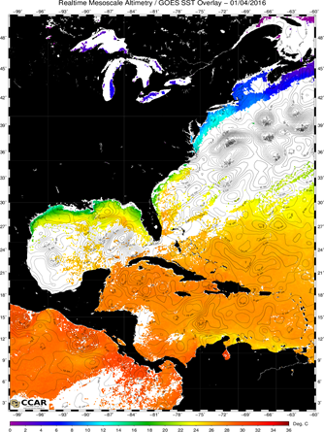
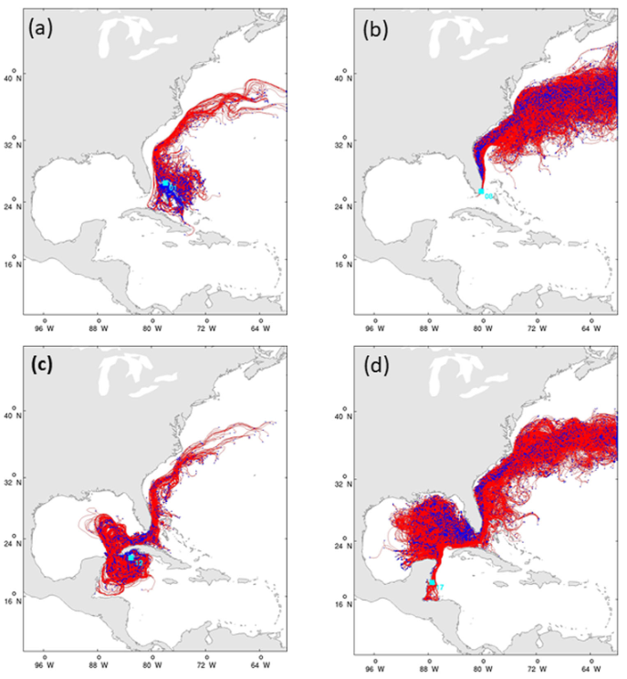
Headshot of yourself
He–Predicting Larval Dispersal for Marine Resource Management
Dr. Ruoying He, North Carolina State University / Fathom Sciences Dr. Aaron Adams, Bonefish & Tarpon Trust
Predicting the Long-Distance Dispersal of Ichthyoplankton in the Intra-Americas Sea: A Data-Assimilative Decision Support Tool for Effective Living Marine Resource Management
Coupled Northwest Atlantic Prediction System (CNAPS)
http://go.ncsu.edu/CNAPS
Laval transport and dispersal trajectories
Satellite
SSH & SST

