Slide 1
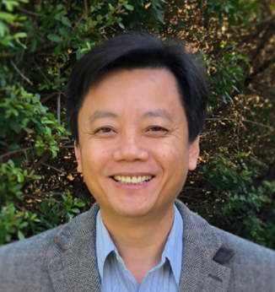
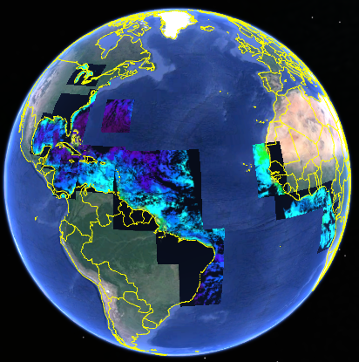
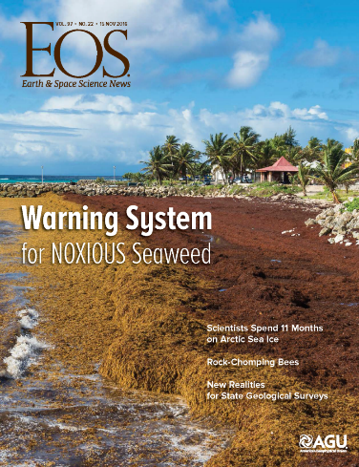
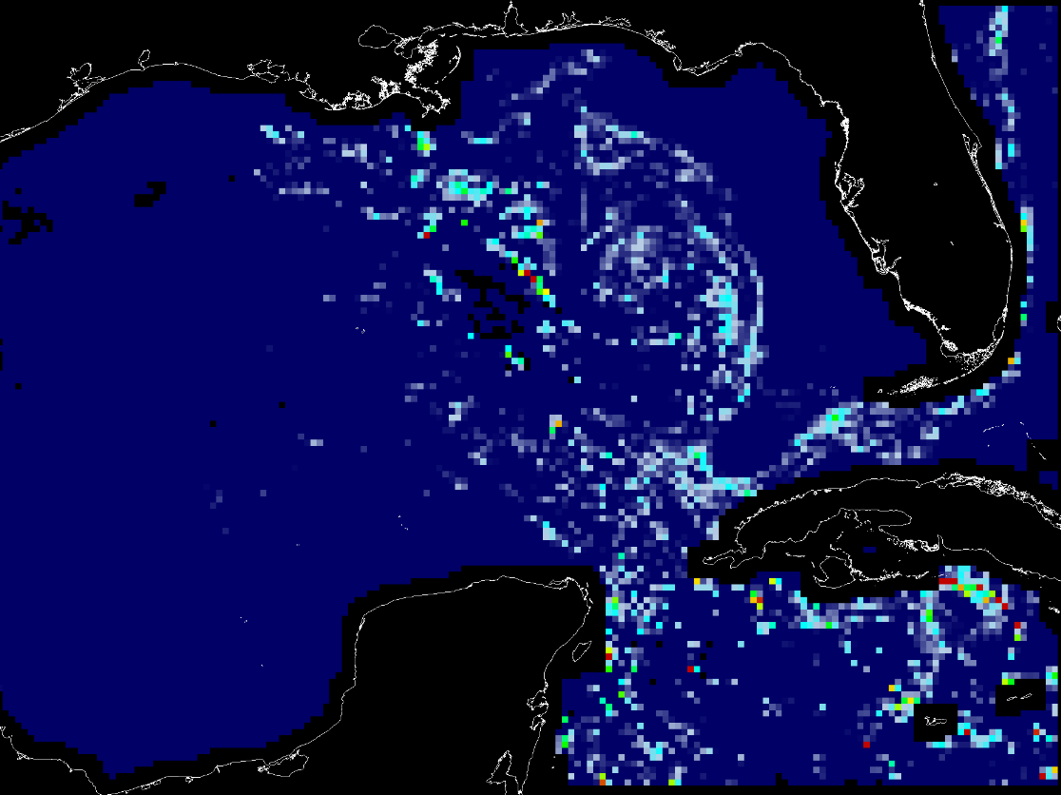
Headshot of yourself
Hu–Sargassum monitoring and forecasting
Chuanmin Hu, University of South Florida Shuai Zhang, Brian Barnes, Brock Murch, Brian Lapointe, Frank Hernandez
NASA Award #: NNX17AE57G; Current ARL: ~9
Sargassum Watch System (SaWS)
https://optics.marine.usf.edu/projects/saws.html
Monthly Sargassum outlook bulletins
Week of May 14 – 20, 2019

