Slide 1
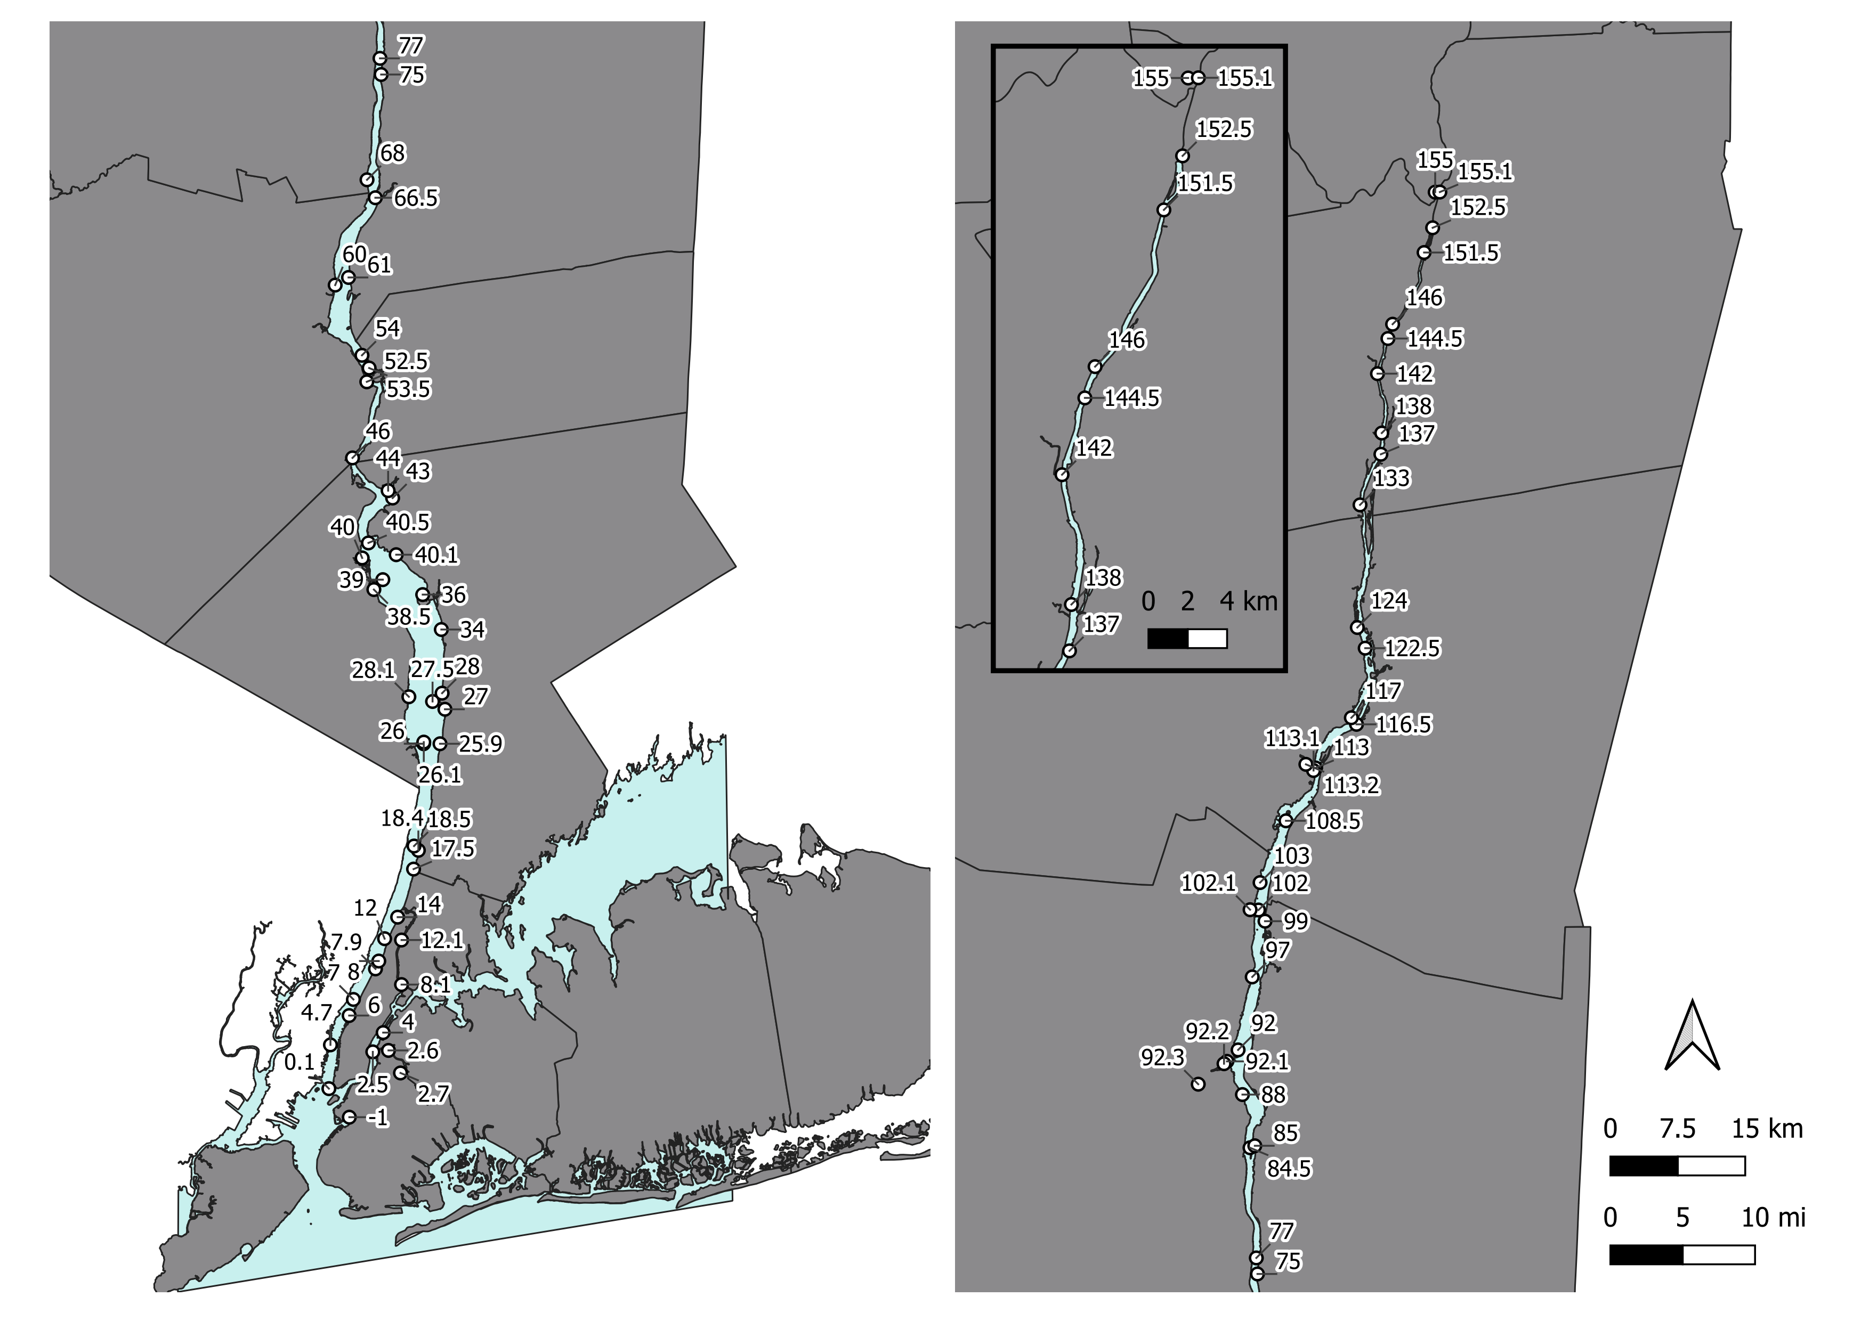
Headshot of yourself
Myers–Variability of Water Transparency and its Drivers in the Hudson River
Elise Myers, Columbia University & Lamont Doherty Earth Observatory Andrew R Juhl, Ajit Subramaniam, Carol Knudson
In the Hudson River Estuary…
How does water transparency vary spatially and temporally?
Q1
What are the primary drivers of water transparency?
Q2
Phytopl-
ankton
Particles
CDOM

