Slide 1
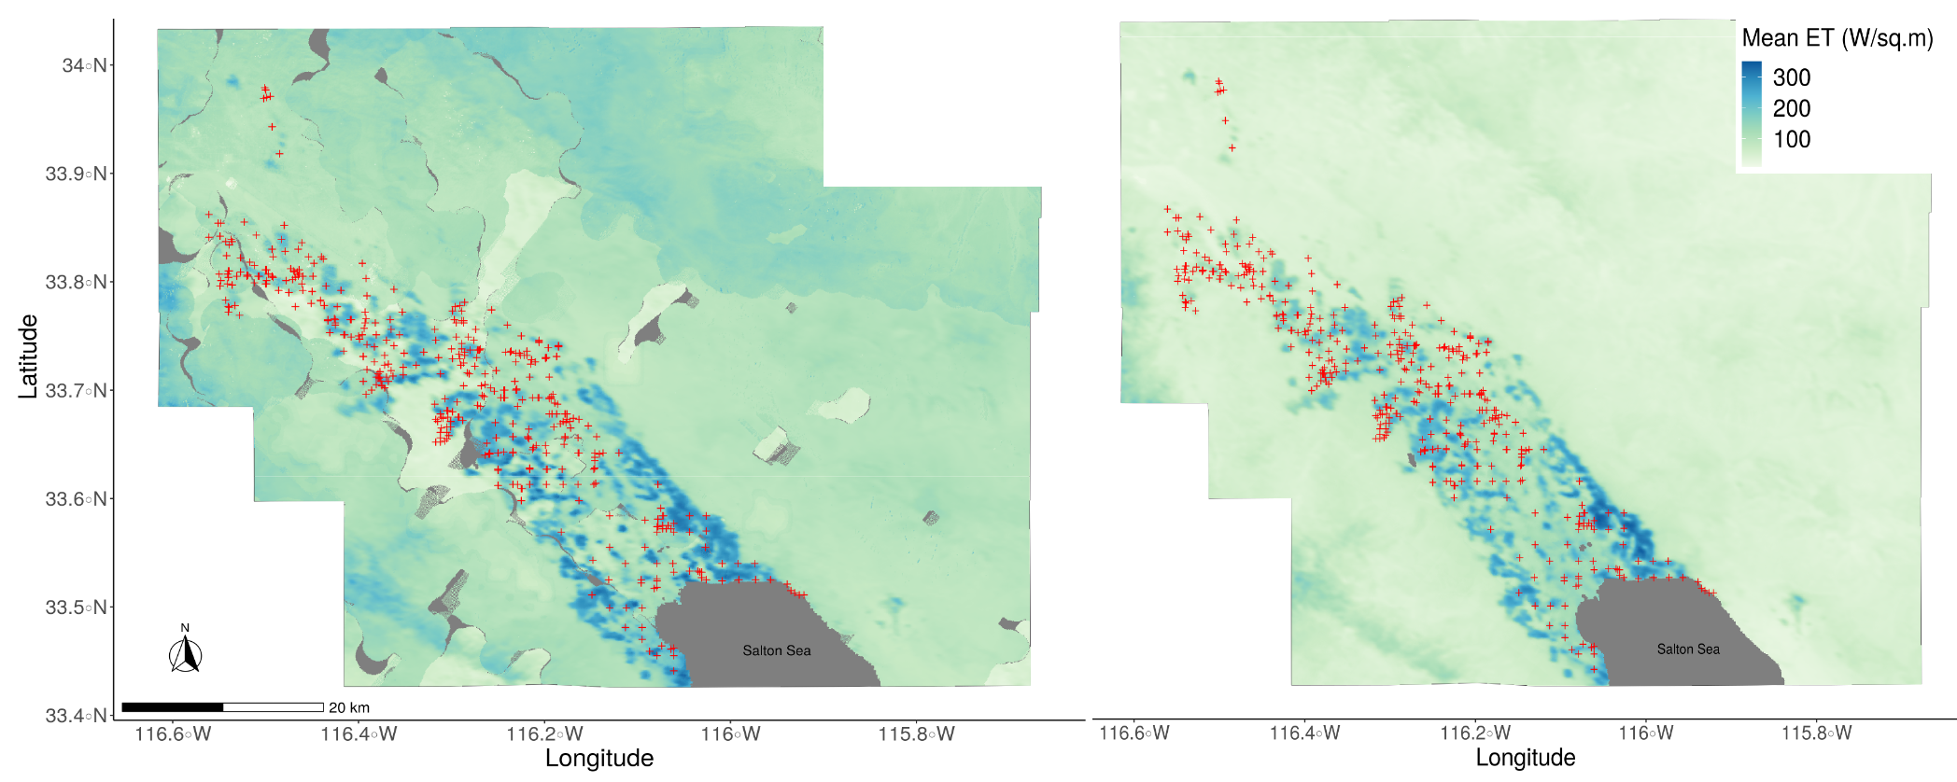
DeFelice–Environmetally informed West Nile virus forecasts
Nicholas DeFelice, Icahn School of Medicine at Mount Sinai M. Sorek-Hamer, M. Ward, K. Vemuri, S. Campbell, J. Henke, C. Romano, M. Santoriello
West Nile virus transmission is driven by an enzootic cycle between mosquito vectors and bird hosts
Identifying the key environmental conditions that facilitate and accelerate this cycle can be used to inform effective vector control
Statistical models using GRIDMET data, 4km resolution, show dry winter followed by warm spring are associated with an increase in mosquito infection rates
ECOSTRESS has potential to identify hydrologically rich areas where mosquitoes and birds interact during a warm spring following a dry winter
A
B
Mean ET (W/m²) as measured by ECOSTRESS in the Coachella Valley, CA during the early season (Figure A: March - May) and late season (Figure B: June - Aug) with trap locations (red x) for 2019.

