Slide 1
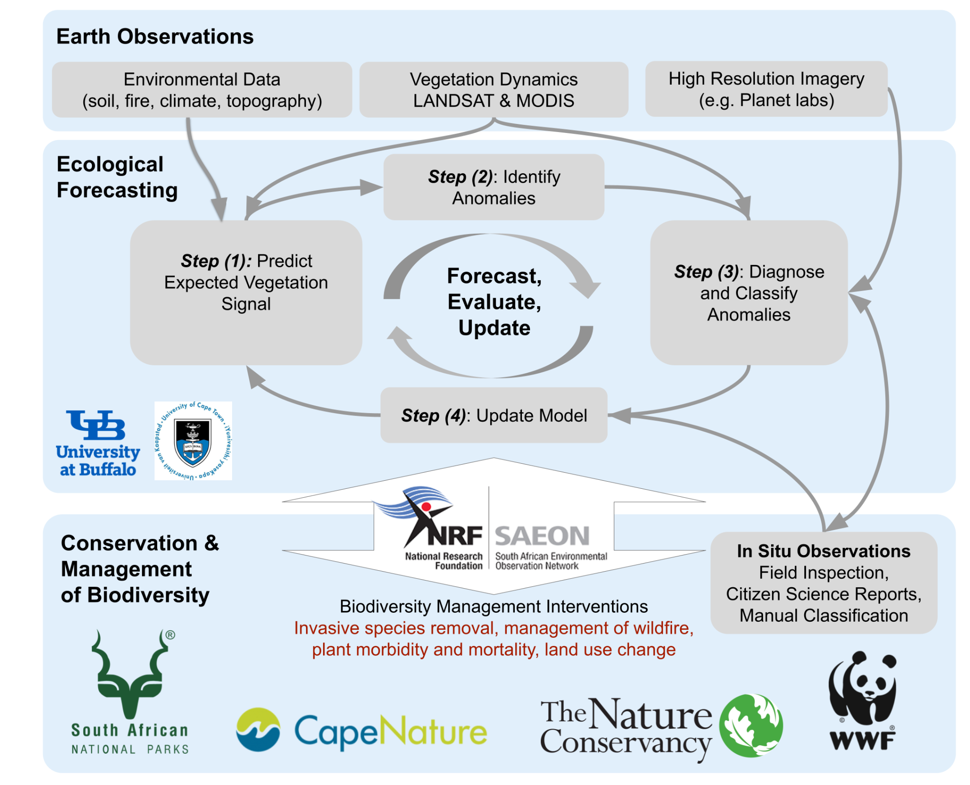
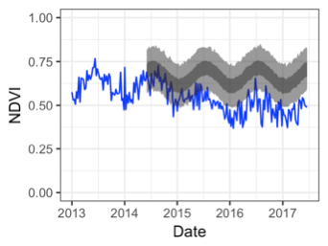
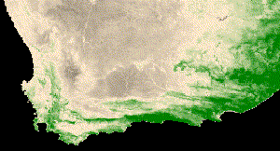
Wilson – Forecasting and Change Detection in a Biodiversity Hotspot
Adam M. Wilson, University at Buffalo
Yingjie Hu, Jasper A. Slingsby, Glenn R. Moncrieff, & Jeremy Malczyk
Many ecosystems experience significant seasonal and interannual variability (fire, drought, etc.)
How to identify change in these dynamic systems?
2000-2020 MODIS NDVI
Use Bayes & AI to detect unusual events
Check out emma.eco for more

