Slide 1
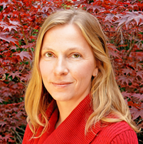


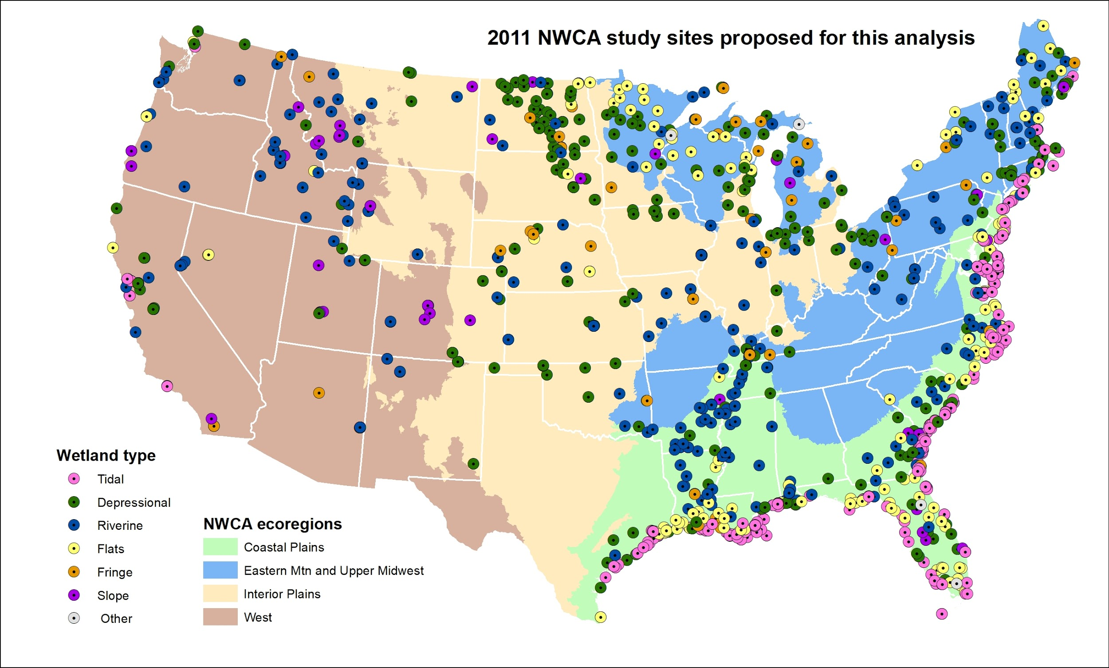
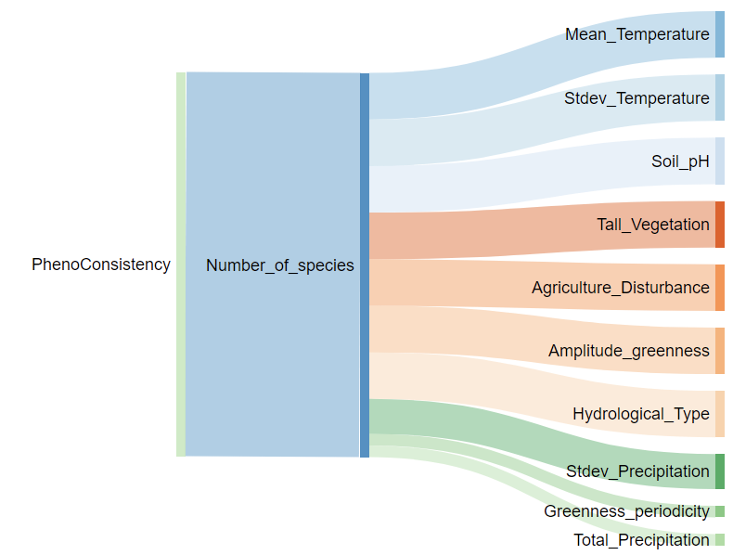
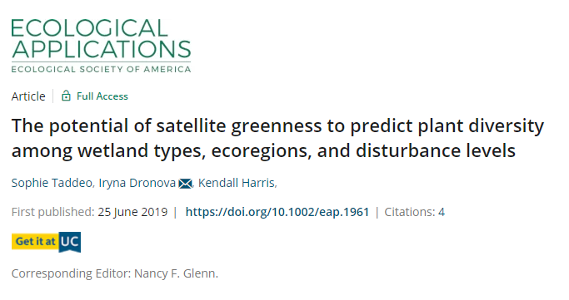
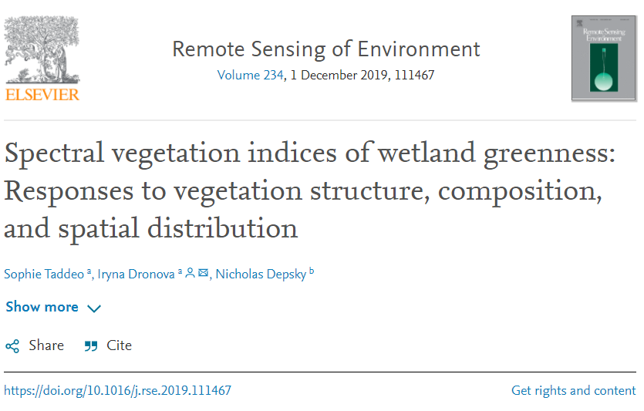
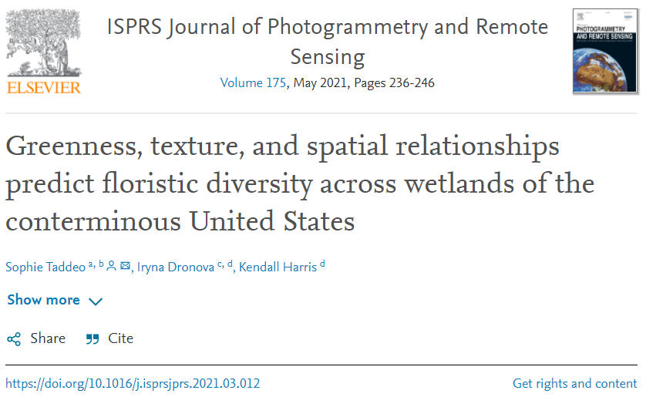
Headshot of yourself
Dronova–Plant diversity & change in complex environments
Iryna Dronova, Associate Professor, University of California Berkeley
Collaborators (current & past): Dr. Sophie Taddeo, Kendall Harris, Nick Depsky, Skyler Lewis
Linking national-scale wetland plant diversity with remotely sensed indicators of ecosystem function, phenology, and long-term change:
Wetland plant diversity: relationships with satellite greenness
  Monitoring plant diversity & its change in limited-access environments
Plant diversity & spatial heterogeneity of spectral indicators
  Contributions of plant diversity & landscape heterogeneity to wetland spectral-spatial patterns
  Implications of image spatial resolution
Links between plant diversity & stability of ecosystem phenology
  New insights into biodiversity contributions to stability of ecosystem function & change responses at policy-relevant scales
  New perspectives on wetland responses to climatic & other change drivers
Many thanks to NASA NIP award 80NSSC18K0755

