Slide 1
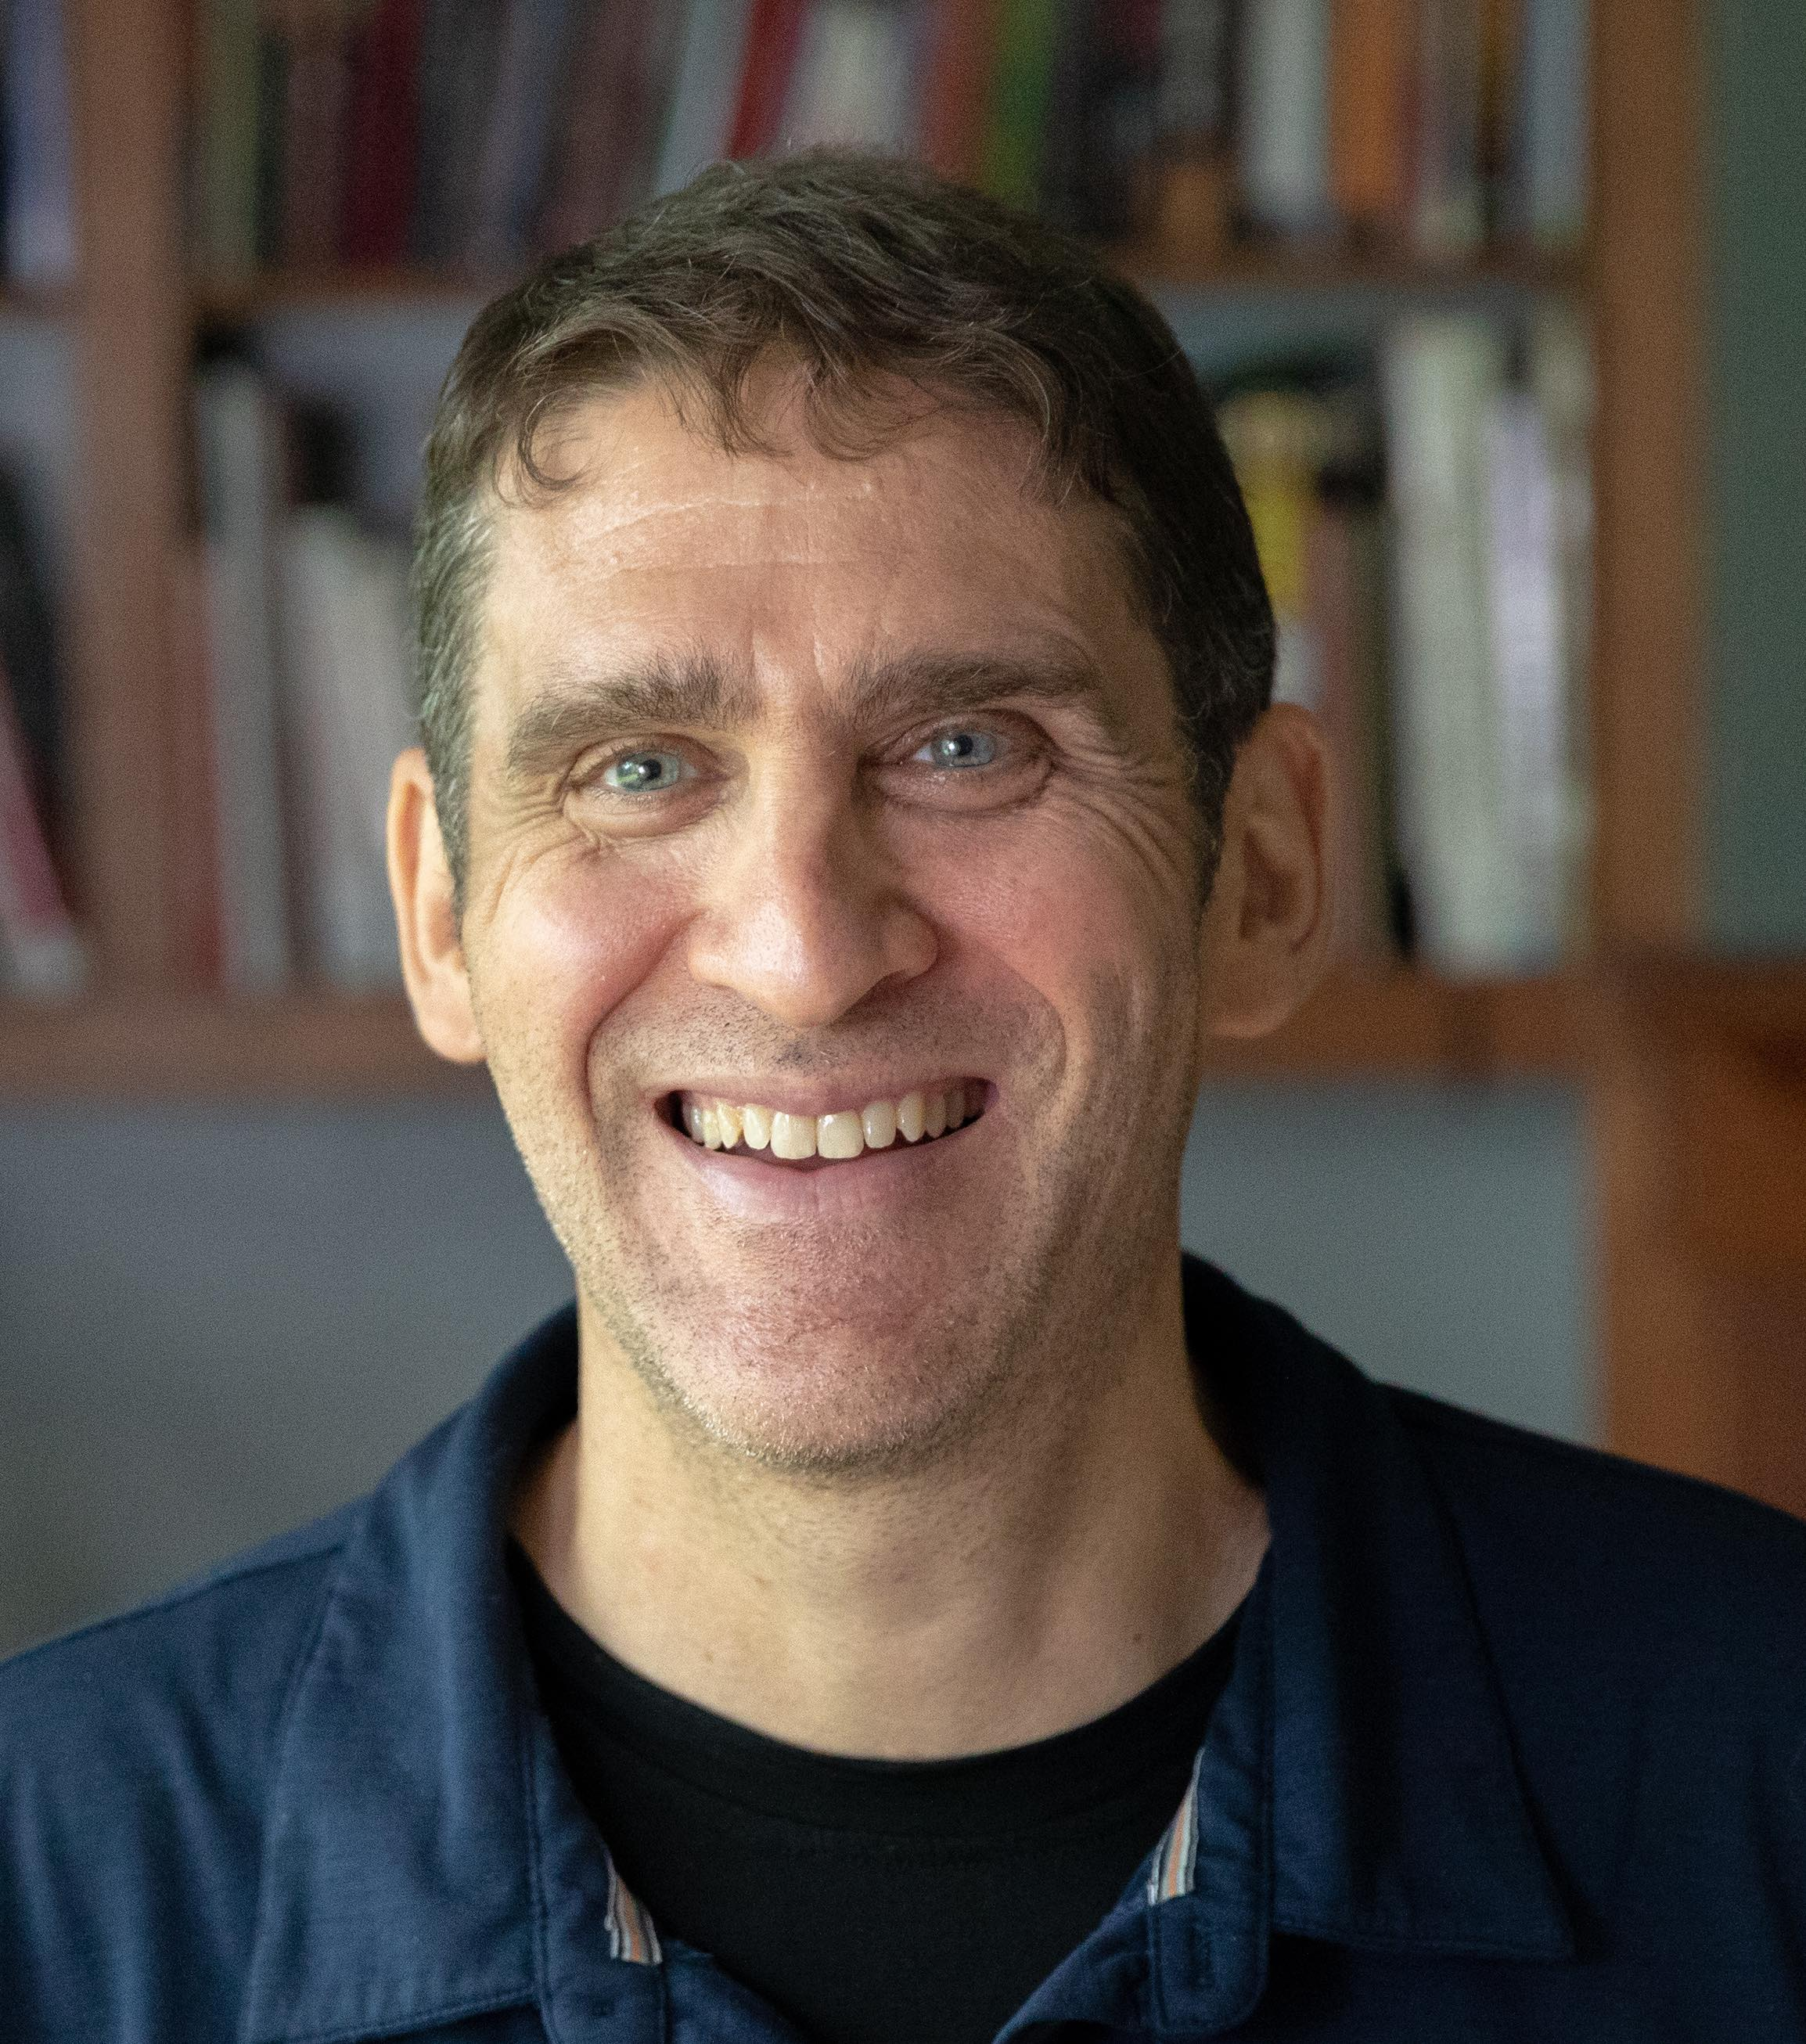
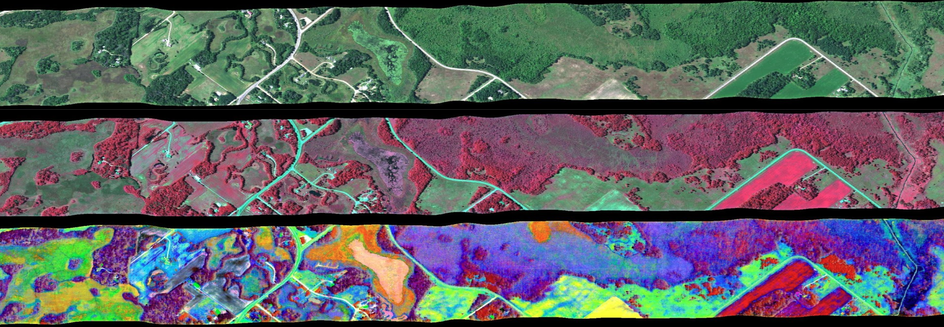
Townsend–ImgSPEC: Cloud-Based On-demand Spectroscopy Processing
Philip Townsend, University of Wisconsin-Madison Natasha Stavros (University of Colorado), Hook Hua, Sujen Shah, Winston Olson-Duvall (JPL)
There is an increasing flood of data such as imaging spectroscopy (aka hyperspectral) data available to the scientific community
Because of its high dimensionality, hyperspectral imagery has great potential for both biodiversity and ecosystem research
There is an ever-growing community of who want to incorporate the products derived from these data sets into their research
These users may not have the resources to generate products from hyperspectral imagery on their own (for example, functional diversity)
ImgSPEC is a prototype of an open-source cloud-based processing system that enables image and algorithm discovery, as well as on-demand product generation

