Slide 1

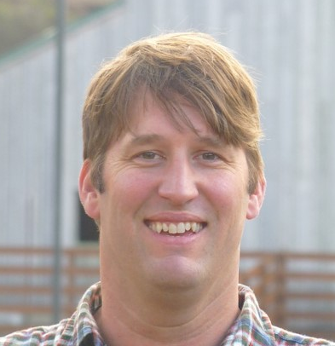


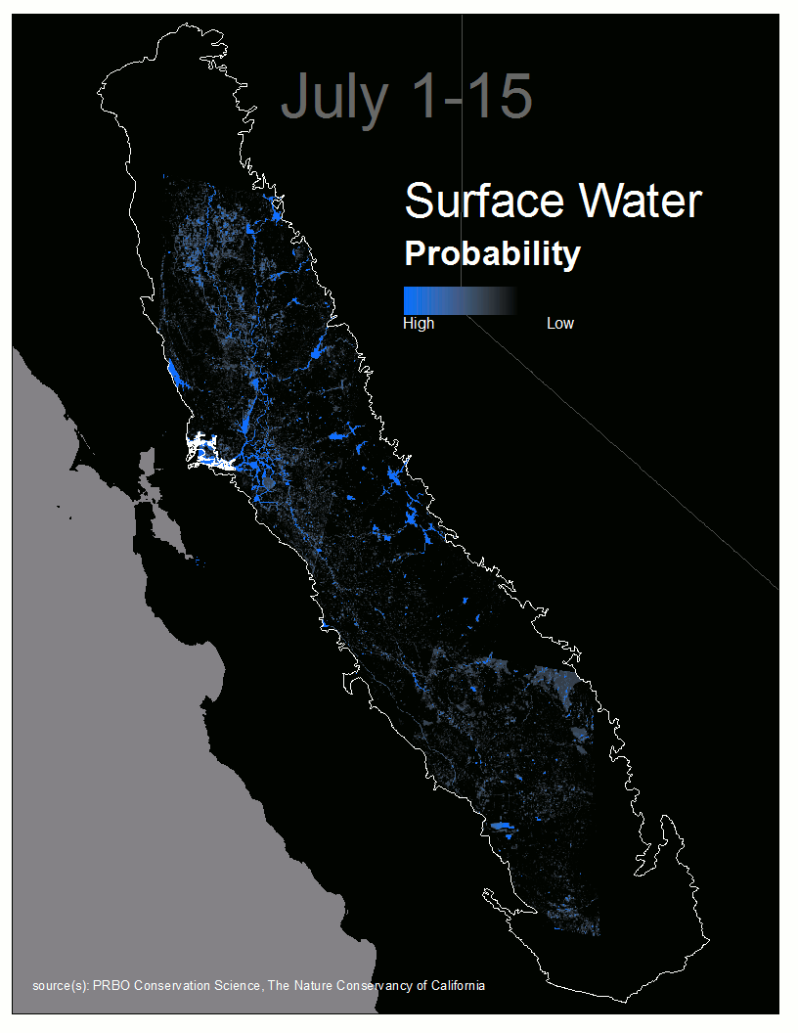
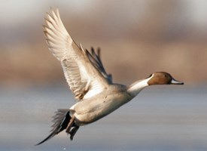
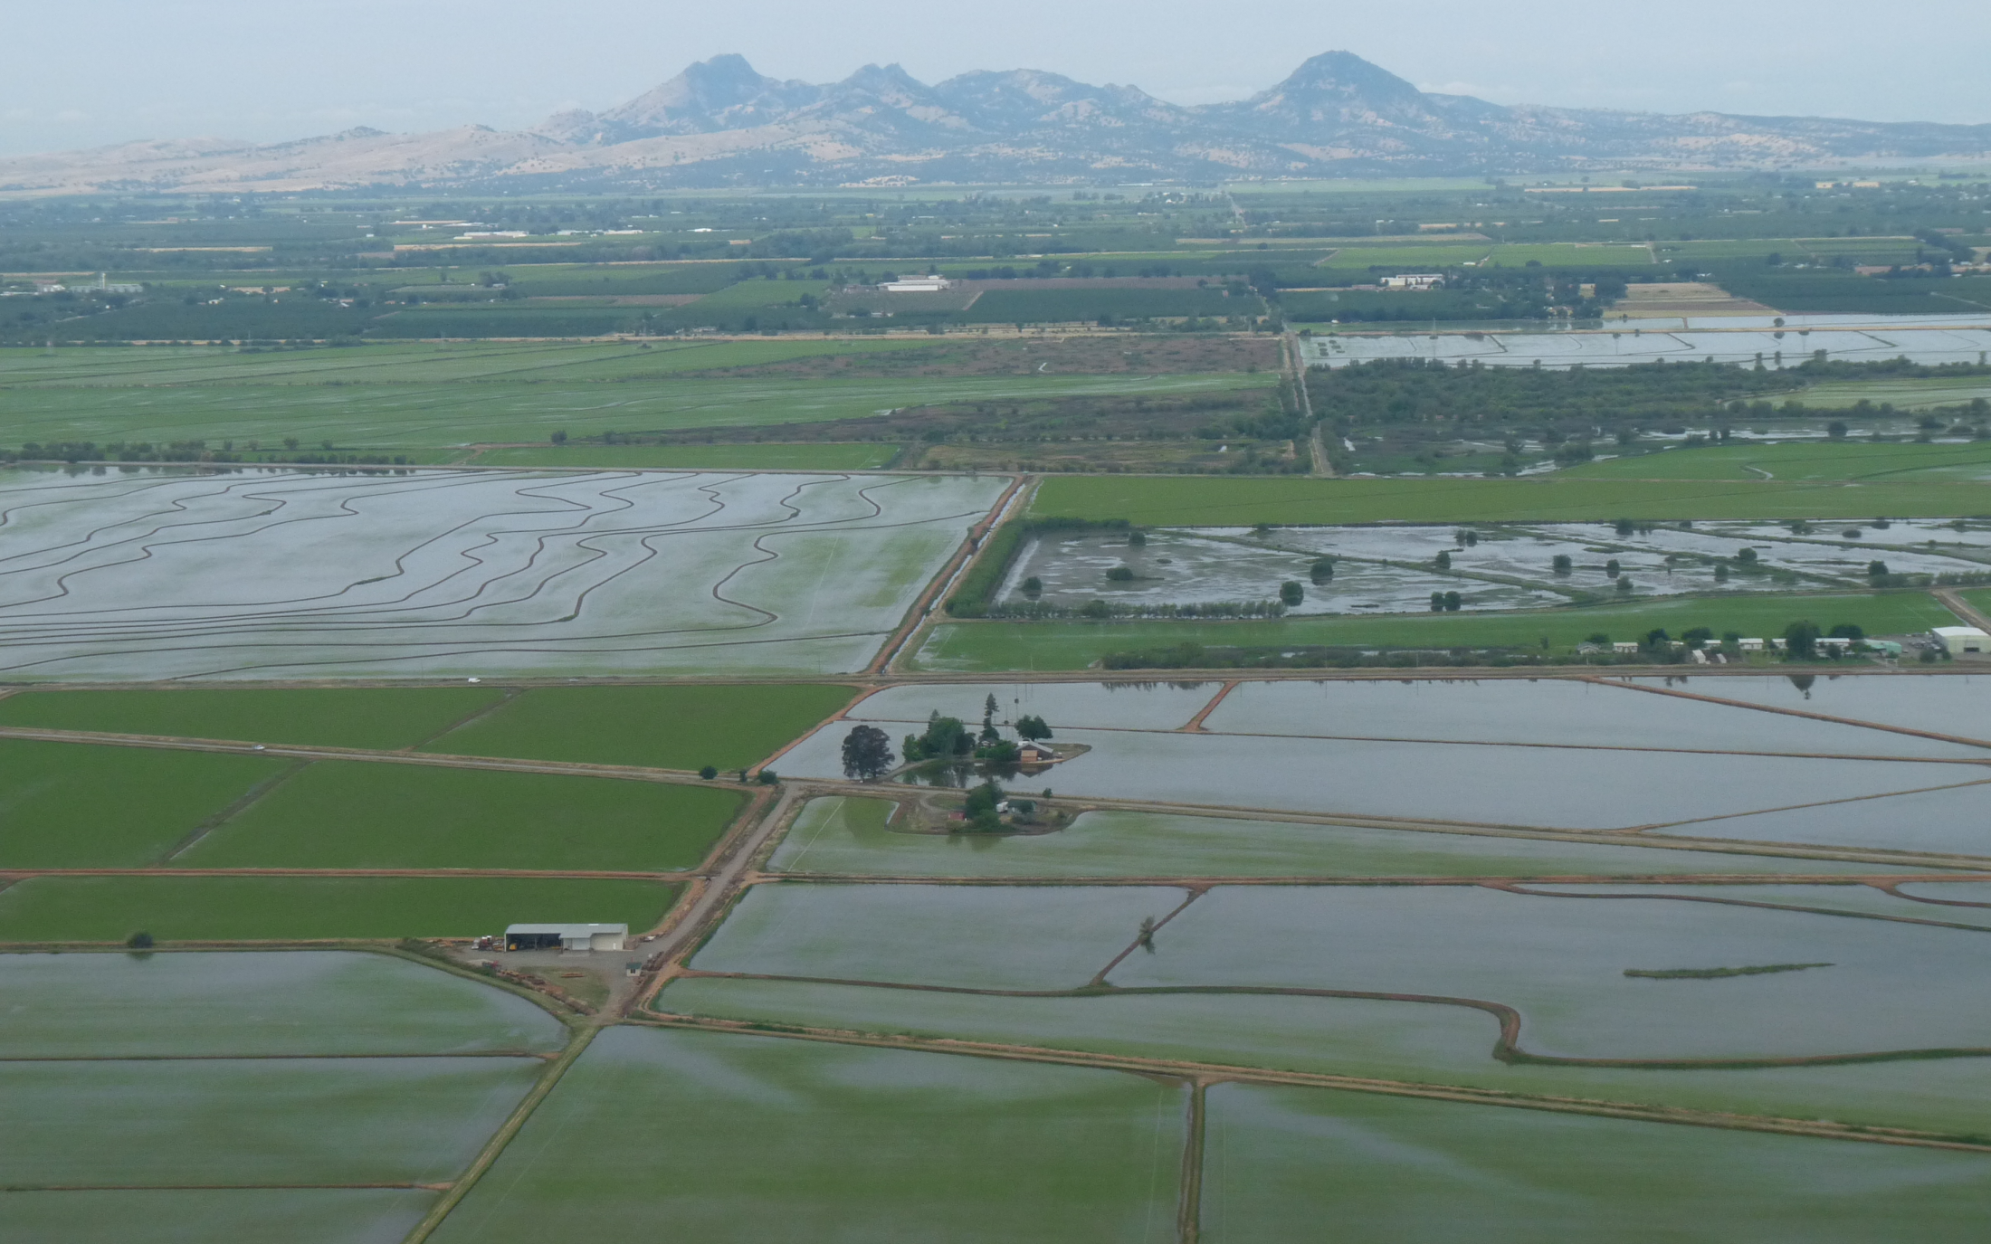

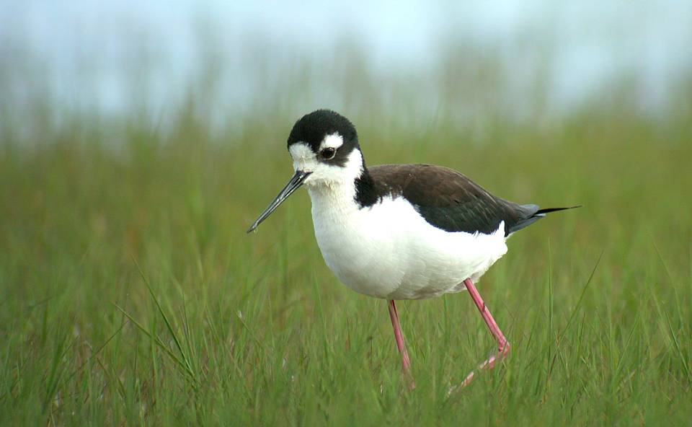


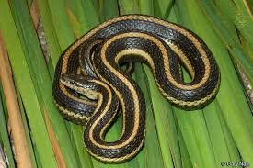



Headshot of yourself
Reiter–Central Valley Water Forecasting for Multiple Benefits
Matthew E. Reiter Ph.D., Point Blue Conservation Science
Kristin Byrd Ph.D., USGS
Where to put water and when to maximize multiple benefits & return on investment?
Coordinated Data-Driven Decision Support Optimizes Water Management to Achieve Multiple-Benefits for today and 100 years from now
Biological Targets
Waterfowl
Shorebirds
Giant Garter Snake
Ecosystem Service Targets
Groundwater Recharge
Freshwater Biodiversity
=
Notes:
Make sure “Last Name-Poster Title” is less than 63 characters as that will be the name of your breakout room
Provide one slide with high-level information to explain what will be shared in your poster session
This slide is not your poster. In your poster breakout room session you can share a pdf, a website, an application, animation, …. The room is yours.
All posters high-level slides for the day will be bundled into one presentation and shown in the plenary session before poster sessions start.
You will have 1 minute to speak to your slide before the slide will change so it is recommended to rehearse timings in PowerPoint (Menu bar Slide Show > Rehearse Timings)

