Slide 1
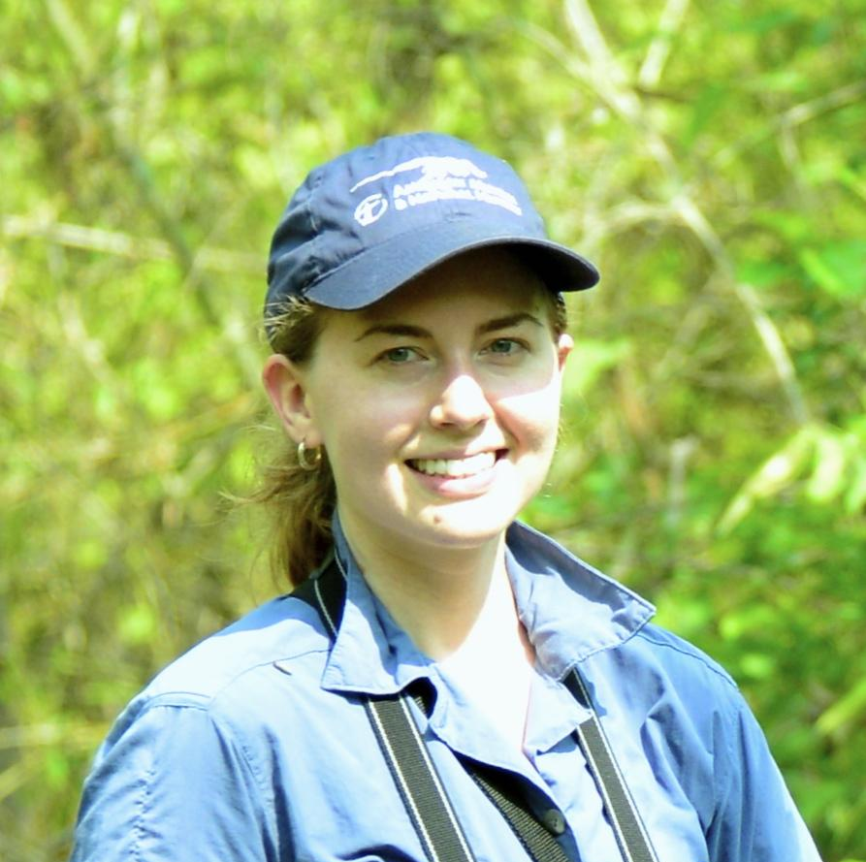
Blair-An integrated biodiversity monitoring system for Colombia
Mary Blair, Center for Biodiversity & Conservation, American Museum of Natural History Co-authors: V. Gutierrez-Velez (Temple U.), P.J. Galante, N. Horning, P. Ersts (AMNH), M.E. Aiello-Lammens (Pace U.), P. Jantz (NAU), J.M. Ochoa, M.C. Londoño, B. Gómez-Valencia, C. Correa-Ayram, J. Burbano-Girón, D. López-Lozano, E. Suarez-Valencia, E.A. Noguera-Urbano (I.Humboldt)
We aim to advance tools to support and test an integrated biodiversity monitoring system for Colombia’s Protected Areas building on current A.50 NASA projects in partnership with the Colombia Biodiversity Observation Network (BON), which have developed:
tools for modeling and mapping species distributions
decision-support infrastructure and tools related to ecosystem distribution and biodiversity indicators
new remote-sensing based datasets on ecosystem structure.
By integrating these tools and datasets, we will generate new information on species, community, and ecosystem representativeness and protected area connectivity in Colombia to deliver a dynamically updated information and monitoring system for Colombia's biodiversity.
The project will inform key decisions about protected area design and monitoring plan strategies in Colombia towards 2030 biodiversity targets.
Notes:
Make sure “Last Name-Poster Title” is less than 63 characters as that will be the name of your breakout room
Provide one slide with high-level information to explain what will be shared in your poster session
This slide is not your poster. In your poster breakout room session you can share a pdf, a website, an application, animation, …. The room is yours.
All posters high-level slides for the day will be bundled into one presentation and shown in the plenary session before poster sessions start.
You will have 1 minute to speak to your slide before the slide will change so it is recommended to rehearse timings in PowerPoint (Menu bar Slide Show > Rehearse Timings)

