Slide 1
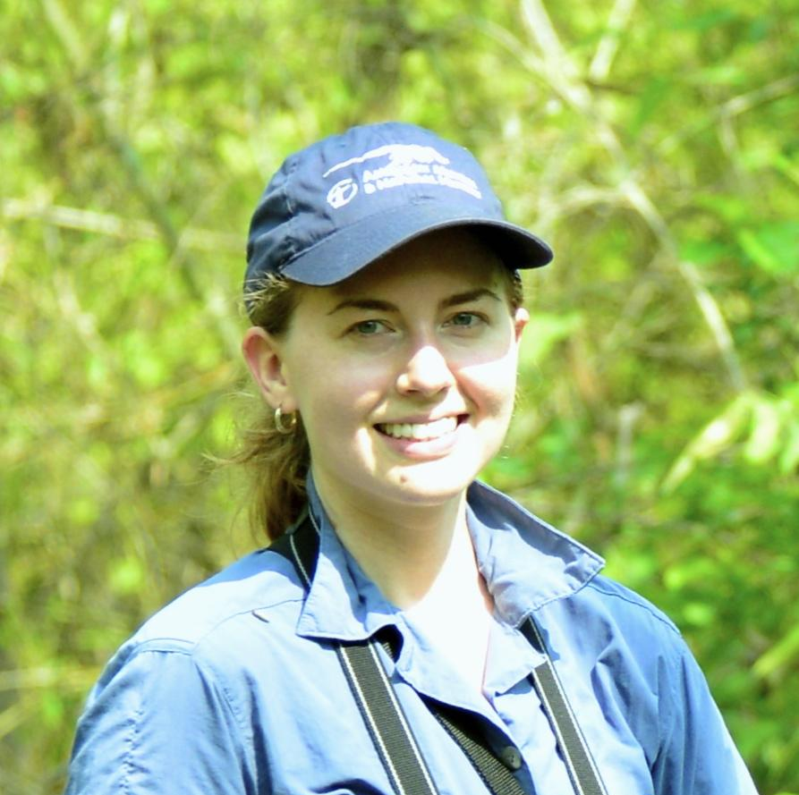
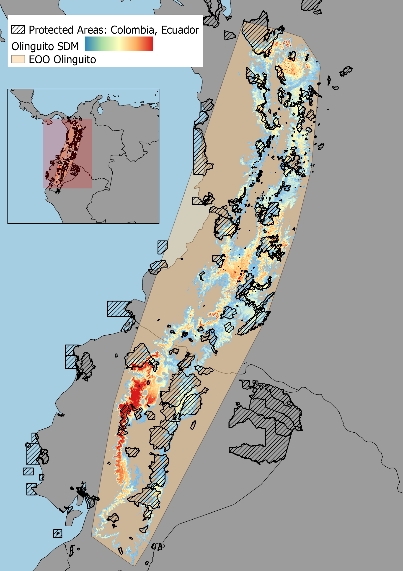
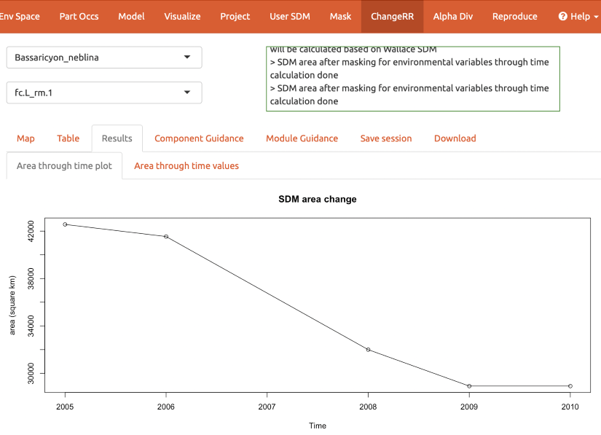
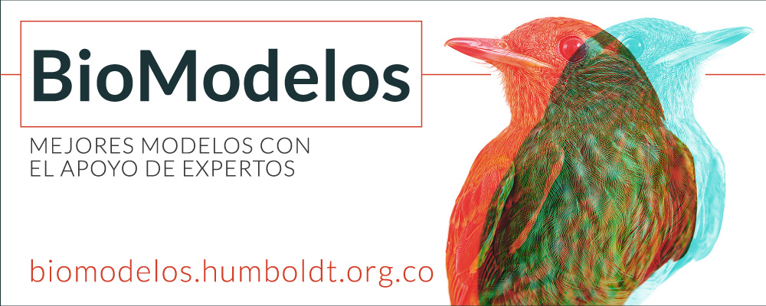
Blair-Expanding Wallace, a tool for species distribution modeling
Mary Blair, Center for Biodiversity & Conservation, American Museum of Natural History Co-authors: P.J. Galante, N. Horning, P. Ersts (AMNH), M.E. Aiello-Lammens, S. Chang (Pace U.), B.E. Gerstner (Michigan State), V. Grisales-Betancur (U. Eafít), J.M. Kass (OIST), C. Merow (UCONN), D. López-Lozano, E. Suarez-Valencia, E.A. Noguera-Urbano (I. A. V. Humboldt), J. Velásquez-Tibatá (Audubon), B. Johnson, G.E. Pinilla-Buitrago, A. Paz, R.P. Anderson (CCNY-CUNY)
Wallace is an R-based, user-friendly, modular application for reproducible modeling of species distributions (SDMs).
We expanded Wallace as a tool for assessment and reporting by Biodiversity Observation Networks (BONs) by developing two new R packages and adding them to Wallace as modules. The new packages leverage Remote Sensing products to post-process SDMs to estimate current ranges and calculate key biodiversity indicators and their change over time & space.
We also integrated Wallace with the Colombia BON's existing BON in a Box tool BioModelos to facilitate updating of species' range and indicator calculations.
Notes:
Note that this was funded through NASA’s GEO BON work program.

