Slide 1
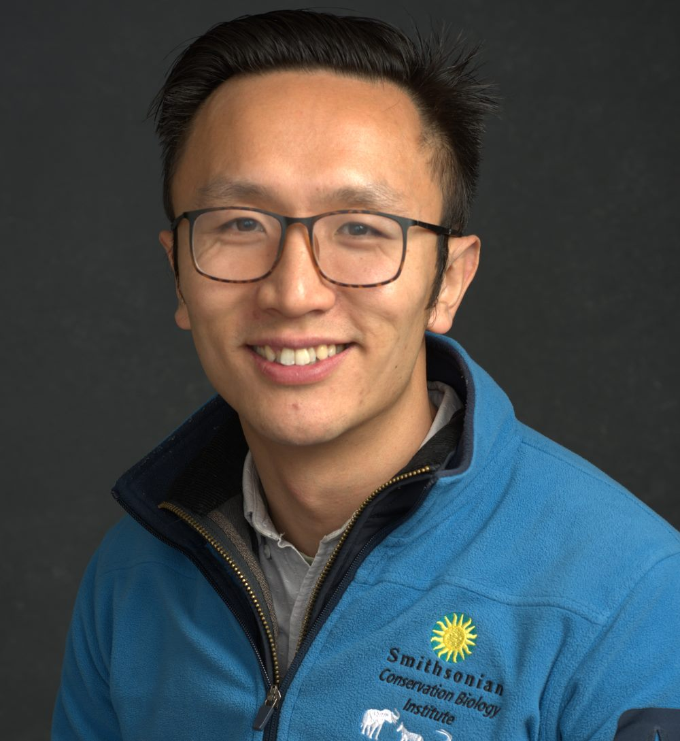
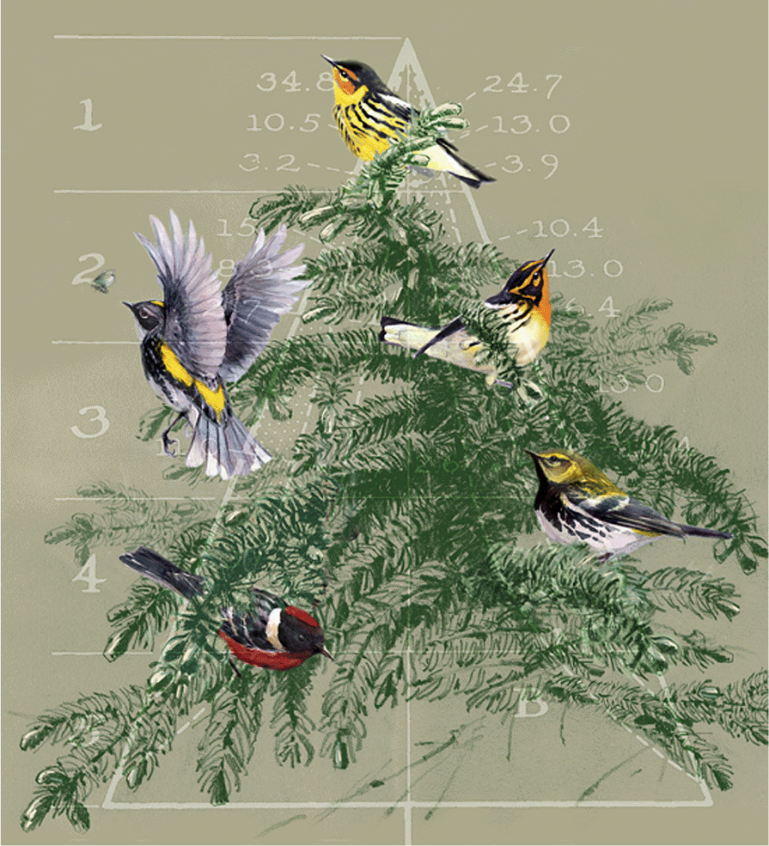
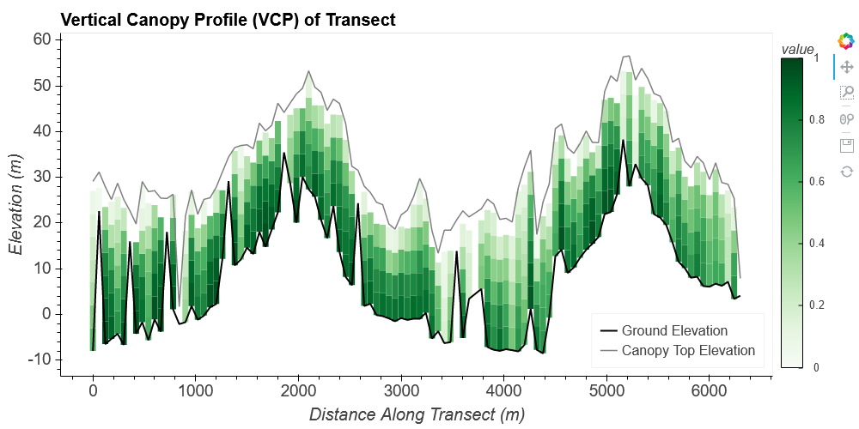
Headshot of yourself
Huang–Power of GEDI: Tools to Map Habitat Heterogeneity & Biodiversity
Qiongyu Huang, Smithsonian Conservation Biology Institute Jin Xu, Volker Radeloff
2020 New Investigator in Earth Science Program Project
Research Objectives:
1. Model avian richness in Western Hemisphere (BBS & eBird datasets).
2. Produce novel habitat heterogeneity products with global coverage.
3. Examine model efficacies in explaining global bird, amphibian, and mammal richness with and without the novel heterogeneity metrics.
Background
Vegetation’s three-dimensional (3-D) structure is a key predictor of biodiversity.
The availability of GEDI data provides an opportunity to evaluate the importance of habitat vertical structure on biodiversity at broad scales.

