Slide 1
Manila Observatory CHECSM Site
James Bernard Simpas, Maria Obiminda Cambaliza, Shane Marie Visaga, Larry Ger Aragon, Angela Monina Magnaye, Paola Angela Bañaga, Grace Betito, Faye Abigail Cruz, Julie Mae Dado, Marco Polo Ibañez, Lyndon Mark Olaguera, Leia Pauline Tonga, Vincent Topacio, Gemma Teresa Narisma+

Slide 2
CHECSM Overview: History & Instrument Status
Jul 2018 - U of Arizona team MOUDI installation and training of MO researchers
Sep 2018 - Betsy Reid with US-NRL and U of Colorado instruments
Dec 2018 - Ilya Razenkov UW-HSRL installation
Jun 2019 - UC-Davis DRUM Sampler
Aug - Oct 2019 - CAMP2Ex
Jun 2020 - HSRL last measurements (pack-up and return TBA)
Jun 2021 - MOUDI ship back to U of Arizona
Ongoing measurements for most deployed instruments

Slide 3
Manila Observatory CHECSM Research
Clouds and Pollution
Cirrus Clouds
Manila PBL Height
Factors affecting Surface Aerosol Loading
Monsoon Meteorology and Convection:
Disdrometer Rainfall Characteristics
Radiation Measurements: Applications in Forecasting (Energy, Climate and Weather)
Using the broadband SPN data for the Wet Bulb Globe Temperature (WBGT) Heat Stress Index
Validation of WRF-Solar Forecasts over Manila Observatory using the broadband SPN data for clear and cloudy sky cases
Notes:
Doc James/ Doc obie (intro) - research done using the CHECSM instruments Each researcher

Slide 4
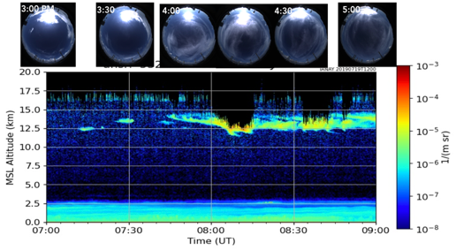
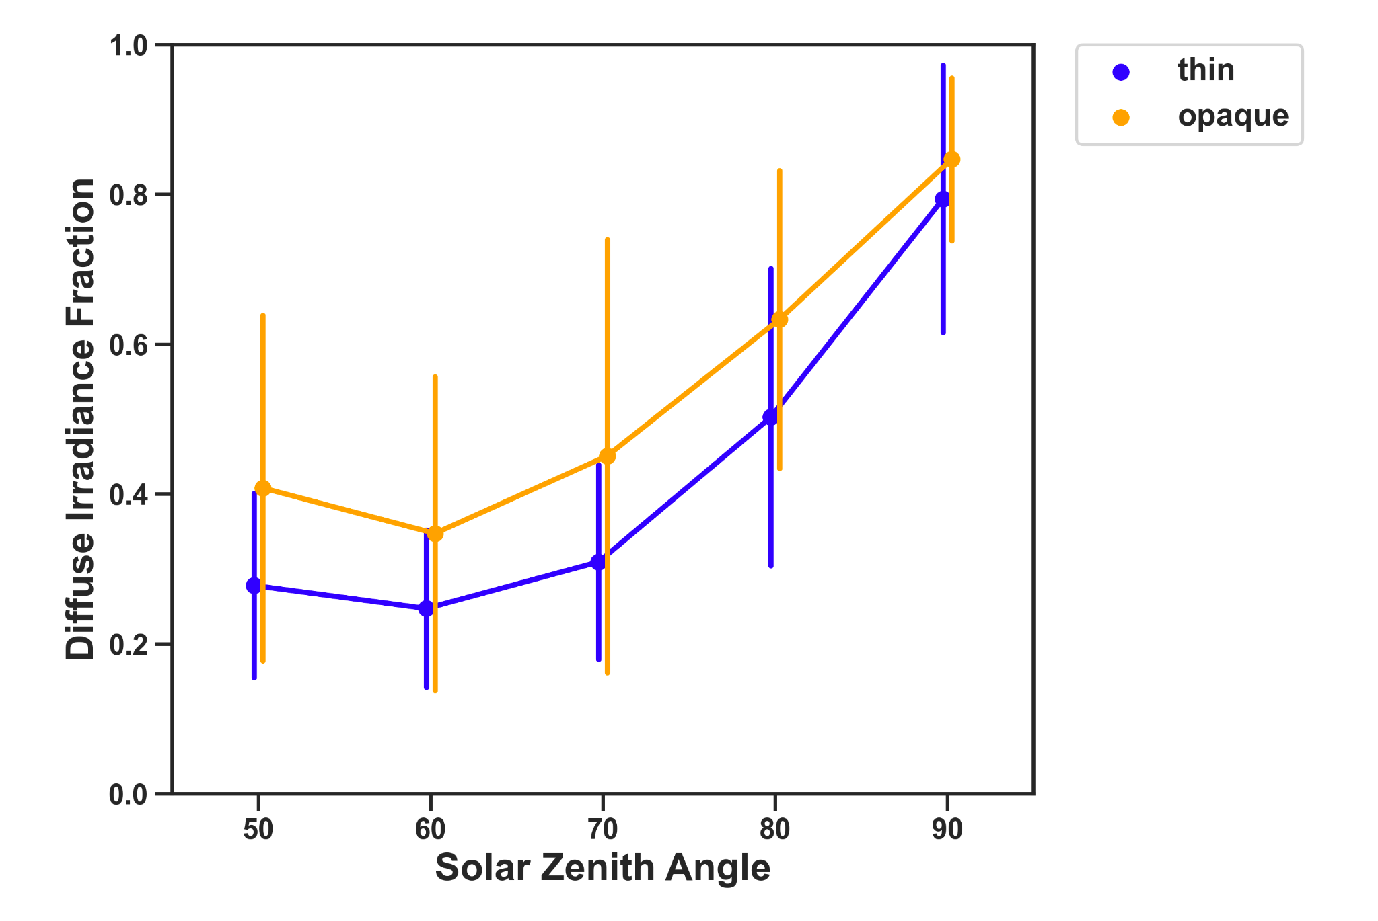
CHECSM: Cirrus Clouds
Zenith & Hemispherical Measurements
Diffuse Irradiance Fraction of Cirrus Clouds
opaque cirrus
thin cirrus
higher F_{diffuse} as the solar zenith angle increases or when the sun is at closer to the horizon
opaque cirrus have higher mean F_{diffuse} than the thin cirrus for specified solar zenith angle range.
next steps: cirrus cloud optical depth effects on PBL Height
Snapshot of the Hemisphere from July 19, 2019 3:00 to 5:00 PM PHT from the All-Sky Camera collocated with the HSRL and the SPN1 and b) HSRL aerosol backscatter cross section measurements for the same time period with labels in UTC.
Cirrus Cloud Detection Algorithm (Pagano et al., 2020)

Slide 5
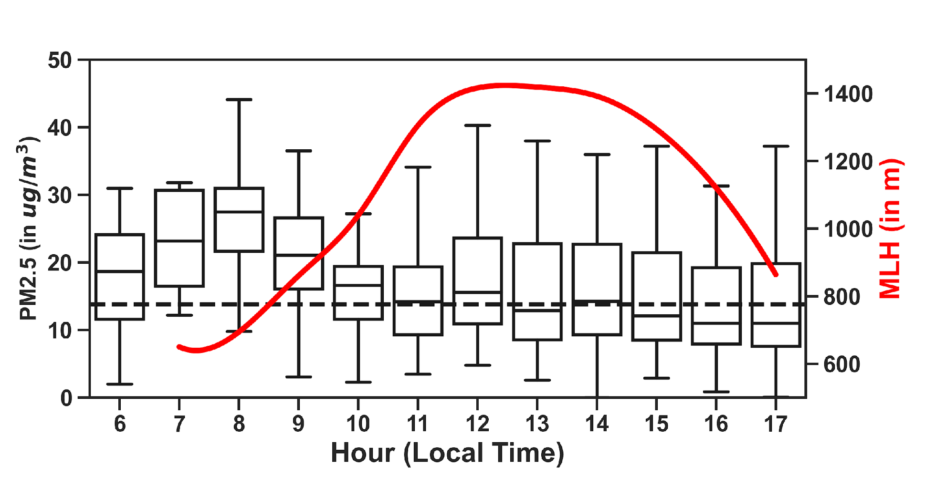
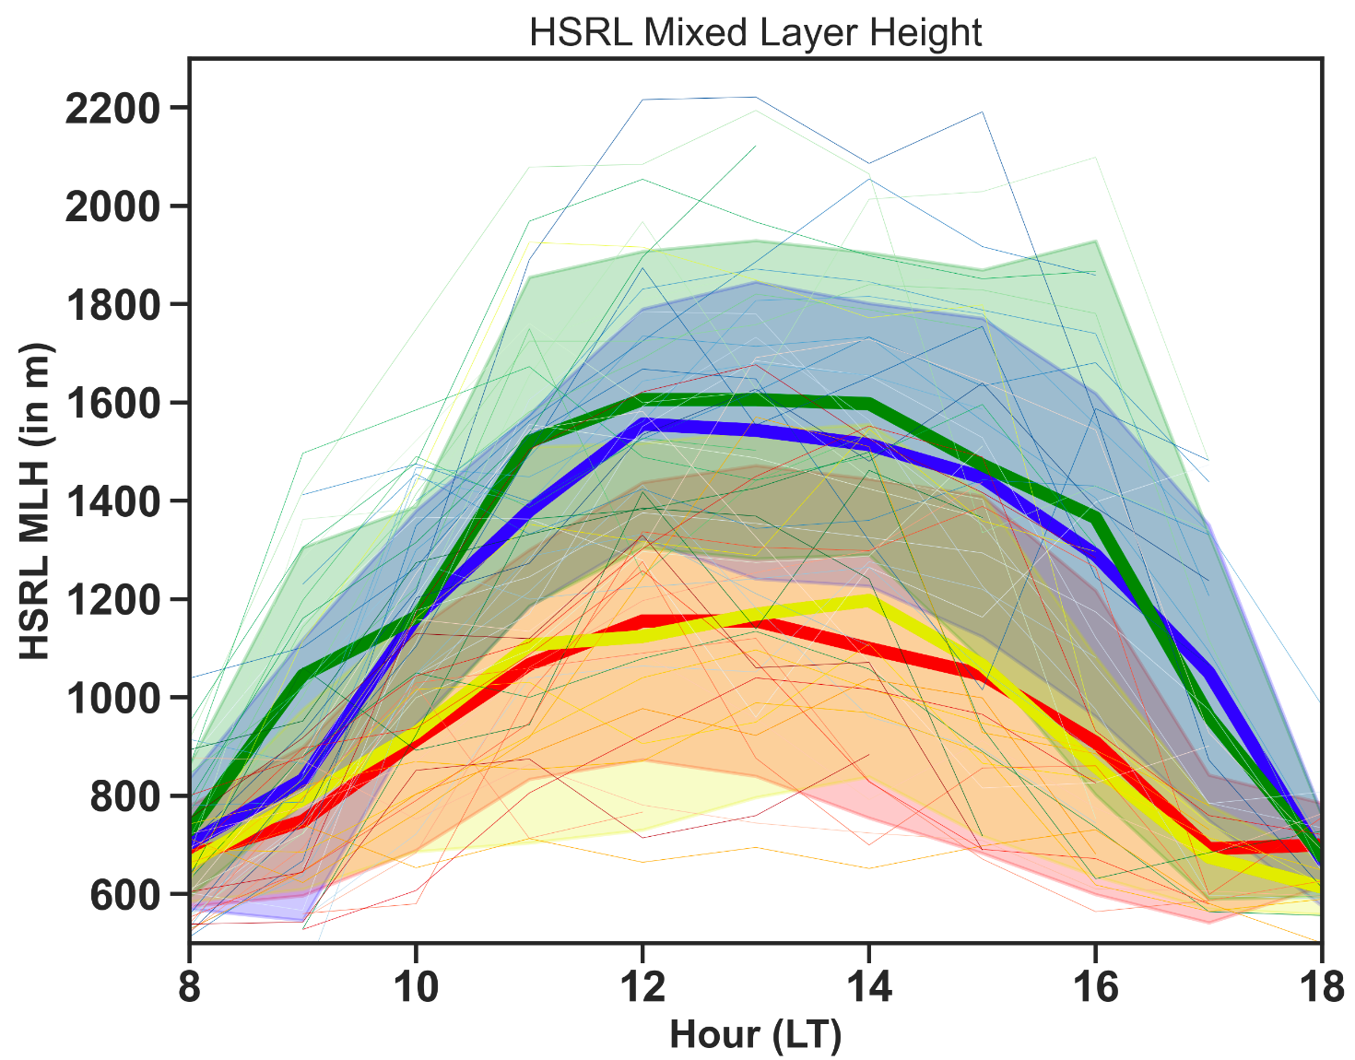
CHECSM Pollution: Manila PBL Height
2019 Seasonal PBL Height from HSRL
PBLH - PM2.5 relationship
highest surface concentrations in the morning (0700-0900 LT) due to low PBLH and morning rush hour
PBL continues to grow (slower) until 1200 LT; partially contributing to dilution of surface concentrations
lower PBLH from Jul- Nov 2019 (CAMP2Ex period)
maximum PBLH from 1200 - 1400 across seasons

Slide 6
CHECSM Pollution: Factors affecting Surface Aerosol Loading
PBLH and Wind Effects on Surface Concentrations
500 – m Integrated Aerosol Backscatter Cross Section (aerosol tracer) and surface PM2.5 decrease as the PBLH increases. Inverse-fit adapted from Su et al., 2018 and Xiang et al., 2019
There is a general decrease in 500-m integrated aerosol backscatter as the PBL grows
But observed better coupling with wind speeds for certain cases; as winds get stronger, less aerosols remain (by entrainment and horizontal advection )

Slide 7
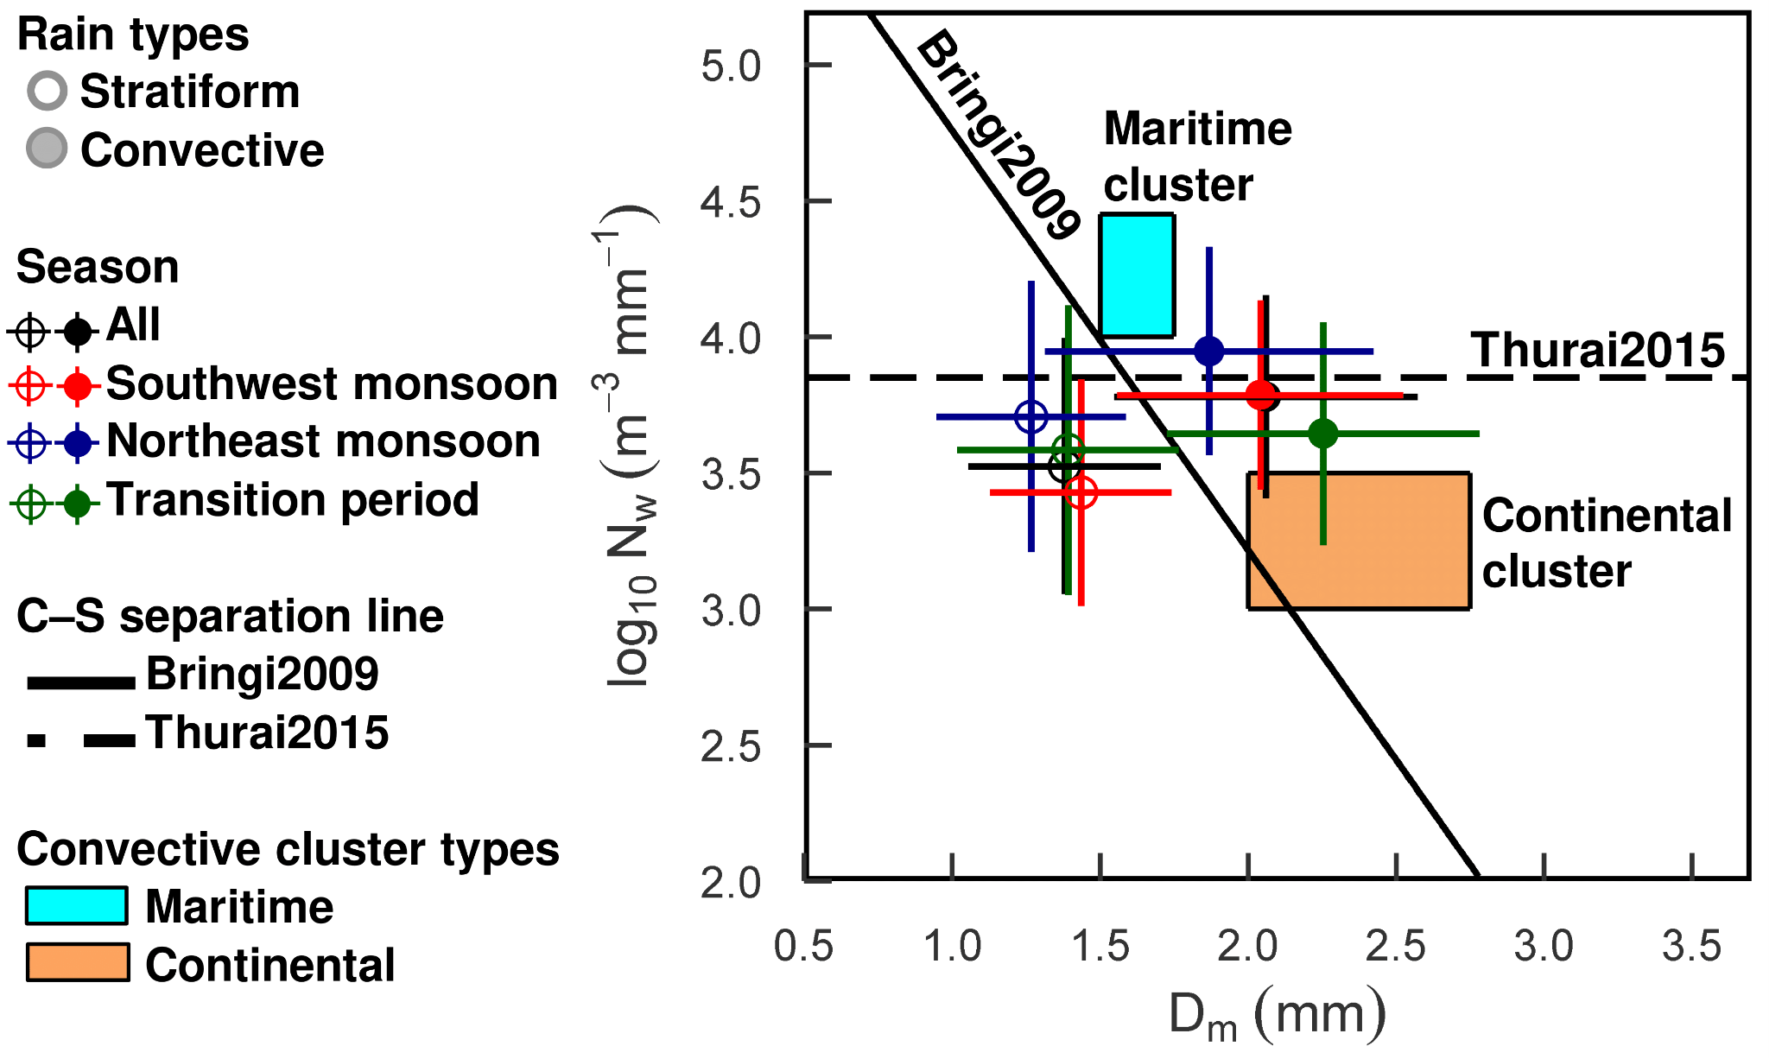
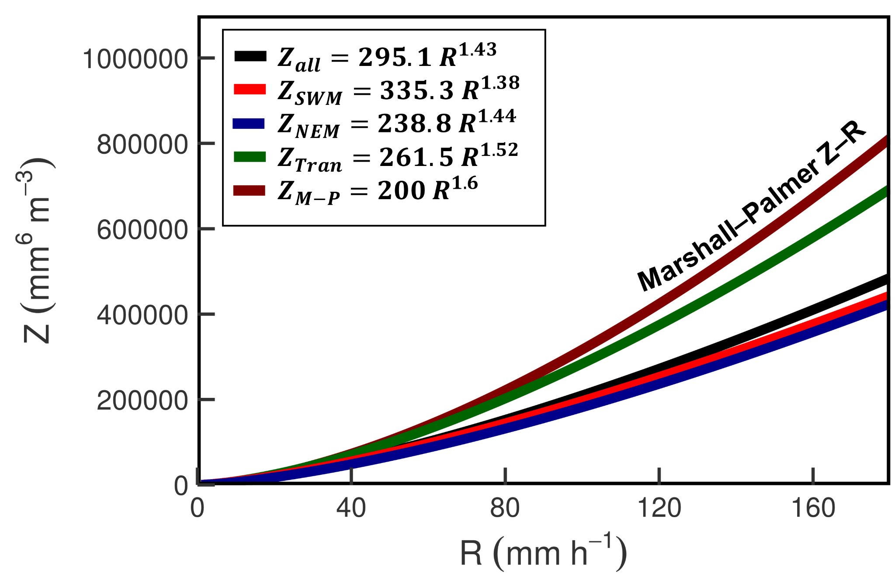
Monsoon Meteorology and Convection: Disdrometer rainfall characteristics
Number-size distribution plot (N_{w} - D_{m} plot)
Empirical Marshall–Palmer and seasonal
radar reflectivity–rain rate (Z–R) relations
Metro Manila rainfall generally comes from warm clouds that exhibit both liquid and ice microphysical processes; convective rainfall in Metro Manila is related to both maritime and continental rainfall.
Northeast Monsoon period - high number concentration of relatively smaller raindrops;
Transition period - high number concentration of relatively larger raindrops;
Southwest Monsoon period - rainfall characteristics is in-between NEM and Transition.
The Marshall-Palmer Z–R relation is likely to underestimate heavy rains in Metro Manila especially during the two monsoon periods.

Slide 8
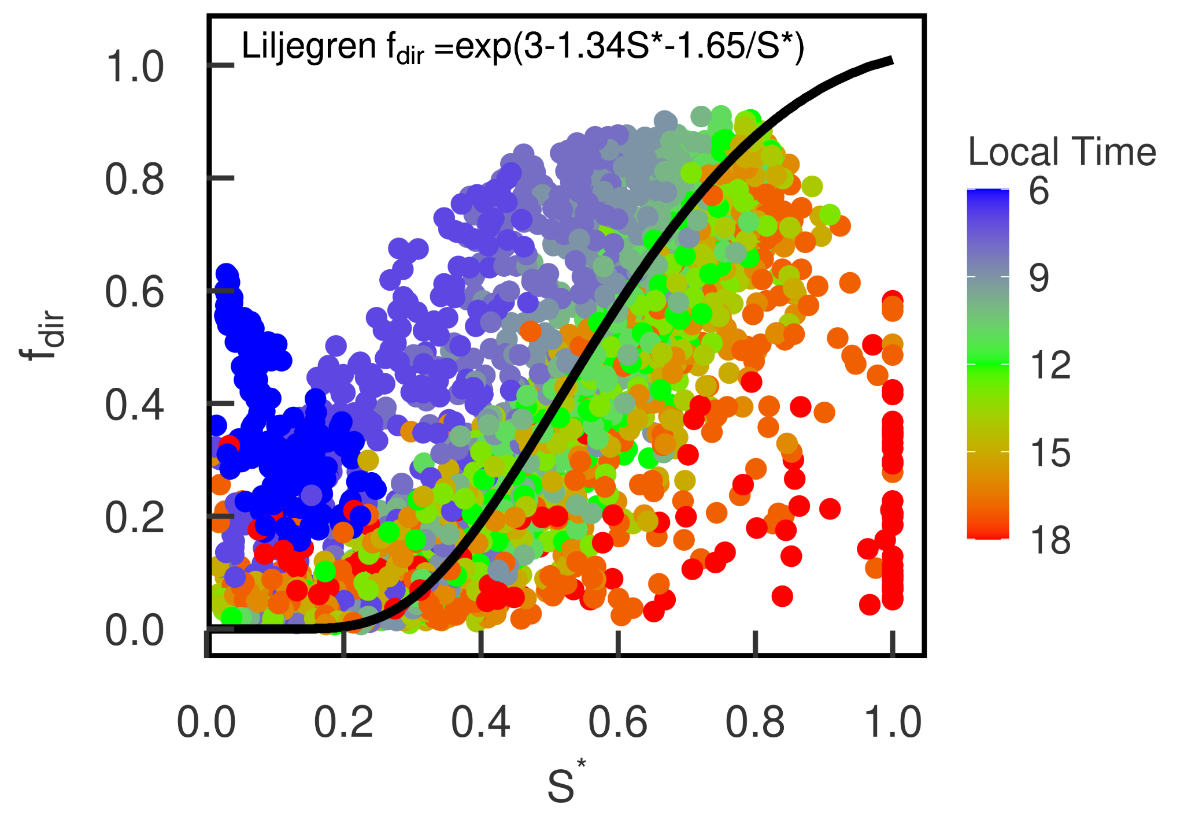
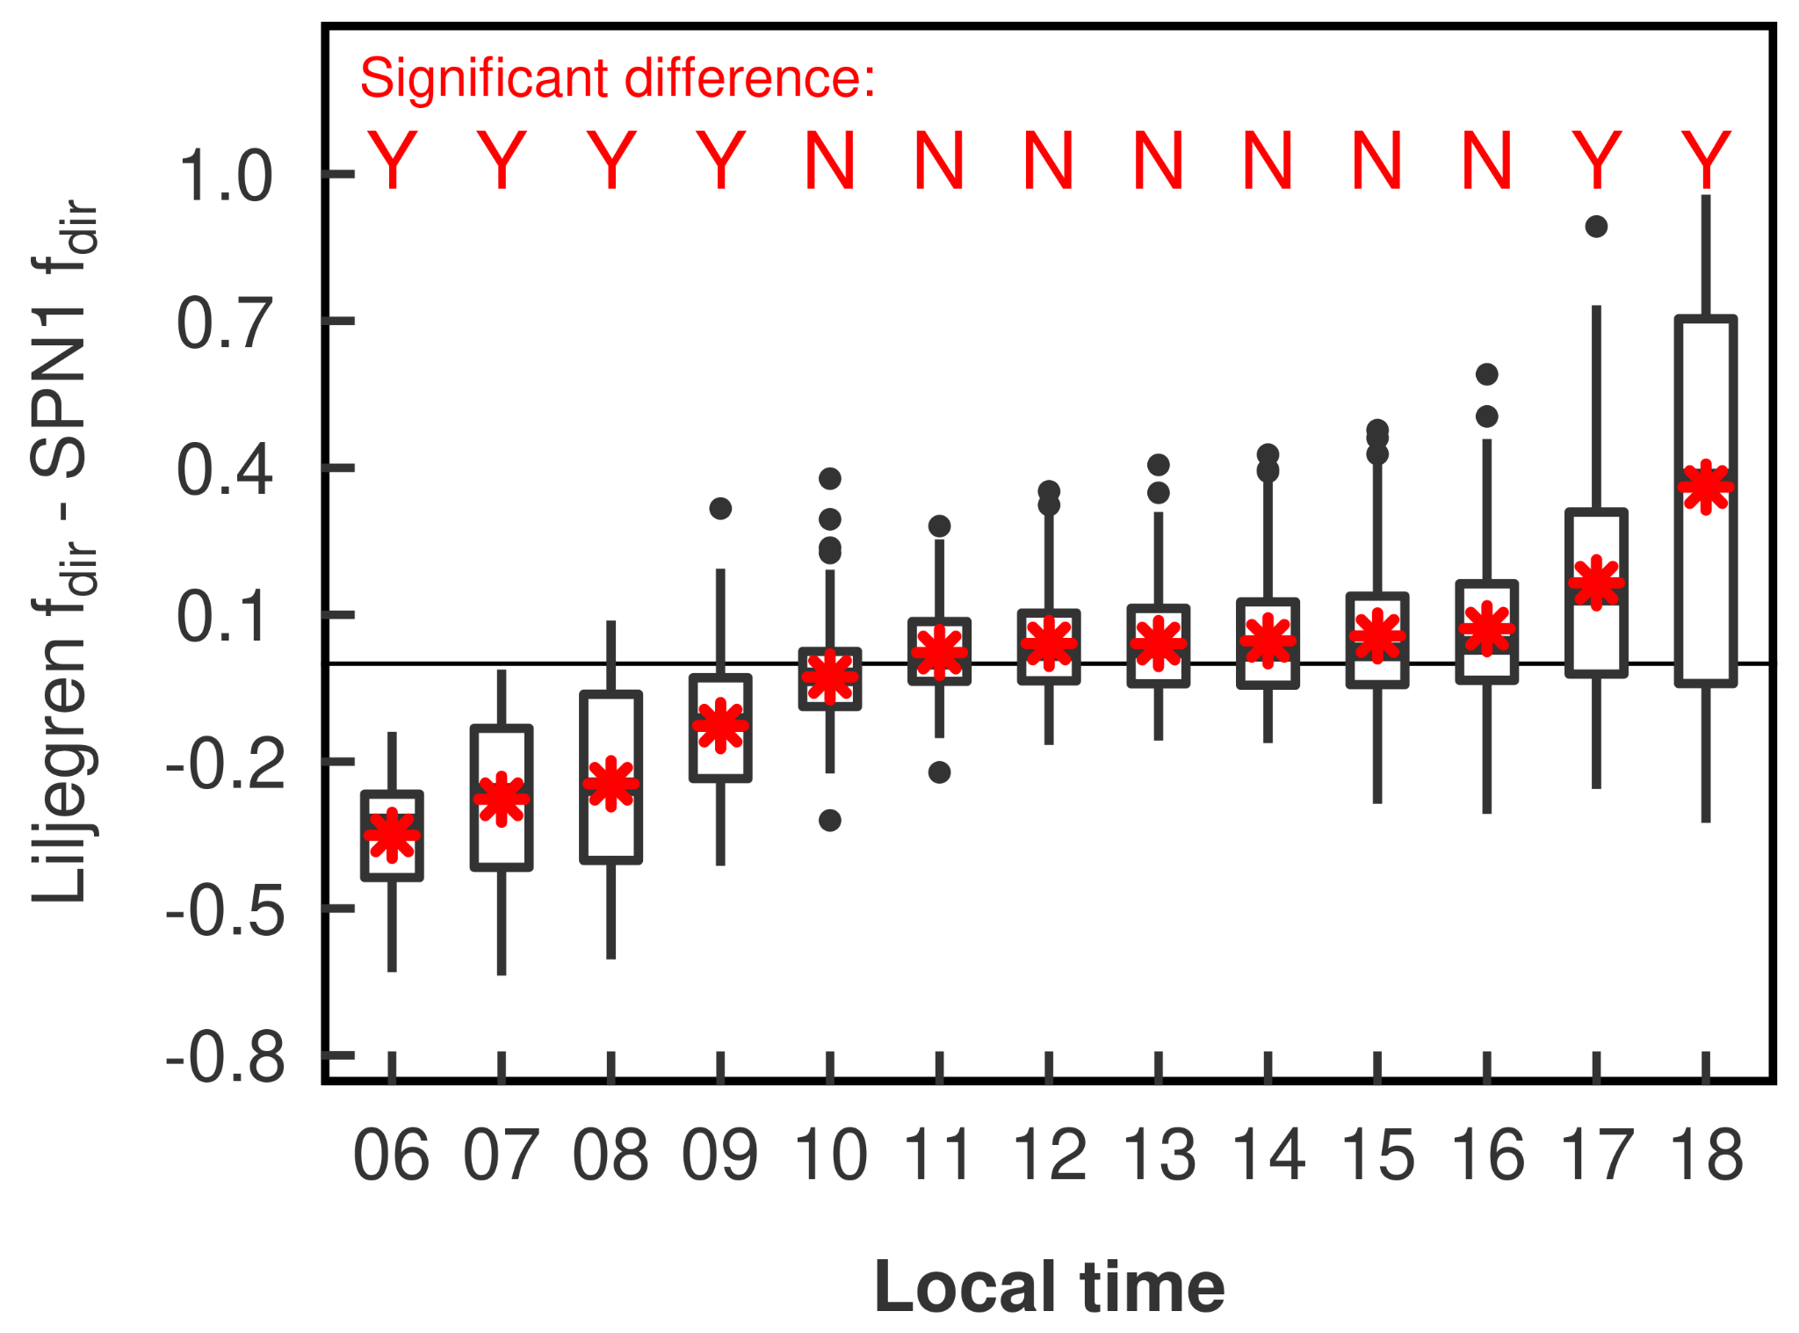
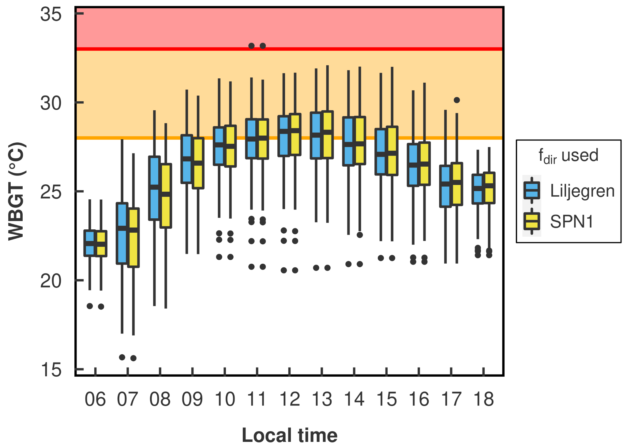
f_{dir}–S* validation using SPN1 pyranometer for
WBGT estimation
Heat warning for potential events that require health-related actions
Wetbulb Globe temperature (WBGT): heat stress index for outdoor conditions
SPN1 f_{dir}–S* scatterplot with Liljegren f_{dir}–S* curve
Difference b/w SPN1 f_{dir} and Liljegren f_{dir}
WBGT using Liljegren f_{dir} and SPN1 f_{dir}
S* = S/S_{max}
Mid-day values follow Liljegren
No significant difference from 10:00 - 16:00 LT
WBGT estimation using Liljegren good for mid-day, when max heat stress is expected
Maximum health risk
Work/rest
cycle needed

Slide 9
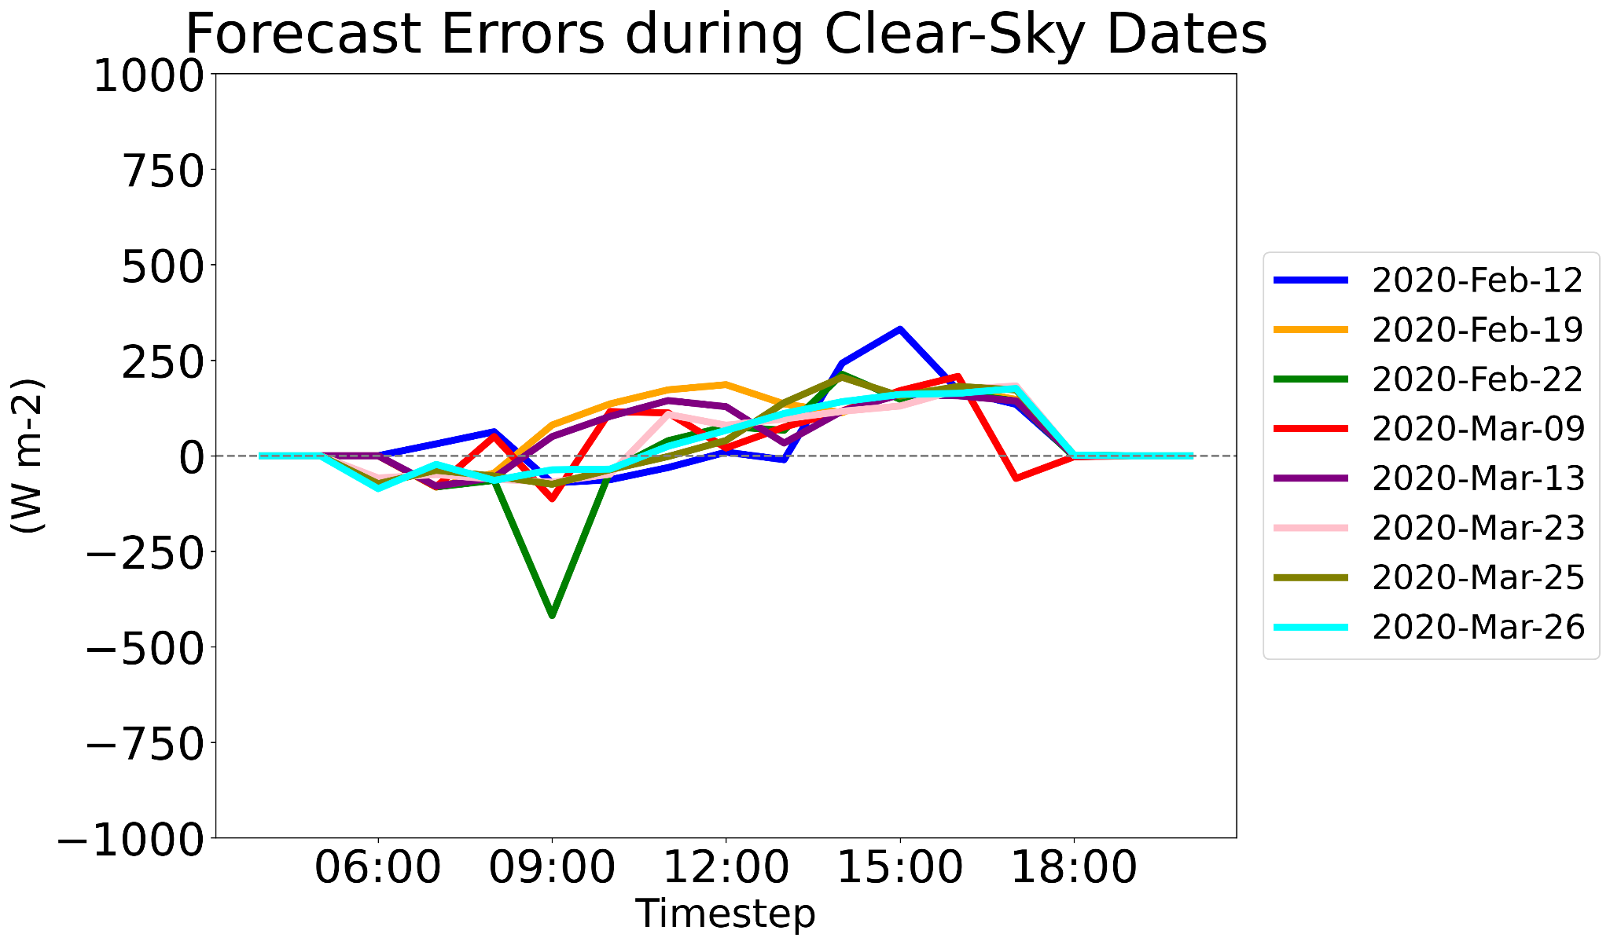
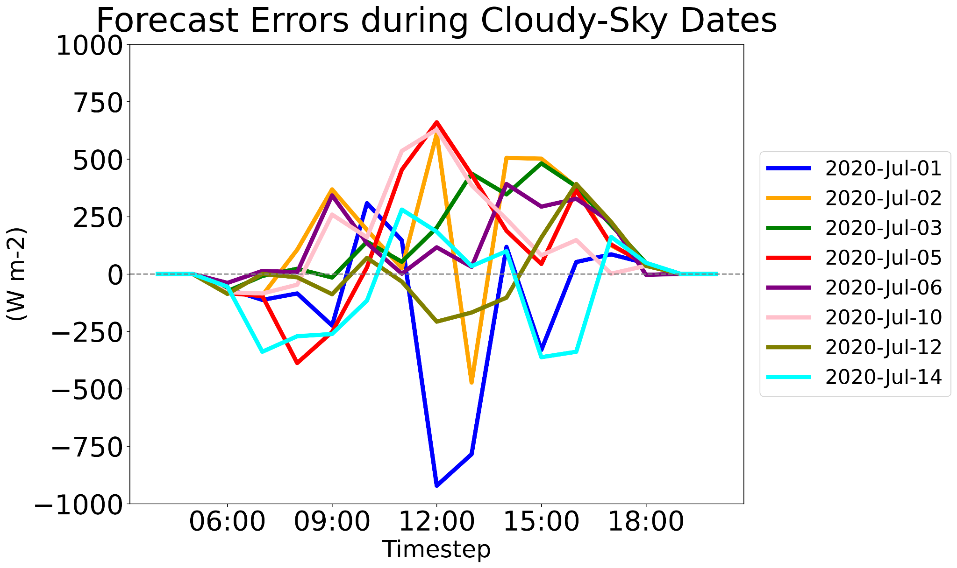
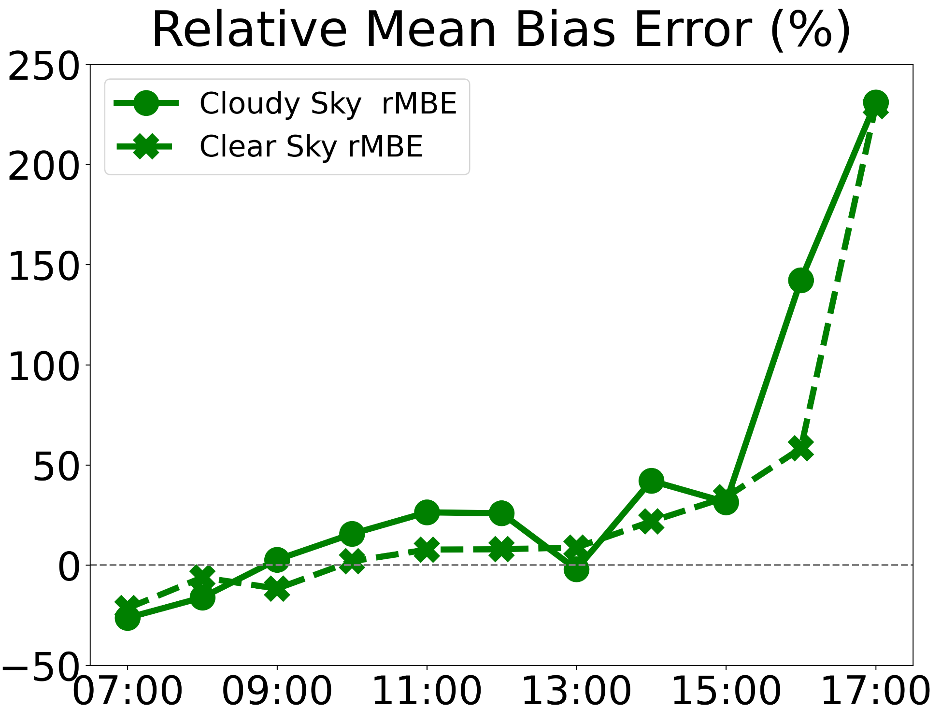
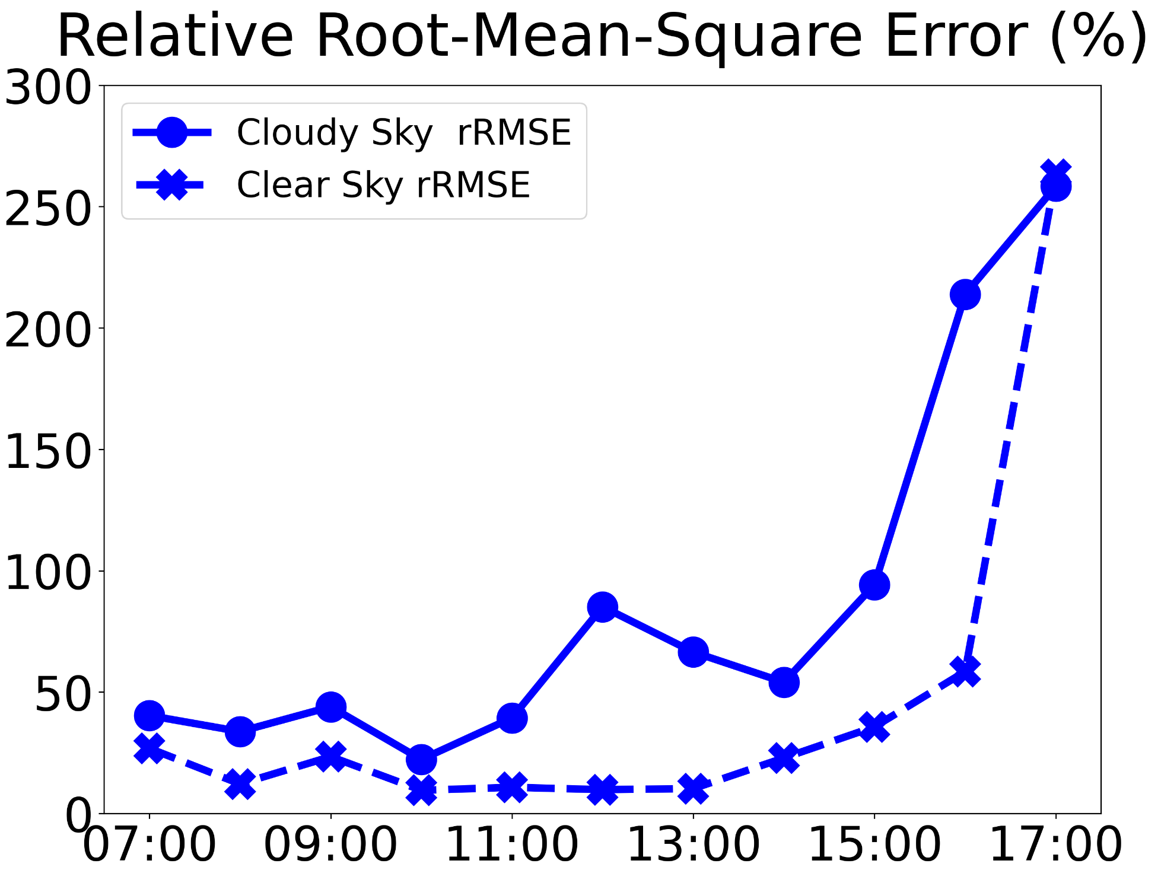
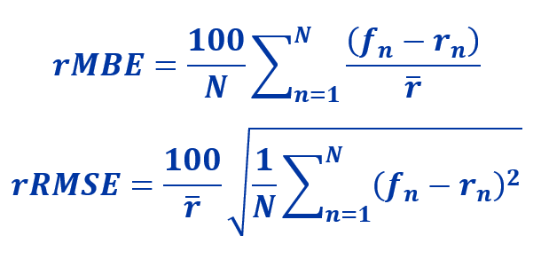
Validation of WRF-Solar Forecasts over Manila Observatory using SPN1 pyranometer
WRF-Solar v4.2.2
(Jimenez et al., 2016)
5 x 5 km horizontal grid resolution
input: NCEP GFS (0.25° grid, hourly)
GHI=(DNI*COSZEN)+DHI
GHI: Global Horizontal Irradiance [W/m²]
DNI: Direct Normal Irradiance [W/m²]
DHI: Diffuse Horizontal Irradiance [W/m²]
COSZEN: Cosine(Solar Zenith Angle)
Forecast Error = WRF - SPN1
(a) clear sky: WRF-Solar underestimates morning and overestimates evening observed GHI
(b) cloudy sky: WRF-Solar mostly overestimates observed GHI
(c,d) both cases: as the day proceeds, magnitude error increases (can be due to timing error)
(a)
(b)
GHI (W/m²)
GHI (W/m²)
PHT
PHT
(c)
(d)
rMBE (%)
rRMSE (%)
PHT
PHT
Notes:
We further used data from SPN1 pyranometer deployed at MO by validating WRF-Solar forecasts, specifically the simulated GHI (global horizontal irradiance). WRF-Solar is a tailored version of NCAR’s Weather Research and Forecasting model. The input is NCEP GFS forecast model at 0.25 degree grid resolution and hourly temporal resolution. We downscaled it at a 5-km grid resolution over the Philippines. We compared the model GHI and observed GHI derived from SPN1. GHI is direct normal irradiance times the cosine of the zenith with added direct horizontal irradiance. The purpose of this study is mainly for solar energy applications, and from our preliminary tests, we selected a couple of clear sky dates and cloudy sky dates from HSRL data.
For forecast error during clear sky dates, in figure (a) or the upper left plot, the x-axis is the hourly evolution in local time, y-axis is the GHI forecast error. Preliminary results show that during clear sky conditions the model underestimates the morning observed GHI while overestimates the evening observed GHI.
figure (b) or upper right plot represents cloudy sky conditions, x-axis in local time, GHI forecast error again as the y-axis. It’s more challenging for the model to simulate, and we find that the model mostly overestimates the observed GHI.
For figures (c) and (d), the lower plots, the x-axis shows the local time from 7AM to 5PM. The y-axis on the lower left plot shows relative mean bias error (rMBE), and on the lower right the y-axis is relative root mean square error (rRMSE). During both clear and cloudy sky conditions, the magnitude error increases as the day progresses, which can be due to a timing difference between model and observed GHI.
In general, WRF-Solar simulates clear-sky dates better than cloudy-sky dates, but again these results are all still very preliminary.

Slide 10
Manila Observatory CHECSM Research
Clouds and Pollution
Cirrus Clouds
Manila PBL Height
Factors affecting Surface Aerosol Loading
Monsoon Meteorology and Convection:
Disdrometer Rainfall Characteristics
Radiation Measurements: Applications in Forecasting (Energy, Climate and Weather)
Using the broadband SPN data for the Wet Bulb Globe Temperature (WBGT) Heat Stress Index
Validation of WRF-Solar Forecasts over Manila Observatory using the broadband SPN data for clear and cloudy sky cases
Notes:
Doc James/ Doc obie (intro) - research done using the CHECSM instruments Each researcher

