Slide 1
CAMP²Ex
Composition Focus-Area Update
Luke Ziemba and Composition Team
Virtual STM-2
September 28, 2021

Slide 2







Aircraft Measurements
Diskin / Digangi (LaRC)
CO, Methane, CO₂
Ozone
Water (DLH)
Flynn (UH)
SO₂
NO
NO_{X}
NO_{Y}
J. Wang (WU in St. Louis)
Fast aerosol size distributions (FIMS)
KL. Thornhill (LaRC)
3D winds
momentum fluxes
Crosbie / Ziemba (LaRC)
Aerosol microphysics (CPCs, SMPS, LAS, APS)
Aerosol optical properties (Nephelometers, scattering f(RH), PSAP)
Aerosol chemical composition (HR-ToF-AMS, SP2, PILS, WIBS)
Scanning super-saturation cloud condensation nuclei (CCN)
Cloud Water Composition (AC3 + CVI)
A. Sorooshian (Arizona)
Onsite laboratory aerosol and cloud-water chemical analyses
Nenes / Battaglia / Weber (GIT/EPFL)
Scanning super-saturation cloud condensation nuclei (CCN)

Slide 3
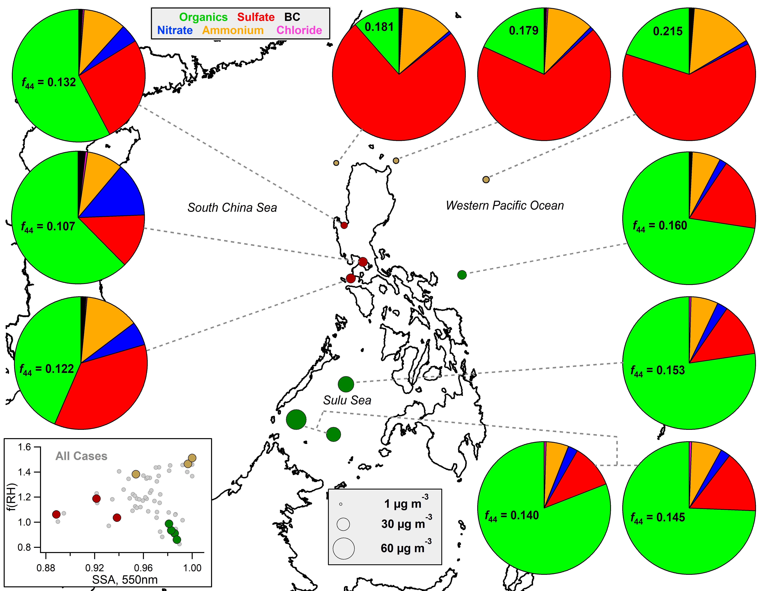
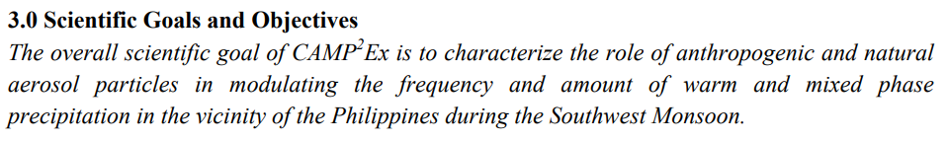
Aerosol Composition Maps to Regional Distribution
Biomass Burning
Urban
Asian
All Cases
Aircraft measurements show composition varies by source
Sources have characteristic hygroscopicity and optical properties
LARGE / Ziemba

Slide 4
Aerosol Composition Maps to Regional Distribution (LARGE et al.)
Biomass Burning
Urban
Asian
All Cases
Aircraft measurements show composition varies by source
Sources have characteristic hygroscopicity and optical properties
LARGE / Ziemba

Slide 5
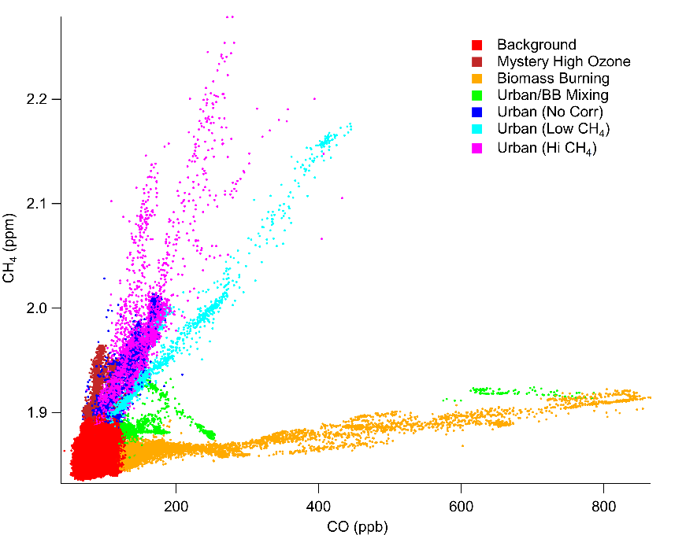
Gas-phase Tracers Enable High Time Resolution Source Apportionment (Digangi et al.)
Urban (All)
Avg Mass Conc.: 5.8 μg/m³
Bio Burning
Avg Mass Conc.: 13 μg/m³
AMS Mass Fractions
Org
SO₄
NO₃
NH₄
Chl
Aerosol composition derived from gas tracers is consistent with qualitative separation
Ozone, NO_{Y} also show distinct source regions
All Urban
35 ± 2 % ppbv/ppb
r²: 0.71
High CH₄ Urban
8.7 ± 0.2 % ppbv/ppb
r²: 0.33
Low CH₄ Urban
1.39 ± 0.04 % ppbv/ppb
r²: 0.38
Biomass Burning
7.6 ± 0.3 % ppbv/ppb
r²: 0.93
Biomass Burning
144 ± 2 % ppbv/ppm
r²: 0.45
[Methane / CO] able to separate airmass sources at high time resolution
TraceGas / Digangi
NOY / Flynn+Yoon

Slide 6
Nucleation and Particle Formation during CAMP²Ex (Wang et al.)
Nucleation and new particle formation were mostly observed above 6000 m. The frequency of particle formation increases with increasing altitude for all airmass types .
New particle formation occurred in airmasses with elevated RH, consistent with vertical transport of precursors and wet scavenging of existing particles by clouds.
Above 6 km, new particles were formed when existing particle surface area was low. In contrast, new particle formations were observed with elevated surface area below 6 km (i.e., in urban plumes processed by clouds).

Slide 7
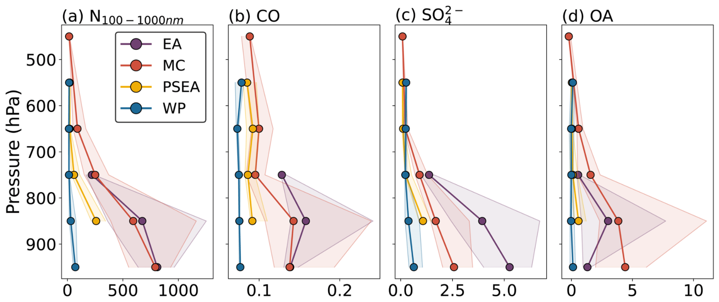
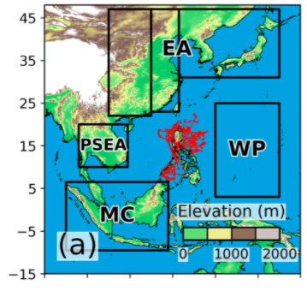
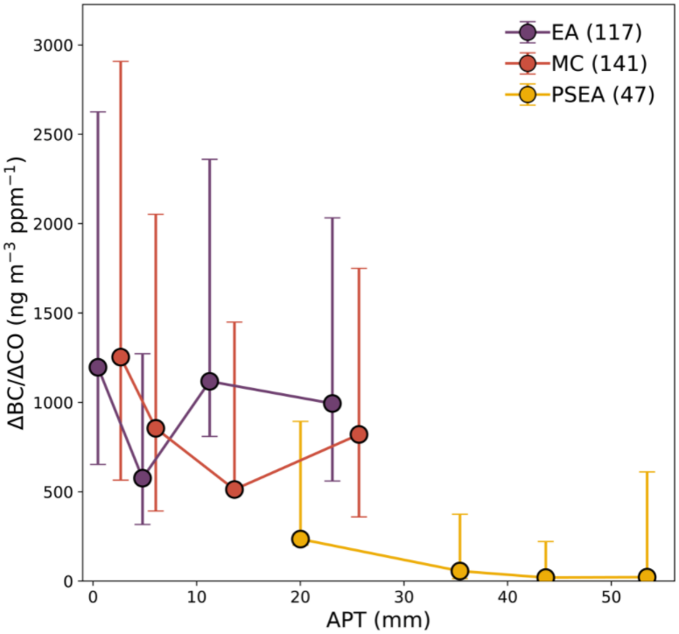
Aerosol Properties Controlled by Long-Range Transport and Wet Scavenging (Hilario et al.)
Composite vertical profiles show differences in composition depending on airmass origin
Aerosol is observed at <2km altitude
Airmasses from PSEA were most influenced by precipitation scavenging

Slide 8
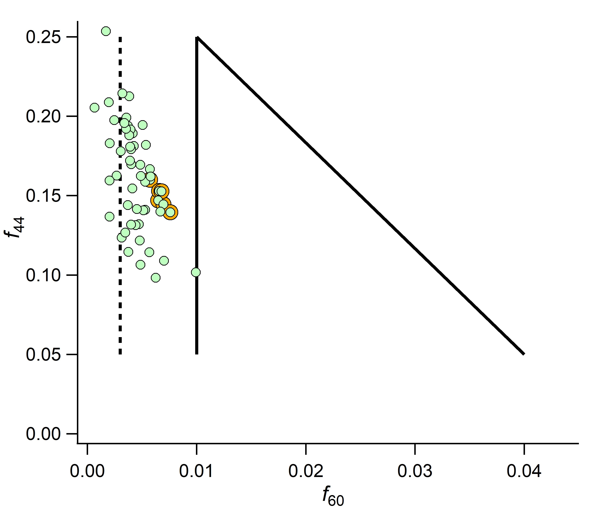
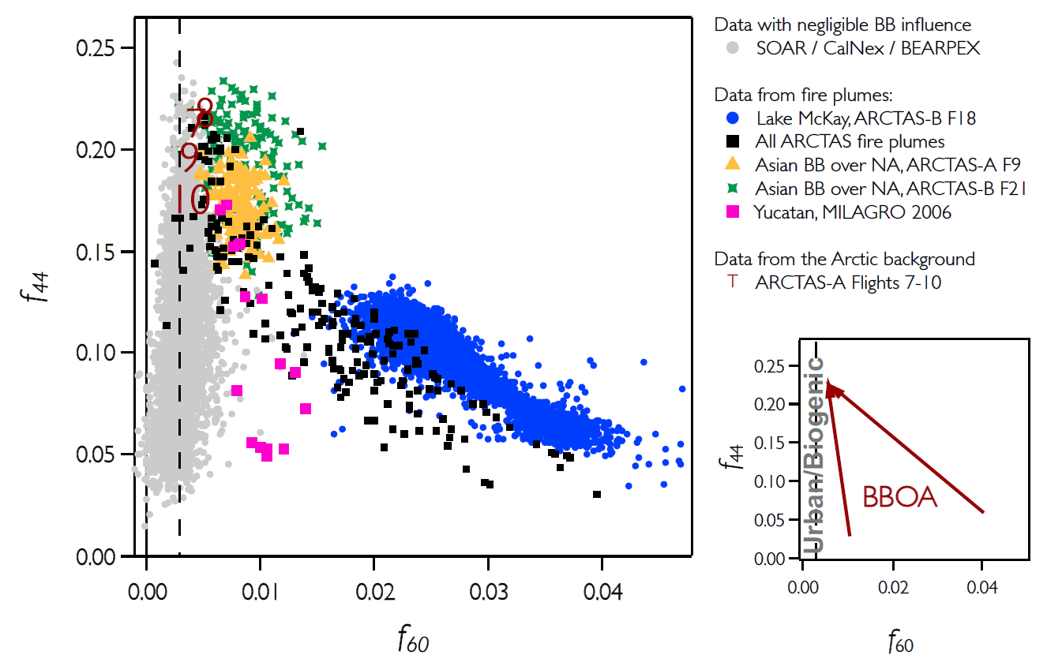

Aerosol Evolution: Biomass Burning Aerosol already Significantly Processed (LARGE-AMS)
Background
Biomass burning aerosol over Sulu Sea (RF9)
Consistent with aged ARCTAS Asian BB
Fresh Biomass Burning
Hours-to-days
processing
LARGE / Ziemba

Slide 9
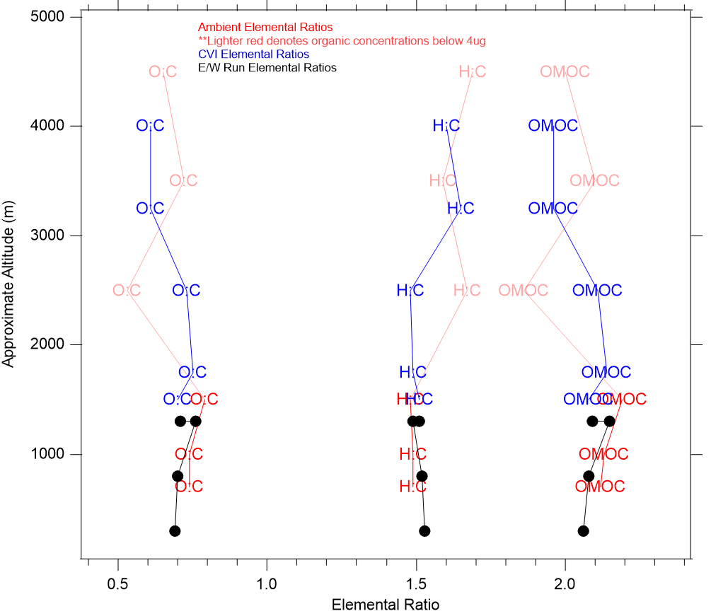
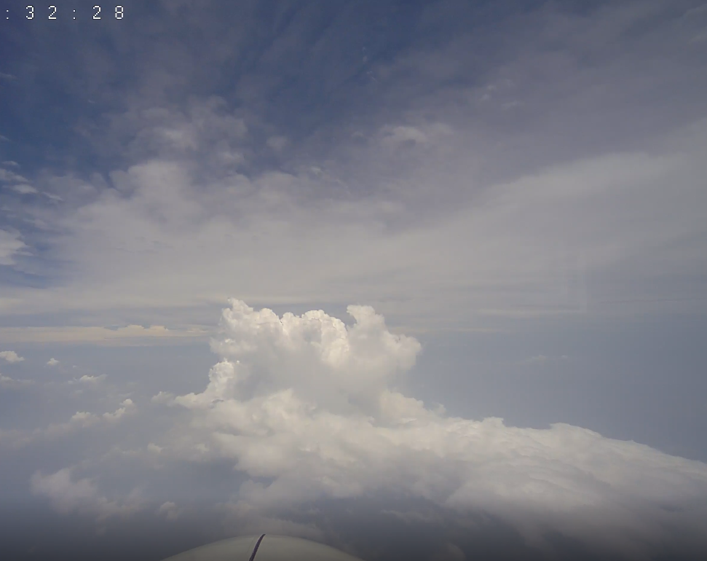
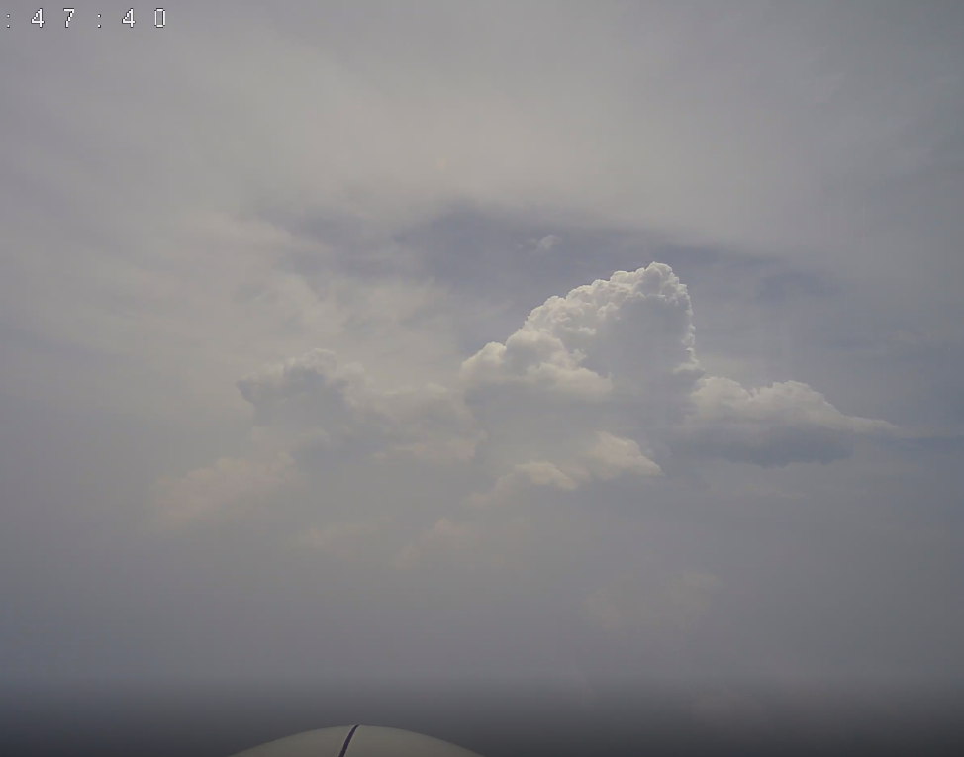
How do Clouds alter Aerosol Composition during Transport? (Robinson et al.)
Ambient Aerosol
Ambient Aerosol (near DL)
CVI Droplet Residuals
Single convective cell embedded in Borneo smoke (RF9)
Atomic ratios from HR-ToF-AMS data
Consistent BL signal throughout region
No obvious evidence for aqueous oxidation from droplet residuals
Sampling Cloud and Aerosol at 4000m
Transect of Sulu Sea (RF9)
LARGE / Robinson
Sampling Cloud and Aerosol at 1500m

Slide 10
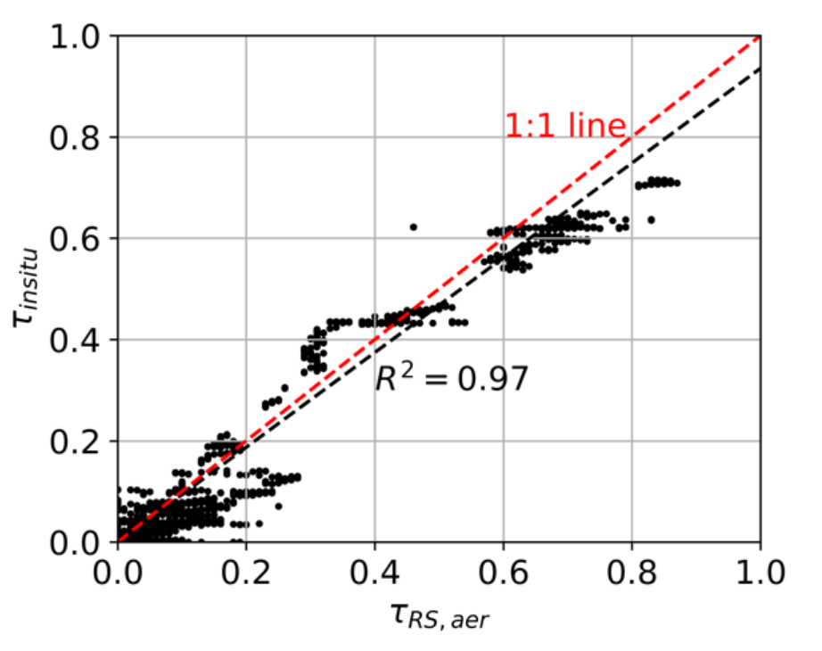
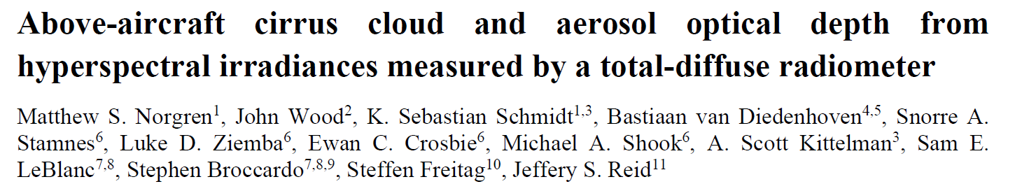
Remote Sensing: Extinction (AOD) Comparison (Norgren et al.)
CAMP²Ex
SPN-S = Sunshine Pyranometer
Able to separate aerosol and cloud optical depth based on spectral shape
Demonstrated skill in deriving aerosol optical depth compared to 4STAR (ORACLES) and in-situ observations (ORACLES and CAMP2Ex)
SPN-S = Sunshine Pyranometer
(Norgren, Schmidt)

Slide 11
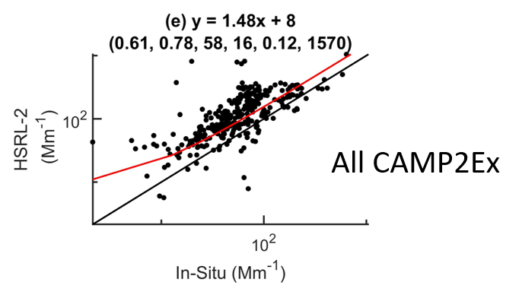
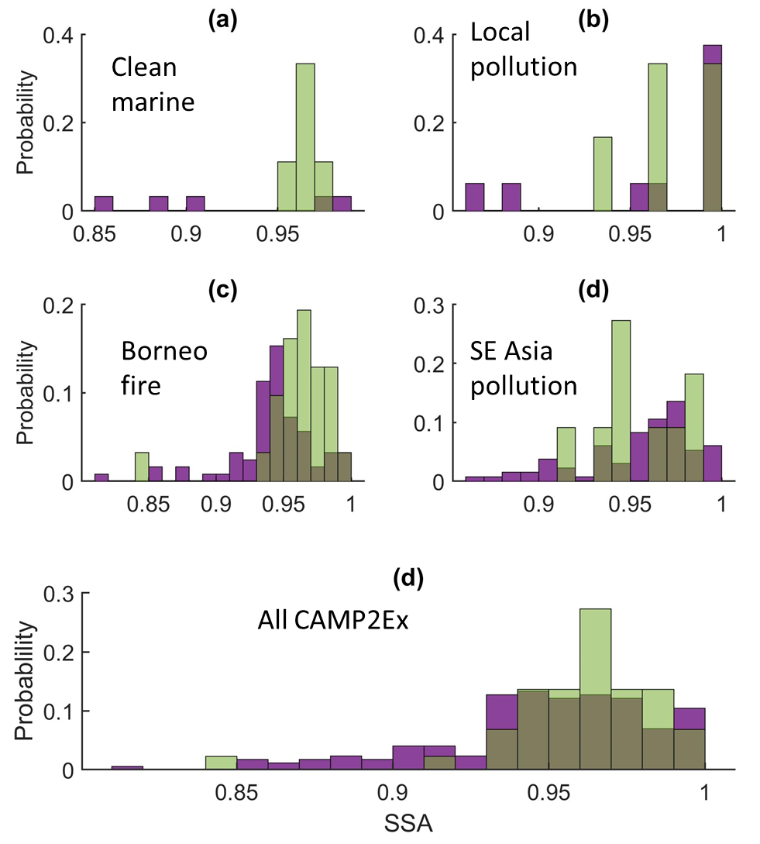
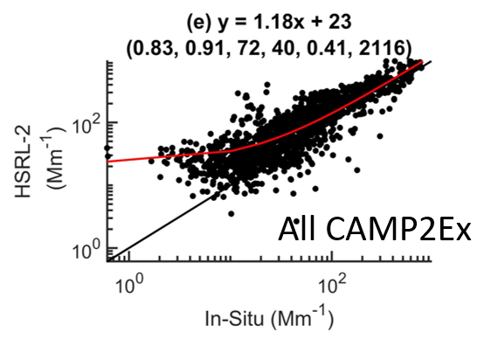
Remote Sensing: Aerosol Microphysical Closure (Schlosser et al.)
ISARA-1
ISARA-2: Improved In-Situ Aerosol property Retrieval Algorithm
ISARA-2 (in situ)
RSP
Retrieves complex refractive index from measured particle size distribution and optical properties
New algorithm improved data coverage and HSRL-2 comparison
SSA retrievals look good with RSP
ISARA-2

Slide 12
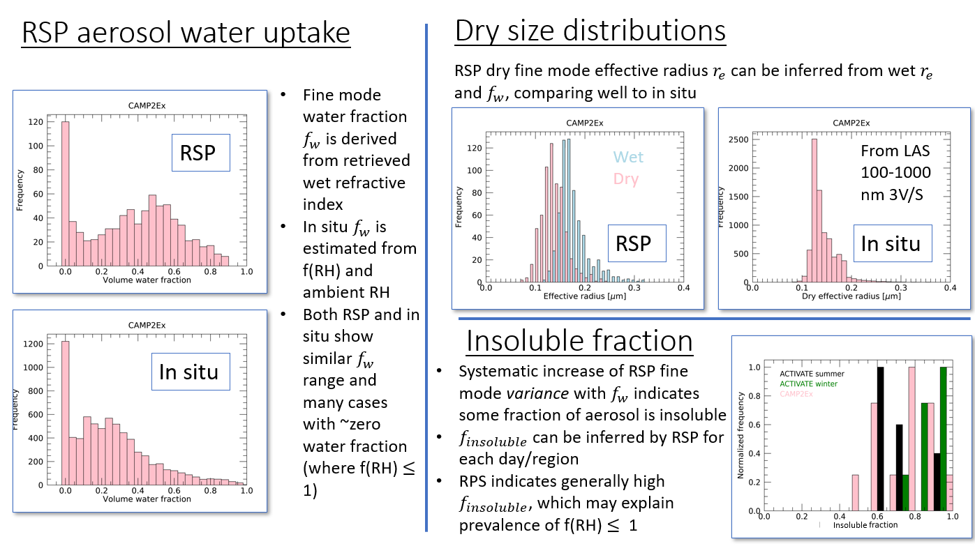
Remote Sensing: Particle Water and R_{EFF} Retrievals (Bastiaan et al.)

Slide 13
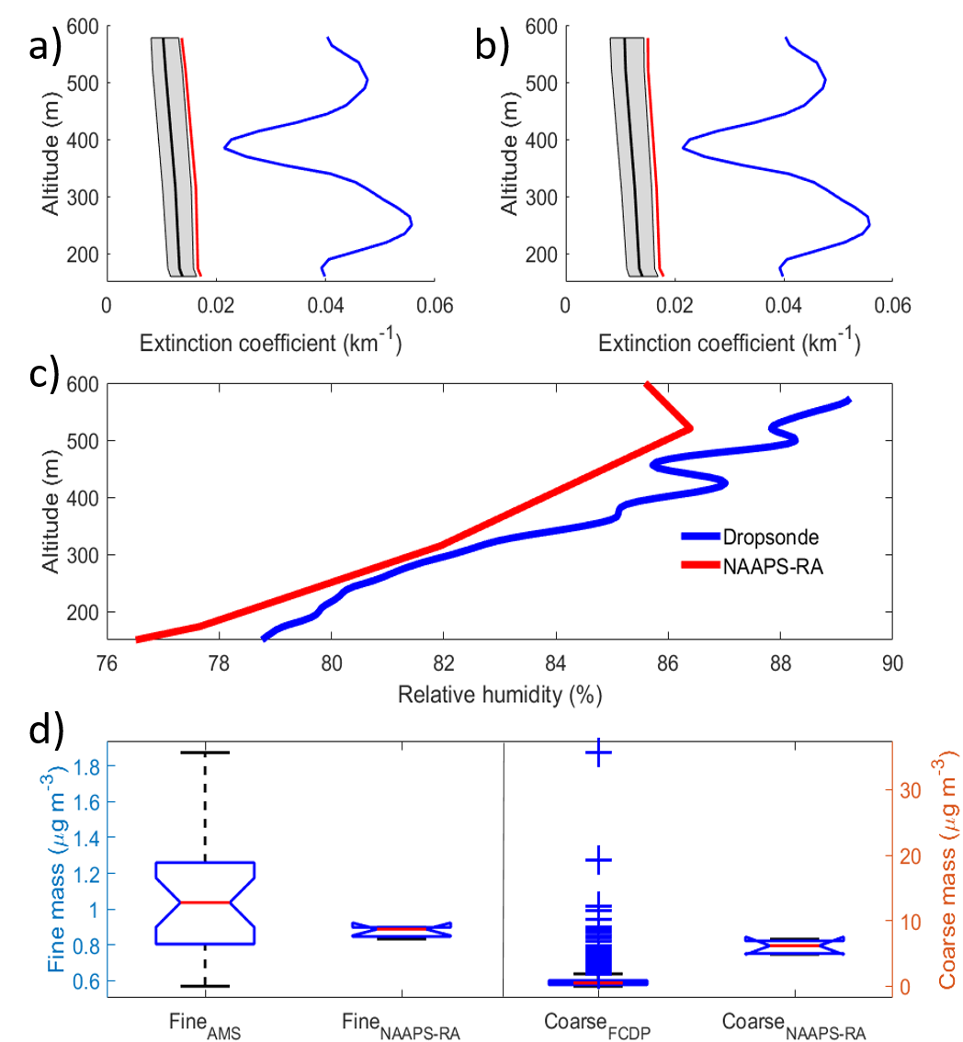
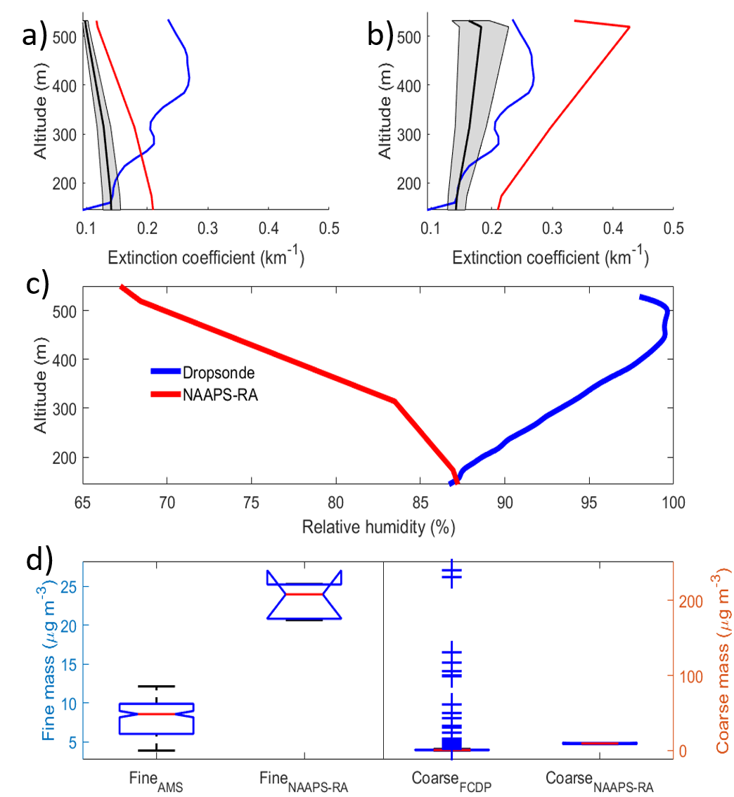
Model Validation Shows Inconsistent Results (Edwards et al.)
Model RH
sonde RH
Model RH
sonde RH
NAAPS w/ model gamma
NAAPS w/ insitu gamma
HSRL
Clean Case
Reasonable mass concentrations and RH; poor Extinction
Asian Case – RF17
Clean Case – RF19
Asian Case
Improved with sonde RH and in-situ gamma, bad mass

Slide 14
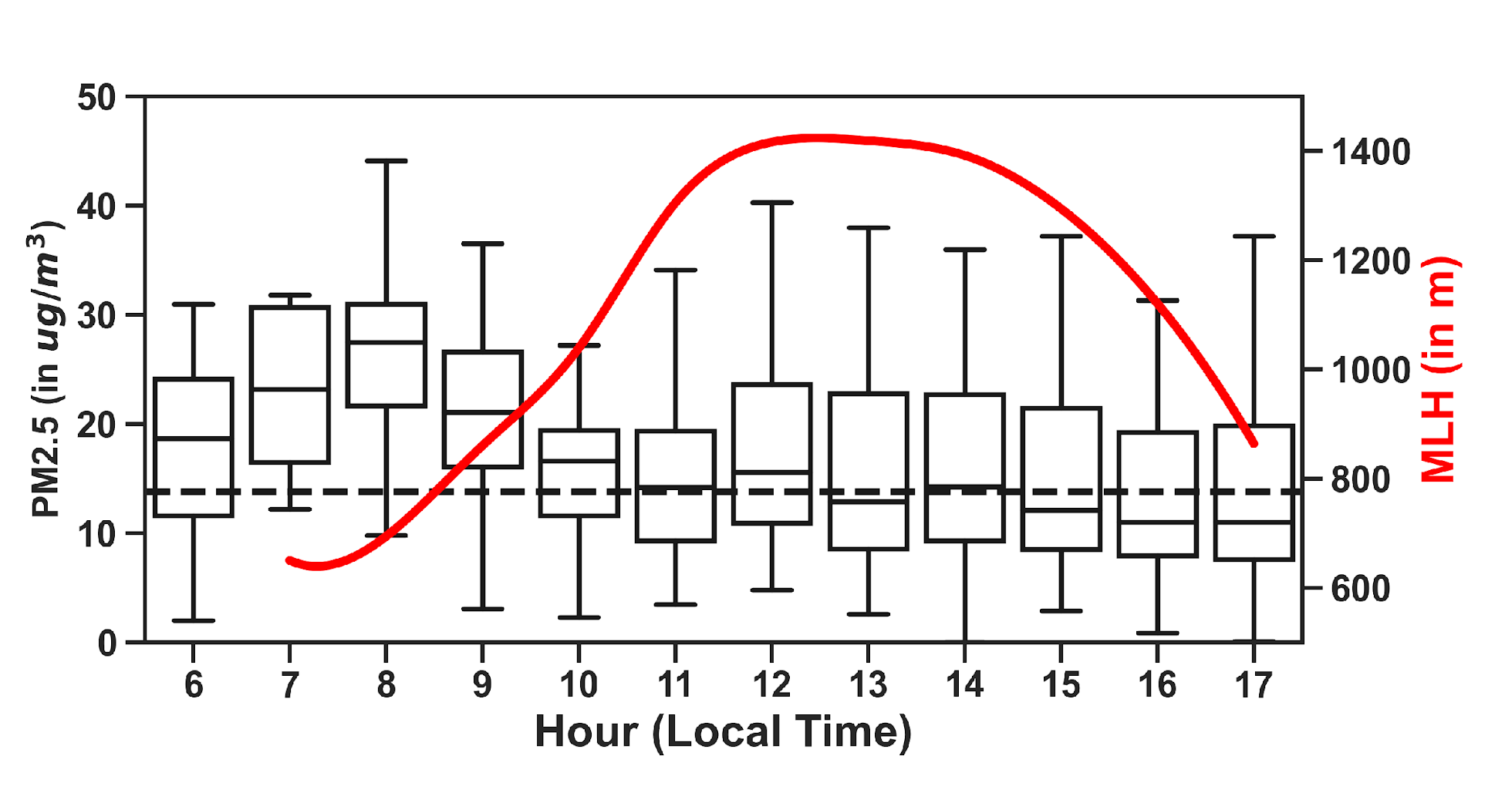
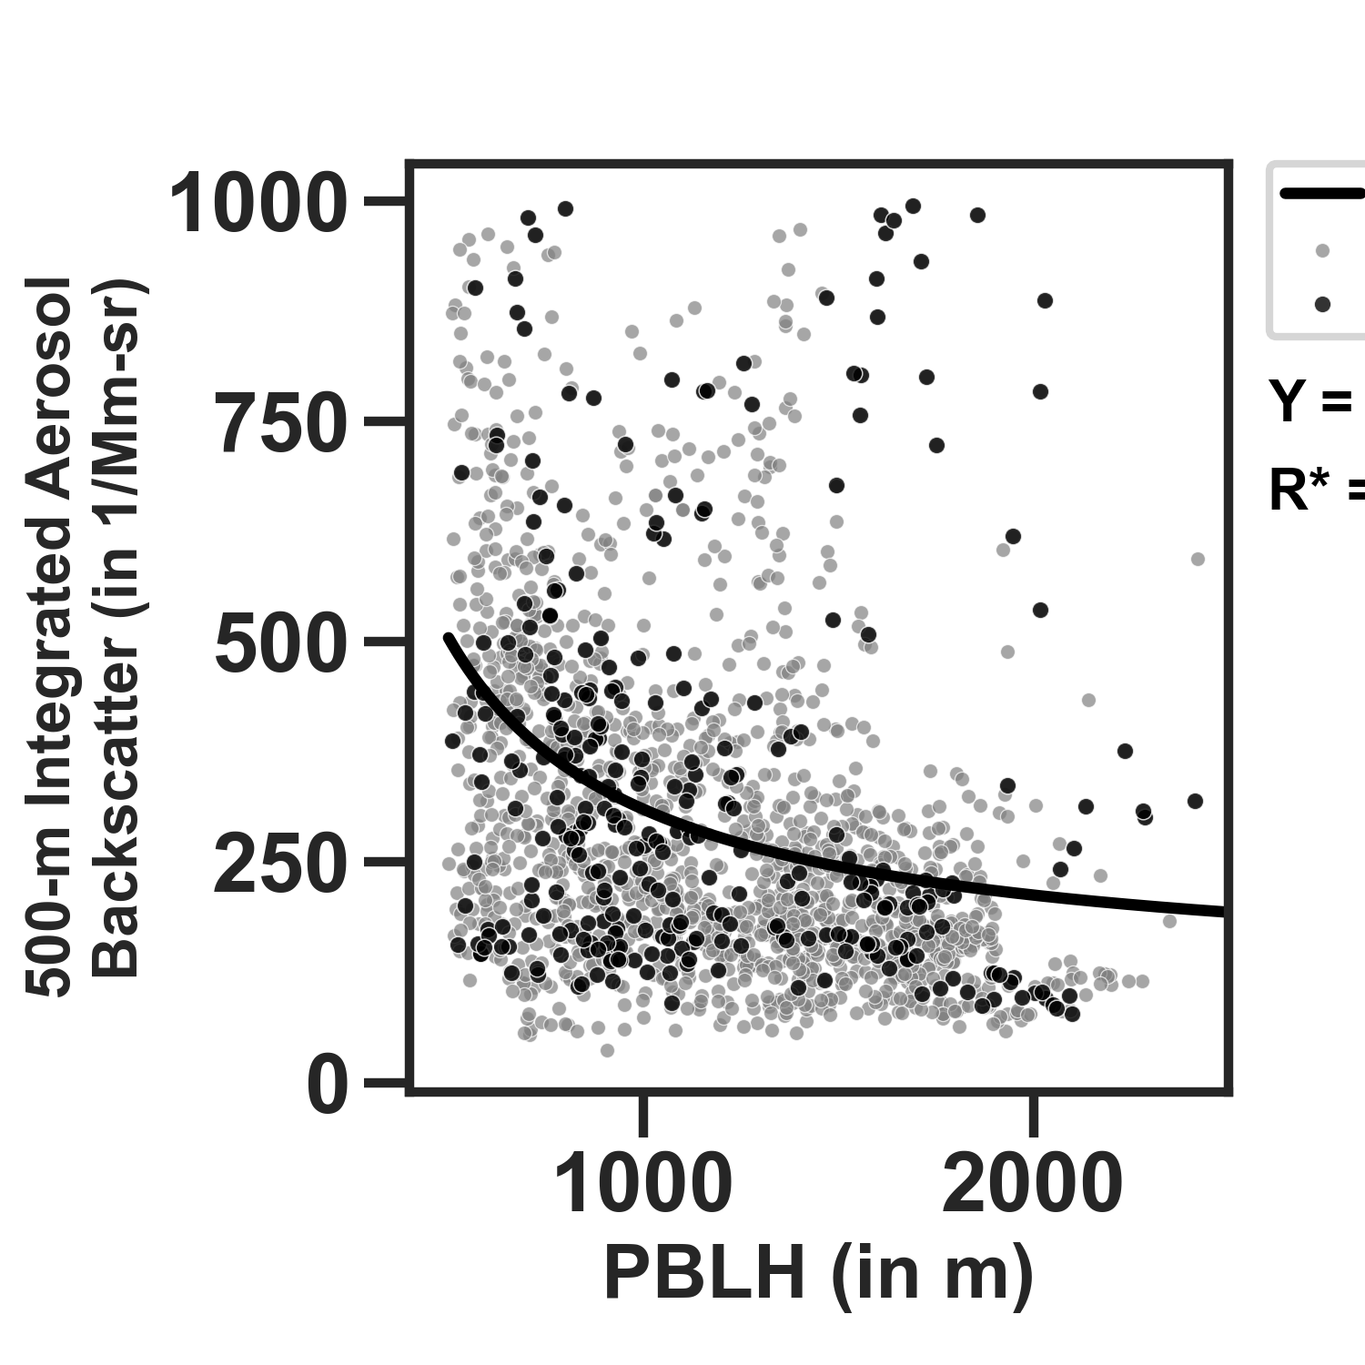

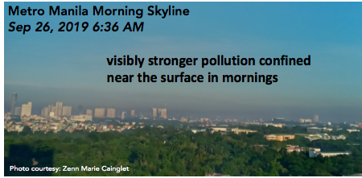
Manila Air Quality & PBL Characterization (Visaga et al.)
2019 PM2.5 Concentrations & HSRL MLH measurements
MLH over Manila Observatory detected using the ground-based HSRL aerosol backscatter cross section (as aerosol tracer) and applying the maximum temporal variance method (Hooper & Eloranta, 1986)
Data: average MLH from Jan- Dec 2019; 1-min 30-m temporal and vertical resolution
Surface PM2.5 and 500–m Integrated Aerosol Backscatter Cross Section (aerosol tracer) decrease
as the PBLH increases. Inverse-fit adapted from Su et al., 2018 and Xiang et al., 2019
  anticorrelated PBLH - PM2.5
  low PBLH and morning rush hour - highest surface concentrations (0700-0900 LT)
Notes:
In a different Metro Manila study, constant 6 AM – 6 PM 2000 vehicles/h at Taft Avenue (Madueno et al., 2019)

Slide 15
Summary and Future Directions
Review:
        Ground** and aircraft measurements demonstrate distinct differences between airmasses affecting the Philippines
        Borneo smoke was already photochemically aged
          Convective transport did not seem to further alter the organic composition significantly
        Advanced retrievals and measurement techniques demonstrate agreement between in-situ and remote sensing observations
        Initial model comparisons show mixed results, illustrate the complexity of validation
        NPF was observed only at higher altitudes, likely associated with convective outflow
Future:
        Incorporate compositional and size-distribution complexity into precipitation sensitivity analysis
          Increased retrieval skill means remote sensors can provide more than AOD
        Borneo smoke: Peat vs. FIREX-AQ
        CVI data is relatively untapped
          Signatures of aqueous processing
          Focus on mixed cases where sources are not obvious
** Cruz et al. (2019) and Braun et al. (2020)

