Slide 1
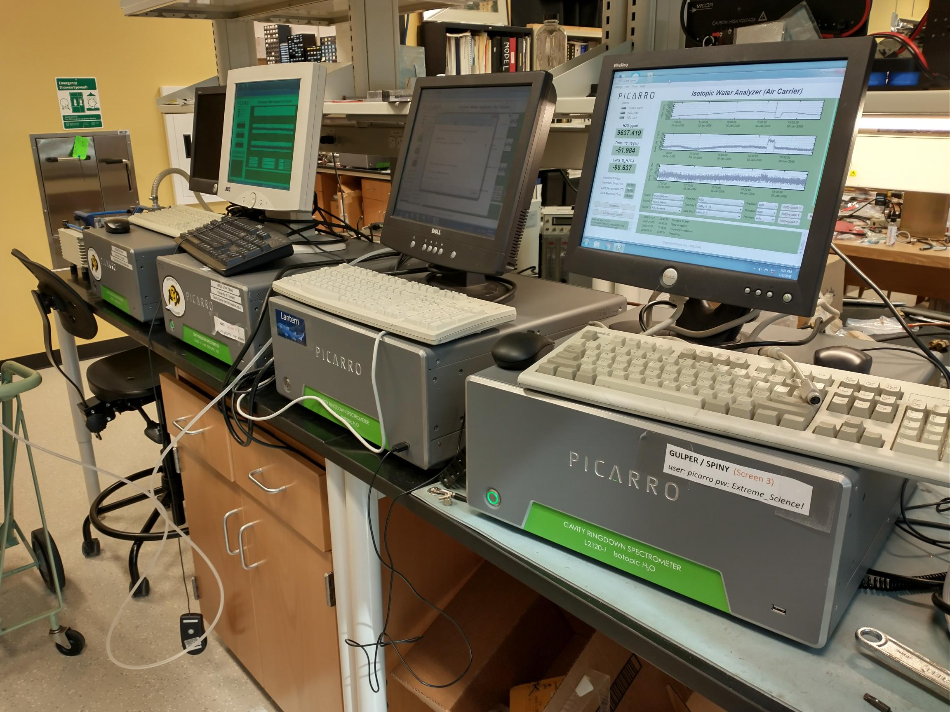
WISPER STATUS REPORT
Darin Toohey and Emily Wein (University of Colorado Boulder)
David Noone (Oregon State University and University of Auckland)
and honorary new team member, Adriana Bailey (NCAR)

Slide 2
“Water Isotope System for Precipitation
and Entrainment Research” (WISPER)
System = counterflow virtual impactor with two cavity-ringdown spectrometers (CRDS) measuring water vapor, HDO, and H₂¹⁸O in clouds.
Condensed water measurements use the same method as on the NSF G-V and C-130 aircraft when flying the NCAR CVI inlet (just different H₂O sensors); results are of similar quality, or better.
OSU inlet was first flown during the 2017 ORACLES field intensive.
Backward facing pick-off tube was added in 2020 to simultaneously measure vapor phase H₂O; these measurements employed a slow-response Picarro CRDS (~30 seconds) and were exploratory for 2020. Serious issues preclude high-quality interpretation of water vapor concentrations and associated isotopologue relationships.

Slide 3
Status of CWC Measurements
Cloud water contents were successfully measured on all science flights.
Short (~1-2 minute) periods of condensation or icing and reevaporation have been identified using isotopologue correlations. These periods will be flagged in the final exchange files.
A small error (< 10%) in CWCs has been identified - a different reference temperature was used in the Alicat flow controllers compared to earlier models, and was not accounted for in the first analysis. Actual CWC values are somewhat smaller than originally reported.
Adjustments for cloud particle sizes < 5 μm will offset the error in CWC by about half, such that final CWCs are within ~5% of those reported previously.

Slide 4
Status of CWC Measurements
Approximately 99% of the reported CWC values will be high quality (~10% accuracy). 1% will be subject to hysteresis due to condensation and evaporation, resulting in reduced response (i.e., true CWC > measured CWC) during those short periods. But even those results are valid to a large extent – they will just appear to be “smoothed.”
There are likely to be no further significant changes in 2020 CWC data product.
Isotopologue calibrations were completed in August, 2021. Required acquisition of a special Picarro water vaporizer, graciously loanedby Adriana Bailey (NCAR) who also provided training and several key calibration standards (an example of a calibration is shown in Virtual Poster 4 by Emily Wein).

Slide 5
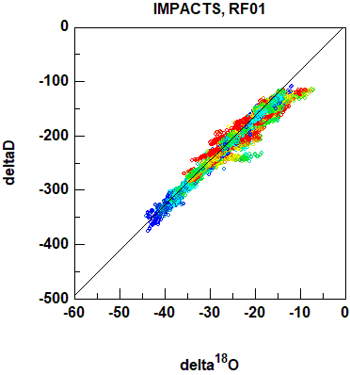
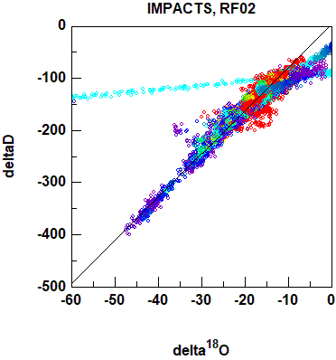
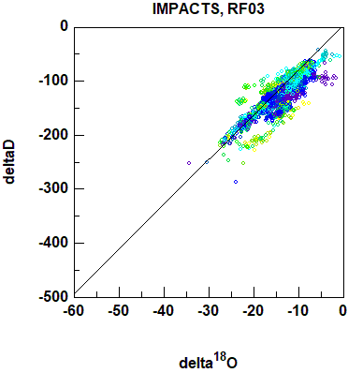
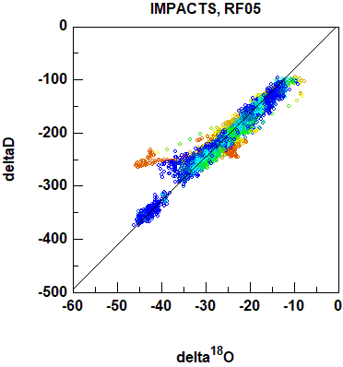
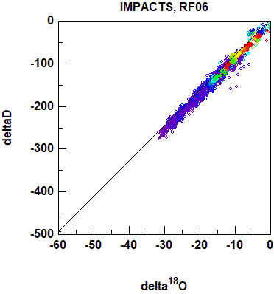
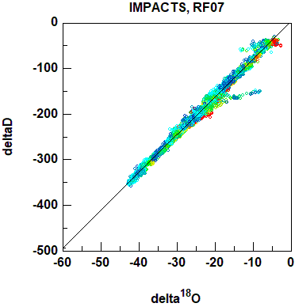
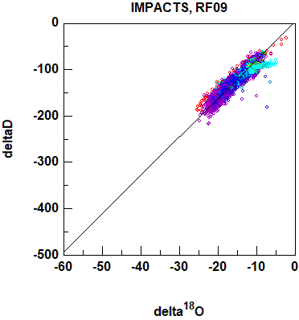
RF01-RF07, RF09, Isotopologue Correlations

Slide 6
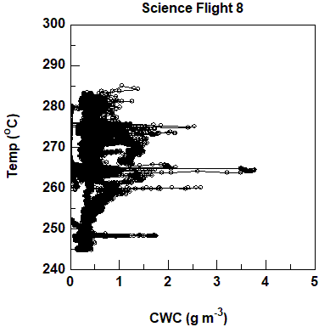
CWC “space” sampled during IMPACTS 2020
From October 2020 IMPACTS Science Team Meeting

Slide 7
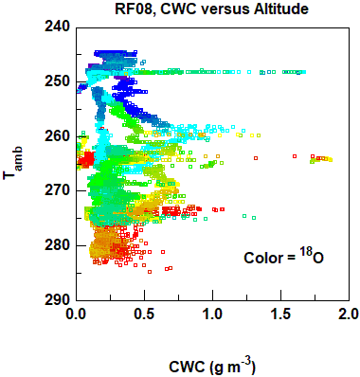
CWC “space” sampled during IMPACTS 2020
Adding one isotopologue reveals vertical structure

Slide 8
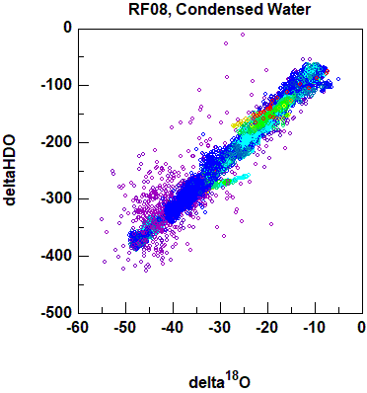
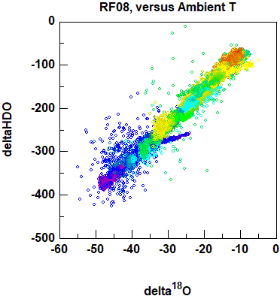
Example of More In-Depth Analysis using
Isotopologue Correlations
Clear gradient with temperature (expected)
Interesting clustering of points at highest condensed water (maybe obvious?)
Color = Condensed Water
Color = Ambient Temperature

Slide 9
Update on Status of Water Vapor Measurements
Water vapor measurements were obtained on 7 flights. Two different Picarros did not operate properly on RF03 and RF05. Both had similar problems traced back to dead batteries on computer motherboards, which will now be rectified by installing new batteries before each campaign.
Quality of water vapor results in clouds is questionable because of severe hysteresis of inlet. Partial data recovery may be possible on case-by-case basis using isotolopogues to guide decision to keep or reject data. Contact the Pis if you plan to use the water vapor results, which will be included in the final data exchange with a description of the inlet difficulties.

Slide 10
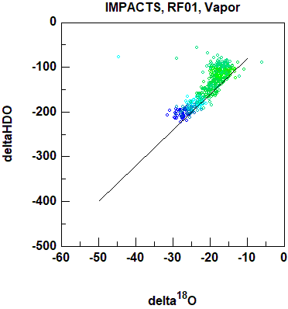
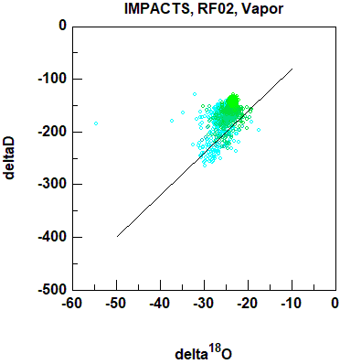
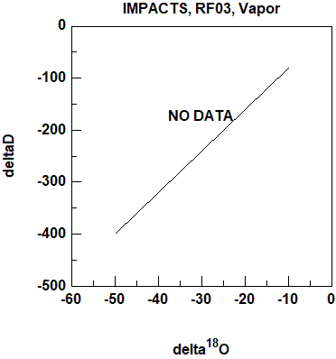
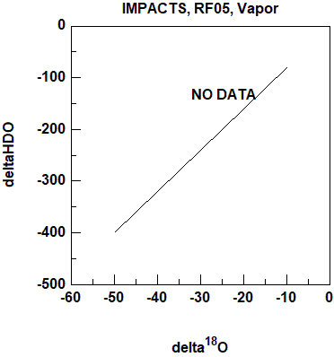
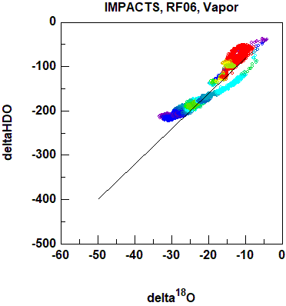
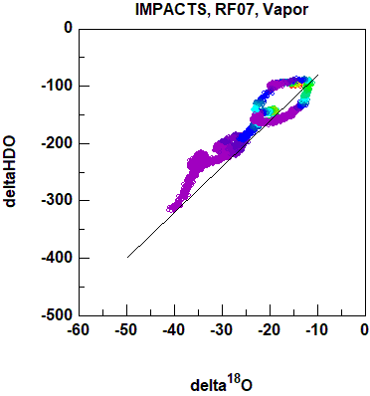
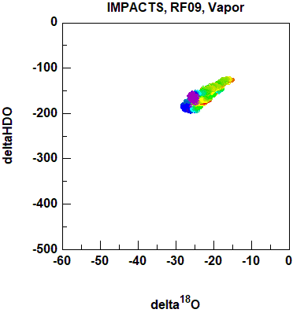
RF01-RF07, RF09, Isotopologue Correlations

Slide 11
Ongoing Work
Data analysis – Produce Final Data Files for Exchange. Will include all parameters reported by WISPER:
1-Hz Cloudwater contents, ΔH₂¹⁸O, ΔHDO
30-second averaged water vapor, ΔH₂¹⁸O, ΔHDO
Laboratory calibrations are complete for post-2020 campaign final data processing and for pre-2022 campaign measurements. These calibrations will be incorporated into first-look results in 2022, allow for rapid exchange (e.g., within 24 hours).
Insulation has been added to the CVI inlet to improve heating stability. A new user-controllable heater with user-setpoints that can be varied in flight has been added to the instrument. We will attempt to measure latent heat to deduce icing/condensation.
Modifications to backward-facing inlet will be implemented during integration in November to improve H₂O vapor measurements

Slide 12
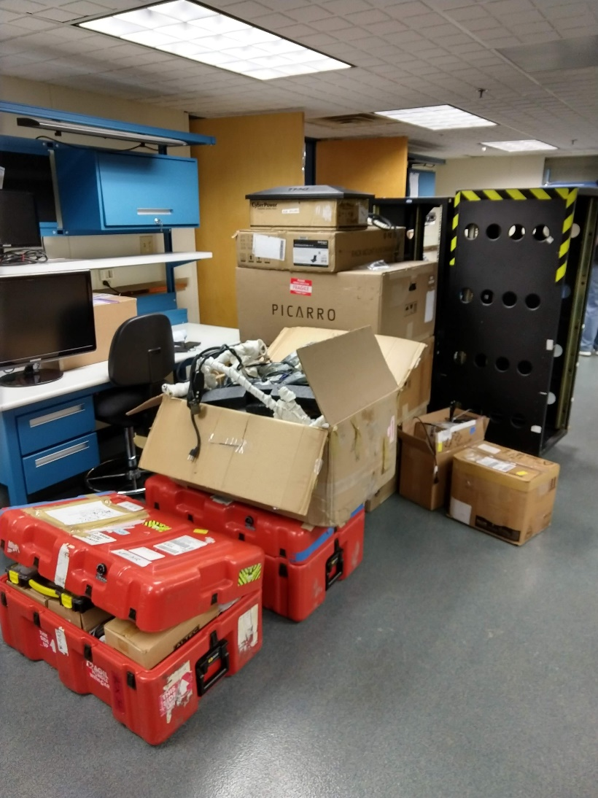
Conclusions
Our long road to calibrating the Picarros is over. The learning curve was steep, but the results for condensed water look very good.
Maintenance will be performed on all three
Picarros prior to shipping to Wallops, and
important modifications have been made
to WISPER that will improve performance
in 2022.
Advertisements - Our team has grown –
two of us will be in the field for a large part
of the 2022 deployment. We are seeking a
third person who can help serve as an
operator due to uncertainties surrounding
the next wave of … (I won’t say it).
Questions - email Darin (toohey@colorado.edu)

