Slide 1
Goddard IMPACTS Science
Mei Han, Scott Braun
  Study microphysical properties, including the mass-weighted mean diameter (D_{m}), using the GPM, aircraft radars and in-situ observations.(1 Feb)
Gerald Heymsfield et al.
  Kinematic & dynamic processes associated with snow bands (5 Feb)
  Elevated convection (25 January)
  Physics of banded structures in extratropical systems (1 Feb)
Mircea Grecu et al.
  Retrieval of snow properties from radar measurements (multiple cases)
Stephen Nicholls, John Yorks, et al. (7 Feb)
  Combined lidar/radar retrieval and model investigation of the microphysical characteristics of IMPACTS winter storms (25 Jan, 5 Feb, 7 Feb, 25 Feb, 27 Feb)
Ian Adams et al.
  CoSMIR science – understanding snow polarization signatures. (multiple cases)
  Ice particle shape/orientation, SLC, etc.
Rob Schrom et al.
  Flexible retrieval of snow properties from radar measurements (multiple cases)

Slide 2
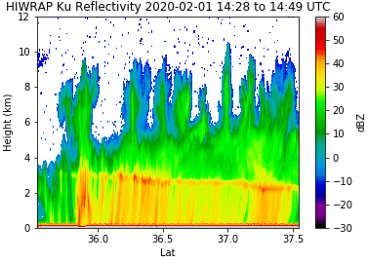
Comparison of microphysical properties for the IMPACTS 2020 Feb 1st case with aircraft and GPM data and MERRA-2 reanalysis
Mei Han^{1,2} and Scott Braun²
1,GESTAR, Morgan State University, 2, mesoscale atmospheric processes laboratory, NASA Goddard space Flight Center
(September 28, 2021, IMPACTS science Team meeting)
GOES
MERRA-2
Purpose – study microphysical properties, including the mass-weighted mean diameter (D_{m}), using the GPM, aircraft radars and in-situ observations.
Analysis:
  A 21-minutes long ER-2 and a 11-minutes long P-3 flight legs were closely along a fixed DPR incident angle.
  GOES ABI radiance shows fine-scale streaks of cloud feature, corresponding to higher reflectivity regions in the GPM radar swath.
  MERRA-2 analysis shows updraft along a sloped frontal zone in the region of cloud and precipitation.
  Generating cells in the HIWRAP Ku and DPR Ku Z_{m} reflectivities appear similar
  The P-3 flight leg went across 2-3 generating cells near a height of 5260 m – coincident with 8 DPR pixels (for the retrieved D_{m})
  The HVPS3 D_{m} (based on liquid equivalent diameter of solid particles) calculated with two m-D relationships are close to each other (gray and black lines)
  The GPM CORRA retrieved D_{m} with both Ku and Ka (MS, black dots) or with Ku only (NS, open blue dots) is somewhat larger than the HVPS3-derived.
ER-2 leg
HIWRAP Ku
DPR Ku
Summary:
  This study is our first attempt to understand the microphysical properties of the frontal precipitation and generating cells in the Feb 1st case.
  Preliminary analysis shows a reasonable comparison between the CORRA retrieved D_{m} and the HVPS3 derived value
  Future work includes comparison of the HIWRAP retrievals and more aircraft data. We may consider other cases and in-depth modeling analysis.
GPM CORRA MS Dm
HVPS3 diameters vs CORRA (i.e. 2BCMB) MS and NS Dm

Slide 3
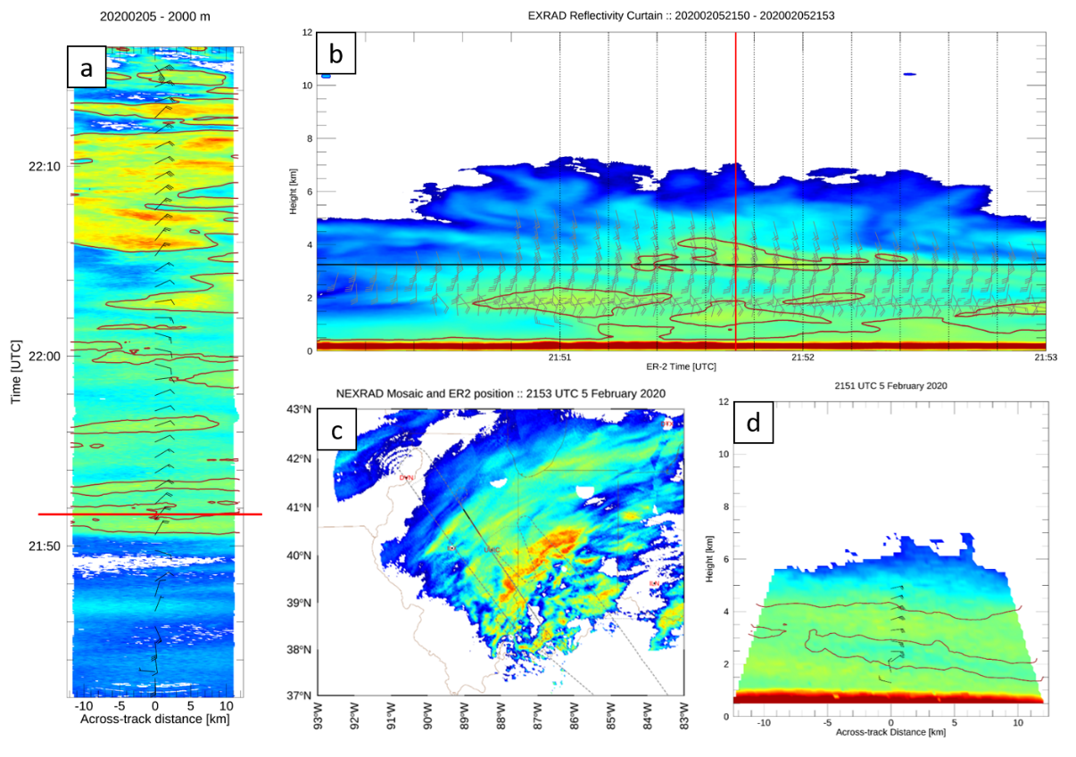
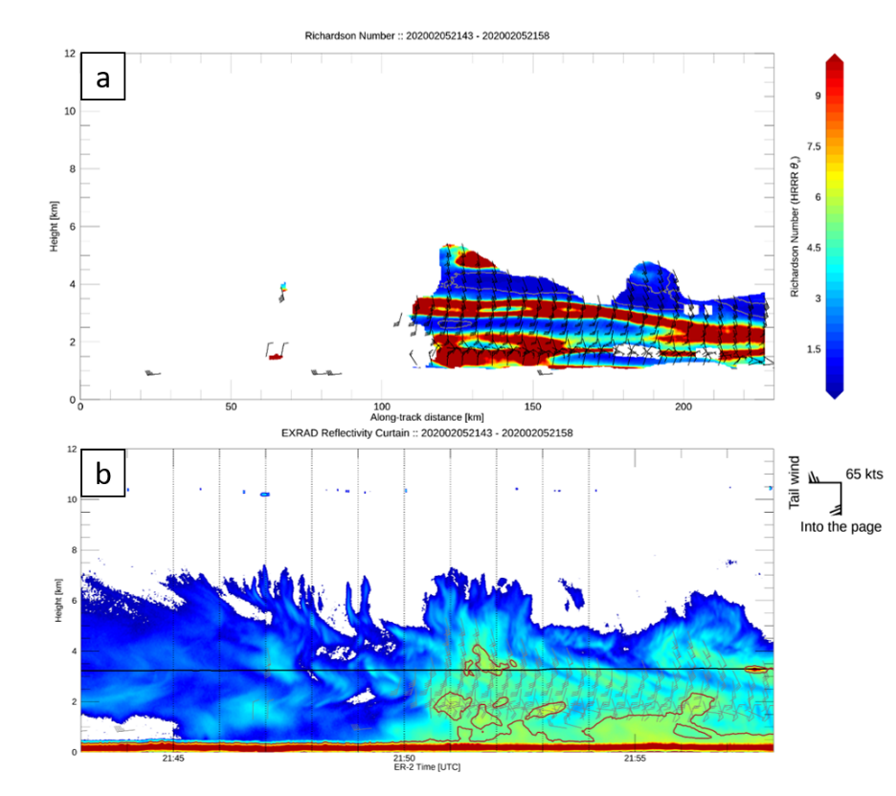
A Study of the Kinematic and Dynamic Processes associated with Mesoscale Snowbands in a Midwest United States Snowstorm on 5 February 2020
Charles N. Helms^{a,b} and Gerald M. Heymsfieldª
ªNASA Goddard Space Flight Center, ^{b}NASA Postdoctoral Program (USRA)
Goal:
Examine the processes responsible for maintaining mesoscale snowbands
Method:
Combine EXRAD radar data (reflectivity, Doppler, VAD winds) with in-situ observations and models
Early Results
Reflectivity features tilt downshear with height: precipitation trailing a generating cell?
K-H instability not supported by Richardson number calculation, but model may be smoothing out the thermodynamics

Slide 4
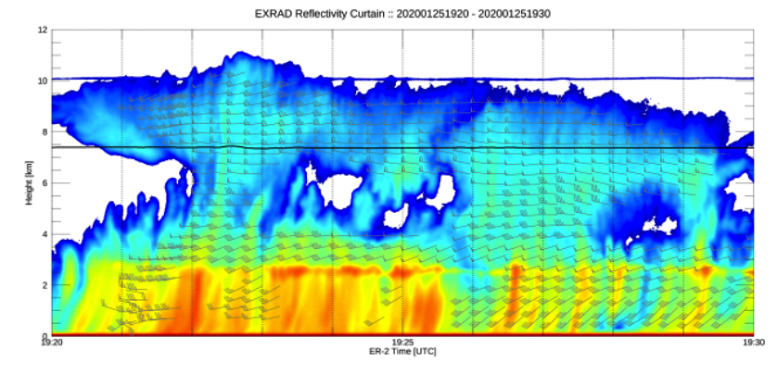
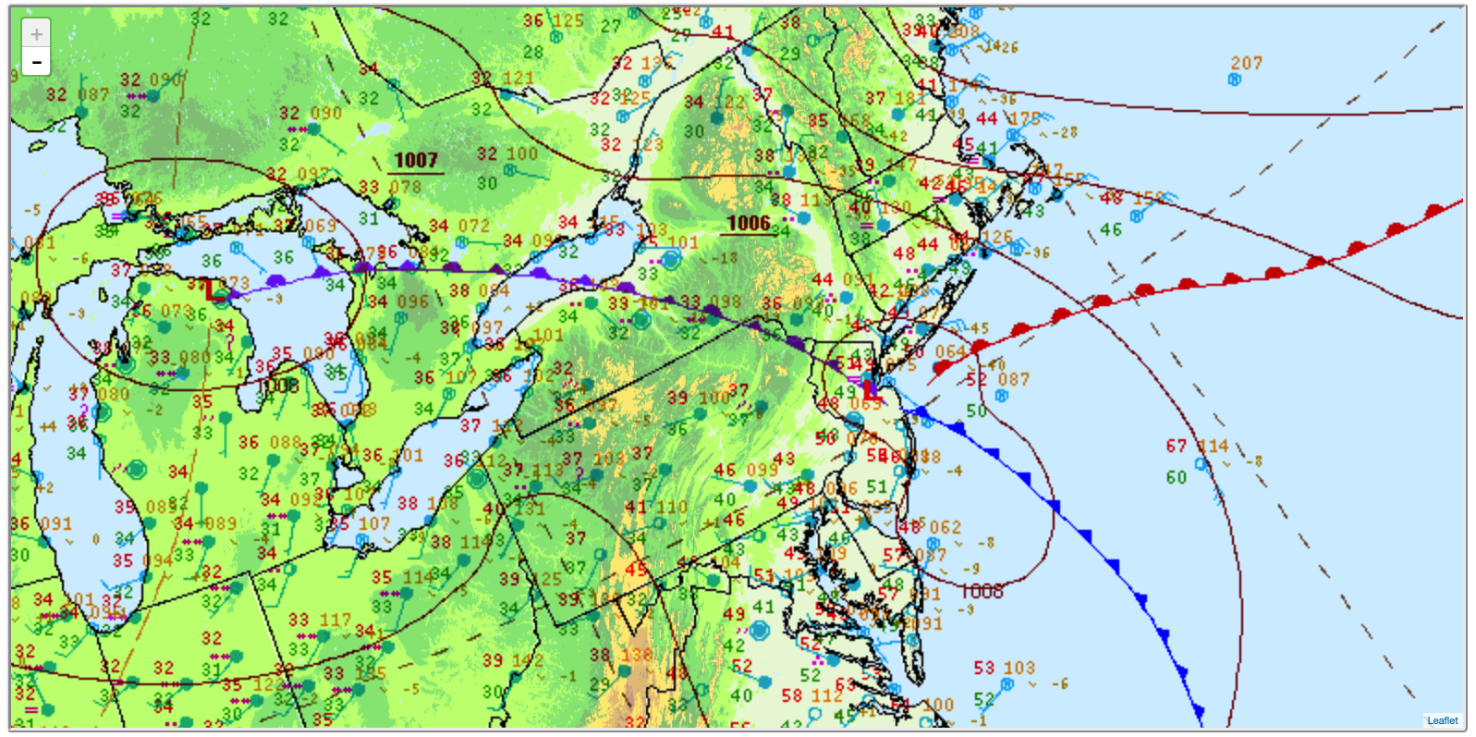
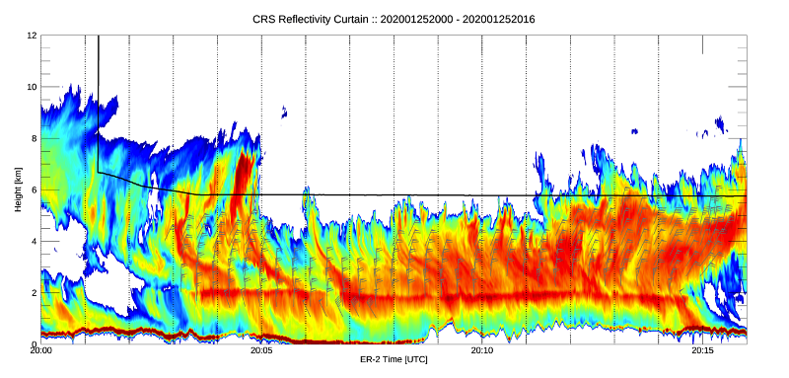
Frontal Convection 25 January 2020
G. Heymsfield, C. Helms, S. Guimond, A. Heymsfield, and A. Bansemer
Most of mission was over warm occlusion but early part of flight was over warm front.
  Characterize the weak & strong elevated convection
  Vertical motions & horizontal winds
  Origins of convection
  Microphysics in convection

Slide 5
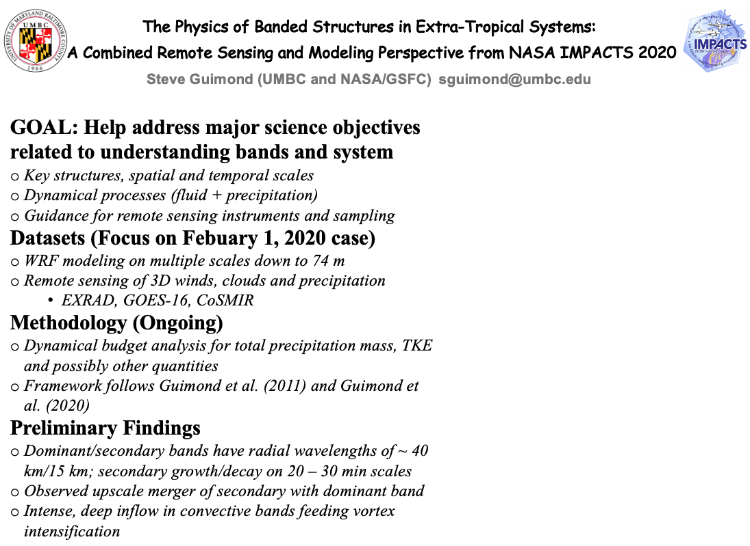
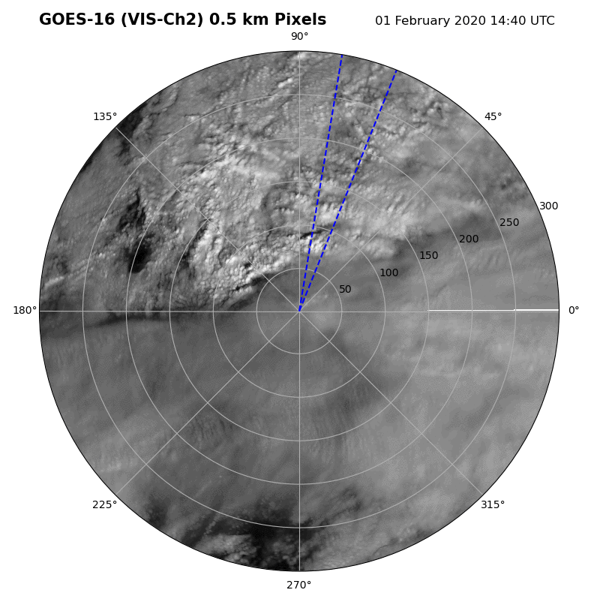
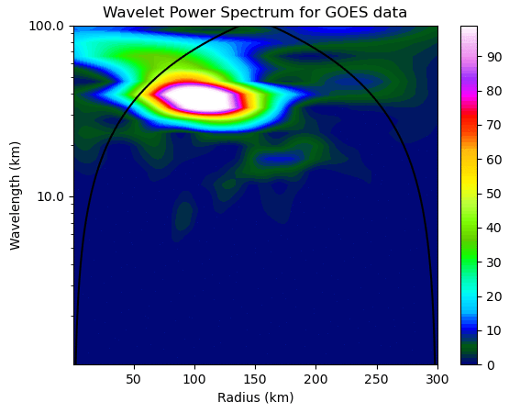

Slide 6
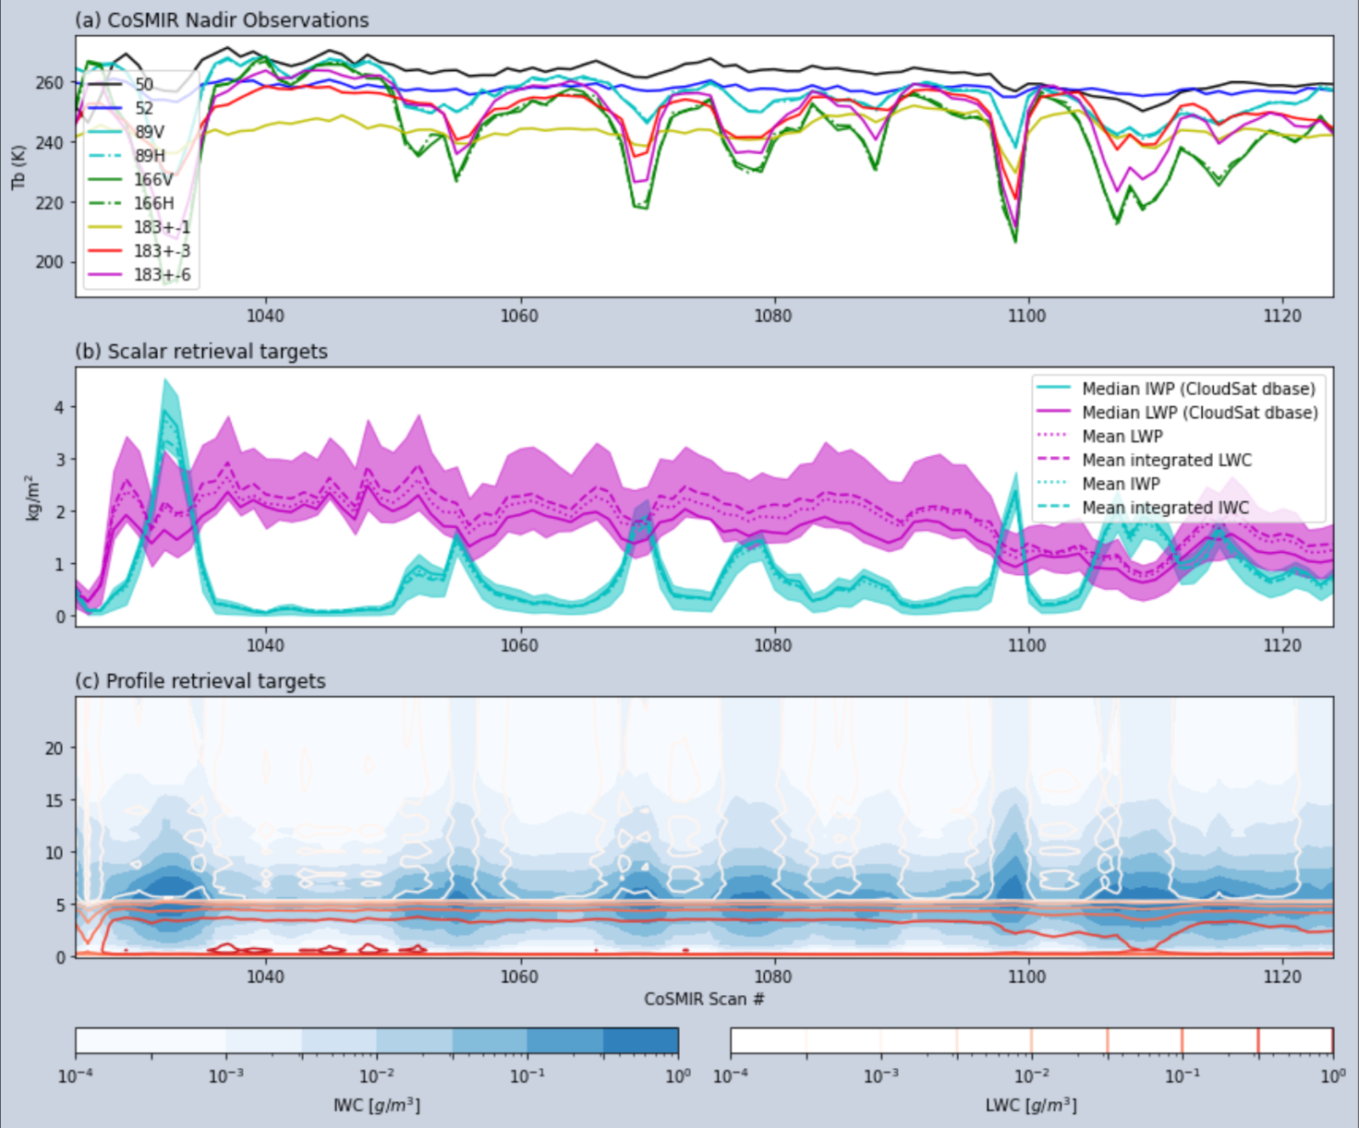
CoSMIR Science
Implemented AI/ML retrievals
  Quantile Regression Neural Networks
  Address sparseness issues of GPROF-like Bayesian retrievals
  Integrated and profile quantities
  Observational and model training sets give consistent results
Investigating relationship between storm structure and polarization
  166-GHz Tbs sensitive to altitudes with dendrite growth and aggregation
  See poster: Adams, day 1, number 4,
figure credit: Joe Munchak

Slide 7
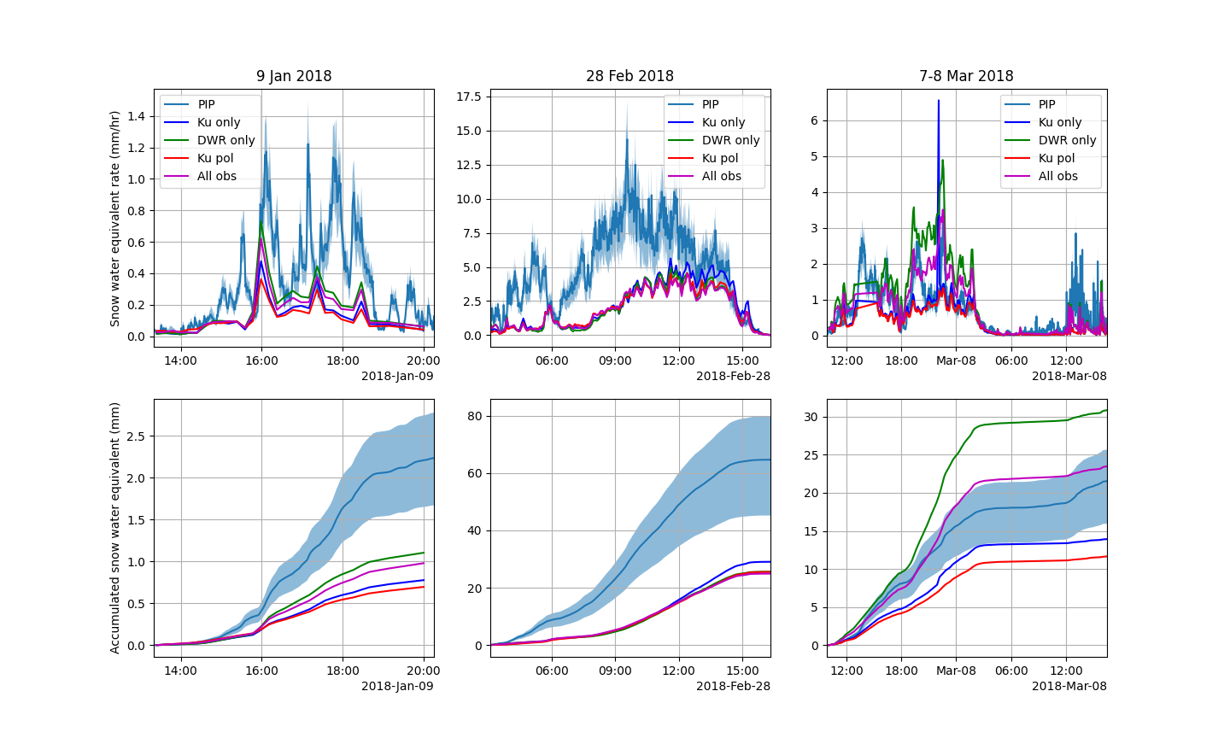
Flexible retrieval of snow properties from radar measurements
Munchak et al. (2021) retrieval of snow microphysical properties from radar measurements (example with ICE-POP data).
Compares favorably with PIP-derived physical properties during heavier snowfall (e.g., snow-water-equivalent shown in figure).
Flexibility in retrieval with different measurement platforms (e.g., airborne, ground-based, multi-frequency, dual-pol).
Improved radar forward model simulations from OpenSSP (Kuo et al. 2016) oriented particles.
Plan to use complementary ER2 radar measurements and/or D3R data to supplement IMPACTS analysis.
Munchak et al. (2021)

Slide 8
Questions?

