Slide 1
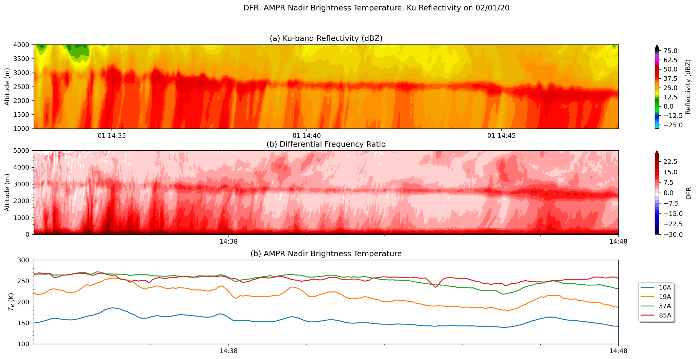
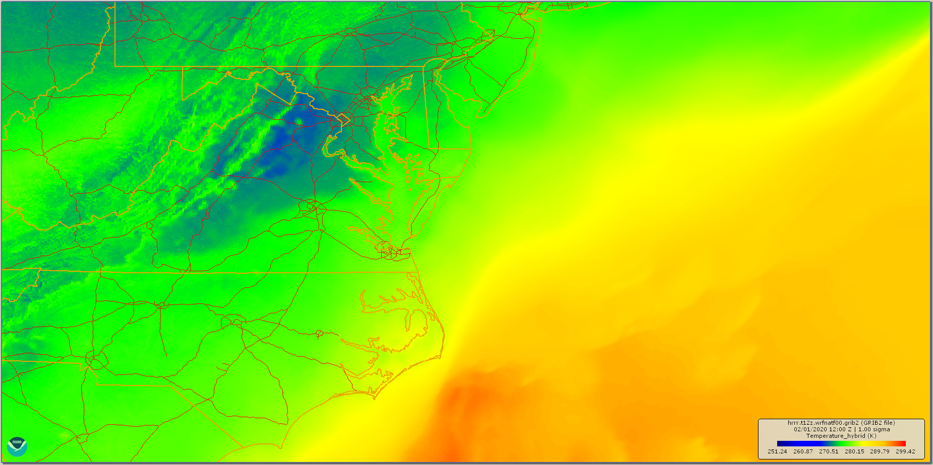
Analysis of AMPR and HIWRAP Data in Two Cases From IMPACTS
Richter et al.
HRRR 1-sigma T
Ku Z
DFR
AMPR Nadir Tb
AMPR sensitive to sloping bright band observed on 1 February 2020
AMPR Swath Tb

