Slide 1
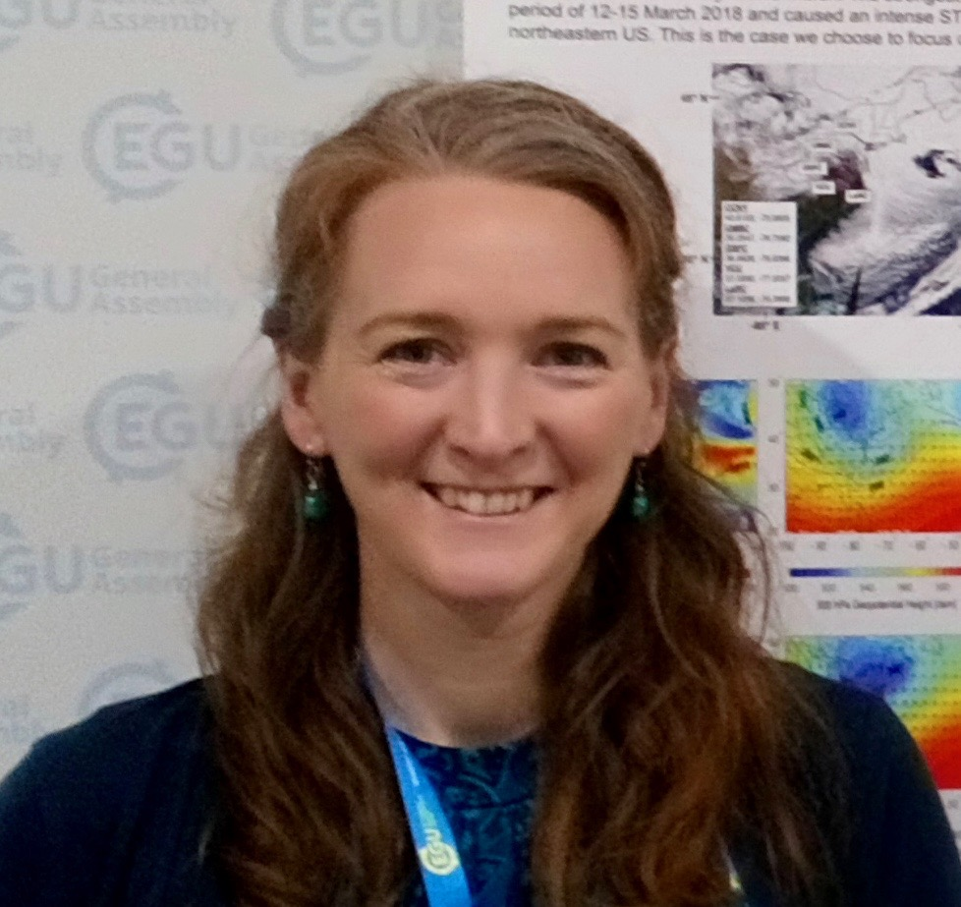
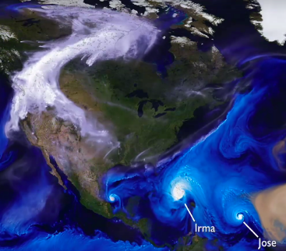
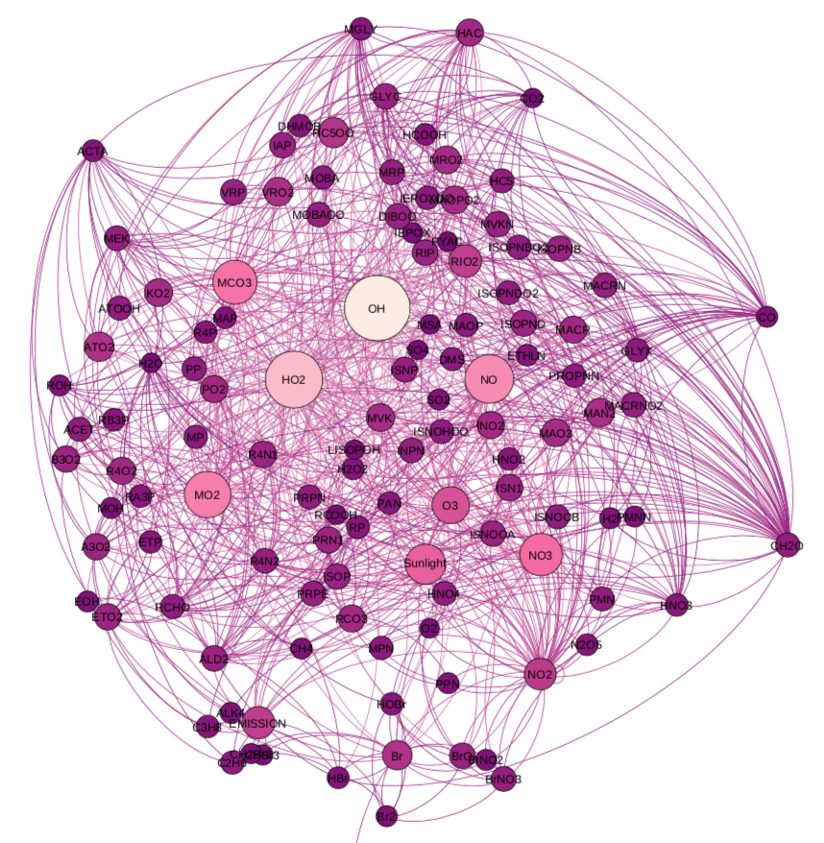
Headshot of yourself
Knowland–NASA GEOS Composition Forecast System, “GEOS-CF”
K. Emma Knowland, USRA/GESTAR NASA GSFC GMAO Christoph Keller, Bryan Duncan, Junhua Liu, Sarah Strode, Pam Wales, Dan Anderson, Larry Coy, Eric Fleming, Julie Nicely, Kris Wargan, Lesley Ott, Steven Pawson
2018 Tropospheric O₃ : GEOS-CF, sondes
GEOS NWP
https://gmao.gsfc.nasa.gov/weather_prediction/GEOS-CF
GEOS - Chem
Keller, C. A., Knowland, K. E. et al. (2021). Description of the NASA GEOS composition forecast modeling system GEOS‐CF v1.0. JAMES https://doi.org/10.1029/2020MS002413

