Slide 1
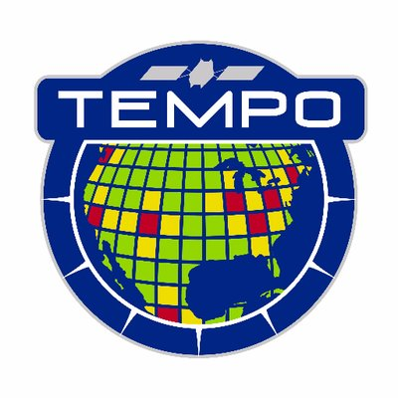
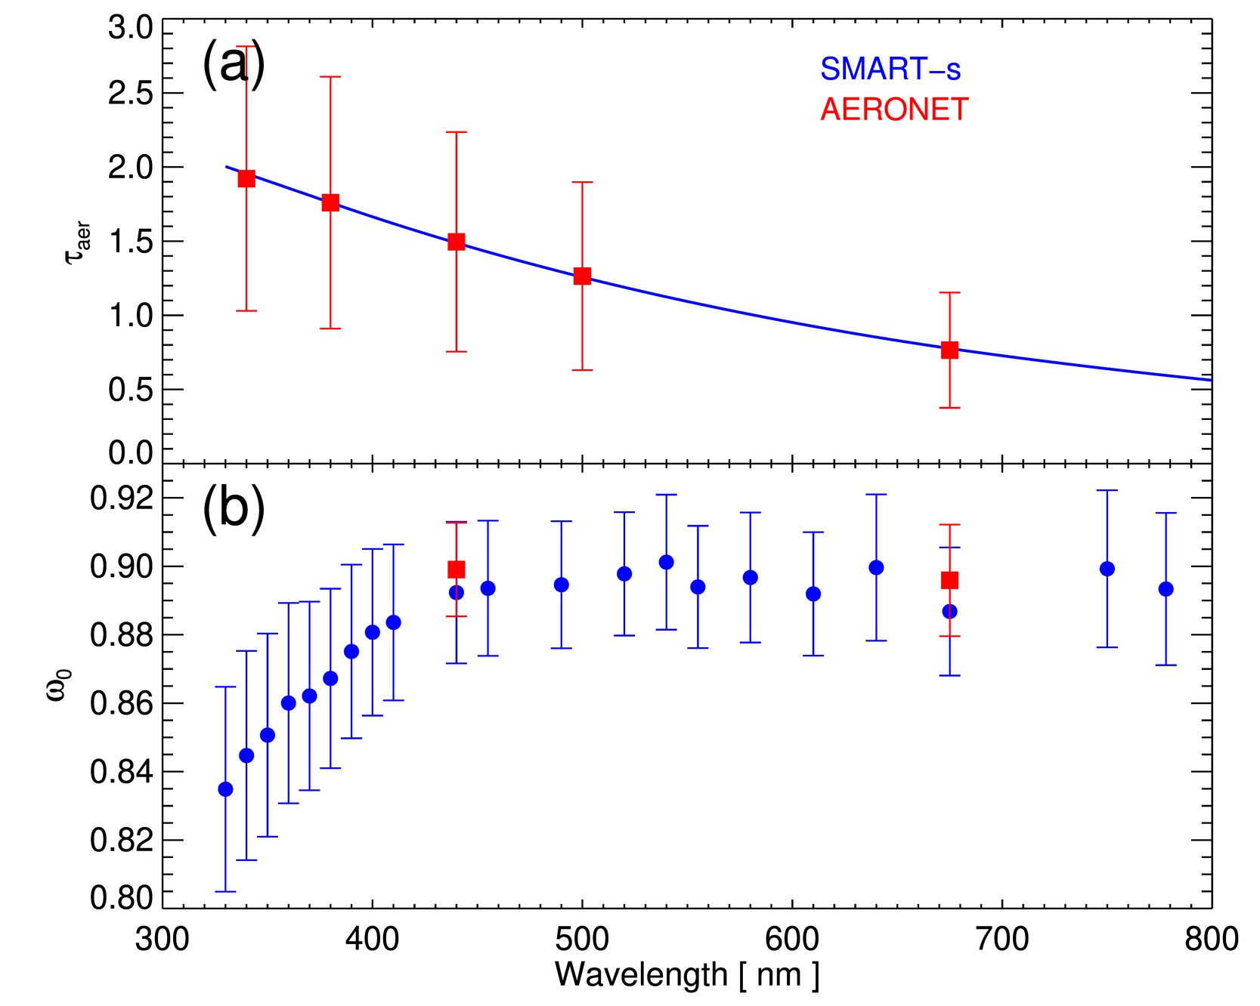
Jeong–Spectral aerosol properties (330–800 nm) from SMART–s
Ukkyo Jeong, University of Maryland / ESSIC (and SMARTLabs of NASA / GSFC) Si-Chee Tsay, NASA / GSFC, and many collaborators (Pandora, AERONET, RCL, NIER, ...)
Full title: High spectral-resolution of aerosol optical properties from 330 to 800 nm retrieved from extended-range Pandora (SMART–s: Spectral Measurements for Atmospheric Radiative Transfer–spectroradiometer) for ancillary information of trace gas algorithms
Radiometric calibration
Combination of laboratory calibration (at RCL of NASA/GSFC), Langley calibration, and reference solar spectrum
Inversion algorithm
Optimal-estimation based scheme provides: Aerosol size, complex refractive index, single scattering albedo, aerosol optical depth with averaging kernel and solution error of each retrieval
Field studies including comparison/validation efforts
Biomass-burning aerosols at Fang (Thailand), Urban background aerosols over NASA/GSFC (USA),
Mixed aerosols over Seosan (Korea)
Future plans/applications
For more details and/or data contact: ukkyo.jeong@nasa.gov or si-chee.tsay-1@nasa.gov
Mean values of (a) spectral aerosol optical thickness (𝜏_{aer}) and (b) Single-scattering albedo (ω₀) from SMART–s (blue) and AERONET (red) within SMART–s spectral range measured from 8 March to 2 May 2019 at Fang, Thailand: (Jeong et al., 2021, under preparation)

