Slide 1
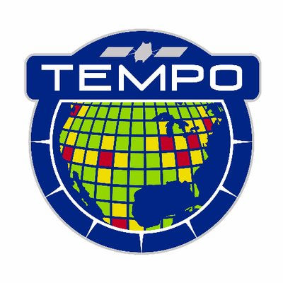
Headshot of yourself
Can we recover surface spectral information in cloudy overcast conditions with (TEMPO) multi-spectral data when our eyes see only clouds?
Joanna Joiner, Zachary Fasnacht, Wenhan Qin, Yasuko Yoshida, Alexander Vasilkov, Nickolay Krotkov, Can Li (NASA/GSFC)
Left: Top: All sky RGB image from GOME-2 on 2 August 2018; Middle and bottom: RGB derived from MODIS MCD43 surface nadir- and BRDF-adjusted reflectances and GOME-2 reconstructed surface reflectance derived with cloudy GOME-2 spectra. But which is which?
If you want to find out more about how we did this, come to the poster. We should be able to do this with TEMPO. It is not magic; it is an approach with a basis in physics.
Implementing such an approach should lead to very timely estimates of particularly surface-related parameters (both ocean and land) that could enhance spatial coverage for a range of TEMPO applications.
Works very well for “atmospheric correction” in both cloudy and/or (absorbing) aerosol loaded conditions.
Uncertainties in reconstructed data are also provided.
Depends critically on quality of auxiliary collocated (MODIS) data

