Slide 1
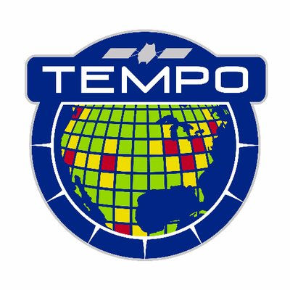
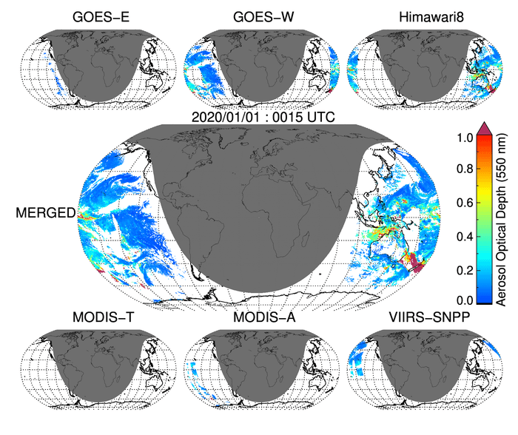
Headshot of yourself
Gupta – LEO-GEO Synergy for Global Diurnal Cycle of Aerosols
Pawan Gupta, USRA/NASA MSFC Robert Levy (GSFC), Shana Mattoo (SSAI/GSFC), DT and GEO-LEO MEaSUREs Teams
In this project (NASA MEaSUREs) dark target aerosol algorithm is implemented on six LEO and GEO sensors globally over both land and ocean. The retrieved aerosol properties are produced from all the six sensors as level 2 data products. The individual aerosol retrievals from each sensors then fused to produce a level 3 gridded data sets at 30 minutes temporal resolution for the sunlit part of the earth. This e-poster will showcase aerosol retrievals from six sensors, validation, data integration and application examples.
Low Earth Orbiting Sensors
MERGED
MODIS-T
MODIS-A
ABI-GW
ABI-GE
VIIRS-SNP
AHI-H08
Geostationary Sensors
Notes:
In this project dark target aerosol algorithm is implemented on six LEO and GEO sensors globally over both land and ocean. The retrieved aerosol properties are produced from all the six sensors as level 2 data products. The individual aerosol retrievals from each sensors then fused to produce a level 3 gridded data sets at 30 minutes temporal resolution for the sunlit part of the earth. This e-poster will showcase aerosol retrievals from six sensors, validation, data integration and application examples.
Pawan Gupta, USRA/NASA MSFC Robert Levy (GSFC), Shana Mattoo (SSAI/GSFC), others?

