Slide 1
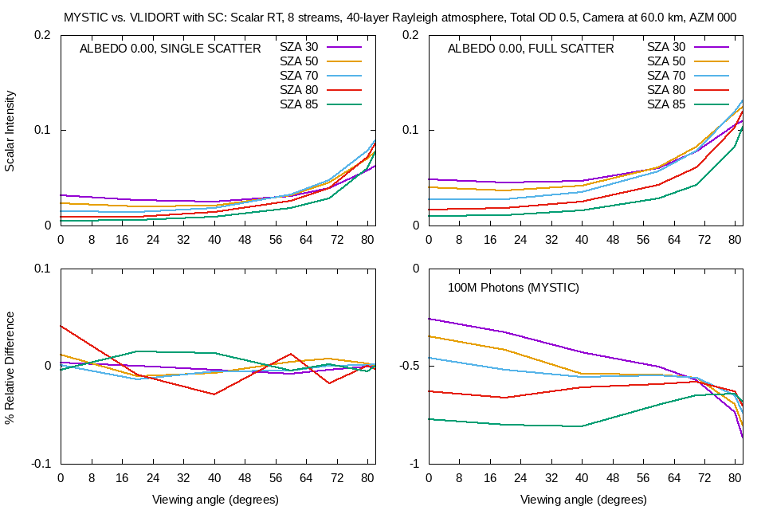
VLIDORT Model Quick Overview
VLIDORT Version 2.8.3. A summary of the latest release.
Robert Spurr(1) and Matt Christi(2)
RT Solutions Inc. , 9 Channing Street, Cambridge MA 02138; (2) Fort Collins, CO 80524
TEMPO Science Team Meeting, 2-3 June 2021
VLIDORT is a vector multiple-scatter multilayer discrete-ordinate radiative transfer model with 1-D plane-parallel scattering for polarized RT.
Pseudo-spherical approximation (incident solar attenuation in curved geometry); separate single-scatter treatment in full-spherical manner.
Solar & thermal/surface emission sources, BRDF & surface-leaving (ocean/SIF) supplements, “planetary problem” feature, isotropic sources at TOA/BOA.
Three multiple geometry modes (lattice, “doublet” or observational “triplet” inputs), output at any level. Integrated quantities (fluxes)
Fully linearized → simultaneous output of analytic Jacobians w.r.t. to any (bulk/profile) atmospheric quantity (e.g. total ozone or ozone profile weighting functions), and/or surface property (albedo, wind-speed….)
Publicly available F90 code, currently at Version 2.8.3.
Contact Point: R. Spurr at rtsolutions@verizon.net.
Spurr, R. J. D., and M. Christi. The LIDORT and VLIDORT Linearized Scalar and Vector Discrete Ordinate Radiative Transfer Models: An Update for the last 10 Years. Light Scattering Reviews, Volume 12, ed. A. Kokhanovsky, Springer, January 2019.
VLIDORT 2.8.3 new features
VLIDORT Version 2.8.3, recently released 01 May 2021.
Green’s function RTE solutions (see green box);
Sphericity corrections to allow multiple scatter sources to vary along line-of-sight paths in a spherical atmosphere (blue box);
Updates to the BRDF (snow reflectance model) and SLEAVE (extended water-leaving treatment) supplements;
“Doublet geometry” option for linked VZA/AZM input pairs;
Several performance enhancements, including solving for Fourier-0 RTE solutions with NSTOKES = 2 (25% speed-up).
In the works….(Version 2.8.3a).
Sphericity correction for the planetary problem.
Airglow emission layering model, with linearization.

